Slide 1
iSCSI Connectivity
Module 14
Accelerated NCDA Boot Camp
Data ONTAP 8.0 7-Mode
Notes:
ISCSI CONNECTIVITY

Slide 2
Module Objectives
By the end of this module, you should be able to:
Describe multiple path implementation with iSCSI connectivity
Configure network ports on Windows®, Red Hat ®, and NetApp® systems
Identify the worldwide node name (WWNN) on Windows, Red Hat, and NetApp systems
Set up and verify multiple path iSCSI connectivity between Windows, Red Hat, and NetApp systems
Notes:
MODULE OBJECTIVES

Slide 3

Data ONTAP
Notes:
DATA ONTAP

Slide 4
Data ONTAP as an iSCSI Target
Data ONTAP® 6.4 and later has support for iSCSI
Data ONTAP features:
  Built-in iSCSI service
  Simple LUN creation and management
Data ONTAP must be properly configured for iSCSI connectivity
  Configure IP interfaces
  Configure iSCSI services
  Configure the iSCSI interfaces
  Identify the worldwide node name (WWNN)
Notes:
DATA ONTAP AS AN ISCSI TARGET

Slide 5
Configuring Interfaces
List the available interfaces:
  ifconfig -a
Take an interface offline:
  ifconfig interface_name down
Configure the interface:
  ifconfig interface_name ipaddress
Bring an interface online:
  ifconfig interface_name up
NOTE: Virtual interfaces (interface groups) may also
be configured to be used with the iSCSI service
Notes:
CONFIGURING INTERFACES

Slide 6
Configuring iSCSI Services in Data ONTAP
Verify the iSCSI service is running:
  iscsi status
Verify iSCSI is licensed (license it if needed):
  license
  license add XXXXXX
Start the iSCSI service:
  iscsi start
Notes:
CONFIGURING ISCSI SERVICES IN DATA ONTAP

Slide 7
Verify Interfaces
Verify the interface is enabled for iSCSI:
  iscsi interface show
  By default, all interfaces are enabled
To enable the interface for iSCSI traffic:
  iscsi interface enable interface_name
To disable iSCSI traffic for a particular interface:
  iscsi interface disable interface_name
Notes:
VERIFY INTERFACES

Slide 8
Interface Access List
Administrators may force initiators to access a storage system through certain interfaces:
  iscsi interface accesslist add initiator_name {-a|interface_name}
  By default, all initiators may use any interface that is enabled for iSCSI traffic
  To display the current access list, use:
  iscsi interface accesslist show
  To remove an entry from the access list, use: iscsi interface accesslist remove initiator_name {-a|interface_name}
Notes:
INTERFACE ACCESS LIST
The accesslist feature controls initiator access to network interfaces. By default, an initiator does not have an access list and can access the storage system through any network interface. The administrator can create an access list using the add subcommand:
iscsi interface accesslist add initiator {-a | interface...}
This creates an access list for the initiator with a list of network interface names.
The specified initiator can only log in through the network interfaces in the access list.
If the specified initiator sends a SendTargets request, it will receive a list of target addresses. These target addresses are associated with only those network interfaces that are included in the access list.
An existing access list can be edited by means of the add and remove subcommands:
iscsi interface accesslist remove <initiator> [-a | <interface>...]
The -a parameter adds or removes all network interfaces. When the last network interface is removed from an access list, the access list itself is removed.

Slide 9
Identifying WWNN in Data ONTAP
To identify the WWNN:
system> iscsi nodename
iSCSI target nodename: iqn.1992-08.com.netapp:system
Remember WWPNs are not used within iSCSI
Notes:
IDENTIFYING WWNN IN DATA ONTAP

Slide 10
Interfaces on the Storage System
Verify interface status:
system> ifconfig -a
...
e0b: flags=108042<BROADCAST,RUNNING,MULTICAST,TCPCKSUM> mtu 1500
ether 00:a0:98:03:28:8f (auto-unknown-down) flowcontrol full
e0c: flags=108042<BROADCAST,RUNNING,MULTICAST,TCPCKSUM> mtu 1500
ether 00:a0:98:03:28:8f (auto-unknown-down) flowcontrol full
...
Enable the interface:
system> ifconfig e0b 10.254.134.75 up
...[system: netif.linkUp:info]: Ethernet e0b: Link up.
system> ifconfig e0c 10.254.134.81 up
...[system: netif.linkUp:info]: Ethernet e0c: Link up.
Ensure that the iSCSI service may use the interface:
system> iscsi interface enable e0b e0c
NOTE: The default is all interfaces are enabled for iSCSI traffic
Notes:
INTERFACES ON THE STORAGE SYSTEM

Slide 11
Windows
Notes:
WINDOWS

Slide 12
Windows as an iSCSI Initiator
NetApp has supported Windows as an iSCSI initiator OS since Windows 2000 Server
  Always check the Interoperability Matrix Tool for current supported operating systems
Windows Server 2008 has many advantages over previous versions:
  New tools such as Storage Explorer and Storage Manager for SANs
Windows Server 2008 R2 has many advantages over Windows Server 2008:
  User interface enhancement and redesign
  iSCSI boot support for up to 32 paths
Windows must be properly configured for iSCSI connectivity over a standard network interface
Notes:
WINDOWS AS AN ISCSI INITIATOR

Slide 13
Windows iSCSI Design and Installation
Verify host operating system releases, required patches, and NetApp iSCSI Host Utility Kit with the Interoperability Matrix Tool and FC and iSCSI configuration guides:
  Use System Properties Dialog
Identify and verify a network interface is properly configured or install a supported iSCSI HBA or TOE.
In Windows Server 2008, the software initiator is preinstalled.
Install compatible NetApp Windows Host Utility Kit:
  Provides Perl scripts to monitor and diagnose iSCSI on Windows
Notes:
WINDOWS ISCSI DESIGN AND INSTALLATION

Slide 14
Windows/NIC Implementation
After installation, to configure a Windows
standard NIC software initiator implementation:
Identify the local network interface(s) to use
Verify iSCSI Initiator driver is enabled and the service is started
Identify the WWNN for the local Windows host
Identify which method of discovery to use and enter the storage system’s portal IP address or iSNS address
Configure authentication security if necessary
Verify discovery and log on to the storage system
Notes:
WINDOWS/NIC IMPLEMENTATION

Slide 15
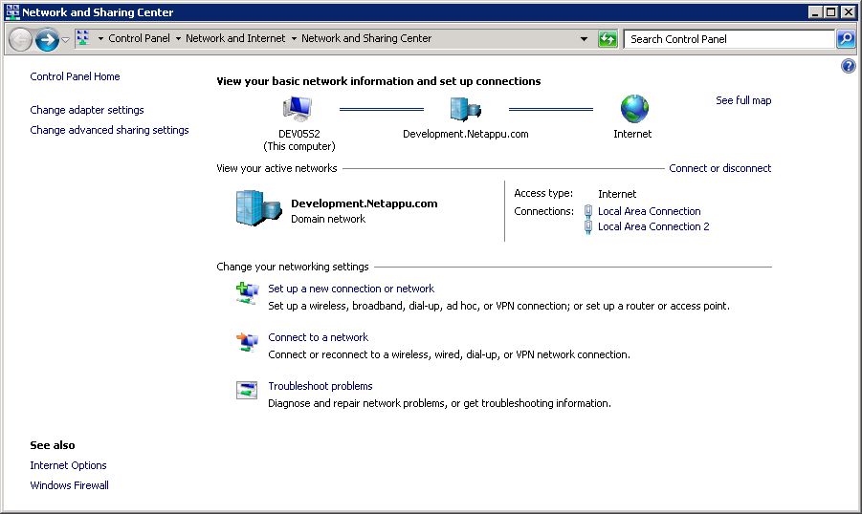
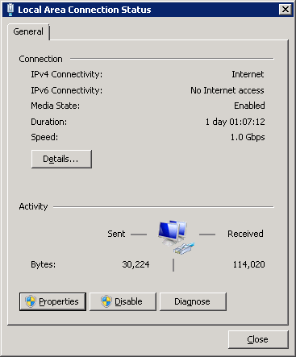
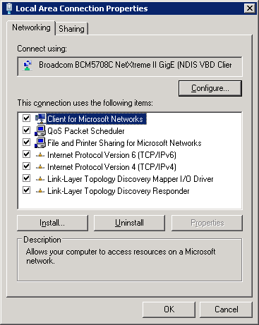
Windows/NIC Implementation (Cont.)
Identify and configure the local interfaces
Notes:
WINDOWS/NIC IMPLEMENTATION (CONT.)

Slide 16
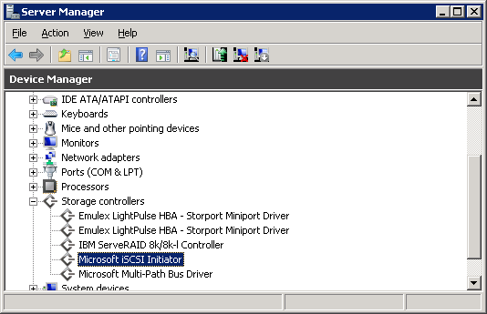
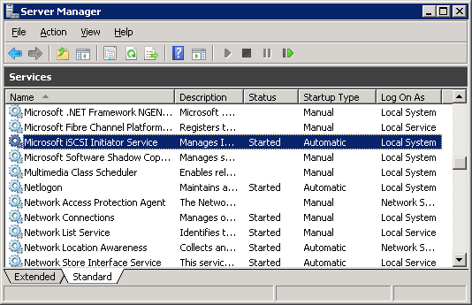
Windows/NIC Implementation (Cont.)
Verify iSCSI Initiator
driver is enabled and verify iSCSI Initiator
service is started
Window Server 2008 R2 version shown. NOTE: In Windows Server 2003, the category is called SCSI and RAID controllers
Notes:
WINDOWS/NIC IMPLEMENTATION (CONT.)

Slide 17
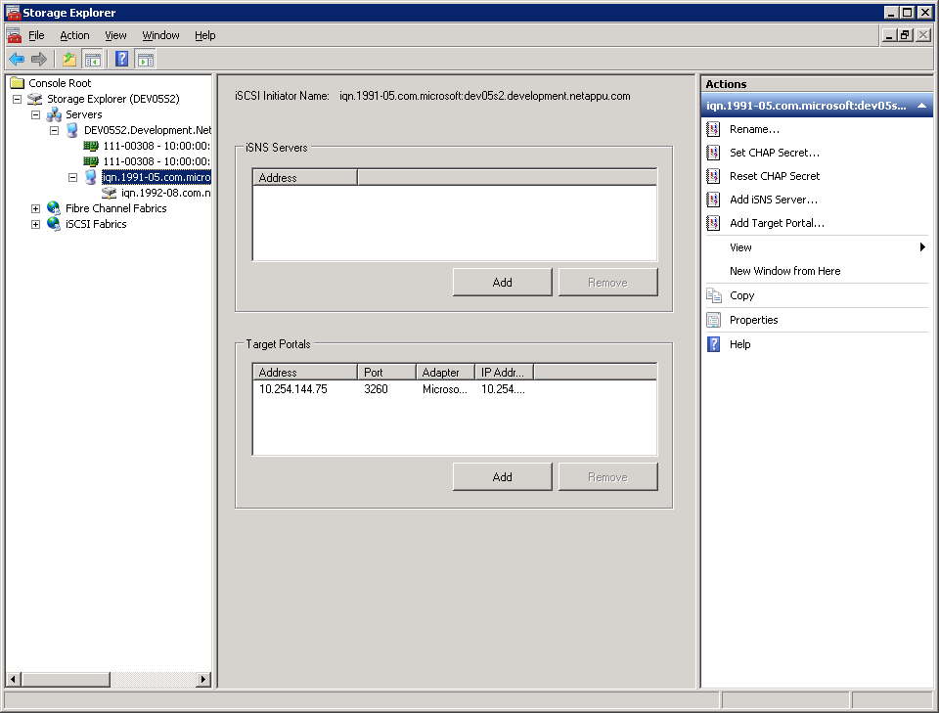
Windows/NIC Implementation (Cont.)
Select
and then
configure
iSCSI initiator may be configured through:
  Storage Explorer
  iSCSI Initiator Properties Dialog
Notes:
WINDOWS/NIC IMPLEMENTATION (CONT.)
The Microsoft® iSCSI software initiator may be configured through either Storage Explorer in Windows Server 2008 or the iSCSI Initiator Properties dialog in Windows Server 2003 or 2008.

Slide 18
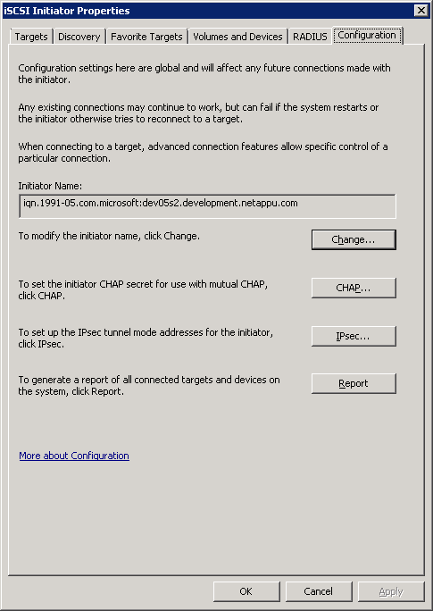
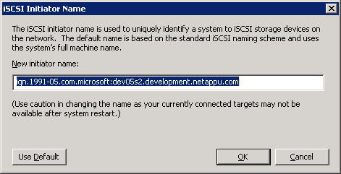
Windows/NIC Implementation (Cont.)
Identify WWNN using iSCSI Initiator Properties
Select first
Current WWNN
To change the WWNN
Notes:
WINDOWS/NIC IMPLEMENTATION (CONT.)
The local host WWNN appears on the Configuration tab of the iSCSI Initiator Properties dialog. It generally does not need to be changed.

Slide 19
WWNN Spoofing
iSCSI node names are:
  Spoof-able
  Sniff-able
  Can be attacked
NetApp recommends using authentication methods and other security techniques (discussed later)
Notes:
WWNN SPOOFING

Slide 20

Discovery
Initiator
Ethernet
Discovery is not automatic
Ethernet
Target
Notes:
DISCOVERY
Unlike FC discovery, iSCSI discovery is not automatic.

Slide 21
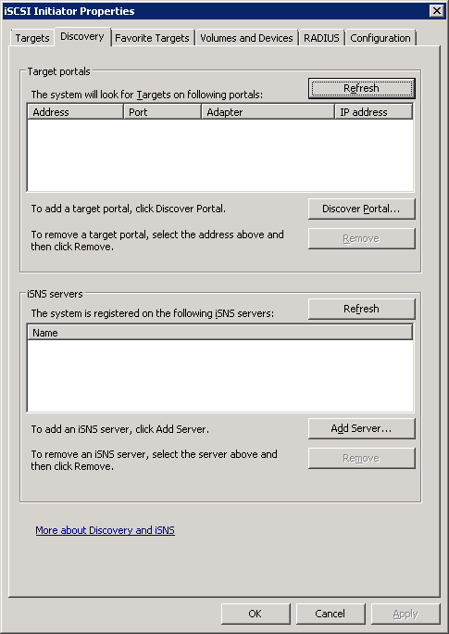
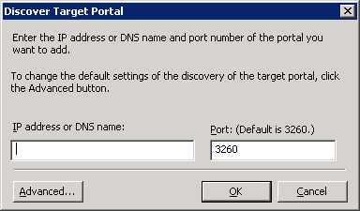
Windows/NIC Implementation (Cont.)
Discovery with iSCSI Initiator Properties Dialog.
Click here to discover
a target portal
Never
change
the port
or add iSNS server to poll
Add storage system’s IP address
To set security
Notes:
WINDOWS/NIC IMPLEMENTATION (CONT.)
From the Discovery tab on the iSCSI Initiator Properties dialog, an administrator may set the method of discovery of targets. Discovery may be accomplished either through add-a-target’s portal address or by polling an Internet Storage Name Service (iSNS) server.
When adding a target portal address, if authentication is required, an administrator will set this by clicking the Advanced button. Next, iSCSI authentication is discussed in detail.

Slide 22
iSCSI Authentication in Windows
To increase security, iSCSI may be configured to require authentication.
  Authentication methods:
    CHAP
      Unidirectional: targets will authenticate initiators
      Bidirectional: initiators and targets will authenticate each other
    RADIUS
  IPsec could also be used to increase security
  This course will discuss using CHAP authentication, but will not use it in the exercise
Notes:
ISCSI AUTHENTICATION IN WINDOWS
There are two methods of authenticating systems in iSCSI:
Challenge Handshake Authentication Protocol (CHAP)
CHAP requires a known secret that is shared by both target and initiator. There are four basic steps of unidirectional authentication:
After the completion of the link establishment phases, the target sends a “challenge” message to the initiator.
The initiator responds with a one-way hash function of the shared secret.
The target checks the response against its own calculation of the expected hash value.
At random intervals, the target will send a new challenge to the initiator and repeat Steps 1, 2, and 3.
NOTE: In bidirectional authentication the process is also implemented in the reverse.
Remote Authentication Dial-In User Service (RADIUS)
RADIUS is a networking protocol that uses access servers to provide centralized management of access to large networks.
Proper authentication resists man-in-the-middle attacks as well as other attacks.
IPsec can also be used to increase security.

Slide 23
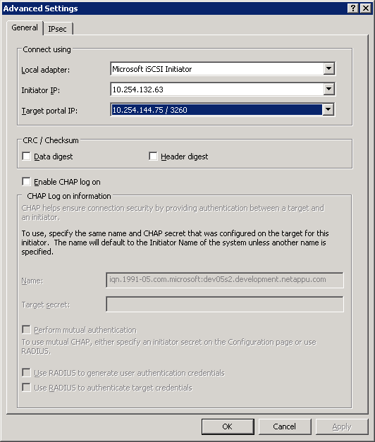
iSCSI Unidirectional CHAP Authentication
Configure the discovery
to use the CHAP
authentication
Check to configure
system> iscsi security add
-i iqn.1991-05.com.microsoft:win
-s CHAP
-n iqn.1991-05.com.microsoft:win
-p thisismysecret
To configure bidirectional, check here and then...
Notes:
ISCSI UNIDIRECTIONAL CHAP AUTHENTICATION
To configure unidirectional (inbound) CHAP authentication for the Microsoft Software Initiator, enter the iscsi security add command on the storage system and enter the user name and shared secret as appropriate. By convention, the user name is generally the same as the WWNN.
The Microsoft iSCSI Software Initiator requires both the initiator and target CHAP passwords to be at least 12 bytes if IPsec encryption is not being used. The maximum password length is 16 bytes regardless of whether IPsec is used.
NOTE: Data ONTAP provides an iscsi security generate command that creates a random 128-bit key that may, in some cases, be used as the password.

Slide 24
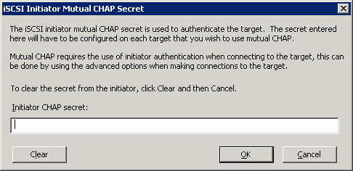
iSCSI Bidirectional CHAP Authentication
Set Windows CHAP secret
On the storage system:
Set CHAP secret from switch -o
system> iscsi security add
-i iqn.1991-05.com.microsoft:win
-s CHAP
-n iqn.1991-05.com.microsoft:win
-p thisismysecret
-o thisismysecret2
-m iqn.1991-05.com.microsoft:win
Notes:
ISCSI BIDIRECTIONAL CHAP AUTHENTICATION
To add bidirectional (inbound and outbound) authentication to the Microsoft software initiator, check the mutual authentication on the Advanced Setting (see previous page) and then add the CHAP secret from switch -o of the iscsi security add command.
NOTE: The user name is the same as the WWNN but the shared secret is different. This is because the user name and password combination cannot be the same for inbound and outbound settings on a storage system.

Slide 25
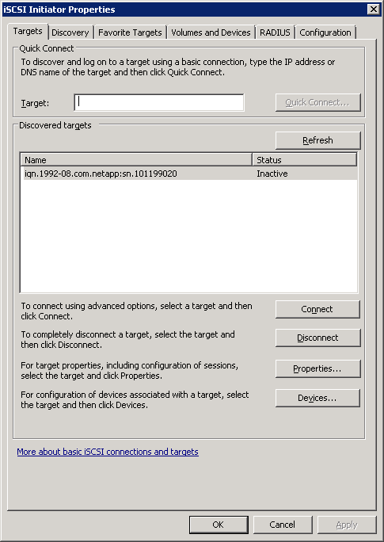
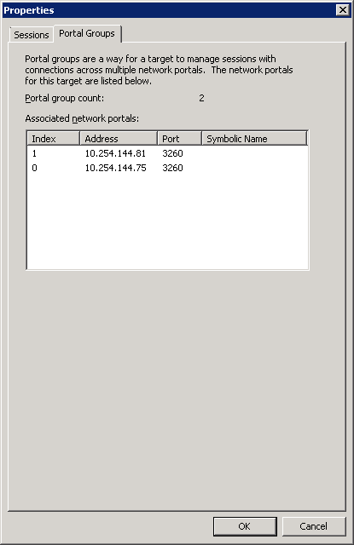
Windows/NIC Implementation (Cont.)
Discovered in iSCSI Initiator Properties Dialog
Storage system is discovered
Both
target portals
discovered
(New in Windows 2008 R2)
Notes:
WINDOWS/NIC IMPLEMENTATION (CONT.)

Slide 26
Binding
iSCSI binding or logging on is the process of creating a session between an initiator and a target
Persistent binding ensures that an initiator binds to a target after a reboot of the initiator OS
Notes:
BINDING

Slide 27
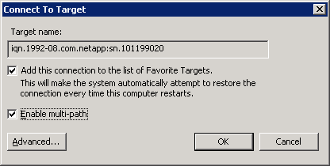
Windows/NIC Implementation (Cont.)
Storage system is discovered
Best practice:
check
both
Click here to connect
To change the interface that is used with which to connect
Targets in the iSCSI Initiator Properties Dialog
Notes:
WINDOWS/NIC IMPLEMENTATION (CONT.)

Slide 28
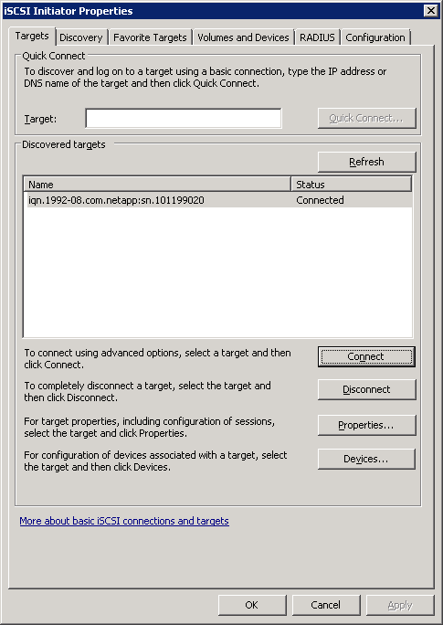
Windows/NIC Implementation (Cont.)
NOTE: Console message appears
[system: iscsi.notice:notice]: ISCSI: New session from initiator iqn.1991-05.com.microsoft:dev05s2.
development.netappu.com at IP addr 10.254.144.75
Connection in iSCSI Initiator Properties Dialog
Notes:
WINDOWS/NIC IMPLEMENTATION (CONT.)

Slide 29
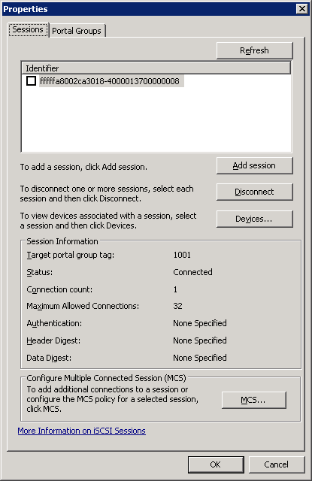
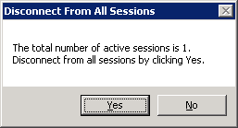
Windows/NIC Implementation (Cont.)
Select session and click
To disconnect all
session for
particular target
Select first
Disconnect in iSCSI Initiator Properties Dialog
Notes:
WINDOWS/NIC IMPLEMENTATION (CONT.)
To disconnect, select the session from the target Properties dialog and click Disconnect.

Slide 30
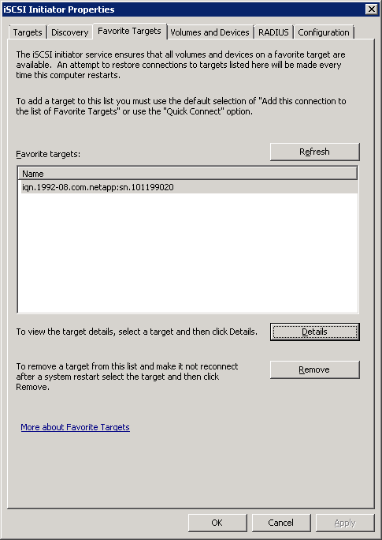
Windows/NIC Implementation (Cont.)
iSCSI persistent binding
Notes:
WINDOWS/NIC IMPLEMENTATION (CONT.)
While logging into a target, an administrator may optionally set the target as a favorite target that automatically logs in when the local host is booted.

Slide 31
Red Hat
Notes:
RED HAT

Slide 32
Red Hat as an iSCSI Initiator
NetApp has supported Red Hat as an iSCSI Initiator OS since Red Hat 4
Red Hat 5.3 has many advantages over previous versions with:
  Packages providing iSCSI device drivers and utilities
  iSCSI software initiator for standard network interfaces
Red Hat must be configured properly for iSCSI connectivity over a standard network interface
Notes:
RED HAT AS AN ISCSI INITIATOR

Slide 33
Red Hat 5.3 Design and Installation
Verify host operating system releases, required patches, and NetApp Linux® Host Utility Kit with Interoperability Matrix:
  Use /etc/redhat-release and uname -a to verify
  Red Hat version
  Interoperability Matrix can be found on the NOW™ site
Install iSCSI software packages and patches:
# rpm -ivh iscsi-initiator-utils-6.2.0.868-0.18.el5.x86_64.rpm
Identify and verify a network interface is properly configured.
Install compatible Linux Host Utility Kit:
  Provides Perl scripts to configure and tune Red Hat for iSCSI
  Example: sanlun application to manage LUNs from Red Hat
Notes:
RED HAT 5.3 DESIGN AND INSTALLATION

Slide 34
Red Hat/NIC Implementation
After installation, to configure a Red Hat standard
NIC software initiator implementation:
Identify the local network interface(s) to use
Verify the iSCSI service and WWNN for host
Configure authentication security if necessary
Identify which method of discovery to use and enter the storage system’s portal IP address
Verify discovery and sessions with the target
Notes:
RED HAT/NIC IMPLMENTATION

Slide 35
Red Hat/NIC Implementation (Cont.)
Unconfigured adapter; configure adapter with ifconfig and
add to rc daemon
Using the software initiator, Red Hat supports iSCSI over standard network interface.
  Investigate and configure interfaces:
  # ifconfig -a
  eth0
  Link encap:Ethernet HWaddr 00:21:5E:6F:18:C4
  inet addr:10.254.132.63 Bcast:10.254.135.25
  Mask:255.255.252.0
  inet6 addr: fe80::221:5eff:fe6f:18c4/64
  Scope:Link UP BROADCAST RUNNING MULTICAST
  MTU:1500 Metric:1
  ...
  eth1
  Link encap:Ethernet HWaddr 00:21:5E:6F:18:C6
  BROADCAST MULTICAST MTU:1500 Metric:1 ...
Notes:
RED HAT/NIC IMPLMENTATION (CONT.)

Slide 36
Red Hat/NIC Implementation (Cont.)
Red Hat WWNN
View the iSCSI Service and initiator node name.
  Start iSCSI service:
  # service iscsi start
  Verify the status of iSCSI service:
  # service iscsi status
  iscsid (pid 5236 5235) is running...
  Identify the initiator’s node name:
  # cat /etc/iscsi/initiatorname.iscsi
  InitiatorName=iqn.1994-05.com.redhat:rhel
Notes:
RED HAT/NIC IMPLMENTATION (CONT.)

Slide 37
Discovery
Initiator
Ethernet
Discovery is not automatic
Ethernet
Target
Notes:
DISCOVERY

Slide 38
iSCSI Authentication in Red Hat 5
To increase security, iSCSI may be configured to require authentication.
  Authentication methods:
    CHAP session authentication
      Unidirectional: targets will authenticate initiators
      Bidirectional: initiators and targets will authenticate each other
    CHAP discovery (send targets) authentication
      Unidirectional: targets will authenticate initiators
      Bidirectional: initiators and targets will authenticate each other
  This course will discuss using CHAP session authentication, but will not use it in the exercise
Notes:
ISCSI AUTHENTICATION IN RED HAT 5

Slide 39
iSCSI Unidirectional CHAP Authentication
Configure initiator’s user name and password:
# vi /etc/iscsi/iscsid.conf
...
#node.session.auth.username = username
#node.session.auth.password = thisismysecret
To configure CHAP, enable CHAP authentication:
# vi /etc/iscsi/iscsid.conf
...
#node.session.auth.authmethod = CHAP
# service iscsi restart
On the storage system, register the CHAP secret:
system> iscsi security add
-i iqn.1994-05.com.redhat:rhel
-s CHAP
-p thisismysecret
-n username
Uncomment
Same user name and
password
Notes:
ISCSI UNIDIRECTIONAL CHAP AUTHENTICATION

Slide 40
iSCSI Bidirectional CHAP Authentication
Configure unidirectional CHAP and then configure the reverse direction:
system> iscsi security add
-i iqn.1994-05.com.redhat:rhel
-s CHAP
-p thisismysecret
-n username
-o thisismysecret2
-m username2
On Red Hat, register the storage system’s CHAP secret:
# vi /etc/iscsi/iscsid.conf
...
#node.session.auth.username = username2
#node.session.auth.password = thisismysecret2
On Red Hat, restart the iSCSI service:
# service iscsi restart
User name and password
of inbound and outbound
cannot be the same
Don’t forgot to
uncomment
Notes:
ISCSI BIDIRECTIONAL CHAP AUTHENTICATION

Slide 41
Red Hat/NIC Implementation
Discovery is possible through either:
  Static discovery
    iSCSI targets added manually
  Send-targets discovery
    IP address of the target is added
    Initiator communicates to target over port 3260
  Internet Storage Name Service (iSNS)
    Centralized management of discovery and configuration of iSCSI networks
  This course will focus on the send-target
  discovery method
Notes:
RED HAT/NIC IMPLEMENTATION

Slide 42
Red Hat/NIC Implementation (Cont.)
Red Hat’s eth0 and eth1 interface name
Use vi or iscsiadm to configure
Set up iSCSI interface (for multiple paths):
# iscsiadm -m iface -I iface0 --op=new
# iscsiadm -m iface -I iface0 --op=update
-n iface.net_ifacename -v eth0
# iscsiadm -m iface -I iface1 --op=new
# iscsiadm -m iface -I iface1 --op=update
-n iface.net_ifacename -v eth1
Verify iSCSI interfaces:
# iscsiadm -m iface
iface0 tcp,default,eth0
iface1 tcp,default,eth1
# ls /var/lib/iscsi/ifaces
iface0 iface1
Notes:
RED HAT/NIC IMPLMENTATION (CONT.)

Slide 43
Red Hat/NIC Implementation (Cont.)
Set up send targets discovery with interfaces:
# iscsiadm -m discovery -t sendtargets -p 10.254.133.239 -I iface0 -I iface1
10.254.133.239:3260,1001 iqn.1992-08.com.netapp:system
10.254.133.239:3260,1001 iqn.1992-08.com.netapp:system
10.254.133.240:3260,1002 iqn.1992-08.com.netapp:system
10.254.133.240:3260,1002 iqn.1992-08.com.netapp:system
IP address of iSCSI-enabled interface on the storage system
Target portals discovered
by each Red Hat interface
Notes:
RED HAT/NIC IMPLMENTATION (CONT.)

Slide 44
Red Hat/NIC Implementation (Cont.)
Explore the iSCSI targets discovered:
# iscsiadm -m node --op=show
#BEGIN RECORD 2.0-868
node.name = iqn.1992-08.com.netapp:system
node.tpgt = 1002
node.startup = automatic
iface.hwaddress = 00:21:5E:6F:18:C6
iface.iscsi_ifacename = iface1
iface.net_ifacename = default
iface.transport_name = tcp
node.discovery_address = 10.254.133.239
...
#BEGIN RECORD 2.0-868
node.name = iqn.1992-08.com.netapp:system
node.tpgt = 1002
node.startup = automatic
iface.hwaddress = 00:21:5E:6F:18:C4
iface.iscsi_ifacename = iface0
...
Notes:
RED HAT/NIC IMPLMENTATION (CONT.)

Slide 45
Red Hat/NIC Implementation (Cont.)
Observe discovered targets:
# iscsiadm -m node
10.254.133.239:3260,1001 iqn.1992-08.com.netapp:system
10.254.133.239:3260,1001 iqn.1992-08.com.netapp:system
10.254.133.240:3260,1002 iqn.1992-08.com.netapp:system
10.254.133.240:3260,1002 iqn.1992-08.com.netapp:system
Notes:
RED HAT/NIC IMPLMENTATION (CONT.)

Slide 46
Red Hat/NIC Implementation (Cont.)
Create a session with discovered targets:
# iscsiadm -m node -l
Logging in to [iface: iface1, target: iqn.1992-08.com.netapp:system, portal: 10.254.133.240,3260]
Logging in to [iface: iface0, target: iqn.1992-08.com.netapp:system, portal: 10.254.133.240,3260]
Logging in to [iface: iface1, target: iqn.1992-08.com.netapp:system, portal: 10.254.133.239,3260]
Logging in to [iface: iface0, target: iqn.1992-08.com.netapp:system, portal: 10.254.133.239,3260]
...
Notes:
RED HAT/NIC IMPLMENTATION (CONT.)

Slide 47
Red Hat iSCSI Sessions
View the current sessions:
View the sessions on the storage system:
# iscsiadm -m session
tcp: [1] 10.254.133.240:3260,1002 iqn.1992-08.com.netapp:system
tcp: [2] 10.254.133.240:3260,1002 iqn.1992-08.com.netapp:system
tcp: [3] 10.254.133.239:3260,1001 iqn.1992-08.com.netapp:system
tcp: [4] 10.254.133.239:3260,1001 iqn.1992-08.com.netapp:system
system> iscsi session show
Session 30
Initiator Information
Initiator Name: iqn.1994-05.com.redhat:rhel
ISID: 00:02:3d:01:00:00
Initiator Alias: dev05s2.development.netappu.com
Session 31
Initiator Information
...
Notes:
RED HAT ISCSI SESSIONS

Slide 48
Module Summary
Notes:
MODULE SUMMARY

Slide 49
Module Summary
In this module, you should have learned to:
Describe multiple path implementation with iSCSI connectivity
Configure network ports on Windows, Red Hat, and NetAppsystems
Identify the worldwide node name (WWNN) on Windows, Red Hat, and NetApp systems
Set up and verify multiple path iSCSI connectivity between Windows, Red Hat, and NetApp systems
Notes:
MODULE SUMMARY

Slide 50
Exercise
Module 14: iSCSI Connectivity
Estimated Time: 90 minutes
Notes:
EXERCISE
Please refer to your Exercise Guide for more instruction.

Slide 51
Check Your Understanding
What is the format for the IQN model of WWNNs naming?
What two iSCSI multipathing techniques are available for Windows Server 2003 and 2008?
What command is used to configure the iSCSI software initiator on Red Hat Enterprise Linux?
Notes:
CHECK YOUR UNDERSTANDING

Slide 52
Answers
Module 14: iSCSI Connectivity
Notes:
ANSWERS
Please refer to your Exercise Guide for more instruction.

Slide 53
Check Your Understanding: Answers
What is the format for the IQN model of WWNNs naming?
  iqn.yyyy-mm.backward_naming_authority:device
What two iSCSI multipathing techniques are available for Windows Server 2003 and 2008?
  MCS
  MPIO
What command is used to configure the iSCSI software initiator on Red Hat Enterprise Linux?
  iscsiadm
Notes:
CHECK YOUR UNDERSTANDING: ANSWERS

