Slide 1
Snapshot Copies
Module 17
Accelerated NCDA Boot Camp
Data ONTAP 8.0 7-Mode
Notes:
SNAPSHOT COPIES

Slide 2
Module Objectives
By the end of this module, you should be able to:
Describe the function of Snapshot™ copies
Explain the benefits of Snapshot copies
Identify and execute Snapshot commands
Create and delete Snapshot copies
Configure and modify Snapshot options
Explain the importance of the .snapshot directory
Describe how disk space is allocated by a Snapshot copy for volumes and aggregates
Schedule Snapshot copies
Configure and manage the Snapshot reserve
Notes:
MODULE OBJECTIVES

Slide 3

Overview
Notes:
OVERVIEW

Slide 4
Snapshot Technology
A Snapshot copy is a read-only image of the active file system at a point in time
The benefits of Snapshot technology are:
  Nearly instantaneous application data backups
  Fast recovery of data lost due to:
    Accidental data deletion
    Accidental data corruption
Snapshot technology is the foundation for:
  SnapRestore® – SnapManager®
  SnapDrive® – SnapMirror®
  FlexClone® – SnapVault®
Back up to Local Storage
  - Recover files
Notes:
SNAPSHOT TECHNOLOGY
Snapshot technology is a key element in the implementation of the WAFL® (Write Anywhere File Layout) file system:
A Snapshot copy is a read-only, space-efficient, point-in-time image of data in a volume or aggregate.
A Snapshot copy is only a “picture” of the file system and does not contain any data file content.
Snapshot copies are used for backup and error recovery.
Data ONTAP® automatically creates and deletes Snapshot copies of data in volumes to support commands related to Snapshot technology.

Slide 5
How Snapshot Technology Works
Active Data
File X
Disk Blocks
A
B
C
Notes:
HOW SNAPSHOT TECHNOLOGY WORKS
Before a Snapshot copy is created, there is a file system tree pointing to data blocks that contain content. When the Snapshot copy is created, a copy of the file structure metadata is created. The Snapshot copy points to the same data blocks.

Slide 6
How Snapshot Technology Works (Cont.)
Active Data
Snapshot
File X
File X
Disk Blocks
A
B
C
Blocks are “frozen” on disk
  Consistent (flushes NVRAM), point-in-time copy
  Ready to use (read-only)
  Consumes no space*
  * With the exception of a 4-KB replicated root inode
  block that defines the Snapshot copy
Notes:
HOW SNAPSHOT TECHNOLOGY WORKS (CONT.)
There is no significant impact on disk space when a Snapshot copy is created. Because the file structure takes up little space, and no data blocks must be copied to disk, a new Snapshot copy consumes almost no additional disk space. In this case, the phrase “consumes no space” really means no appreciable space. The so-called “top-level root inode,” which is necessary to define the Snapshot copy, is 4 KB.

Slide 7

How Snapshot Technology Works (Cont.)
Active Data
Snapshot
File/LUN: X
File/LUN: X
Disk Blocks
A
B
C
C’
New
Data
Client sends new data for block C
Notes:
HOW SNAPSHOT TECHNOLOGY WORKS (CONT.)
Snapshot copies begin to use space when data is deleted or modified. WAFL writes the new data to a new block (C’) on the disk and changes the root structure for the active file system to point to the new block.
Meanwhile, the Snapshot copy still references the original block C. As long as there is a Snapshot copy referencing a data block, the block remains unavailable for other uses. This means that Snapshot copies start to consume disk space only as the file system changes after a Snapshot copy is created.

Slide 8
How Snapshot Technology Works (Cont.)
Active version of X is now comprised of blocks A, B, C’
Snapshot version of X remains comprised of blocks A, B, C
Moves active data to new consistent state
Active Data
Snapshot
File X
File X
Disk Blocks
A
B
C
C’
Notes:
HOW SNAPSHOT TECHNOLOGY WORKS (CONT.)

Slide 9
Snapshot and WAFL
Snapshot technology is a core feature of the storage system’s WAFL (Write Anywhere File Layout) file system
Every file in WAFL has at least one inode that organizes its data
Each volume can contain up to 255 Snapshot copies
Notes:
SNAPSHOT AND WAFL

Slide 10
Inodes
An inode is a data structure that is used to represent file system objects such as files and directories
An inode is 192 bytes that describe a file’s attributes and includes the following:
  Type of file (regular file, directory, link, and so on)
  Size
  Owner, group, permissions
  Pointer to xinode (ACLs)
  Complete file data if the file is 64 bytes or less
  Pointers to data blocks
Notes:
INODES
WAFL inodes are similar to Berkeley FFS (Fast File System) inodes. Veritas™ and Microsoft® file systems are based upon the Berkeley FFS, which force writes to pre-allocated locations. The primary difference is in the way WAFL writes contiguous data and metadata blocks to the next available block instead of predefined locations.
The most important metadata file is the inode file, which contains the inodes that describe all other files in the file system. The inode that describes the inode file itself is called the root inode. The root inode is in a fixed disk location.

Slide 11
Snapshot Copies and Inodes
Snapshot copies are a copy of the root inode of a volume
The inodes of a Snapshot copy are read-only
When the Snapshot inode is created:
  It points to exactly the same disk blocks as the root inode
  Brand new Snapshot copies consume only the space for the inode itself
Notes:
SNAPSHOT COPIES AND INODES
A Snapshot copy is a frozen, read-only image of a traditional volume, a FlexVol® volume, or an aggregate that reflects the state of the file system at the time the Snapshot copy was created. Snapshot copies are your first line of defense for backing up and restoring data. You can configure the Snapshot copy schedule.

Slide 12
Managing Inodes
To verify the amount of inodes:
  df -i
To increase the maximum:
  maxfiles
Notes:
MANAGING INODES
df -i
The df -i command displays the amount of inodes in a volume. For more information about this command, see the manual pages.
maxfiles
The maxfiles command increases the number of inodes designated in a volume. For more information about this command, see the manual pages. NOTE: Do not use this command unless under the supervision of NetApp Global Support. There are certain increments that have to be used as well as memory implications.

Slide 13
Creating Snapshot Copies
Notes:
CREATING SNAPSHOT COPIES

Slide 14
Taking a Snapshot Copy
Administrators can take Snapshot copies of:
  Aggregates
    Aggregate default for Snapshot reserve is 5% of aggregate
    Restoring an aggregate Snapshot copy restores all volumes within that aggregate
  Volumes
    Volume default for Snapshot reserve is 20% of volume
    Administrators can restore the entire volume or one or more files
To change the amount of Snapshot reserve:
snap reserve [ -A | -V ] [volume_name] [percent]
Notes:
TAKING A SNAPSHOT COPY
Volumes
Snapshot copies for traditional and flexible volumes are stored in special subdirectories that can be made accessible to Windows® and UNIX® clients so that users can access and recover their own files without assistance. The maximum number of Snapshot copies per volume is 255.
Aggregates
In an aggregate, 5% of space is reserved for Snapshot copies. In normal, day-to-day operations, aggregate Snapshot copies are not actively managed by a system administrator. For example, Data ONTAP automatically creates Snapshot copies of aggregates to support commands related to the SnapMirror software, which provides volume-level mirroring.
NOTE: Even if the Snapshot reserve is 0%, you can still create Snapshot copies. If there is no Snapshot reserve, Snapshot copies take their blocks from the active file system.

Slide 15
Snapshot Reserve
Aggregates
  Each aggregate has 5% allocated for Snapshot reserve
Flexible volumes
  Each volume has 20% allocated for Snapshot reserve by default; the remainder is used for client data
  For volumes used in a SAN configuration, NetApp recommends 0% reserve
Snapshot reserve
  The amount of space allocated for Snapshot reserve is adjustable; to use this space for data (which is not recommended) you must manually override the allocation used for Snapshot copies
Aggregate Space
Active File
System
80%
snap reserve
20%
Snap Reserve 5%
Notes:
SNAPSHOT RESERVE

Slide 16
CLI: Snapshot Creation
Snapshot copies can be:
  Scheduled
  Manual
To manually create Snapshot copies, use either:
system> snap create [ -A aggrname | -V volname]
[snapshotname]
To rename Snapshot copies:
system> snap rename [ -A aggrname | -V volname]
[oldfilename] [newfilename]
Notes:
CLI: SNAPSHOT CREATION
In the snap command, option A is used for aggregates and option V is used for volumes. If neither A nor V is specified, volume is the default.
The following table lists the commands used to create and manage Snapshot copies. If you omit the volume name from any of these commands, the command will apply to the root volume.

Slide 17
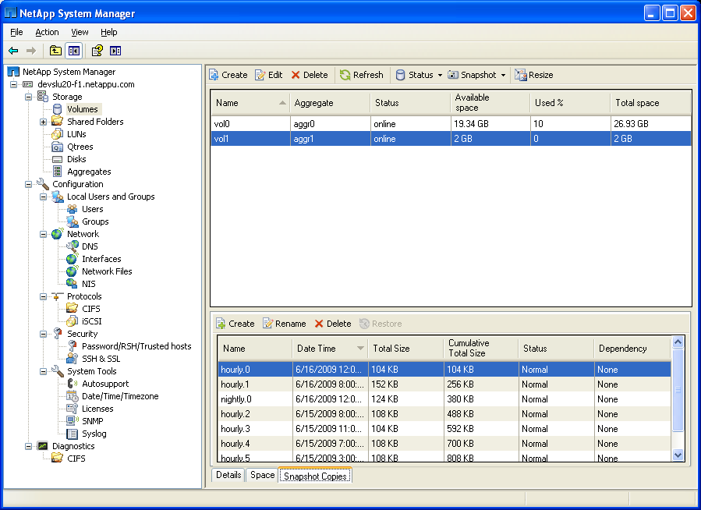
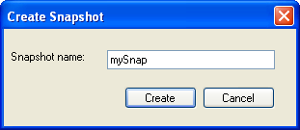
System Manager: Snapshot Copies
Select the volume
and Snapshot > Create
to create a new Snapshot copy
Notes:
SYSTEM MANAGER: SNAPSHOT COPIES

Slide 18

System Manager: Snapshot Copies (Cont.)
The newly created
Snapshot copy
Notes:
SYSTEM MANAGER: SNAPSHOT COPIES (CONT.)

Slide 19
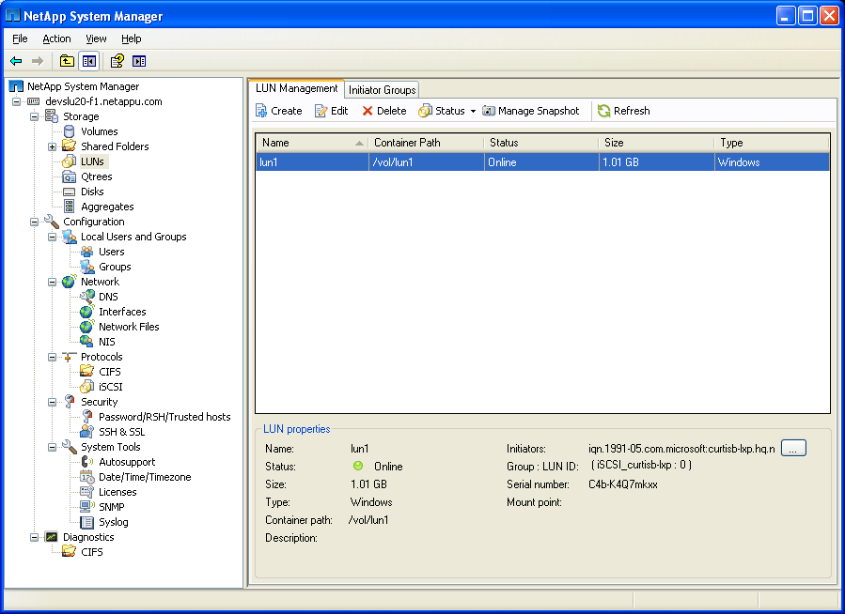
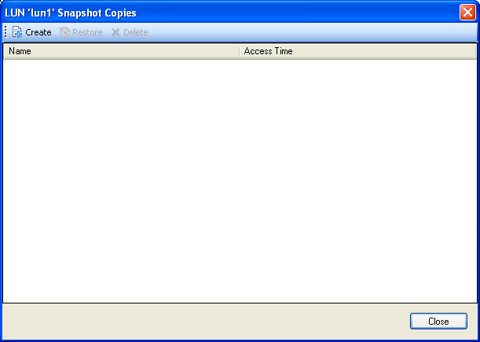
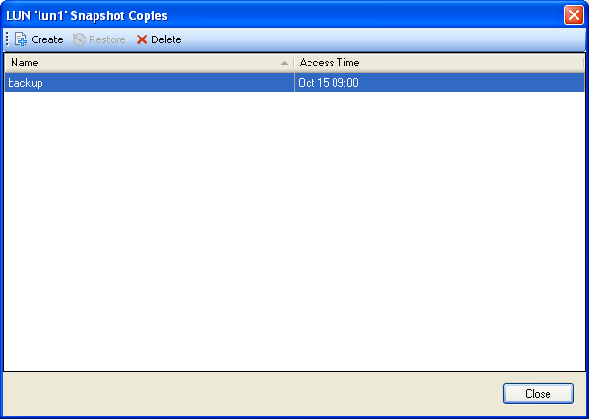
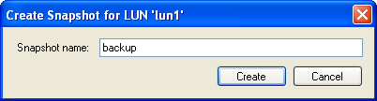
System Manager: LUN Snapshot Creation
Ensure that
LUN Snapshot copies
are consistent
NOTE: This is taking a
snapshot copy of the volume
containing the LUN
Notes:
SYSTEM MANAGER: LUN SNAPSHOT CREATION

Slide 20
Scheduling Snapshot Copies
Notes:
SCHEDULING SNAPSHOT COPIES

Slide 21
Snapshot Schedule
To print current schedule for all volumes:
system> snap sched
To print schedule per volume:
system> snap sched [volume_name]
To change current schedule per volume:
system> snap sched
[volume_name[weeks[days[hours[@list]]]]]
Example:
system> snap sched vol2 1 6 5@4,8,12,16,20
  The Snapshot schedule above keeps the following Snapshot copies for vol2:
    One weekly Snapshot copies
    Six nightly Snapshot copies
    Five hourly Snapshot copies taken at 4:00 a.m., 8:00 a.m., 12:00 p.m., 4:00 p.m., and 8:00 p.m.
Notes:
SNAPSHOT SCHEDULE
The snap sched command sets a schedule to automatically create Snapshot copies and specifies how many of each type are stored. When the limit is reached, the oldest Snapshot copy for each interval is deleted and replaced by a new Snapshot copy.
Snapshot copies are like a picture of a volume. The only difference between a weekly Snapshot copy and a nightly or hourly copy is the time at which the Snapshot copy was created and any data that was changed between the Snapshot copies.

Slide 22
Scheduling Snapshot Copies
Default schedule:
system> snap sched vol0
Volume vol0: 0 2 6@8, 12, 16, 20
  Once nightly, Monday through Saturday, at midnight (12:00 a.m.)
  Four hourly at 8:00 a.m., 12:00 p.m., 4:00 p.m., and 8:00 p.m.
  Retains:
    Zero weekly
    Two most recent nightly
    Six most recent hourly
First in, first out:
  Oldest nightly Snapshot copy
  Oldest hourly Snapshot copy
Disable automatic Snapshot copies:
  system> vol options volname nosnap [on|off]
NOTE: If you change the root volume’s Snapshot
schedule, all new volumes will adopt the altered schedule by default
Notes:
SCHEDULING SNAPSHOT COPIES

Slide 23
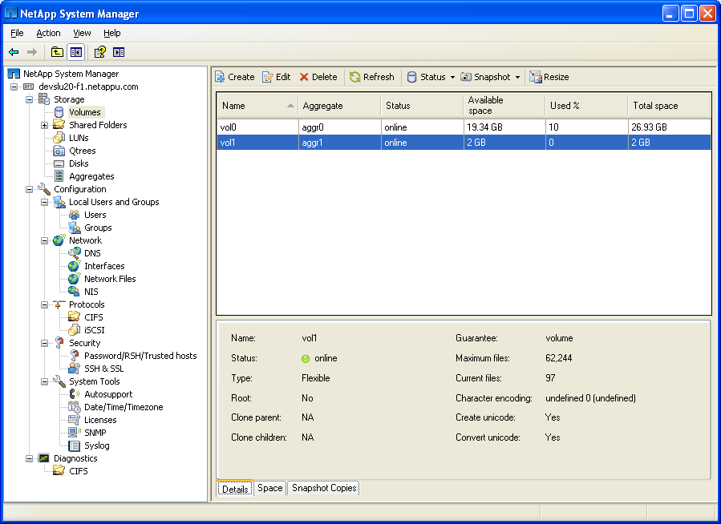
System Manager: Snapshot Copies
Select the volume
and Snapshot > Configure
to manage Snapshot
technology on the volume
To configure volumes
Notes:
SYSTEM MANAGER: SNAPSHOT COPIES

Slide 24
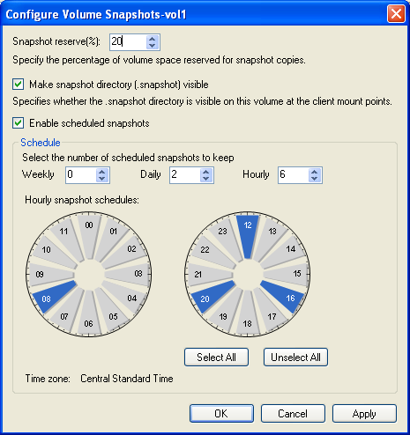
System Manager: Snapshot Copies (Cont.)
Notes:
SYSTEM MANAGER: SNAPSHOT COPIES (CONT.)

Slide 25
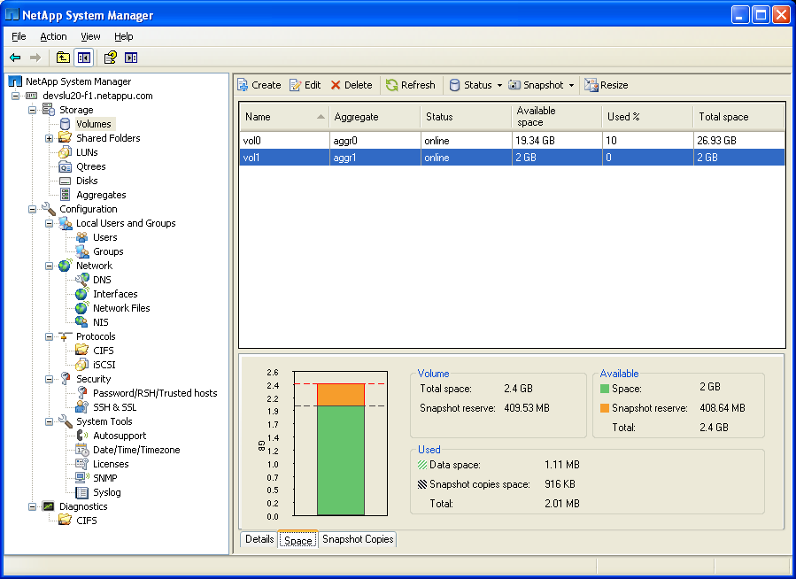
System Manager: Snapshot Copies (Cont.)
Select Space
Notes:
SYSTEM MANAGER: SNAPSHOT COPIES (CONT.)

Slide 26
Restoring Snapshot Copies
Notes:
RESTORING SNAPSHOT COPIES

Slide 27
Recovering Data
When recovering data, you have two options:
  Copy the data from a Snapshot copy
  Use SnapRestore (see Module 18)
To copy data from a Snapshot copy:
  Locate the Snapshot copy
  Recover the copy from .snapshot directory
    To overwrite, copy to the original location
    For a new, writeable version, copy to a new location
Notes:
RECOVERING DATA
Using Snapshot copies to Recover Data
To recover data, you can:
Restore a file from a Snapshot copy
Use SnapRestore (license required)
To restore a file from a Snapshot copy:
Locate the Snapshot copy that contains the correct version of the file.
Restore the file from the .snapshot directory.
To overwrite existing data, copy to the original location.
To restore a writeable version, copy to a new location.

Slide 28
Snapshot Visibility to Clients
Make the .snapshot directory invisible to clients, and turn off access to the .snapshot directory:
  vol options volname nosnapdir [on|off]
Make the ~snapshot directory visible to CIFS clients:
  options cifs.show_snapshot [on|off]
Make the .snapshot directory visible to NFS clients:
  options nfs.hide_snapshot [on|off]
  NOTE: Default values are in bold
Notes:
SNAPSHOT VISIBILITY TO CLIENTS
The following table lists the options available for controlling the creation of Snapshot copies and access to those copies and Snapshot directories on a volume:
Disable automatic Snapshot copies. Setting the nosnap option to on disables automatic Snapshot creation. You can still create Snapshot copies manually at any time.
Make the .snapshot directory invisible to clients and turn off access to the .snapshot directory. Setting the nosnapdir option to on disables access to the Snapshot directory that is present at client mountpoints and the root of CIFS directories, and makes the Snapshot directories invisible. (NFS uses .snapshot for directories, while CIFS uses ~snapshot.) By default, the nosnapdir option is off (directories are visible).
Make the ~snapshot directory visible to CIFS clients by completing the following steps:
1. Turn the cifs.show_snapshot option on.
2. Turn the nosnapdir option off for each volume that you want directories to be visible.
NOTE: You must also ensure that Show Hidden Files and Folders is enabled on your Windows system.

Slide 29
The .snapshot Directory
/
mnt
etc
usr
var
system
Snapshot directories are at every level
but show up only at the top level of the mount
vol1
.snapshot Directory
data
.snapshot Directory
nightly.0
Directory
nightly.1
Directory
nightly.0
Directory
nightly.1
Directory
Files on vol1
(as of previous
midnight)
Files on vol1
(as of night-
before-last)
Files in data
(as of previous
midnight)
Files in data
(as of night-
before-last)
Notes:
THE .SNAPSHOT DIRECTORY
The .snapshot directory is at the root of a volume.
In the figure above, the directory structure is shown for an NFS client mounting vol1 to the mountpoint /mnt/system.

Slide 30
Snapshot View from a UNIX/Linux Client
# pwd
/system/vol0/.snapshot
# ls -l
total 240
drwxrwxrwx 9 root other 2288 Jan 29 16:19 hourly.0
drwxrwxrwx 9 root other 3288 Jan 29 15:19 hourly.1
drwxrwxrwx 9 root other 4288 Jan 29 14:19 hourly.2
drwxrwxrwx 9 root other 5288 Jan 29 13:19 hourly.3
drwxrwxrwx 9 root other 6288 Jan 29 12:19 hourly.4
drwxrwxrwx 9 root other 7288 Jan 29 11:19 hourly.5
drwxrwxrwx 9 root other 12288 Jan 28 16:19 nightly.0
drwxrwxrwx 9 root other 22288 Jan 27 16:19 nightly.1
drwxrwxrwx 9 root other 32288 Jan 22 16:19 weekly.1
drwxrwxrwx 9 root other 42288 Jan 15 16:19 weekly.2
Notes:
SNAPSHOT VIEW FROM A UNIX/LINUX CLIENT
Snapshot Directories
Every volume in your file system contains a special Snapshot subdirectory that allows you to access earlier versions of the file system to recover lost or damaged files.
Viewing Snapshot Copies from a UNIX Client
The Snapshot subdirectory appears to NFS clients as .snapshot. The .snapshot directories are usually hidden and are not displayed in directory listings.
To view a .snapshot directory, complete the following steps:
1. On the storage appliance, log in as root and ensure that the nosnapdir option is set to off.
2. To view hidden directories, from the NFS mountpoint, enter the ls command with the -a (all) option.
When listing the client Snapshot directories, the date/timestamp is usually the same for all directories. To find the actual date/time of each Snapshot copy, use the snap list command on the storage system.

Slide 31
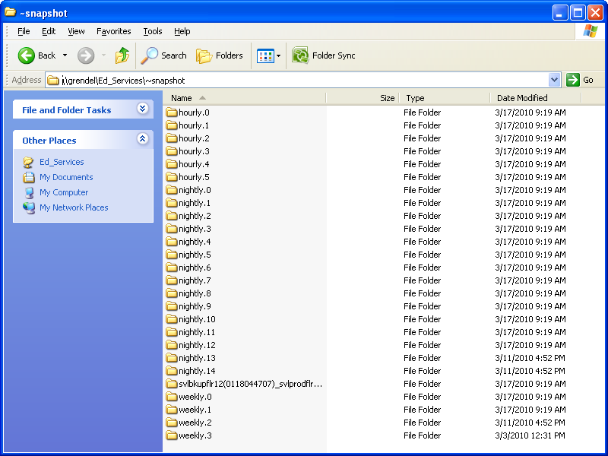
Snapshot View from a Windows Client
Snapshot copies are visible to Windows clients that have File Manager configured to display “hidden files”
Notes:
SNAPSHOT VIEW FROM A WINDOWS CLIENT
Snapshot directories are hidden on Windows clients. To view them, you must first configure the File Manager to display hidden files, then navigate to the root of the CIFS share and find the directory folder.
The subdirectory for Snapshot copies appears to CIFS clients as ~snapshot. Files displayed here are those files created automatically for specified intervals. Manually created Snapshot copies would also be listed here.
Restoring a File
To restore a file from the ~snapshot directory, rename or move the original file, then copy the file from the ~snapshot directory to the original directory.

Slide 32
FlexClone
Notes:
FLEXCLONE

Slide 33
FlexClone Volume Clones
Enables multiple, instant dataset clones with no storage overhead
Provides dramatic improvement for application test and development environments
Renders competitive methods archaic
Notes:
FLEXCLONE VOLUME CLONES
FlexClone volume clones provide an efficient way to copy data for:
Manipulation
Projection operations
Upgrade testing
Data ONTAP allows you to create a volume duplicate with the original volume and clone volume sharing the same disk space for storing unchanged data.

Slide 34
How Volume Cloning Works
Volume cloning:
Starts with a volume
Takes a Snapshot copy of the volume
Creates a clone (a new volume based on the Snapshot copy)
Result:
Independent volume copies
are efficiently stored
Aggregate
FlexVol Volume
Parent
Snapshot
Clone
Notes:
HOW VOLUME CLONING WORKS
FlexClone volumes are managed similarly to regular FlexVol volumes, with a few key differences. The following is a list of important facts about FlexClone volumes:
FlexClone volumes are a point-in-time, writable copy of the parent volume. Changes made to the parent volume after the FlexClone volume is created are not reflected in the FlexClone volume.
You can only clone FlexVol volumes. To create a copy of a traditional volume, you must use the vol copy command, which creates a distinct copy with its own storage.
FlexClone volumes are fully functional volumes managed just like the parent volume using the vol command.
FlexClone volumes always exist in the same aggregate as parent volumes.
FlexClone volumes can be cloned.
FlexClone volumes and parent volumes share the same disk space for common data. This means that creating a FlexClone volume is instantaneous and requires no additional disk space (until changes are made to the clone or parent).
A FlexClone volume is created with the same space guarantee as the parent.
You can sever the connection between the parent and the clone. This is called splitting the FlexClone volume. Splitting removes all restrictions on the parent volume and causes the FlexClone volume to use its own storage.
IMPORTANT: Splitting a FlexClone volume from its parent volume deletes all existing Snapshot copies of the FlexClone volume and disables the creation of new Snapshot copies while the splitting operation is in progress.
Quotas applied to a parent volume are not automatically applied to the clone.
When a FlexClone volume is created, existing LUNs in the parent volume are also present in the FlexClone volume, but are unmapped and offline.

Slide 35
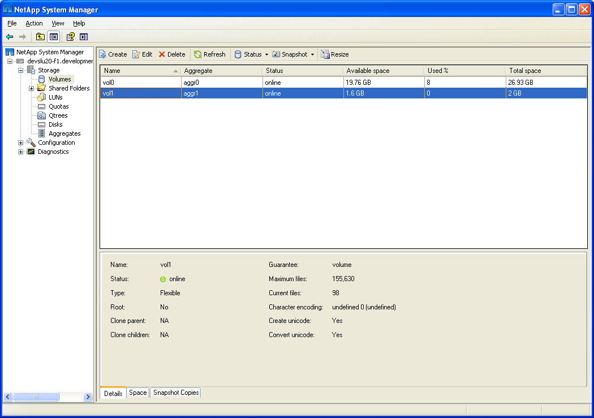
System Manager: FlexClone
Select the volume and Snapshot > Clone
NOTE: FlexClone must be licensed first
Notes:
SYSTEM MANAGER: FLEXCLONE

Slide 36
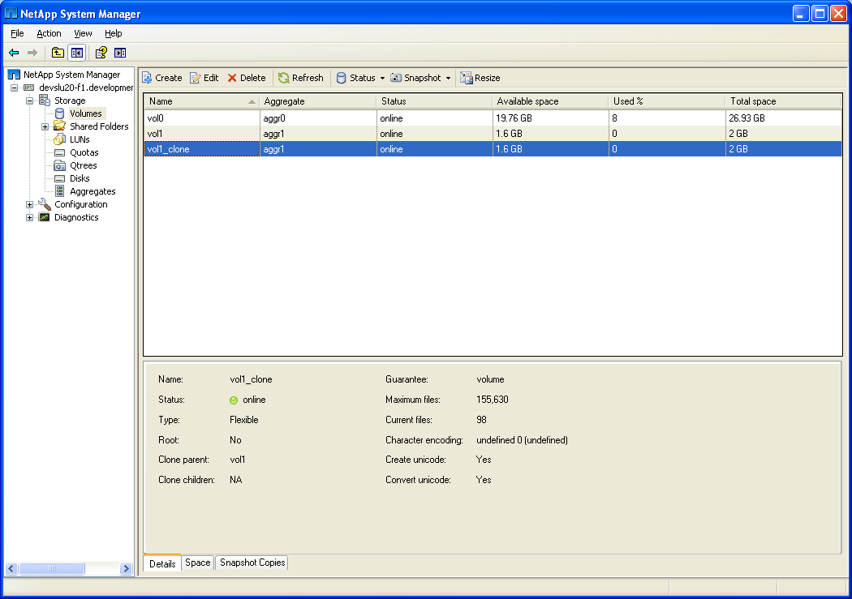
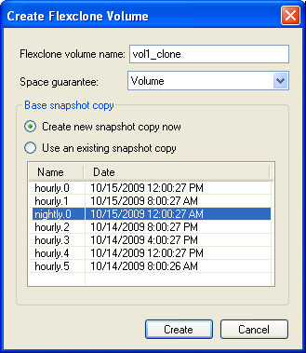
System Manager: FlexClone (Cont.)
Notes:
SYSTEM MANAGER: FLEXCLONE (CONT.)

Slide 37
Flexible Volume Clone Syntax
Use the vol clone create command to create a flexible volume clone
  Syntax: vol clone create volname
  [-s none | file | volume]
  -b parent_volname [parent_snapshot]
The following is an example of a CLI entry used to create a flexible volume clone:
system> vol clone create clone1 –b flexvol1 flex1
system> vol status clone1
Volume State Status Options
clone1 online raid_dp, flex
guarantee=volume(disabled)
Clone, backed by volume 'flex1’ snapshot
clone_clone1.1'
Containing aggregate: 'aggr1’
Notes:
FLEXIBLE VOLUME CLONE SYNTAX

Slide 38
Splitting Volumes
Split volumes when most of the data on a volume is not shared
Replicate shared blocks in the background
Result
New, permanent volume
is created for forking
project data
Volume 1
Snapshot of
Volume 1
Cloned Volume
Notes:
SPLITTING VOLUMES
Splitting a FlexClone volume from its parent removes any space optimizations currently employed by the FlexClone volume. After the split, both the FlexClone volume and the parent volume require the full space allocation specified by their space guarantees. After the split, the FlexClone volume becomes a normal FlexVol volume.
When splitting clones, keep the following in mind:
When you split a FlexClone volume from its parent, all existing Snapshot copies of the FlexClone volume are deleted.
During the split operation, no new Snapshot copies of the FlexClone volume can be created.
Because the clone-splitting operation is a copy operation that could take some time to complete, Data ONTAP provides the vol clone split stop and vol clone split status commands to stop clone-splitting or check the status of a clone-splitting operation.
The clone-splitting operation executes in the background and does not interfere with data access to either the parent or the clone volume.
If you take the FlexClone volume offline while clone-splitting is in progress, the operation is suspended. When you bring the FlexClone volume back online, the splitting operation resumes.
After a FlexClone volume and its parent volume have been split, they cannot be rejoined.

Slide 39
vol clone split Command
To start a clone split:
  system> vol clone split start volname
To stop a clone split:
  system> vol clone split stop
To check the status of a clone split:
  system> vol clone split status [volname]
To estimate the time of completion:
  system> vol clone split estimate [volname]
Notes:
VOL CLONE SPLIT COMMAND
How to View the results of a clone split command
Example:
vol clone split status:
vol clone split start clone1
Tue Oct 12 23:49:43 GMT [wafl.scan.start:info]: Starting volume clone split on volume clone1.
Clone volume 'clone1' will be split from its parent.
Monitor system log or use 'vol clone split status' for progress.
vol clone split status
Volume 'clone1', 117193 of 364077 inodes processed (32%)
18578 blocks scanned. 18472 blocks updated.

Slide 40
Space Usage
Notes:
SPACE USAGE

Slide 41
Using the CLI to Monitor Space Used
To monitor space used for Snapshot copies, use:
  From the command-line interface
  NetApp System Manager
To determine how much space you will get back:
  snap list
  snap reclaimable
  snap delta
To delete:
  A particular Snapshot copy:
  system> snap delete [ -A | -V ]
  [aggrname|volname] [snapshotname]
  All Snapshot copies:
  system> snap delete [ -A | -V ] -a
  [aggrname|volname]
Notes:
USING THE CLI TO MONITOR SPACE USED

Slide 42
The snap list Command
system> snap list
Volume vol0
working...
%used %total date name
------- ------ ------------ --------
0% (0%) 0% (0%) Apr 20 12:00 hourly.0
17% (20%) 1% (1%) Apr 20 10:00 hourly.1
33% (20%) 2% (1%) Apr 20 08:00 hourly.2
%Used
The % used column shows the relationship between accumulated Snapshot copies and the total disk space consumed by the active file system; Values in parentheses show the contribution of this individual Snapshot copy
%Total
The % total column shows the relationship between accumulated Snapshot copies and the total disk space consumed by the volume; Values in parentheses show the contribution of this individual Snapshot copy
Date
The date column shows the date and time the Snapshot copy was taken; Time is indicated
on the 24-hour clock, and in this example reflects the hours set in the automatic Snapshot schedule
Name
Scheduled Snapshot copies are automatically
renumbered as new ones are taken so that the most recent is always “0”; This also ensures that the file with the highest number
is always the oldest
Notes:
THE SNAP LIST COMMAND
The snap list command displays a single line of information for each Snapshot copy in a volume. In the Snapshot List Example in the figure above, a list of Snapshot copies is displayed for the engineering volume. The following is a description of each column in the list:
%used—Shows the relationship between accumulated Snapshot copies and the total disk space consumed by the active file system. Values in parentheses show the contribution of this individual Snapshot copy.
%total—Shows the relationship between accumulated Snapshot copies in the total disk space consumed by the volume. Values in parentheses show the contribution of this individual Snapshot copy.
date—Shows the date and time the Snapshot copy was taken. Time is indicated on the 24-hour clock, and in this example, reflects the hours set in the automatic Snapshot copy schedule.
name—Lists the names of each of the saved Snapshot copies. Scheduled Snapshot copies are automatically renumbered as new ones are created so that the most recent copy is always .0. This also ensures that the file with the highest number (in this case, hourly.2) is always the oldest Snapshot copy.

Slide 43
snap delta and snap reclaimable
snap delta (provides the rate of change)
snap reclaimable
system> snap delta vol0
Volume vol0
working...
From Snapshot To kB changed Time Rate(kB/hour)
-------------------------------------------------------
nightly.0 AFS 46932 0d 23:00 3911.000
nightly.1 nightly.0 16952 1d 00:00 4237.705
nightly.2 nightly.1 16952 1d 00:00 4237.705
system> snap reclaimable vol0 hourly.0 nightly.0
Processing (Press Ctrl-C to exit) ......................
snap reclaimable: Approximately 47108 Kbytes would
be freed.
Notes:
SNAP DELTA AND SNAP RECLAIMABLE
snap delta [ vol_name [ snap ] [ snap ]] Displays the rate of change of data between Snapshot copies. When used without any arguments it displays the rate of change of data between Snapshot copies for all volumes in the system, or all aggregates in the case of snap delta -A. If a volume is specified, the rate of change of data is displayed for that particular volume. The query can be made more specific by specifying the beginning and ending Snapshot copies to display the rate of change between them for a specific volume. If no ending Snapshot is listed, the rate of change of data between the beginning Snapshot copy and the active file system is displayed.
The rate of change information is displayed in two tables. In the first table each row displays the differences between two successive Snapshot copies. The first row displays the differences between the youngest Snapshot in the volume and the active file system. Each following row displays the differences between the next older Snapshot copy and the previous Snapshot copy, stepping through all of the Snapshot copies in the volume until the information for the oldest Snapshot copy is displayed. Each row displays the names of the two Snapshot copies being compared, the amount of data that changed between them, how long the first Snapshot copy listed has been in existence, and how fast the data changed between the two Snapshot copies.
The second table shows the summarized rate of change for the volume between the oldest Snapshot copy and the active file system.

Slide 44
Snapshot Automatic Delete
Snapshot automatic delete determines when (if) Snapshot copies will be automatically deleted
  Set at volume level:
  snap autodelete vol [on|off|show|reset]
If autodelete is enabled, then options:
  snap autodelete vol option val
  Options Value
  commitment try, disrupt
  trigger volume, snap_reserve, space_reserve
  target_free_space 1-100
  delete_order oldest_first, newest_first
  defer_delete scheduled, user_created, prefix, none
  prefix <string>
Notes:
SNAPSHOT AUTOMATIC DELETE

Slide 45
snap autodelete: commitment
What Snapshot copies can autodelete remove?
The user can protect certain kinds of Snapshot copies from deletion
The commitment option defines:
  try
    Deletes Snapshot copies that are not being used by any
    data mover, recovery, or clones (NOT LOCKED)
  disrupt
    Deletes Snapshot copies locked by applications that move
    data (such as SnapMirror), dump data, and restore data
    (mirror and dumps are aborted)
Notes:
SNAP AUTODELETE: COMMITMENT

Slide 46
snap autodelete: trigger
When does snap autodelete occur?
When the “trigger” criteria is nearly full:
volume
  The volume is nearly full (98%)
snap_reserve
  The reserve is nearly full
space_reserve
  The space reserved is nearly full (useful for
  volumes with fractional_reserve < 100)
Notes:
SNAP AUTODELETE: TRIGGER

Slide 47
snap autodelete: target_free_space
When does snap autodelete stop?
When the free space in the trigger criteria reaches a user-specified percentage,
snap autodelete stops
  This percentage is controlled by the value of target_free_space
  The default percentage is 20%
Notes:
SNAP AUTODELETE: TARGET_FREE_SPACE

Slide 48
snap autodelete: order
In what order are Snapshot copies deleted?
The delete_order option defines the age order. If the value is set to:
  oldest_first
    Delete oldest Snapshot copies first
  newest_first
    Delete newest Snapshot copies first
Notes:
SNAP AUTODELETE: ORDER

Slide 49
snap autodelete: order (Cont.)
Snapshot copies are deleted in the following
order:
The defer_delete option defines the order for deletion
If the value is set to:
  scheduled
    Delete the scheduled Snapshot copies last (identified by the
    scheduled Snapshot naming convention)
  user_created
    Delete the administrator-created Snapshot copies last
  prefix
    Delete the Snapshot copies with names matching the prefix
    string last
Notes:
SNAP AUTODELETE: ORDER (CONT.)

Slide 50
snap autodelete: prefix
In what order are Snapshot copies deleted?
The prefix option value pair is only considered when defer_delete is set to prefix
Otherwise, it is ignored
Notes:
SNAP AUTODELETE: PREFIX

Slide 51
System Manager: Space Monitoring
The space consumed
in the volume
Notes:
SYSTEM MANAGER: SPACE MONITORING

Slide 52
Module Summary
Notes:
MODULE SUMMARY

Slide 53
Module Summary
In this module, you should have learned to:
Describe the function of Snapshot copies
Explain the benefits of Snapshot copies
Identify and execute Snapshot commands
Create and delete Snapshot copies
Configure and modify Snapshot options
Explain the importance of the .snapshot directory
Describe how disk space is allocated by a Snapshot copy for volumes and aggregates
Schedule Snapshot copies
Configure and manage the Snapshot reserve
Notes:
MODULE SUMMARY

Slide 54
Exercise
Module 17: Snapshot Copies
Estimated Time: 30 minutes
Notes:
EXERCISE
Please refer to your Exercise Guide for more instruction.

Slide 55
Check Your Understanding
What is a Snapshot copy?
What are some of the NetApp products that are based on Snapshot technology?
What are some of the Snapshot commands?
What is the Snapshot schedule syntax?
Notes:
CHECK YOUR UNDERSTANDING

Slide 56
Answers
Module 17: Snapshot Copies
Notes:
ANSWERS
Please refer to your Exercise Guide for more instruction.

Slide 57
Check Your Understanding: Answers
What is a Snapshot copy?
  A read-only image of the file system
What are some of the NetApp products that are based on Snapshot technology?
  SnapRestore
  SnapMirror
  SnapVault
  SnapManager
  SnapDrive
  FlexClone
Notes:
CHECK YOUR UNDERSTANDING: ANSWERS

Slide 58
Check Your Understanding: Answers (Cont.)
What are some of the Snapshot commands?
  snap list
  snap create
  snap delete
  snap delta
  snap reclaimable
What is the Snapshot schedule syntax?
  snap sched [volume_name [weeks[days[hours[@list]]]]]
Notes:
CHECK YOUR UNDERSTANDING: ANSWERS (CONT.)

