Slide 1
High-Availability
Module 21
Data ONTAP 8.0 7-Mode Administration
Notes:
HIGH-AVAILABILITY

Slide 2
Module Objectives
By the end of this module, you should be able to:
Define the high-availability controller configuration
Describe the three modes of high-availability operation with a high-availability pair
Analyze the effect on client protocols during failover and giveback operations
Notes:
MODULE OBJECTIVES

Slide 3
Loss of Controller
Loss of a controller may be overcome by configuring a high-availability pair
Loss of Cable
Loss of Shelf
Loss of Controller
Loss of Building
Loss
of Site
Loss of Region
Notes:
LOSS OF CONTROLLER

Slide 4
High-Availability Controller Configuration
Connected to its own disk shelves
Connected to the other controller’s disk shelves
Add multipathing to the disk shelves
Storage controllers are connected to each other
If a storage controller fails, the surviving partner serves the data of failed controller
Notes:
HIGH-AVAILABILITY CONTROLLER CONFIGURATION
A high-availability configuration is two storage systems (nodes) whose controllers are connected to each other either directly or through switches.
The nodes are connected to each other through a cluster adapter or NVRAM adapter, which allows one node to serve data to the disks on its failed partner node. Each node continually monitors its partner, mirroring data for the partner’s NVRAM.

Slide 5
High-Availability Features
High-availability controller configuration provides:
  Fault tolerance
  Nondisruptive software upgrades
  Nondisruptive hardware maintenance
Notes:
HIGH-AVAILABILITY FEATURES
High-availability configurations provide fault tolerance and the ability to perform nondisruptive upgrades and maintenance.
High-availability configurations provide the following benefits:
Fault tolerance—When one node fails or becomes impaired, a takeover occurs and the partner node continues to serve the data of the failed node.
Nondisruptive software upgrades—When you halt one node and allow takeover, the partner node continues to serve data for the halted node, allowing you to upgrade the halted node. For more information about nondisruptive software upgrades, see the Data ONTAP® Upgrade Guide.
Nondisruptive hardware maintenance—When you halt one node and allow takeover, the partner node continues to serve data for the halted node, allowing you to replace or repair hardware on the halted node.

Slide 6
Requirements for High Availability
Architecture compatibility
Storage capacity
Disk and disk shelf compatibility
Cluster interconnect adapters and cables installed
Nodes attached to the same networks
Same software licensed and enabled
Notes:
REQUIREMENTS FOR HIGH AVAILABILITY
The number of disks in a standard high-availability configuration must not exceed the maximum configuration capacity. In addition, the total amount of storage attached to each node must not exceed the capacity of a single node.
To determine your maximum configuration capacity, see the System Configuration Guide at http://now.netapp.com/NOW/knowledge/docs/hardware/hardware_index.shtml.
NOTE: When a failover occurs, the takeover node temporarily serves data from all the storage in the high-availability configuration. When the single-node capacity limit is less than the total high-availability configuration capacity limit, the total disk space in a cluster can be greater than the single-node capacity limit. It is acceptable for the takeover node to temporarily serve more than the single-node capacity would normally allow, as long as it does not own more than the single-node capacity.
Disks and disk-shelf compatibility
Both Fibre Channel (FC) and SATA storage is supported in standard high-availability configurations, as long as the two storage types are not mixed on the same loop.
If needed, a node can have only FC storage and the partner node can have only SATA storage.
Cluster interconnect adapters and cables must be installed.
Nodes must be attached to the same network and the network interface cards must be configured correctly.
System features such as CIFS, NFS, or SyncMirror® software must be licensed and enabled on both nodes.

Slide 7
Partner Communication
In a high-availability controller configuration, partners communicate through the interconnect with a heartbeat
  System state is written to disk in a “Mailbox”
  Data not committed to disk is written to the local and partner nonvolatile RAM (NVRAM)
Notes:
PARTNER COMMUNICATION
To ensure that both nodes in a high-availability controller configuration maintain the correct and current status of the partner node, heartbeat information and node status are stored on each node in the mailbox disks. The mailbox disks are a redundant set of disks used in coordinating takeover or giveback operations. If one node stops functioning, the surviving partner node uses the information on the mailbox disks to perform takeover processing, which creates a virtual storage system. In the event of an interconnect failure, the mailbox heartbeat information prevents an unnecessary failover from occurring. Moreover, if cluster configuration information that is stored on the mailbox disks is out of sync during boot, the high-availability controller nodes automatically resolve the situation. The FAS system failover process is extremely robust, preventing split-brain issues from occurring.

Slide 8
High-Availability Controllers and NVRAM
Each node reserves half of the total NVRAM for the partner’s data
During takeover, the surviving partner performs the down system’s reads and writes using the mirror NVLOG
NVRAM During Normal Mode
Storage System 1
Storage System 2
Storage System 1
NVLOG
Storage System 2
NVLOG
Storage System 2
NVLOG
(mirror)
Storage System 1
NVLOG
(mirror)
Notes:
HIGH-AVAILABILITY CONTROLLERS AND NVRAM
Data ONTAP uses the WAFL® file system to manage data processing and NVRAM to guarantee data consistency before committing writes to disks. If the storage controller experiences a power failure, the most current data is protected by the NVRAM, and file system integrity is maintained.
In the high-availability controller environment, each node reserves half of the total NVRAM size for the partner node’s data to ensure that exactly the same data exists in NVRAM on both storage controllers. Therefore, only half of the NVRAM in the high-availability controller is dedicated to the local node. If failover occurs, when the surviving node takes over the failed node, all WAFL checkpoints stored in NVRAM are flushed to disk. The surviving node then combines the split NVRAM.
How the Interconnect Works
The interconnect adapters are a critical component in the high-availability controller configuration. Data ONTAP uses these adapters to transfer system data between the partner nodes, which maintain data synchronization in the NVRAM on both controllers. Other critical information is also exchanged through the interconnect adapters, including the heartbeat signal, system time, and details about temporary disk unavailability due to pending disk-firmware updates.

Slide 9
Configuring High Availability
License the high-availability service called cf:
system and system2> license add xxxxxx
Reboot:
system and system2> reboot
Enable the service on one of the two systems:
system or system2> cf enable
Check the status:
    system or system2> cf status
To check the partner:
system or system2> cf partner
Notes:
CONFIGURING HIGH AVAILABILITY
To add the license, enter the following command on both node consoles for each required license:
license add xxxxxx
where xxxxx is the license code you received for the feature
To reboot both nodes, enter the following command:
reboot
To enable the license, enter the following command on the local node console:
cf enable
To verify that controller failover is enabled, enter the following command on each node console:
cf status

Slide 10
Setting Matching Node Options
Analyze the values of the options for each nodes.
Verify that the options settings are the same.
Correct any mismatched options.
The following table lists parameters that must be the
same for both nodes:
Parameter | Setting for
Date | date, rdate
NDMP | NDMP (on or off)
Published route table | route
Route | routed (on or off)
Time zone | timezone
Notes:
SETTING MATCHING NODE OPTIONS
Because some Data ONTAP options need to be the same on both the local and partner node, you need to check these options with the options command on each node and change them as necessary.
STEPS
1. View and note the values of the options on the local and partner nodes, using the following command on each console:
options
The current option settings for the node are displayed on the console. Output similar to the following is displayed:
autosupport.doit TEST
autosupport.enable on
2.Verify that the options with comments in parentheses are set to the same value for both nodes. The comments are as follows:
Value might be overwritten in takeover
Same value required in local+partner
Same value in local+partner recommended
3.Correct any mismatched options using the following command:
options option_name option_value

Slide 11
Normal Operation
Each storage controller handles its own storage requests
Notes:
NORMAL OPERATION

Slide 12
Takeover Operation
system> cf takeover
Surviving partner has two identities, with each identity able to access appropriate volumes and networks only
You can access the failed node using console commands
system
system2
Notes:
TAKEOVER OPERATION
When a takeover occurs, the functioning partner node takes over the functions and disk drives of the failed node by creating an emulated storage system that:
Assumes the identity of the failed node
Accesses the failed node’s disks and serves its data to clients
The partner node maintains its own identity and its own primary functions, but also handles the added functionality of the failed node through the emulated node.

Slide 13
Takeover Events
Takeover occurs on the following events:
  A node undergoes a software or system failure that leads to a panic
  A node undergoes a system failure (for example, a loss of power) and cannot reboot
  There is a mismatch between the disks that one node believes it owns and the disks that the other node believes it owns
  One or more network interfaces configured to support failover becomes unavailable
  A node cannot send heartbeat messages to its partner and no other mechanism is available
  A node is halted: halt
  A takeover is manually initiated
Notes:
TAKEOVER EVENTS

Slide 14
Configurable Takeover Events
To allow a high-availability storage system to take over if the partner node panics:
system> options cf.takeover.on_panic on
To allow a high-availability storage system to take over if the partner node reboots:
system> options cf.takeover.on_reboot on
Default value
Default value, unless FC or iSCSI is licensed
Notes:
CONFIGURABLE TAKEOVER EVENTS

Slide 15
partner
To access the failed storage controller:
system(takeover)> partner
system2/system>
Execute commands as needed:
  NOTE: Some commands are unavailable in partner mode
To toggle back to the prompt of the first system:
system2/system> partner
system(takeover)>
Failed controller / Takeover controller >
Notes:
PARTNER

Slide 16
Giveback Operation
system> cf giveback
cf giveback command terminates the emulated node
The failed node resumes normal operation
The high-availability configuration resumes normal operation
system
system2
Notes:
GIVEBACK OPERATION
After a partner node is repaired and operating normally, you can use the cf giveback command to return operations to the partner.
When the failed node is functioning again, the following events can occur:
You initiate a cf giveback command that terminates the emulated node on the partner.
The failed node resumes normal operation, serving its own data.
The high-availability configuration resumes normal operation, with each node ready to take over for its partner if the partner fails.

Slide 17
Automatic Giveback
When a storage system that had given control over to its partner successfully boots up, the high-availability partner can perform an automatic giveback if configured
system> options cf.giveback.auto.enable on
To adjust the giveback delay time for automatic giveback:
system> options cf.giveback.auto.delay.seconds 300
Default value is off
Default value
Notes:
AUTOMATIC GIVEBACK

Slide 18
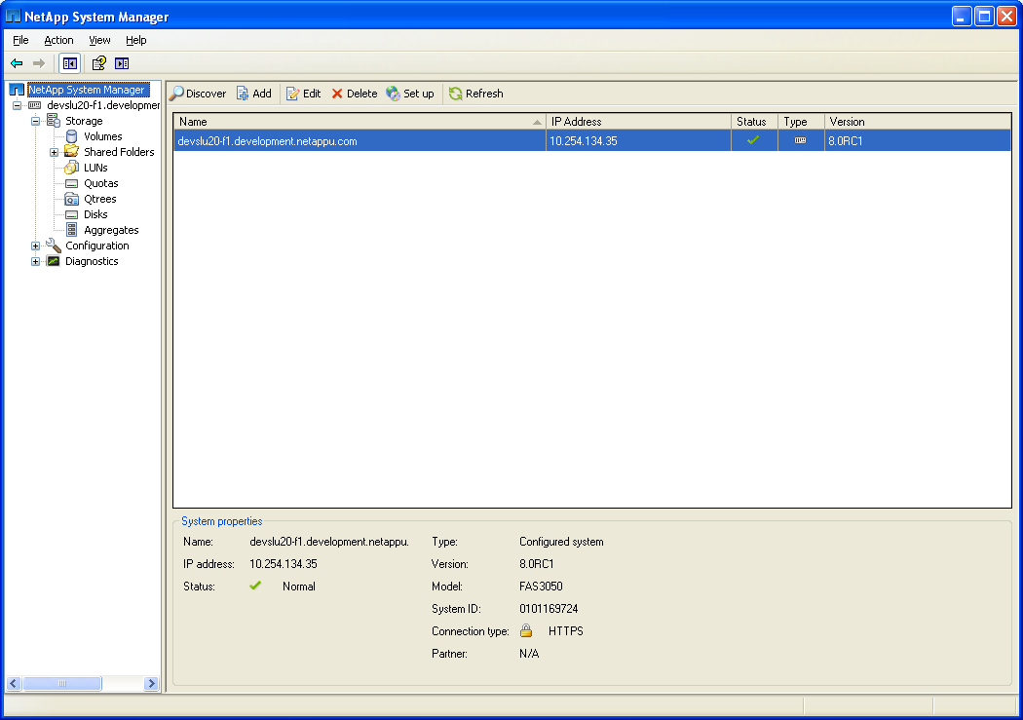
System Manager: High-Availability
Storage system must be removed from NetApp System Managerand then re-added
after high availability is configured
Notes:
SYSTEM MANAGER: HIGH-AVAILABILITY

Slide 19
System Manager: High-Availability (Cont.)
Currently, we cannot enable high-availability from NetApp System Manager so we will have to perform this operation from the command-line interface:
  License controller failover (cf):
    system> license add xxxxxx
    system2> license add xxxxxx
  Reboot:
    system> reboot
    system2> reboot
  Enable controller failover:
  system> cf enable
  Check status:
    system> cf status
Notes:
SYSTEM MANAGER: HIGH-AVAILABILITY (CONT.)

Slide 20
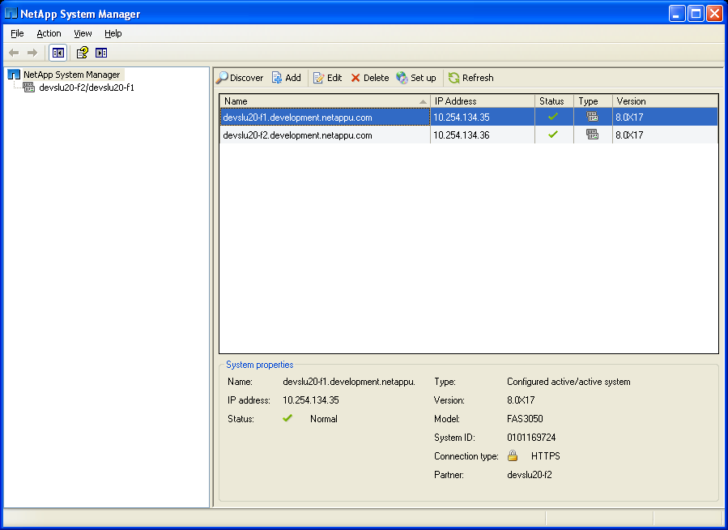
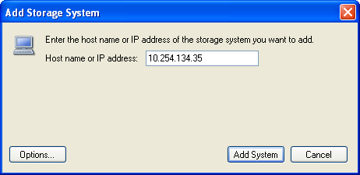
System Manager: High-Availability (Cont.)
Add one of the
storage systems
to NetApp System Manager
and the partner is
automatically identified
Notes:
SYSTEM MANAGER: HIGH-AVAILABILITY (CONT.)

Slide 21
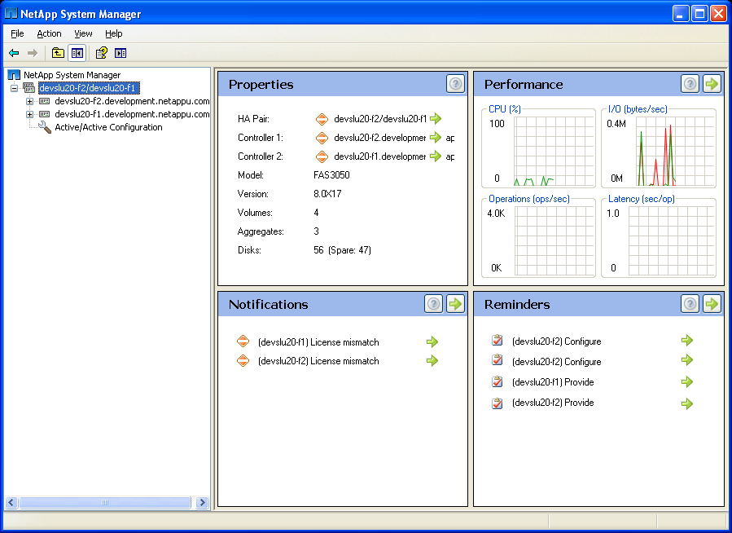
System Manager: High-Availability (Cont.)
The high-availability pair
High-availability
configuration
problems
Notes:
SYSTEM MANAGER: HIGH-AVAILABILITY (CONT.)

Slide 22
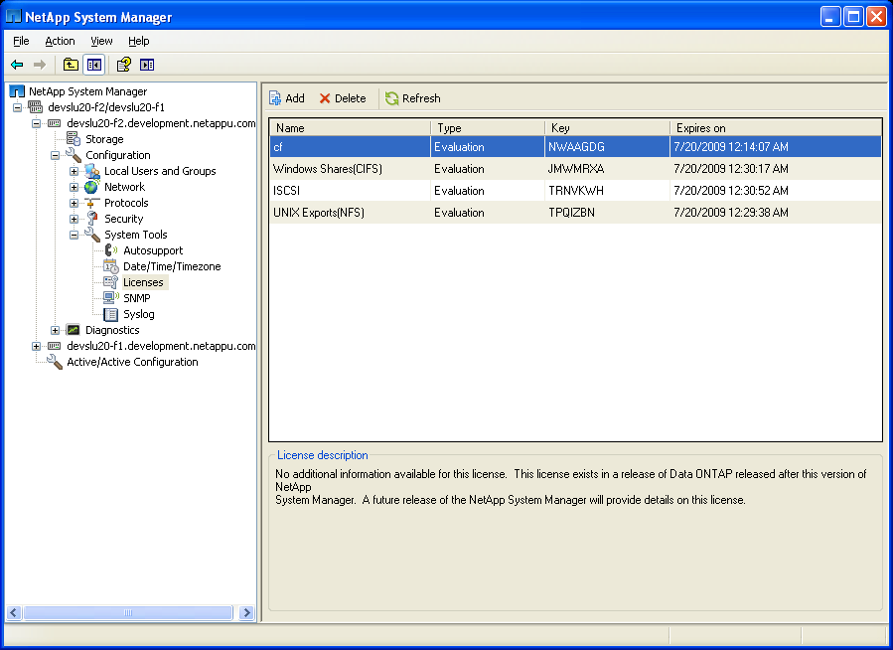
System Manager: High-Availability (Cont.)
Verify licenses
match with the partner
Notes:
SYSTEM MANAGER: HIGH-AVAILABILITY (CONT.)

Slide 23
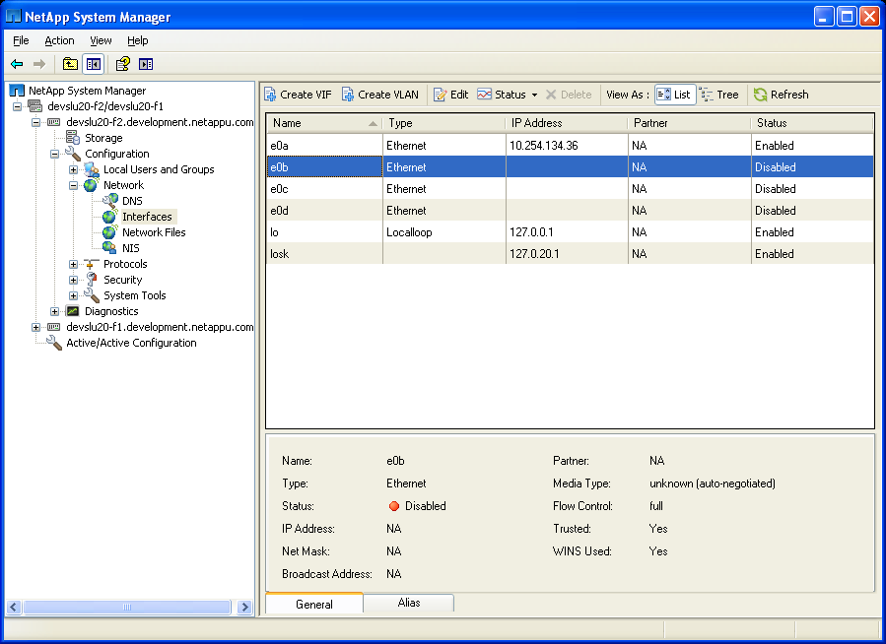
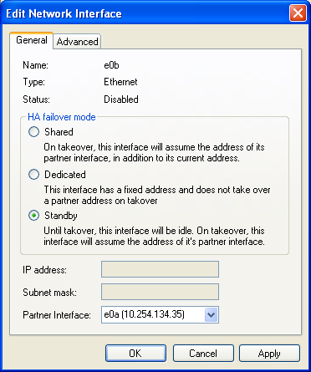
System Manager: High-Availability (Cont.)
Configure an IP
address to take over the
partner’s IP and enable
the interface
Notes:
SYSTEM MANAGER: HIGH-AVAILABILITY (CONT.)

Slide 24
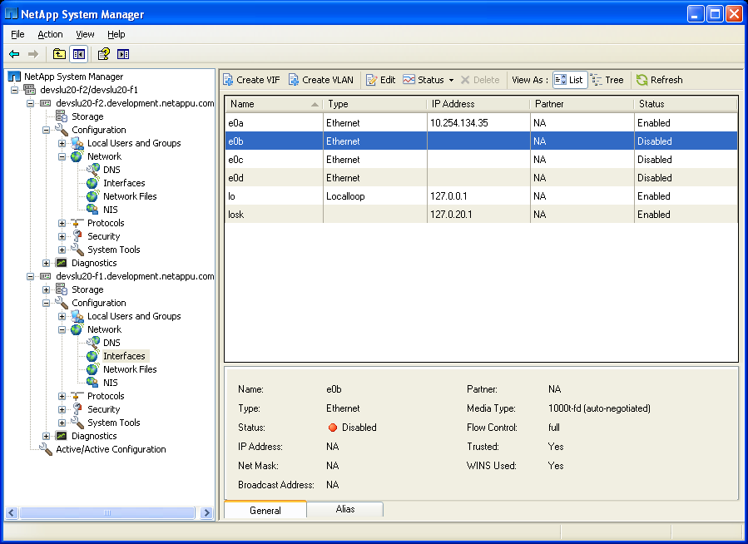
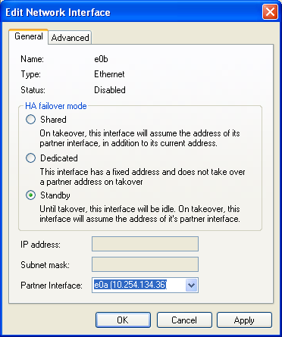
System Manager: High-Availability (Cont.)
Do the same task
for the other partner;
remember to enable
the interface
Notes:
SYSTEM MANAGER: HIGH-AVAILABILITY (CONT.)

Slide 25
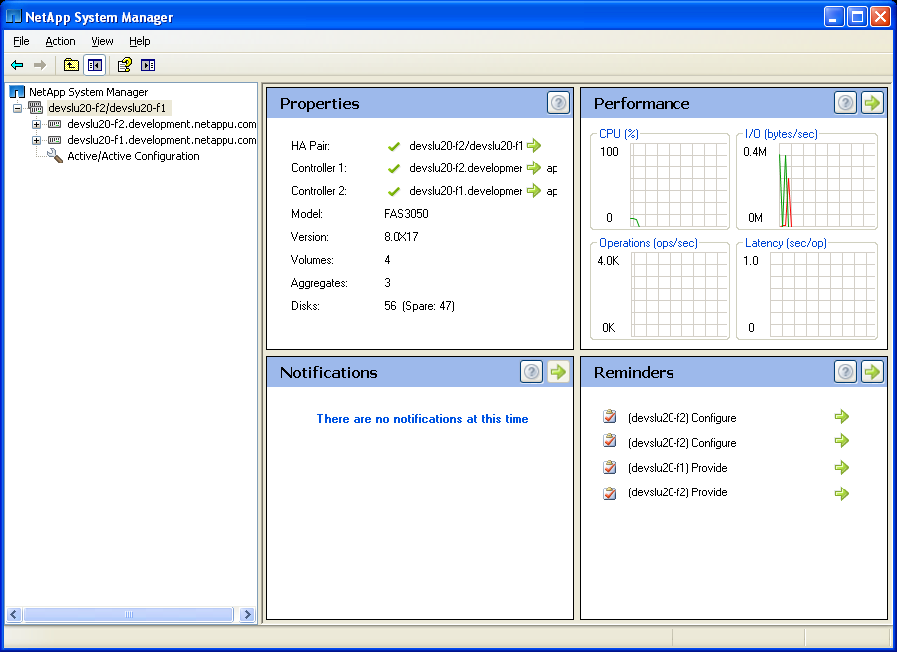
System Manager: High-Availability (Cont.)
Fixed the high-availability
configuration
problems
Notes:
SYSTEM MANAGER: HIGH-AVAILABILITY (CONT.)

Slide 26
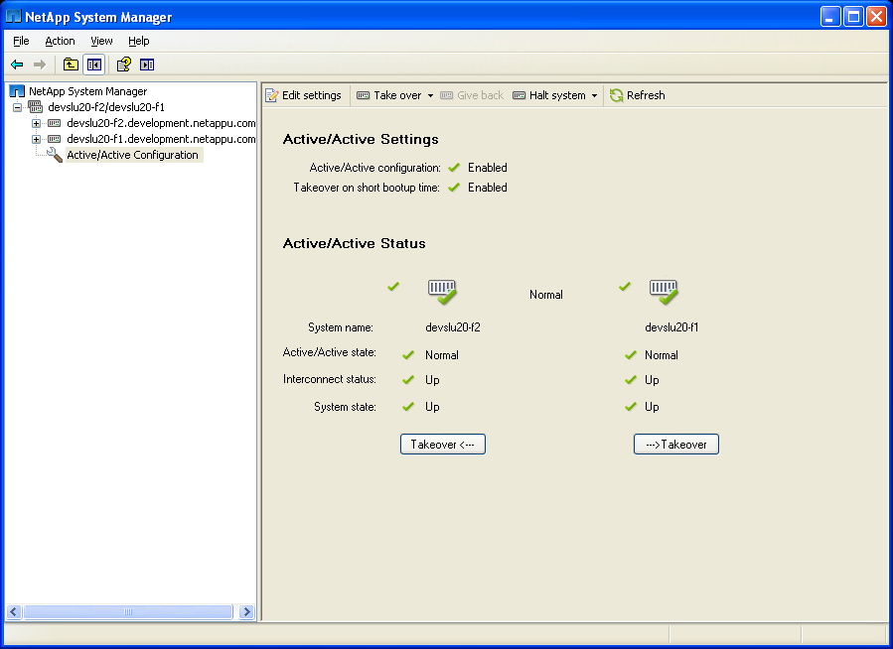
System Manager: High-Availability (Cont.)
To perform a takeover
To configure high availability
Notes:
SYSTEM MANAGER: HIGH-AVAILABILITY (CONT.)

Slide 27
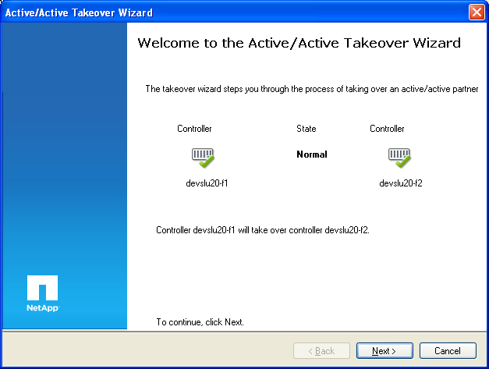
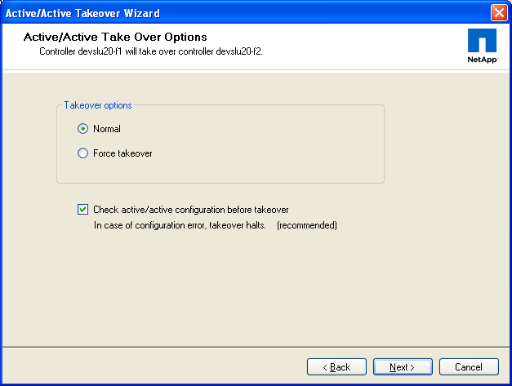
System Manager: High-Availability (Cont.)
Notes:
SYSTEM MANAGER: HIGH-AVAILABILITY (CONT.)

Slide 28
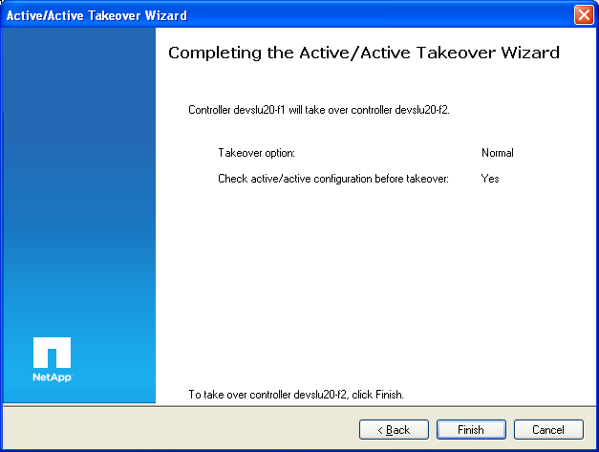
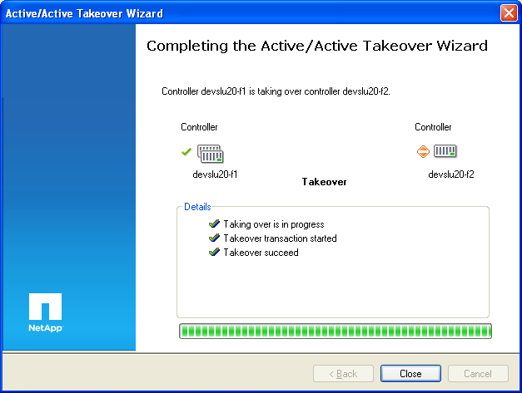
System Manager: High-Availability (Cont.)
Notes:
SYSTEM MANAGER: HIGH-AVAILABILITY (CONT.)

Slide 29

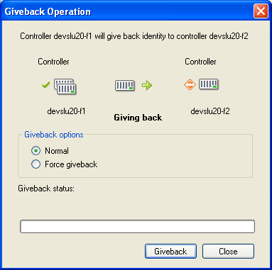
NetApp System Manager: High-Availability Configuration (Cont.)
To perform a giveback
Notes:
NETAPP SYSTEM MANAGER: HIGH-AVAILABILITY CONFIGURATION (CONT.)

Slide 30
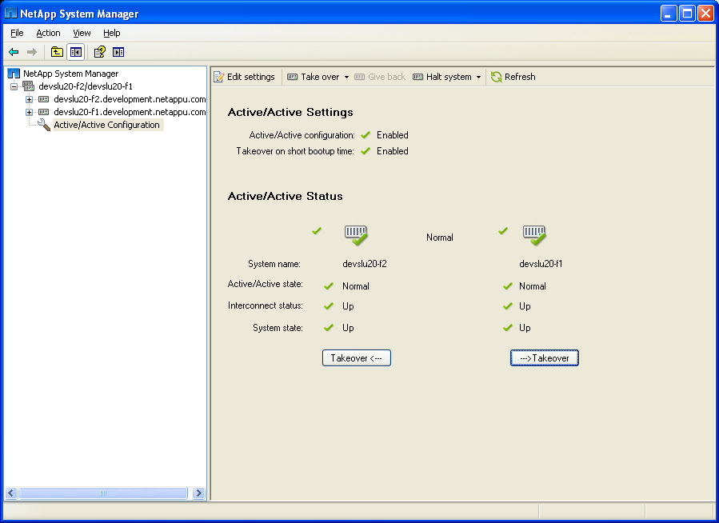
System Manager: High-Availability (Cont.)
Giveback
complete
Notes:
SYSTEM MANAGER: HIGH-AVAILABILITY (CONT.)

Slide 31
Failover Effects on Client Connections
For clients or applications using NFS v3, NFS v4, HTTP, FC, and iSCSI protocols, I/O requests are suspended during the takeover/giveback period
Connections can usually be resumed when the takeover or giveback process is complete
For CIFS (SMB 1.0), sessions are lost
Stateful clients and applications may—and usually do—attempt to re-establish the session
Notes:
FAILOVER EFFECTS ON CLIENT CONNECTIONS

Slide 32
Negotiated Failover
Data ONTAP allows failover to occur with failure of one or more network interfaces to ensure continual client interaction
To enable negotiated failover (NFO):
  system> options cf.takeover.on_network_interface_failure on
To configure policy for marked NICs:
system> options cf.takeover.on_network_interface_failure.policy
  <all_nics | any_nics>
To mark a NIC to participate in NFO:
system> ifconfig <interface> nfo
To unmark NIC and prevent it from participating in NFO:
system> ifconfig <interface> -nfo
Off by default
Set on each system in high-availability pair
Notes:
NEGOTIATED FAILOVER
To enable negotiated failover in the event of a failed network interface, you must explicitly enable the cf.takeover.on_network_interface_failure option, set the failover policy, and mark each interface that can trigger a negotiated failover (NFO).
NOTE: The cf.takeover.on_network_interface_failure.policy option must be set manually on each controller in a high-availability pair: all_nics= ALL interfaces marked for failover must fail before takeover will occur any_nic= ANY interface marked for failover will trigger a high-availability takeover. The use of the cf.takeover.on_network_interface_failure option is not the first line of defense against a network switch being a single point of failure. This option should only be considered when a single-mode vif or second-level vif cannot be used. Controller failover is disruptive to CIFS clients and can be disruptive to NFS clients using soft mounts. However, vif failover is completely nondisruptive and is therefore the preferred method. However, negotiated failover is used increasingly in a MultiStore® environment.

Slide 33
Best Practices
Test failover and giveback operations before placing high-availability controllers into production
Monitor:
  Performance of network
  Performance of disks and storage shelves
  CPU utilization of each controller to ensure it does not exceed 50%
Enable AutoSupport
NOTE: For more information about high availability, please see the High Availability Web-based course
Notes:
BEST PRACTICES
General best practices require comprehensive testing of all mission-critical systems before introducing them into a production environment. High-availability controller testing should include takeover and giveback, or functional testing as well as performance evaluation. Extensive testing validates planning.
Monitor network connectivity and stability.
Unstable networks not only affect total takeover and giveback times, they adversely affect all devices on the network in various ways. NetApp® storage controllers are typically connected to the network to serve data, so if the network is unstable, the first symptom is degradation of storage-controller performance and availability. Client service requests are retransmitted many times before reaching the storage controller, appearing to the client as slow responses from the storage controller. In a worst-case scenario, an unstable network can cause communication to time-out, and the storage controller appears to be unavailable.
During takeover and giveback operations in the high-availability controller environment, storage controllers attempt to connect to numerous types of servers on the network, including Windows® domain controllers, DNS, NIS, LDAP, and application servers. If these systems are unavailable or the network is unstable, the storage controller continues to retry establishing communications, which delays takeover or giveback times.

Slide 34

Module Summary
Notes:
MODULE SUMMARY

Slide 35
Module Summary
In this module, you should have learned to:
Define the high-availability controller configuration
Describe the three modes of high-availability operation with a high-availability pair
Analyze the effect on client protocols during failover and giveback operations
Notes:
MODULE SUMMARY

Slide 36
Exercise
Module 21: High-Availability
Estimated Time: 30 minutes
Notes:
EXERCISE
Please refer to your Exercise Guide for more instruction.

Slide 37
Check Your Understanding
What are three modes of operation for a high-availability controller configuration?
What is the purpose of using a high-availability controller configuration?
What happens during a takeover?
True or false?
  Options must be set the same on both nodes.
  The license must be set the same on both nodes.
  Both nodes must have the same number of disks.
  Both nodes must be part of the same domain.
Notes:
CHECK YOUR UNDERSTANDING

Slide 38
Answers
Module 21: High-Availability
Notes:
ANSWERS
Please refer to your Exercise Guide for more instruction.

Slide 39
Check Your Understanding: Answers
What are three modes of operation for a high-availability controller configuration?
  Normal, Takeover, Giveback
What is the purpose of using a high-availability controller configuration?
  Fault tolerance
  Nondisruptive software upgrades
  Nondisruptive hardware maintenance
What happens during a takeover?
  Surviving partner has two identities; each identity can only access appropriate volumes and networks
Notes:
CHECK YOUR UNDERSTANDING: ANSWERS

Slide 40
Check Your Understanding: Answers (Cont.)
True or false?
Options must be set the same on both nodes.
  True
The license must be set the same on both nodes.
  True
Both nodes must have the same number of disks.
  False
Both nodes must be part of the same domain.
  False
Notes:
CHECK YOUR UNDERSTANDING: ANSWERS (CONT.)

