Slide 1
NCDA Overview
Module 1
Accelerated NCDA Boot Camp
Data ONTAP 8.0 7-Mode
Notes:
NCDA OVERVIEW

Slide 2
Module Objectives
By the end of this module, you should be able to:
Explain the NCDA certification
Review key concepts from the Data ONTAP® 8.0 7-Mode Administration course
Notes:
MODULE OBJECTIVES

Slide 3

NCDA Certification
Notes:
NCDA CERTIFICATION

Slide 4
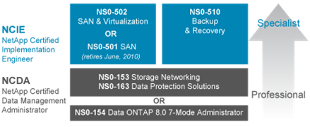
NCDA Certification
NetApp® certification is proof that you have the skills necessary to manage and deploy NetApp technologies
NetApp Certified Data Management Administrators (NCDAs) must prove they have in-depth knowledge to administrate NetApp technologies
Additional certifications are available
Notes:
NCDA CERTIFICATION
As a NetApp Certified Data Management Administrator, you will have proven skills in performing in-depth support, administrative functions, and performance management for CIFS, NFS, and FC for SCSI or iSCSI for TCP/IP protocols on NetApp storage systems running the Data ONTAP® operating system in NFS and Windows® (CIFS) multiprotocol environments. You will also be able to implement active-active controller configuration and SyncMirror® software to ensure continuous data availability and rapid recovery of data in the event of a disaster, and use the SnapMirror®, SnapRestore®, and SnapVault® products to manage and protect mission-critical data.

Slide 5

Benefit of Certification
With certification, storage administrators receive:
  Recognition of industry achievement
  Proof of skills needed to manage and deploy NetApp technologies
Notes:
BENEFIT OF CERTIFICATION

Slide 6
Recommended Courses
To prepare for the NCDA certification, NetApp strongly recommends:
  The instructor-led Data ONTAP 8.0 7-Mode Administration course
Additional recommended courses:
  CIFS Administration
  NFS Administration
  SAN Administration
  NetApp Protection Software Administration
  High Availability (Web-based training only)
Notes:
RECOMMENDED COURSES

Slide 7
Data ONTAP 8.0
7-Mode Administration Course
Notes:
DATA ONTAP 8.0 7-MODE ADMINISTRATION COURSE

Slide 8
Data ONTAP 8.0 7-Mode Administration
The following topics are covered in the Data ONTAP 8.0 7-Mode Administration course:
  Introduces NAS and SAN technologies
  Distinguishes between modes within Data ONTAP 8.0
  Identifies and discusses the benefits of the NetApp storage architecture
  Describes role-based access controls
  Steps to administer a NetApp storage system
The next slides discuss some (but not all) of the important topics covered in this course
Notes:
DATA ONTAP 8.0 7-MODE ADMINISTRATION

Slide 9







NAS and SAN Topology
NFS
iSCSI
Corporate
LAN
CIFS
FCoE
FC
NAS
SAN
NetApp FAS
Notes:
NAS AND SAN TOPOLOGY
SAN is a block-based storage system that makes data available over the network using FC, FCoE, and iSCSI protocols.
NAS is a file-based storage system that makes data available over the network using NFS and CIFS protocols.
The NetApp SAN and unified storage architecture provides an outstanding level of investment protection and flexibility. The fabric-attached storage (FAS) system at the bottom of the graphic implies one “box.” However, the actual storage environment includes small and large FAS systems, and NetApp VTL systems.

Slide 10
Data ONTAP 8.0 Review
Data ONTAP 8.0 comes in two modes:
  7-Mode
  Cluster-Mode
Data ONTAP 8.0
7-Mode
Cluster-Mode
Data ONTAP 7G
Data ONTAP GX
Notes:
DATA ONTAP 8.0 REVIEW
Achieve new levels of scalability and storage flexibility, resulting in lower TCO, while providing maximized business agility and 24x7 business continuity.
Accelerate your move to a service-oriented architecture with Data ONTAP 8.0, which enables service levels across a diverse set of applications and extends data center virtualization. Data ONTAP 8.0 provides a single unified, scalable platform to address your NAS, SAN, multi-tier, multi-protocol, and multi-tenant virtualized environments.

Slide 11

Data ONTAP 8.0
7-Mode
  Designed to be a
  simple transition from
  Data ONTAP 7G
  Scale-up technology allows aggregates to be up to100 TB
  (higher in the future)
  Simple configuration for NAS or SAN
Cluster-Mode
  Designed to be a
  simple transition from
  Data ONTAP GX
  Scale-out technology allows a pool of storage controllers to manage the storage cluster
  Single NAS shared namespace across the cluster
7-Mode
Cluster-Mode
Storage Pool
Storage Pool
Notes:
DATA ONTAP 8.0
NetApp storage solutions help you manage data in your enterprise environment with a scalable and flexible operating system we call Data ONTAP 8.0 7-Mode. Data ONTAP 8.0 7-Mode provides:
More efficient storage
High availability
Business continuance
Reduced storage management complexity
Deploy Data ONTAP 8.0 Cluster-Mode for high performance and high capacity. NetApp Data ONTAP 8.0 Cluster-Mode helps you achieve results and get to market faster by providing the massive throughput and scalability you need to meet the demanding requirements of your high-performance computing and digital media content applications. Achieve high levels of performance, manageability, and reliability for your large Linux®, UNIX®, or Microsoft® Windows clusters with Data ONTAP 8.0 Cluster-Mode. The Data ONTAP 8.0 Cluster-Mode operating system includes:
Multi-node scaling using a global namespace
NetApp FlexVol® storage virtualization
Clustered file system
Snapshot™ replication and mirroring

Slide 12
Storage Architecture
Storage architecture
  Aggregate
  Plex
  RAID group
  Disk
aggr1
plex0
rg0
rg1
system> sysconfig -r
...
RAID group /aggr1/plex0/rg0 (normal)
RAID Disk Device HA SHELF BAY CHAN Pool...
--------- ------ ------------- ---- ----
parity 0a.24 0a 1 8 FC:A 0...
data 0a.25 0a 1 9 FC:A 0...
...
Notes:
STORAGE ARCHITECTURE
Data ONTAP 8.0 7-Mode storage architecture is as following:
Aggregate - provide storage to a volume or volumes that they contain. Each aggregate contains its own plex(es), RAID configuration and a set of assigned physical disks.
Plex - contain RAID groups and are associated with an aggregate. Normally, an aggregate will have only one plex. Mirrored aggregates using SyncMirror with have two plexes (plex0 and plex1) with plex1 containing a mirror of the plex0’s data.
RAID group - contains physical disks and are associated with a plex. RAID groups will either be RAID4 or RAID-DP configurations.
Disks - are either parity, double-parity, or data disks.

Slide 13
Creating an Aggregate Using the CLI
To create a 64-bit aggregate:
  system> aggr create aggrname -B 64 24
  Creates a 64-bit aggregate called aggrname with 24 disks
  By default, this aggregate uses RAID-DP®
  24 disks must be available (spares) for the command to succeed
  To create a 32-bit aggregate:
  system> aggr create aggrname -B 32 24
or
  system> aggr create aggrname 24
Notes:
CREATING AN AGGREGATE USING THE CLI
For more information about 64-bit aggregates, please see the Technical Report 3786 found at www.netapp.com/us/library/technical-reports/tr-3786.html.

Slide 14
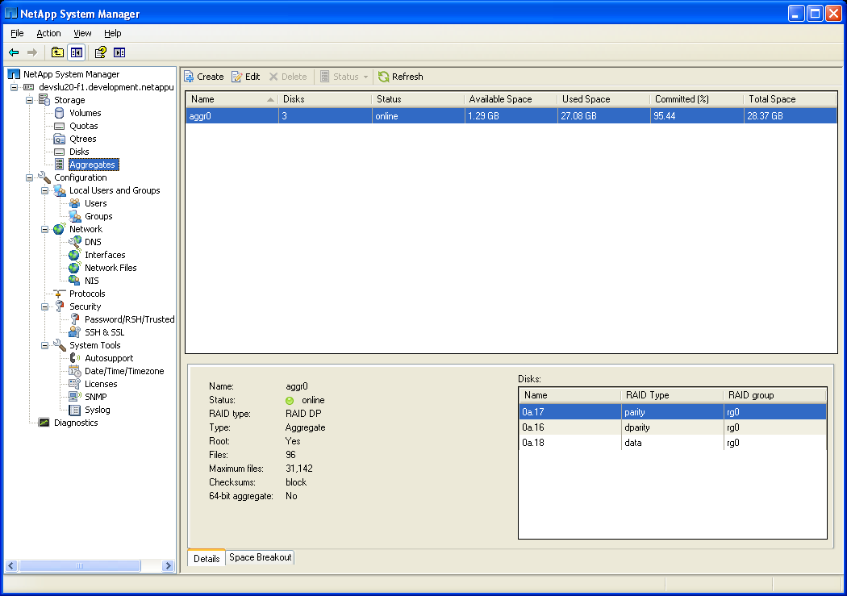
NetApp System Manager: Aggregate
Select Aggregates
to administrate
aggregates
Select Create to
create a new
aggregate
Notes:
NETAPP SYSTEM MANAGER: AGGREGATE

Slide 15
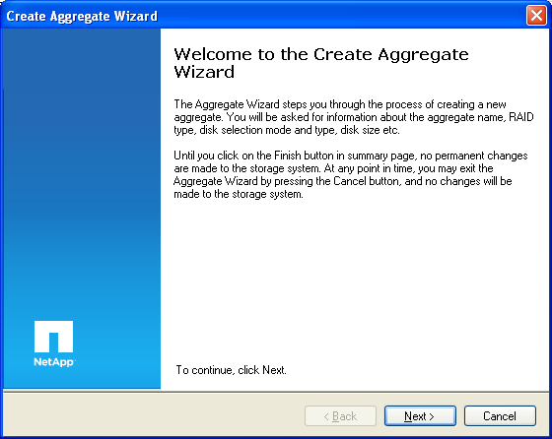
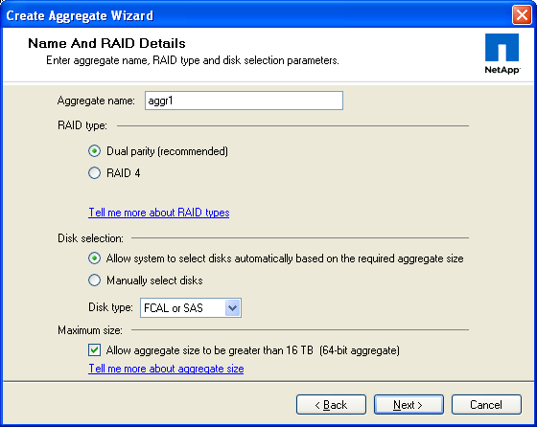
Create Aggregate Wizard
Check for a 64-bit aggregate
or leave it blank for a
32-bit aggregate
Notes:
CREATE AGGREGATE WIZARD

Slide 16
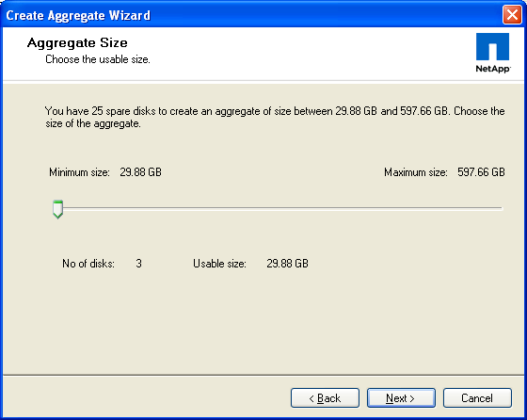
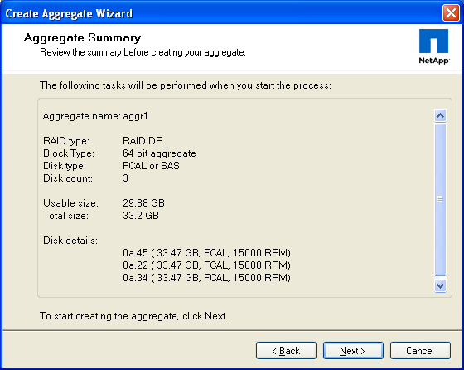
Create Aggregate Wizard (Cont.)
Notes:
CREATE AGGREGATE WIZARD (CONT.)

Slide 17
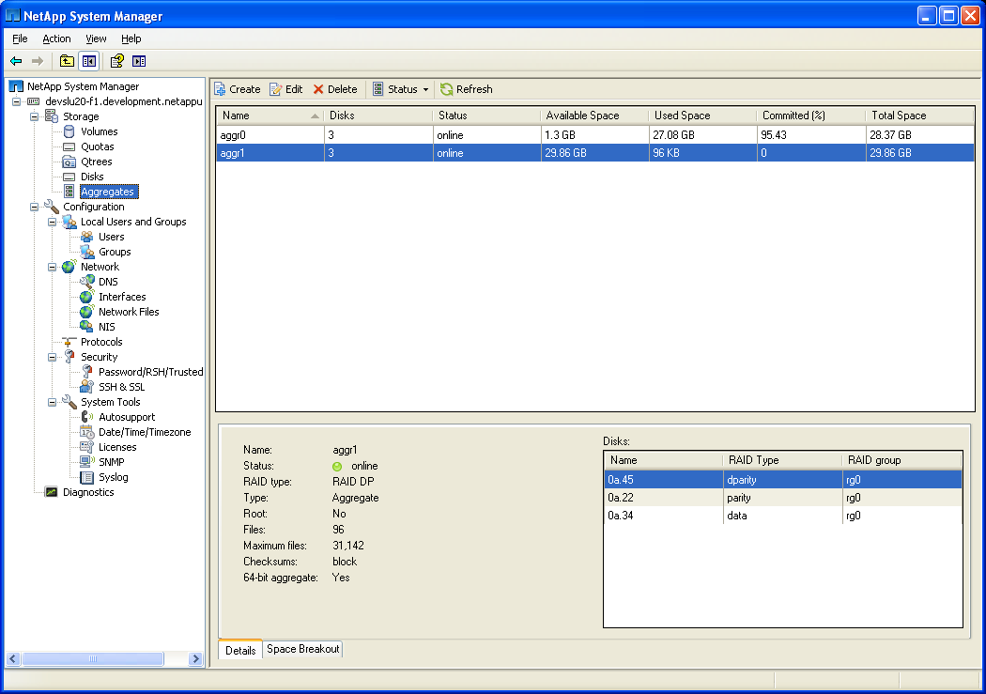
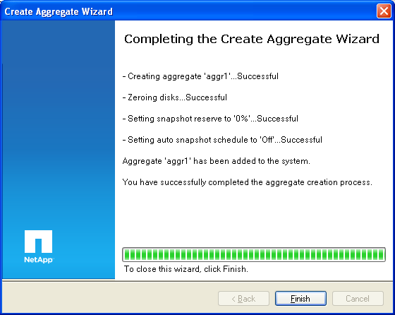
Create Aggregate Wizard (Cont.)
Notes:
CREATE AGGREGATE WIZARD (CONT.)

Slide 18
Flexible Volumes
Flexible volumes manage the logical layer independent of the physical layer
Multiple flexible volumes can exist within a single aggregate
aggr1
FlexVol 1
FlexVol 2
Notes:
FLEXIBLE VOLUMES
A flexible volume (also called a FlexVol volume) is a volume that is loosely coupled to its container aggregate. Because the volume is managed separately from the aggregate, you can create small FlexVol volumes (20 MB or larger), and then increase or decrease the size of the FlexVol volumes in increments as small as 4 KB.
Advantages of flexible volumes:
You can create flexible volumes almost instantaneously. These volumes:
Can be as small as 20 MB
Are limited to aggregate capacity (if guaranteed)
Can be as large as the volume capacity supported for your storage system (not guaranteed)
You can increase and decrease a flexible volume while online, allowing you to:
Resize without disruption
Size in any increment (as small as 4 KB)
Size quickly

Slide 19
Aggregates and FlexVol Volumes
Create an aggregate
  RAID groups are created as result
Create FlexVol 1
  Only metadata space is used
  There is no pre-allocation of disk blocks to a
  specific volume
Create FlexVol 2
  WAFL® allocates aggregate space as data is written
Populate volumes
FlexVol 1
FlexVol 2
FlexVol 3
vol1
vol2
vol3
Aggregate
RG1
RG2
RG3
aggr1
Notes:
AGGREGATES AND FLEXVOL VOLUMES
A FlexVol guarantee is an option of a flexible volume which determine when space is allocated out of the containing aggregate space for a volume or the files within the volume. There are three possible guarantees:
Volume - is the default option and indicates that space is allocated or “taken away” from the aggregate when the volume is created.
File - indicates that space is allocated or “taken away” from the aggregate when certain “space-reserved” files (such as a space-reserved LUN) is created.
None - indicates that space is not allocated or “taken away” from the aggregate until it is used by the file. This is also referred to as “thin provisioning” a FlexVol.

Slide 20




Role-Based Access Control
Role-based Access Control (RBAC)
  Mechanism for managing a set of capabilities that an administrator can perform on a storage system
Steps to implement:
  Create a role with specific capabilities
  Create a group with one or more assigned roles
  Create user(s) assigned to one or more groups
Groups
Roles
Capabilities
Notes:
ROLE-BASED ACCESS CONTROL
Role-based access control (RBAC) specifies how users and administrators can use a particular computing environment.
Most organizations have multiple system administrators, some of whom require more privileges than others. By selectively granting or revoking privileges for each user, you can customize the degree of access that each administrator has to the system.
RBAC allows you to define sets of capabilities that apply to one or more users. Users are assigned to groups based on their job functions, and each group is granted a set of roles to perform those functions.

Slide 21

Interface Groups
Previously called virtual interfaces (vifs)
Interface groups allow trunking of one or more Ethernet interfaces
  IEEE 802.3ad link aggregation
Types:
  Single-mode
  Multi-mode
Command:
system> ifgrp...
Interface Group
Interface Group
0
1
2
3
4
5
6
7
0
1
2
3
4
5
6
7
Notes:
INTERFACE GROUPS
Virtual interfaces (vifs) were renamed in Data ONTAP 8.0 7-Mode to eliminate any confusion with the term vif, which was used in Data ONTAP GX and Data ONTAP 8.0 Cluster-Mode.

Slide 22
Module Summary
Notes:
MODULE SUMMARY

Slide 23
Module Summary
In this module, you should have learned to:
Explain the NCDA certification
Review key concepts from theData ONTAP 8.0 7-Mode Administration course
Notes:
MODULE SUMMARY

Slide 24
Exercise
Module 1: NCDA Overview
Estimated Time: 15 minutes
Notes:
EXERCISE
Please refer to your Exercise Guide for more instruction.

Slide 25
Check Your Understanding
How is Data ONTAP 7G and Data ONTAP GX related in Data ONTAP 8.0?
What are the two storage topologies supported by Data ONTAP?
How is SAN different than NAS?
Notes:
CHECK YOUR UNDERSTANDING

Slide 26
Answers
Module 1: NCDA Overview
Notes:
ANSWERS
Please refer to your Exercise Guide for more instruction.

Slide 27
Check Your Understanding: Answers
How is Data ONTAP 7G and Data ONTAP GX related in Data ONTAP 8.0?
  Data ONTAP 7G and Data ONTAP GX are now merged into a single code under Data ONTAP 8.0, however, a storage system may be only configured one mode at a time
What are the two storage topologies supported by Data ONTAP?
  NAS
  SAN
How is SAN different than NAS?
  SAN topologies are used for block-based storage
  NAS topologies are used for file-based storage
Notes:
CHECK YOUR UNDERSTANDING: ANSWERS

