Slide 1
NFS Setup
Module 3
Accelerated NCDA Boot Camp
Data ONTAP 8.0 7-Mode
Notes:
NFS SETUP

Slide 2
Module Objectives
By the end of this module, you should be able to:
Configure Network File System (NFS) on a NetApp® storage system
Add Network Information Server (NIS) to manage users, groups, and name-to-IP resolution
Administer a storage system to perform Domain Name System (DNS) lookups
Configure a storage system to access a Lightweight Directory Access Protocol (LDAP) server to centrally manage users and groups
Set up PC-NFS and WebNFS environments to extend the reach of NFS
Notes:
MODULE OBJECTIVES

Slide 3

Environments
Notes:
ENVIRONMENTS

Slide 4
NFS Environments
NFS can be configured in many types of environments, for example:
  NFS with local identification
  NFS with NIS
  NFS with DNS and LDAP
  NFS with PC-NFS
  NFS with WebNFS
Your environment will be based upon your requirements
Notes:
NFS ENVIRONMENTS

Slide 5
NFS
Notes:
NFS

Slide 6
NFS Configuration
Setting up NFS on the clients and server (storage system) involves:
  Step 1: Licensing NFS on the storage system
    Use license add or NetApp System Manager
      Starts daemons (mountd and nfsd) that handle NFS remote procedure call protocol
  Step 2: Configuring NFS
    (discussed in the remainder of this module)
  Step 3: Exporting file systems from the storage system (discussed in the next module)
    Step 4: Mounting file systems on clients
    (discussed in the next module)
Notes:
NFS CONFIGURATION

Slide 7
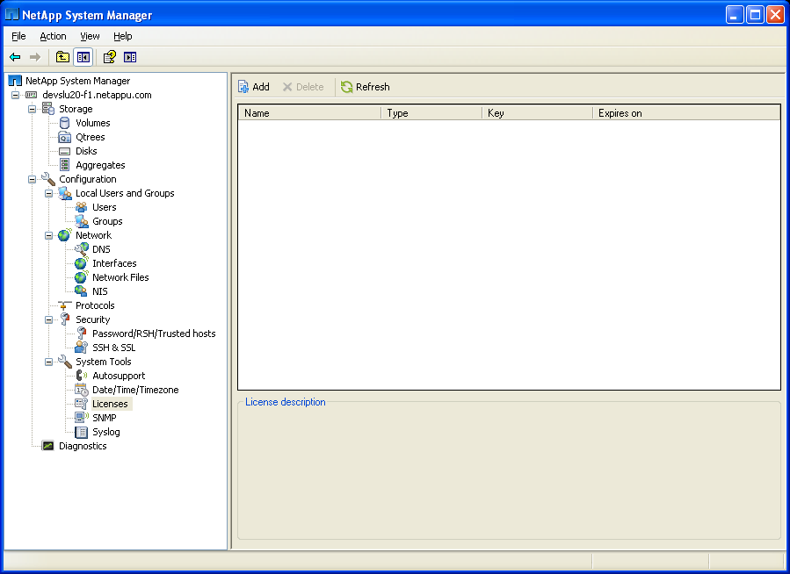
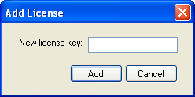
System Manager: NFS Setup
To configure licenses
Enter the NFS
license code
Notes:
SYSTEM MANAGER: NFS SETUP

Slide 8
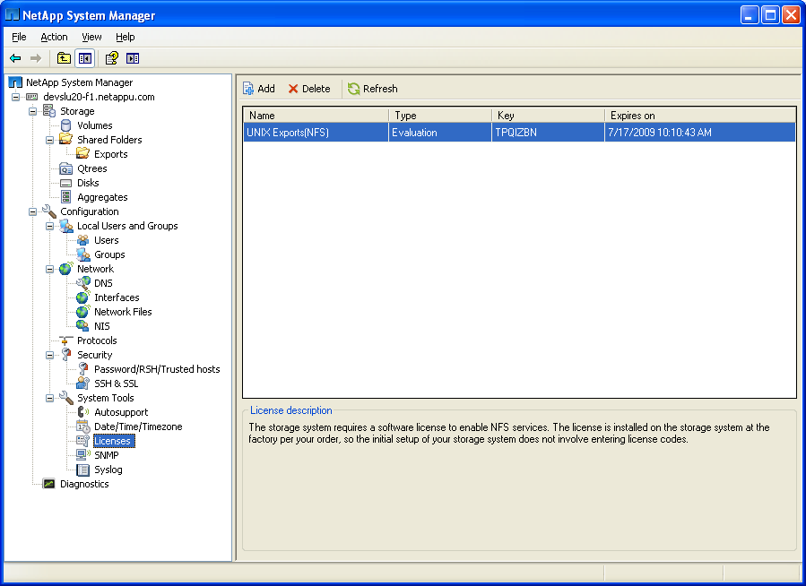
System Manager: NFS Setup (Cont.)
The newly added
license code
Exports Added
Notes:
SYSTEM MANAGER: NFS SETUP (CONT.)

Slide 9
NFS Versions
As stated in Module 2, the storage system can support NFS v2, v3, or v4
But what version do you choose?
Version 2 is the default and can’t be disabled
Version 3 is a common choice because:
  It’s backward compatible with v2
  It supports 64-bit file size
  It has asynchronous writes, which eliminates the synchronous write system blockages of v2
Notes:
NFS VERSIONS
NFS v3 has clear advantages:
The client and server implementations of NFS v3 provide backward compatibility with NFS v2 by supporting both NFS v2 and NFS v3.
The 64-bit extensions in NFS v3 support both 32-bit and 64-bit clients and servers.
NFS v3 asynchronous writes eliminate the synchronous write system blockages in NFS v2.
In NFS v2, all operations that modify the file system must be committed to stable storage before the remote procedure call can be acknowledged. Most servers do not have battery-backed memory; the stable storage requirement means that all written data must be on the disk before the servers can reply to the remote procedure call. For a growing file, an update may require up to three synchronous disk writes: one for the inode to update its size, one for the indirect block to add a new data pointer, and one for the new data itself. Each synchronous write takes several milliseconds; this delay severely restricts the write throughput for any given client file. Version 3 of the NFS protocol eliminates some of the synchronous writes by adding a new asynchronous write remote procedure call request. When such a request is received by the server, it is permitted to acknowledge the remote procedure call without writing the new data to stable storage.
Typically, a client will do a series of asynchronous write requests followed by a commit remote procedure call request when it reaches the end of the file or it runs out of buffer space to store the file. The commit remote procedure call request causes the server to write any unwritten parts of the file to stable storage before acknowledging the commit remote procedure call. The server benefits by having to write the inode and indirect blocks for the file only once per batch of asynchronous writes, instead of on every write remote procedure call request. The client benefits from having higher throughput for file writes. The client does have the added overhead of having to save copies of all asynchronously written buffers until a commit remote procedure call is done, because the server may crash before having written one or more of the asynchronous buffers to stable storage. When the client sends the commit remote procedure call, the acknowledgment to that remote procedure call tells which of the asynchronous blocks were written to stable storage. If any of the asynchronous writes done by the client are missing, the client knows that the server has crashed during the asynchronous-writing period, and resends the unacknowledged blocks. After all the asynchronously written blocks have been acknowledged, they can be dropped from the client cache.
For more information, see NFS Version 3 Design and Implementation, which can be found at www.netapp.com/ftp/NFSv3_Rev_3.pdf.

Slide 10
NFS Versions (Cont.)
Unlike previous versions, NFS v4:
  Integrates file locking
  Provides strong security
  Enables better support for access over the Internet
NFS v4 does it all; it:
  Eliminates the need for the Network Lock Manager Protocol and the Mount Protocol in v2 and v3
  Implements mandatory file locking
  Uses well-defined ports that easily transit through firewalls
  Groups several remote procedure calls to increase performance
Notes:
NFS VERSIONS (CONT.)
NFS v4 is introduces a major structural change to the protocol compared to prior versions and the elimination of ancillary protocols. In NFS v2 and v3, the Mount protocol was used to obtain the initial file handle, while file locking was supported by way of the Network Lock Manager protocol. NFS v4 is a single protocol that uses a well-defined port, which, coupled with the use of TCP, allows NFS to easily transit firewalls to enable support for the Internet. As in WebNFS, the use of initialized file handles obviates the need for a separate Mount protocol. Locking has been fully integrated into the protocol—which was also required to enable mandatory locking. The lease-based locking support adds significant state (and concomitant error recovery complexity) to the NFS v4 protocol.
Another structural difference between NFS v4 and its predecessors is the introduction of a COMPOUND remote procedure call procedure that allows the client to group traditional file operations into a single request to send to the server. In NFS v2 and v3, all actions were remote procedure call procedures. NFS v4 is no longer a "simple" remote-procedure-call- based distributed application. In NFS v4, work is accomplished through operations. An operation is a file system action that forms part of a COMPOUND procedure. NFS v4 operations correspond functionally to remote procedure call procedures in former versions of NFS. The server in turn groups the operation replies into a single response. Error handling is simple on the server—evaluation proceeds until the first error or last operation whereupon the server returns a reply for all evaluated operations.
See The NFS Version 4 Protocol at www.netapp.com/library/tr/3085.pdf for more information.

Slide 11
NFS Versions (Cont.)
NFS v4
  Requires Kerberos v5 implementation (discussed in Module 4)
  Requires TCP
  Creates pseudo-file systems
    Separate volumes may be exported with a single common root
    system> mount -t nfs4 system:/ /mnt/system
The server view
What the client sees
/vol/
/
pseudo-file system
Export
vol
Exported
vol0 vol1 vol2
vol0 vol2
home
admin
home
admin
Notes:
NFS VERSIONS (CONT.)
On most UNIX® systems, when a system provides files to share, or “export,” the exports are relative to root or /. Because Data ONTAP® provides the ability to create multiple volumes, there was a need to distinguish between the volumes and therefore the /vol/volumename convention was created. In NFS v3, if you do not use the complete path (/vol/) and you mount /, the mount path is assumed to be /vol/vol0 if vol0 is the root. This default was created to maintain compatibility with most UNIX systems. In NFS v4, if you mount /, you will mount the root of a pseudo file system.
To better see this, consider the following example: The storage system has three volumes: vol0, vol1, and vol2 with the following exports: /vol/vol0 and /vol/vol2/admin. In NFS v4, the server provides a single view of the exported file system to the client as shown in this slide regardless of which volume the resource originated from.
When a server chooses to export a disconnected portion of its namespace (that is, vol0 and vol2/admin), the server creates a pseudo-file system to bridge the unexported portions of the namespace allowing a client to reach the export points from the single common root (that is, /). This pseudo-file system is a structure containing only directories that allows a client to browse the hierarchy of exported file systems. The client can notice the underlying volume transitions on the server by observing that the fsID changes. The client's view of the pseudo-file system is limited to those paths that lead to exported file systems. Because /vol/vol1 is not exported in this example, it does not appear to the client during browsing operations as shown in the client's view in this slide. But a pseudo vol2 does appear because it is part of the export /vol/vol2/admin.
To explore this further, we will look at an actual example:
system> exportfs/vol/vol0 –sec=sys:krb5, rw/vol/vol2/admin –sec=sys:krb5, rw
Only vol0 and vol2/admin are exported. When a client attempts to mount / on the storage system with the command mount -t nfs4 system:/ /mnt/system using NFS v4, the storage system will create a pseudo file system. This pseudo-file system will consist of the following:
/vol – a pseudo-file system
/vol/vol0 – a real file system
/vol/vol2 – a pseudo-file system
(note it is a pseudo–file system because vol2 was not explicitly exported)
/vol/vol2/admin – a real file system
To explore the pseud-file system, navigate to the mount path:
# cd /mnt/system
# lsvol0 vol2
# cd vol2
# lsadmin
Notice that moving from one file system (/vol) to another (/vol/vol2) is seamless. Back on the storage system, we can see that this is actually changing volumes by referring to the underlying fsID.
system*> showfh4 -v /vol/vol (really /vol): exp.fileid=0x00042b exp.snapgen=0x000001 flags=0x05 snapid=0x0 unused=0x0 fileid=0x00042b gen=0x000001 fsid=0x000002 handle_type=0x02
system*> showfh4 -v /vol/vol0/vol/vol2 (really /vol/vol2): exp.fileid=0x000040 exp.snapgen=0x1da07d flags=0x00 snapid=0x0 unused=0x0 fileid=0x000040 gen=0x1da07d fsid=0xe802e1 handle_type=0x02
system*> showfh4 -v /vol/vol2/admin/vol/vol2/admin (really /vol/vol2/admin): exp.fileid=0x000064 exp.snapgen=0x355073 flags=0x00 snapid=0x0 unused=0x0 fileid=0x000064 gen=0x2355073 fsid=0xc1504d handle_type=0x00

Slide 12
Configuring NFS Versions
NFS Version | Option | Default Value
v2 | nfs.v2.df_2gb_lim | off
v3 | nfs.v3.enable | on
v4 | nfs.v4.enable nfs.v4.id.domain nfs.v4.acl.enable nfs.v4.read_delegation nfs.v4.write_delegation nfs.v4.setattr_acl_preserve | off off off off off off
Notes:
CONFIGURING NFS VERSIONS
By default, NFS v2 and v3 are enabled. You can use the options command to enable versions that are not currently enabled.

Slide 13
Network Configuration
nfs.tcp.enable on
  When enabled, NFS uses TCP as transport
nfs.udp.enable on
  When enabled, NFS uses User Datagram
  Protocol (UDP) as transport
nfs.udp.xfersize 32768
  Data transfer size in bytes
nfs.ifc.xmt.high 16
  High-limit transmit-flow control value
nfs.ifc.xmt.low 8
  Low-limit transmit-flow control value
Notes:
NETWORK CONFIGURATION
nfs.tcp.enable
When enabled, NFS uses TCP as transport.
nfs.udp.enable
When enabled, NFS uses User Datagram Protocol (UDP) as transport.
nfs.udp.xfersize
This is the UDP data transfer size. The default is 32,768.
nfs.ifc.xmt.high
The limit of outstanding requests for which NFS will go into flow control. The default is 16 and the maximum is 64. This is a persistent option.
nfs.ifc.xmt.low
The limit of outstanding requests for which NFS comes out of flow control. The default value for this option is set to 8. Its minimum value is 0. This is a persistent option.
Please see the Data ONTAP 8.0 Network Management Guide for details about each configuration option.

Slide 14
Other NFS Configurations
In an NFS environment with a local identification model:
  Hostname-to-IP resolution must be configured
  Netgroups will likely also be configured
  The resolution mechanism must be verified
Notes:
OTHER NFS CONFIGURATIONS

Slide 15
/etc/hosts file
List of IP addresses followed by the hostname
There are three types of entries:
  Local hosts loopback device
  Local hostname
  Remote hosts
system> rdfile /etc/hosts
#Auto-generated by setup Tue May 8 1:01:01
127.0.0.1 localhost
10.61.77.156 system system-e0a
#0.0.0.0 system system-e0b
#0.0.0.0 system system-e0c
#0.0.0.0 system system-e0d
10.61.77.122 lux-client
Notes:
/ETC/HOSTS FILE
Each entry in the /etc/hosts file lists an IP address followed by the hostname and any aliases for that host. The hosts file has three types of entries, containing information about the:
Local hosts loopback device, which ensures that data packets sent from a machine to itself are not sent on to the network
Local hostname
Remote hosts

Slide 16
Using Netgroups
The following /etc/netgroup snippet contains three netgroups:
trustedhosts (host1,,) (host2,,)
untrustedhosts (host3,,) (host4,,) (host5,,)
allhosts trustedhosts untrustedhosts
In an exports entry, you can specify the trustedhosts, untrustedhosts, or allhosts netgroup as the export target with the rw, ro, and root options (discussed in the next module)
Case-sensitive file
Notes:
USING NETGROUPS
/etc/netgroup defines network-wide groups used for access permission checking during remote mount request processing.
Each line defines a group and has the format:
groupname member-list
Each element in member-list is either another group name or a triple of the form:
(hostname, username, domainname)
Network groups can also be stored in a network information services, such as LDAP, NIS, or NIS+ (in NIS compatibility mode only).

Slide 17
/etc/nsswitch.conf file
/etc/nsswitch.conf file
  Determines the order in which identification systems are queried
  system> rdfile /etc/nsswitch.conf
  #Auto-generated by setup Fri Jun 30 07:35:27
  hosts: files nis dns
  passwd: files nis ldap
  netgroup: files nis ldap
  group: files nis ldap
  shadow: files nis
/etc/hosts
Notes:
/ETC/NSSWITCH.CONF FILE

Slide 18
NIS
Notes:
NIS

Slide 19
NFS Versus NFS and NIS
Architecture options:
  NFS alone server-client model is used in small networks for easier localized maintenance, but is not scalable
  NFS server with NIS server-client model is used in large distributed networks, provides centralized maintenance, and is scalable
Notes:
NFS VERSUS NFS AND NIS
Both NFS and NIS are client-server applications, which means that they sit at the top layer of the protocol stack and use External Data Representation (XDR) and remote procedure call services.
In addition to NFS servers, NIS servers are typically used in large distributed networks.
A major problem in running a distributed computing environment is maintaining separate copies of common configuration files, such as the passwd, group, and hosts files. Ideally, the network should be consistent in its configuration so that users do not have to worry about where they have accounts or if they will be able to find a new machine on the network. Preserving consistency, however, means that every change to one of these common files must be propagated to every host on the network, which is difficult and not scalable. The NIS addresses these problems. It is a distributed system that replaces copies of commonly replicated configuration files with a centralized management facility. Machines that are using NIS retrieve information from one centralized database that maintains updates and propagates changes to the rest of the network. Files that are generally the same on all hosts in a network, such as /etc/passwd and /etc/hosts, reside on the NIS database.
Typically, NIS is a lookup service that NFS and mount depend on. It performs host lookup from the export maps, reverse lookups, and so on.

Slide 20
NIS Configuration
NIS is used to resolve:
  User
  Hostname-to-IP resolution
  Netgroup
To configure NIS:
  nis.enable on
    Default is off
  nis.domainname domain_name
  nis.servers server_name_or_ip, server…
Use nis info to display configuration information
Other commands: ypcat, ypgroup, ypmatch, ypwhich
NOTE: The storage system will only work with an NIS+ server if NIS+ server is set to NIS-compatibility mode
Notes:
NIS CONFIGURATION

Slide 21
NIS Slave Mode
NIS slave
  Downloads NIS maps from master servers every 45 minutes to the storage system
  Handles all NIS lookups from local NIS slave maps
To configure Data ONTAP:
  nis.slave.enable on
    Default is off
Notes:
NIS SLAVE MODE
Data ONTAP 7.1 or later can be configured as an NIS slave. The slave can be turned on or off using the following option:
options nis.slave.enable on | off
After the maps are downloaded by the slave, all NIS requests are serviced using the downloaded maps. There will not be any NIS requests going to the NIS servers. If the slave is disabled the storage system will revert back to the client behavior. The slave has two major functions:
Download the maps from the NIS master: The NIS slave checks every 45 minutes with the master server for updates. If there are updates, these updates are downloaded.
Service YPPUSH requests. All other NIS/YP requests are denied. If the storage system is configured as a slave on the NIS master, when the maps on the master are updated, the administrator has an option to notify all the slaves.
The downloaded maps are stored under /etc/yp/<NIS_domain_name>/. There needs to be sufficient space on the root volume of the storage system to download maps for the slave to function correctly. The amount of space needed depends on the size of the maps. It takes almost the same size as maps on the NIS server. The maps are stored in a database file and you can verify the data in each of the map database files using a "db_dump185 –p <map_name>".
NOTE: The NIS slave mode is for storage system use only, not to serve NIS requests to other NIS clients.
Slave mode caches a copy of the information that would otherwise be on the NIS master server. This allows for better lookup performance.

Slide 22
DNS and LDAP
Notes:
DNS AND LDAP

Slide 23
DNS
DNS performs hostname-to-IP resolution
To configure:
  dns.enable on
  dns.domainname domainname
  dns.cache.enable on
    Disabling cache – clears cache
  dns flush command
    Clears cache without disabling the cache
  dns info command
    Displays configuration information
  Modify /etc/resolv.conf (discussed next)
Notes:
DNS
The DNS is the name service provided by the Internet for TCP/IP networks. It was developed so that workstations on the network could be identified with common names instead of Internet addresses. DNS performs naming between hosts within your local administrative domain and across domain boundaries. The collection of networked workstations that use DNS are referred to as the DNS namespace. The DNS namespace can be divided into a hierarchy of domains. DNS uses Secure Sockets Layer (SSL) to authenticate users before they can change definitions.
DNS is the name resolution system used for wide-area networks such as the Internet. DNS in UNIX uses a resolver configuration file (the /etc/resolv.conf file). This file lists the domain and name servers available on the local network, which the system can use to resolve name queries of remote machines. The resolver uses the domain list when translating names that are not fully qualified. It queries the name server when attempting to look up a name.

Slide 24
/etc/resolv.conf File
Has two types of entries:
  Search (domain) entry lists the names of up to six local DNS domains
  Nameserver entries
The resolver queries the DNS servers in the order in which they are listed
# cat /etc/resolv.conf
nameserver 215.243.23.25
nameserver 10.61.77.193
Notes:
/ETC/RESOLV.CONF FILE
For DNS, the /etc/resolv.conf file has two types of entries, with each entry structured as a keyword followed by a value. The file’s search entry lists the names of up to six local DNS domains to search. These domains are arranged from specific to general, so subdomains are listed before the parent domains. Search domain names are appended to partially qualified hostnames when a lookup is performed.
Instead of the search keyword, some older systems feature the domain keyword, which specifies the local domain name only.
There are nameserver entries, each indicated by the nameserver keyword listed after the search entry in the /etc/resolv.conf file. These specify the DNS nameservers and their IP addresses.
When attempting to look up a name, the resolver queries the name servers in the order in which they are listed in the file. Therefore, the name server closest to the host should be listed first in this file to ensure faster name resolution times. If a request times out, the system queries the next server listed. If no name server responds, the system starts again with the first name server listed.

Slide 25
LDAP
LDAP centrally maintains users and groups
To configure LDAP on a storage system:
  ldap.servers.preferred servername,…
  ldap.servers servername, servername…
  ldap.port port_number
  ldap.ssl.enable
    If enabled, provide key with keymgr install root command
  Configure /etc/nsswitch.conf to use LDAP
    netgroup: ldap files nis
Notes:
LDAP
Data ONTAP chooses an LDAP server based on your LDAP server option settings.
See the Data ONTAP 8.0 Network Administration Guide for more information.
NOTE: For more information, please see Technical Report 3458 for UNIX authorization using Microsoft® Active Directory LDAP server and Technical Report 3464 for UNIX-based LDAP Servers.

Slide 26
LDAP (Cont.)
To configure LDAP (Cont.)
  ldap.base name
    Example name:
    “c=ntap,c=us”
  ldap.base.passwd name
    Example name: “ou=People,dc=domain,dc=com”
  ldap.base.group name
    Example name: “ou=Groups,dc=domain,dc=com”
Notes:
LDAP (CONT.)
The LDAP base is the distinguished name of the LDAP tree in which user information is stored. All lookup requests sent to the LDAP server will be limited to the search base and scope specified by the ldap.base option value, unless further restricted by a more specific base and scope lookup value, such as ldap.base.passwd or ldap.base.group.

Slide 27
PC-NFS and WebNFS
Notes:
PC-NFS AND WEBNFS

Slide 28
PC-NFS
PC-NFS allows non-UNIX clients to mount file system paths
To configure PC-NFS:
  pcnfs.enable on
    Default is off
  Create local users through /etc/passwd file or /etc/passwd and /etc/shadow files
  Create local groups through /etc/groups
  To determine the default umask (permissions) setting when PC-NFS client creates files
    pcnfsd.umask umask_number
Notes:
PC-NFS
Unlike NFS users, PC-NFS users cannot execute the UNIX umask command to set the file mode creation mask (umask), which determines the default file permissions. However, Data ONTAP defines a umask for all PC-NFS users.
The permissions for each file are defined by three octal values, which apply to owner (sometimes called user), group, and other (sometimes called world). When a PC-NFS client creates a new file, Data ONTAP subtracts the umask, which is a three-digit octal number from 666. The results are the file permissions for the new file.
Digit in the umask Description
0 Read and write permission
2 Write permission
4 Read-only permission
6 No permission

Slide 29
WebNFS
WebNFS extends NFS to the Internet
Access files through URLs such as
nfs://computer.site.com/filedirectory/file
To configure WebNFS:
  nfs.webnfs.enable off
    Change the default and enable WebNFS
  nfs.webnfs.rootdir XXX
    Root directory for WebNFS
  nfs.webnfs.rootdir.set off
    Enables or disables root directory for WebNFS
Default
Notes:
WEBNFS
nfs.webnfs.enable
Enables WebNFS. Default is off.
nfs.webnfs.rootdir
Specifies the WebNFS rootdir. Once the rootdir is set, WebNFS clients can issue lookups relative to the rootdir. The default value for this option is XXX.
nfs.webnfs.rootdir.set
This option needs to be enabled for the rootdir setting to take effect. Disabling this option disables the existing rootdir setting.

Slide 30
Module Summary
Notes:
MODULE SUMMARY

Slide 31
Module Summary
In this module, you should have learned to:
Configure NFS on a NetApp storage system
Add NIS to manage users, groups, and name-to-IP resolution
Administer a storage system to perform DNS lookups
Configure a storage system to access an LDAP server to centrally manage users and groups
Set up PC-NFS and WebNFS environments to extend the reach of NFS
Notes:
MODULE SUMMARY

Slide 32
Exercise
Module 3: NFS Setup
Estimated Time: 20 minutes
Notes:
EXERCISE
Please refer to your Exercise Guide for more instruction.

Slide 33
Check Your Understanding
What command would you use to view configured NFS characteristics?
Can you use NFS v4 over UDP?
NFS v4 doesn’t require Kerberos. True or false?
Can Data ONTAP be an NIS slave?
Will Data ONTAP use an NIS+ environment?
LDAP can be configured to use SSL. True or false?
Notes:
CHECK YOUR UNDERSTANDING

Slide 34
Answers
Module 3: NFS Setup
Notes:
ANSWERS
Please refer to your Exercise Guide for more instruction.

Slide 35
Check Your Understanding: Answers
What command would you use to view configured NFS characteristics?
  options nfs
Can you use NFS v4 over UDP?
  No, disabling TCP will disable NFS v4.
NFS v4 doesn’t require Kerberos. True or false?
  False
Can Data ONTAP be an NIS slave?
  Yes
Will Data ONTAP use an NIS+ environment?
  Only in NIS compatibility mode
LDAP can be configured to use SSL. True or false?
  True
Notes:
CHECK YOUR UNDERSTANDING: ANSWERS

