Slide 1
Exports and Mounts
Module 4
Accelerated NCDA Boot Camp
Data ONTAP 8.0 7-Mode
Notes:
EXPORTS AND MOUNTS

Slide 2
Module Objectives
By the end of this module, you should be able to:
Identify exportable resources
Export and unexport resources to clients, subnets, and netgroups
Administer storage system with the exportfs command
Create mountpoints and mount exported resources on a client
Monitor the usage of exported resources
Notes:
MODULE OBJECTIVES

Slide 3

Exports Using the Command-Line Interface
Notes:
EXPORTS USING THE COMMAND-LINE INTERFACE

Slide 4
Exporting Resources
To export resources with NFS:
  Modify or update /etc/exports file
    Syntax: path options
      Example: /vol/volx –rw=host1:host2
    Load file with exportfs –a or reboot or
    nfs off and nfs on
  Run the exportfs command on the command-line interface
    Syntax: exportfs options path
    Example: exportfs –o rw=host1:host2 /vol/volx
NOTE: The export must be in memory to be accessible
Notes:
EXPORTING RESOURCES
The /etc/exports files has the following limitations:
Contains up to 10,240 entries with no limit to size of entry
Entry can span multiple lines
Entry consists of path name and options

Slide 5
Resources
An export provides resources to targets
Exportable resources:
  Volume
  Directory
    Qtree
  File
Exported resources will have default access security (covered in detail later)
  Example: read-write (rw) or read-only (ro)
Notes:
RESOURCES
Resources are made available to client hosts (targets) through exports. The following storage objects may be exported: volumes, directories, qtrees, and individual files.

Slide 6
Targets
Target examples from /etc/exports:
  Host – use the hostname or IP address
    /vol/vol0/home –rw=venus
  Netgroup – use the group name
    /vol/vol0/home –rw=mygroup
  Subnet – specify the subnet address
    /vol/vol0/home –rw=“192.168.0.0 255.255.255.0”
    /vol/vol0/home –rw=192.168.0.0/24
  DNS domain
    /vol/vol0/home –rw=“.eng.netapp.com”
Notes:
TARGETS
Examples of destinations to which resources are exported include:
Host – Typically the UNIX®/Linux® host system connected to the storage system.
Netgroup – A netgroup is a network-wide group of machines granted identical access to certain network resources for security and organizational reasons. Use an @ sign to indicate that a name is a group if you have host the same name as a netgroup.
Subnet – A subnet is a physical grouping of connected network devices. Nodes on a subnet tend to be located in close physical proximity to each other on a LAN.
DNS Subdomain – A subdomain is a domain that is part of a larger domain. A DNS hierarchy consists of the root-level domain at the top, underneath which are the top-level domains, followed by second-level domains, and finally the subdomains.

Slide 7
Rules for Exporting Resources
Specify complete path name; must begin with /vol prefix
  Example: /vol/vol0/home
Cannot export /vol, which is not a path name to a file, directory, or volume
  Export each volume separately
When you export a resource to multiple targets, separate the target names with
a colon (:)
  Example: /vol/vol0/home –rw=venus:mars
Notes:
RULES FOR EXPORTING RESOURCES
If the storage system has multiple volumes, export each volume separately; it is not recommended to export volumes by specifying /vol as the exported directory. Although this method works in a UNIX environment, it doesn’t work in a Data ONTAP® environment.
Example: For a storage system with four volumes – vol0, users, builds, and testnfs, make sure all four volumes are exported separately.
/vol/vol0 –root=toaster,rw=venus:mars
/vol/users –root=toaster,ro=venus:mars
/vol/builds –root=toaster,rw=venus:mars
/vol/testnfs –root=toaster,rw=venus:mars
You cannot export /vol by itself, for example: /vol –root=toaster, -rw=mars:venus is not allowed.

Slide 8
Rules for Exporting Resources (Cont.)
Storage system must resolve hostnames using DNS, NIS, or /etc/hosts per order in /etc/nsswitch.conf
Exporting ancestors and descendants is allowed
  /vol/vol1/home -rw=admingroup
  /vol/vol1/home/jim -rw=jim_host
Storage system determines permissions by matching the longest prefix
Notes:
RULES FOR EXPORTING RESOURCES (CONT.)
To export directories to hosts, the storage system must be able to resolve hostnames into IP addresses. Resolution can be based on DNS, NIS, or /etc/hosts file entries.
Exporting Parents and Children (Ancestors and Descendants)
The storage system permits directories that have exported ancestors to be exported. In many implementations of the UNIX operating system, a directory cannot be exported if an exported parent (ancestor) is in the same file system.
The following example shows exports allowed by the storage system:
/vol/vol0 -rw=adminhost,root=adminhost/vol/vol0/home -rw=blender:mixer
In this example, the volume “vol0” and directory “home” are explicitly specified in the /etc/exports file, with root access granted to adminhost for “vol0” and access granted to both “blend and mixer” for the “home” directory.
Determining Permissions by Storage System Matching Longest Prefix
In the preceding example, a client mounting /vol/vol0/home/user1 gets permissions for /vol/vol0/home because /vol/vol0/home is the longest matching prefix. A client mounting /vol/vol0 gets -rw=adminhost and -root=adminhost permissions.
For example, the following shows a /etc/exports file that creates a security breach by enabling any host to mount the /vol/vol0 directory while restricting specific hosts from mounting the /vol/vol0/home directory. In this example, any host can gain access to the /vol/vol0/home directory by mounting the /vol/vol0 directory:
/vol/vol0/vol/vol0/home -rw=bashful:dopey:sleepy

Slide 9
Access Restrictions
Access restrictions specify what operations a target can perform on a resource
  Whether access is read-write (rw) or read-only (ro)
  What is the effective user ID (UID) of a client root user
  What is the actual path of the mountpoint
  What is the effective UID of all root users
  Whether files can be created with the SETUID or SETGID bit
  Whether UNIX Auth_SYS security is used or Kerberos
Notes:
ACCESS RESTRICTIONS
When you export a resource, you can specify the access restrictions that govern how the resource can be mounted. If you export a resource without specifying access restrictions, it can be mounted read-write by all hosts.
You specify access restrictions using export options in the /etc/exports file or with command-line options for the exportfs command. (These options are identical using either method.) Access restriction options determine:
Which hosts can mount the resource
Whether the resource can be mounted read-write (rw) or read-only (ro)
Whether the root user on the client can access the resource and its user ID (UID)
Whether files can be created with the setuid or setgid bit
When multiple restrictions are applied to the same resource, the most restrictive option always takes precedence.

Slide 10
Access Options
Default is read-write (rw) and UNIX AUTH_SYS (sys)
To specify something different:
  ro option provides read-only access to all hosts
  ro= option provides read-only access to specified hosts
  rw= option provides read-write access to specified hosts
  root= option specifies that root on the target has root permissions for this resource when it is mounted from the storage system; use this to specify root access to specific hosts or for all hosts
If a different option is set, everyone else gets nothing
Notes:
ACCESS OPTIONS
The root Option
This option determines the UID for the root user on the client who sends the NFS requests after mounting the resource. The following list describes the effect of including or excluding a host from the root option:
If you specify a host with the root option, the root user on that host keeps the root UID (0) when accessing the resource.
The rw option gives read-write access to specified hosts; if no host is specified, all hosts have read-write access.
The ro option gives read-only access to specified hosts; if no host is specified, all hosts have read-only access.
If no root option is specified for the resource, or if the host trying to access the resource is not specified with the root option, access by root on the client is either denied or subject to modification by the anon option.

Slide 11
How the Access Rules Work
Example:
If the /etc/exports file contains:
/vol/vol72 -ro=host1:host3,rw=host2,root=host2
  Only host1, host2, and host3 can access /vol/vol72
  Read-write access is granted to host2
  Read-only access is granted to both host1 and host3
  Root access is granted to host2
NOTE: Certain invalid combinations when entered for options in
exports file return errors on Data ONTAP when loaded
Notes:
HOW THE ACCESS RULES WORK
Access control in NFS exists at the server as well as the client. The server uses permissions to limit read or write access to exported resources by clients. In addition, the server can limit access by using normal UNIX “rwx” controls.
The /etc/exports file contains the permissions assigned to exported resources. By default, if neither the ro nor rw permissions are specified, read-write is the default permission. If –rw= is present, read-only is not the default for all other hosts not listed for the resource.
Also, when specifying permission levels with ro and rw options, note that the following are invalid combinations for /etc/exports:
You cannot specify the ro option in addition to the ro= option (that is, you cannot specify everyone ro, and then also specify individual hosts with ro).
You cannot specify the rw option in addition to the rw= option (that is, you cannot specify everyone rw, and then also specify individual hosts with rw).
You cannot exclude an NFS client identifier from the ro= or rw= option and include the same NFS client identifier in the other option.
The order of precedence of the options is:
The ro option takes precedence over the rw option.
The ro= option takes precedence over the rw option.
The rw= option takes precedence over the ro option.
The ro= option takes precedence over the rw= option.
A hostname or IP address in the ro= or rw option takes precedence over a netgroup, subnet, or domain in the other option.
Hostnames and IP addresses take precedence from left to right within an option.
For details of other permissions and options, see the online manual page for exports.

Slide 12
Actual Path Option
Helpful with migrations
Example:
  A previous server had data at old:/old/server/info
  Hundreds of NFS clients mounted this point
  Data then migrated to FAS1:/vol/vol0/data
  Old server is taken offline
  FAS1 is given old server hostname/IP or alias created
  FAS1 then uses actual option for data
  exportfs –o actual=/vol/vol0/data
  /old/server/info
  NFS clients’ mountpoints work as normal
NOTE: Not supported in NFS v4
Notes:
ACTUAL PATH OPTION
Beginning in Data ONTAP 6.4, there is an "actual" option that allows NFS clients to mount a storage system volume using a different pathname than the storage system's pathname. The -actual parameter allows for a server side aliasing of path names in the event that the storage has been moved and clients have not yet been updated to the new path.
An example of how you can export the path using the -actual option:
new_system> exportfs -o actual=/vol/vfilers/vf19,rw=pets,root=workers /vol/vol9/vf19
In the example above, you are actually exporting /vol/vfilers/vf19 on ‘new_system' under the name or alias of /vol/vol9/vf19 which may have existed in ‘old_system' or could have been simply a bogus name on the same storage system. However, if it existed in ‘old_system’, the NFS clients are probably still pointing to old_system:/vol/vol9/vf19, so you need to set an alias that allows the clients to be sent to the new storage system and new path: /vol/vfilers/vf19.
Here is how you determine the actual path to storage using the -s option:
new_system> exportfs -s /vol/vol9/vf19/vol/vfilers/vf19new_system> exportfs -s /vol/vol9/vf19/src/vol/vfilers/vf19/src
When you enter the exportfs command or you enter a line in the /etc/exports file, you can specify a symbolic virtual path (which may or may not exist on the storage system, but it needs to start with the /vol/) to actually export another path (the one specified in the -actual option).

Slide 13
Automatic Exports
If nfs.export.auto-update is enabled,
  /etc/exports file is automatically updated when:
    Volume is created: vol create volnfs 3g
    Volume is renamed: vol rename volnfs vol2nfs
    Volume is destroyed: vol destroy vol2nfs
  NOTE: admin.hosts (a hidden option) determines the defaults mount permissions
    If set, then the auto-export feature will only grant RW to machines defined in admin.hosts and deny all other hosts
    If not set, then auto-export feature will grant RW to all hosts
When providing an adminhost during storage system setup; if it is in a different DNS domain, use a fully qualified domain name (FQDN)
Qtrees exported by:
  Using exportfs -o command
  Modifying and loading the /etc/exports file
Notes:
AUTOMATIC EXPORTS
options nfs.export.auto-update
The default for this option is enabled. This option controls whether automatic updates are performed on the /etc/exports file. If it is not set, then the commands vol create, vol delete, and vol rename will not automatically rewrite the file.
When security of access to the data is paramount, this value should be off.
Using Fully Qualified Domain Name (FQDN)
When providing an adminhost that is in a different domain name during setup, use a fully qualified domain name.

Slide 14
Common exportfs Switches
Displays all current exports in memory
  exportfs
Adds exports to the /etc/exports file and in memory
  exportfs -p [options] path
Saves existing exports in memory to exports file
  exportfs -w pathname
Unexports an export and removes it from /etc/exports
  exportfs -z [path]
Reloads only exports from /etc/exports files
  exportfs -r
Unexports a specific export
  exportfs -u [path]
Unexports all exports with verbose output
  exportfs -uav
Verifies the actual path to which a volume is exported
  exportfs -s pathname
Displays export options per file system path
  exportfs -q pathname
Notes:
COMMON EXPORTFS SWITCHES
The exportfs command can be used to export directories and files, determine the current exports, check the access cache for an export, determine the actual storage path of an export, and revert the export file to a rule version prior to Data ONTAP 6.5.
If no pathname is provided, exportfs lists all currently exported directories and files. If pathname is provided, exportfs makes the specified file or directory available or unavailable for mounting by NFS clients.
In UNIX, it is illegal to export a directory that has an exported ancestor in the same file system. Data ONTAP does not have this restriction. For example, you can export the /vol/vol0 directory and the /vol/vol0/home directory. In determining permissions, the storage system uses the longest matching prefix.

Slide 15
Sample Output of Exports
system> exportfs
/vol/test -sec=sys,rw,root=10.254.134.38,nosuid
/vol/flex1/a -sec=sys,rw
/vol/flex1/ngA -sec=sys,rw=trusted_hosts
/vol/north -sec=sys,rw,root=10.254.134.38,nosuid
/vol/flex1/net -sec=sys,rw=10.254.134.0/24
/vol/vol0/home -sec=sys,rw,root=10.254.134.38,nosuid
/vol/vol0 -sec=sys,ro,rw=10.254.134.38,root=10.254.134.38,nosuid
/vol/flex1 -sec=sys,rw,root=10.254.134.38,nosuid
/vol/flex1/mktg -sec=sys,ro,nosuid
/vol/flex1/unix -sec=sys,rw=10.254.134.38,root=10.254.134.10,nosuid
system> rdfile /etc/exports
...
/vol/flex1 -sec=sys,rw,root=10.254.134.38,nosuid
/vol/vol0 -sec=sys,ro,rw=10.254.134.38,root=10.254.134.38,nosuid
/vol/test -sec=sys,rw,root=10.254.134.38,nosuid
/vol/north -sec=sys,rw,root=10.254.134.38,nosuid
/vol/vol0/home -sec=sys,rw,root=10.254.134.38,nosuid
Notes:
SAMPLE OUTPUT OF EXPORTS
To verify which resources have been exported, use the exportfs command without any flag, and all exported resources will be displayed. Next, use the rdfile command to show which resources are in the /etc/exports file.
In this example, an administrator has loaded the exports from the /etc/exports file but has also added additional exports by way of the exportfs command.

Slide 16
Picking the Correct Export
1. Grant root access to /vol/vol0 to adminhost.
/vol/vol1 -rw=host1:host3
/vol/vol0 -rw=adminhost,root=adminhost
/vol/vol0/home -rw=host1:host2
/vol/vol3 -ro=adminhost,root=adminhost
/vol/vol1 -rw=host1,ro=host3
/vol/vol0/home -rw=host1,ro=host2
1
2. Grant read-write access to /vol/vol0/home to host1 and host2.
2
3. Grant read-write access to /vol/vol1 to host1 and read-only access to host3.
3
Notes:
PICKING THE CORRECT EXPORT

Slide 17
Exports Using
NetApp System Manager
Notes:
EXPORTS USING NETAPP SYSTEM MANAGER

Slide 18
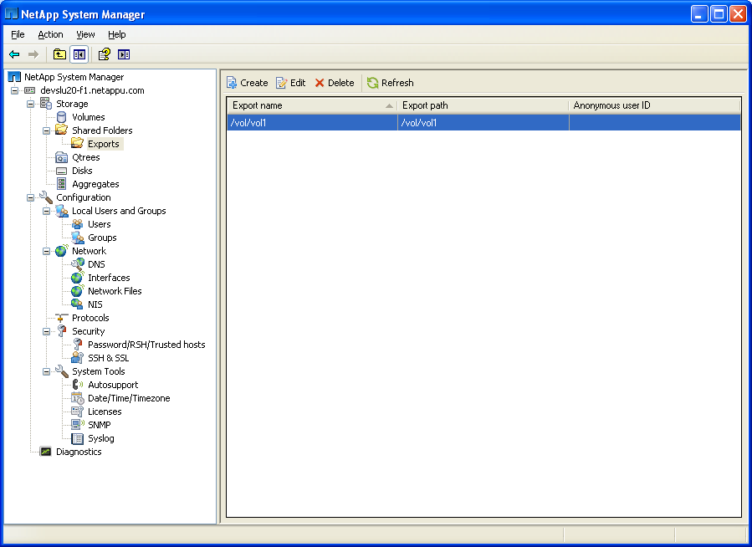
NetApp System Manager: Exporting
Current /etc/exports file
To configure exports
Notes:
NETAPP SYSTEM MANAGER: EXPORTING

Slide 19
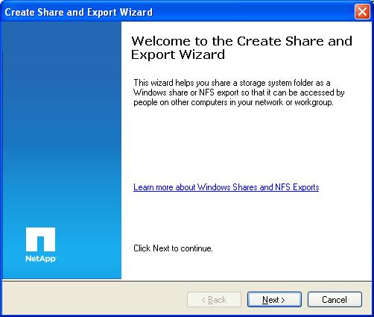
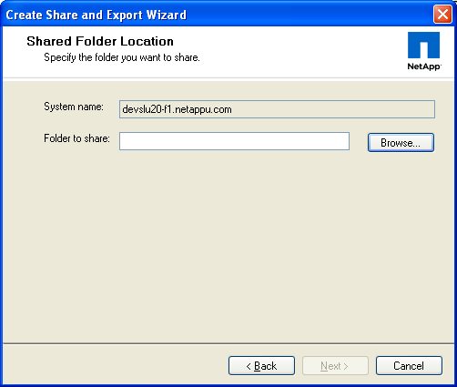
NetApp System Manager: Exporting (Cont.)
Notes:
NETAPP SYSTEM MANAGER: EXPORTING (CONT.)

Slide 20
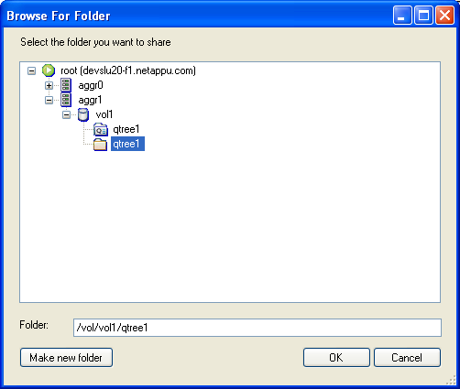
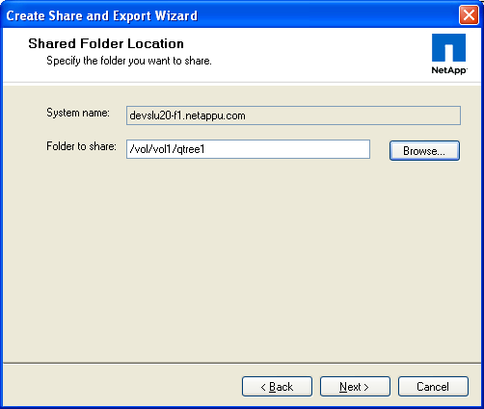
NetApp System Manager: Exporting (Cont.)
Notes:
NETAPP SYSTEM MANAGER: EXPORTING (CONT.)

Slide 21
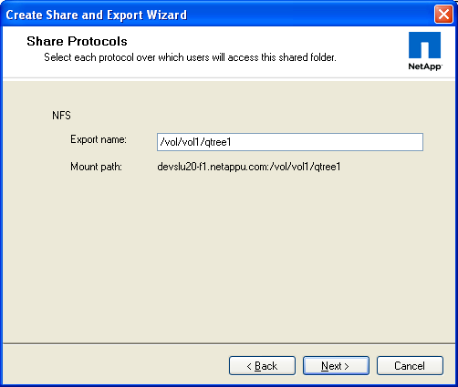
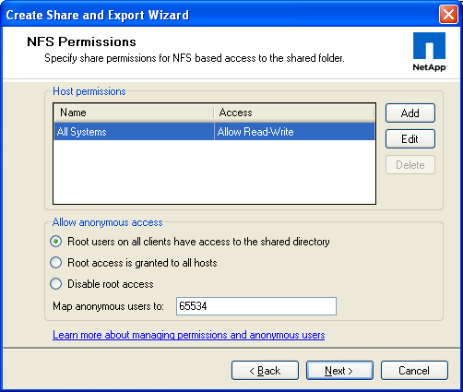
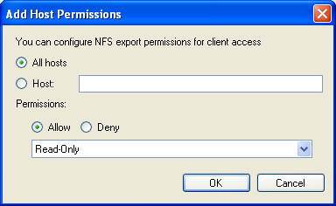
NetApp System Manager: Exporting (Cont.)
Notes:
NETAPP SYSTEM MANAGER: EXPORTING (CONT.)

Slide 22
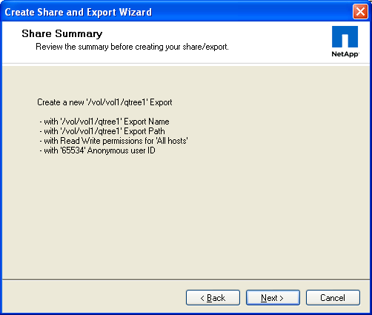
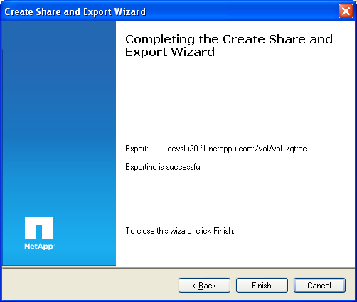
NetApp System Manager: Exporting (Cont.)
Notes:
NETAPP SYSTEM MANAGER: EXPORTING (CONT.)

Slide 23
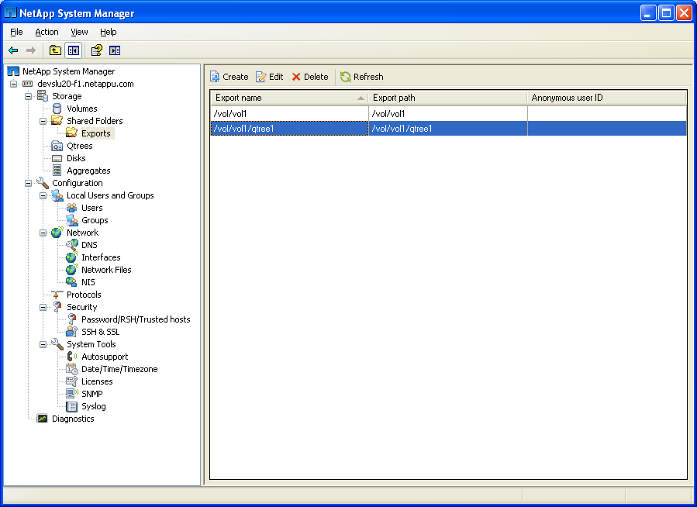
NetApp System Manager: Exporting (Cont.)
The newly added
export
Notes:
NETAPP SYSTEM MANAGER: EXPORTING (CONT.)

Slide 24
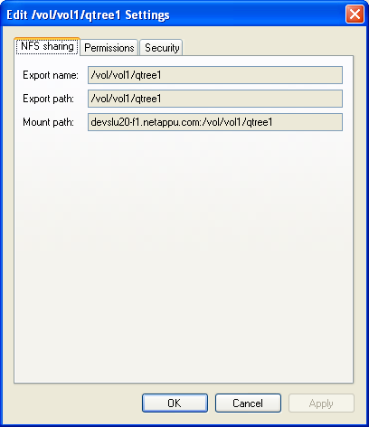
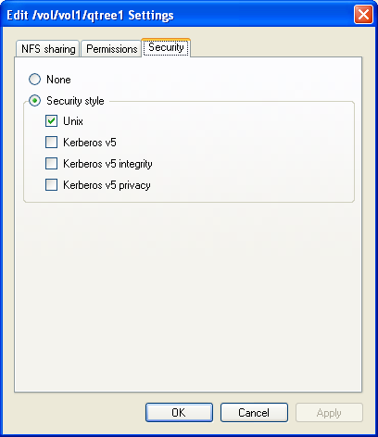
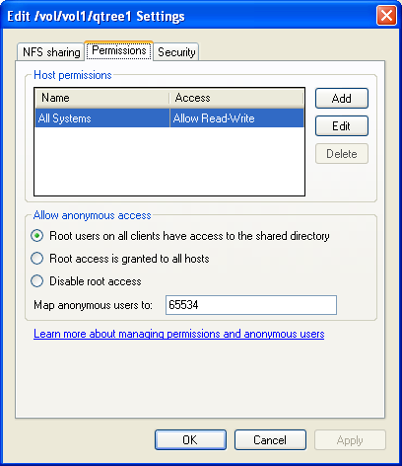
NetApp System Manager: Exporting (Cont.)
anon applies
only to root users
anon=0 (root)
anon=65534
(nobody)
anon=65535 (deny access
to root users)
Notes:
NETAPP SYSTEM MANAGER: EXPORTING (CONT.)

Slide 25
Mounts
Notes:
MOUNTS

Slide 26
Mounts
Mounts are used to attach a storage system’s exported hierarchy to the target’s file system hierarchy
    Requires a mountpoint―that is, a directory
    Mounted by way of:
      The mount command
      Mount tables (for example, /etc/vfstab on Solaris)
      Automounters
Notes:
MOUNTS

Slide 27
The Mount Process
Client
Server (storage system)
Portmap
Mount
NFS
What services do you have ?
Mount V1, V3, and NFS v2, v3, v4
I want to mount /vol/vol0
Here is the file handle for /vol/vol0
Do operation x on <file handle> with parameters <params>
<results of operation >
Abbreviated Mount Process
Notes:
THE MOUNT PROCESS

Slide 28
Mount Configuration
At the client
  Create a directory (mountpoint)
    # mkdir /nfsmount
To mount the storage system export, use the mount command from the command line as follows:
  # mount <server>:/vol/vol0/home /nfsmount
Use umount command to unmount the export
Notes:
MOUNT CONFIGURATION

Slide 29
Target Mount Tables
To make the mounts persistently reload during boot up, edit the /etc/vfstab (or equivalent) file to include the following entries:
  Server:/vol/vol0/home - /nfsmount nfs rw 0 0;
    Storage system is mounted when client reboots
    Entry above automatically mounts the directory; user can only make changes to content in /vol/vol0/home after mounting the directory
Notes:
TARGET MOUNT TABLES
For persistent mounts across reboots, edit the vfstab file (for systems, such as Solaris™ host systems), or fstab file (for BSD systems, such as Linux host systems). To mount directories, use the mount command from the command line. Be aware that the mount instruction from the command line is not persistent across storage system reboots.

Slide 30
Automounter
Automounter is an remote procedure call daemon on a target that automatically mounts NFS exports
  Mount times out and disconnects when not in use
  Useful with a large amount of resources to mount or unmount on startup or shutdown, for example, with home directories
Uses an automounter map to store information
Each automounter map contains:
  Information about the server hosting the file system
  The pathname of the file system in the server
  The local pathname
  Mount options that apply to the file system
Notes:
AUTOMOUNTER
In the UNIX world, automounter is a program that mounts a resource when requested by a user, and when the user is done with it, the mount will time out and automatically disconnect itself. This can be useful when there is a large amount of resources to mount and unmount on startup and shutdown, like home directories.
There are two different types of automounter maps: direct and indirect. Direct maps are sets of unrelated mountpoints that can be spread out across the file system. An indirect map sets aside a directory and mounts everything in the map within that directory; users’ home directories are a great example of this. Automounter maps may be distributed by using a directory service, such as NIS or NIS+, for centralized management.

Slide 31
Verifying Mounts
To verify exports on a target:
  mount (without option displays mounted files)
  showmount –a storagesystemx
    Displays list of clients mounting from the storage system
  showmount –e storagesystemx
    Prints list of shared file systems
To verify mounts on a storage system:
  /etc/rmtab
    Refreshes when the storage system boots
Notes:
VERIFYING MOUNTS
To verify the exported resources, use the mount command in UNIX systems. Use showmount –e or nfsstat –m or an equivalent command on the client to view output that verifies exported resources and also shows the mount options. With the showmount command, you can display what is being exported by the storage system and the clients mounting the storage system. /etc/rmtab stores the mount requests that the storage system has received since boot up. NOTE: /etc/rmtab may not be reliable to see which clients are actually mounted because a client may crash without unmounting the directory and then the mount entry will remain in the /etc/rmtab file.

Slide 32
Access Cache
Notes:
ACCESS CACHE

Slide 33
Access Cache
When an NFS target attempts to access an export, mountd must determine whether to grant or deny access
  First checks the access cache
  If no entry, determines a client’s read, write and root access to an export path; possible values:
    Positive = granted access
    Negative = denied access
    Delayed = Could not resolve
    In Progress = Attempting to resolve
    Uninitialized = Error condition
Access cache is used after the mount when determining export permissions of a client
Notes:
ACCESS CACHE
Whenever an NFS client attempts to access a file system path, Data ONTAP must determine whether to grant or deny access. The cache is a reservoir of access results. Each access result is cached for particular client address and export path for their read, write, and root access. Possible values for each of these three access types are: positive (that is, granted access), negative (that is, denied access), delayed (that is, could not be resolved--usually because netgroup or hostname could not be resolved), in progress, or uninitialized.
The access cache is persisted to disk every 15 minutes. The files are saved as: /etc/exports_arc/cache and /etc/exports_arc/restore. This helps improve the storage system’s response time during the period after a restart. To turn off the access cache persistence, set nfs.acache.persistence.enable to off.

Slide 34
Cache Administration
To check NFS target-to-access cache
  exportfs -c clientaddr path [options] [securitytype]
To remove entries from access cache
  exportfs -f [path]
To specify the cache expiration
  options nfs.export.neg.timeout
    Refresh time for denied access entries
  options nfs.export.pos.timeout
    Refresh time for granted access entries
  options nfs.export.harvest.timeout
    Sets idle expiration time for entries in cache
Notes:
CACHE ADMINISTRATION
Exportfs –c parameters:
clientaddr
The IP address of the NFS client
path
The file system path
accesstype
ro | rw | root
security type
sys | none | krb5 | krb5i | krb5p
Negative (that is, denied access) cache entries are purged from the access cache after the period of seconds set by the nfs.export.neg.timeout option. The negative timeout defaults to 1800 seconds or 30 minutes. The minimum value for this option is 60 seconds. The maximum value for this option is 7 days.
Positive (that is, granted access) cache entries are purged from the access cache after the period of seconds set by the nfs.export.pos.timeout option. The positive timeout defaults to 36000 seconds or 10 hours. The minimum value for this option is 60 seconds. The maximum value for this option is 7 days.
Delayed cache entries are purged from the access cache after 15 seconds. This timeframe cannot be changed.
A cache entry that has not been accessed will be purged from the access cache after the period of seconds set by the nfs.export.harvest.timeout option.

Slide 35
Module Summary
Notes:
MODULE SUMMARY

Slide 36
Module Summary
In this module, you should have learned to:
Identify exportable resources
Export and unexport resources to clients, subnets, and netgroups
Administer storage system with the exportfs command
Create mountpoints and mount exported resources on a client
Monitor the usage of exported resources
Notes:
MODULE SUMMARY

Slide 37
Exercise
Module 4: Exports and Mounts
Estimated Time: 60 minutes
Notes:
EXERCISE
Please refer to your Exercise Guide for more instruction.

Slide 38
Check Your Understanding
What is a target?
What is a resource?
Give examples of a target.
Give examples of a resource.
Can you specify rw and ro for the same host within a single export?
What must be defined on the target to receive exported resources?
The /etc/exports file typically resides on the target. True or false?
What does exportfs –c 10.0.0.1 /vol/vol2 rw do?
Notes:
CHECK YOUR UNDERSTANDING

Slide 39
Answers
Module 4: Exports and Mounts
Notes:
ANSWERS
Please refer to your Exercise Guide for more instruction.

Slide 40
Check Your Understanding: Answers
What is a target?
  A destination to which resources are exported
What is a resource?
  An exported object
Give examples of a target.
  Subnet
  Netgroup
  Client
  Subdomain
Give examples of a resource.
  Volume
  Directory
  File
  Qtree
Notes:
CHECK YOUR UNDERSTANDING: ANSWERS

Slide 41
Check Your Understanding: Answers (Cont.)
Can you specify rw and ro for the same host within a single export?
  Yes, but that entry will result in an error
What must be defined on the target to receive exported resources?
  Mountpoint
The /etc/exports file typically resides on the target. True or false?
  False
What does exportfs –c 10.0.0.1 /vol/vol2 rw do?
  Verifies if the host can mount a path read-write
Notes:
CHECK YOUR UNDERSTANDING: ANSWERS (CONT.)

