Slide 1
CIFS Domains
Module 9
Accelerated NCDA Boot Camp
Data ONTAP 8.0 7-Mode
Notes:
CIFS DOMAINS

Slide 2
Module Objectives
By the end of this module, you should be able to:
Terminate the CIFS service to prepare for CIFS domain configuration
Reconfigure the CIFS service for a Windows® domain
Identify the resulting files
Create domain users and add the domain users to a local storage system group
Set up Preferred Domain Controllers (DCs)
Notes:
MODULE OBJECTIVES

Slide 3

Reconfiguring CIFS Using cifs setup
Notes:
RECONFIGURING CIFS USING CIFS SETUP

Slide 4
Reconfiguring CIFS
To reconfigure CIFS on a storage system:
  Disconnect users and stop CIFS service:
    cifs terminate
  Reconfigure CIFS service:
    cifs setup
CIFS server restarts with the new configuration
Next we will investigate reconfiguring a storage system for an Active Directory domain
Notes:
RECONFIGURING CIFS
To reconfigure CIFS on a storage system:
Disconnect users and stop CIFS service:
cifs terminate
Reconfigure CIFS service:
cifs setup
The storage system automatically attempts to restart the CIFS service with the new CIFS configuration.

Slide 5
CLI cifs setup: AD
(1) Active Directory domain authentication
(Active Directory domains only)
(2) Windows NT 4 domain authentication
(Windows NT or Active Directory domains)
(3) Windows Workgroup authentication using
the filer's local user accounts
(4) /etc/passwd and/or NIS/LDAP
authentication
Selection (1-4)? [1]:
Notes:
CLI CIFS SETUP: AD
This is an example of the administrator configuring the storage system for an Active Directory (AD) domain.

Slide 6
CLI cifs setup: AD (Cont.)
What is the name of the Active Directory
domain? []: development.netappu.com
In Active Directory-based domains, it is essential that the filer's time match the domain's internal time so that the Kerberos-based authentication system works correctly.
If the time difference between the filer and the domain controllers is more than 5 minutes, CIFS authentication will fail. Time services currently are not configured on this filer.
Would you like to configure time services? [y]:
Notes:
CLI CIFS SETUP: AD (CONT.)
AD uses a time-based key mechanism. It is important for the domain controller and the storage system to be in sync by five (5) minutes or less.

Slide 7
CLI cifs setup: AD (Cont.)
CIFS Setup will configure basic time services. To continue, you
must specify one or more time servers. Specify values as a
comma or space separated list of server names or IPv4
addresses. In Active Directory-based domains, you can also
specify the fully qualified domain name of the domain being
joined (for example:(“DEVELOPMENT.NETAPPU.COM") and time
services will use those domain controllers as time servers.
Enter the time server host(s) and/or address(es)
[DEVELOPMENT.NETAPPU.COM]:10.254.134.2
Would you like to specify additional time servers? [n]:
Wed Jun 21 16:28:22 GMT [rc:ALERT]: timed: time daemon started
NOTE: The IP address is for the domain controller or a time server
Notes:
CLI CIFS SETUP: AD (CONT.)
The IP address is for the domain controller or a time server. It is best to enter the IP address of the main (root) domain controller for the domain.
The timed daemon allows the storage system to synchronize its time with external resources.
You need to configure the following:
options timed.max_skew 30m
options timed.protontp
options timed.sched hourly
options timed.servers [server_ip_or_name,…]
options timed.enable on
options timed.log on

Slide 8
CLI cifs setup: AD (Cont.)
In order to create an Active Directory machine account for the filer, you must supply the name and password of a Windows
account with sufficient privileges to add computers to the DEVELOPMENT.NETAPPU.COM domain.
Enter the name of the Windows user
[Administrator@DEVELOPMENT.NETAPPU.COM]:
[This Windows user is the domain administrator or any other account with privileges to add computer accounts to the domain.]
Password for Administrator@DEVELOPMENT.NETAPPU.COM:
CIFS -Logged in as Administrator@DEVELOPMENT.NETAPPU.COM.
Notes:
CLI CIFS SETUP: AD (CONT.)
This Windows user is the domain account administrator that has privileges to join (add) the storage system to the domain controller.

Slide 9
CLI cifs setup: AD (Cont.)
NOTE: CN means
common name
The storage system is being registered in active computer as a computer under the default OU
The user that you specified has permission to
create the filer's machine account in several (4)
containers. Please choose where you would like
this account to be created.
(1) CN=computers
(2) OU=Domain Controllers
(3) OU=Additional_OU
(4) OU=sub_Additional_OU,OU=Additional_OU
(5) None of the above
Selection (1-5)? [1]: 1
Notes:
CLI CIFS SETUP: AD (CONT.)
The container list displays Organizational Units (OUs) in which you have permission to create computer accounts. The list reflects your AD domain structure and may contain customized OUs.

Slide 10
CLI cifs setup: AD (Cont.)
Wed Jun 21 16:29:23 GMT [wafl.quota.sec.change:notice]: security style for /vol/vol0/ changed from unix to ntfs
CIFS - Starting SMB protocol...
It is highly recommended that you create the local administrator account (system\administrator) for this filer. This account allows access to CIFS from Windows when domain controllers are not accessible.
Do you want to create the system\administrator account? [y]:
Enter the new password for system\administrator:
Retype the password:
Notes:
CLI CIFS SETUP: AD (CONT.)
The local administrator account has privileges to administer CIFS on the storage system even if the domain controller is down. The local administration can set up local users on the storage system with the useradmin user add command.

Slide 11
CLI cifs setup: AD (Cont.)
Currently, the user “system\administrator" and members of the group “DEVELOPMENT\Domain Admins" have permission to administer CIFS on this filer. You may specify an additional user or group to be added to the filer's "BUILTIN\Administrators" group, thus giving them administrative privileges as well.
Would you like to specify a user or group that can administer CIFS? [n]:
Wed Jun 21 16:30:18 GMT [nbt.nbns.registrationComplete:info]: NBT: All CIFS name registrations have completed for the local server.
Welcome to the DEVELOPMENT.NETAPPU.COM (DEVELOPMENT) Active Directory(R) domain.
CIFS local server is running.
Notes:
CLI CIFS SETUP: AD (CONT.)

Slide 12
Reconfiguring CIFS Using NetApp System Manager
Notes:
RECONFIGURING CIFS USING NETAPP SYSTEM MANAGER

Slide 13
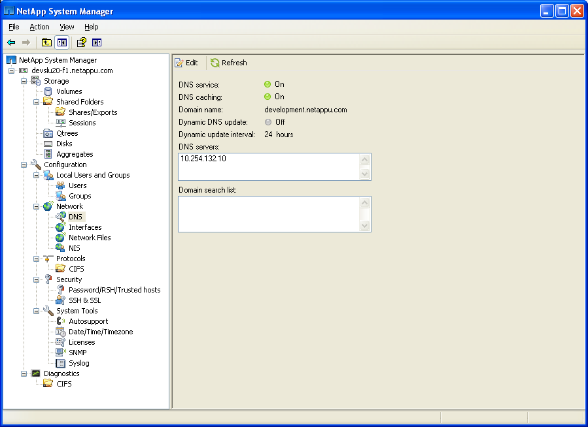
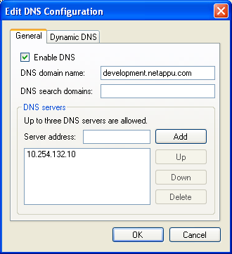
System Manager: CIFS Setup
Prior to setting up CIFS, verify DNS
Notes:
SYSTEM MANAGER: CIFS SETUP

Slide 14
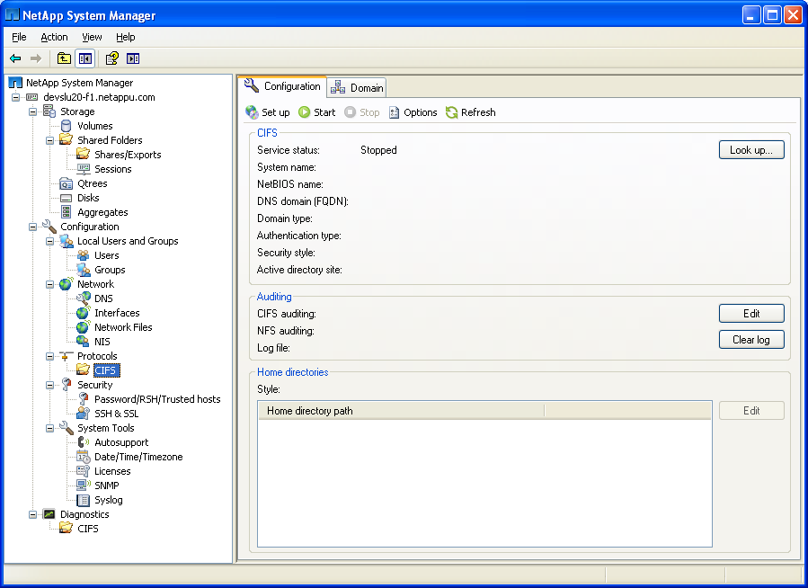
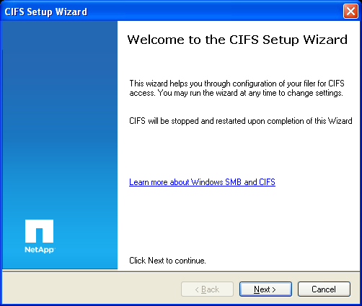
System Manager: CIFS Setup (Cont.)
To configure CIFS
Notes:
SYSTEM MANAGER: CIFS SETUP (CONT.)

Slide 15
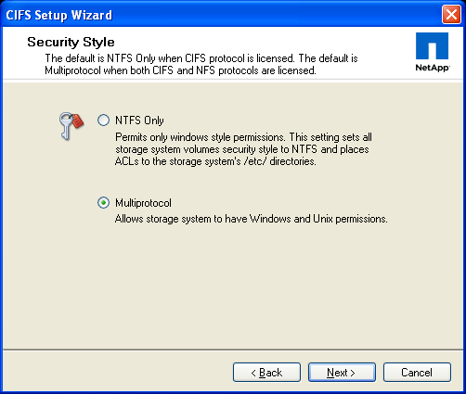
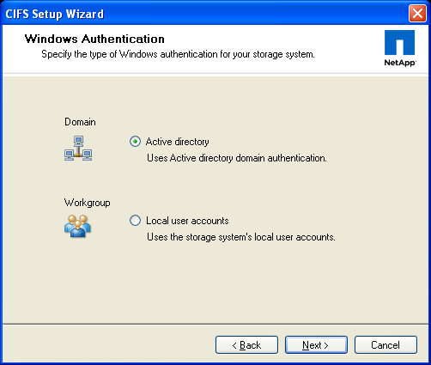
System Manager: CIFS Setup (Cont.)
Notes:
SYSTEM MANAGER: CIFS SETUP (CONT.)

Slide 16
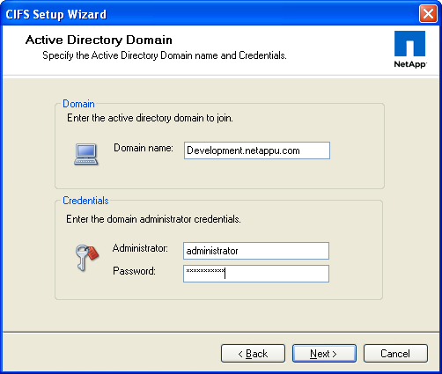
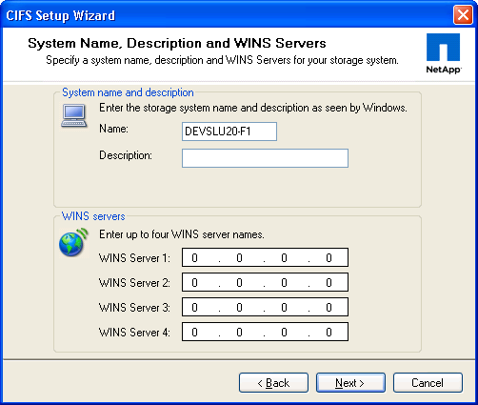
System Manager: CIFS Setup (Cont.)
Notes:
SYSTEM MANAGER: CIFS SETUP (CONT.)

Slide 17
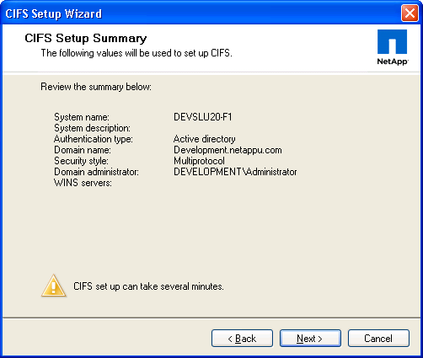
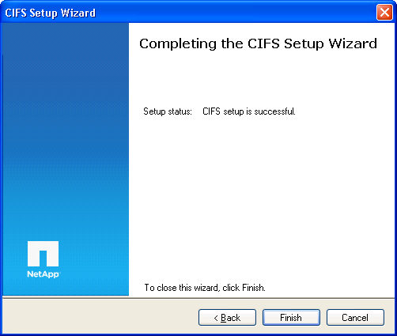
System Manager: CIFS Setup (Cont.)
Notes:
SYSTEM MANAGER: CIFS SETUP (CONT.)

Slide 18
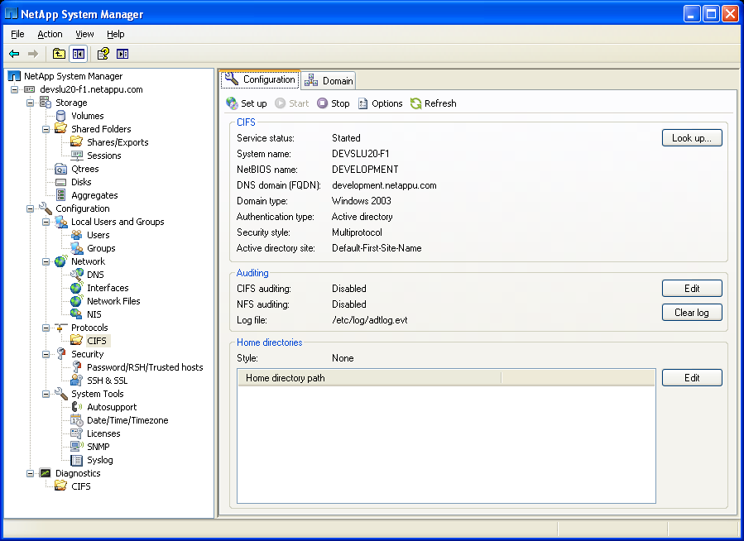
System Manager: CIFS Setup (Cont.)
CIFS services
configuration
Notes:
SYSTEM MANAGER: CIFS SETUP (CONT.)

Slide 19
Results
Notes:
RESULTS

Slide 20
Results
Additional files created in domain environment:
/etc/filersid.cfg
  Contains the storage system SID
/etc/cifssec.cfg
  Contains the Windows domain SID
NOTE: These files are not readable; do not edit the files
Notes:
RESULTS
The /etc/filersid.cfg file is created in a domain environment and contains the storage system security ID (SID).
The /etc/cifssec.cfg file contains the Windows domain controller account information.
NOTE: These files are not readable; do not edit the files.

Slide 21
lclgroups.cfg Changes
Domain administrators are added to lclgroups.cfg:
system> rdfile /etc/lclgroups.cfg
[ "Replicators" 552 ( "not supported" ) ]
[ "Backup Operators" 551 ( "Members can bypass file security to backup files" ) ]
[ "Power Users" 547 ( "Members that can share directories" ) ]
[ "Guests" 546 ("Users granted Guest Access") ]
[ "Users" 545 ( "Ordinary Users" ) ]
[ "Administrators" 544 ( "Members can fully administer the filer" ) ]
S-1-5-21-265246955-68147109-1151652928-500
S-1-5-21-3723512375-496415379-1150184651-512
Remember to use cifs lookup to resolve SIDs
Local Administrator
Domain Admins Group
Notes:
LCLGROUPS.CFG CHANGES

Slide 22
Domain-Specific Commands
After configuring the storage system for a
domain environment, do the following:
Display your domain information:
  cifs domaininfo
Test the storage system connection using NetBIOS over TCP/IP if used:
  When CIFS has been successfully started and is operational:
    cifs testdc
  When the CIFS subsystem is not running:
    cifs testdc [WINSsvrIPaddress]domainname [storage_sys_name]
Notes:
DOMAIN-SPECIFIC COMMANDS

Slide 23
CLI: cifs domaininfo Command
Example output from the cifs domaininfo command:
system> cifs domaininfo
NetBios Domain: DEVELOPMENT
Windows 2000 Domain Name: Development.netappu.com
Type: Windows 2000
Filer AD Site: none
Notes:
CLI: CIFS DOMAININFO COMMAND

Slide 24
CLI: cifs domaininfo Command (Cont.)
Example output from the cifs domaininfo command (cont.):
Current Connected DCs: \\WIN2K3
Total DC addresses found: 2
Preferred Addresses: None
Favored Addresses: None
Other Addresses: 10.0.0.5 WIN2K3 PDC
Connected AD LDAP Server: \\win2k3.netapp.com
Preferred Addresses: None
Favored Addresses: None
Other Addresses: 10.0.0.5 win2k3.netapp.com
10.0.0.6 win2k3-2.netapp.com
Notes:
CLI: CIFS DOMAININFO COMMAND (CONT.)

Slide 25
CLI: cifs testdc Command
The following example is output from the cifs testdc command on a storage system in a domain
system> cifs testdc
Using Established configuration
Current Mode of NBT is B Mode
Netbios scope ""
Registered names...
system < 0> Broadcast
system < 3> Broadcast
system <20> Broadcast
GRUMPY < 0> Broadcast
GRUMPY < 3> Broadcast
GRUMPY <20> Broadcast
HAPPY < 0> Broadcast
HAPPY < 3> Broadcast
HAPPY <20> Broadcast
B Mode = Uses broadcast
for name registration and
resolution
These three names
correspond to the
Workstation,
Server, and
Messenger services,
respectively
Notes:
CLI: CIFS TESTDC COMMAND
For more information about NetBIOS over TCP/IP, see chapter 11 of TCP/IP Fundamentals for Microsoft® Windows: www.microsoft.com/downloads/details.aspx?familyid=c76296fd-61c9-4079-a0bb-582bca4a846f&displaylang=en.

Slide 26
CLI: cifs testdc Command (Cont.)
Output from the cifs testdc command (cont.):
SNEEZY < 0> Broadcast
SNEEZY < 3> Broadcast
SNEEZY <20> Broadcast
DEVELOPMENT < 0> Broadcast
Testing all Primary Domain Controllers
found 1 unique addresses
found PDC WIN2K3 at 10.0.0.5
Testing all Domain Controllers
found 1 unique addresses
found DC WIN2K3 at 10.0.0.5
Notes:
CLI: CIFS TESTDC COMMAND (CONT.)

Slide 27
Preferred DCs
Notes:
PREFERRED DCS

Slide 28
Preferred DCs
Microsoft Active Directory members use a mechanism called “site awareness” to discover their closest domain controllers within AD
A site is a physical, geographical, or subnet boundary of the network
Storage system administrators accept the default and have cifs.site_awareness.enable turned on
Storage system administrators can override this default mechanism by setting preferences for other domain controllers
  system> options cifs.site_awareness.enable off
Notes:
PREFERRED DCS
Site awareness, also called site discovery, is the process of automatically discovering the preferred domain controller. By default, a storage system is configured with cifs.site_awareness.enable turned on. A storage administrator can override this default mechanism by turning the cifs.site_awareness.enable option to off and setting preferred domain controllers using the cifs prefdc command.

Slide 29
Configuring prefdc List
The cifs prefdc command configures and displays
CIFS preferred domain controller information
To display the preferred domain controller list:
  system> cifs prefdc print [domain]
To add a preferred domain controller list:
  system> cifs prefdc add domain address [address]
To delete a preferred domain controller list:
  system> cifs prefdc delete domain
Example:
  system> cifs prefdc print
  No preferred domain controllers configured.
  Domain controllers will be automatically
  discovered.
Notes:
CONFIGURING PREFDC LIST
The cifs prefdc command configures and displays CIFS preferred domain controller information.
To display the preferred domain controller list:
cifs prefdc print [domain]
To add a preferred domain controller list:
cifs prefdc add domain address [address…]
To delete a preferred domain controller list:
cifs prefdc delete domain
In the following example, there are no preferred domain controllers configured and domain controllers will be automatically discovered.
system> cifs prefdc print
No preferred Domain Controllers configured.
DCs will be automatically discovered.

Slide 30

DC Ping Ordering
Best!
Specified
by the Admin
Preferred
Determined
by DC Ping
Ordering
Favored
Other
Worst!
Notes:
DC PING ORDERING
Most Windows server environments have multiple domain controllers. A NetApp® storage system contacts a domain controller in the following order:
Preferred: Any domain controller(s) configured as preferred with the cifs prefdc command
Favored: Any domain controller(s) that is determined by site awareness rules to be readily accessible
Other: Any other domain controller(s) that is reachable
NOTE: DC ping occurs every time the CIFS service starts, every time cifs prefdc is executed, and every four hours.

Slide 31
Domain Users
Notes:
DOMAINS USERS

Slide 32
Domain User
Domain user is:
  Created in a domain
  Authenticated by the domain
  Created with the Active Directory Users and Computers tool
Notes:
DOMAIN USER
A domain user is a non-local user who belongs to a Windows domain and is authenticated by the domain. This type of user also can be placed into storage system groups to grant them capabilities on the storage system. On the Windows workstation, you can create a domain user with the Active Directory Users and Computers tool. The Windows Active Directory Users and Computers tool allows management of users, groups, organizational units, and all other Active Directory objects. You can administer and publish information in the directory.

Slide 33
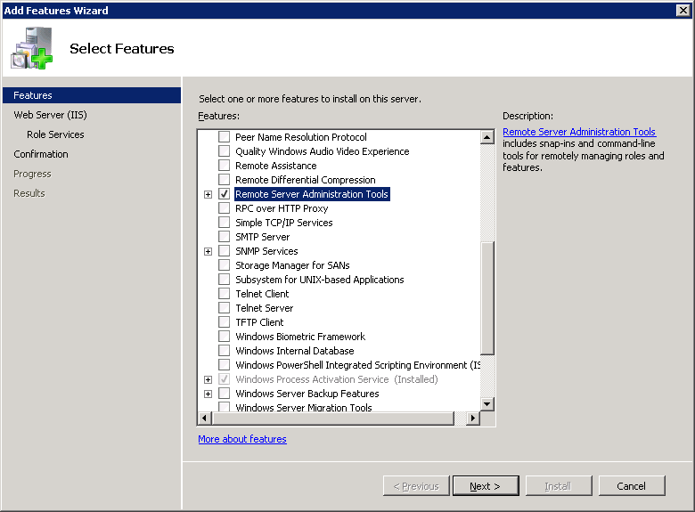
W2k8R2: Remote Administration Tools
Within Windows Server 2008 R2, administrators must added the Remote Administration Tools to remotely administrate Active Directory
  Same as the AdminPack for Windows Server 2003
NOTE:
Reboot required
Notes:
W2K8R2: REMOTE ADMINISTRATION TOOLS

Slide 34
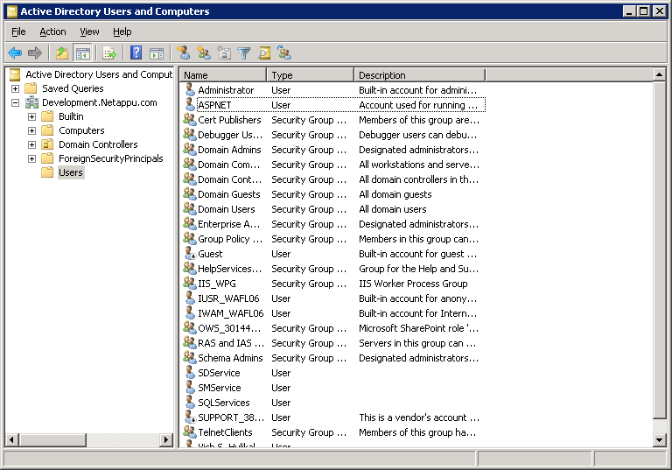
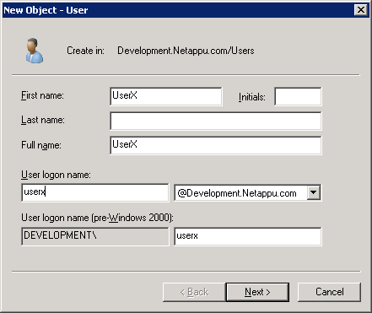
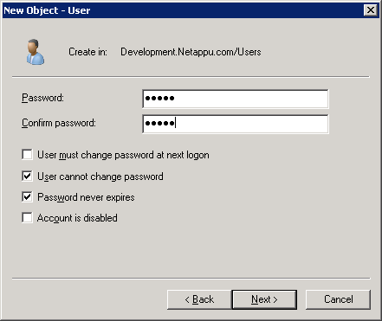
Creating a Domain User
Right-click the
Users folder and
select New
Notes:
CREATING A DOMAIN USER
To create a domain user with the Active Directory Users and Computers Tool, perform the following steps:
1. To open the tool from your Windows workstation, go to Start > Control Panel> Administrative Tools > Active Directory Users and Computers.
2. To add a new domain user, right-click the Users folder and choose New > User
3. In the New Object – User window, type the name of the user in the First name, Last name, and Full name text boxes.
In this example, user_jdoe (for Jane Doe) is typed in the First name text box and repeated in the Full name text box.
4. In the User logon name text box, type the user logon of user_jdoe to add the domain user Jane Doe.
5. Click the Next button.
6. In the password window, type the password for Jane Doe and confirm the password.
7. Mark the Password never expires check box for this example.
8. Click the Next button.
9. Click the Finish button to complete adding user_jdoe to the domain.

Slide 35
Local User Authentication
When the storage system is using CIFS Domain
authentication:
Local user authentication is still possible
Additional MMC functionality is available
  Users:
    Displays a current list of local users only
    Cannot create, delete, or view properties of local users
    Cannot administer passwords
  Groups:
    Can display, create, and delete a group, and add or delete users in the group
    Cannot add or modify roles (and hence, capabilities) for the group
Notes:
LOCAL USER AUTHENTICATION

Slide 36
Adding Domain Users to Groups
Assign a Windows domain user to a custom or
predefined local group
CLI: useradmin domainuser
  Syntax
  system> useradmin domainuser add user
  -g group | Administrators |
  "Backup Operators“ | Guests |
  "Power Users“ | Users
  To add an existing Windows domain user to a group:
  system> useradmin domainuser add user –g group
  To list Windows domain users in a group:
  system> useradmin domainuser list –g group
Computer Management (MMC)
Notes:
ADDING DOMAIN USERS TO GROUPS

Slide 37
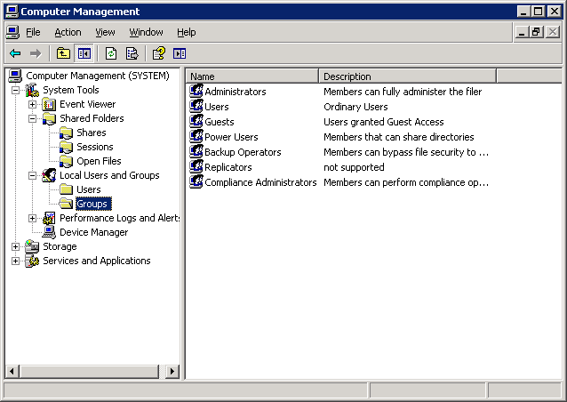
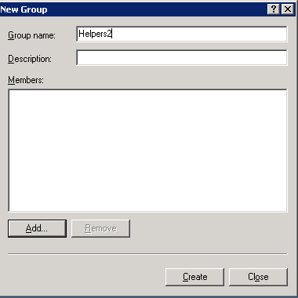

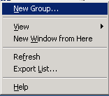
MMC: Groups
Right-click
Groups folder
Type the Group name
Click the Add button to add members
Choose New Group….
Notes:
MMC: GROUPS
As an example with the Windows Computer Management GUI, in the Groups folder, add a new group Helpers2 and add local user Jane to the group by performing the following steps:
1. Go to System Tools > Local Users and Groups > Groups.
2. Right-click the Groups folder and choose New Group.
3. In the New Groups window, in the Group name text box, type the group name Helpers2.
4. Click the Add button to add members to the new group.

Slide 38
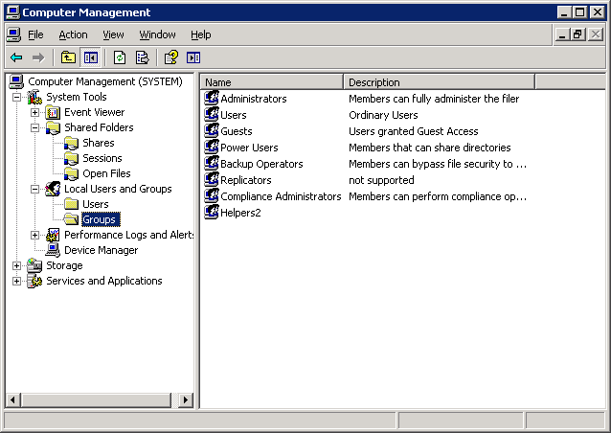
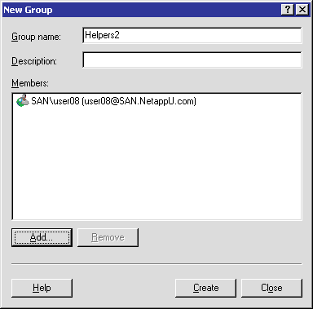
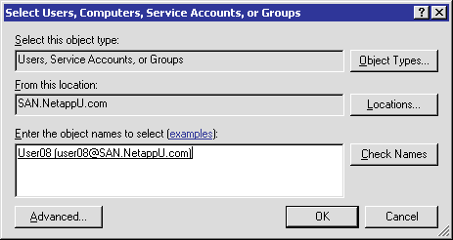
MMC: Groups (Cont.)
Click the Create button, and then click the Close button
Type the domain user
Notes:
MMC: GROUPS (CONT.)
(The following continues the adding of a new local group.)
5.In the Select User, Computers, or Groups window, add the domain user.
6.Click the OK button. The New Group window displays the domain user as a member of a local storage system group.
7.In the New Group window, click the Create button, and then click the Close button.

Slide 39
MMC: Groups (Cont.)
Note that the new group
Helpers2 has been added.
Notes:
MMC: GROUPS (CONT.)
(The following continues the adding of a new local group.)
8. Note that in the Computer Management GUI, the new group Helpers2 has been added.

Slide 40
Module Summary
Notes:
MODULE SUMMARY

Slide 41
Module Summary
In this module, you should have learned to:
Terminate the CIFS service to prepare for CIFS domain configuration
Reconfigure the CIFS service for a Windows domain
Identify the resulting files
Create domain users and add the domain users to a local storage system group
Set up Preferred Domain Controllers (DCs)
Notes:
MODULE SUMMARY

Slide 42
Exercise
Module 9: CIFS Domains
Estimated Time: 60 minutes
Notes:
EXERCISE
Please refer to your Exercise Guide for more instruction.

Slide 43
Check Your Understanding
For which objects can you create shares?
What are three methods used to manage CIFS shares?
CIFS Kerberos-based authentication fails if the time difference between the storage system and the domain controller is more than how many minutes?
Which command or commands allow you to configure the preferred domain controllers?
Notes:
CHECK YOUR UNDERSTANDING

Slide 44
Answers
Module 9: CIFS Domains
Notes:
ANSWERS
Please refer to your Exercise Guide for more instruction.

Slide 45
Check Your Understanding: Answers
For which objects can you create shares?
  Folders
  Qtrees
  Volumes
What are three methods used to manage CIFS shares?
  Command-line interface
  Microsoft tools such as Computer Management
  NetApp System Manager
CIFS Kerberos-based authentication fails if the time difference between the storage system and the domain controller is more than how many minutes?
  Five minutes
Which command or commands allow you to configure the preferred domain controllers?
  cifs prefdc
Notes:
CHECK YOUR UNDERSTANDING: ANSWERS

