Slide 1
LUN Access
Module 15
Accelerated NCDA Boot Camp
Data ONTAP 8.0 7-Mode
Notes:
LUN ACCESS

Slide 2
Module Objectives
By the end of this module, you should be able to:
Describe the steps to allow a Windows® Server 2008 R2 initiator to access a LUN on a storage system
Describe the steps to allow a Red Hat® initiator to access a LUN on a storage system
Notes:
MODULE OBJECTIVE

Slide 3

LUN Access Overview
Notes:
LUN ACCESS OVERVIEW

Slide 4
LUN Access
To connect an initiator to a target’s LUN:
Create an igroup if necessary
Create the LUN
Map the LUN to the igroup
Find the LUN on the initiator
Prepare the LUN as a new disk on the initiator
Notes:
LUN ACCESS

Slide 5

1. Create an Igroup
Initiator
Ethernet
Fibre Channel
Ethernet
Fibre Channel
My_IP_igroup
iqn.1999-04.com.a:system
OS Type: Windows
My_FC_igroup
21:00:00:2b:34:26:a6:56
OS Type: Windows
Target
Place WWNN (IQN or eui) in igroups for iSCSI
Place WWPN in igroups for FC
Notes:
1. CREATE AN IGROUP
If necessary, create an igroup to provide access to a LUN.
Initiator groups (igroups) are tables of host identifiers (FC WWPNs or iSCSI WWNs) that are used to control access to LUNs. Typically, you want all of the host's host bus adapters (HBAs) or software initiators to have access to a LUN. If you are using multipathing software or have clustered hosts, each HBA or software initiator of each clustered host needs redundant paths to the same LUN.
You can create igroups that specify which initiators have access to the LUNs either before or after you create LUNs, but you must create igroups before you can map a LUN to an igroup.
Initiator groups can have multiple initiators, and multiple igroups can have the same initiator. However, you cannot map a LUN to multiple igroups that have the same initiator.
NOTE: An initiator cannot be a member of igroups of differing operating systems types (ostypes). Also, a given igroup can be used for FC or iSCSI, but not both.

Slide 6
Steps to Create an Igroup
Optionally, verify initiators connectivity:
  fcp show initiators
  iscsi initiators show
Create the igroup and place the initiators into the igroup:
  igroup create {-i|-f} -t ostype
  igroup_name[node, node…]
    i = iSCSI igroup
    f = FC igroup
    ostype= solaris, windows, hpux, aix, linux, netware, vmware, hyper_v, xen
    node
      iSCSI type has worldwide node (WWNN - IQN or eui)
      FC type has worldwide port name (WWPN - may be aliased)
Verify the igroup:
  igroup show
Notes:
STEPS TO CREATE AN IGROUP
Use the igroup create command to configure an igroup on a storage system. Note that you add nodes to the igroup and, therefore, the optional step of listing the currently connected initiators is provided in the first step.

Slide 7
Data ONTAP Configuration
NOTE: Connected
using paths displayed
Add WWPNs to igroup:
system> igroup create -f -t windows iWIN_fcp
system> igroup add iWIN_fcp WIN1-FC WIN2-FC
Verify igroup:
system> igroup show -v
iWIN_fcp (FCP) (ostype: windows):
10:00:00:00:c9:6b:77:b3 (logged in on: 0d, 0c)
WWPN Alias(es): WIN1-FC
10:00:00:00:c9:6b:77:b4 (logged in on: 0d, 0c)
WWPN Alias(es): WIN2-FC
Notes:
DATA ONTAP CONFIGURATION

Slide 8
2. Create a Logical Unit
Do not put
LUNs in
root volume
Initiator
Ethernet
Fibre Channel
LUNs may exist in any volumes or qtrees
with no NAS data
Ethernet
Fibre Channel
Target
LUNa exists in vol1 in aggr1 /vol/vol1/LUNa.lun
LUNa
LUNb
LUNb exists in vol2 in aggr1 /vol/vol2/LUNb.lun
Notes:
2. CREATE A LOGICAL UNIT
LUNs may exist in any volume or qtree. When creating traditional or flexible volumes that contain LUNs, follow these guidelines:
Do not create any LUNs in the system’s root volume. Data ONTAP® uses this volume to administer the storage system. The default root volume is /vol/vol0.
Ensure that no other files or directories exist in a volume that contains a LUN. If this is not possible and you are storing LUNs and files in the same volume, use a separate qtree to contain the LUNs.
If multiple hosts share the same volume, create a qtree on the volume to store all LUNs for the same host. This is a recommended best practice that simplifies LUN administration and tracking.
To simplify management, use naming conventions for LUNs and volumes that reflect their ownership or the way that they are used.

Slide 9
Steps to Create a LUN
Create the aggregate for the LUN:
system> aggr create aggr_SAN 7
Create the volume for the LUN:
system> vol create vol_SAN0 aggr_SAN 10g
Set Snapshot™ policy for the volume:
(more on this in Module 13)
system> snap reserve vol_SAN0 0
system> vol options vol_SAN0 nosnap on
Optional: Create a qtree for the LUN:
system> qtree create /vol/vol_SAN0/qtSAN0
Notes:
STEPS TO CREATE A LUN

Slide 10
Steps to Create a LUN (Cont.)
Create a LUN:
  lun create -s size -t ostype lun_path
    size = in bytes by default
      Use m for megabytes
      Use g for gigabytes
      NOTE: LUN sizing is discussed in detail in Module 13
    ostype = solaris, vld, windows, hpux, aix, linux, netware, vmware, windows_gpt, windows_2008, openvms, xen, hyper_v, and solaris_efi
    lun_path
      LUN path begins with /vol/{VolumeName}/[qtreeName]
      Last portion of path is the LUN Name
      Example: /vol/vol_SAN0/qtSAN0/lun0
Verify the LUN:
  lun show
Notes:
STEPS TO CREATE A LUN (CONT.)
Use the lun create command to create a LUN.
The host ostype indicates the type of operating system running on the host that accesses the LUN, which also determines the following:
Geometry used to access data on the LUN
Minimum LUN sizes
Layout of data for multiprotocol access

Slide 11
3. Map a Logical Unit to an Igroup
NOTE: This step is also called LUN masking
Initiator
Ethernet
Fibre Channel
Map a logical unit to an igroup by assigning a logical unit number
Ethernet
Fibre Channel
My_IP_igroup
iqn.1999-04.com.a:system
OS Type: Windows
My_FC_igroup
21:00:00:2b:34:26:a6:56
OS Type: Windows
Target
1
2
LUNa
LUNb
Notes:
3. MAP A LOGICAL UNIT TO AN IGROUP
When you map the LUN to the igroup, you grant the initiators in the igroup access to the LUN. If you do not map a LUN, the LUN is not accessible to any hosts. Data ONTAP maintains a separate LUN map for each igroup to support a large number of hosts and to enforce access control.

Slide 12
Steps to Mask the LUN
Map a LUN to an igroup:
  lun map lun_path igroup_name [lun_id]
    lun_path = path name of a LUN
    igroup_name = name of an initiator group
    lun_id = unique identification number that the initiator uses when the LUN is mapped to it
      If not entered, automatically assigned
    Example:
    lun map /vol/vol1/qtree1/luna My_IP_igroup 1
Verify the LUN mapping:
  lun show –m
Notes:
STEPS TO MASK THE LUN
Use the lun map command to map an igroup to a LUN.
You map a LUN to an igroup by specifying the following attributes:
LUN name
Specify the path name of the LUN to be mapped.
Initiator group
Specify the name of the igroup that contains the hosts that will access the LUN.
LUN ID
Assign a number for the LUN ID, or accept the default LUN ID. Typically, the default LUN ID begins with 0 and increases in increments of one as each additional LUN is created. The host associates the LUN ID with the location and path name of the LUN. The range of valid LUN ID numbers depends on the host. For detailed information, see the documentation provided with your host utilities kit.

Slide 13
Windows Setup
Notes:
WINDOWS SETUP

Slide 14
Windows Steps
To connect an initiator to a target’s LUN:
Create an igroup
Create the LUN
Map the LUN to the igroup
Find the LUN on the initiator
Prepare the LUN as a new disk on the initiator
Notes:
WINDOWS STEPS

Slide 15
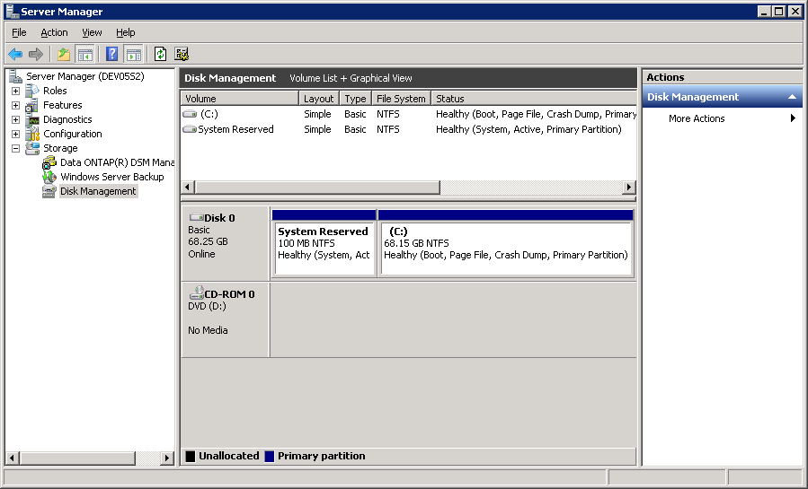

4. Find the LUN on Windows
Select Disk
Management
Right-click and choose
“Rescan Disks”
Using the Disk Management Tool, “Rescan Disks”
Notes:
4. FIND THE LUN ON WINDOWS
On a Windows host, you must partition and format any new LUN. To perform these tasks on Windows, use the Disk Management tool. First, access Computer Management by right-clicking My Computer and selecting Manage. Select Disk Management.
NOTE: The Disk Management tool will see and treat the LUN as though it is a local disk.
Within Computer Management, expand Storage and double-click Disk Management. In order for Disk Management to discover the new LUNs (virtual disks), select Action > Rescan Disks. From the Action menu, you can see tasks that may be performed on the new disk(s).

Slide 16
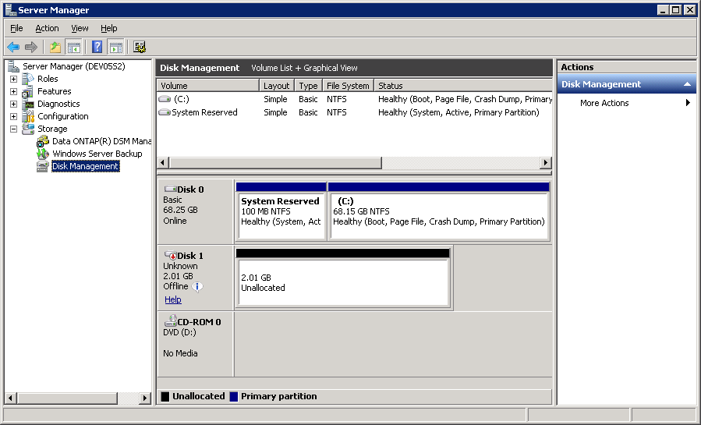
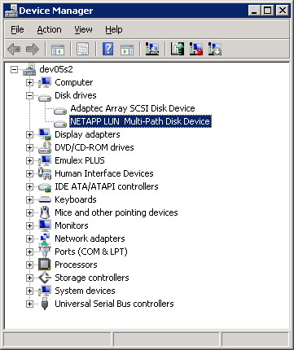
4. Find the LUN on Windows (Cont.)
The LUN
is offline
The LUN appears
Notes:
4. FIND THE LUN ON WINDOWS (CONT.)

Slide 17
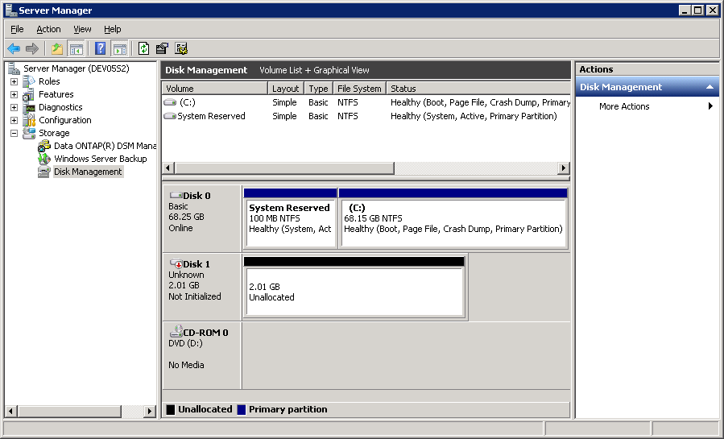
5. Preparing the LUN for Windows
Right-click,
select Online
NOTE: The LUN
is not initialized
Make the LUN online
Notes:
5. PREPARING THE LUN FOR WINDOWS
The disk must be brought online before we can use it. To bring the disk online, right-click “Disk #” and select Online.

Slide 18
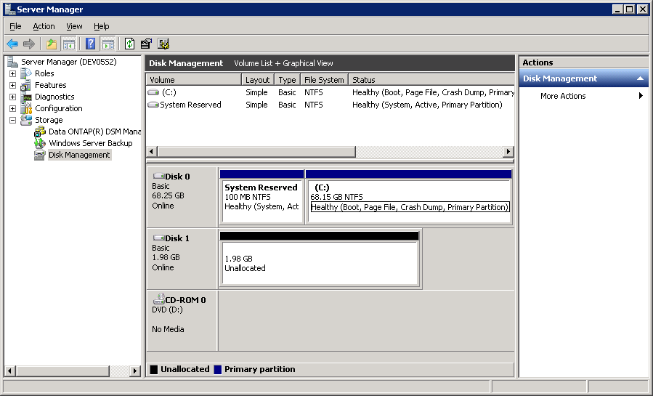
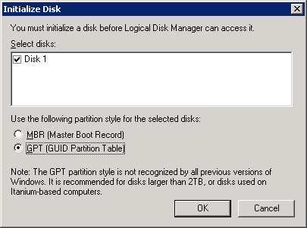
5. Preparing the LUN for Windows (Cont.)
Right-click,
select Initialize
NOTE: MBR is the default
Initialize the LUN in Windows Server 2008
Notes:
5. PREPARING THE LUN FOR WINDOWS (CONT.)
The disk must be initialized before it is formatted and partitioned. To initialize a disk, right-click “Disk #” and select Initialize. The administrator may select either a Master Boot Record (MBR) or a GUID Partition Table (GPT).

Slide 19
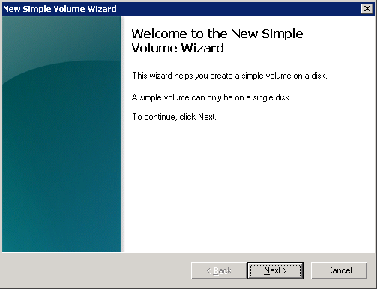
5. Preparing the LUN for Windows (Cont.)
Right-click,
select
New Simple Volume
The wizard will launch
Windows Server 2008 has Disk Management’s New Simple Volume Wizard
Notes:
5. PREPARING THE LUN FOR WINDOWS (CONT.)
In Windows Server 2003, to partition the disk, select Action > All Tasks > Create Partition or right-click the unallocated box and select Create Partition.
In Windows Server 2008, to partition the disk, select Action > All Tasks > New Simple Volume or right-click the unallocated box and select New Simple Volume.
After the disk is initialized, partitioned, and formatted, you should test access to the disk by navigating to it and creating a file.
NOTE: The presentation displays the Windows Server 2008 version of the wizard. There are only cosmetic changes between the Windows Server 2003 and Windows Server 2008 version.

Slide 20
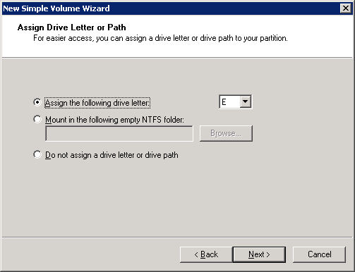
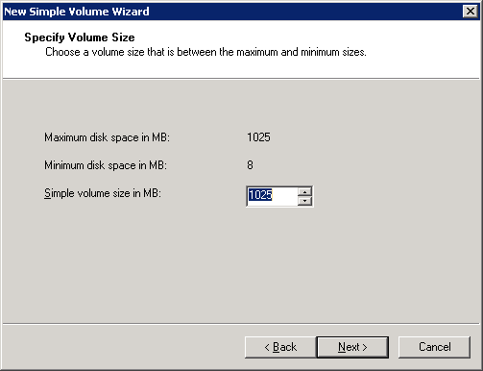
5. Preparing the LUN for Windows (Cont.)
Specify the volume size
Specify the method
to mount
New Simple Volume Wizard (Cont.)
Notes:
5. PREPARING THE LUN FOR WINDOWS (CONT.)

Slide 21
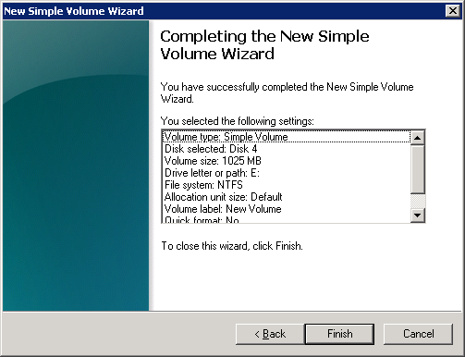
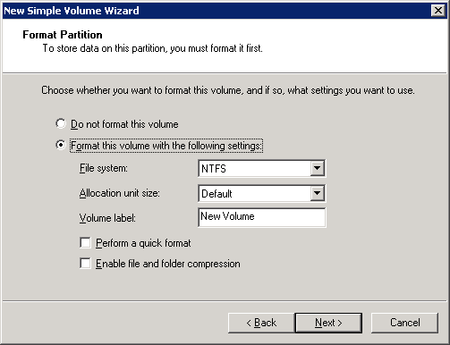
5. Preparing the LUN for Windows (Cont.)
Specify the format
Verify the configuration
and finish
New Simple Volume Wizard (Cont.)
Notes:
5. PREPARING THE LUN FOR WINDOWS (CONT.)

Slide 22
Red Hat Setup
Notes:
RED HAT SETUP

Slide 23
Red Hat Steps
To connect an initiator to a target’s LUN:
Create an igroup
Create the LUN
Map the LUN to the igroup
Find the LUN on the initiator
Prepare the LUN as a new disk on the initiator
Notes:
RED HAT STEPS

Slide 24
4. Find the LUN and 5. Prepare the LUN
Rescan HBA
# cd /usr/sbin/lpfc
# ./lun_scan
Use the fdisk -l command
# fdisk -l
...
Disk /dev/sdb: 2147 MB, 2147483648 bytes
67 heads, 62 sectors/track, 1009 cylinders
Units = cylinders of 4154 * 512 = 2126848 bytes
Disk /dev/sdb doesn't contain a valid partition table
Disk /dev/sdc: 2147 MB, 2147483648 bytes
67 heads, 62 sectors/track, 1009 cylinders
Units = cylinders of 4154 * 512 = 2126848 bytes
Disk /dev/sdc doesn't contain a valid partition table
...
The LUN shows up eight times... sdb - sdi; therefore use multipath
Notes:
4. FIND THE LUN AND 5. PREPARE THE LUN

Slide 25
Single Disk Configuration
Format a device:
# fdisk /dev/sda
Command (m for help): n
Command action
e extended
p primary partition (1-4)
p
Partition number (1-4): 1
First cylinder (1-261, default 1): 1
Last cylinder or +size or +sizeM or +sizeK
(1-261, default 261): 261
Command (m for help): t
Hex code (type L to list codes): 83
Command (m for help): w
Notes:
SINGLE DISK CONFIGURATION

Slide 26
More Information
Additional resources are available in the
SAN Implementation Workshop instructor-led course available from NetApp
  Using dynamic disks within Microsoft Windows 2008 R2
  Configure FC and iSCSI accessed LUN in VMware® vSphere™
  DM-Multipath configuration in Red Hat Enterprise Linux®
  LUN Provisioning Guidelines, including thin provisioning best practices
Notes:
MORE INFORMATION

Slide 27
Module Summary
Notes:
MODULE SUMMARY

Slide 28
Module Summary
In this module, you should have learned to:
Describe the steps to allow a WindowsServer 2008 R2 initiator to access a LUN on a
storage system
Describe the steps to allow a Red Hat initiator to access a LUN on a storage system
Notes:
MODULE SUMMARY

Slide 29
Exercise
Module 15: LUN Access
Estimated Time: 45 minutes
Notes:
EXERCISE
Please refer to your Exercise Guide for more instruction.

Slide 30
Check Your Understanding
What is an igroup?
How does an FC igroup differ from an iSCSI igroup?
Can you add a LUN to a different igroup using the LUN ID?
Notes:
CHECK YOUR UNDERSTANDING

Slide 31
Answers
Module 15: LUN Access
Notes:
ANSWERS
Please refer to your Exercise Guide for more instruction.

Slide 32
Check Your Understanding: Answers
What is an igroup?
  A group of one or more initiators
How does an FC igroup differ from an iSCSI igroup?
  An FC igroup contains initiator’s WWPN
  An iSCSI igroup contains initiator’s WWNN
Can you add a LUN to a different igroup using the LUN ID?
  Yes
Notes:
CHECK YOUR UNDERSTANDING: ANSWERS

