Slide 1
Availability Overview
Module 16
Accelerated NCDA Boot Camp
Data ONTAP 8.0 7-Mode
Notes:
AVAILABILITY OVERVIEW

Slide 2
Module Objectives
By the end of this module, you should be able to:
List the methods to back up and recover data for data availability
Describe the methods to ensure system availability
Notes:
MODULE OBJECTIVES

Slide 3
Availability
Data storage providers need to be able to guarantee availability of user data
To accomplish this, storage administrators need to develop a disaster recovery plan including:
  A backup strategy for data availability
  A system availability plan
Notes:
AVAILABILITY

Slide 4
Disaster Recovery Plan
Before you deploy a backup strategy, you need to set up a disaster recovery plan to:
  Ensure continuity of operations
  Guarantee availability of critical resources
  Quickly recover vital business data
The disaster recovery solution must be well-planned, rehearsed, tested, and documented before a disaster occurs
Notes:
DISASTER RECOVERY PLAN
Disaster recovery by definition includes the process, policies, and procedures related to the recovery of data, the continuation of data, as well as preparing for a data loss disaster. There are several approaches to protect data and maintain data availability in the face of hardware, software, or even site failures. However, before you deploy a backup strategy, purchase redundant hardware components, or replicate data between sites, you need to set up a disaster recovery plan.
A disaster recovery plan ensures the continuity of operations, the availability of critical resources and lists how to recover vital business operations successfully and quickly in the event of a disaster. The disaster recovery solution must be well-planned, rehearsed, tested, and documented before a disaster occurs.

Slide 5
Standard Disaster Recovery Metrics
Two basic recovery measures
  Recovery Point Objective (RPO)– a measure backward in time from when the data was last protected
  Recovery Time Objective (RTO)– a measure forward in time from the data loss event plus the accumulated time required to bring an application back online and re-create any lost transactions
The amount of data replicated over a bandwidth size is used to predict the RPO
The choice of a solution architecture helps determine the RTO
Notes:
STANDARD DISASTER RECOVERY METRICS
There are two basic recovery measures: recovery point and recovery time. Recovery point is a measure backwards in time from the data loss event that shows when data was last backed up or protected off-site. Recovery time is a measure forward in time from the data loss event; it is the accumulated time required to bring an application back online and re-create any lost transactions.
Recovery Point Objectives (RPOs) and Recovery Time Objectives (RTOs) are the key elements in any recovery design. The traditionally accepted RPO and RTO are 24 hours, but this is changing with new technology and business requirements, including laws for some industries that require a near zero RPO.
When architecting a solution, administrators will need to identify the RPO and RTO targets. To do this, you need to assess the economic impact of incidents and disruptions that result from denial of access by way of systems, services, and facilities. This process might already be part of an organization’s ongoing business impact analysis or risk analysis process.
Keep in mind that not all data has the same value or needs the same level of protection.

Slide 6
Considerations for Disaster Recovery
When deploying a disaster recovery solution, consider:
  The distance between the data center and the disaster recovery site
  Which data needs protection
  The RPO
    The maximum age of the data to be recovered
  The RTO
    The length of time required to recover
Notes:
CONSIDERATIONS FOR DISASTER RECOVERY
When deciding which type of disaster recovery solution to implement, you have to consider the following:
How far away from the primary storage site will the disaster recovery site be located? The distance between the main production center and the disaster recovery site depends on the likely geographic impact of the disaster.
Which applications need protection?
What are the RPO and the RTO in case of a disaster?
RPO is the maximum age of the data that the company must be able to recover in the event of a disaster. This parameter defines the amount of time for which work may be lost in the event of an unplanned outage at the primary site. It is used to define how frequently data is replicated to the disaster recovery site. A zero RPO implies no data loss, which can only be addressed by a synchronous replication solution. For higher RPO, an asynchronous replication solution with RPO in minutes or hours is flexible and cost-effective.
RTO is the length of time required to recover from a disaster. This parameter defines how quickly you need to fail over to a disaster recovery site —in seconds, minutes, hours, or days. Customers have to typically make tradeoffs between RPO, RTO, and cost. The target storage, the networking infrastructure, the software license and the deployment costs all contribute to the total cost of the overall disaster recovery solution.

Slide 7
Disaster Recovery Solutions
Data
Recovery
Techniques
(RPO)
Data
Recovery
Techniques
(RPO)
Tape /
VTape
Data Vault
w/ Tier Copy
Data
Vault
Data
Replication
Sample Data Loss
8-24 Hours
Near 0
Near 0
Near 0
Equipment
Provisioning
(RTO)
Equipment
Provisioning
(RTO)
Tape or
Disk-to-Disk
Hot Site
Re-Leveraged
Resources
Standby
Sample
Recovery Times
30-76
Hours
12-48
Hours
4-12
Hours
0-4
Hours
Hosting Options
Mobile
Hot Site
Co-Location
Internal
NDMP
with 3rd party
or
VTL
SnapVault
with
SnapMirror
SnapVault
SnapMirror
NetApp
Solution
Hosting
Options
Notes:
DISASTER RECOVERY SOLUTIONS

Slide 8
Availability
We will discuss the following:
  Data availability overview
    through backup and recovery techniques
  System availability overview
    through business continuous techniques
Notes:
AVAILABILITY

Slide 9

Data Availability
Overview
Notes:
DATA AVAILABILITY OVERVIEW

Slide 10
Backup and Recovery Spectrum
Back up to Local Storage
  - Recover files
Back up to Local Storage
  - Recover single file, volume, or aggregate
Back up to Local/Remote Storage
  - Recover files
Back up to Remote Storage
  - Recover qtrees, directories, or files
Back up to Local or Remote Tape
  - Recover directories or files
Back up with Third-Party Tools
  - Recover qtrees, directories, or files
Notes:
BACKUP AND RECOVERY SPECTRUM

Slide 11


Snapshot Copies
Covered
in
Module 17
Administrators may back up and recover files quickly--almost instantaneously--with Snapshot™ copies
NOTE: Snapshot copies do not replace standard backups to another media location
Back up to Local Storage
  - Recover files
Data Center
Notes:
SNAPSHOT COPIES

Slide 12
SnapRestore
Covered
in
Module 18
SnapRestore® reverts a file system back to any specified Snapshot copy or restores single file from a Snapshot copy
  Fast online restores of files, volumes, and aggregate
  Multiple recovery points
  Easy recovery process based on a single command input
  Requires the snaprestore license code
Use SnapRestore to recover from data corruption or to revert a file system
Back up to Local Storage
  - Recover single file, volume, or aggregate
Notes:
SNAPRESTORE
SnapRestore enables you to quickly revert a local volume or a file on a storage system to the state it was in when a particular Snapshot copy was taken. In most cases, reverting a file or volume is much faster than restoring files from tape or copying files from a Snapshot copy to the active file system.
You use SnapRestore to recover from data corruption. If a primary storage system application corrupts data files in a volume, you can revert the volume or specified files in the volume to a Snapshot copy taken before the data corruption. You can also use SnapRestore if you are testing a volume or file and want to restore that volume or file to pretest conditions.
You must purchase and install the snaprestore license code to enable and use the SnapRestore service.

Slide 13
ndmpcopy Command
Covered
in
DOTA
The ndmpcopy command:
  Used to transfer data between storage systems that support NDMP v3 or v4
    system> ndmpd on
  Can carry out full and incremental transfers
  Limits incremental transfers to a maximum
  of two levels (one full and up to two incremental)
  Applies NetApp® to NetApp only
  Syntax:
  system> ndmpcopy [options]
  source_host:source_path
  destination_host:destination_path
Back up to Local/Remote Storage
  - Recover files
Data Center
Notes:
NDMPCOPY COMMAND
The ndmpcopy command enables you to transfer file system data between storage systems that support NDMP v3 or v4, and the UNIX® file system (UFS) dump format.
Using the ndmpcopy command, you can carry out both full and incremental data transfers. However, incremental transfers are limited to a maximum of two levels (one full and no more than two incremental). You can transfer full or partial volumes, qtrees, or directories, but not individual files.
To copy data within a storage system or between storage systems using ndmpcopy, use the following command from the source or the destination system, or from a storage system that is not the source or the destination:
system> ndmpcopy [options] source_hostname:source_path destination_hostname:destination_path
Where source_hostname and destination_hostname can be host names or IP addresses. If destination_path does not specify a volume (or specifies a nonexistent volume), the root volume is used.

Slide 14
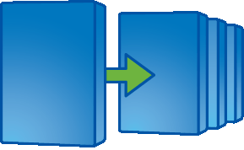
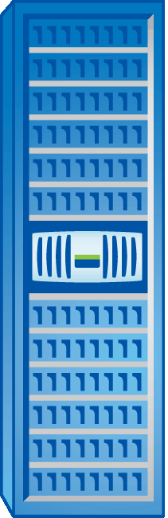
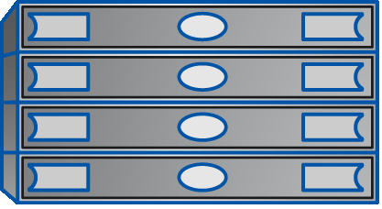
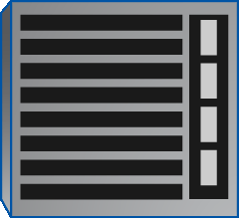
SnapVault
Covered
in
Module 19
SnapVault® is the NetApp embedded disk-to-disk backup and archival software
Administrators may back up and recover:
  Qtrees
  Directories on
  non NetApp storage
Back up to Remote Storage
  - Recover qtrees, directories, or files
Data Center
Central Repository
FAS1
FAS2
SnapVault
SnapVault
Primary
Storage Systems
Open Systems SnapVault
Non NetApp
Storage
Secondary
Storage System
Notes:
SNAPVAULT
SnapVault is a disk-based storage backup feature of Data ONTAP®. SnapVault enables data stored on multiple storage systems to be backed up to a central, secondary storage system quickly and efficiently as read-only Snapshot copies.
In event of data loss or corruption on a storage system, backed-up data can be restored from the SnapVault secondary with less downtime and uncertainty than is associated with conventional tape backup and restore operations.
Additionally, users who wish to perform a restore of their own data may do so without the intervention of a system administrator. The SnapVault secondary may be configured with NFS exports and CIFS shares to let users copy the file from the Snapshot copy to the correct location.

Slide 15
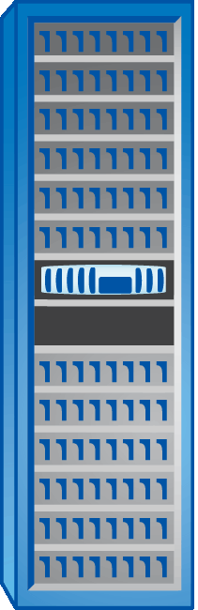

Tape Dumps and Restores
Covered
in
DOTA
NetApp provides support for:
  Classical tape backup and recovery
  Virtual Tape Library (VTL)
Back up to Local or Remote Storage
  - Recover directories or files
Data Center
Tape
System
VTL
System
Notes:
TAPE DUMPS AND RESTORES

Slide 16
NDMP
Covered
in
DOTA
NDMP is an open standard that allows backup applications to control native backup and recovery functions on NetApp storage systems and other NDMP servers
NDMP-compliant backup applications interact with the ndmpd process on the storage system
NDMP requests from backup applications prompt the storage system to invoke native dump and restore commands to initiate backups and restores
Back up with Third-Party Tools
  - Recover qtrees, directories, or files
Notes:
NDMP
The NDMP is an open standard for centralized control of data management across the enterprise. NDMP enables backup software vendors to provide support for NetApp storage systems without having to port client code.
An NDMP-compliant solution separates the flow of backup and restore control information from the flow of data to and from the backup media. These solutions invoke the Data ONTAP® operating system’s native dump, and restore to back up data from, and restore data to a NetApp storage system.
NDMP also provides low-level control of tape devices and media changers.
Using data protection services through backup applications that support NDMP offers a number of advantages:
Provides sophisticated scheduling of data protection operations across multiple storage systems
Provides media management and tape inventory management services to eliminate or minimize manual tape handling during data protection operations
Supports data catalogue services that simplify the process of locating specific recovery data; Direct Access Recovery optimizes the access of specific data from large backup tape sets
Supports multiple topology configurations, allowing efficient sharing of secondary storage resources (tape library) through the use of three-way network data connections

Slide 17
System Availability Overview
Notes:
SYSTEM AVAILABILITY OVERVIEW

Slide 18
System Availability Spectrum
Loss of Cable
Loss of Shelf
Loss of Controller
Loss of Building
Loss
of Site
Loss of Region
NetApp provides solutions
to overcome all these
business continuity problems
High availability is the process of providing solutions that increase storage
resiliency
Notes:
13-18
SYSTEM AVAILABILITY SPECTRUM

Slide 19
Loss of Cable
Loss of a cable between the storage system and a shelf can be overcome by
shelf multipathing
Loss of Cable
Loss of Shelf
Loss of Controller
Loss of Building
Loss
of Site
Loss of Region
Covered
in
DOTA
Notes:
LOSS OF CABLE

Slide 20
Loss of Shelf
Loss of a shelf can be overcome by implementing SyncMirror®
  A RAID 1 implementation
  where the RAID groups
  are mirrored
Loss of Cable
Loss of Shelf
Loss of Controller
Loss of Building
Loss
of Site
Loss of Region
Covered
in
DOTA
Notes:
LOSS OF SHELF

Slide 21
Loss of Controller
Loss of a controller may be overcome by configuring a high-availability pair
Loss of Cable
Loss of Shelf
Loss of Controller
Loss of Building
Loss
of Site
Loss of Region
Covered
in
Module 21
Notes:
LOSS OF CONTROLLER

Slide 22
Loss of Building
Loss of a entire building can be overcome by implementing stretch MetroCluster
Loss of Cable
Loss of Shelf
Loss of Controller
Loss of Building
Loss
of Site
Loss of Region
Covered
in
Module 22
Notes:
LOSS OF BUILDING

Slide 23
Loss of Site
Loss of a site can be overcome by implementing fabric-attached
MetroCluster
Loss of Cable
Loss of Shelf
Loss of Controller
Loss of Building
Loss of Site
Loss of Region
Covered
in
Module 22
Notes:
LOSS OF SITE

Slide 24
Loss of Region
Loss of a region can be overcome by implementing SnapMirror®
Loss of Cable
Loss of Shelf
Loss of Controller
Loss of Building
Loss
of Site
Loss of Region
Covered
in
Module 23
Notes:
LOSS OF REGION

Slide 25
Module Summary
Notes:
MODULE SUMMARY

Slide 26
Module Summary
In this module, you should have learned to:
List the methods to back up and recover data for data availability
Describe the methods to ensure system availability
Notes:
MODULE SUMMARY

Slide 27
Exercise
Module 16: Availability Overview
Estimated Time: 15 minutes
Notes:
EXERCISE
Please refer to your Exercise Guide for more instruction.

Slide 28
Check Your Understanding
Which Data ONTAP solutions would you use for backup and rapid recovery?
Which Data ONTAP solutions would you use for system availability?
Notes:
CHECK YOUR UNDERSTANDING

Slide 29
Answers
Module 16: Availability Overview
Notes:
ANSWERS
Please refer to your Exercise Guide for more instruction.

Slide 30
Check Your Understanding: Answers
Which Data ONTAP solutions would you use for backup and rapid recovery?
  Snapshot copies
  SnapRestore
  SnapVault
Which Data ONTAP solutions would you use for system availability?
  Shelf multipathing
  SyncMirror
  High-availability
  MetroCluster
  SnapMirror
Notes:
CHECK YOUR UNDERSTANDING: ANSWERS

