Slide 1
CIFS Workgroups
Module 6
Accelerated NCDA Boot Camp
Data ONTAP 8.0 7-Mode
Notes:
CIFS WORKGROUP

Slide 2
Module Objectives
By the end of this module, you should be able to:
License CIFS on a storage system
Join a storage system to a Windows® workgroup environment using the cifs setup command
Observe the results of cifs setup
Manage newly created configuration files for the CIFS workgroup environment
Notes:
MODULE OBJECTIVES

Slide 3

Setup Overview
Notes:
SETUP OVERVIEW

Slide 4
CLI: CIFS Setup
To prepare a storage system to support Windows client users, complete the following steps:
  License CIFS
  Perform the initial CIFS configuration by running the cifs setup program or using NetApp® System Manager
If the setup is successful, the CIFS server starts automatically
Notes:
CLI: CIFS SETUP

Slide 5
Configuring CIFS Using cifs setup
Notes:
CONFIGURING CIFS USING CIFS SETUP

Slide 6
CLI cifs setup: WINS
During cifs setup
system> cifs setup
This process will enable CIFS access to the filer
from a Windows system.
Note: Use "?" for help at any prompt and Ctrl C to exit without committing changes.
Your filer does not have WINS configured and is
visible only to clients on the same subnet.
Do you want to make the system visible via WINS?
[n]:
Notes:
CLI CIFS SETUP: WINS
Windows Internet Name Service (WINS) is Microsoft’s implementation of NetBIOS Name Server on Windows. As of Windows 2000 Server, DNS is preferred over WINS, particularly for Active Directory. WINS servers are required for supporting pre-Windows 2000 Server and mixed Windows 2000 Server installs.

Slide 7
CLI cifs setup: Initial Questions
During cifs setup (Cont.)
A filer can be configured for multiprotocol access,
or as an NTFS-only filer. Since NFS, DAFS, VLD,
FCP, and iSCSI are not licensed on this filer, we
recommend that you configure this filer as an NTFS-only filer
(1) NTFS-only filer
(2) Multiprotocol filer
Selection (1-2)? [1]:
This list varies depending
on other licensed protocols
Notes:
CLI CIFS SETUP: INITIAL QUESTIONS
If the storage system will be in a Windows-only environment, selecting the NTFS-only option configures the storage system to be most compliant with Microsoft® environments. NOTE: All existing volumes will be converted to NTFS, but qtrees are unaffected.
If the storage will participate in both Windows and non-Windows environments, the storage system should be configured as multiprotocol.
When storage system has both NFS and CIFS are licensed, option 1 will be Multiprotocol. If only CIFS is licensed, option 1 will be NTFS-only as shown.

Slide 8
Results of NTFS-Only
NTFS-only security style changes as a result of cifs setup
Verify by options wafl command
  NOTE: NTFS-only will change all existing volumes’ security style
Option | Defaults Before | Values After
wafl.default_security_style | unix | ntfs
wafl.nt_admin_priv_map_to_root | on | off
Notes:
RESULTS OF NTFS-ONLY
After running the cifs setup command, the options wafl command is run. The option wafl.default_security_style is changed from UNIX® to NTFS. This causes all new volumes to default to NTFS security style.
Additionally, the nt_admin_priv_map_to_root option changes from on to off.

Slide 9
Switching Back to Multiprotocol
To switch back to multiprotocol:
  Use cifs setup and select multiprotocol
    Switches wafl.default_security_style to unix
    Switches wafl.nt_admin_priv_map_to_root to on
Results of switching NTFS-only to multiprotocol:
  Existing ACLs (if any) are unchanged
  Security style of volumes and qtrees remains unchanged
  New volumes have security style of UNIX
Notes:
SWITCHING BACK TO MULTIPROTOCOL
Although you can change a storage system from NTFS-only to multiprotocol using the cifs setup command, you can achieve the same effect more easily by simply setting the wafl.default_security_style option to unix.
The results of changing an NTFS-only storage system to a multiprotocol storage system are as follows:
Existing ACLs remain unchanged
The security style of all volumes and qtrees remains unchanged
When you create a volume, its default security style is UNIX
The wafl.default_security_style option is set to UNIX

Slide 10
Switching Back to Multiprotocol (Cont.)
Root volume security style will remain ntfs
UNIX root user might be denied access
You can gain access:
  Map of Windows user to UNIX root
  (Discussed in Module 10)
  cifs.nfs_root_ignore_acl on
Notes:
SWITCHING BACK TO MULTIPROTOCOL (CONT.)
Because the security style of the root volume remains NTFS after you change the storage system from NTFS-only to multiprotocol, you might be denied access to the root volume when you connect from UNIX as root.
You can gain access if the ACL for the root volume allows full control for the Windows user that maps to root
You also can gain access by setting the cifs.nfs_root_ignore_acl option to on
When this option is on, ACLs will not affect root access from the Network File System (NFS)

Slide 11
CLI cifs setup: Root User
During CIFS setup (Cont.):
CIFS requires local /etc/passwd and /etc/group files and default files will be created. The default passwd file contains entries for 'root','pcuser', and 'nobody'.
NOTE: These files are used during CIFS authentication processing when mapping Windows users to UNIX users even if it is NTFS-only security style.
Enter the password for the root user [ ]:
Retype the password:
The password is entered, but it is not displayed
Notes:
CLI CIFS SETUP: ROOT USER
With respect to CIFS, the root user is used in a non-Windows (UNIX) workgroup only and when authentication is performed with the /etc/passwd file.
This is the root user that was created in the /etc/passwd file. With respect to CIFS, this root user is used in a non-Windows workgroup only and when authentication is performed with the /etc/passwd file.

Slide 12
CLI cifs setup: Server Name
During CIFS setup (Cont.):
The default name for this CIFS server is ' system '.
would you like to change this name? [n]:
System’s name should be the same as registered in the infrastructures DNS server
Notes:
CLI CIFS SETUP: SERVER NAME

Slide 13
CIFS Authentication Methods
During CIFS setup (Cont.):
Data ONTAP CIFS services support four styles of user authentication.
Choose the one from the list below that best suits your situation.
    Active Directory domain authentication (Active Directory domains only)
    Windows NT 4 domain authentication (Windows NT or Active Directory domains)
    Windows Workgroup authentication using the filer's local user accounts
    etc/passwd and/or NIS/LDAP authentication
Selection (1-4)? [1]:
Notes:
CIFS AUTHENTICATION METHODS
If you plan to have the storage system join a Windows domain and make use of that domain's users and groups, you should choose Option 1 or 2. Options 3 and 4 are authentication methods that do not require the use of domain controllers, but may still require other systems for full functionality.
Option 1: Use this option if the storage system is joining an Active Directory Native Mode.
Option 2: Use this option if the storage system is joining a Windows NT® 4-based domain or an Active Directory Mixed Mode.
Option 3: Use this option if you want to join a Windows Workgroup and do not want to depend on external domain controllers. You will need to define a set of local users on the storage system.
Option 4: Use this option for a non-Windows Workgroup that uses UNIX style authentication. This style requires the use of cleartext passwords from Windows clients.

Slide 14
CLI: cifs setup Workgroup
Selecting Windows Workgroup:
  Active Directory domain authentication (Active Directory domains only)
  Windows NT 4 domain authentication (Windows NT or Active Directory domains
  Windows Workgroup authentication using the filer's local user accounts
  /etc/passwd and/or NIS/LDAP authentication
  Selection (1-4)? [1]: 3
Notes:
CLI: CIFS SETUP WORKGROUP

Slide 15
CLI: cifs setup Workgroup (Cont.)
What is the name of the Workgroup? [WORKGROUP]: workgroup1
Fri Jun 23 19:32:53 GMT [wafl.quota.sec.change:notice]:
security style for /vol/vol0/ changed from unix to ntfs
CIFS - Starting SMB protocol...
It is recommended that you create the local administrator
account(system\administrator)for this filer.
Do you want to create the system\administrator account? [y]: y
Enter the new password for system\administrator:
Retype the password:
Notes:
CLI: CIFS SETUP WORKGROUP (CONT.)
The local administrator account can be locally authenticated by way of CIFS authentication and has privileges to administer CIFS on the storage system. The local users and passwords are stored in the storage system registry file.

Slide 16
CLI: cifs setup Workgroup (Cont.)
Workgroup completion continued
Welcome to the WORKGROUP1 Windows(R) workgroup
CIFS local server is running.
system> Fri Jun 23 19:33:18 GMT
[nbt.nbns.registrationComplete:info]: NBT: All CIFS name
registrations have completed for the local server.
Notes:
CLI: CIFS SETUP WORKGROUP (CONT.)

Slide 17
Configuring CIFS Using NetApp System Manager
Notes:
CONFIGURING CIFS USING NETAPP SYSTEM MANAGER

Slide 18
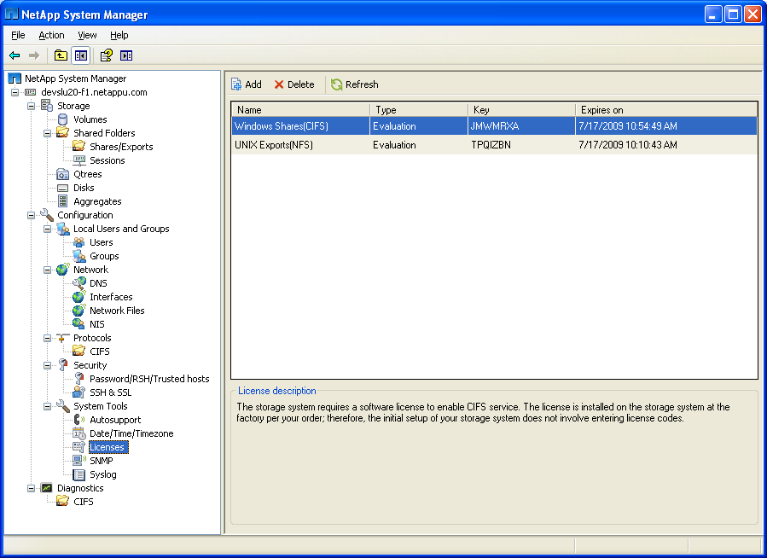
System Manager: CIFS Setup
The newly added
CIFS license
Notice the new
categories
Notes:
SYSTEM MANAGER: CIFS SETUP

Slide 19
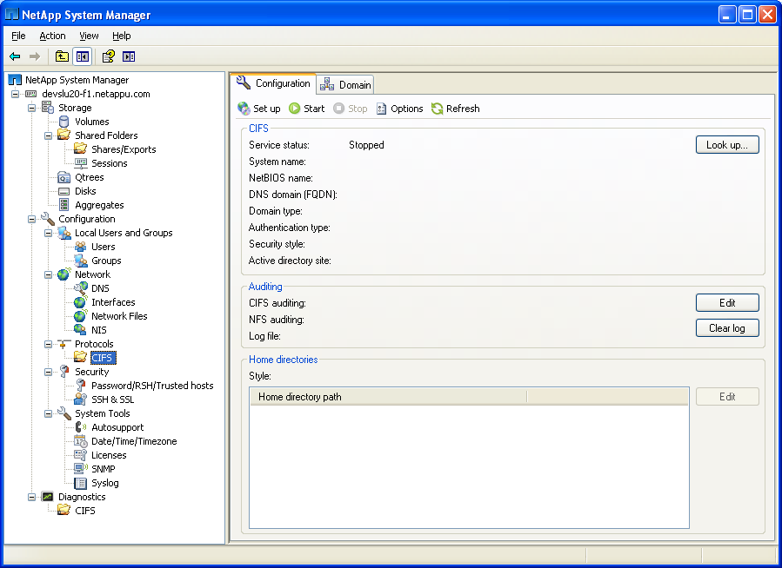
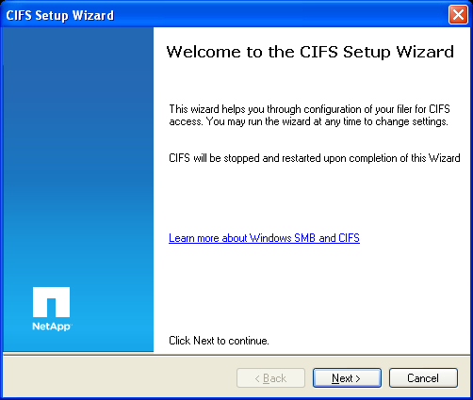
System Manager: CIFS Setup (Cont.)
To configure CIFS
Wizard is similar to cifs setup
and shown in detail in Module 9
Notes:
SYSTEM MANAGER: CIFS SETUP (CONT.)

Slide 20
Results
Notes:
RESULTS

Slide 21
CIFS Server Files Created During Setup
/etc/cifsconfig_setup.cfg
  Stores CIFS setup configuration
/etc/usermap.cfg
  Multiprotocol support for NFS and CIFS
  (Discussed in Module 10)
/etc/passwd
  Multiprotocol and UNIX workgroup
/etc/cifsconfig_share.cfg
  Default share definitions
/etc/lclgroups.cfg
  Local groups definitions
NOTE: Additional files are created depending on the environment
NetApp
recommends
not to edit
these files
directly
Notes:
CIFS SERVER FILES CREATED DURING SETUP
During the CLI cifs setup script or NetApp System Manager’s CIFS Setup Wizard, CIFS support and configuration files are created in the /etc directory. The number and content of the files are dependent on the environment.
The following are files that are common to all environments:
/etc/cifsconfig_setup.cfg (stores the CIFS setup configuration)
/etc/usermap.cfg (multiprotocol support for mapping users of NFS and CIFS)
/etc/passwd (multiprotocol and UNIX workgroup)
/etc/cifsconfig_shares.cfg (default shares definitions)
Additional files are created depending on the environment as in a workgroup (Windows or non-Windows) or a Windows domain.

Slide 22
/etc/cifsconfig_setup.cfg File
/etc/cifsconfig_setup.cfg file
  Contents are persistent across reboots
  Runs each time the CIFS service is started
system> rdfile /etc/cifsconfig_setup.cfg
#Generated automatically by cifs commands
cifs setup -security unix -cp 0 -NTFSonly
    NOTE: The content of the file varies depending on the
    environment that is selected
Notes:
/ETC/CIFSCONFIG_SETUP.CFG FILE
The following shows the contents of an /etc/cifsconfig_setup.cfg file:
system> rdfile /etc/cifsconfig_setup.cfg
#Generated automatically by cifs commands
cifs setup -security unix -cp 0 -NTFSonly
The content of the file varies depending on the environment that is selected. This file is used each time CIFS service is started and persists across reboots.

Slide 23
/etc/passwd File
/etc/passwd file
  system> rdfile /etc/passwd
root:_J9../ongnoStt3Ei79o:0:1::/:
    pcuser::65534:65534::/:
    nobody::65535:65535::/:
    ftp::65533:65533:FTP Anonymous:/home/ftp:
  Is checked during CIFS authentication processing when mapping Windows users to UNIX UID and GID
  Can be used for authentication in a non-Windows (UNIX) workgroup environment
An encrypted root user password is shown
NOTE: Unless the Windows user is mapped to a specific UNIX user name, pcuser is the default (See Module 10)
Notes:
/ETC/PASSWD FILE
NOTE: This root user was created during CIFS setup for the /etc/passwd file. This is not for the storage system user “root” that is used for system administration.

Slide 24
CIFS Default Shares
Setup creates three default shares:
  C$ maps to /vol/<root volume>
  ETC$ maps to /vol /<root volume>/etc
  HOME is /vol /<root volume>/home
    Home directory is accessible to everyone
$ shares are hidden
C$ and ETC$ are available only to administrators
Notes:
CIFS DEFAULT SHARES
These are the three default share definitions:
C$ is /vol/<root volume>. This is a hidden “admin share” to root of the root volume.
ETC$ is /vol /<root volume>/etc. This is a hidden “admin share” to the /etc directory
on the root volume. The /etc directory stores storage system configuration files, executables that are required to boot the system, and some log files.
HOME is /vol /<root volume>/home. This share is the path to the /home directory on the root volume that is accessible to everyone.
A hidden share means that it is not visible when browsing. An “admin share” is only available to users who are members of an administrator group.
The storage system default root volume is /vol/vol0. You can change which volume on your storage system is used as the root volume or create a new one and in the process designate a different name for the root volume. The root volume contains special directories and configuration files for administering the storage system.

Slide 25
/etc/cifsconfig_share.cfg File
/etc/cifsconfig_share.cfg file
  system> rdfile /etc/cifsconfig_share.cfg
  #Generated automatically by cifs commands
  cifs shares -add "ETC$" "/etc" "Remote Administration“
  cifs access "ETC$" S-1-5-32-544 Full Control
  cifs shares -add "HOME" "/vol/vol0/home“ "Default Share“
  cifs access "HOME" S-NONE "nosd"
  The HOME share maps to the user who logs in
  The security descriptors on the user’s home directory applies
  cifs shares -add "C$" "/" "Remote Administration"
  cifs access "C$" S-1-5-32-544 Full Control
This file can be altered by way of command-line interface commands or GUIs
nosd = No Security Descriptor
Notes:
/ETC/CIFSCONFIG_SHARE.CFG FILE
The HOME share is unique because it maps to the user who is trying to log in. The security descriptors on the user’s home directory apply.

Slide 26
/etc/lclgroups.cfg File
The local administrator is added to lclgroups.cfg:
  system> rdfile /etc/lclgroups.cfg
  [ "Replicators" 552 ( "not supported" ) ]
  [ "Backup Operators" 551 ( "Members can bypass file security to backup files" ) ]
  [ "Power Users" 547 ( "Members that can share directories" ) ]
  [ "Guests" 546 ( "Users granted Guest Access" ) ]
  [ "Users" 545 ( "Ordinary Users" ) ]
  [ "Administrators" 544 ( "Members can fully
  administer the filer" ) ]
S-1-5-21-265246955-68147109-1151652928-500
Local Administrator
Notes:
/ETC/LCLGROUPS.CFG FILE
The lclgroups.cfg maps groups to RIDs. A RID is a unique number that is generated when a group or user is created. For more information, check out this link in NOW: http://now.netapp.com/NOW/knowledge/docs/ontap/rel732_vs/html/ontap/sysadmin/GUID-89A9ACCA-501C-42DB-949B-B57B9AFBB.B98.html.

Slide 27
SIDs
Notes:
SIDS

Slide 28
CLI: cifs lookup
Windows security identifiers (SIDs) can be converted to user and group IDs or the reverse
  CLI: cifs lookup command
  NetApp System Manager
system> cifs lookup administrator
SID = S-1-5-21-265246955-68147109-1151652928-500
system> cifs lookup S-1-5-32-544
name = BUILTIN\Administrators
system> cifs lookup S-1-5-21-265246955-68147109-1151652928-500
name = system\administrator
NOTE: SID might be listed in the/etc/lclgroups.cfg file
Notes:
CLI: CIFS LOOKUP
Security IDs (SIDs) can be converted to user and group IDs using the command-line interface or NetApp System Manager.
The following examples demonstrate conversion using the command-line interface with the cifs lookup command.
system> cifs lookup S-1-5-32-544
name = BUILTIN\Administrators
The SID S-1-5-32-544 is the name “BUILTIN\Administrators.”
system> cifs lookup S-1-5-21-265246955-68147109-1151652928-500
name = system\administrator
This is the SID for the local administrator, system’s administrator, which also is listed in the /etc/lclgroups.cfg file.

Slide 29
SID Cache
To manage the SID Cache,
options cifs.sidcache.enable on
  Turns on SID Cache
options cifs.sidcache.lifetime time
  Sets the normal life span of cached SIDs
cifs sidcache clear all
  Clears all CIFS SID-to-name map cache entries
cifs sidcache clear domain [domain]
  Clears CIFS SID-to-name map cache entries for a particular domain
cifs sidcache clear user [user]
  Clears CIFS SID-to-name map cache entries for a particular user
cifs sidcache clear sid [sid]
  Clears CIFS SID-to-name map cache entries for a particular SID
Notes:
SID CACHE
CIFS frequently is required to map SIDs to user and group names and vice versa for user authentication, quota management, console command processing, and various remote procedure call responses. The SID-to-name map cache contains entries that map SIDs to pre-Windows 2000 Server user and group names.
The storage system obtains the SID-to-name mapping information by querying the domain controller. To minimize multiple lookups of the same names, SID-to-name information received from the domain controller is saved in the SID-to-name map cache on the storage system.
The SID-to-name map cache is enabled on the storage system by default. You can manually control the cache by changing the lifetime of the entries, clearing entries, or turning the SID-to-name map caching off or on. The cache persists if CIFS is terminated or restarted, but it does not persist across a reboot or a takeover and giveback.
When the storage system requires SID-to-name mapping information, it first looks for a matching entry in the SID-to-name map cache. If a matching entry is not found or if an expired matching entry is found, the storage system queries the appropriate domain controller for current mapping information. If the domain controller is not available, an expired mapping entry might be used by the storage system.
Defaults for the SID cache lifetime is 1440 minutes (24 hours) with a minimum value of 20 minutes and a maximum value of 100080 minutes (168 hours).

Slide 30
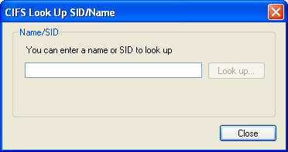
NetApp System Manager: SID Look Up
Notes:
NETAPP SYSTEM MANAGER: SID LOOK UP

Slide 31
NetBIOS Aliases
Notes:
NETBIOS ALIASES

Slide 32
NetBIOS
NetBIOS over TCP/IP
  Means “Network Basic Input/Output System”
  Is an API that allows machines to be discovered by “name” over TCP/IP
    A single machine can have multiple names
  Is typically used by various applications such as Network Neighborhood and net use
Windows clients use the LMHOSTS file to provide NetBIOS name resolution
On the storage system, set NetBIOS name(s) using nbalias and the cifs_nbalias.cfg file
Notes:
NETBIOS
Network Basic Input/Output System, or NetBIOS, is an application programming interface (API) that provides simple networking services, enabling users to share and use one another’s resources easily.
NetBIOS over TCP/IP (NBT or NetBT) is the standard protocol used for CIFS prior to Windows 2000 Server. The NetBIOS Name Server (NBNS) protocol is part of the NetBIOS over TCP/IP family of protocols. For more information about the NetBIOS over TCP/IP, see chapter 11 of TCP/IP Fundamentals for Microsoft Windows located at: www.microsoft.com/downloads/details.aspx?familyid=c76296fd-61c9-4079-a0bb-582bca4a846f&displaylang=en.

Slide 33
NetBIOS Aliases
system> rdfile /etc/cifs_nbalias.cfg
#
# This file contains NetBIOS aliases used by the filer.
# See the System Administrator's Guide for a full
# description of this file.
#
# There is a limit to the number of aliases that may be specified.
# Currently that limit is 200.
#
# Aliases must be entered one per line.
#
# After editing this file, use the console command "cifs nbalias load"
# to make the filer process the entries in this file.
#
# Note that the "#" character is valid in a CIFS NetBIOS alias.
# Therefore the "#" character is only treated as a comment in this
# file if it is in the first column.
#
LegacyEMC
Clariion1
Celerra2
OldHitachi1
Stumpy
Notes:
NETBIOS ALIASES
The /etc/cifs_nbalias.cfg configuration file contains the NetBIOS aliases for the storage system. A NetBIOS alias allows the storage system to be accessed by a Windows client using an alternate name for the storage system. To list the current NetBIOS aliases, do the following:
system> cifs nbalias
No NetBIOS aliases
system> rdfile /etc/cifs_nbalias.cfg
# After editing this file, use the console command
# "cifs nbalias load"
# to make the filer process the entries in this file.
#
# Note that the "#" character is valid in a CIFS# NetBIOS alias.
# Therefore the "#" character is only treated as a# comment in this file if it is in the first column.
grumpy
happy [Edit and add the NetBIOS aliases.]

Slide 34
NetBIOS Aliases (Cont.)
List aliases
  system> cifs nbalias
Load file after making changes
  system> cifs nbalias load
Notes:
NETBIOS ALIASES (CONT.)
After the /etc/cifs_nbalias.cfg file has been edited with the proper NetBIOS aliases, use the cifs nbalias load command to register the update with the WINS server.

Slide 35
Terminating and Restarting CIFS
Notes:
TERMINATING AND RESTARTING CIFS

Slide 36
Stopping and Restarting CIFS
To terminate CIFS service (a complete shutdown) where all CIFS sessions are ended:
  system> cifs terminate [-t minutes]
  To stop a cifs terminate command if you have set a duration, click Control-C
To restart CIFS service after terminating:
  system> cifs restart
  Or reconfigure CIFS services (will start automatically)
  system> cifs setup
Notes:
STOPPING AND RESTARTING CIFS

Slide 37
CLI: Stopping and Restarting CIFS
As an example, stop and restart CIFS services on the storage system called “system”
  system> cifs terminate
  CIFS local server is shutting down...
  CIFS local server has shut down...
  system> cifs restart
  CIFS local server is running.
  GMT[nbt.nbns.registrationComplete:info]: NBT:
  All CIFS name registrations have completed for
  the local server.
Notes:
CLI: STOPPING AND RESTARTING CIFS

Slide 38
Module Summary
Notes:
MODULE SUMMARY

Slide 39
Module Summary
In this module, you should have learned to:
License CIFS on a storage system
Join a storage system to a Windows workgroup environment using the cifs setup command
Observe the results of cifs setup
Manage newly created configuration files for the CIFS workgroup environment
Notes:
MODULE SUMMARY

Slide 40
Exercise
Module 6: CIFS Workgroups
Estimated Time: 30 minutes
Notes:
EXERCISE
Please refer to your Exercise Guide for more instruction.

Slide 41
Check Your Understanding
In cifs setup, what are the two security style choices for which a storage system can be configured?
During the initial questions in cifs setup, for which root user can you enter a password?
What are the three default share volumes created as a result of cifs setup?
What is the name of the NetBIOS alias file?
Notes:
CHECK YOUR UNDERSTANDING

Slide 42
Answers
Module 6: CIFS Workgroups
Notes:
ANSWERS
Please refer to your Exercise Guide for more instruction.

Slide 43
Check Your Understanding: Answers
In cifs setup, what are the two security style choices for which a storage system can be configured?
  NTFS-only
  Multiprotocol
During the initial questions in cifs setup, for which root user can you enter a password?
The UNIX root user in the /etc/passwd file
Used in a non-Windows workgroup only
What are the three default share volumes created as a result of cifs setup?
C$, ETC$, HOME
What is the name of the NetBIOS alias file?
  cifs_nbalias.cfg
Notes:
CHECK YOUR UNDERSTANDING: ANSWERS

