Slide 1
CIFS Shares and Sessions
Module 7
Accelerated NCDA Boot Camp
Data ONTAP 8.0 7-Mode
Notes:
CIFS SHARES AND SESSIONS

Slide 2
Module Objectives
By the end of this module, you should be able to:
Display all shares available on the storage system
List the default shares
Configure a client machine to access any share
Identify the CIFS sessions established by accessing a share on the storage system
Add, modify, and delete shares
Notes:
MODULE OBJECTIVES

Slide 3
Share Administration
Shares may be managed by way of:
  The command-line interface
  NetApp® System Manager
  Microsoft® Management Console (MMC)
    Computer Management
Share administration includes:
  Display shares
  Add shares
  Provide access to shares
  Remove shares
Notes:
SHARE ADMINISTRATION

Slide 4

Displaying Shares
Notes:
DISPLAYING SHARES

Slide 5
CLI: Displaying CIFS Shares
As a result of setting up the CIFS service, default shares are created
To display all shares: cifs shares
Example:
system> cifs shares
Name Mount Point Description
---- ----------- -----------
ETC$ /etc Remote Administration
BUILTIN\Administrators / Full Control
HOME /vol/vol0/home Default Share
everyone / Full Control
C$ / Remote Administration
BUILTIN\Administrators / Full Control
Notes:
CLI: DISPLAYING CIFS SHARES

Slide 6
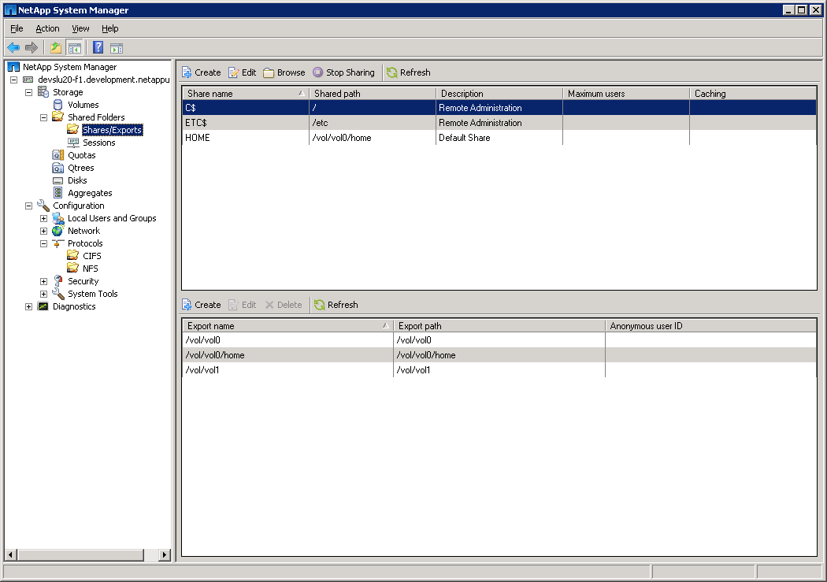
System Manager: Displaying CIFS Shares
Shares
Default Shares
Exports
Notes:
SYSTEM MANAGER: DISPLAYING CIFS SHARES

Slide 7
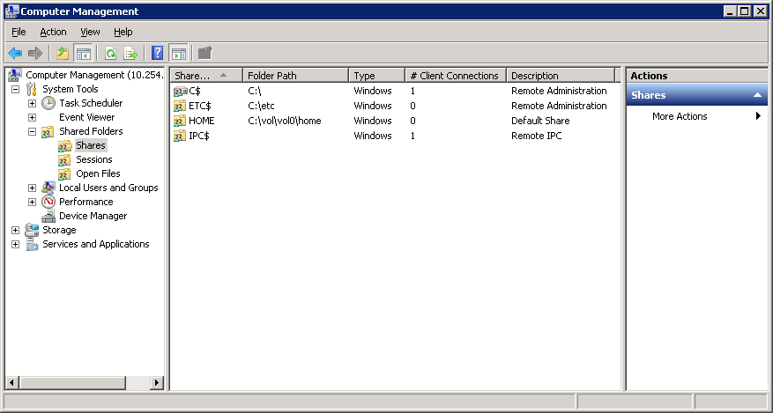
MMC: Displaying Storage System Shares
Connect to the storage system by right-clicking, and then selecting “Connect to another computer…”
You are now interacting with the storage system.
NOTE: You must log in with a user account that is defined in the BUILTIN\Administrators group
Notes:
MMC: DISPLAYING STORAGE SYSTEM SHARES
To display storage system shares, first connect to the storage system by right-clicking and then selecting “Connect… to another computer…” Click the Shares folder in the console tree. The three default shares―C$, ETC$, and HOME―display, as does the hidden IPC$ share.
The IPC$ share is an inter-process communications mechanism for temporary connections between clients and servers. It is primarily used to administer network servers remotely. This share enables the communication between the Windows® Computer Management GUI and the storage system.

Slide 8
Accessing Shares
Notes:
ACCESSING SHARES

Slide 9
Accessing a Share
After the share has been created, it may be
accessed from Windows by:
  Microsoft’s net use command
  C:\> net use e: \\toaster\jdoe /user:marketing\jdoe
  Using the run dialog
  Mapping a drive from the GUI
Notes:
ACCESSING A SHARE

Slide 10
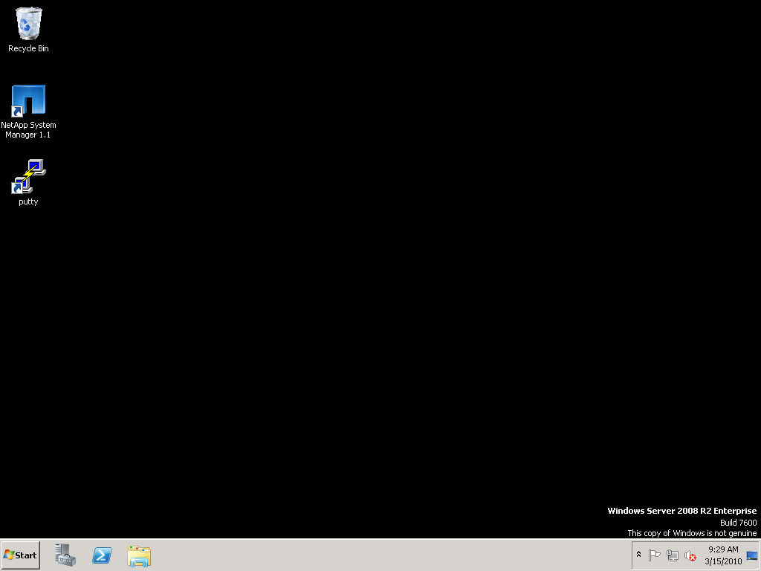
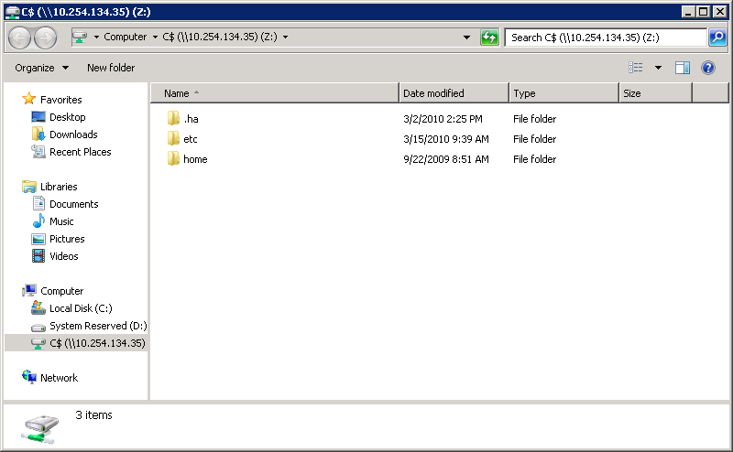
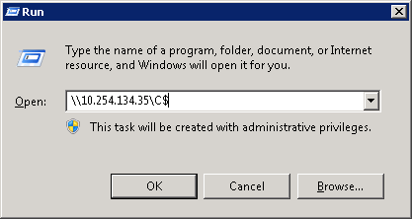
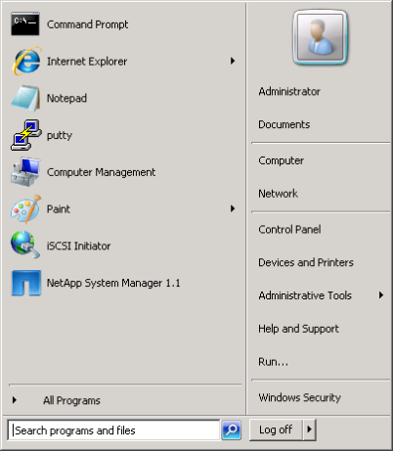
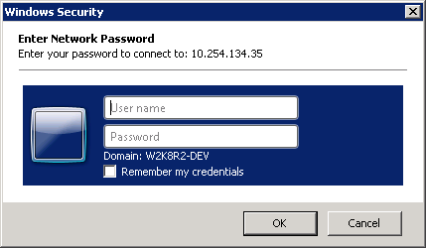
Run Dialog
Notes:
RUN DIALOG
On a Windows workstation using the Windows “run line,” access the C$ share on the storage system “system” by performing the following steps:
On the Windows desktop, click the Start menu and choose Run. The Run window appears.
In the Open text box, type \\storage_system_name\C$ (\\system\C$). Note: The storage system name can be the name or IP address. Click the OK button, and then the Connect To window appears.
In the Connect To window, type the user name administrator and the password, and then click the OK button. The \\system\C$ window appears with the share access to C$ that displays the “etc” and “home” folders.

Slide 11
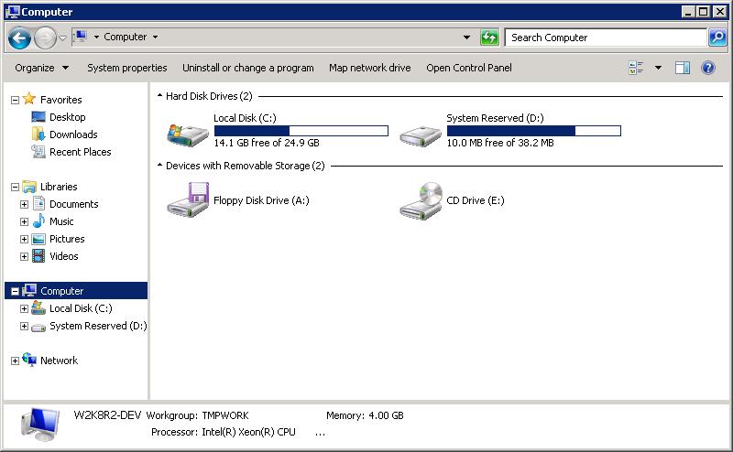
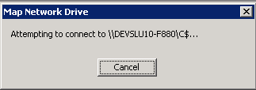
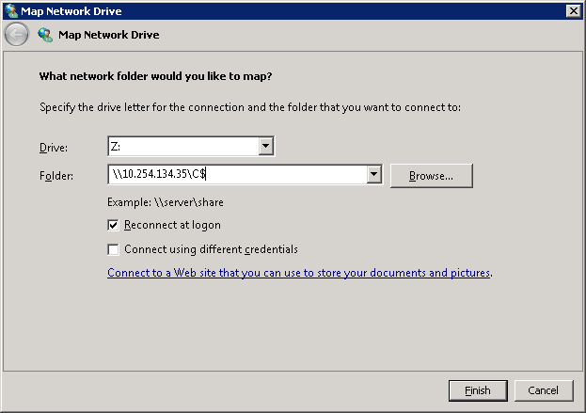
Mapping a Drive to a Share
\\10.254.134.35\C$...
Notes:
MAPPING A DRIVE TO A SHARE
On a Windows workstation, map a network drive letter to a share by performing the following steps:
Open Windows Explorer and go to Tools > Map Network Drive. The Map Network Drive window appears.
In the Drive list box, select any unused letter. In the example, the letter K is selected.
In the Folder list box, type \\storage_system\C$. Note: The storage system name can be the name or IP address.
Click the Finish button. The Map Network Drive attempts to connect to the storage system and share.
When the Connect to window appears, in the User name text box, type administrator and in the Password text box, type the administrator’s password.
Click the OK button.

Slide 12
Mapping a Drive to a Share (Cont.)
Notes:
MAPPING A DRIVE TO A SHARE (CONT.)
(The following continues the mapping of a network drive letter to a share.)
The mapped network drive letter (K is shown in this example) displays the mapping to the C$ share. Both the etc and home folders are in the C$ share.

Slide 13
Encoding
CIFS uses Unicode for its encoding
If a volume is exclusively being accessed by CIFS, consider:
  system> vol options vol create_ucode on
  system> vol options vol convert_ucode on
If the ucode options are not set, Data ONTAP® will transparently convert a non-Unicode directory when first accessed by CIFS
  Time consuming
  If read-only (that is, Snapshot™ copy), then access is refused
Notes:
ENCODING
The CIFS protocol requires the Unicode encoding method. Unicode is an industry standard allowing computers to consistently represent text in most of the world’s writing systems. Unicode provides a unique number for every character regardless of the language. See www.unicode.org for more information.
If a volume is exclusively being accessed by CIFS or NFS v4 or later, then consider setting the create_ucode and convert_ucode volume options. The Create_ucode option forces newly created directories to be Unicode directories for both NFS and CIFS. By default it is set to off, in which case all directories are created in a non-Unicode format and the first CIFS access will convert it to the Unicode format. The convert_ucode on option forces all directories to be converted to the Unicode format when accessed from both NFS and CIFS. By default, this option is set to off.
Unicode is not defaulted on a storage system because Unicode directories take up more space and are slower on some workloads.

Slide 14
Sessions
Notes:
SESSIONS

Slide 15
CIFS Sessions
A client establishes a session with a storage system upon the first share access
  Access is based on user authentication and share access rules
Display a CIFS session status by using these methods:
  CLI: cifs sessions command
  NetApp System Manager
  Windows Computer Management: MMC > System Tools > Shared Folders > Sessions
Notes:
CIFS SESSIONS
A client user establishes a session with a storage system upon the first share access. Access is based on user authentication and share access rules. The authentication method is defined by the environment into which the storage system is added.
You can display a CIFS session status by using these methods:
CLI cifs sessions command
NetApp System Manager
Windows Computer Management GUI ->SystemTools -> SharedFolders -> Sessions

Slide 16
cifs sessions Command
With the cifs sessions command, you can
display the following types of session
information:
A summary of session information, including the number of open shares and files opened by user
  system> cifs sessions
Share and file information about a specified connected user or all connected users, including shares and files opened
  system> cifs sessions [username|IPaddress|host]
  system> cifs sessions * [all connected users]
Security information
  system> cifs sessions -s
Notes:
CIFS SESSIONS COMMAND
With the cifs sessions command, you can display the following types of session information:
A summary of session information, including storage system information and the number of open shares and files opened by each connected user:
cifs sessions
Share and file information about a specified connected user or all connected users, including:
The names of shares opened by a specified connected user or all connected users
The access levels of opened files
cifs sessions user_name | IP_address |workstation_name
cifs sessions * [all connected users]
Security information about a specified connected user or all connected users, including the UNIX® user ID (UID) and a list of UNIX groups and Windows groups to
which the user belongs:
cifs sessions –s user_name | IP_address | workstation_name
cifs sessions –s [all connected users]
NOTE: The number of open shares shown in the session information includes the hidden IPC$ share.
The cifs sessions command can be used as a “status” command even when there is no session.
Example 1 is a storage system in a Windows workgroup. The storage system uses local user authentication.
system> cifs sessions
Server Registers as 'system' in workgroup 'WORKGROUP1'Root volume language is not set. Use vol lang. Using Local Users authentication
Comment: This is a Windows workgroup server
===================================================
PC IP(PC Name) (user) #shares #files
Example 2 is a storage system in a Windows 2000 Server domain. The storage system uses the domain controller for authentication.
system> cifs sessions
Server Registers as 'system' in Windows 2000 domain 'DEVELOPMENT'
Root volume language is not set. Use vol lang.
Selected domain controller \\DEVDC01 for authentication
Comment: This is a Windows 2000 member server
====================================================
PC IP(PC Name) (user) #shares #files
Options:
The -t option displays the total count of CIFS sessions, open shares, and open files.
If you include the user argument, the command displays information about the specified user, along with the names and access level of files that user has opened. If you use * as the specified user, the command lists all users.
Specifying the -c option with a user argument will display the names of open directories and the number of active change notify requests against the directory.
The -s option displays security information for a specified connected user. If you do not specify a user or workstation name, the command displays security information for all users.
Here are examples using the machine_name and machine_IP_address arguments:
system> cifs sessions 192.168.228.4
users shares/files opened
TORTOLA (nt-domain\danw - root)
HOME
system> cifs sessions tortola
users shares/files opened
TORTOLA (nt-domain\danw - root)
HOME
Here is an example using the -t option:
system> cifs sessions -t
Using domain authentication. Domain type is Windows NT.
Root volume language is not set. Use vol lang.
Number of WINS servers: 2
CIFS sessions: 1
CIFS open shares: 1
CIFS open files: 3
CIFS sessions using security signatures: 0

Slide 17
cifs sessions Example
The following example of the cifs sessions command shows a session with a storage system in a Windows domain
system> cifs sessions
Server Registers as ‘system' in workgroup ‘WORKGROUP'
Root volume language is not set. Use vol lang.
Using Local Users authentication
====================================================
PC IP(PC Name) (user) #shares #files
10.254.134.40() (system\administrator 1 0
- root)
Notes:
CIFS SESSIONS EXAMPLE
The following example of the cifs sessions command shows a session with a storage system in a Windows workgroup.
The PC IP address 10.254.134.40 is the Windows workstation WIN.
The system\administrator user is the local administrator account on the storage system.
The user mapping for this account is root.
One share is currently being accessed.

Slide 18
CLI: cifs sessions Security Information
system> cifs sessions -s
users
Security Information
10.254.134.40() (system\administrator - root)
***************
UNIX uid = 0
user is a member of group daemon (1)
user is a member of group daemon (1)
NT membership
system\administrator
BUILTIN\Administrators
User is also a member of Everyone, Network Users,
Authenticated Users
***************
Notes:
CLI: CIFS SESSIONS SECURITY INFORMATION
The following example of cifs sessions -s command shows security information for a user with a session with a storage system in a Windows workgroup.

Slide 19
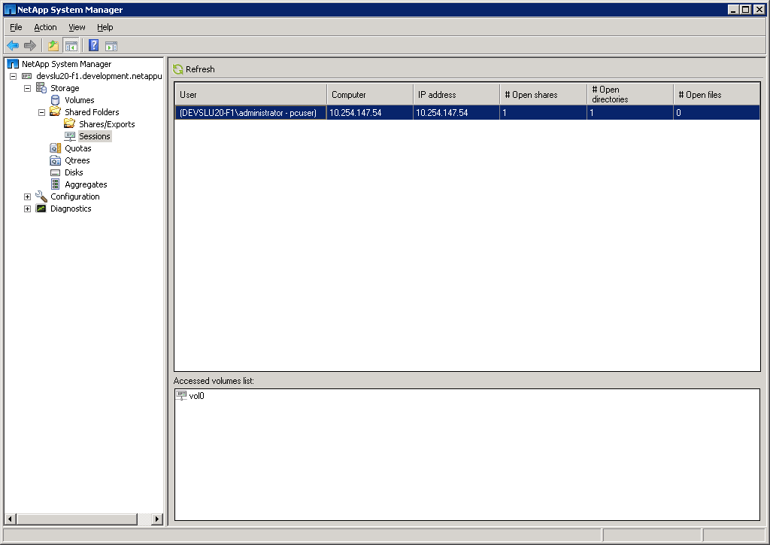
NetApp System Manager: CIFS Sessions
Current Sessions
Local storage system’s administrator
account shown
Highlighted session’s
access volume
Notes:
NETAPP SYSTEM MANAGER: CIFS SESSIONS

Slide 20
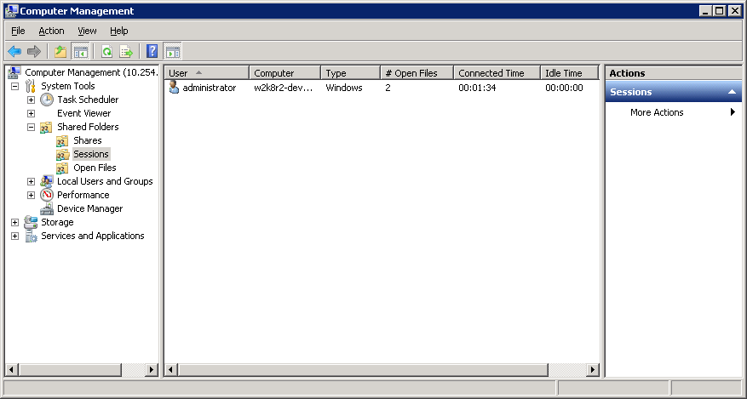
MMC: CIFS Sessions
GUI connected to the storage system
List and terminate all the current sessions except
the session that Computer Management uses
Notes:
MMC: CIFS SESSIONS
With the Computer Management GUI, click the System Tools->SharedFolders->Sessions folders to display the CIFS sessions.
In this example, the local administrator has a session with the storage system DEV270-1, which is in a Windows workgroup.
The name of the administrator’s computer is 10.254.134.40
The number of Open Files is 3
This account is not a Guest account

Slide 21
Broadcasting a Message
To display a message on Windows users’ sessions:
  system> cifs broadcast [workstation| -v volname] “message”
  You can inform users about pending terminations or other important events
The Messenger service on the Windows workstation must be enabled
  On your Windows workstation, go to: Start > Programs > Administrative Tools > Services > Messenger
  If the Messenger service is disabled, start the service
NOTE: The Messenger service is not available on Microsoft
Windows Server 2008 R2 and therefore the cifs broadcast
command is not available
Notes:
BROADCASTING A MESSAGE
To display a message on Windows users’ workstations, use the following command:
cifs broadcast {workstation | -v volname} “message”
You can inform users about pending terminations or other important events.
The Messenger service on the Windows workstation must be enabled. NOTE: It is disabled by default for security reasons.
To enable the Messenger service on your Windows workstation:
Go to Start->Programs->Administrative Tools->Services->Messenger.
If the Messenger service is disabled, start the service. (The default is disabled.)

Slide 22
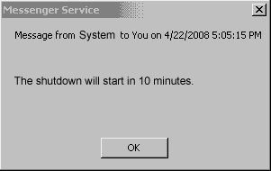
Broadcasting a Message Example
Example of broadcasting a message from a storage system:
system> cifs broadcast -v flexvol1 "The shutdown will start in 10 minutes."
The following message displays on the Windows workstation:
Notes:
BROADCASTING A MESSAGE EXAMPLE
The following is an example of broadcasting a message using the volume option from a storage system:
system> cifs broadcast -v flexvol1 "The shutdown will start in 10 minutes."
The message “The shutdown will start in 10 minutes” will be broadcasted to all users that have sessions on the volume named flexvol1.

Slide 23

Terminating Sessions
cifs terminate Host1
Host1
cifs terminate [-t time] [host]
Host2
cifs terminate
Host3
Host4
Notes:
TERMINATING SESSIONS
The cifs terminate command stops the CIFS service. If a single host is named, all CIFS sessions opened by that host are terminated. If a host is not specified, all CIFS sessions are terminated and the CIFS service is shut down.
If you run the cifs terminate command without specifying a time until shutdown and there are users with open files, you are prompted to enter the number of minutes to delay before terminating. If the CIFS service is terminated immediately on a host that has one or more files open, users will not be able to save changes. You can use the -t option to warn users of an impending service shutdown. If you execute cifs terminate from rsh, you must supply the -t option.

Slide 24
Creating and Deleting Shares
Notes:
CREATING AND DELETING SHARES

Slide 25
Default Shares
As you recall, three default share definitions are created upon completion of cifs setup:
  C$
  ETC$
  HOME
But you can create new shares…
Notes:
DEFAULT SHARES

Slide 26
Creating a Share
When you create a share, you must provide:
  Complete path name
  Name of the share
  Optionally, a description of the share
Data ONTAP CLI also allows:
  Group membership for files in the share
  Support for wide symbolic links
  Disabling or enabling of virus scanning when files in the share are first opened
MMC also allows permissions for the share
Notes:
CREATING A SHARE
When you create a share, you must provide these items:
The complete path name of an existing volume or directory to be shared
The name of the share entered by users when they connect to the share
Optionally, a description of the share
When creating a share from the Data ONTAP command-line interface, you can specify a variety of share properties, including group membership for files in the share, support for wide symbolic links, and disabling of virus scanning when files in the share are first opened. Virus scanning occurs when files are opened, renamed, and closed after being modified.
Microsoft interfaces additionally allow the administrator to set permissions as the share is created.

Slide 27
Creating a Share (Cont.)
Additional properties can be set or modified after creating a share:
  Maximum number of users who can simultaneously access the share
    If not specified, the limit is defined by the storage system’s memory
  Share-level access control list (ACL)
Notes:
CREATING A SHARE (CONT.)
After you have created a share, you can specify these share properties:
Maximum number of users who can simultaneously access the share
If you do not specify a number, the number of users is limited by storage system memory
Share-level access control list (ACL)

Slide 28
CLI: Preparing to Create a Share
You can create shares for folders, qtrees, or volumes
For example:
  To prepare for creating a share on a qtree, first create the following resources:
    An aggregate (aggr1)
    A flexible volume (flexvol1) on aggr1
    A qtree (datatree1) on flexvol1
NOTE: This path example will be used throughout this module
Notes:
CLI: PREPARING TO CREATE A SHARE
You can create shares for volumes or directories including qtrees.
For example, to prepare for creating a share on a qtree, first create the following resources:
An aggregate (aggr1)
A flexible volume (flexvol1) on aggr1
A qtree (datatree1) on flexvol1

Slide 29
CLI: Adding a Share
Name ---- | Mount Point ----------- | Description -----------
datatree1 | /vol/flexvol1/datatree1 everyone / Full control | Qtree for Windows Users
Default access control (discussed later)
As an example, add a share called datatree1 (for the qtree datatree1)
system> cifs shares -add datatree1
/vol/flexvol1/datatree1
-comment "Qtree for Windows Users"
The share name 'datatree1' will not be accessible by some MS-DOS workstations
Are you sure you want to use this share name? [n]: y
Notes:
CLI: ADDING A SHARE
For example, on a storage system, add a share called datatree1 (for the qtree datatree1).
system> cifs shares -add datatree1 /vol/flexvol1/datatree1 -comment "Qtree for Windows Users"
The share name 'datatree1' will not be accessible by some MS-DOS workstations
Are you sure you want to use this share name? [n]:y
system> cifs shares datatree1
Name Mount Point Description
---- ----------- -----------
datatree1 /vol/flexvol1/datatree1 Qtree for Windows Users
everyone / Full Control
The default access control is full control for everyone.

Slide 30
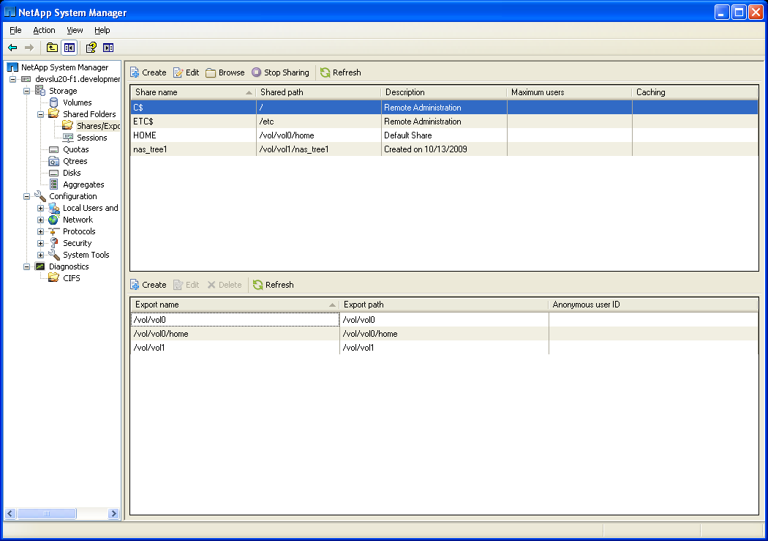
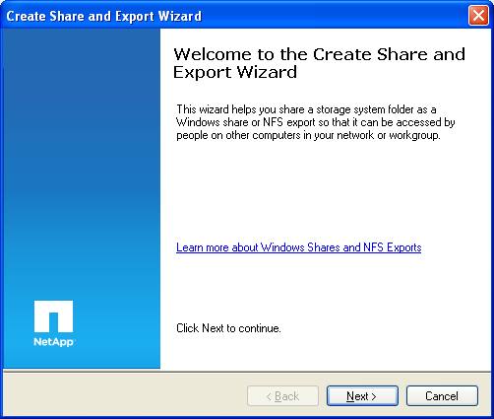
NetApp System Manager: Adding a Share
Select Shares/Exports
Follow the
wizard…
Notes:
NETAPP SYSTEM MANAGER: ADDING A SHARE

Slide 31
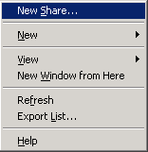
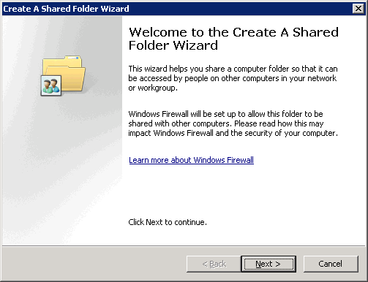
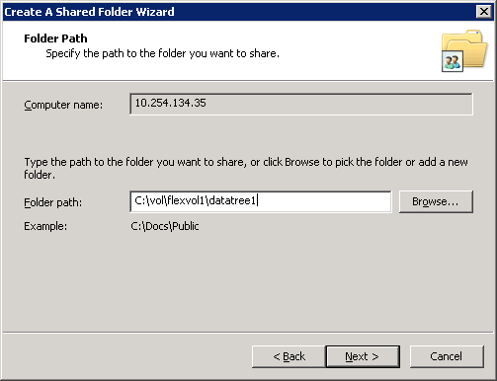
MMC: Adding a Share
Right-click Shares
Path always
begins
with
C:\vol\
Choose New Share...
Notes:
MMC: ADDING A SHARE
As an example with the Windows Computer Management GUI, add a new share called datatree1 (for the qtree datatree1) on volume flexvol1 by performing the following steps:
In the console tree, right-click the Shares folder and choose New Share…. The Welcome to the Share a Folder Wizard appears.
Click the Next button to start the wizard, and the Folder path page displays with the Computer name text box showing your storage system name or IP address.
In the Folder path text box, type the path C:\vol\flexvol1\datatree1 for the datatree1 share, and click the Next button.

Slide 32
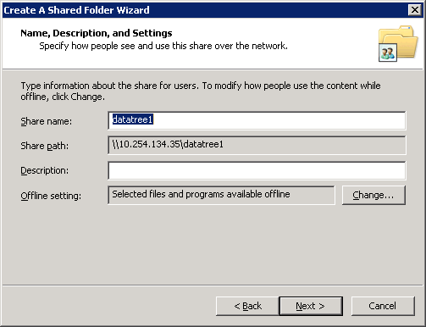
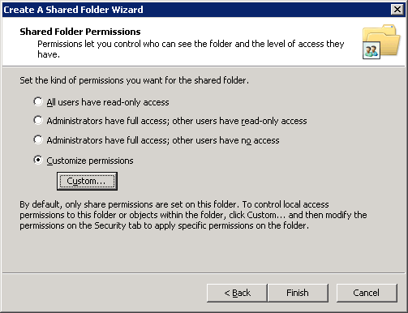
MMC: Adding a Share (Cont.)
Choose New Share...
Click the Customize button.
Notes:
MMC: ADDING A SHARE (CONT.)
(The following continues the adding of a CIFS share.)
On the “Name, Description, and Settings” page, in the Share name text box, enter datatree1.
In the Description text box, type Qtree for Windows Users, and then click the Next button.
In the “Permissions” page, mark the Use custom share and folder permissions radio button, and then click the Customize button.

Slide 33
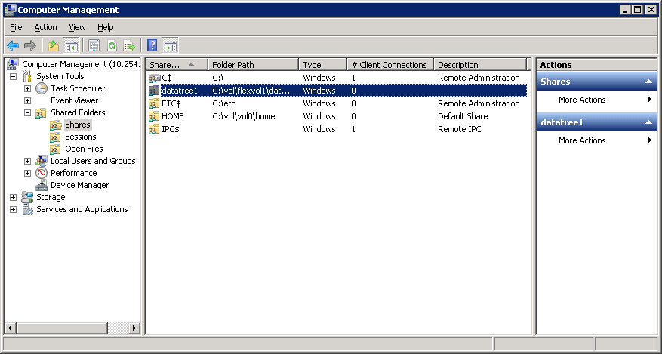
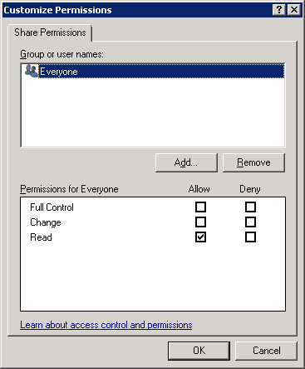
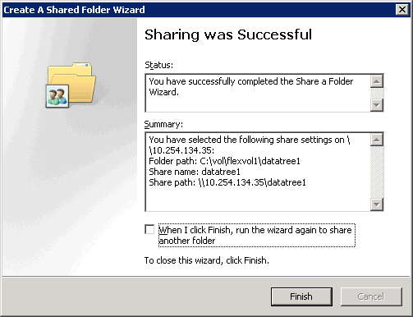
MMC: Adding a Share (Cont.)
Notes:
MMC: ADDING A SHARE (CONT.)
(The following continues the adding of a CIFS share.)
In the Customize Permissions window, mark the check boxes for Full Control, Change, and Read, and click the OK button.
In the Permissions page, click the Finish button.
You receive a message stating that sharing was successful.
Click the Close button to close the wizard.

Slide 34
CLI: Deleting a Share
As an example, delete the share called datatree1
system> cifs shares -delete datatree1
system> cifs shares
Name Mount Point Description
---- ----------- -----------
ETC$ /etc Remote Administration
BUILTIN\ Administrators / Full Control
HOME /vol/vol0/home Default Share
everyone / Full Control
C$ / Remote Administration
BUILTIN\ Administrators / Full Control
NOTE: The share datatree1 is deleted not the underlying volume, qtree, or directory
Notes:
CLI: DELETING A SHARE
For example, delete the share called datatree1:
system> cifs shares -delete datatree1
system> cifs shares
Name Mount Point Description
---- ----------- -----------
ETC$ /etc Remote Administration
BUILTIN\Administrators / Full Control
HOME /vol/vol0/home Default Share
everyone / Full Control
C$ / Remote Administration
BUILTIN\Administrators / Full Control
NOTE: The share datatree1 is deleted.

Slide 35
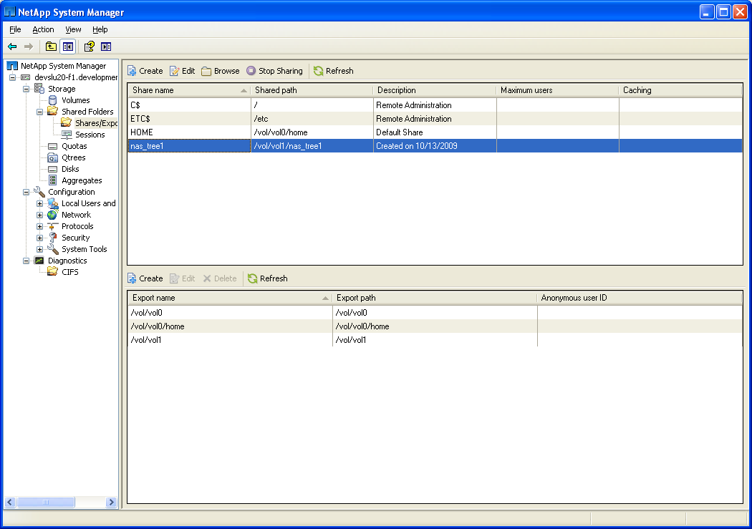
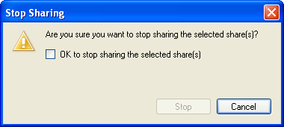
NetApp System Manager: Deleting a Share
Select the share and
click Stop Sharing
Notes:
NETAPP SYSTEM MANAGER: DELETING A SHARE

Slide 36
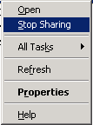
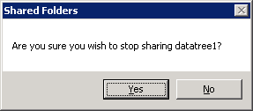
MMC: Deleting a Share
Right-click datatree1 share
Choose Stop Sharing
Click the Yes button to confirm stop sharing datatree1
Notes:
MMC: DELETING A SHARE
As an example with the Windows Computer Management GUI, delete the share called datatree1 by performing the following steps:
In the Computer Management window, right-click the datatree1 share and choose Stop Sharing.
In the Shared Folders window, when it asks if you are sure that you wish to stop sharing datatree1, click the Yes button.

Slide 37
Module Summary
Notes:
MODULE SUMMARY

Slide 38
Module Summary
In this module, you should have learned to:
Display all shares available on the storage system
List the default shares
Configure a client machine to access any share
Identify the CIFS sessions established by accessing a share on the storage system
Add, modify, and delete shares
Notes:
MODULE SUMMARY

Slide 39
Exercise
Module 7: CIFS Shares and Sessions
Estimated Time: 15 minutes
Notes:
EXERCISE
Please refer to your Exercise Guide for more instruction.

Slide 40
Check Your Understanding
For which storage objects can you create shares?
What are three methods to manage CIFS shares?
What command would you use to view the connected CIFS users?
Notes:
CHECK YOUR UNDERSTANDING

Slide 41
Answers
Module 7: CIFS Shares and Sessions
Notes:
ANSWERS
Please refer to your Exercise Guide for more instruction.

Slide 42
Check Your Understanding: Answers
For which storage objects can you create shares?
  folders
  qtrees
  volumes
What are three methods to manage CIFS shares?
  CLI
  NetApp System Manager
  Microsoft tools such as Computer Management
What command would you use to view the connected CIFS users?
  cifs sessions
Notes:
CHECK YOUR UNDERSTANDING: ANSWERS

