Slide 1
CIFS Access Control
Module 8
Accelerated NCDA Boot Camp
Data ONTAP 8.0 7-Mode
Notes:
CIFS ACCESS CONTROL

Slide 2
Module Objectives
By the end of this module, you should be able to:
Create and manage local users for a storage system
Identify how to create a local group and make a local user a member of that group
Use the command-line interface, NetApp® System Manager or Microsoft® tools to add, delete, and modify access permissions of shares
Use Microsoft tools to add, delete, and modify access permissions of files and folders
Notes:
MODULE OBJECTIVES

Slide 3

Local Users
Notes:
LOCAL USERS

Slide 4
Local Users
Local users are:
Accounts that are authenticated locally
Associated with groups on the storage system
Created and managed using the useradmin command or a text editor
Saved in /etc/registry or /etc/passwd
Notes:
LOCAL USERS
On the storage system, the domain administrators group and the local administrator account are part of the BUILTIN\Administrators group. They can do the following:
Provide a text editor to edit configuration files. Data ONTAP® does not include an editor.
Provide the ability to administer a storage system and hence have access to the root file system (C$ and ETC$).
Modify the share access for C$ and ETC$ to grant additional users access.
The local administrator can set up local users on the storage system with the useradmin user add command.

Slide 5
Purpose of Local Users
Two main reasons for local user authentication:
Provides local administrators the ability to configure the storage system
  Discussed in the Data ONTAP 8.0 7-Mode Administration course
Provides local client users access to the resources on the storage system for all environments
  Windows® workgroup
  Non-Windows workgroup
  Windows domain
NOTE: You can create a maximum of 96 local user accounts
Notes:
PURPOSE OF LOCAL USERS
Reasons for local user accounts include the following:
Windows workgroup
You must create local user accounts so that the storage system can authenticate local users.
Non-Windows workgroup (UNIX mode)
Do not create local user accounts because the storage system authenticates users with the UNIX password (/etc/passwd) database.
Windows domain
The storage system can authenticate users (with the local user accounts) who try to connect to the storage system from an untrusted domain.
Local users can access the storage system when the domain controller is down or not available for domain authentication.
NOTE: You can create a maximum of 96 local user accounts.

Slide 6
Purpose of Local Users (Cont.)
When the CIFS server is configured for:
Windows workgroup
  You must create local user accounts so that the storage system can authenticate users
  Use the useradmin command
  User accounts are stored in /etc/registry
Non-Windows workgroup (UNIX mode)
  You must create local UNIX users
  Use the passwd command
  User accounts are stored in /etc/passwd and /etc/shadow
Notes:
PURPOSE OF LOCAL USERS (CONT.)

Slide 7
Purpose of Local Users (Cont.)
When the CIFS server is configured for:
Windows domain
  Storage system can authenticate users (with the local user accounts) who try to connect to the storage system from an untrusted domain
  Local users can access the storage system when the domain controller is down or not available for domain authentication
  Use the useradmin command
  User accounts are stored in /etc/registry
Notes:
PURPOSE OF LOCAL USERS (CONT.)

Slide 8
Local Administrator
As you recall, during cifs setup, the local
administrator account may be created
It is highly recommended that you create the local
administrator account: (system\administrator) for
this filer. This account allows access to CIFS
from Windows when domain controllers are not
accessible.
Do you want to create the system\administrator
account? [y]:
Enter the new password for system\administrator:
Retype the password:
Notes:
LOCAL ADMINISTRATOR

Slide 9
Local User Definitions
List the local users on the storage system
system> useradmin user list
Name: root
Info: Default system administrator.
Rid: 0
Groups:
Name: administrator
Info: Built-in account for administering the filer
Rid: 500
Groups: Administrators
This is the storage system root user account
Notes:
LOCAL USER DEFINITIONS
A local administrator is added to the user list if the response during cifs setup was to create a local administrator account for the storage system. Be sure to set an appropriate password for the administrator account.

Slide 10
Administrating Local Users
Local users
  Must provide a unique name
  Associate user to a group
  Created only by way of the command-line interface’s useradmincommand when the storage system is set to CIFS workgroup authentication
Notes:
ADMINISTRATING LOCAL USERS

Slide 11
Local User Management
Manage local users fully by using the command-line interface useradmin command
To add a new local user:
system> useradmin user add user –g group
To modify a local user :
system> useradmin user modify user –g group
To list user information:
system> useradmin user list user
To delete a local user:
system> useradmin user delete user
Notes:
LOCAL USER MANAGEMENT

Slide 12
CLI: Adding a New Local User
As an example, add a local user called Jane to the predefined Guests group
  NOTE: User names are not case sensitive
system> useradmin user add jane -g Guests
New password:
Retype new password:
user <jane> added.
system> Mon Jul 31 01:13:18 GMT
[useradmin.added.deleted:info]:
The user 'jane' has been added.
Password is typed but not displayed
Notes:
CLI: ADDING A NEW LOCAL USER
As an example, add a local user called Jane to the predefined Guests group.
NOTE: User names are not case sensitive.
system> useradmin user add jane -g Guests
New password:Retype new password:User <jane> added.system> Mon Jul 31 01:13:18 GMT [useradmin.added.deleted:info]: The user 'jane' has been added.
NOTE: The password is typed but not displayed.

Slide 13
CLI: Adding a New Local User (Cont.)
In the example, verify that the local user Jane has been added to the predefined Guests group
system> useradmin user list jane
Name: jane
Info:
Rid: 131075
Groups: Guests
Full Name:
Allowed Capabilities:
Password min/max age in days: 0/4294967295
Status: enabled
Notes:
CLI: ADDING A NEW LOCAL USER (CONT.)
In the example, verify that the local user Jane has been added to the predefined Guests group.
system> useradmin user list jane
Name: jane
Info:
Rid: 131075
Groups: Guests
Allowed Capabilities:
Password min/max age in days: 0/4294967295
Status: enabled
NOTE: Jane has no allowed capabilities in the Guests group, but she can log in and be authenticated.

Slide 14
Local Groups
Notes:
LOCAL GROUPS

Slide 15
Local Groups
Local groups
  Contain local and domain users
  Created only by way of the command-line interface’s useradmin command when the storage system is set to CIFS workgroup authentication
Notes:
LOCAL GROUPS
MMC tools have some capabilities that are discussed in the next module because they only are available when the storage system is using CIFS domain authentication.

Slide 16
CLI: Group Management
Manage local groups by using the command-line interface command useradmin
  To add a new group:
  system> useradmin group add group –r role
  To modify an existing group:
  system> useradmin group modify group –g newName
  To list group information:
  system> useradmin group list group
  To delete a group:
  system> useradmin group delete group
Notes:
CLI: GROUP MANAGEMENT

Slide 17
CLI: Local Groups
As an example, add a local group called Helpers with the predefined admin role
system> useradmin group add Helpers -r admin
Group <Helpers> added.
system > Mon Jul 31 02:02:43 GMT
[useradmin.added.deleted:info]: The group
'Helpers' has been added.
system > useradmin group list Helpers
Name: Helpers
Info:
Rid: 131076
Roles: admin
Allowed Capabilities: login-*, cli-*, api-*,
security-*
Notes:
CLI: LOCAL GROUPS
As an example, add a local group called Helpers with the predefined admin role and verify the results.
system> useradmin group add Helpers -r admin
Group <Helpers> added.system> Mon Jul 31 02:02:43 GMT [useradmin.added.deleted:info]: The group 'Helpers' has been added.
system> useradmin group list Helpers
Name: Helpers
Info:
Rid: 131076
Roles: admin
Allowed Capabilities: login-*,cli-*,api-*,security-*
NOTE: The admin role has full capabilities.
When groups are created, they are placed in the lclgroups.cfg file. Normally, this file is for administrative reference only; it is not used to reload groups into the system memory. However, sometimes you need Data ONTAP to reload this file―for example, when you migrate a storage system. Do not edit this file without direction from Technical Support.

Slide 18
Share Permissions
Notes:
SHARE PERMISSIONS

Slide 19
Permissions
Permissions can be set at:
  Share level
  Folder or file level
Both permission levels must be satisfied to gain access to the resource
Notes:
PERMISSIONS

Slide 20
Share Permissions
Share permissions can be managed by:
  Command-line interface: cifs access command
  NetApp System Manager
  MMC such as Computer Management
Windows share permissions are the following:
  Read-only
  Full control
  Change
If all the permissions are denied, then there is no access
Notes:
SHARE PERMISSIONS

Slide 21
cifs access Command
The command-line interface cifs access command sets or modifies the share-level ACL to share definitions
  To modify a share access:
  cifs access <share> [-g] [user_rights]
  To delete an ACL entry for a user on a share:
  cifs access -delete <share> [-g] [user]
The –g option specifies that the user is the name of a UNIX group; use this command when you have:
  A UNIX group and a UNIX user or an NT user or group with the same name
Notes:
CIFS ACCESS COMMAND
The command-line interface cifs access command sets or modifies the share-level access control list (ACL) to share definitions.
To modify a share access:
cifs access <sharename> [-g] [user_rights]
To delete an ACL entry for a user on a share:
cifs access -delete <sharename> [-g] [user]
The -g option specifies that the user is the name of a UNIX group. Use this command when you have a UNIX group and a UNIX user or an NT user or group with the same name.

Slide 22
CLI: Setting and Deleting Share Access
As an example, on the datatree1 share, set the share access for the friends group to Full Control and delete the Everyone access
system> cifs access datatree1 friends Full Control
1 share(s) have been successfully modified
system> cifs access -delete datatree1 everyone
1 share(s) have been successfully modified
system> cifs shares datatree1
Name Mount Point Description
---- ----------- -----------
datatree1 /vol/flexvol1/datatree1 Windows Qtree
  system\friends / Full Control
NOTE: This is the storage system local administrator
Notes:
CLI: SETTING AND DELETING SHARE ACCESS

Slide 23
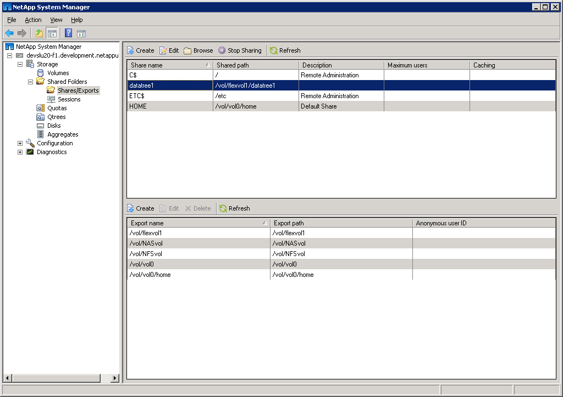
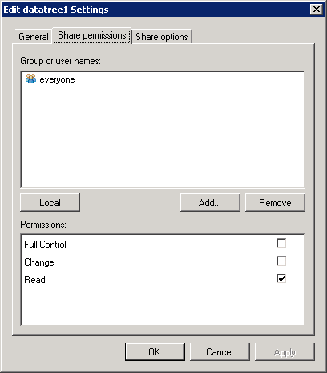
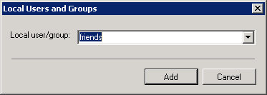
System Manager: Setting Share Access
Select the share and
right-click or click Edit
Click the Share
Permissions tab
Click the Add button to add Windows users or groups to the share
Click the Local button to add Data ONTAP users or groups
Notes:
SYSTEM MANAGER: SETTING SHARE ACCESS

Slide 24
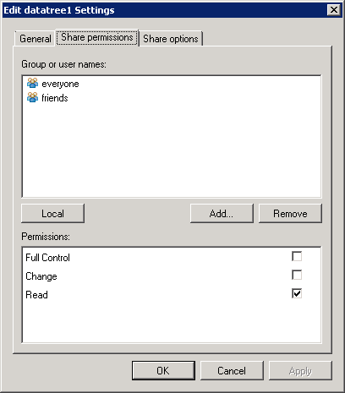
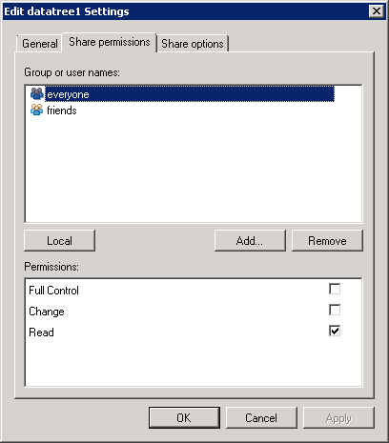
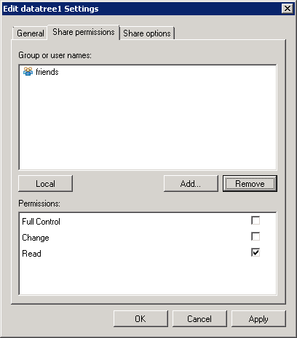
System Manager: Deleting Share Access
Select everyone
Click the Remove button
Click the OK or Apply button to commit the changes
Notes:
SYSTEM MANAGER: DELETING SHARE ACCESS

Slide 25
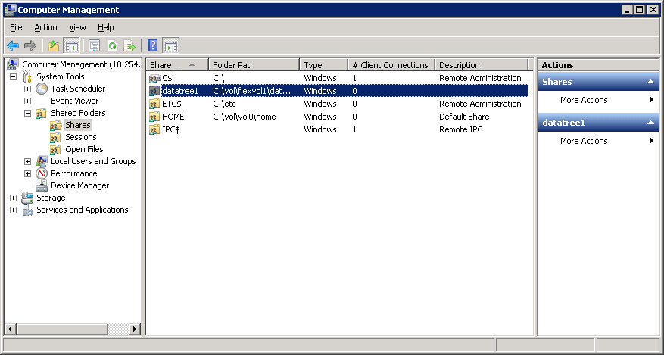
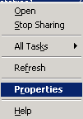
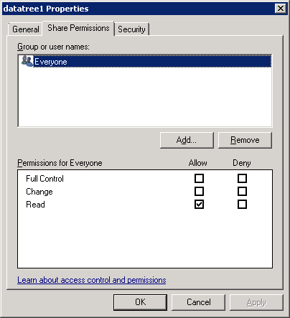
MMC: Setting and Deleting Share Access
Connect to storage system
Right-click datatree1 share
Choose Properties
Click the Share Permissions tab
Notes:
MMC: SETTING AND DELETING SHARE ACCESS
As an example with Windows Computer Management GUI, on the datatree1 share, set the share access for the administrator to Full Control and delete the Everyone access by performing the following steps:
Right-click the datatree1 share and choose Properties.
In the datatree1 Properties window, the General tab appears displaying the share name, folder path, and description for the datatree1 share. Click the Share Permissions tab.

Slide 26
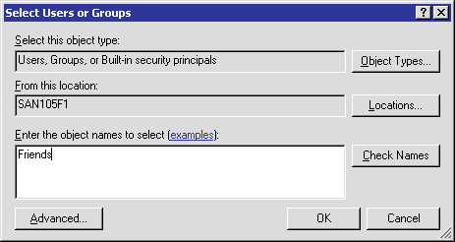
MMC: Managing Share Access (Cont.)
Location of users or groups
Click the Add button
Type Friends
Notes:
MMC: MANAGING SHARE ACCESS (CONT.)
(The following continues the setting and deleting of share access.)
In the Share Permissions tab, click the Add button. The Select Users, Computers, or Groups window appears.
In the Enter the object names to select text box, type friends group and click the OK button. The datatree1 Properties window appears, displaying the new share access for the friends group.

Slide 27
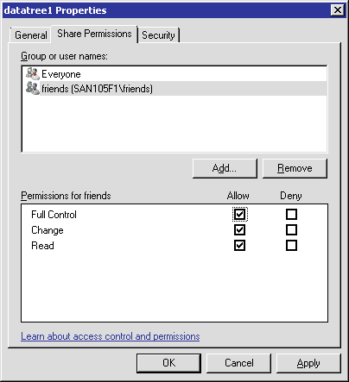
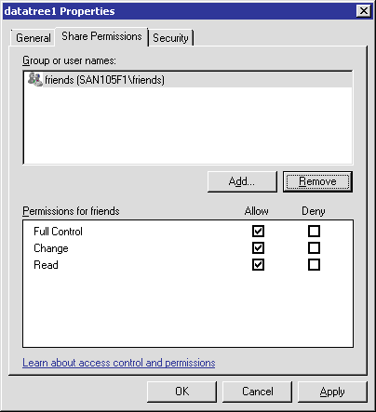
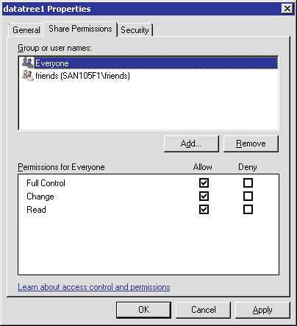
MMC: Managing Share Access (Cont.)
Select Everyone
Full control, defaults to Read only
Click the Remove button
Click the OK or Apply button to commit the changes
Notes:
MMC: MANAGING SHARE ACCESS (CONT.)
(The following continues the setting and deleting of share access.)
In the dataree1 Properties window, select Everyone and click the Remove button to delete share access for Everyone.
The datatree1 Properties window displays that the Everyone share access is deleted.

Slide 28
File Permissions
Notes:
FILE PERMISSIONS

Slide 29
Folder and File Permissions
A storage system stores the NTFS file-level permissions for folders and files
  Managed only from a Windows client or GPOs
Standard Windows GUI tools display and set permissions
Manage permissions as you would an NTFS file system on a Windows workstation or server
Notes:
FOLDER AND FILE PERMISSIONS
A storage system stores the NTFS file-level permissions for folders and files. They can be managed from a Windows client only or Group Policy Objects (GPOs).
Standard Windows GUI tools display and set permissions. Manage permissions as you would an NTFS file system on a Windows workstation or server.

Slide 30
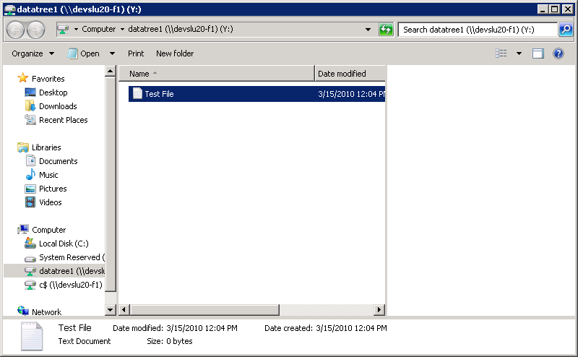
File Permissions of a Mapped Drive
Right-click and choose Properties
Notes:
FILE PERMISSIONS OF A MAPPED DRIVE
To display the file permissions, perform the following steps:
From a mapped network drive, right-click the file.
Choose Properties from the shortcut menu.

Slide 31
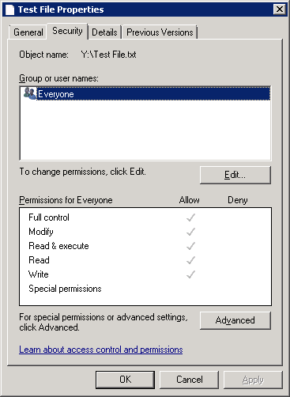
Security Tab
Click the Security tab
NOTE: Grayed out permission
is inherited from parent folders
The Everyone system group
has full control for permissions,
including Modify, Read & Execute,
Read, Write, and Special Permissions
Notes:
SECURITY TAB
In the file Properties window, click the Security tab.
Note the group and user names and the permissions for the group or user.
Click the OK button.
In this example, the Everyone system group has full control for permissions including Modify, Read & Execute, Read, Write, and Special Permissions.

Slide 32
Access-Based Enumeration
Notes:
ACCESS-BASED ENUMERATION

Slide 33
Access-Based Enumeration
Share permissions conventionally allow users to view shared folders or files regardless of whether the users have access to them
  Causes security risk
Administrators can protect sensitive information using the Access-Based Enumeration (ABE) option
  cifs shares -change share
  [-accessbasedenum | -noaccessbasedenum]
  May be set with -add switch when creating shares
  No ABE is the default
Notes:
ACCESS-BASED ENUMERATION
Conventional share properties allow you to specify which users (individually or in groups) have permission to view or modify shared resources. However, they do not allow you to control whether shared folders or files are visible to users who do not have permission to access them. This could pose problems, if the names of shared folders or files describe sensitive information, such as the names of customers or new products under development.
Access-Based Enumeration (ABE) extends share properties to include the enumeration of shared resources. When ABE is enabled on a CIFS share, users who do not have permission to access a shared folder or file underneath it (whether through individual or group permission restrictions) do not see that shared resource displayed in their environment. ABE therefore enables you to filter the display of shared resources based on user access rights.
ABE for a CIFS share on a NetApp storage system can be managed by the CIFS shares option [–accessbasedenum | -noaccessbasedenum].

Slide 34
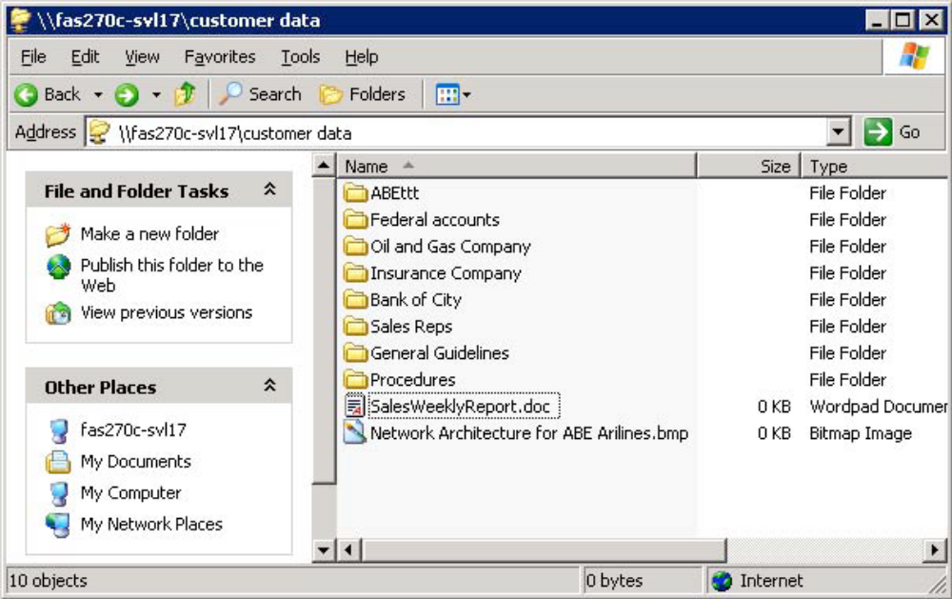
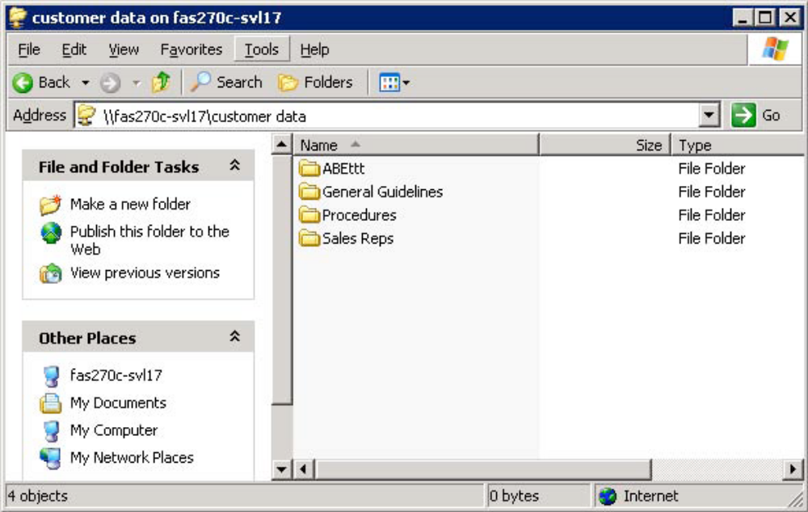
Access-Based Enumeration (Cont.)
Without ABE
With ABE
Notes:
ACCESS-BASED ENUMERATION (CONT.)
The two figures illustrate how ABE affects the Data ONTAP directory listing. In the first figure, all the folders under the share “customer data” are visible to the user, even though the user does not have access to some of the folders containing sensitive information. In the bottom figure, after enabling ABE on this share, users can see only the folders to which they have access.

Slide 35
Module Summary
Notes:
MODULE SUMMARY

Slide 36
Module Summary
In this module, you should have learned to:
Create and manage local users for a storage system
Identify how to create a local group and make a local user a member of that group
Use the command-line interface, NetApp System Manager or Microsoft tools to add, delete, and modify access permissions of shares
Use Microsoft tools to add, delete, and modify access permissions of files and folders
Notes:
MODULE SUMMARY

Slide 37
Exercise
Module 8: CIFS Access Control
Estimated Time: 30 minutes
Notes:
EXERCISE
Please refer to your Exercise Guide for more instruction.

Slide 38
Check Your Understanding
What is the purpose of a local administrator account on a storage system, and why does cifs setup recommend creating one?
What does it mean when a storage system is configured for multiprotocol access?
What command adds local users and groups to the storage system?
Notes:
CHECK YOUR UNDERSTANDING

Slide 39
Answers
Module 8: CIFS Access Control
Notes:
ANSWERS
Please refer to your Exercise Guide for more instruction.

Slide 40
Check Your Understanding: Answers
What is the purpose of a local administrator account on a storage system, and why does cifs setup recommend creating one?
  The local administrator can administer CIFS access to
  the storage system when the domain controller is down
What does it mean when a storage system is configured for multiprotocol access?
  Any file can be accessed by NFS (UNIX users) and CIFS
  (Windows users) protocols; both NFS and CIFS must be licensed
What command adds local users and groups to the storage system?
  useradmin
Notes:
CHECK YOUR UNDERSTANDING: ANSWERS

