Slide 1
FC Connectivity
Module 13
Accelerated NCDA Boot Camp
Data ONTAP 8.0 7-Mode
Notes:
FC CONNECTIVITY

Slide 2
Module Objectives
By the end of this module, you should be able to:
Describe multiple path implementation with Fibre Channel (FC) connectivity
Describe how to configure FC ports on Windows®, for Red Hat®, and NetApp® systems
Describe commands and utilities to identify the worldwide node name (WWNN) and worldwide port name (WWPN) on Windows, Red Hat, and NetApp systems
Notes:
MODULE OBJECTIVE

Slide 3
FC Connectivity Configuration
The following are the steps to configure FC SAN:
Determine the FC topology
Verify host HBA configuration, drivers, firmware, cables, and multipathing software
Configure the switch (if in the topology)
Configure the target(s)
Configure the initiator(s)
Cable the devices together
Implement FC zoning (if required)
Notes:
FC CONNECTIVITY CONFIGURATION

Slide 4

Data ONTAP
Notes:
DATA ONTAP

Slide 5
High-Availability
The exercise environment’s storage systems have been configured as a high-availability pair
To configure controller failover:
  system and system2> license add xxxxxx
  system and system2> reboot
  system> cf enable
Notes:
HIGH-AVAILABILITY

Slide 6
Data ONTAP as an FC Target
Data ONTAP® 6.3 and later has support for FC
Data ONTAP features:
  Built-in FC functionality
  Simple LUN creation and management
To properly configure Data ONTAP for FC connectivity:
  Confirm FC HBA(s) and port(s)
  Configure and verify Fibre Channel protocol
  Configure the FC Target HBA(s)
  Identify the worldwide node name (WWNN)
  Identify the worldwide port name (WWPN)
Notes:
DATA ONTAP AS AN FC TARGET

Slide 7
HBA Confirmation
Confirm the current HBAs:
system> sysconfig -a
To identify the type of the on-board FC ports:
system> fcadmin config
Local
Adapter Type State Status
------------------------------------------------
0a initiator CONFIGURED online
0b initiator CONFIGURED online
0c initiator CONFIGURED online
0d initiator CONFIGURED online
NOTE: Add-on cards are configured to be either an initiator or target and cannot be changed
Notes:
HBA CONFIRMATION
The fcadmin utility manages the Fibre Channel adapters used by the storage subsystem. Use these commands to show link-level and loop-level protocol statistics, list the storage devices connected to the storage system, and configure the personality of embedded adapters.

Slide 8
HBA Confirmation (Cont.)
Down the interface
Reconfigure the interface as a target
A reboot is required
To change an onboard interface from an initiator to a target:
system> fcadmin config -d 0b
system> fcadmin config -t target 0b
system> reboot
To change an onboard interface from a target to an initiator:
system> fcadmin config -d 0b
system> fcadmin config -t initiator 0b
system> reboot
Notes:
HBA CONFIRMATION (CONT.)

Slide 9
Configuring FC Services in Data ONTAP
Verify Fibre Channel protocol service is running:
  fcp status
Verify FC is licensed (license the FC services if needed):
  license
  license add XXXXXX
Start the FC service:
  fcp start
Notes:
CONFIGURING FC SERVICES IN DATA ONTAP

Slide 10
Configuring FC HBA in Data ONTAP
List the installed target HBAs:
  fcp show adapters
Take an HBA offline:
  fcp config adapter down
Set target HBA speed to the FC switch port’s speed to improve takeover and giveback performance:
  fcp config adapter speed [auto|1|2|4]
Bring an HBA online:
  fcp config adapter up
Notes:
CONFIGURING FC HBA IN DATA ONTAP

Slide 11
Identify WWNN in Data ONTAP
Data ONTAP 7.3.1.1
and later
WWNN uniquely identifies the storage system
  The default WWNN is generated by a serial number in its NVRAM and stored on disk
    Normally doesn’t need to be changed
To identify the WWNN:
system> fcp nodename
Fibre Channel nodename: 50:0a:09:80:86:f7:c7:86
(500a098086f7c786)
To change the WWN:
system*> fcp nodename new_nodename
Notes:
IDENTIFY WWNN IN DATA ONTAP

Slide 12
Identify WWPN in Data ONTAP
Use fcp portname
show -v to list available WWPNs
WWPN uniquely identifies an FC HBA port
WWPNs are determined by:
  WWNN
  Controller failover mode (cfmode)
  Internal port index
To verify the default WWPN:
system> fcp portname show
Portname Adapter
-------- -------
50:0a:09:81:86:f7:c7:86 0c
50:0a:09:82:86:f7:c7:86 0d
To change a WWPN:
system> fcp portname set adapter
Notes:
IDENTIFY WWPN IN DATA ONTAP
Within Fibre Channel (FC) SAN, worldwide port names (or WWPNs) uniquely identify each Fibre Channel port. Each 64-bit name is determined by three factors. The first factor is the worldwide node name (WWNN), which is the unique identifier for the NetApp storage system running as an FC target device server. The second factor is the controller failover mode (cfmode) currently set on the NetApp storage system. The third and final factor is that each FC target port has an internal port index range that assists in assigning the WWPNs.

Slide 13
FC cfmodes Defined
Controller failover mode (cfmode) determines how HBAs of storage systems in an high-availability configuration:
  Log in to the fabric
  Provide access to local and partner LUNs
Both storage systems in the active-active configuration must have the same settings
  fcp show cfmode to verify current setting
  fcp set cfmode to set the cfmode
    Requires advanced mode to set cfmode
    priv set advanced
Notes:
FC CFMODES DEFINED
Cfmode only applies to Fibre Channel environments in an high-availability NetApp storage controller configuration. The cfmode determines how target ports do the following:
Log in to the fabric
Handle local and partner traffic for a cluster
Provide access to local and partner LUNs in a cluster
In the original release of Data ONTAP 6.3, which included SAN support for Fibre Channel, cfmode standby was the implied default. There was not a setting for cfmode in that release, and it was not called cfmode standby. However, when Data ONTAP 6.5 was released, four cfmodes were introduced. One of these modes was standby. The others were partner, mixed, and dual fabric. In Data ONTAP 7.1, a new cfmode called single system image (SSI) became available. SSI is the default cfmode for new installations with Data ONTAP 7.2. The availability of standby, partner, mixed, and dual fabric modes is dependent on the storage controller model, Data ONTAP version, and/or the use of 2-Gb or 4-Gb FC ports. With Data ONTAP 7.3 and later, the only configurable cfmode is single system image.

Slide 14
FC cfmode Types
Prior to Data ONTAP 7.3, there were five types of cfmodes:
cfmode | Supported Systems | Benefits and Limitations
standby | All systems except the FAS270c, FAS20x0, FAS31x0, FAS6040, FAS6080, and FAS6030 and FAS6070 with a 4-Gb or 8-Gb FC adapter | Requires more switch ports Supports only Windows and Solaris™ hosts
partner | All systems except the FAS270c, FAS20x0, FAS3040, FAS3070, FAS31x0, FAS60x0, and any FAS system with a 4-Gb or 8-Gb target FC adapter | Supports all host OS types Supports all switches
dual_fabric | FAS270c only | Supports all host OS types Requires fewer switch ports Does not support all switches; requires switches that support public loop
mixed | All systems except the FAS270c, FAS20x0, FAS30x0, FAS31x0, FAS6040, FAS6080, and FAS6030 and FAS6070 with a 4-Gb or 8-Gb FC adapter | Supports all operating systems Does not support all switches; requires switches that support public loop
single_image | All systems | Supports all host OS types Supports all switches Makes all LUNs available on all target ports
Notes:
FC CFMODES TYPES
There are five possible cfmodes on the storage controller. Only one cfmode can be set per each storage controller, and in a cluster situation the cfmode must be the same for both systems.
Standby
The standby mode is supported on all systems except the FAS270c. It supports only Windows and Solaris operating systems. In addition, this mode requires additional switch ports.
Partner
The partner mode is supported on all systems except the FAS270c and the FAS6000 series. All switches and host operating systems are supported.
Dual-Fabric
The dual-fabric mode is only supported on a FAS270c. All host operating systems are supported by this mode. This mode requires a switch that supports a public loop.
Mixed
The mixed mode is supported on all systems except the FAS270c and the FAS6000 series. Mixed mode supports all host operating systems, but requires a switch that supports a public loop.
Single Image
The single image mode is supported on all systems, switches, and host operating systems. This mode makes all LUNs available on all target ports.

Slide 15
FC cfmodes Types (Cont.)
Data ONTAP 7.3 and later supports only single_image cfmode
  Partner and standby are supported only on upgrades of existing systems that currently support and use these cfmodes modes
  After an upgrade to Data ONTAP 7.3 or later, a storage system pair may only be (re)configured to single_image
single_image cfmode
  Each high-availability pair has a single WWNN, allowing both storage systems in the active-active configuration to function as a single Fibre Channel storage system
  All LUNs in a high-availability configuration are available on all ports in the high-availability pair
  Multipathing software is required
Notes:
The single_image cfmode setting is available in Data ONTAP 7.1. This cfmode setting is the default for new installs Data ONTAP 7.2 and later. Upgrades to Data ONTAP 7.2 will retain the cfmode from the previous version. In SSI cfmode, an high-availability storage controller configuration has a single WWNN, and both systems in the configuration function as a single Fibre Channel node. Each node in the cluster shares the partner node’s LUN map information.
All LUNs in the cluster are available on all ports in the cluster by default. As a result, more paths to each LUN are stored on the cluster. Any port can provide access to both local and partner LUNs. You can specify the LUNs available on a subset of ports by defining port sets and binding them to an igroup. Any host in the igroup can then access the LUNs only by connecting to the target ports in the port set.

Slide 16



Single Image Example
Host
Fabric 1
Fabric 2
Solid blue lines are paths to the LUNs being served by Controller 1
0c
0d
0c
0d
Dashed green lines are paths to the LUNs being served by Controller 2
High-Availability
Configuration
Controller 1
Controller 2
LUNs
LUNs
Multipathing software required
Notes:
LUNs from both controllers are visible through a single physical (and logical) port.
A single FC port is a primary path for a LUN served by that controller and a secondary path for a LUN on the partner controller.

Slide 17
Single Image Example (Cont.)
Host
Switch/Fabric 1 will experience a failure
MP layer works around the failure
x
Fabric 1
Fabric 2
Solid blue lines are paths to the LUNs being served by Controller 1
0c
0d
0c
0d
Dashed green lines are paths to the LUNs being served by Controller 2
High-Availability
Configuration
Controller 1
Controller 2
LUNs
LUNs
Multipathing software required
Notes:
Switch 1 experiences a failure. The host multipathing software layer works around that failure to reroute the I/O through Fabric 2 to the LUN.

Slide 18
Single Image Example (Cont.)
Host
Controller 1 will experience a failure
Controller 2 takes over all operations MP layer works around the failure
Fabric 1
Fabric 2
Solid blue lines are paths to the LUNs being served by Controller 1
x
0c
0d
0c
0d
Dashed green lines are paths to the LUNs being served by Controller 2
High-Availability
Configuration
Controller 1
Controller 2
LUNs
LUNs
Multipathing software required
Notes:
When Controller 1 experiences a failure, Controller 2 takes over all operations. The host multipathing software layer works around the failure by rerouting I/O through the Controller 2 path to the LUN.

Slide 19
Single Image Example (Cont.)
Host
Loop Mode
Loop Mode
Solid blue lines are paths to the LUNs being served by Controller 1
0c
0d
0c
0d
Dashed green lines are paths to the LUNs being served by Controller 2
High-Availability
Configuration
Controller 1
Controller 2
LUNs
LUNs
Multipathing software required
Notes:
Single system image does support this configuration. SSI allows ports to alternate between fabric point-to-point login and individual loop. All LUNs are available on a single port in the event that one of the links fails.

Slide 20
fcp config (Single System Image Mode)
system or system2> fcp nodename
Fibre Channel nodename: 50:0a:09:80:86:f7:c7:86 (500a098086f7c786)
system or system2> fcp show cfmode
fcp show cfmode: single_image
system> fcp config
0c: ONLINE <ADAPTER UP> PTP Fabric
host address 011000
portname 50:0a:09:81:96:f7:c7:86 nodename 50:0a:09:80:86:f7:c7:86
mediatype auto speed auto
0d: ONLINE <ADAPTER UP> PTP Fabric
host address 011100
portname 50:0a:09:82:96:f7:c7:86 nodename 50:0a:09:80:86:f7:c7:86
mediatype auto speed auto
system2> fcp config
0c: ONLINE <ADAPTER UP> PTP Fabric
host address 011200
portname 50:0a:09:81:86:f7:c7:86 nodename 50:0a:09:80:86:f7:c7:86
mediatype auto speed auto
0d: ONLINE <ADAPTER UP> PTP Fabric
host address 011300
portname 50:0a:09:82:86:f7:c7:86 nodename 50:0a:09:80:86:f7:c7:86
mediatype auto speed auto
Notes:
FCP CONFIG (SINGLE SYSTEM IMAGE MODE)
This is an example of the adapter settings for single_image cfmode. Notice that all node names are identical and that the media type is set to auto. This means that the ports log in to the fabric using point-to-point mode. If point-to-point mode fails, then the ports will try loop mode.

Slide 21
Windows
Notes:
WINDOWS

Slide 22
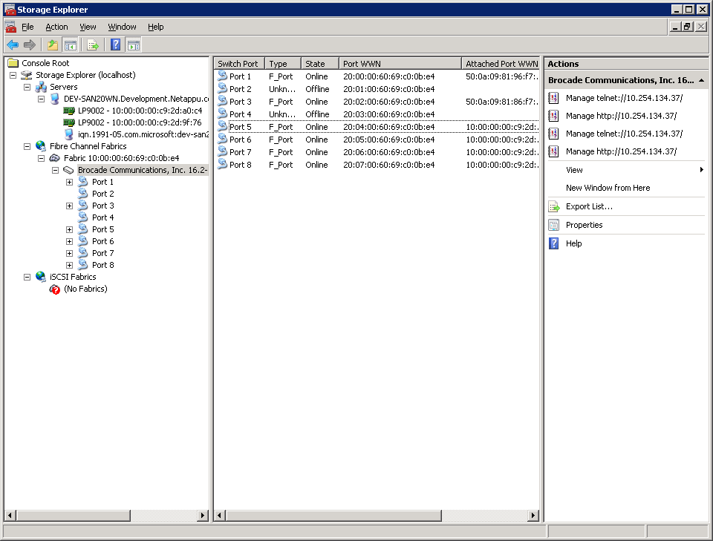
Windows as an FC Initiator
NetApp has supported Windows as an FC initiator OS since Windows 2000 Server
Windows Server 2008 has many advantages over previous versions
  New tools
    Storage Explorer
    Storage Manager for
    SANs
  Multipath I/O (MPIO)
  Built-in FC drivers
Windows must be properly configured for FC connectivity
Notes:
WINDOWS AS AN FC INITIATOR
Windows Server 2008 provides many new features that make configuring an FC SAN easier. Storage Explorer provides a one-stop interface for investigating local HBAs as well as the FC switches, if present. Storage Manager for SANs is an additional tool that is available in Windows Server 2003 R2 and later. This tool allows the configuration of a SAN environment. Storage Manager for SANs requires the Virtual Disk Service add-in provided by NetApp at the NOW™ (NetApp on the Web) site.

Slide 23
Windows FC Design and Installation
Verify host operating system releases, required patches, and NetApp Windows Host Utility Kit with Interoperability Matrix:
  Use System Properties dialog to verify release
Install compatible host bus adapters (HBAs).
Install and configure required HBA drivers and utilities.
Verify an HBA:
  Emulex®: Use HBAnyware®
  QLogic®: Use SANsurfer
  All HBA Types: Device Manager Dialog
Install compatible NetApp Windows Host Utility Kit:
  Provides Perl scripts to diagnose and troubleshoot Windows
  Example: windows_info provides diagnostic information
Notes:
WINDOWS FC DESIGN AND INSTALLATION
Host utilities contain software tools and documentation that allow you to configure a host in a NetApp SAN environment.
NOTE: Host utilities were formerly called Host Attach and Support Kits. Kits that were released before this naming convention changed are still called Host Attach and Support Kits. The term host utilities will be used in this course, but be aware that NetApp is in the process of transitioning to this name.
Host utilities are available from the Download Software page on the NOW site at: now.netapp.com/NOW/cgi-bin/software.

Slide 24
Windows Implementation
After installation, to configure a Windows Emulex
or QLogic implementation:
Verify the HBA is enabled
Identify the WWNN on the host HBA(s)
Identify the WWPN on the host HBA(s)
Verify connectivity between the initiator(s) and target
Notes:
WINDOWS IMPLEMENTATION

Slide 25
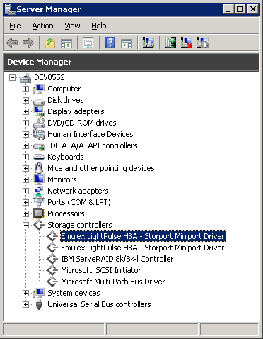
Windows/Emulex Implementation
Within Device Manager
Select Storage controllers
Enabled Emulex HBAs
Double-click to investigate
Verify that Windows Server 2008 has identified the HBA(s)
Notes:
WINDOWS/EMULEX IMPLMENTATION

Slide 26
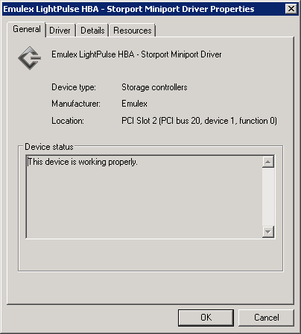
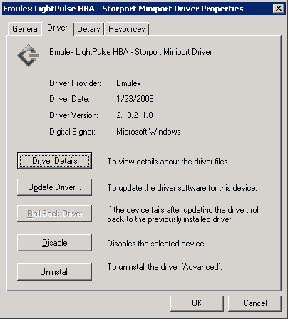
Windows/Emulex Implementation (Cont.)
Other HBAs will be at
a different location
For more
information
Identify the driver associated with the HBA(s)
Notes:
WINDOWS/EMULEX IMPLMENTATION (CONT.)

Slide 27
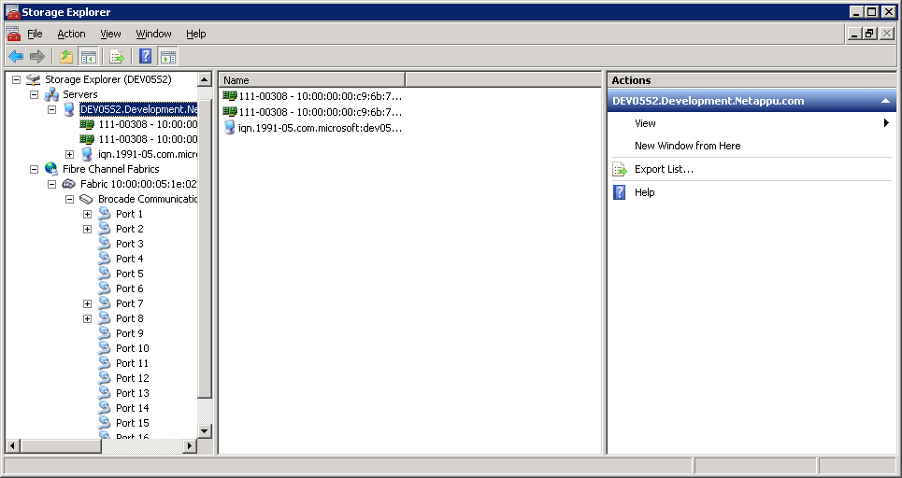
Windows/Emulex Implementation (Cont.)
Locate the correct server
In this example, two Emulex HBAs are installed
Verify the HBA(s) is connected on Windows Server 2008
Notes:
WINDOWS/EMULEX IMPLMENTATION (CONT.)

Slide 28
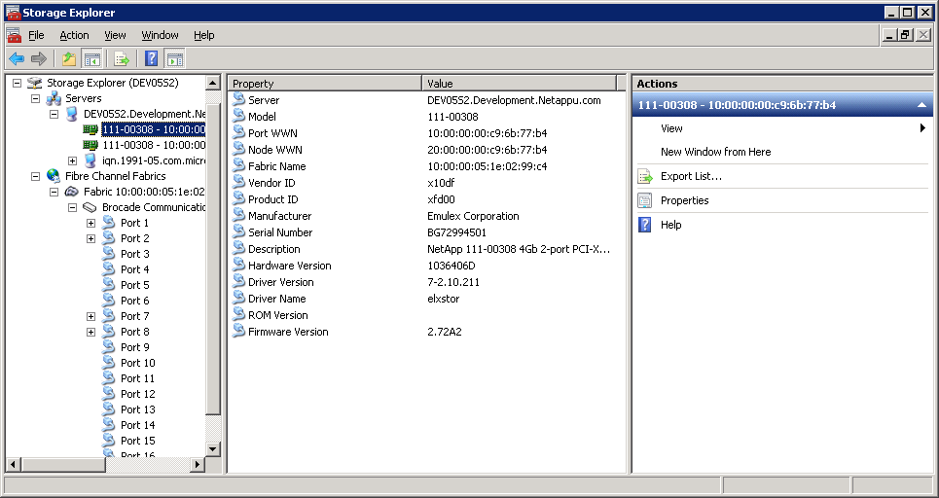
Windows/Emulex Implementation (Cont.)
Select one of the HBAs
The WWPN
The WWNN
Identify the local WWPN(s) on Windows Server 2008
Notes:
WINDOWS/EMULEX IMPLMENTATION (CONT.)

Slide 29

Discovery
Initiator
Fibre Channel
When ports are active (and properly zoned), discovery is automatic
Fibre Channel
Target
Notes:
DISCOVERY
Within FC SAN, discovery is automatic unless switch zoning prevents it. See Appendix 1 for a discussion about switch zoning.

Slide 30
Data ONTAP Discovery of Initiators
Windows WWPN
Verify connectivity from the storage system:
system> fcp show initiators
Initiators connected on adapter 0c:
Portname Group
-------- -----
10:00:00:00:c9:6b:77:b4
NOTE: For convenience, you may assign an alias to the Windows WWPN
Notes:
DATA ONTAP DISCOVERY OF INITIATORS

Slide 31
WWPN Aliases
In large FC installations, it can be difficult to identify WWPNs because of their cryptic 64-bit name
  Example: 10:00:00:00:c9:6b:77:b4
For convenience, WWPN may be assigned a name or “alias” within Data ONTAP
Both target and initiator ports may be aliased
Notes:
WWPN ALIASES
One common problem administrators face in large Fibre installations is determining how to distinguish between WWPNs due to their cryptic 64-bit naming conventions. Now with Data ONTAP 7.3 and later, administrators can rename or “alias” a WWPN with a more convenient name to assist in easy identification. Aliases may be used for both target and initiator ports.

Slide 32
fcp wwpn-alias Command
To alias a WWPN:
  Use fcp wwpn-alias set [-f] alias wwpn
  Example:
  system> fcp wwpn-alias set WIN1-FC
  10:00:00:00:c9:6b:77:b4
To remove an alias:
  Use fcp wwpn-alias remove {-a alias…|-w wwpn}
  Example:
  system> fcp wwpn-alias remove -a WIN1-FC WIN2-FC
  (removes the aliases)
  system> fcp wwpn-alias remove -w
  10:00:00:00:c9:6b:77:b4
  (removes all aliases for a particular WWPN)
To show aliases:
  Use fcp wwpn-alias show [-a alias | -w wwpn]
Notes:
FCP WWPN-ALIAS COMMAND
To alias a WWPN, an administrator must use the new fcpwwpn-alias set command. The -f switch can be used to force or reassign an existing alias to a new WWPN. The new WWPN may have multiple aliases, but only one alias can be assigned to a single WWPN.
To remove an alias, an administrator may use either the -a switch to remove one or more particular aliases or the -w switch to remove all aliases for a given WWPN with the new fcpwwpn-alias remove command.
To verify all aliases, an administrator may use the fcpwwpn-alias show command. The administrator can then limit the alias return by requesting to see only a particular alias with the -a switch or a particular WWPN with the -w switch.

Slide 33
Alias Rules
A storage system can have up to 1,024 aliases
An alias can have the following characters:
A-Z, a-z, 0-9, '_','-','.','{','}' and no spaces
Many aliases may be associated with a single WWPN, but each alias will be assigned to only one WWPN
Use fcp wwpn-alias help subcommand for more information on the subcommand
Notes:
ALIAS RULES
The following rules apply to WWPN aliases:
A storage system can have up to 1,024 aliases.
An alias can have the following characters: A-Z, a-z, 0-9, '_', '-', '.', '{', and '}', but no spaces.
Many aliases may be associated with a single WWPN, but each alias will be assigned to only one WWPN.
Use the fcpwwpn-alias help <subcommand> function for more information on a particular subcommand.

Slide 34
WWPN Aliases Example
system> fcp wwpn-alias set WIN1-FC
10:00:00:00:c9:6b:77:b4
system> fcp wwpn-alias show
WWPN Alias
---- -----
10:00:00:00:c9:6b:77:b4 WIN1-FC
system> fcp show initiators
Initiators connected on adapter 0c:
Portname Group
-------- -----
10:00:00:00:c9:6b:77:b4
WWPN Alias(es): WIN1-FC
Notes:
WWPN ALIASES EXAMPLE

Slide 35
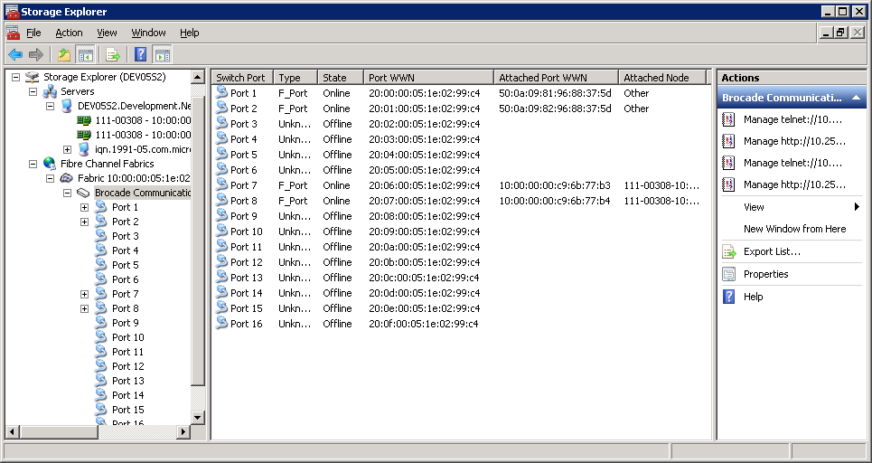
Windows Discovery of Targets
Storage systems’ WWPNs show up
Windows WWPNs show up
Select the Brocade® fabric
Verify connectivity on Windows Server 2008
Notes:
WINDOWS DISCOVERY OF TARGETS

Slide 36
Binding
Binding or mapping in FC SAN is the process of associating an OS device name to a target’s worldwide port name
Persistent binding in FC SAN is the process of ensuring that the same binding occurs even after a host OS reboot
NOTE: Binding is done automatically in most modern OS; therefore, it does not need to be manually configured
Notes:
BINDING

Slide 37
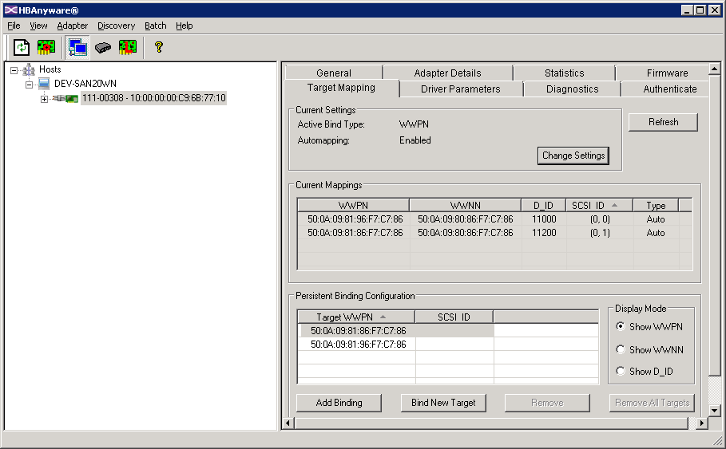
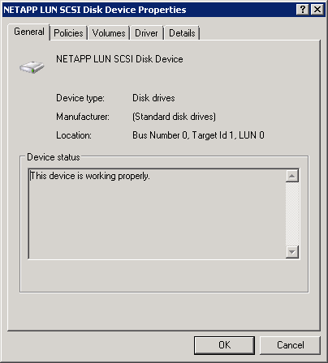
Window/Emulex Binding
Select
Current
SCSI IDs
From Device Properties ...
Current
Bindings
Do not use
persistent
binding
SCSI ID = Bus Number, Target ID
Notes:
WINDOW/EMULEX BINDING
There are no native Windows Server 2003 or 2008 tools for verifying binding of an initiator and one or more targets. Therefore, an administrator must use third-party tools such as HBAnyware from Emulex.
NOTE: FC-persistent binding is not supported by NetApp.

Slide 38
Command-Line Interface for Server Core
Command-line interface commands for FC management is available for the HBA vendors
  Emulex: hbacmd
  QLogic: scli
Commands available to:
  Verify connectivity
  Interrogate the fabric
  Manage bindings
  Verify configuration
  Administrate VPORTs
Notes:
COMMAND-LINE INTERFACE FOR SERVER CORE

Slide 39
Multipath I/O
Notes:
MULTIPATHING I/O

Slide 40

Multiple Paths to a LUN
Windows Server 2008 R2
6
7
Switch
port
0c - 0
0d - 1
0c - 2
0d - 3
Storage System 1
Storage System 2
Fibre Channel
Notes:
MULTIPLE PATHS TO A LUN

Slide 41
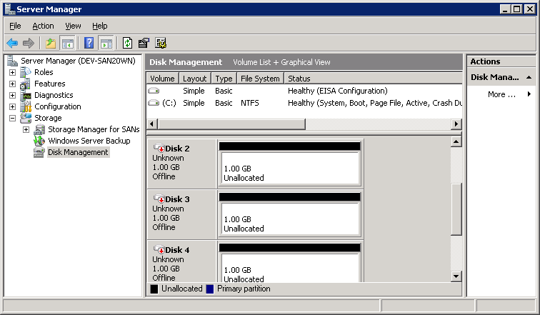
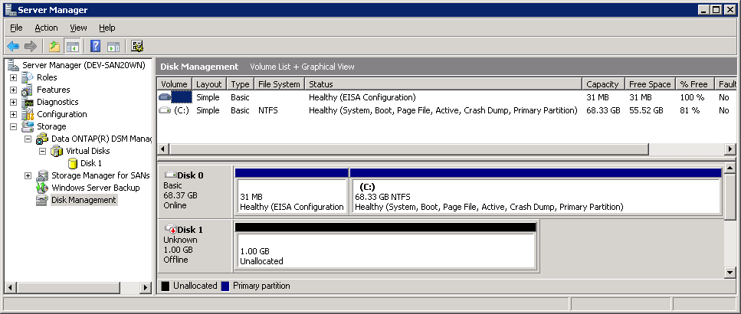
Multiple Paths
When multiple paths are present to a LUN, the same LUN would appear multiple times
  The same LUN would appear a single instance for each path available
Without multipathing software
With multipathing software
Notes:
MULTIPLE PATHS

Slide 42
Optimized or Non-Optimized Paths
Not all paths are necessarily equal
  Optimized or primary or favored = active path between initiator and target
    Same latency level
  Non-optimized or secondary or unfavored = inactive path between initiator and target
    Latency differs between path
Notes:
OPTIMIZED OR NON-OPTIMIZED PATHS

Slide 43
Multipath Access
Symmetric
  All paths are favored or optimized
Asymmetric
  Only certain paths are favored or optimized
But how
do you determine
which path to use?
0c
0d
0c
0d
LUN
Notes:
MULTIPATH ACCESS

Slide 44
Windows Multipath FC Implementation
Storage management software available for Windows:
  Native Windows Disk Management
  Veritas™ Storage Foundation
When possible, use the NetApp DSM and do not enable ALUA on the igroup
  system> igroup set my_igroup alua off
Native Disk Management in W2K8 will use ALUA by default with Microsoft® native Device Specific Module (DSM); enable ALUA on the igroup
  system> igroup set my_igroup alua on
This course focuses on native Disk Management, NetApp DSM, and Emulex HBAs
Pre-defined igroup
Default is off
Notes:
WINDOWS MULTIPATH FC IMPLEMENTATION

Slide 45
ALUA Output
Example:
  system> igroup show -v
iWIN1_fcp (FCP) (ostype: windows):
10:00:00:00:c9:6b:77:b3 (logged in on: 0b, 0d)
WWPN Alias(es): dev05s1-fc1
iWIN2_fcp (FCP) (ostype: windows):
10:00:00:00:c9:6b:77:b4 (logged in on: 0d, 0b)
WWPN Alias(es): dev05s2-fc1
ALUA: YES
No ALUA
ALUA enabled
Notes:
ALUA OUTPUT

Slide 46
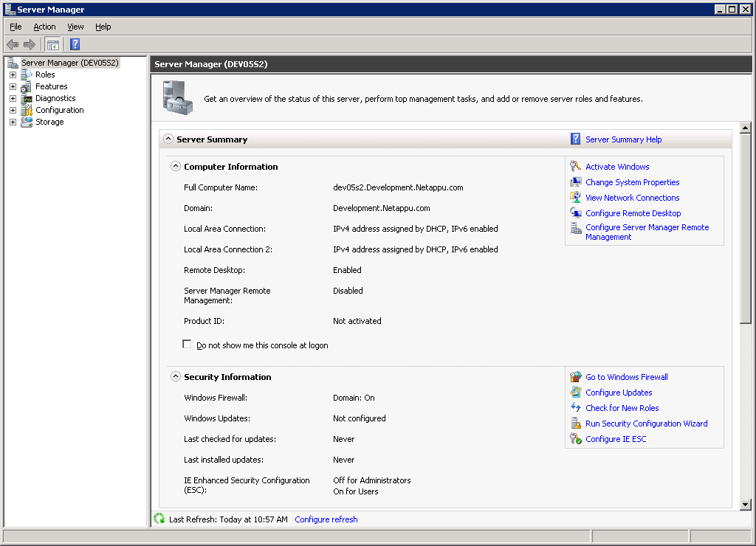
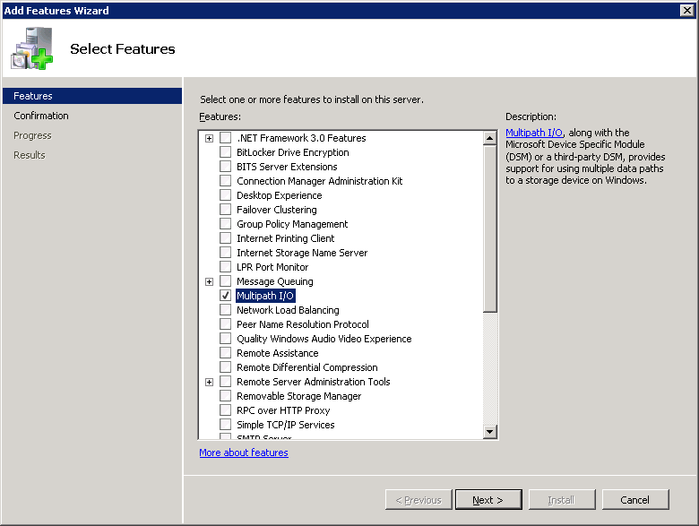
Windows Native Multipath I/O
Windows Server 2008 can be configured to support Multipath I/O
Right-click Features and select Add Feature
Multipath I/O added
No need for a
reboot in R2
Notes:
WINDOWS NATIVE MULTIPATH I/O

Slide 47
Windows Native Multipath I/O (Cont.)
Out of the box, Windows multipath I/O comes with a generic DSM
NetApp recommends installing the NetApp Data ONTAP DSM
  Verify with Interoperability Matrix for the recommended version
Notes:
WINDOWS NATIVE MULTIPATH I/O (CONT.)

Slide 48
NetApp Data ONTAP DSM 3.3.1
Features:
  Supports Windows Server 2008 R2
  Supports multiple load-balancing policies
  Support for claiming iSCSI LUNs
  Coexists with other DSMs
  Multiprotocol LUN support (simultaneous iSCSI and FC paths to the same LUN)
Requirements:
  Windows Server 2003 or 2008 or 2008 R2
  Data ONTAP 7.2.2+
Notes:
NETAPP DATA ONTAP DSM 3.3.1
The Data ONTAP DSM for Windows MPIO is a Device Specific Module (DSM) that works with the Microsoft Windows MPIO drivers (mpdev.sys, mpio.sys, and mpspfltr.sys) to manage multiple paths between NetApp & IBM® N series storage systems and Windows host computers. The DSM includes the storage-system-specific intelligence needed to correctly identify paths and to manage path failure and recovery.

Slide 49
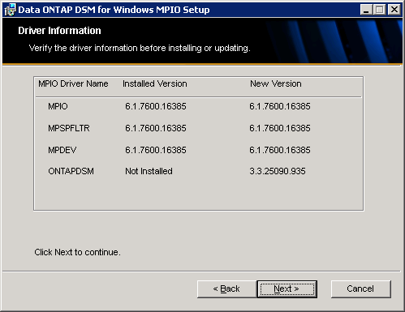
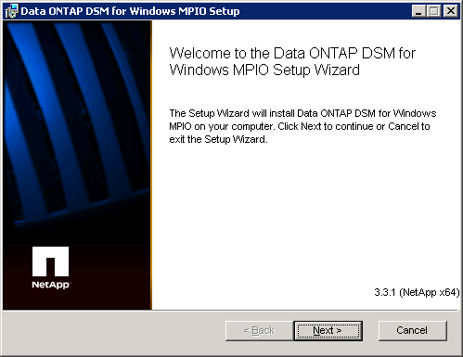
Install NetApp DSM
Notes:
INSTALL NETAPP DSM

Slide 50
Red Hat
Notes:
RED HAT

Slide 51
Red Hat as an FC Initiator
NetApp has supported Red Hat as an FC initiator OS since Red Hat 3
Red Hat 5.3 has many advantages over previous versions:
  Updated FC and iSCSI drivers
  Better scalability
Red Hat must be properly configured for FC connectivity
Notes:
RED HAT AS AN FC INITIATOR

Slide 52
Red Hat 5.3 Design and Installation
Verify host operating system releases, required patches, and NetApp Linux® Host Utility Kit with Interoperability Matrix:
  Use /etc/redhat-release and uname -a to verify Red Hat version
  Interoperability Matrix can be found on the NOW site
Install compatible host bus adapters (HBAs).
Install and configure required HBA drivers and utilities if needed.
Verify an HBA:
  All HBA Types: lspci
  Emulex: Use /usr/sbin/lpfc/lputil or HBAnyware
  QLogic: Use /usr/bin/scli or SANsurfer
Notes:
RED HAT 5.3 DESIGN AND INSTALLATION

Slide 53
Red Hat/Emulex Implementation
After installation, to configure a Red Hat/Emulex
implementation:
Identify the correct HBA driver
Verify that Red Hat has correctly identified the HBA and loaded the driver
Identify the WWNN and WWPN on the host
Verify connectivity between the initiator and target
Notes:
RED HAT/EMULEX IMPLEMENTATION

Slide 54
Red Hat/Emulex Implementation (Cont.)
Emulex HBA(s) or in this case one HBA with two ports
# cat fwrev
2.72A2 (B3F2.72A2), sli-3
NetApp part number
of NetApp sold HBAs
# cat lpfc_drvr_version
Emulex LightPulse
Fibre Channel SCSI
driver 8.2.0.33.3p
Current installed driver
Verify that Red Hat has identified the HBA(s)
# cd /sys/class/scsi_host
# ls
host0 host1 host2
Identify the driver associated with the HBA(s)
# cd host1
# ls
... fwrev
... modeldesc
... modelname
... npiv_info
... portnum
... serialnum
... lpfc_drvr_version
Notes:
RED HAT/EMULEX IMPLEMENTATION (CONT.)

Slide 55
Red Hat/Emulex Implementation (Cont.)
Interoperability Matrix requires an update to driver based upon existing firmware:
  # tar zxf lpfc_2.6_driver_kit-8.2.0.39-1.tar.gz
  # cd lpfc_2.6_driver_kit-8.2.0.39-1
  # ./lpfc-install ...
  # reboot
The driver can be found here:
  # ls /lib/modules/2.6.18-128.el5/kernel/drivers/scsi/lpfc
  lpfc.ko
To verify the driver when loaded:
  # modprobe -c | grep lpfc
To load the driver (if needed):
  # modprobe -v lpfc
The kernel build
number of Linux
Notes:
RED HAT/EMULEX IMPLEMENTATION (CONT.)

Slide 56
Red Hat/Emulex Implementation (Cont.)
Install compatible Linux Host Utility Kit (HUK)
  Provides Perl scripts to configure and tune Red Hat
    Example: sanlun application to manage LUNs from Red Hat
  HUK requires packages to be installed:
    libnl.so = libnl-1.0-0.10.pre5.5.x86_64.rpm
    libnl.so = libnl-1.0-0.10.pre5.5.i386.rpm
    HBAnyware = elxlinuxapps-4.0a31-8.2.0.39-1-1.tar
Use 64-bit
version
Use 32-bit
version
NOTE: You must install these libraries in this order
Notes:
RED HAT/EMULEX IMPLEMENTATION (CONT.)

Slide 57
Red Hat/Emulex Implementation (Cont.)
Install HBAnyware:
  # tar xvf elxlinuxapps-4.0a31-8.2.0.39-1-1.tar
  # cd elxlinuxapps-4.0a31-8.2.0.39-1-1
  # ./install
  Select desired mode of operation for HBAnyware
  1 Local Mode : HBA's on this Platform can be managed by
  HBAnyware clients on this Platform Only.
  2 Managed Mode: HBA's on this Platform can be managed by
  local or remote HBAnyware clients.
  3 Remote Mode : Same as '2' plus HBAnyware clients on this
  Platform can manage local and remote HBA's.
  ...
Notes:
RED HAT/EMULEX IMPLEMENTATION (CONT.)

Slide 58
Red Hat/Emulex Implementation (Cont.)
Install HUK:
  # tar zxf netapp_linux_host_utilities_5_0.tar.gz
  # cd netapp_linux_host_utilities_5_0
  # ./install
  # cd /opt/netapp/santools
  # ./san_version
  NetApp Linux Host Utilities version 5.0
Identify WWPN of HBA(s):
  # cd /opt/netapp/santools
  # sanlun fcp show adapters
  host1 WWPN:10000000c96b77b4
  host2 WWPN:10000000c96b77b3
  or
  # cat /sys/class/fc_host/host1/port_name
  0x10000000c96b77b4
Same as
/sys/class/scsi_host
Notes:
RED HAT/EMULEX IMPLEMENTATION (CONT.)

Slide 59
Discovery and Session Creation
Initiator
Fibre Channel
When ports are active (and properly zoned), discovery is automatic
Fibre Channel
Target
Notes:
DISCOVERY AND SESSION CREATION

Slide 60
Data ONTAP Discovery of Initiators
Red Hat WWPNs
Verify connectivity from the storage system:
system> fcp show initiators
Initiators connected on adapter 0c:
Portname Group
-------- -----
10:00:00:00:c9:6b:77:b3
10:00:00:00:c9:6b:77:b4
NOTE: For convenience, alias the Red Hat WWPNs
Notes:
DATA ONTAP DISCOVERY OF INITIATORS

Slide 61
Module Summary
Notes:
MODULE SUMMARY

Slide 62
Module Summary
In this module, you should have learned to:
Describe multiple path implementation with Fibre Channel (FC) connectivity
Describe how to configure FC ports on Windows, Red Hat, and NetApp systems
Describe commands and utilities to identify the worldwide node name (WWNN) and worldwide port name (WWPN) on Windows, Red Hat, and NetApp systems
Notes:
MODULE SUMMARY

Slide 63
Exercise
Module 13: FC Connectivity
Estimated Time: 0 minutes
Notes:
EXCERCISE
Please refer to your Exercise Guide for more instruction.

Slide 64
Check Your Understanding
Using Data ONTAP 8.0 7-Mode, which cfmode(s) can you configure a new storage system?
What two FC multipathing software stacks are available for Windows?
Which three software libraries are required for the sanlun command function in the Linux Host Utilities Kit?
Administrators should use what tool, provided by NetApp and available on the NOW site, to verify their Red Hat configuration?
Notes:
CHECK YOUR UNDERSTANDING

Slide 65
Answers
Module 13: FC Connectivity
Notes:
ANSWERS
Please refer to your Exercise Guide for more instruction.

Slide 66
Check Your Understanding: Answers
Using Data ONTAP 8.0 7-Mode, which cfmode(s) can you configure a new storage system?
  single_image
What two FC multipathing software stacks are available for Windows?
  Veritas and Native Windows
Which three software libraries are required for the sanlun command function in the Linux Host Utilities Kit?
  HBAnyware and 32-bit and 64-bit version of libnl.so
Administrators should use what tool, provided by NetApp and available on the NOW site, to verify their Red Hat configuration?
  Interoperability Matrix Tool
Notes:
CHECK YOUR UNDERSTANDING: ANSWERS

