Slide 1
Protection Manager Overview
Appendix A
Accelerated NCDA Boot Camp
Data ONTAP 8.0 7-Mode
Notes:
PROTECTION MANAGER OVERVIEW

Slide 2
Module Objectives
By the end of this module, you should be able to:
Describe the basic function and operation of Protection Manager
Notes:
MODULE OBJECTIVES

Slide 3

Managing NetApp Data Protection with Protection Manager
Notes:
MANAGING NETAPP DATA PROTECTION WITH PROTECTION MANAGER

Slide 4




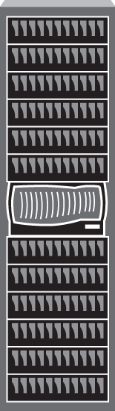



Managing NetApp Protection Technology
DFM ZAPIs SOAP for ITaaS Management
Operations Manager (DFM)
Protection Manager
NMC
NetApp protection solutions are based on Data ONTAP Snapshot technology
NetApp Management Console
Primary Storage
SnapVault
UNIX/Windows
Hosts
Open Systems SnapVault
SnapMirror
Primary Storage
SnapMirror
Secondary Storage
Tertiary Storage
Notes:
MANAGING NETAPP PROTECTION TECHNOLOGY
NetApp data protection technology, based on Data ONTAP Snapshot technology, efficiently replicates data stored on NetApp storage systems, UNIX hosts, or Windows hosts using SnapVault, Open Systems SnapVault, or SnapMirror. The DataFabric Manager database engine, the Operations Manager application, and the Protection Manager administrative interface automate and simplifies the management of heterogeneous data and application backup and recovery. DataFabric Manager can send and receive messages in the widely used SOAP (Simple Object Access Protocol) API for storage management in heterogeneous, traditional data center environments as well as in public, private, or hybrid ITaaS environments.
Protection Manager provides high level of assurance for data protection by proactively identifying unprotected data, checking for errors in configurations, diagnosing root cause of issues and suggesting corrective actions, and providing detailed status reports.
Protection Manager has a conformance engine that eliminates common setup errors ahead of time. Protection Manager helps you manage disaster recovery by providing DR verification for the failover and failback process.
Download the NetApp Management Console (NMC) software, which contains Protection Manager, from Operations Manager and install the package on either a UNIX or Windows host.
Protection Manager uses the information stored in the Operations Manager database to be aware of primary and secondary storage systems, OSSV clients, and existing SnapVault and SnapMirror relationships.
Protection Manager operates with Snapshot technology, SnapVault, Open Systems SnapVault and SnapMirror to create new or import existing SnapVault or SnapMirror relationships and to automate replication from primary to secondary and tertiary relationships.

Slide 5
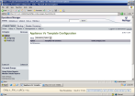
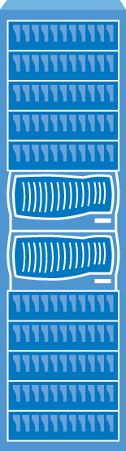




Operations Manager Architecture
User Interface
Protection Manager
(Java-based UI)
Operations Manager (Web UI)
Server
Operations Manager (DFM Server)
Discovery
Monitoring
Alerting
Reporting
API Server
DFM Repository
Targets
NetApp Host Agent
NetApp Storage Systems
Notes:
OPERATIONS MANAGER ARCHITECTURE
Operations Manager is the user interface for a Web-based application called DataFabric Manager. DataFabric Manager discovers, monitors, and manages NetApp storage systems and can be implemented in groups of DataFabric Manager installation for larger or multiple data centers.
The DataFabric Manager server is divided into three major components:
User Interface — Operations Manager. Operations Manager provides central database and agent coordination for Operations Manager, Provisioning Manager, Protection Manager, and Performance Advisor.
NetApp Management Console— Protection Manager, Provisioning Manager, and Performance Advisor. The NetApp Management Console can be installed on any Windows or Linux system and is a Java-based client.
Targets– the NetApp storage system hosts and open system hosts. The NetApp Host Agent is installed on a file server and is responsible for file-level reporting and tracking SAN components. Operations Manager does not require agents to monitor NetApp storage systems. However, NetApp host agent must be installed on target hosts for file-level reporting.
Protection Manager consolidates storage system aggregates into resource pools and can also manage thin provisioning. Protection Manager makes it easier for non-experts who may be called upon to manage backups because Protection Manager eliminates manual configuration, by using pre-designed policies for “configure once – apply many” management to protects new primary data. You can also preview details of set up steps.
Protection Manager simplifies management of credentials. You can set up role-based access with Operations Manager and Protection Manager will inherit permissions. Protection Manager integrates the NetApp suite of products with other products in the market for management of ITaaS deployments as well as industry tape backup solutions. You can also use the Protection Manager command line interface so that you can implement scripting if necessary.

Slide 6
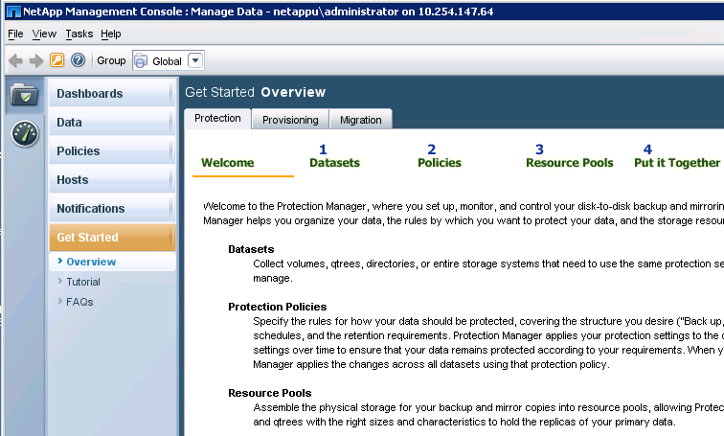
Protection Manager Overview and Tutorials
The Get Started Overview provides flash tutorials
Overview defines each component of Protection Manager
Not actual workflow order
Notes:
PROTECTION MANAGER OVERVIEW AND TUTORIALS
After downloading and installing the NetApp Management Console (NMC), from Operations Manager, you will launch the NMC on your desktop and log in using the same credentials as for Operations Manager.
Protection Manager will open; you will see buttons for Provisioning Manager and Provisioning Manager on the far left panel.
On the bottom left panel, click the Get Started button for tutorials and definitions of datasets, protection policies, and resource pools.
You will notice the “1, 2, 3, 4” on the Overview screen that is the first screen you will see. Note that the numbers do not denote workflow. Datasets are not necessarily the first component that you will add in your administration of Protection Manager. As you will see, there are some preliminary tasks performed to set up Protection Manager and then some routine tasks performed in the ongoing management of data protection.
Protection Manager

Slide 7







Protection Manager Components Defined
Hosts
Datasets
Data Resource Pools
Protection Policies
Provisioning Manager
and Schedules
Provisioning Policies
Conformance Checker
Notes:
PROTECTION MANAGER COMPONENTS DEFINED
Protection Manager has several components that work together to provide data protection.
Datasets are collections of units of primary storage such as storage system volumes, qtrees, and directories stored on Windows or UNIX hosts. The units of primary storage are grouped together to be protected by the same protection policy and schedule.
Hosts are NetApp or IBM storage systems, V-Series storage systems, vFilers, or open systems Windows or UNIX hosts. Hosts can be primary or secondary storage and are added to Protection Manager to be protected or to be used to provide storage for secondary copies of data.
Data Resource Pools, (referred to as resource pools) are collections of secondary storage that are configured similarly and are assigned to datasets to provide secondary or tertiary storage.
Protection policies are the rules established by the administrator for how data should be handled when the protection policy is attached to a dataset.
Schedules are created in accordance with the disaster recovery plan (DRP) and assigned to protection policies.
Conformance Checker is an algorithm of Protection Manager that compares configurations with Protection Manager rules, thresholds, alarms, and administrator policies to ensure that data is properly protected.
Provisioning policies are a function of Provisioning Manager. Provisioning policies set rules for the selection of secondary storage systems. Provisioning policies, if created, provisioning policies are added to the criteria used by the Conformance Checker to ensure that the intent of the administrator is upheld.
The workflow entails setting up each component and then putting the components together to protect primary data that has been organized into datasets.

Slide 8





Components are Created and Put Together
Add primary hosts and assign to Resource Pools
Add secondary hosts and assign to Datasets
Define Protection Policies, Schedules, and assign to Datasets
Define Provisioning and Protection Policies, then assign to Datasets
Notes:
COMPONENTS ARE CREATED AND PUT TOGETHER
To put it all together with the goal of protecting primary data, a logical beginning is to add primary and secondary hosts. Hosts are the physical resources assigned to resource pools or to datasets.
After hosts have been added to Protection Manager, the next logical step would be to define resource pools. The topic of how you will provide secondary storage comes up in the Add Datasets Wizard. Resource pools are assigned to datasets. (Note that resource pools are not mandatory; you can add secondary storage to datasets manually by selecting a storage system or an aggregate of a storage system.)
The next logical move would be to define protection policies with schedules that will live up to your disaster recovery plan. Protection policies are assigned to datasets to carry out the data protection plan.
Another option to consider as a setup step is to define provisioning policies to govern the selection of secondary storage and to set the configuration options of volumes being created to store mirror and backup copies. Provisioning policies are assigned to datasets.
The next segment explains the integration of Provisioning Manager to provide management tools for configuring storage devices.

Slide 9


Protection Manager Workflow
Setup tasks that require planning and design:
  Adding Hosts (both primary and secondary)
  Adding Data Resource Pools (designate secondary storage)
  Designing protection policies with schedules
  Defining provisioning policies to select appropriate storage automatically
Administrative tasks performed routinely:
  Adding primary data to be protected in datasets
  Monitoring protected and unprotected data
  Restoring data
Notes:
PROTECTION MANAGER WORKFLOW
The setup tasks require planning and design. These tasks involve the disaster recover plan of the organization, the inventory of primary data and available secondary storage, schedules that are based on RPO and RTO. The data protection setup tasks for Protection Manager include:
Adding hosts, both primary and secondary, to be managed by Protection Manager
Adding resource pools that ensure adequate secondary storage
Designing protection policies that work with the disaster recovery plan
Creating schedules that work with RPO
Adding provisioning policies to govern the selection of secondary storage and configure volume settings
Administrative tasks performed routinely:
Adding data to be protected in datasets
Monitoring protected and unprotected data
Restoring data
A setup task for using Protection Manager is to add the primary and secondary storage systems on the Hosts screen. You can add physical storage systems, vFilers (virtualized storage systems), or vFiler templates.
A vFiler template is a set of vFiler configuration settings, including the corresponding CIFS, DNS, NIS, and administrative host configuration settings, that you want to use as default settings for one or more vFiler units that you plan to add as hosts. You can configure as many vFiler templates as you need.
When adding a vFiler unit as a host, you can specify a vFiler template that provides the default configuration settings for that vFiler unit. In addition to the configuration settings provided by the vFiler template, you also must specify those values that are unique to the vFiler unit, such as name and IP address.
To collect data and manage physical or virtualized storage systems, Protection Manager needs credentials. You can set these credentials Protection Manager on the Hosts page. Select the host and use the Edit button or the Diagnose button. You also need to enable NDMP and enter the storage system NDMP user name. Protection Manager will then configure the NDMP credentials automatically.
Administrators can also add the open system hosts that are to be protected. We will provide more details about protecting Windows, Linux, and UNIX systems when we cover Open Systems SnapVault later in this course.
We are referring to this task as a setup task because you will not have to repeatedly add hosts to Protection Manager. Once this step is completed for your data center, you will only add new hosts when you change or acquire new storage or open systems.
Another setup task not repeated often is creating resource pools. Once you organize the storage system hosts into resource pools for backups and mirror copies, Protection Manager can provision storage out of these resource pools, as needed. As part of planning for data protection you have already created aggregates of unused space on the storage system hosts you intend to assign to resource pools.
Each resource pool can be assigned to multiple datasets. Protection Manager performs calculations to ensure that there is adequate space to contain the mirror copies and backups designated in new and existing protection policies.
Once you create your resource pools, you can maintain adequate storage by adding disks to aggregates or adding more aggregates to a resource pool.
Another setup task is to set up protection policies. Data Protection provides pre-defined policies that perform common data protection sequences; such as, Back up, then mirror, Local backups only, Mirror and back up. Protection Manager provides end-to-end, policy-based management and seamless integration with Snapshots, SnapVault, SnapMirror, and Open Systems SnapVault. Protection Manager selects the appropriate technology to perform the action required in the protection policy.
The disaster recovery plan, expected RTO and RPO will determine what pre-defined protection policies will be selected. RTO and RPO will also determine what schedules will be assigned to the protection policy.
The data protection administrator can set up hosts, resource pools, and several protection policies with names that indicate the type of datasets each protection policy was intended for. After the preliminary tasks have been set up according to the organizations disaster recovery plan, even an administrator who is unfamiliar with data protection accomplish on-going management of data protection by working with the established hosts, resource pools, and protection policies.

Slide 10
Module Summary
Notes:
MODULE SUMMARY

Slide 11
Module Summary
In this module, you should have learned to:
Describe the basic function and operation of Protection Manager
Notes:
MODULE SUMMARY

