Slide 1
Emerging Technology
14
Feb
Motti Finkelstein
Overview

Slide 2
Summary
Small CATE team dedicated to leveraging Emerging technology to Citi’s benefit
  Engagement with Citi’s Tech businesses :
  Tech Banking, CIRA and Equity Capital markets, TTS
Alignment to major infrastructure trends
  Cyber Security
  Cloud / Software defined Datacenter
  Data / Analytics
  End User / Mobile
Leverage Innovation opportunities
  Business Innovation Labs - Dublin, TLV, Miami etc.
  Accelerator programs
    Accenture / Fintech – NYC, Dublin, London,
    TLV accelerator, Citi Ventures /Plug and play

Slide 3
Agenda
Engagement with Citi’s Tech businesses :
  Tech Banking, CIRA and Equity Capital markets, TTS
Alignment to major infrastructure trends
  Cyber Security
  Cloud / Software defined Datacenter
  Data / Analytics
  End User / Mobile
Leverage Innovation opportunities
  Business Innovation Labs - Dublin, TLV, Miami etc
  Accelerator programs
    Accenture / Fintech – NYC, Dublin, London,
    TLV accelerator, Citi Ventures /Plug and play

Slide 4
4
Business Interactions

Slide 5
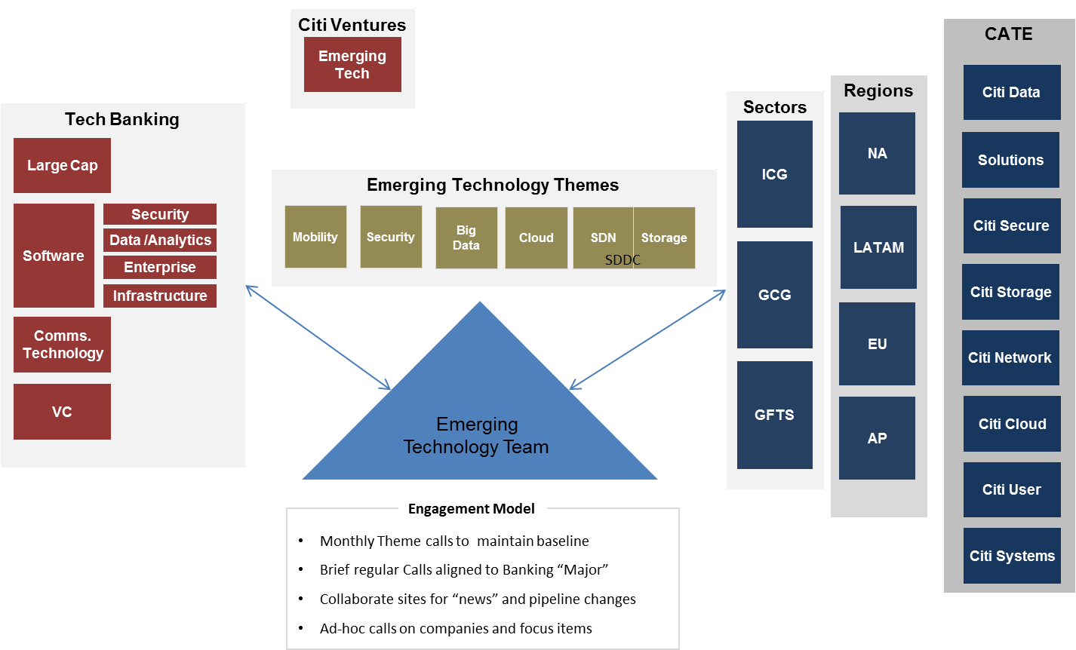
Tech Banking / Ventures

Slide 6
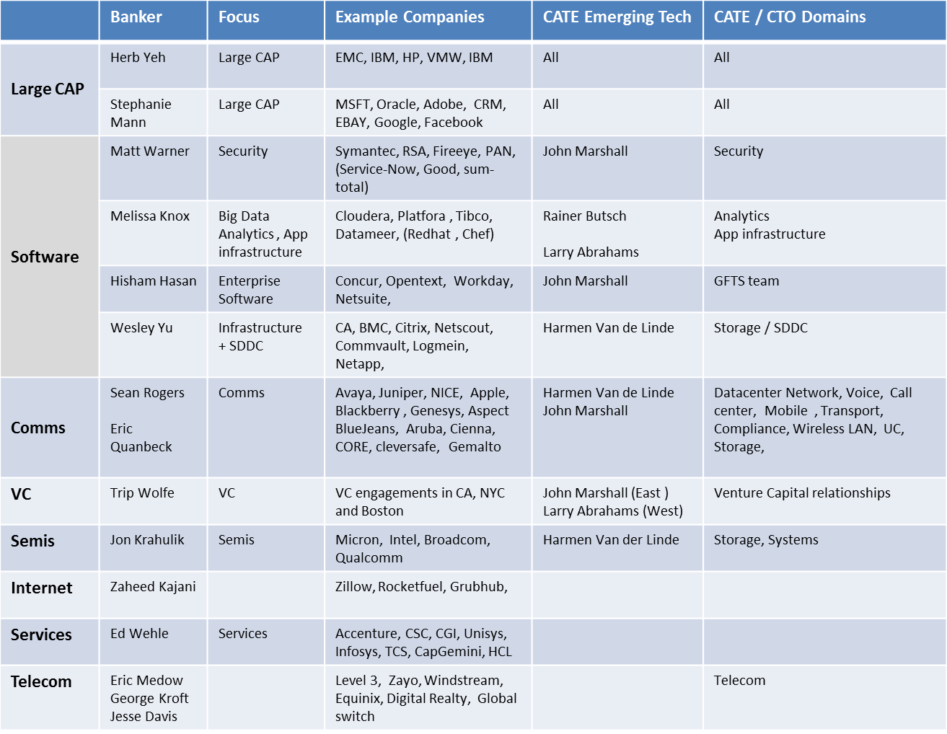
Tech Banking Alignment Matrix
Proactive
engagement
Ad-Hoc
engagement

Slide 7
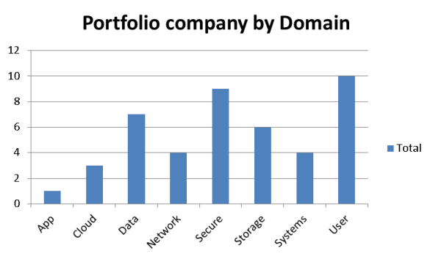
VC roadshows – Silicon Valley and Boston
Visits with Tier 1 &2 Venture capital companies to develop relationships, exchange views on market trends and disrupters, and introduce new portfolio companies. Meetings are brokered by Investment Banking to enable Banking to get increased visibility and relevance to VCs and M&A opportunities
Currently scheduling a Silicon Valley VC roadshow - end March with Tech Banking
Silicon Valley : June 3,4,5,6
12 VCs, 45 Companies, 4 days
Continued innovation in Next generation Storage was a distinct theme across VCs.
Mobile security and other security areas are still attracting many new entrants.
The stand-out company was Tanium, at Andressen ,
Citi purchased Tanium in Dec 2014
Boston : Oct 21/22
5 VCs, 24 Companies, 2 days
VC | Count of company
Atlas | 10
Battery | 3
Flybridge Capital | 2
General Catalyst | 2
NONE | 1
Northbridge | 6
Grand Total | 24
Venture | Total
Accel | 4
Andressen | 5
Bessemer | 4
ClearVP | 5
Greylock | 2
Highland Capital | 2
Lightspeed | 4
Meritech | 4
Sequoia | 4
Sierra | 3
Trident | 4
True ventures | 4
Grand Total | 45
Endpoint Security and Anomaly detection were a prominent theme. Follow-ups and deep dives being scheduled
Met over 127 new vendors in 2014 YTD

Slide 8
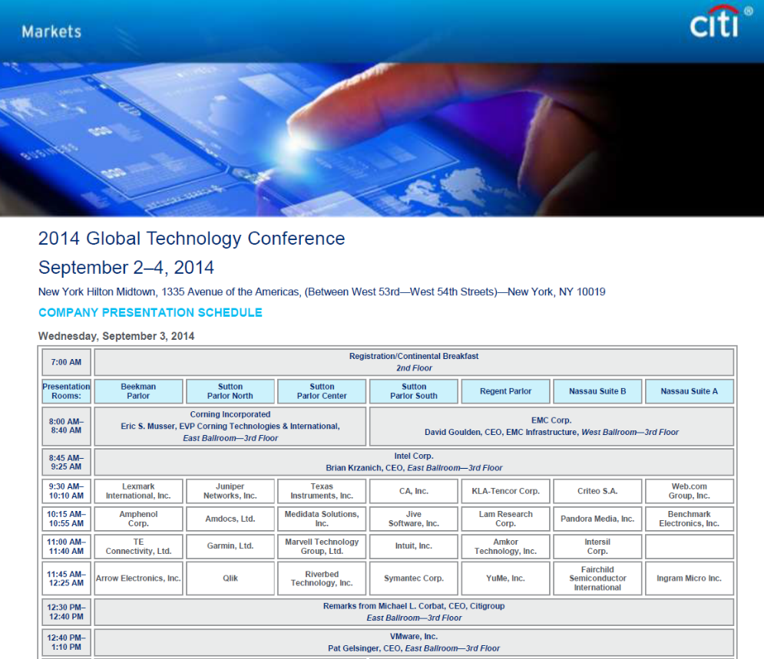

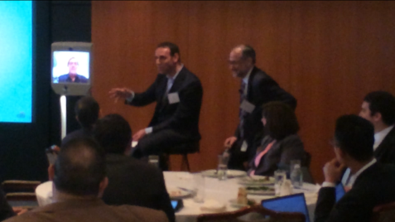
CIRA – Equities
Citi Global tech conference
IT Unplugged
1200 attendees, 158 IT Companies
Over 70 Investment Analysts attended
Citi IT Unplugged: Tech Themes that Matter
Hosts: Ehud Gelblum, Walter Pritchard, Jim Suva, Ashwin Shirvaikar
Join us for a day of interactive sessions focused on various technology topics hosted by Citi’s Tech analysts and IT department.
a ‘franchise-enhancing day’ for our Markets business
(Gibson Smith, MD, Global Markets)
Highlight : Mike Corbat introduces Pat Gelsinger
+Two CATE Panels next day

Slide 9
9
Alignment to Key Industry themes

Slide 10
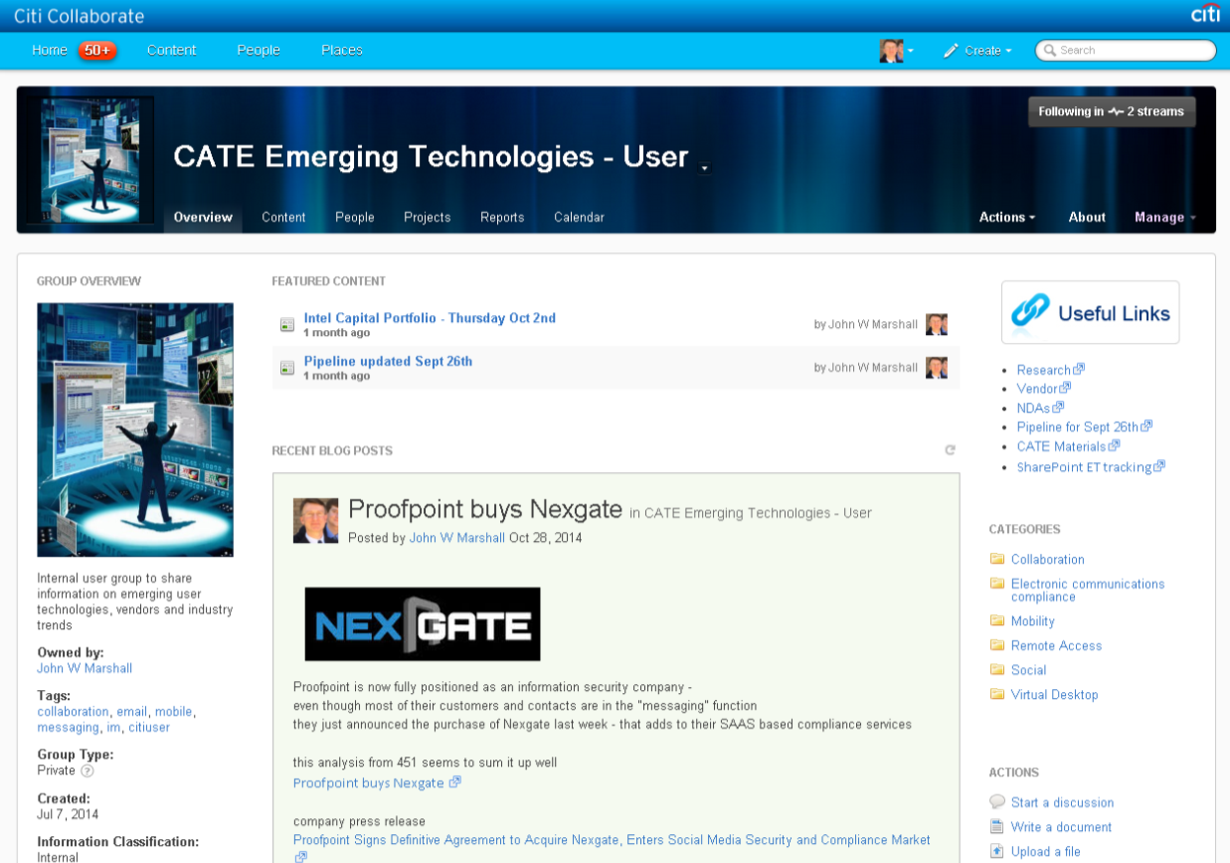
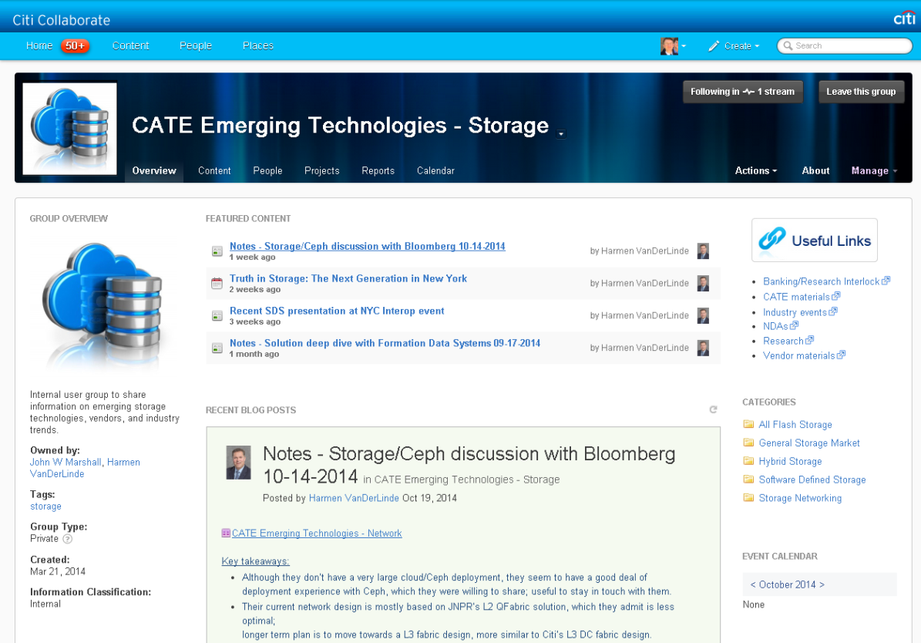
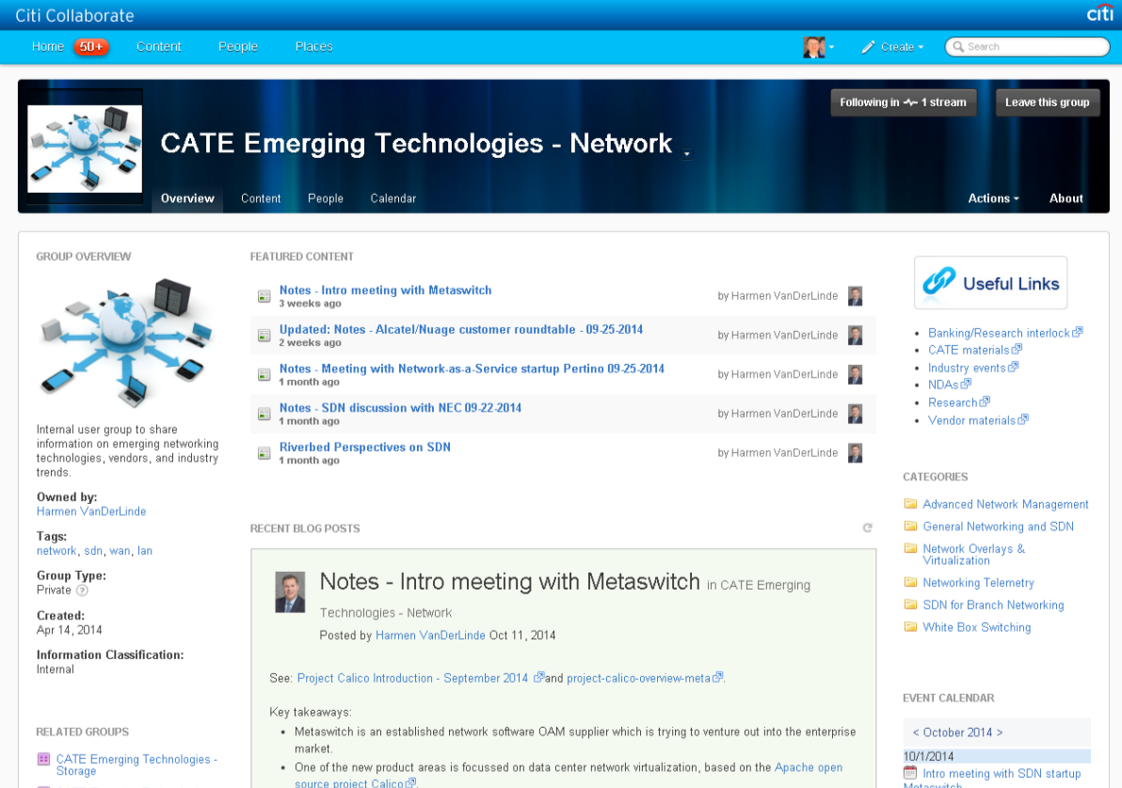
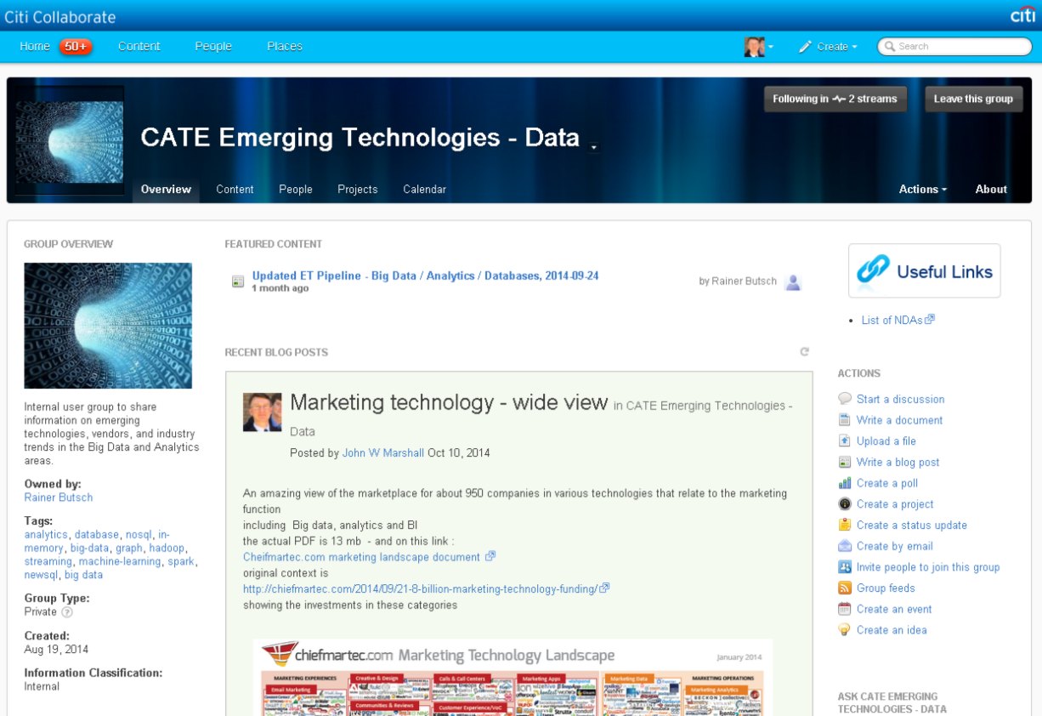
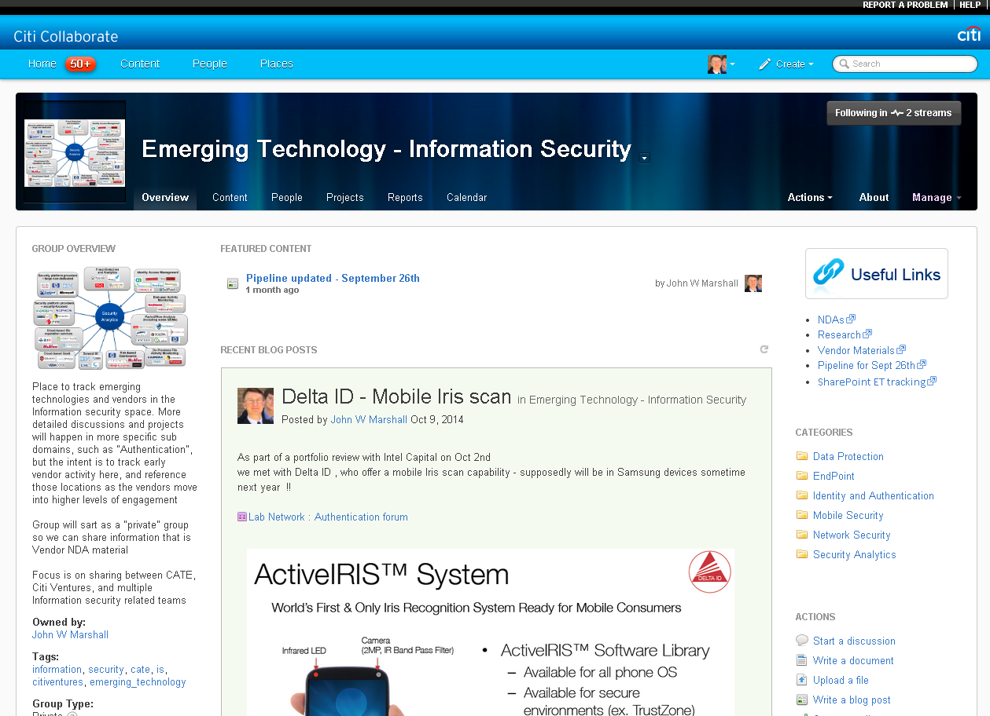
Emerging Tech
Collaborate Pages
Private Communities for :
CATE
Citi Ventures
Banking
CTI
Business Labs

Slide 11
11
Innovation opportunities

Slide 12

Citi Global Innovation Labs
Monthly Calls with Innovation labs
Ensure CATE alignment
Topics such as API, Authentication
Wearables
David Fleming / Paud O’Keefe
Dublin
Silicon Valley
Blue Ash
Tel Aviv
Miami
Jay Naik
Citi Ventures
Shai Ruben
Ruth Polachek
Driss Temsamani
Singapore

Slide 13
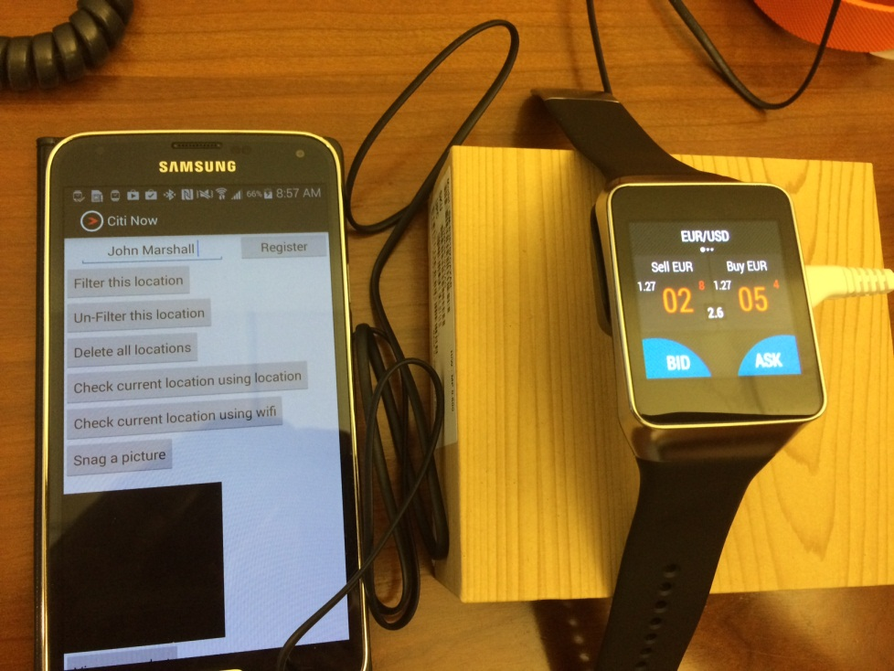
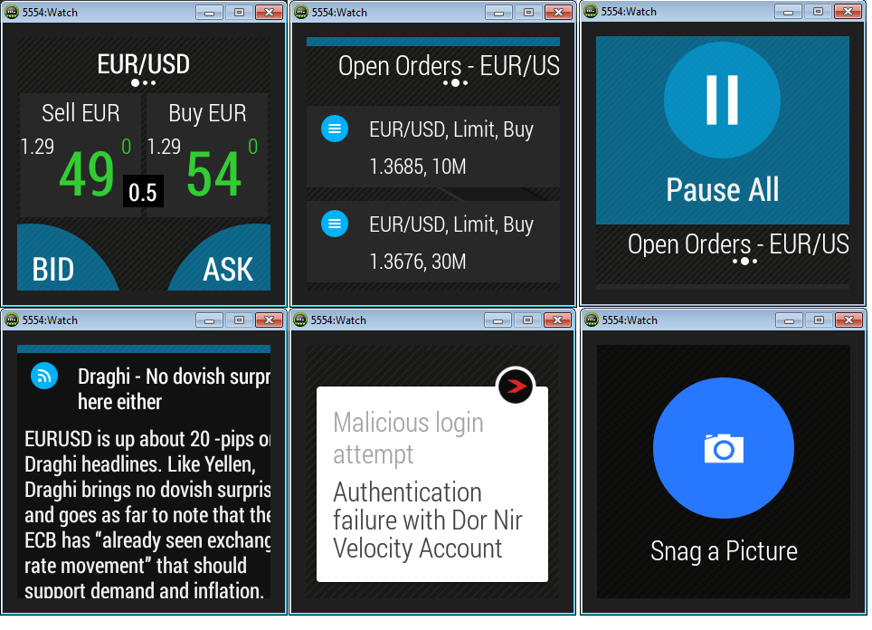
Emerging Tech – Business Labs
Monthly touch points with
Dublin TTS Labs
GCG- Blue Ash
Israel Accelerator program
- Lab link- lab heads
Citi Ventures / Lablink reviews
Review of Innovation funding requests
Examples :
  API management - Dublin
    Irvinder Singh
  Agile Authentication – Dublin and GCG/ Blue Ash
    Mike Bass / Jay Gould
  Wearables
    Israeli TTS Labs
    Miami TTS Labs

Slide 14
Citi Global Accelerator Programs
In Progress
Planned
Accenture
FinTech Accelerator
Plug & Play
Axel Springer Accelerator
Dublin
NYC
Berlin
Valencia
Silicon Valley
Tel Aviv
Accenture
Fintech Accelerator
Plug & Play
Accelerator
Citi Innovation Lab
Accelerator
Plug & Play
FinTech & Security Accelerator
Citi Ventures Global Anchor Partner
Plug & Play
FinTech Accelerator
Singapore
San Paulo
Plug & Play
Abril Accelerator

Slide 15
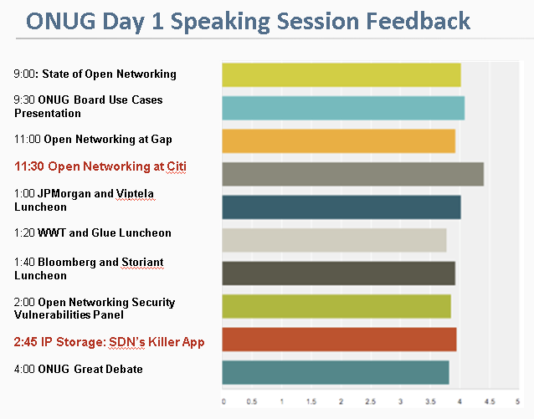

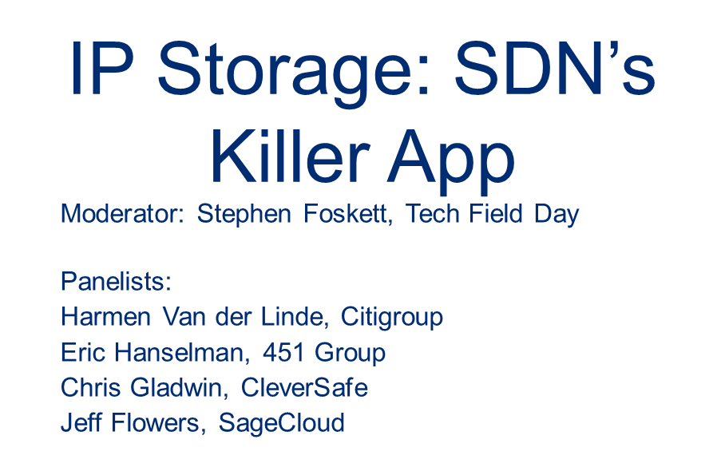

Examples of Leadership
Over 360 attendees. Citi presentation got highest score.
Next Generation Cloud and
Data Center at Citigroup
Greg Lavender
CTO – Citi Architecture and Technology Engineering

Slide 16
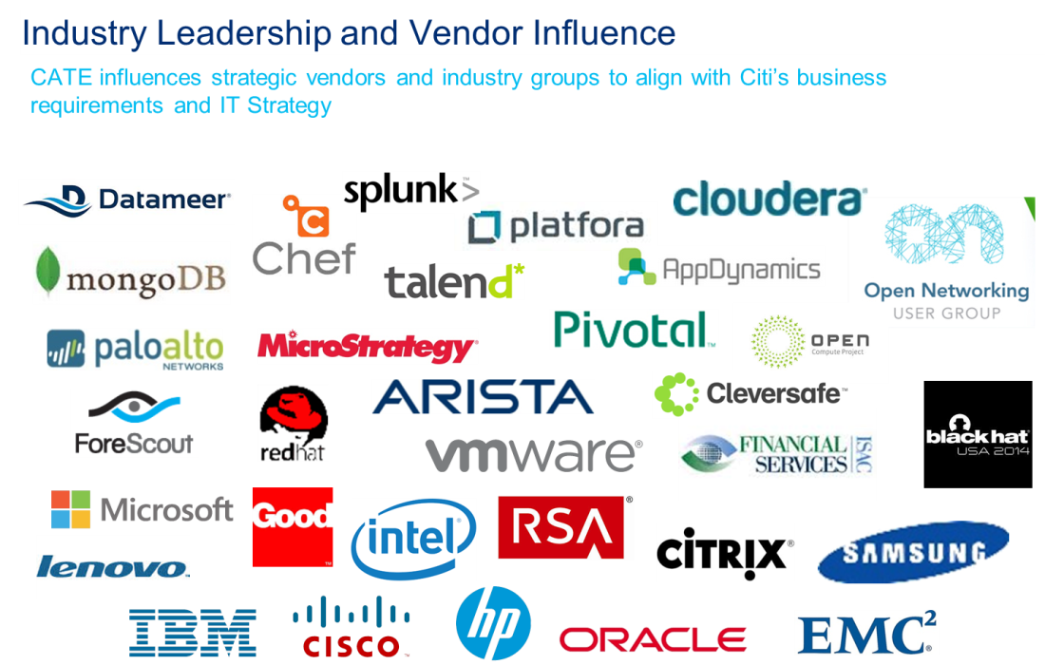
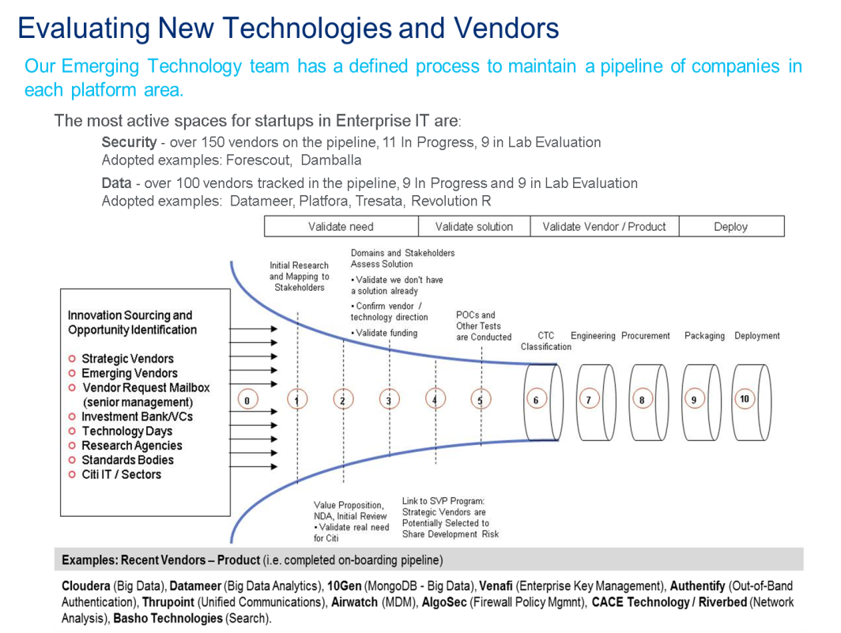
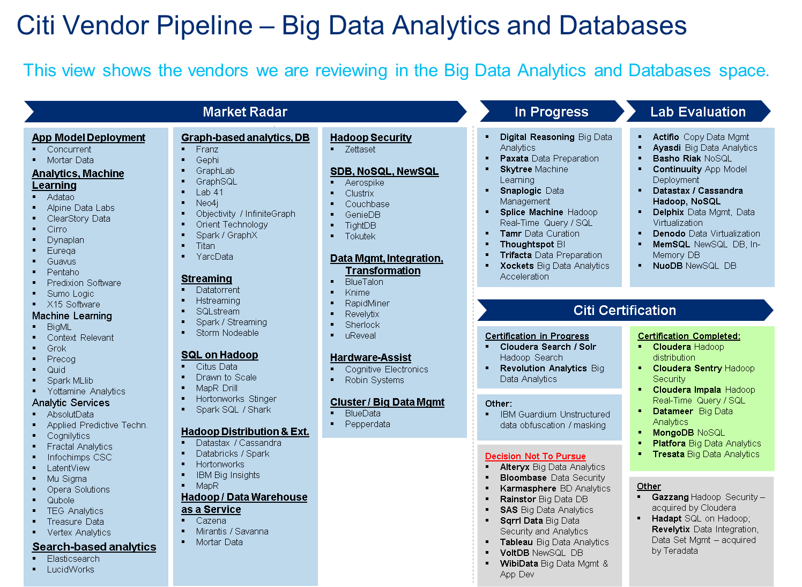
Board update ….
Slides presented to Gary Reiner
October 7th 2014

Slide 17
17
Appendix

Slide 18
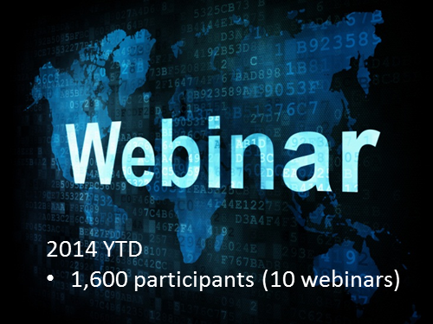
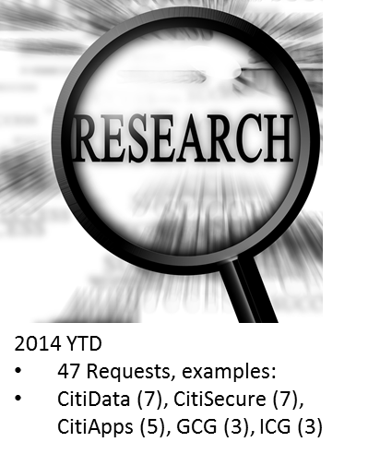


2014 Update ….Other activities
Non-Disclosure Agreements
65 NDAs initiated
Cloud , Mobility and the API revolution
Natural Language in the Enterprise
NoSQL overview
Amazon and Netflix architectures
Digital Banking
Paas
Identity Assurance
NDA 2014 YTD | Quantity
CitiApp | 2
CitiCloud | 4
CitiData | 13
CitiNetworks | 8
CitiSecure | 4
CitiStorage | 20
CitiSystems | 5
CitiUser | 7
NA | 1
Solutions Development | 1
Grand Total | 65
Vendor request Mailbox
Briefing Books
Executive | YTD
Don Callahan | 150
Mark Torkos | 129
Jagdish Rao | 58
Greg Lavender | 38
John D'Onofrio | 3
Mike Corbat | 1
Total | 379
38 Including
Juniper
EMC
Tibco
Cisco
Microsoft
HP
Oracle

Slide 19
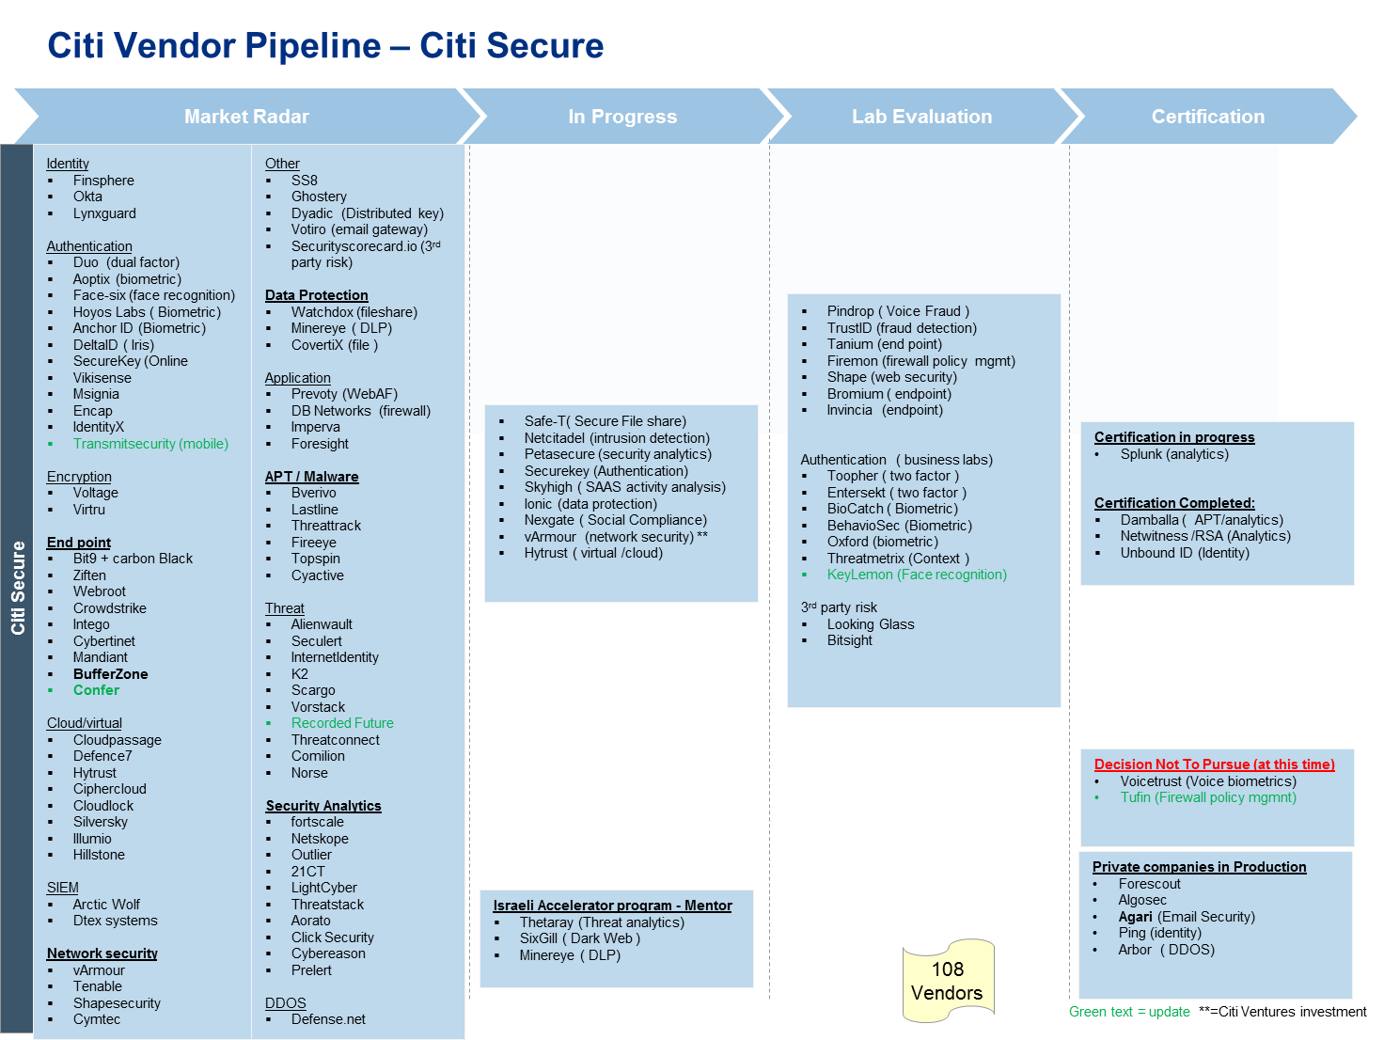

Slide 20
Emerging Technology - 2015 Update
Implemented the new coverage model in 2014
  Data / Analytics 4 strategic initiatives have coverage
Recent “Applied” assignments
  “Hands-on” leadership on 2 key initiatives
  Larry Abrahams - Cloud.next
  Harmen Van der Linde – CitiCloud/Converged Infrastructure
Developed Collaborate sites to share Emerging tech materials
  Citi Ventures, CATE, Banking
Collaborate : Sites for each Domain
  Security
  End-user / Mobile
  Storage
  Network
  Data - Analytics

Slide 21
Emerging Technology - Update
Realigned with Banking – new large CAP / Software team coverage
ONUG – Citi Hosted the ONUG event in the spring, and participated (Greg and Harmen presented) in the Fall event
Organized customer work shop event for Arista at 388 (~ 80 attendees)
Developed pipeline of over 150 Info security vendors – by industry segment
Met over 127 new vendors in 2014 YTD
Participated in Fintech NYC :
  Introduction to dozen Financial related vendors per year,
  Companion programs in UK, and new in A-P
  Mike Corbat met the companies this year
  Alumni include - Digital Reasoning (cognitive computing) , Kasisto (NLP), Inktank (Ceph)
Business liaison with CIB
  Status with Banking, Research ( Nancy Kalmus , Gavin Skinner ) has been “green” all year

Slide 22
22
Problem definitions

Slide 23
Emerging Tech – Areas of focus - Opportunities to find solutions
Data / Analytics
Need for improvements to a data preparation / integration layer on top of a big data storage layer.
Machine learning in analytical workloads and data preparation for productivity .
Graph analytics for threat detection. Incorporating in-memory real-time analytics into workflow.
Decouple storage from compute on Hadoop and provide more granular capacity management and elasticity.
Need to Retain Metadata lineage from source (traditional DWH) to target (Hadoop) for dependency analysis and audit traceability.
Virtualization technologies to combine varieties of data sources (traditional DWH and Hadoop) in common accessible view.
Cloud
Viability of .Next reference architecture and vendors being validated in Stratus
Determine the possible role of other Cloud Foundry based PAAS solutions
Create a viable model for securely leveraging public clouds starting with Amazon
Re-engineering the Developer Experience to take advantage of Cloud Scale economics at all levels
User
Unified communications compliance – multi-media Archiving, supervision / E-discovery tools, decrease cost and complexity
Mobile data and app security - Alternatives to Good Containerization and secure app / data delivery
Wearables strategy and security
B2B and Employee mobile Collaboration - file sync and share, with security and compliance controls
Real-time communication – B2B IM services and mobility
Software Defined Infrastructure
Development of Next generation storage strategy
SDN strategy and architecture
Develop overall architecture view
Set Expectations on realistic benefits and timeline
Economics model to demonstrate benefits
Security
Must Win Battles - Diverse Authentication services : OTP, Biometrics, Risk-based and Multi-factor
Enhanced Data protection solutions - Network and Endpoint security,
Third party access defenses - containment and external connectivity management
real-time analytics for anomaly detection
Improved DLP , Perimeter security for Collaboration tools
Mobile platform security

Slide 24
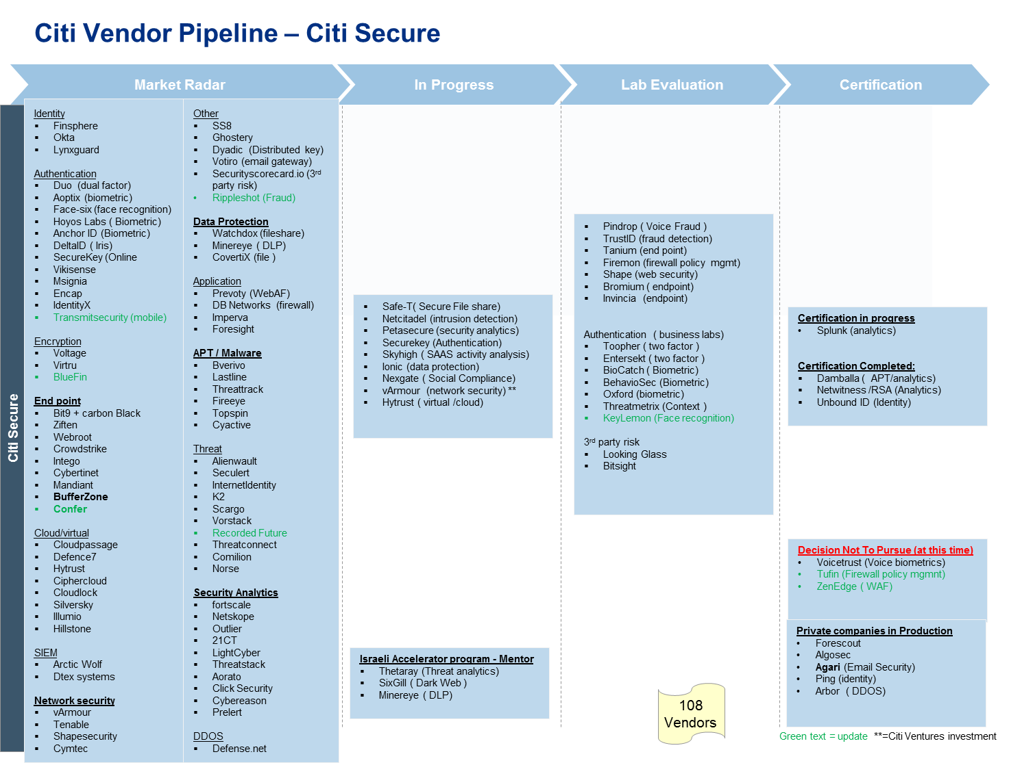
Update

Slide 25
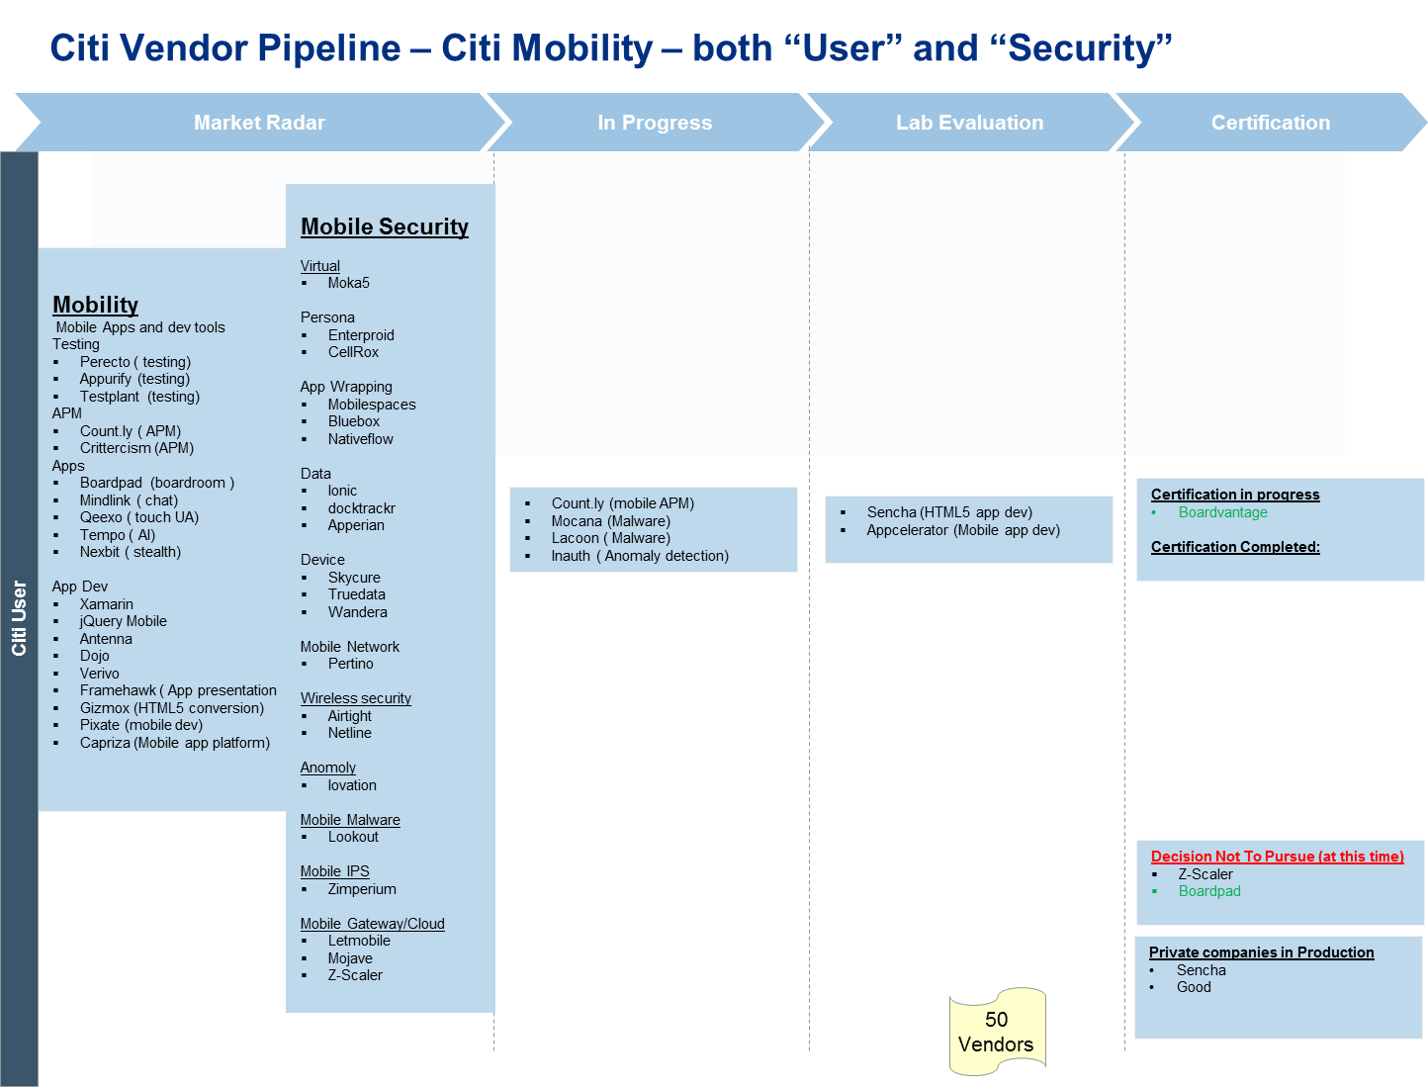
Update

Slide 26
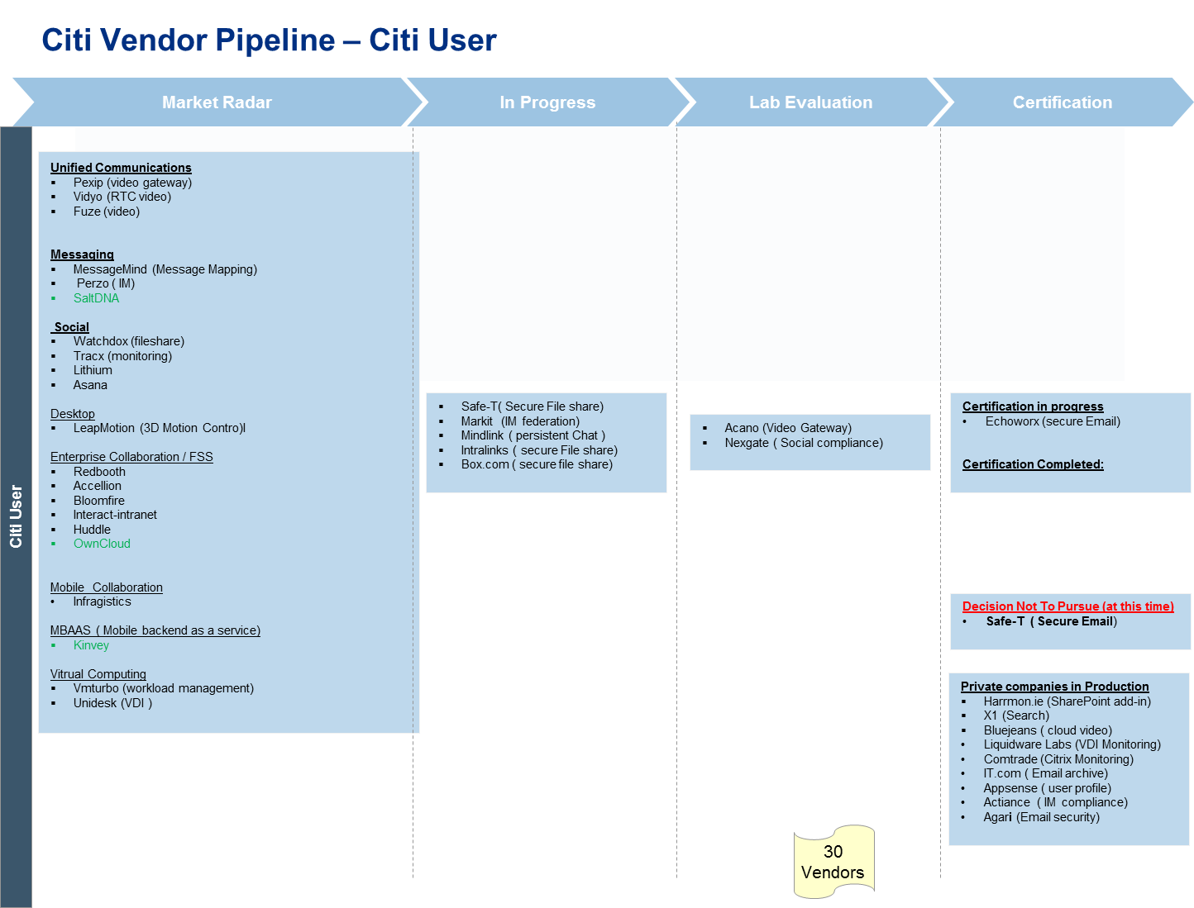
Update

Slide 27
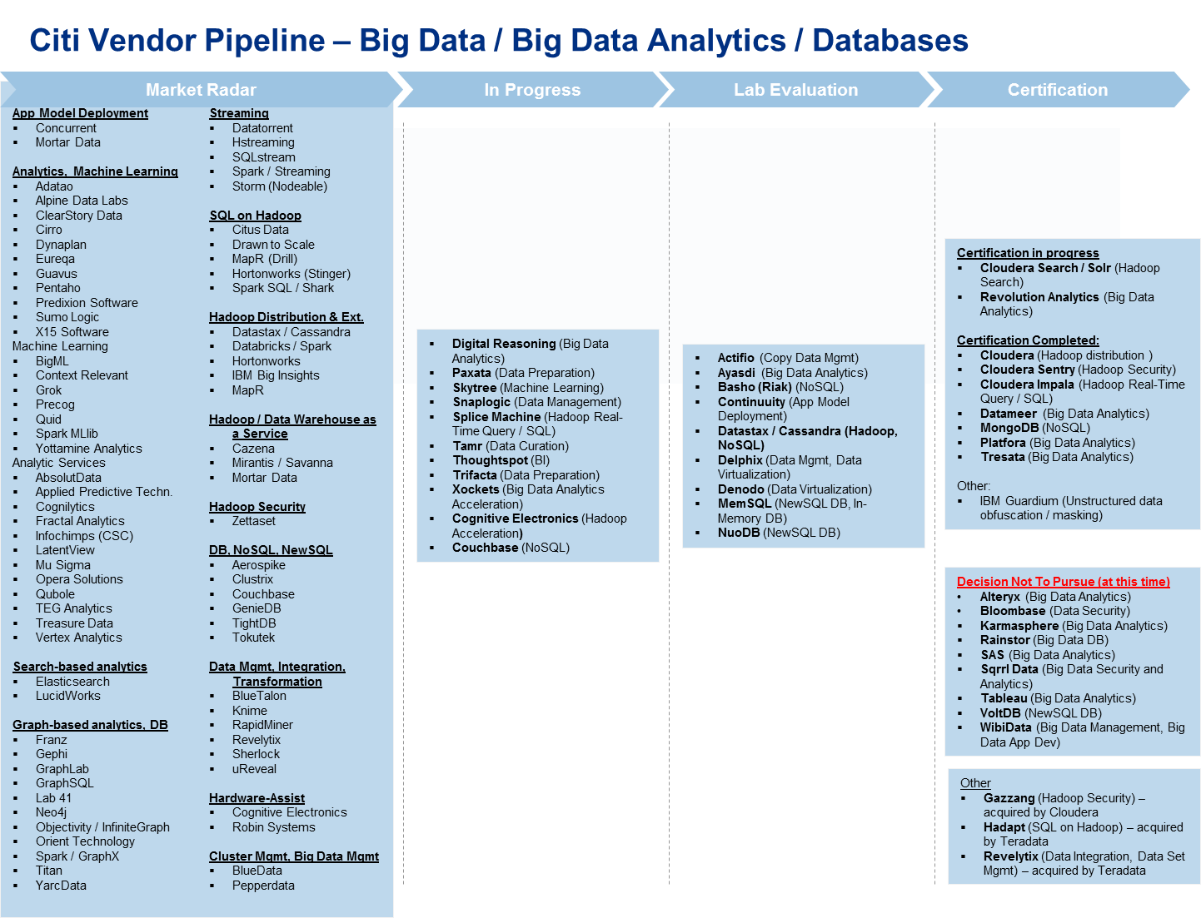

Slide 28
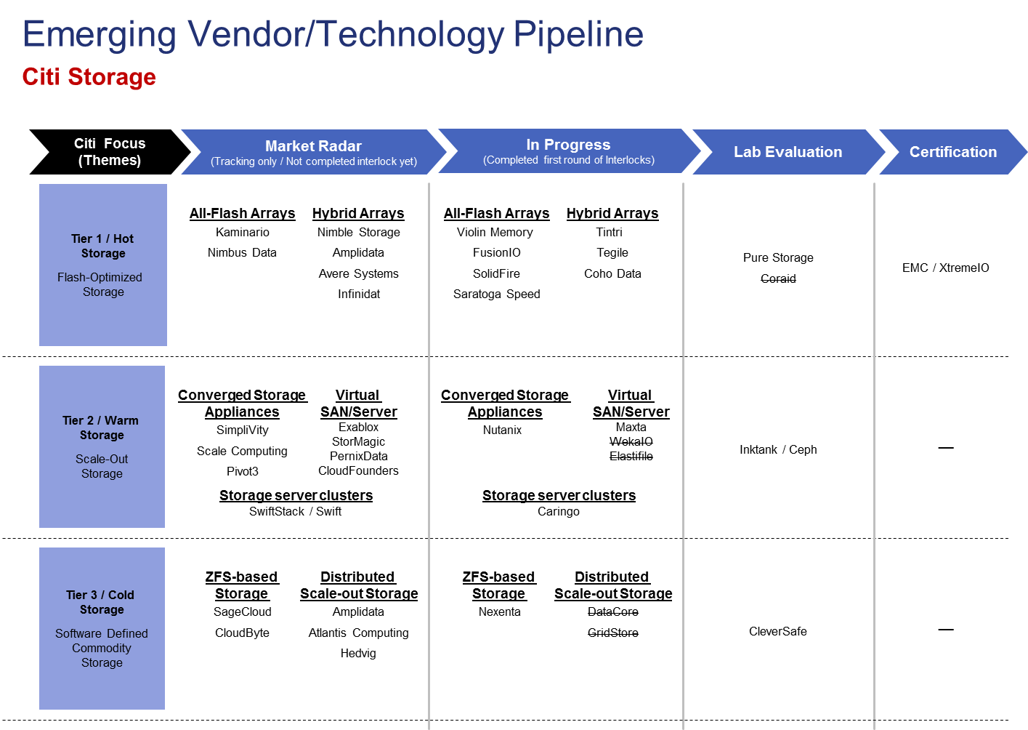

Slide 29
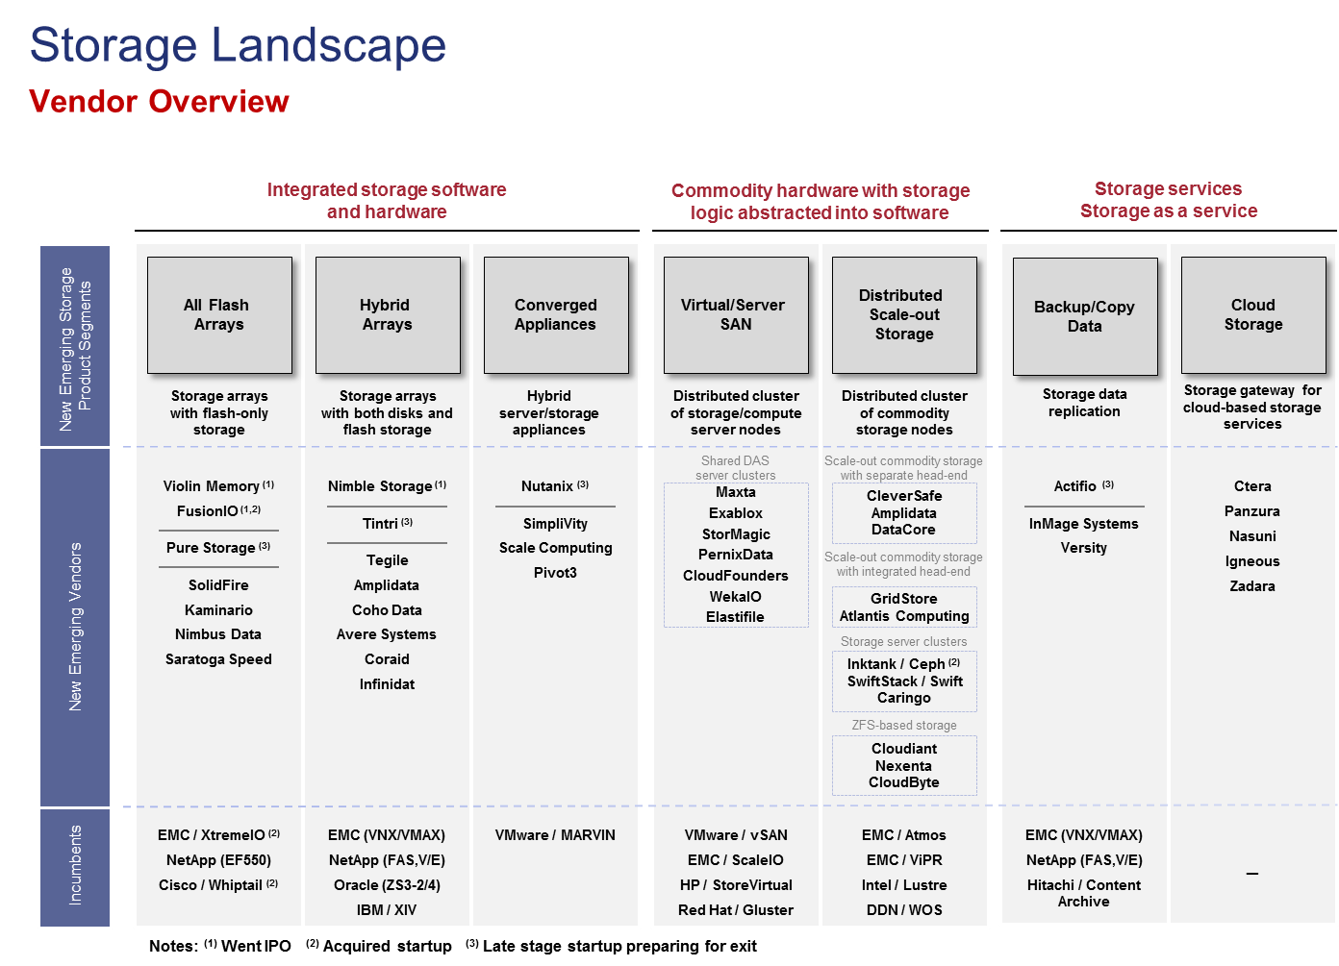

Slide 30
CATE Engagement Model – Emerging technology Scope
CATE will create value for Citi by leveraging emerging technology and our business relationships with both technology vendors and Citi businesses. It will aim to identify and evaluate emerging technology trends and vendors and their solutions to position Citi to maximize the opportunity through the CATE strategic initiatives. Key focus areas include:
  Develop strategy, architecture and adoption approach for key emerging technologies
  Track the adoption of new vendors and technologies to provide visibility and opportunity
  Influence vendor roadmaps to solve business problems for Citi
ICG Tech
CTO
CDO / GFTS
CIO Council
CATE “Board of Directors”
Global Consumer Tech
CTI
Share Technology Trends -
Build the Bank
Run the Bank
- Certify Standards
Partner on Business Tech Strategies -
- Automate Deployment and Maintenance
Enable Sector Solutions -
- OPEX/CAPEX Reduction
Increase Developer Productivity -
ROI
- Operational Effectiveness
- Reduce Complexity, Simplify Operations
Vendors
and Startups
Strategy and
Requirements
CATE
Architect & Engineer Solutions
Citi Competitive Advantage
and Mature Technologies
Products & Technology,
Early Adoption
Strategy and Planning – Emerging Technology
Drive vendor roadmaps to benefit Citi
Leverage standards and commoditization
ROI
Leverage Startup Investments -
Consult
- Advise on M&A and IPO Activities
Identify Emerging Technologies -
Tech Roadmaps
Advise
- Enhance Top Line Revenue Opportunities for IB
Technology Due Diligence/Risk Evaluation -
- Influence Vendor Product Features
Review Long Term Roadmaps -
- Drive Market Innovation
Citi
Ventures
Citi Research
Citi Investment Banking

Slide 31
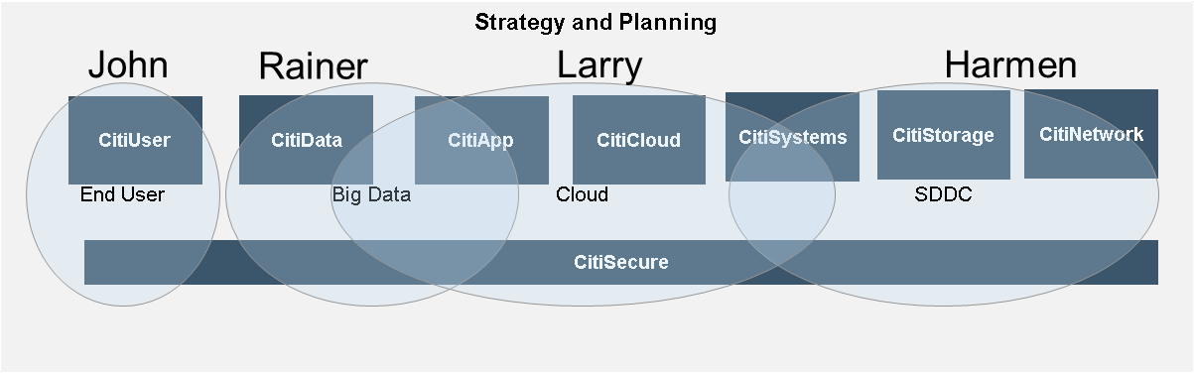
Emerging Tech Alignment
Citi Secure** is a matrix / franchise model
 | Strategic Initiative | Domain Focus | Location | Non-CATE Key Stakeholders
Larry Abrahams | Cloud | Citi Cloud Citi App CATE solutions | West Coast | Sector Dev teams
John Marshall | End User | Citi User Citi Secure** | East Coast | Highly Mobile businesses – IB, CIRA
Harmen Van der Linder | SDDC | Citi Network Citi Systems | East Coast | CTI
Rainer Butsch | Big Data | Citi Data + Analytics | West Coast | SR / DIO, Sector Analyst teams

Slide 32
Horizontal Roles and Responsibilities
VC Liaison
Leads: Larry (West)
John (East)
Analyst
Relations
Lead: Rainer
VCs
Portfolio Companies
Investment Bankers
Citi Ventures
Analysts
Technology Challenges, Initiatives, Strategies
Lead: Harmen
Vendor Pipeline Management
Lead: Rainer
Labs Network
Lead: John
CATE
Sectors

Slide 33

2014 Year in Review - Snapshot
TALENT
GOALS
APPROACH
CLIENTS, PARTNERS, CONSTITUENTS
OUTCOMES
SAMPLE ACCOMPLISHMENTS
APPS
85
SOLUTIONS
200+
BYOD
Desktop Optimization
New Databases supported
Digital Strategy
Citi Voice Manager
Execution 2.0
IT Process Automation
IT Compliance
MongoDB as a Service
Storage MIS
Security automation
Cloud Automation
DB CAP resolution
Connecting Citi
Tech Expos
CTO Financial Dashboard
CTO Risk & Control Dashboard
End User Productivity
PM Productivity
Lab expansion / network
Hackathons
ITPAG → CAMP
Developer Events, Digest, Collaboration
Developer VDI
CPMC Compliance
PC Admin Access
App Entitlement Mgmt
Citi Directory
Marketplace “re-imagining”
CATE
CTI
Internal Digitization
PRACTICE
DEV
OTRM
Delivering Productivity
PRACTICE
UX
CTO
Developing for the Future
237 RESOURCES
SECTORS
Enabling Key Initiatives
PRACTICE
MOBILE
FUNCTIONS
CTO Goals
PRACTICE
INNOV-ATION
DEV
COMMUNITY

