Slide 1
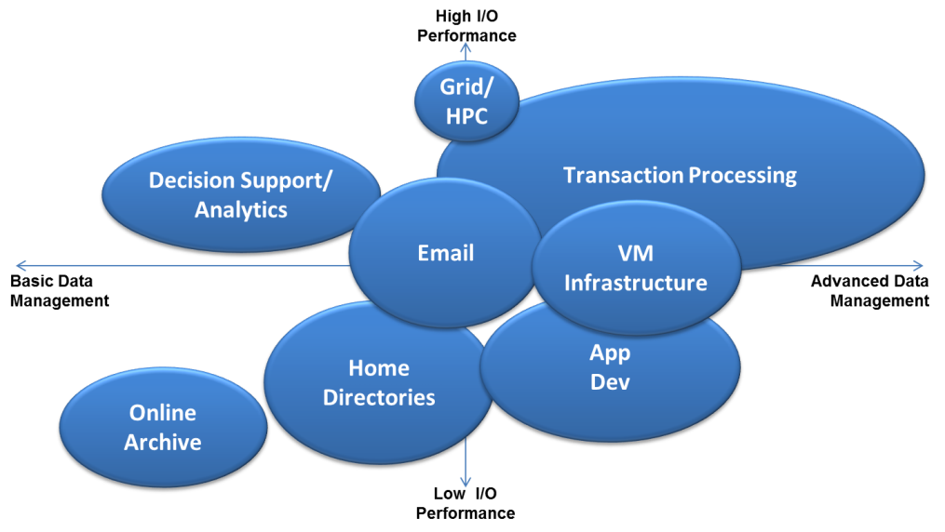
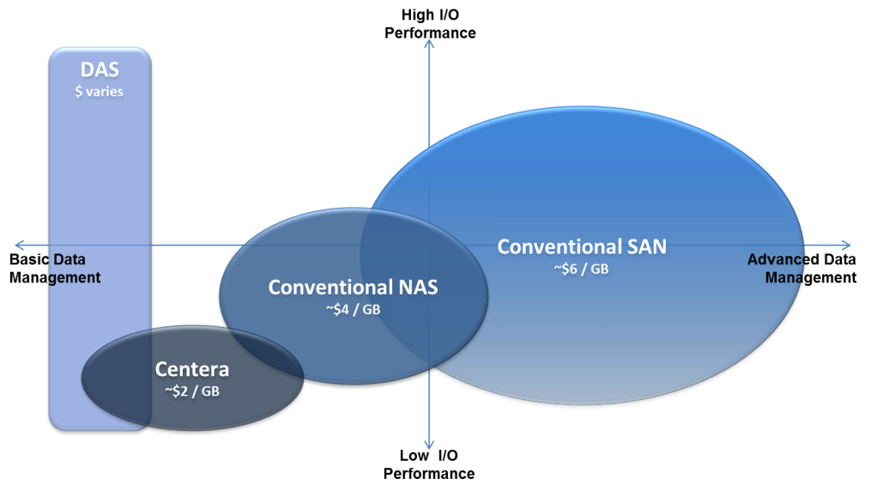
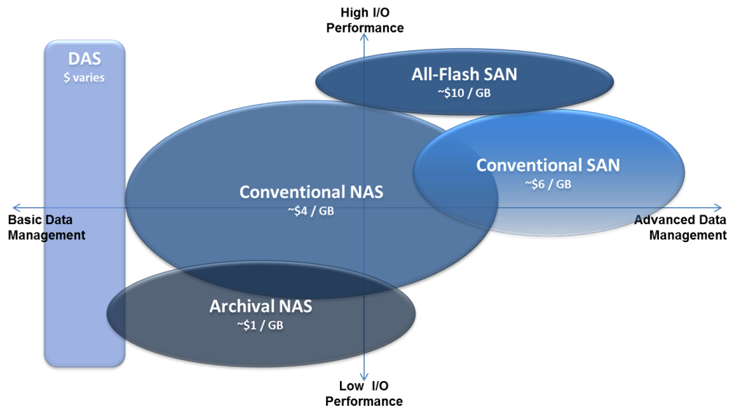
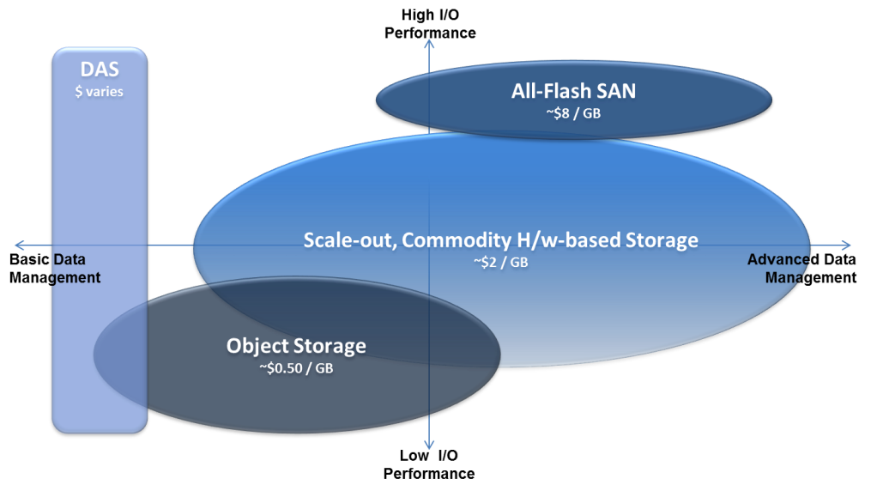
Storage Consumption and Cloud Storage Economics
Storage Today
Storage in 2014 and 2015
Storage in 2015 and Beyond
Notes:
Drive the majority of use to Cheaper Storage
Drive the minority of use to Faster Storage where top performance is needed:
Deliver automation - a self-service, self-healing, multi-tenancy framework

