Slide 1
FTSM – SCRIPT IMPLEMENTATION
Dated – 22nd Feb 2016

Slide 2
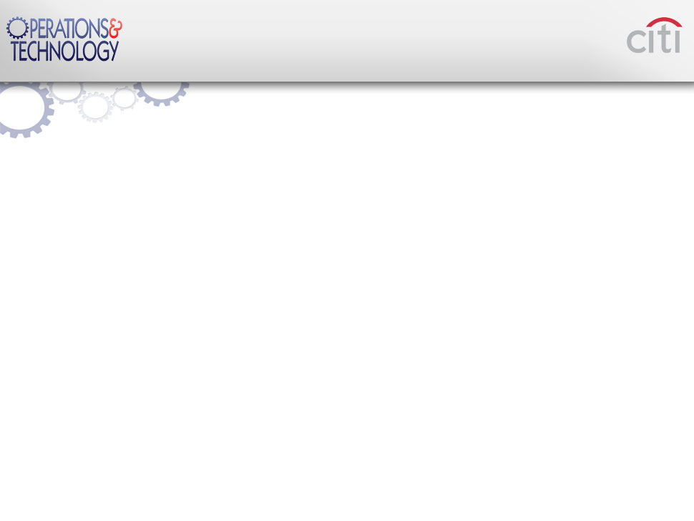
FTSM - Scripts Implementation
Objective
Objective of this presentation is to document and explain
  The in-house-generated scripts and programs.
  How to use the scripts and the outputs derived.
  How these scripts could be used to generate reports.
  How to do health checks of storage subsystems
  How some of these scripts are automated and how the alerts are implemented.
Also to reduce considerable amount of time for Storage administrators in the day to day BAU.
Scope
This scripts are written and automated using Unix shell scripts
All Control Work Stations in NAM are involved.
This covers, general day-to-day Storage administration tools, diagnostics, report generation, Alert implementation etc.
This is designed or aimed to have ease of use, to alleviate manual commands, and also to save time by automation of validations.

Slide 3
FTSM - Scripts Implementation
Tools Used
  Solutions Enabler – Symmetrix
  RAIDCOM – HDS ( VSP, HUS-VM, USP-V)
  NAVISECCLI – CX & VNX
  SSH – MDS FC Switches
Daily reports are generated for :
  Symmetrix - 165 frames[VMAX]
  MDS - 692 Switches [CISCO MDS]
  HDS Frames - 35 frames [VSP, HUS-VM,USP_V]
  CX/VNX FRAMES - 21 Frames
CWS : Control Work Stations - Linux ( Primary and Secondary)

Slide 4
FTSM - Scripts Implementation
SCRIPTS/REPORTS NFS SHARE
MEX-Jardines-DC
VMAX
VSP
USPV
HUSVM
CX
VNX
CWS
/apstor
CWS
/apstor
MEX-Quadero-DC
FABRIC
CWS
/apstor
NAS SHARE(NFS)
nasrut156v1san:/vol/san_vol1/apstor
CWS
/apstor
CWS
/apstor
CWS
/apstor
O’Fallon-DC
Midwest-DC
CWS
/apstor
Georgetown-DC
Roanoke-DC
Rutherford-DC
CWS : Control Work Stations - Linux ( Primary and Secondary)

Slide 5
FTSM - Scripts Implementation
What does the script do?
It simply creates configuration reports in a daily basis so that information about the environment is readily available for support activities, reporting, monitoring, alerting….etc
So what..!
Now it takes hardly some time to identify all the storage arrays from which capacity is allocated to a host or hosts along with its fabric ports including zoning and its status ( online/offline)
it is historical..!
Easy for migration preparations, COB activities…!
All reports are accessible from any of the control work stations across NAM
CWS : Control Work Stations - Linux ( Primary and Secondary)

Slide 6
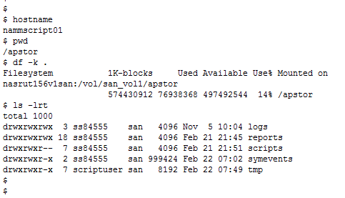
FTSM - Scripts Implementation
Directory Structure
Mount Point
Logs generated during script run
All reports are here
All Scripts are here
Historical data of Symmetrix Events
Interim files
CWS : Control Work Stations - Linux ( Primary and Secondary)

Slide 7
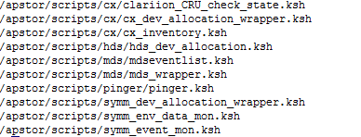
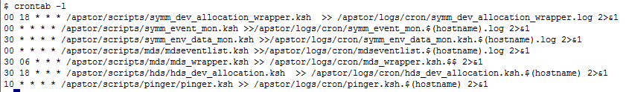
FTSM - Scripts Implementation
Scheduled scripts
Hourly Jobs to check CX/VNX health state and send alerts
Daily script to collect CX/VNX provisioning details ( device level)
Generates daily inventory file ucode, ip address, model…etc
Daily script to collect VSP/HUS-VM provisioning details
Hourly job which captures any events in the fabric and send alert
Daily job to capture mds flogi table , zone , member state..etc
Hourly job which pings all mgmt IPs and alerts on failure
Daily script to collect VMAX provisioning details
Hourly job to alert Symmetrix failures
Hourly job to alert Symmetrix events
CWS : Control Work Stations - Linux ( Primary and Secondary)

Slide 8
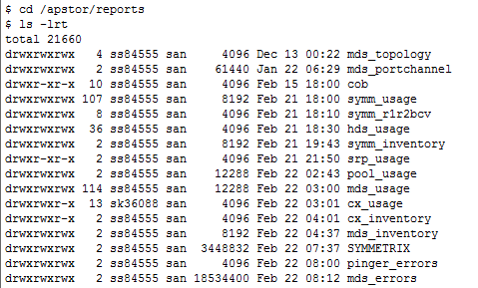
FTSM - Scripts Implementation
REPORTS DIRECTORY
Fabric topology details will be here ( manual run)
Port channel errors are recorded here ( manual run)
Symmetrix provisioning reports are here ( daily)
Symmetrix R1-BCV- R2-BCV mapping (daily)
HDS Provisioning details are here ( daily)
Symmetrix inventory files generated here.
VMAX SRP usage (Daily)
VMAX/HDS/CX/VNX Pool usage ( daily)
Fabric information ( daily)
CX/VNX provisioning reports are here ( daily)
VX/VNX inventory files generated here.(daily)
MDS inventory files generated here ( Daily with switch location).
CWS : Control Work Stations - Linux ( Primary and Secondary)

Slide 9
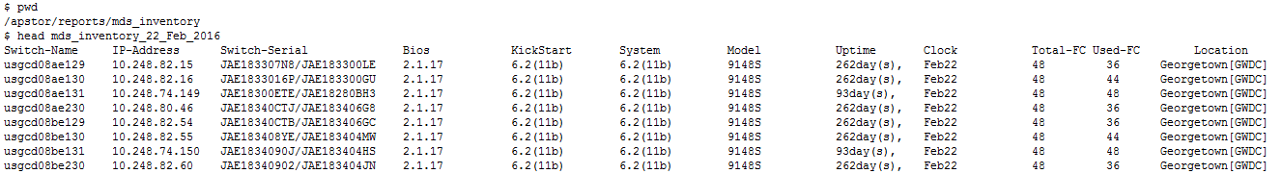
Automation and Reporting - Alert / Monitoring
SCRIPT TITLE : mdscfglist.ksh
CATEGORY : Reporting
DESCRIPTION : Creates inventory reports for all MDS switches in a single file ( daily)
ARGUMENTS : NONE ( refers /apstor/scripts/mds/mds_dat_1 file)
TECHNOLOGY : CISCO MDS / SSH
ACTION : Generates inventory reports in folder /apstor/reports/mds_inventory/
SCHEDULE : DAILY
SAMPLE OUTPUT
==============================================================================================================
SWITCH SR#
USAGE
IP ADRESS
MODEL
LOCATION
Switch name
FIRMWARE
Plan for your capacity, firmware upgrade and locate your switch or send your report instantly..!!!

Slide 10
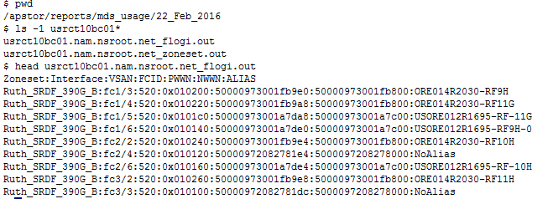
Automation and Reporting - Alert / Monitoring
SCRIPT TITLE : cisco_mds_allocation.ksh
CATEGORY : Reporting
DESCRIPTION : Creates flogi table report (.out) and zoning information (xls) files
ARGUMENTS : NONE ( refers /apstor/scripts/mds/mds_dat_1 file)
TECHNOLOGY : CISCO MDS / SSH
ACTION : Creates flogi table report (.out) and zoning information (xls) files in folder /apstor/reports/mds_usage/ [ 2 files / switch)
SCHEDULE : DAILY
SAMPLE OUTPUT
==============================================================================================================
DATE
Switchname.out file
VSAN
FC Port
ALIAS
Zoneset
WWPN
Tracking a host with its wwn among 695 switches is made easier….! ( Go to Lab)

Slide 11
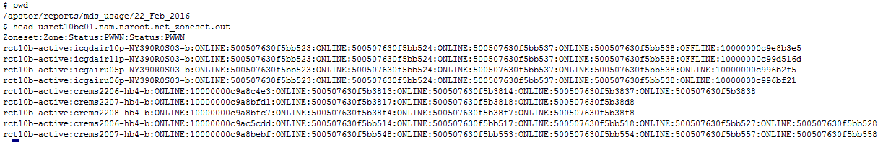
Automation and Reporting - Alert / Monitoring
SCRIPT TITLE : cisco_mds_allocation.ksh
CATEGORY : Reporting
DESCRIPTION : Creates flogi table report (flogi.out) and zoning information (zoneset.out) files
ARGUMENTS : NONE ( refers /apstor/scripts/mds/mds_dat_1 file)
TECHNOLOGY : CISCO MDS / SSH
ACTION : Creates flogi table report (flogi.out) and zoning information (zoneset.out) files in folder /apstor/reports/mds_usage/ [ 2 files / switch)
SCHEDULE : DAILY
SAMPLE OUTPUT
==============================================================================================================
DATE
Zoneset.out file
MEMBER1 Status
MEMBER2 Status
ZONENAME
MEMBER1
Zoneset
You get all zone details of a WWN and zone member status in seconds…! ( Go to Lab)

Slide 12
Automation and Reporting - Alert / Monitoring
SCRIPT TITLE : mdseventlist.ksh
CATEGORY : Monitoring/Alerting
DESCRIPTION : Monitor the MDS fabric and sends alert on selected events..! ( Email)
ARGUMENTS : NONE ( refers /apstor/scripts/mds/mds_dat_1 file)
TECHNOLOGY : CISCO MDS / SSH / MAIL
ACTION : SCANs through the switches for selected errors and sends an email ( hourly)
SCHEDULE : HOURLY
SAMPLE OUTPUT
==============================================================================================================
Currently not set to mailing group…!
Subject will have switch and location
This can be noisy but you have an alternate way of knowing your san issue…!

Slide 13
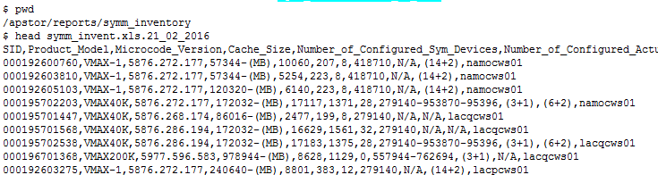
Automation and Reporting - Alert / Monitoring
SCRIPT TITLE : symm_inventory.ksh
CATEGORY : Reporting
DESCRIPTION : Creates inventory reports for all SYMMETRIX ARRAYS in a single file ( daily)
ARGUMENTS : NONE ( scans through the CWS)
TECHNOLOGY : Solutions Enabler
ACTION : Generates inventory reports in folder /apstor/reports/symm_inventory/
SCHEDULE : DAILY
SAMPLE OUTPUT
==============================================================================================================
uCODE
LOCAL CWS
( all local)
VMAX MODEL
RAID TYPES
Symmetrix ID
CACHE
Plan for your firmware upgrade or send your report instantly..!!!
Refer this file and get to know your local control workstation(s)

Slide 14
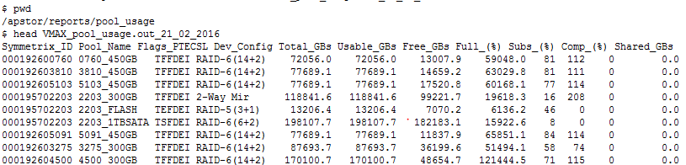
Automation and Reporting - Alert / Monitoring
SCRIPT TITLE : symm_pool_report.ksh
CATEGORY : Reporting
DESCRIPTION : Creates pool reports for all SYMMETRIX ARRAYS in a single file ( daily)
ARGUMENTS : NONE ( scans through the CWS)
TECHNOLOGY : Solutions Enabler
ACTION : Generates pool usage reports in folder /apstor/reports/pool_usage
SCHEDULE : DAILY
SAMPLE OUTPUT
==============================================================================================================
DATE
Flags
% full
Pool Name
Capacity
Symmetrix ID
RAID
All virtually provisioned VMAX arrays’ pool usage is here in a single file which is generated everyday

Slide 15
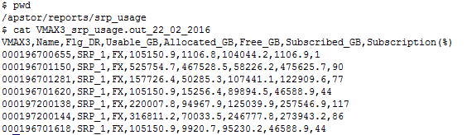
Automation and Reporting - Alert / Monitoring
SCRIPT TITLE : symm_srp_report.ksh
CATEGORY : Reporting
DESCRIPTION : Creates SRP reports for all VMAX3 ARRAYS in a single file ( daily)
ARGUMENTS : NONE ( scans through the CWS)
TECHNOLOGY : Solutions Enabler
ACTION : Generates SRP usage reports in folder /apstor/reports/srp_usage
SCHEDULE : DAILY
SAMPLE OUTPUT
==============================================================================================================
DATE
Free
% subscription
Flags
SRP Name
Symmetrix ID
All VMAX3s SRP usage can be verified from this single file

Slide 16
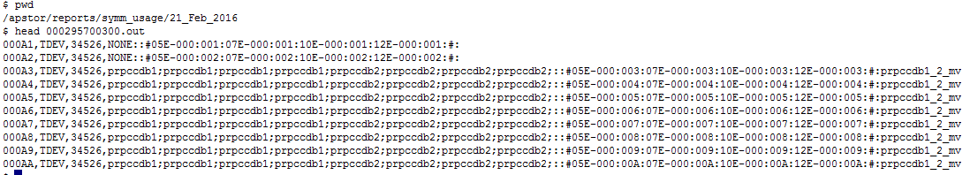
Automation and Reporting - Alert / Monitoring
SCRIPT TITLE : symm_dev_allocation.ksh
CATEGORY : Reporting
DESCRIPTION : Creates device level details (SID.out), initiator details ( SID.WWN) and a summary (SID.xls) of capacity allocations
ARGUMENTS : NONE ( scans through the CWS)
TECHNOLOGY : Solutions Enabler
ACTION : Generates SID.out and SID.xls in /apstor/reports/symm_usage/<DATE>
SCHEDULE : DAILY
SAMPLE OUTPUT
==============================================================================================================
Size in MB
Masking Views
Shows the number of paths to storage devce.
If path is offline, it will be marrked “nolog”
NONE means unused device
FE Ports and LUN#
DEV Type
TDEV
Symdev
Get the allocated device details across the frames
Plan for migrations
Generate alerts for offline paths for any reason
Cleanup the frames by getting rid of the un-used devices
Check the history….!! It will be useful ( continue to next slide)

Slide 17
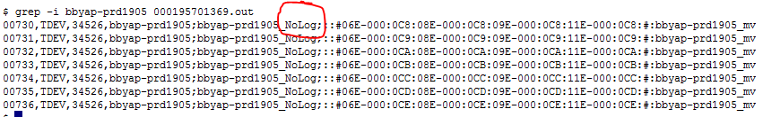
Automation and Reporting - Alert / Monitoring
SCRIPT TITLE : symm_dev_allocation.ksh
CATEGORY : Reporting
DESCRIPTION : Creates device level details (SID.out), initiator details ( SID.WWN) and a summary (SID.xls) of capacity allocations
ARGUMENTS : NONE ( scans through the CWS)
TECHNOLOGY : Solutions Enabler
ACTION : Generates SID.out and SID.xls in /apstor/reports/symm_usage/<DATE>
SCHEDULE : DAILY
SAMPLE OUTPUT
==============================================================================================================
Indiacates one of the path is offline
With history, you know when onwards..!

Slide 18
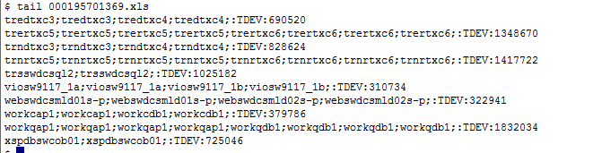
Automation and Reporting - Alert / Monitoring
SCRIPT TITLE : symm_dev_allocation.ksh
CATEGORY : Reporting
DESCRIPTION : Creates device level details (SID.out), initiator details ( SID.WWN) and a summary (SID.xls) of capacity allocations
ARGUMENTS : NONE ( scans through the CWS)
TECHNOLOGY : Solutions Enabler
ACTION : Generates SID.out and SID.xls in /apstor/reports/symm_usage/<DATE>
SCHEDULE : DAILY
SAMPLE OUTPUT
==============================================================================================================
DEV Type
TDEV
Total Capacity allocated to host based on
Its uniqeness
[number pf paths, or host or type of device etc]
Hostpaths
Capacity is calculated based on allocations. Ie , shared or dedicated and its device type and its # of paths..etc:
You need a capacity report for a host which has TDEV, RDFs, BCVs with some devices shared with another,
don’t look further, you have it all here…! ( continued)

Slide 19
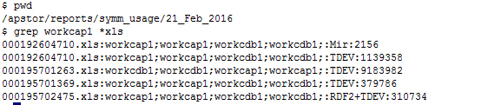
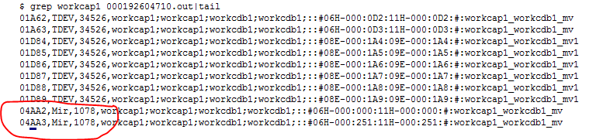
Automation and Reporting - Alert / Monitoring
SCRIPT TITLE : symm_dev_allocation.ksh
CATEGORY : Reporting
DESCRIPTION : Creates device level details (SID.out), initiator details ( SID.WWN) and a summary (SID.xls) of capacity allocations
ARGUMENTS : NONE ( scans through the CWS)
TECHNOLOGY : Solutions Enabler
ACTION : Generates SID.out and SID.xls in /apstor/reports/symm_usage/<DATE>
SCHEDULE : DAILY
SAMPLE OUTPUT
==============================================================================================================
This shows a host “workcap1” has:
Two paths
Sharing all its devices with another host “workcbd1”
It is connected to 4 different Symmetrix arrays
It has both replicated and non-replicated devices
All paths on both the hosts were online when the script was run
Going through the SID.out file will
Provide the device detail for the host
In this case, the 1GB
2-Way-Mirrir could be the cluster
Quorum/heart-beat disks

Slide 20
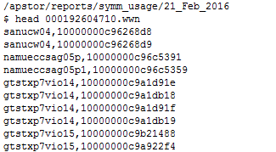
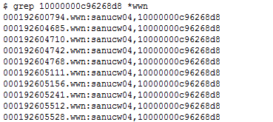
Automation and Reporting - Alert / Monitoring
SCRIPT TITLE : symm_dev_allocation.ksh
CATEGORY : Reporting
DESCRIPTION : Creates device level details (SID.out), initiator details ( SID.WWN) and a summary (SID.xls) of capacity allocations
ARGUMENTS : NONE ( scans through the CWS)
TECHNOLOGY : Solutions Enabler
ACTION : Generates SID.out and SID.xls in /apstor/reports/symm_usage/<DATE>
SCHEDULE : DAILY
SAMPLE OUTPUT (SID.WWN)
==============================================================================================================
It is possible that the same initiator is referred ( initiator group name) differently across
Symmetrix arrays. Use SID.WWN file to get the host name and scan through the rest
This confirms the initiator group name
is consistent across all the
frames where from the host is provisioned
Its WWN
Hostname referred in
SID.out and SID.xls files

Slide 21
Automation and Reporting - Alert / Monitoring
SCRIPT TITLE : emc_r1r2r3bcv.ksh
CATEGORY : Reporting
DESCRIPTION : Creates inventory R1-BCV-R2-BCV mapping file for VMAX arrays which has RDF1 devices
ARGUMENTS : NONE ( scan through CWS)
TECHNOLOGY : Solutions Enabler
ACTION : Creates inventory R1-BCV-R2-BCV mapping file for VMAX arrays which has RDF1 devices /apstor/reports/symm_r1r2bcv/
SCHEDULE : DAILY
SAMPLE OUTPUT
==============================================================================================================
SRC FRAME
Host Allocated
BCV Host
R2 Frame
Local BCV
R2 Device
RDF1 Device Name
R2 HOST
Dev Grp Name
GNS
LBCV PAIR STATUS
This report is a place where you to look for :
COB preparations ( end to end mapping..!)
Replication discrepancies
Host masking discrepancies
GNS correctness
TF Type
Mirror/clone
And So on…!!

Slide 22
Automation and Reporting - Alert / Monitoring
HDS , VNX and CX Arrays will have the similar reports generated in its respective directories.
- Device wise allocation
Host allocation summary
Host to WWN mapping
Pool usage
      ( LAB)

Slide 23
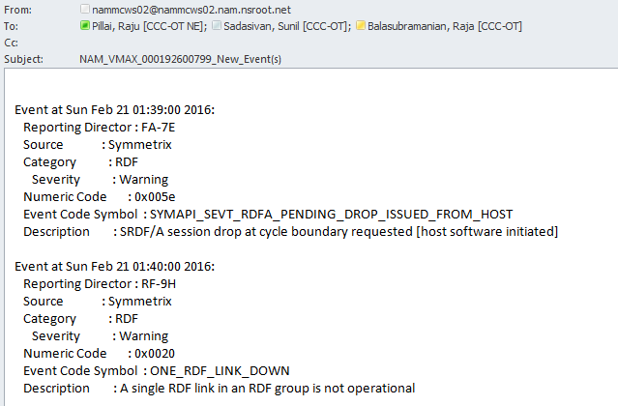
Automation and Reporting - Alert / Monitoring
SCRIPT TITLE : sym_event_mon.ksh
CATEGORY : Monitoring - Alerts
DESCRIPTION : Check symevent for new alerts via solutions enabler symcli
ARGUMENTS : Symmetrix ID
TECHNOLOGY : EMC DMX/VMAX
ACTION : Send email to group DL with alert details
SCHEDULE : Hourly
SAMPLE OUTPUT
=================================================================================

Slide 24
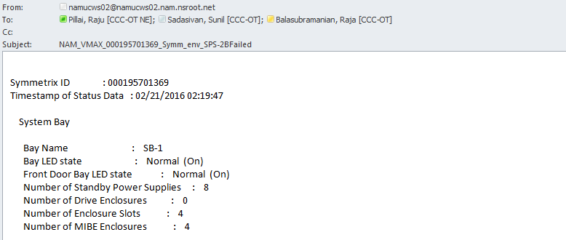
Automation and Reporting - Alert / Monitoring
SCRIPT TITLE : symm_env_data_mon.ksh
CATEGORY : Monitoring - Alerts
DESCRIPTION : Check symevent for new alerts via solutions enabler symcli
ARGUMENTS : Symmetrix ID
TECHNOLOGY : EMC DMX/VMAX
ACTION : Send email to group DL with alert details
SCHEDULE : Hourly
SAMPLE OUTPUT
=================================================================================
The alert will be sent ( hourly) until the issue is fixed..!!!

Slide 25
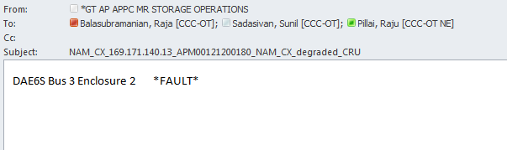
Automation and Reporting - Alert / Monitoring
SCRIPT TITLE : clariion_CRU_check_state.ksh
CATEGORY : Monitoring - Alerts
DESCRIPTION : Check symevent for new alerts via solutions enabler naviseccli
ARGUMENTS : NONE
TECHNOLOGY : NAVISECCLI
ACTION : Send email to group DL with alert details
SCHEDULE : Hourly
SAMPLE OUTPUT
=================================================================================
The alert will be sent ( hourly) until the issue is fixed..!!!

Slide 26
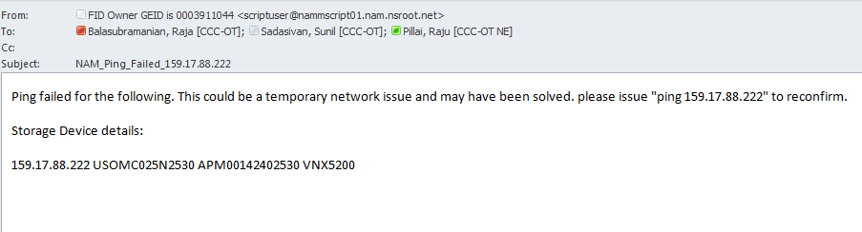
Automation and Reporting - Alert / Monitoring
SCRIPT TITLE : pinger.ksh
CATEGORY : Monitoring
DESCRIPTION : Polls all storage equipment management IPs every hour to check status.
ARGUMENTS : IP address
TECHNOLOGY : All
ACTION : Send email to group DL if ping fails
SCHEDULE : Hourly
SAMPLE OUTPUT
============================================================================================================
The alert will be sent ( hourly) until the issue is fixed..!!!

