Slide 1
Frame 0425 Pool/Drive Utilization
Analysis period from April 22⁻24th

Slide 2
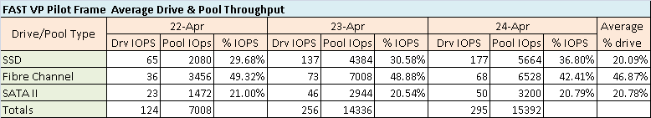
Average Drive Throughput (IOPS)

Slide 3
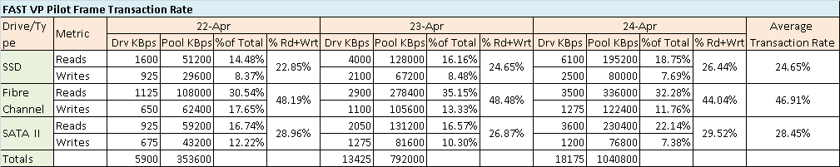
Average Drive Transaction Rate (KBps)

Slide 4
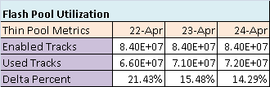
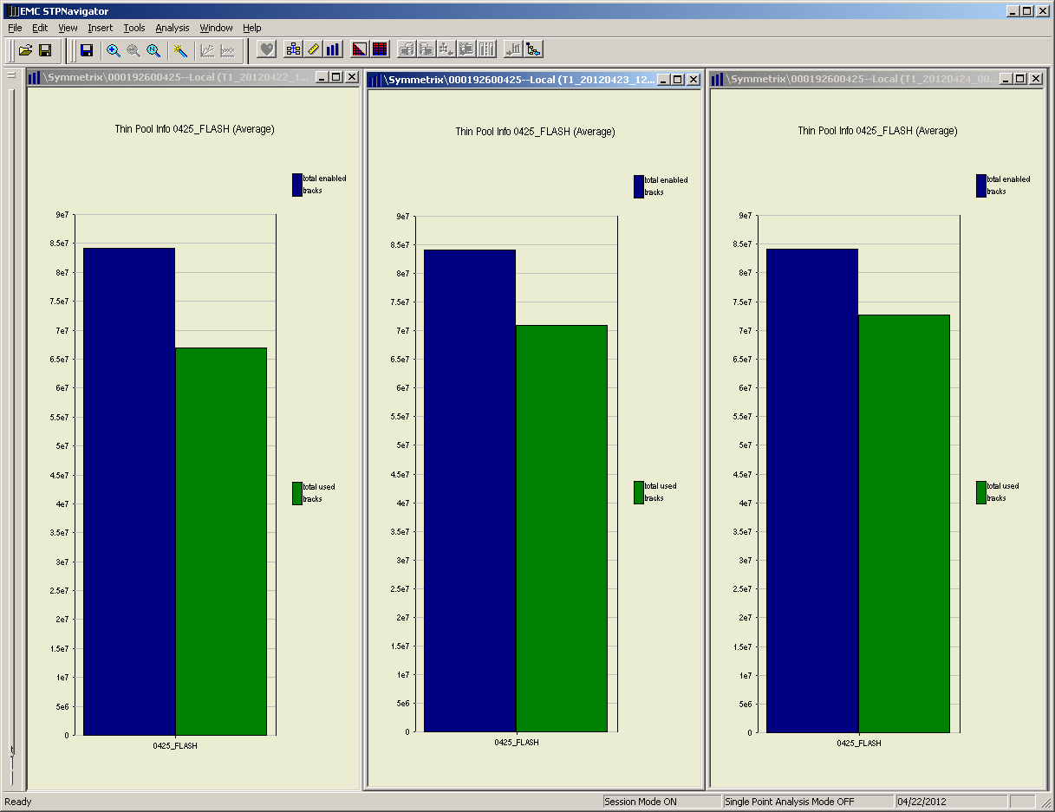
Flash Pool Utilization
Notes:
EMC indicated the flash pool fill should be higher, especially when the PRC is set to 1. An Epack to fix this issue should be coming shortly.

Slide 5
Frame 0425 Reference Metrics
Apr 24 metrics

Slide 6
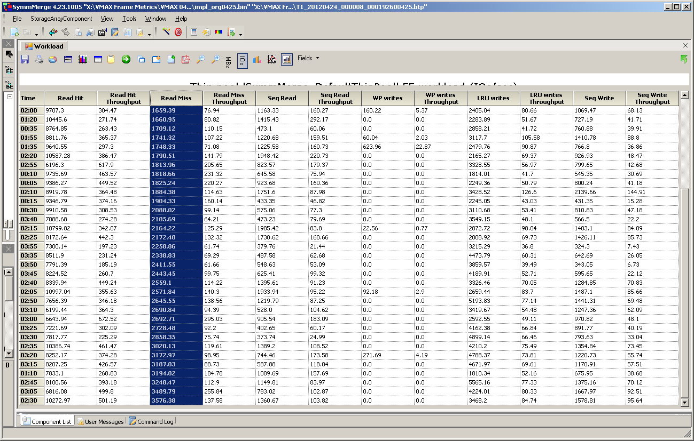
I/O Profile from Frame 0425
Notes:
The I/O profile obtained from the FAST pilot frame was used to derive the I/O profile used in the simulations.

Slide 7
Frame 0425 Reference Metrics

Slide 8
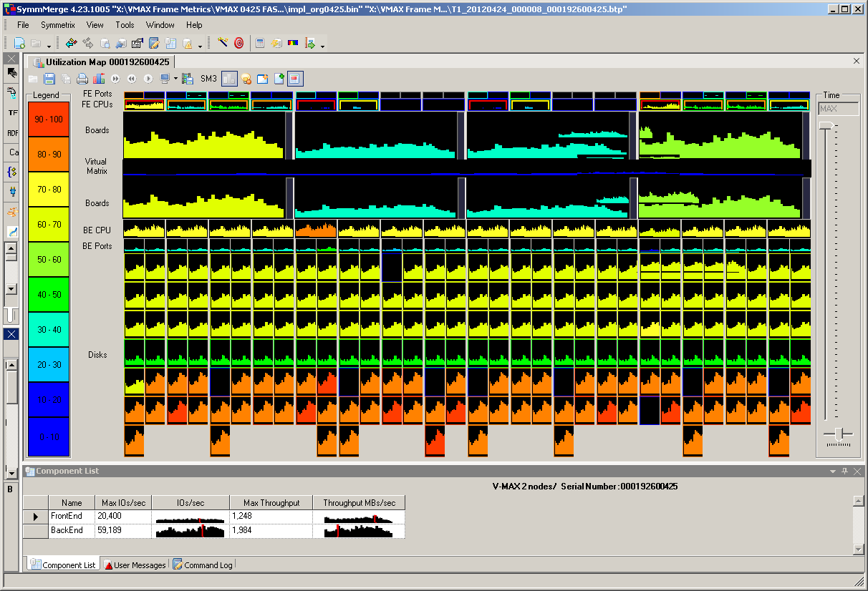
Actual Heat Map
BE to FE ratio of 2.9:1
Notes:
Configure SymmMerge to emulate our FAST pilot performance metrics, note that the backend Max IOs/sec were twice as high on the actual frame. SymmMerge showed 28,877 IOps versus 59,189 IOps for the pilot frame, a delta of 30,312. Based on the STP data backend IOps should be closer to 30,590. At first glance EMC Engineering believe this is an issue with SymmMerge.

Slide 9
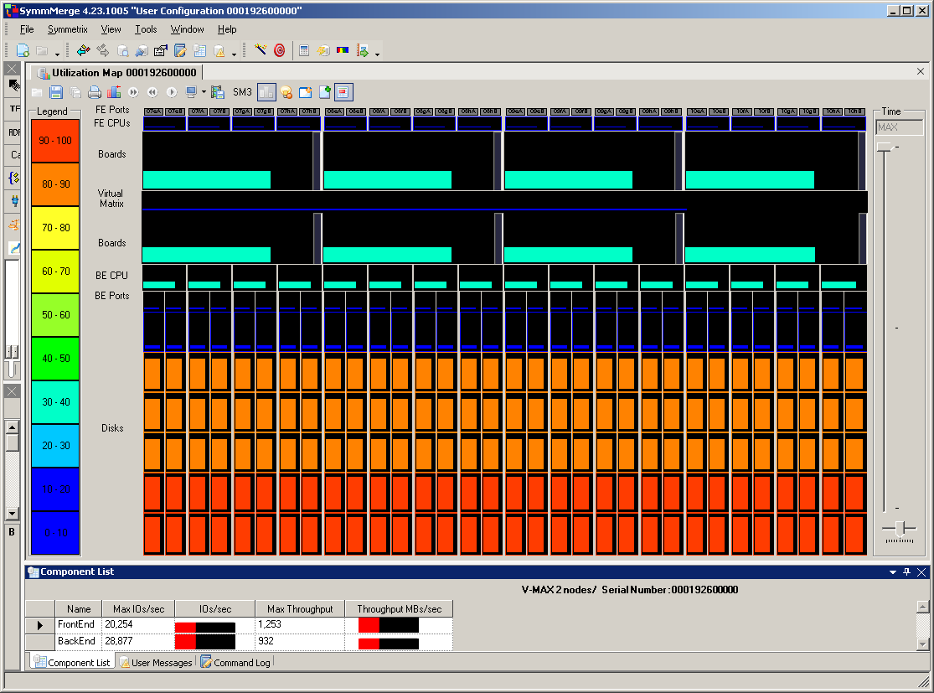
Simulated Heat Map
Be to FE ratio of 1.43:1
Notes:
Based upon a SymmMerge simulation the I/O metrics taken from frame 0425 should generate a BE I/O of 28,877. The simulation took into account the distribution of the host I/O between the 3 tiers; however, BE-to-BE requests generated by FAST VP is beyond the capabilities of the simulator.

Slide 10
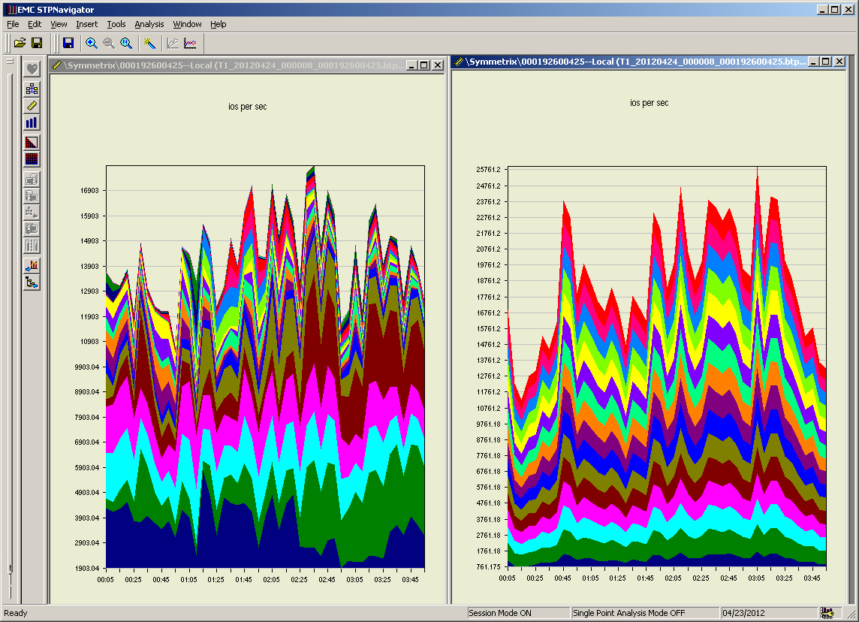
FE vs. BE Total IOPS
FE Rate
BE Rate
Notes:
@ 2:45 FE = 16100 and the BE = 23000 for a BE to FE ratio of 1.43:1.

Slide 11
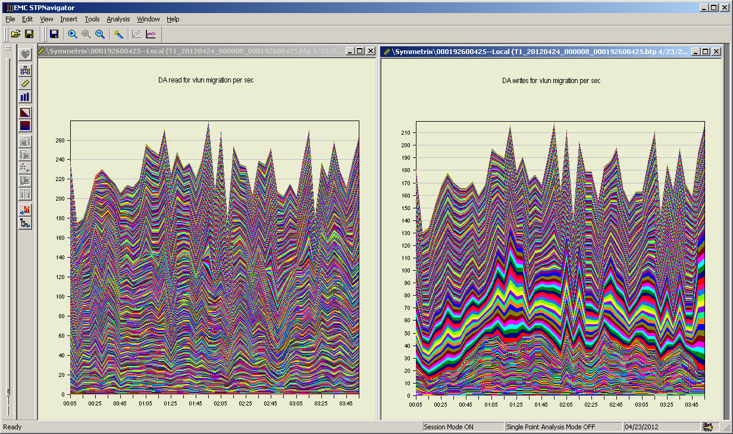
Device Level VLUN Read & Write Rate
Notes:
Estimated BE to BE IOPS as the result of FAST VP migrations @ 2:45:
Read rate = 250, 250 X 12= 3000
Write rate = 198, 198 X (12 X 6) = 14256
Total VLUN BE to BE IOPS of 17,256

Slide 12
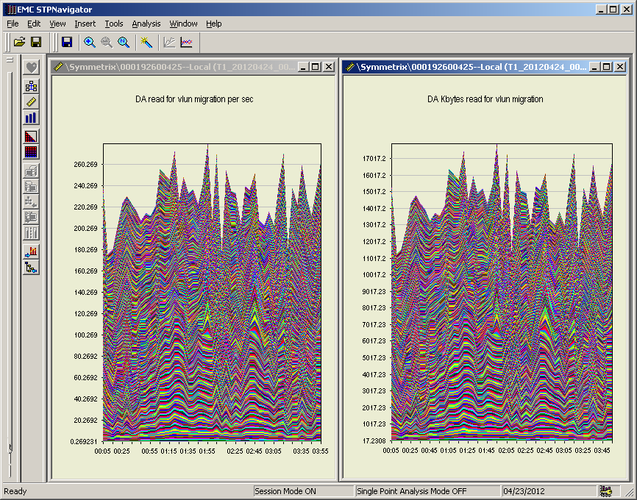
Total VLUN Migration Read Metrics
280 IOPS
18,000KB/s
Notes:
18,000KBps/280IOps= 64.3KB per read request

Slide 13
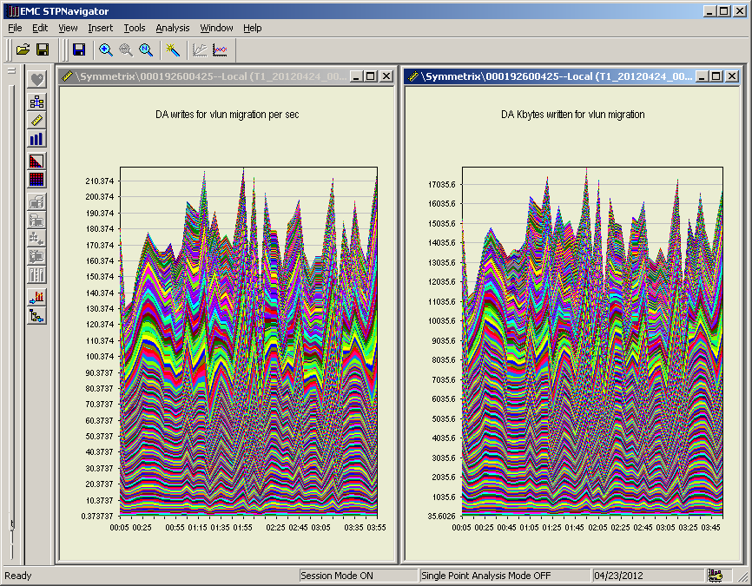
Total VLUN Migration Write Metrics
220 IOPS
18,000KB/s
Notes:
18,000KBps/220IOps= 81.8KB per read request
The 81.8KB per write request is an indication that the extent migration were either 1 or 2 tracks. The VLUN migration will only send tracks that are actually used. Therefore, FAST VP measure business and migrates by extents, but movement maybe less than an extent if some tracks within the extent has not been written to.

Slide 14
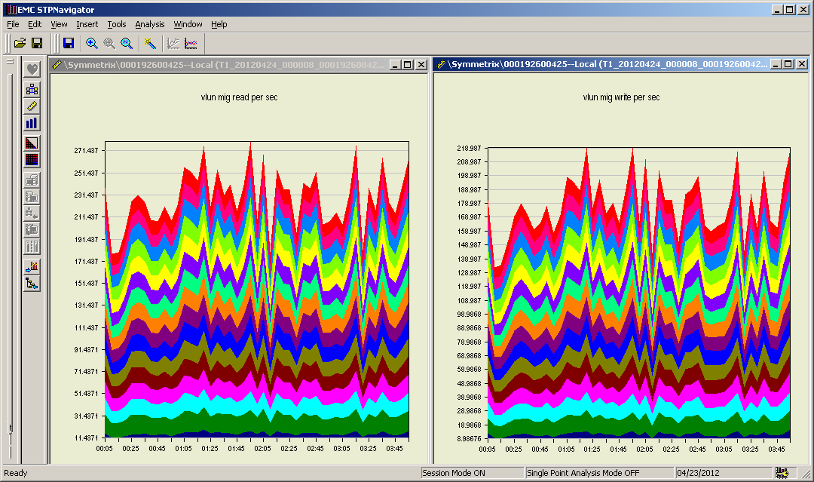
BE Level VLUN Migration IOPS
Notes:
@ 2:45
Read IOPS = 250
Write IOPS = 198

Slide 15
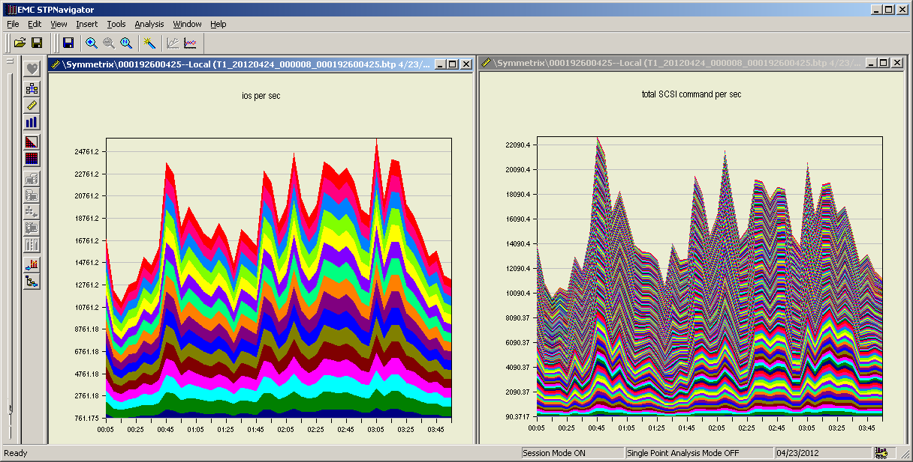
BE Loop & Disk Total IOPS
Notes:
@ 2:45
BE Loop total IOPS = 23261
Disk Total IOPS = 18590

Slide 16
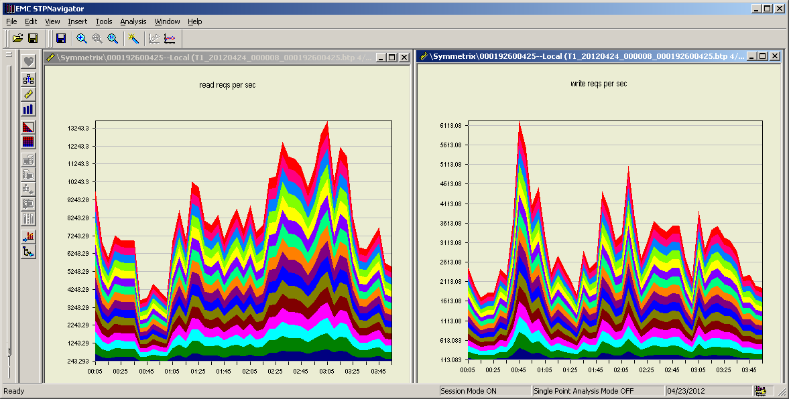
BE Loop Read & Write Total
Notes:
@ 2:45
Read IOPS = 11000
Write IOPS = 3400

Slide 17
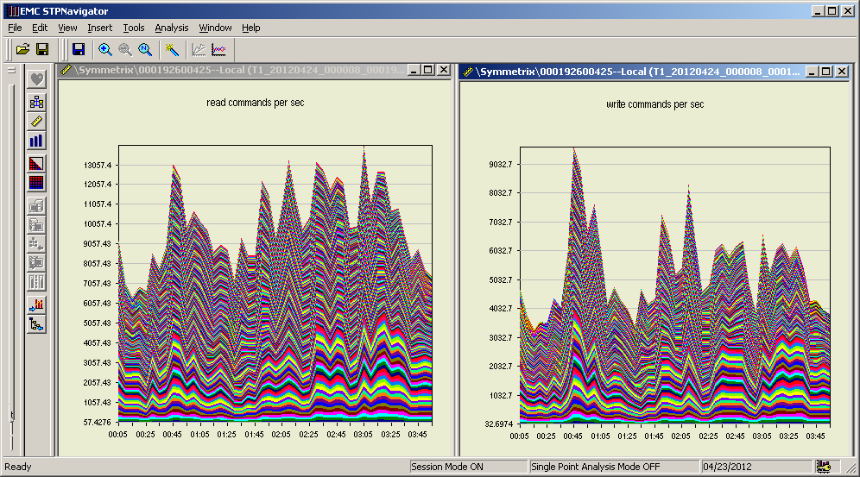
Disk Read and Write Total IOPS
Notes:
@2:45
Read IOPS = 12300
Write IOPS = 6290
Total IOPS = 18,590

Slide 18
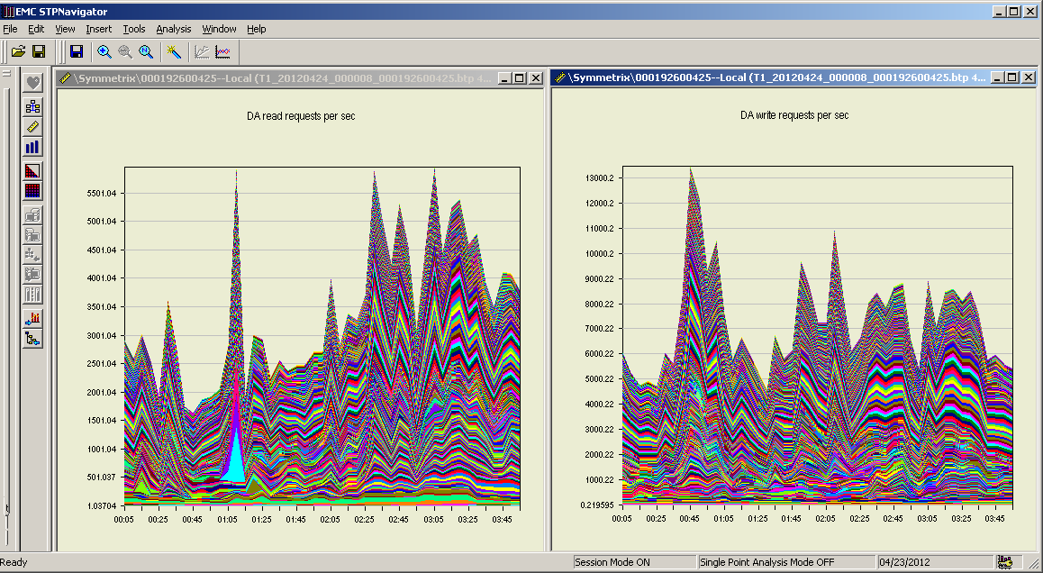
Device Level DA Read & Write Total IOPS
Notes:
@ 2:45
Read IOPS = 5300
Write IOPS = 8700
Total = 14,000

Slide 19
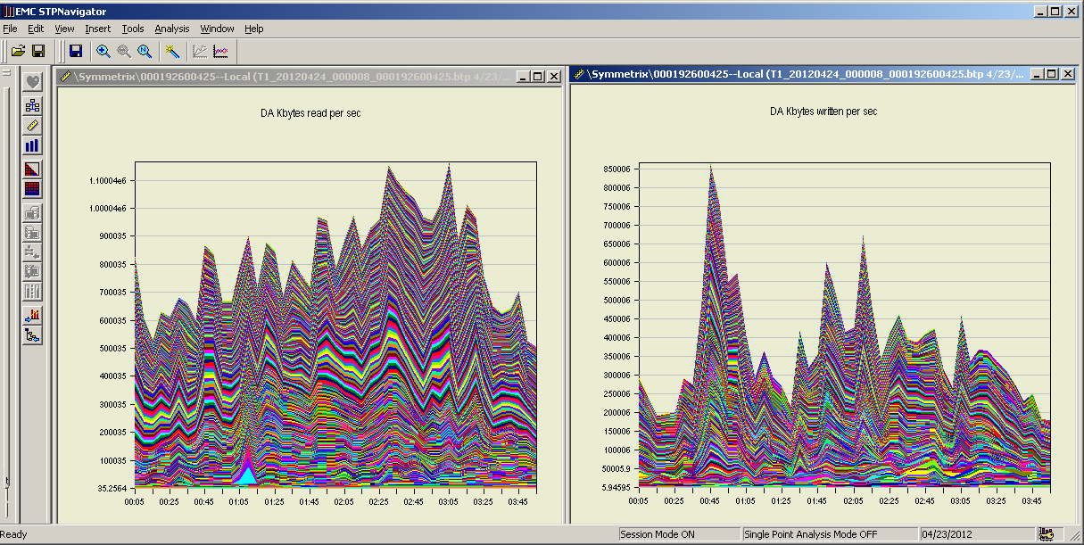
Device Level DA Read & Write Total TRate
Notes:
@2:45
Read TRate = 1.025004E6KB = 1049604096B/s = 1001.5MB/s Avg. 198,038B per transaction
Write TRate = 420006KBps = 43014144B/s = 41.4MB/s Avg. 49,44B per transaction

Slide 20
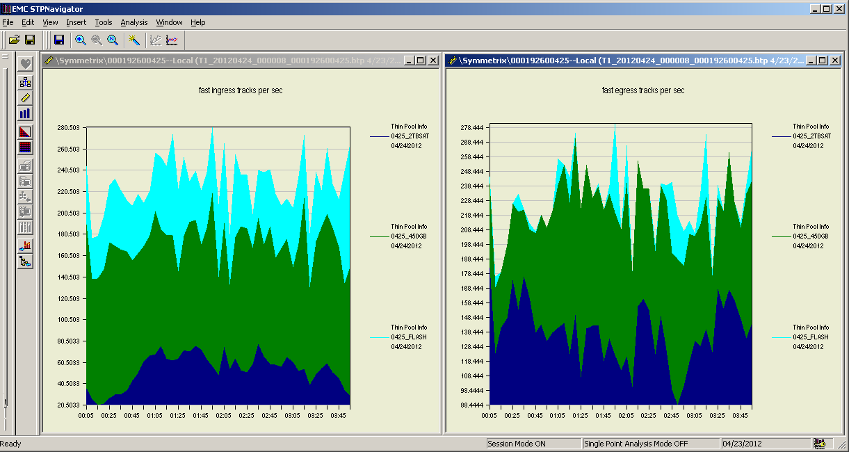
Total Tier Ingress & Egress
Notes:
@2:45
Ingress IOPS = 240 trks/s
Egress IOPS = 240 trks/s
Average over sample period
Ingress IOPS = 229 trks/s
Egress IOPS = 229 trks/s

Slide 21
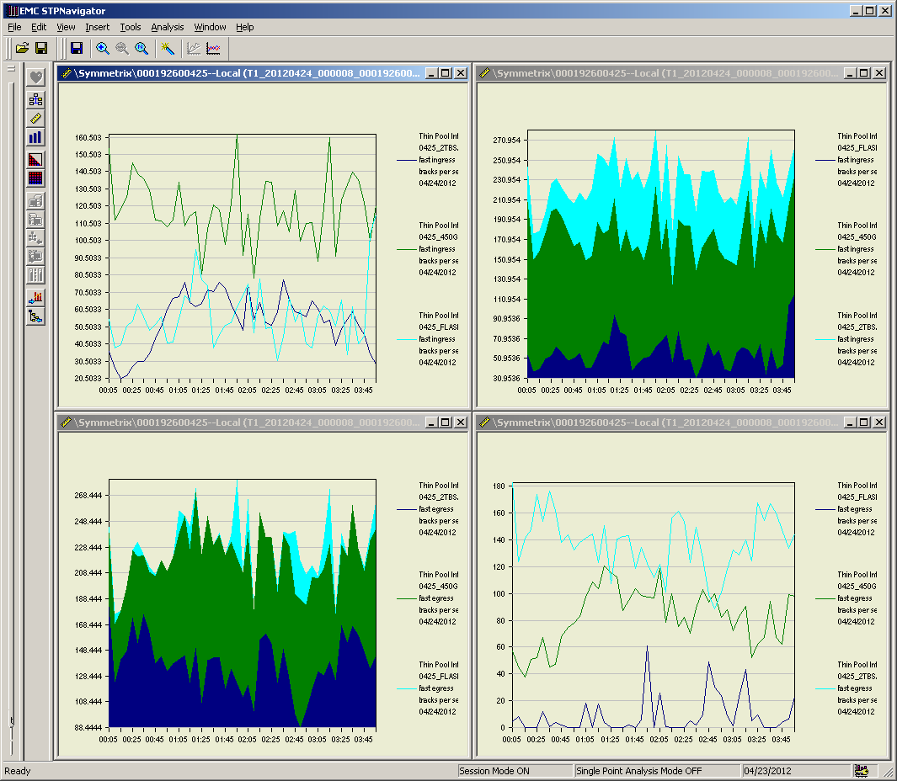
Thin Pool Ingress & Egress Pool Distribution
Ingress Tracks
Ingress Tracks
Egress Tracks
Egress Tracks
Notes:
Ingress tracks: 54% FC, 24% Flash, 22% SATA
Egress tracks: 61% SATA, 35% FC, 4% Flash

Slide 22
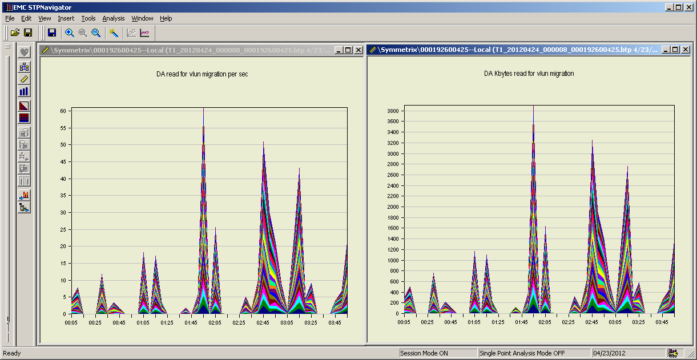
DA (devive level) VLUN Migration Flash Pool TDAT Read IOPS and KB/s
Notes:
@ 2:45
Read IOPS = 51
KB/s = 3250
Flash Pool VLUN read migration size: 64KB

Slide 23
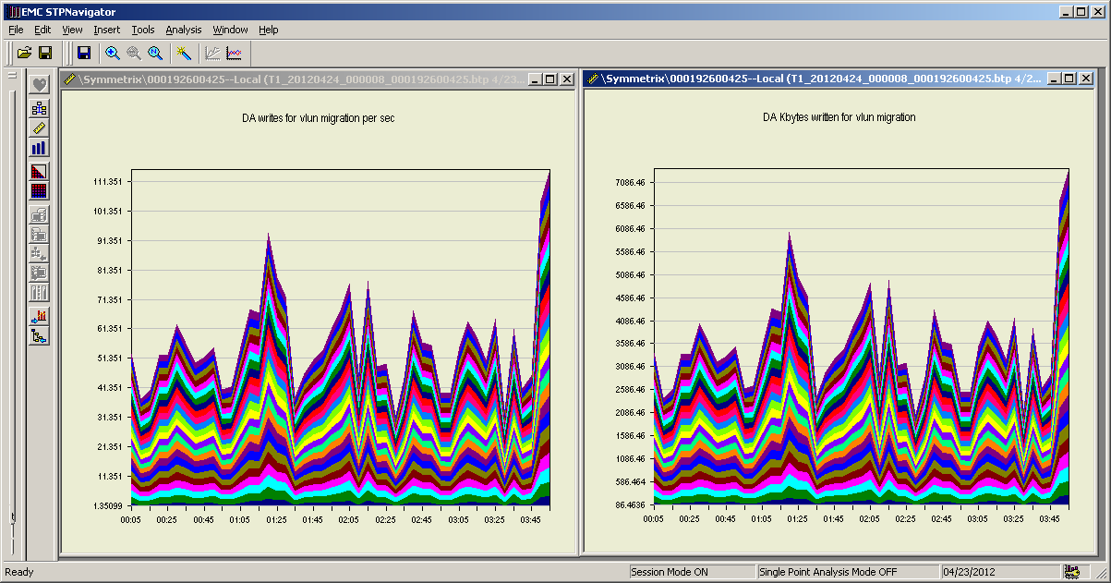
DA VLUN Migration Flash Pool TDAT Write IOPS and KB/s
Notes:
@ 2:45
Write IOPS = 56
KB/s = 3600
Flash pool VLUN write migration size: 64KB

Slide 24
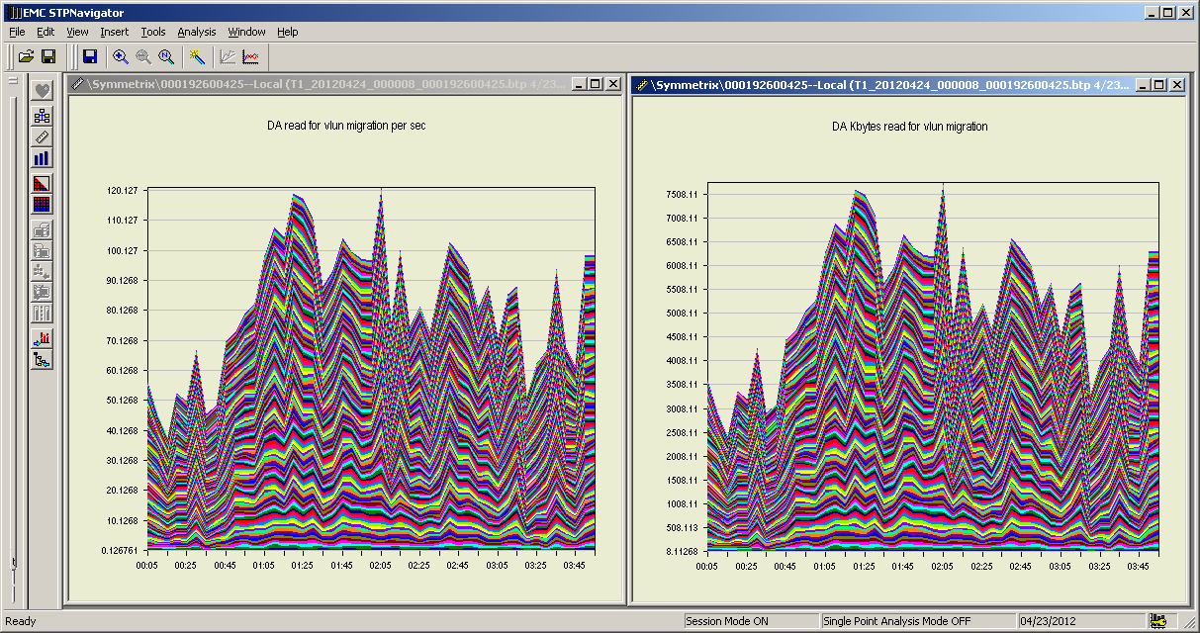
DA VLUN Migration FC Pool TDAT Read IOPS and KB/s
Notes:
@ 2:45
Read IOPS = 99
KB/s = 6400
FC Pool VLUN read migration size: 64KB

Slide 25
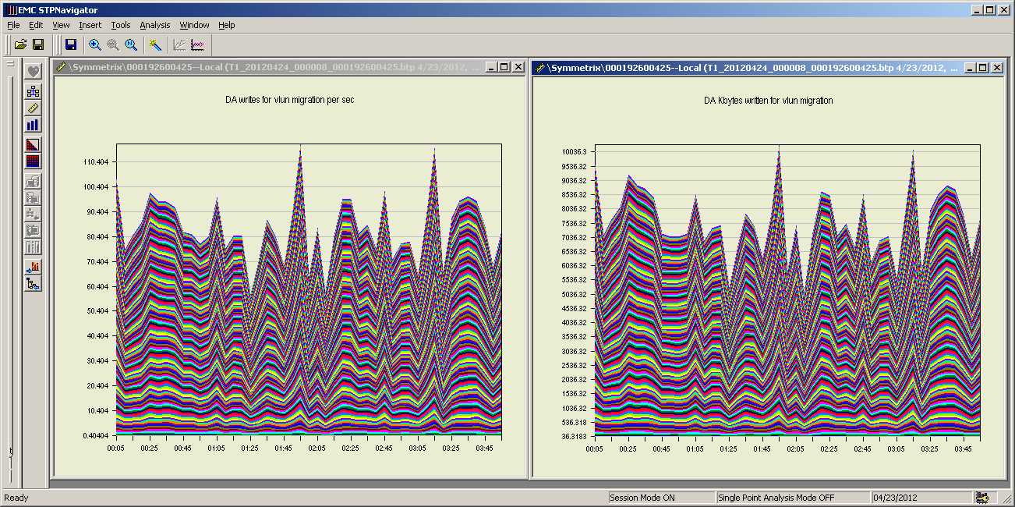
DA VLUN Migration FC Pool TDAT Write IOPS and KB/s
Notes:
@ 2:45
Write IOPS = 99
KB/s = 8340
FC Pool VLUN migration size: 92KB

Slide 26
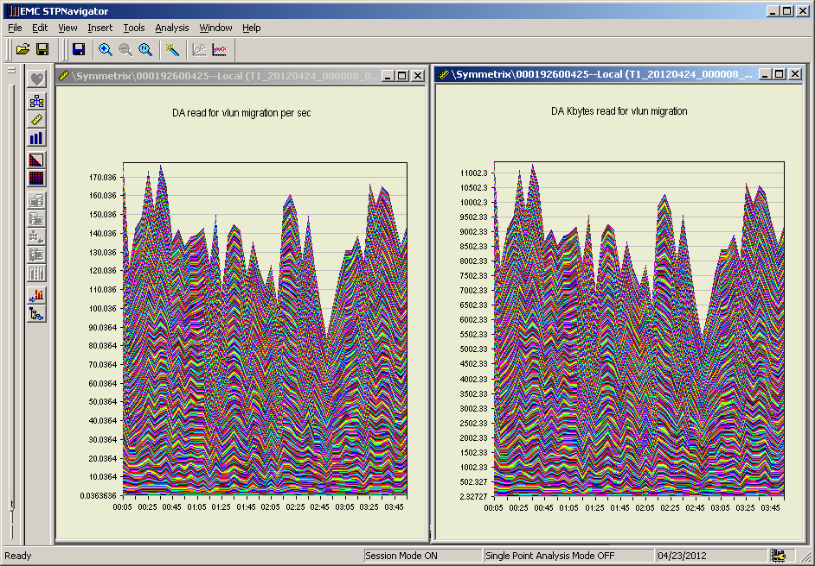
DA VLUN Migration SATA II Pool TDAT Read IOPS and KB/s
Notes:
@ 2:45
Read IOPS = 105
KB/s = 6600
SATA pool VLUN read migration size: 64KB

Slide 27
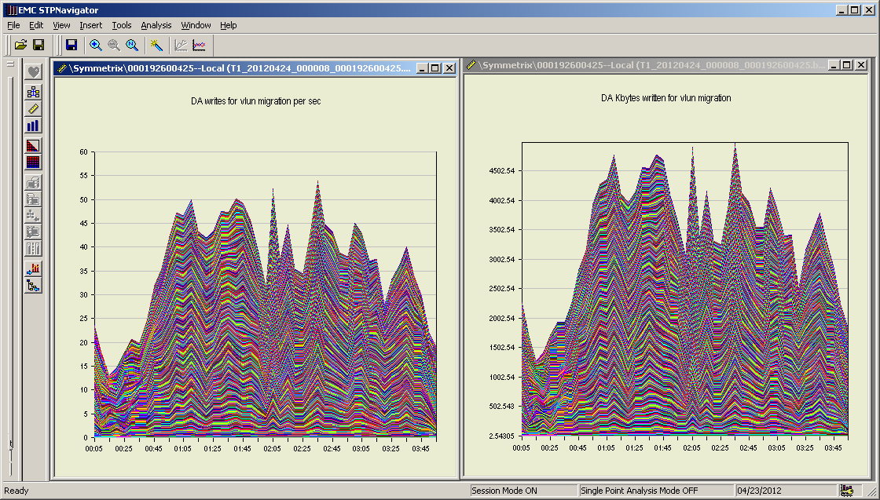
DA VLUN Migration SATA II Pool TDAT Write IOPS and KB/s
Notes:
@ 2:45
Write IOPS = 43
KB/s = 4000
SATA pool VLUN write migration size: 93KB

Slide 28
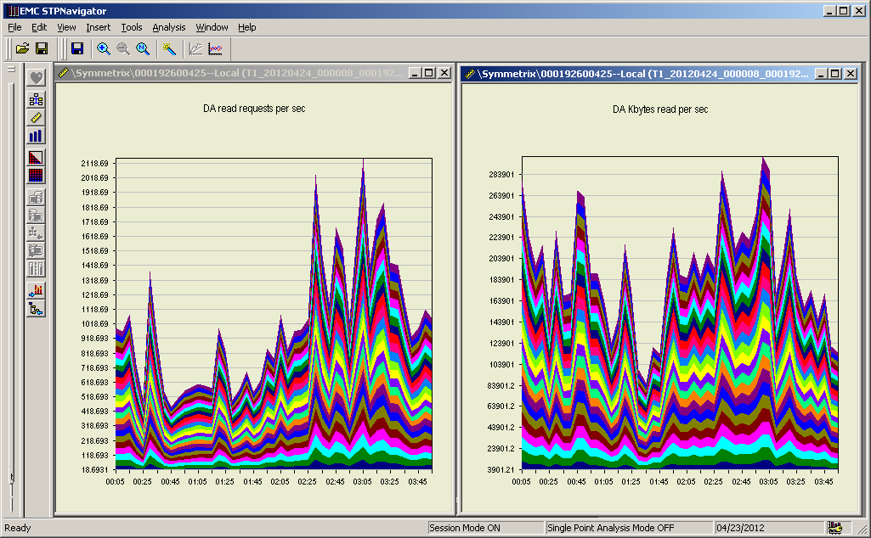
DA Flash TDAT Read IOPS and KB/s
Notes:
Read request size ranged from 11KB to 634KB with an average of 151KB.

Slide 29
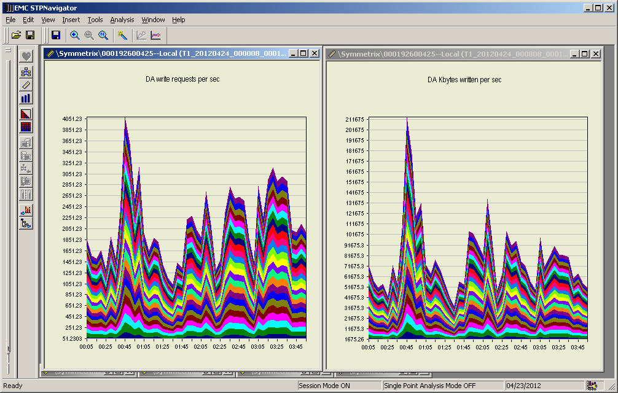
DA Flash TDAT Write IOPS and KB/s
Notes:
Write request size average of 35KB.

Slide 30
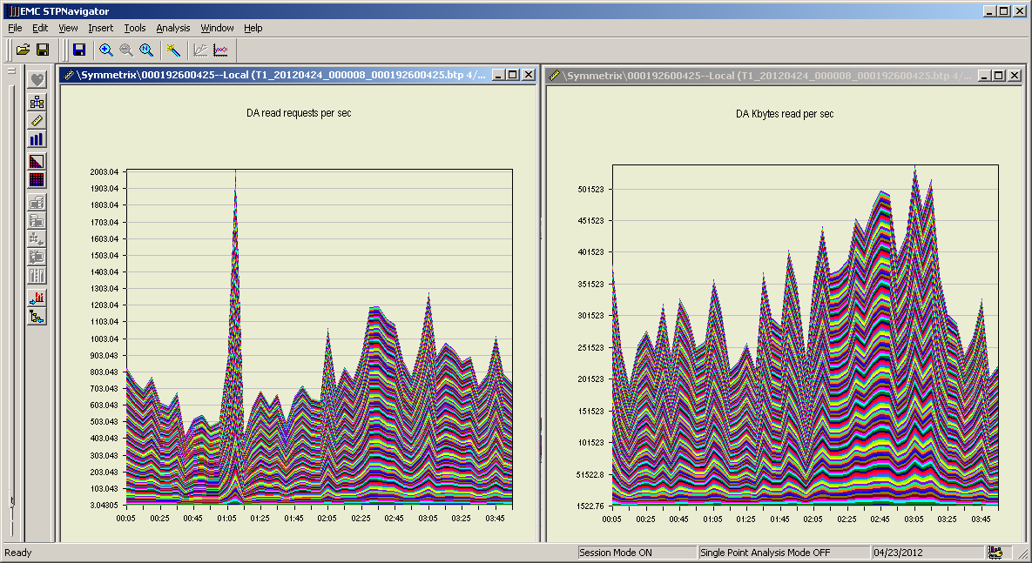
DA FC TDAT Read IOPS & KB/s
Notes:
Read average request size of 407KB.

Slide 31
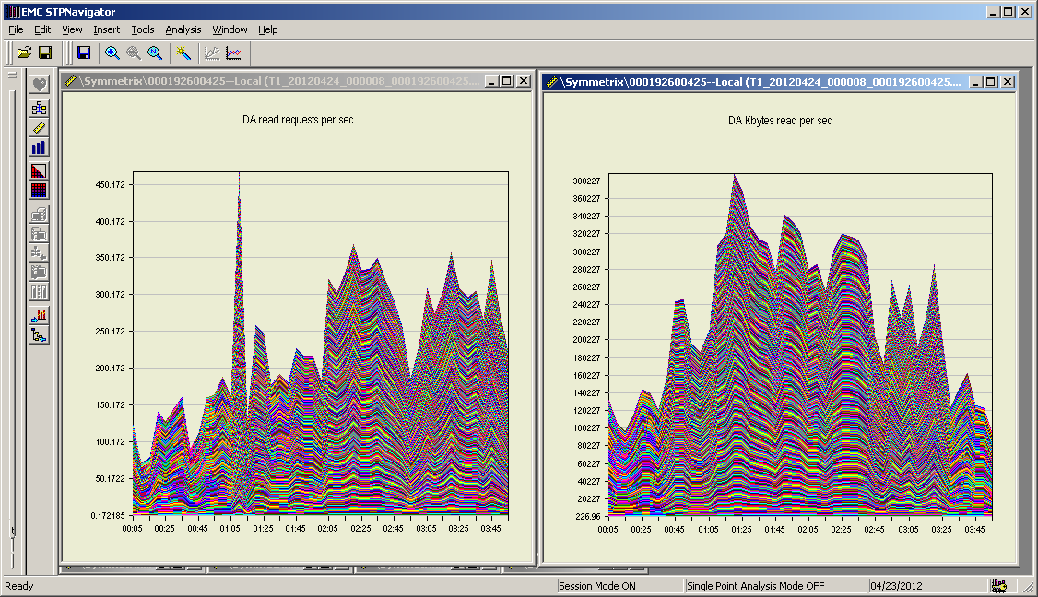
DA SATA II TDAT Read IOPS and KB/s
Notes:
Read request average read size of 880KB.

Slide 32
DA SATA II TDAT Write IOPS and KB/s
Notes:
Write request average size of 38KB.

Slide 33
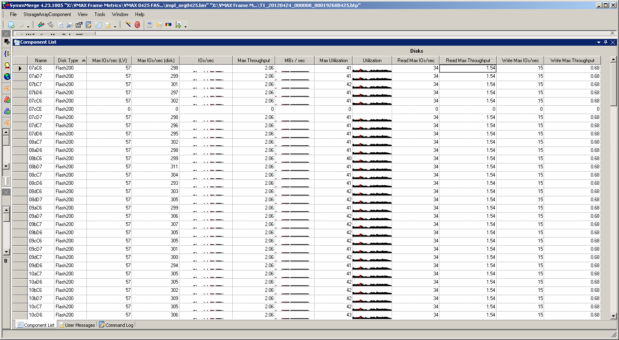
Flash Drive Metrics

Slide 34
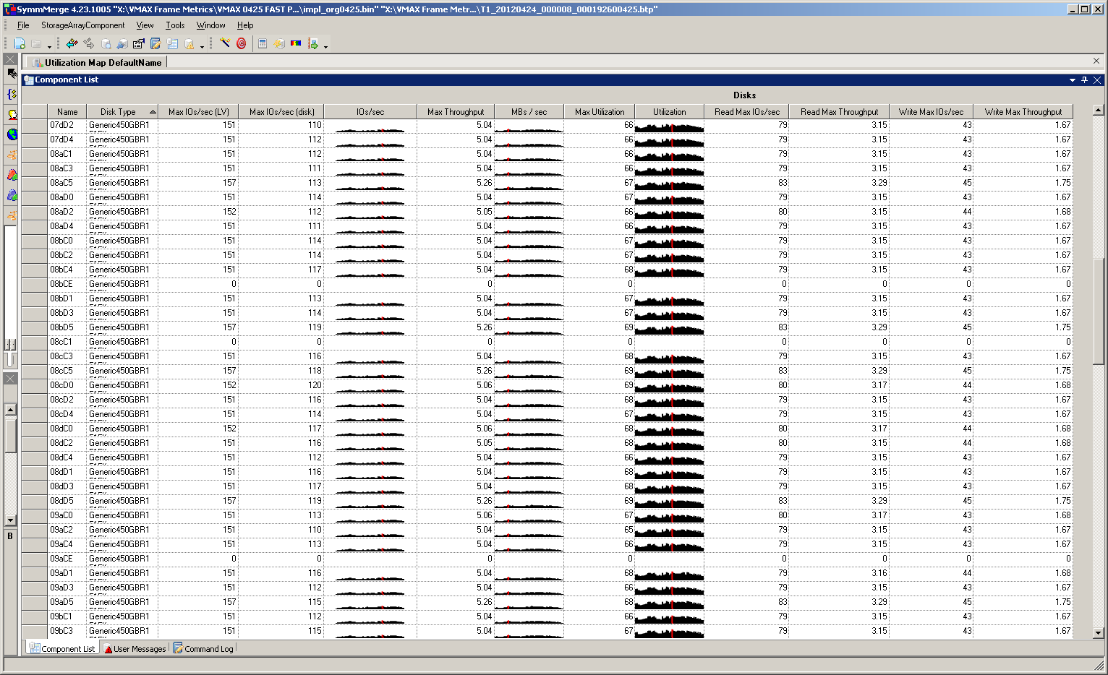
Fibre Channel Drive Metrics

Slide 35
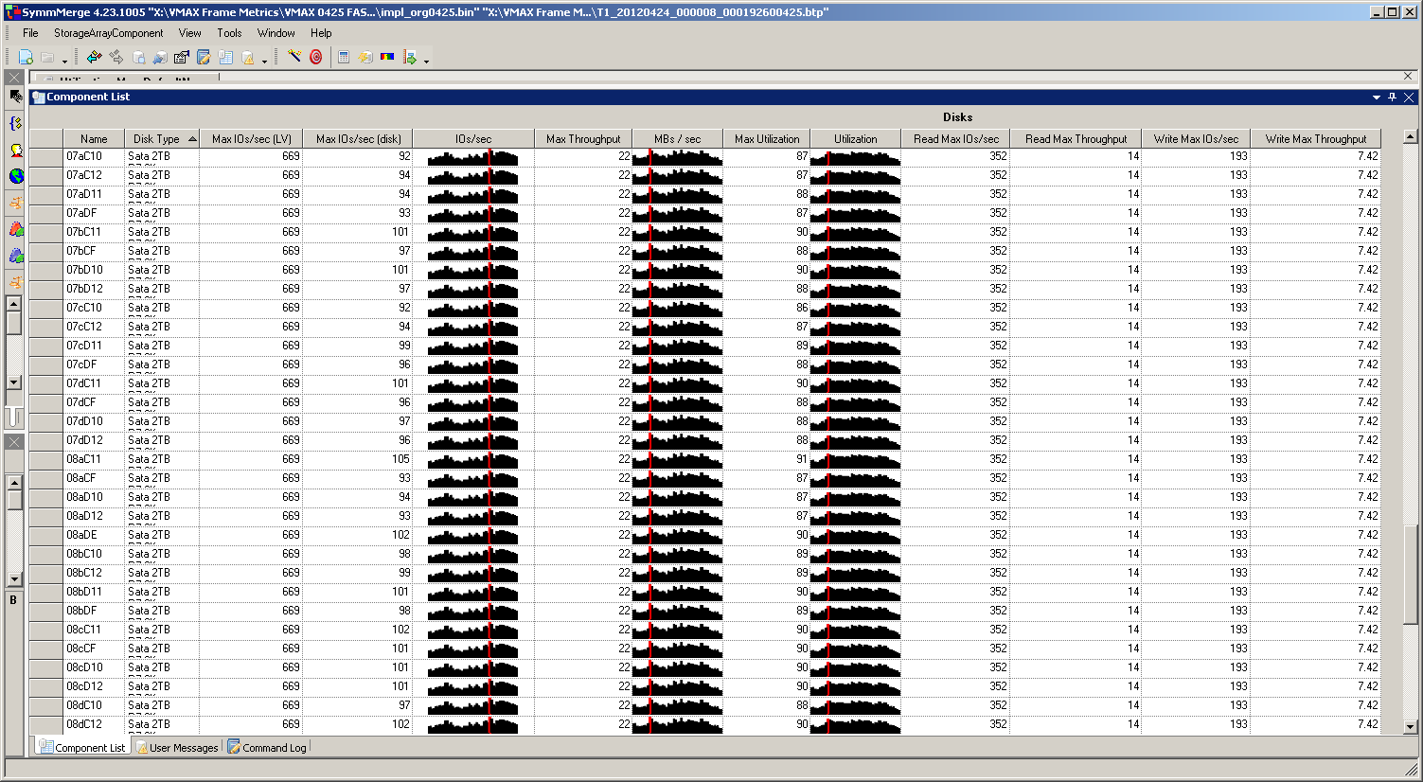
SATA II Drive Metrics
Notes:
Per SATA drive: ~97 Max IOs/sec with 22MB/s equals 227KB average transaction size.

Slide 36
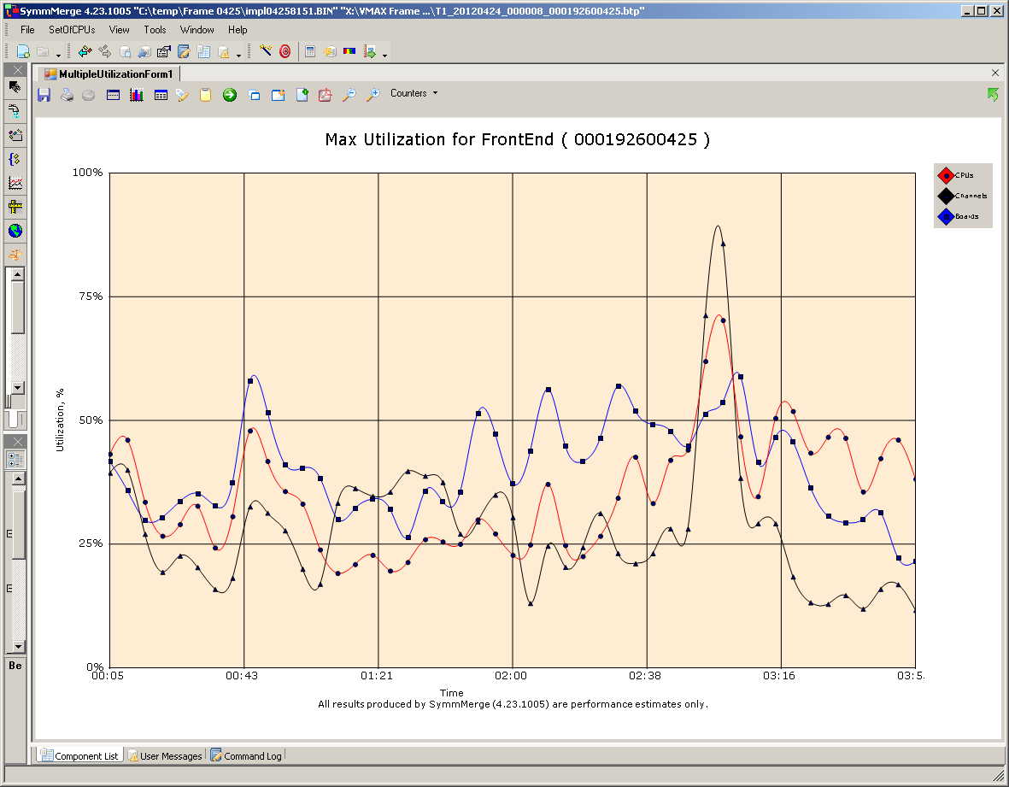
FE Port Graph

Slide 37
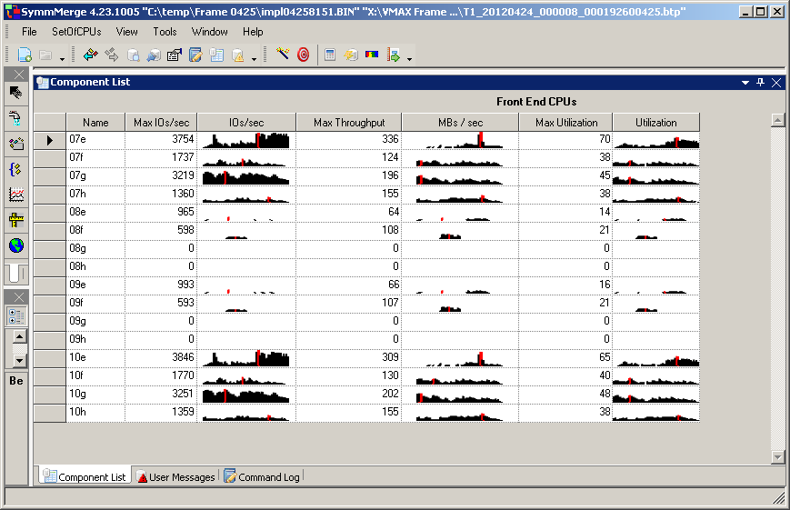
FE Port metrics

Slide 38
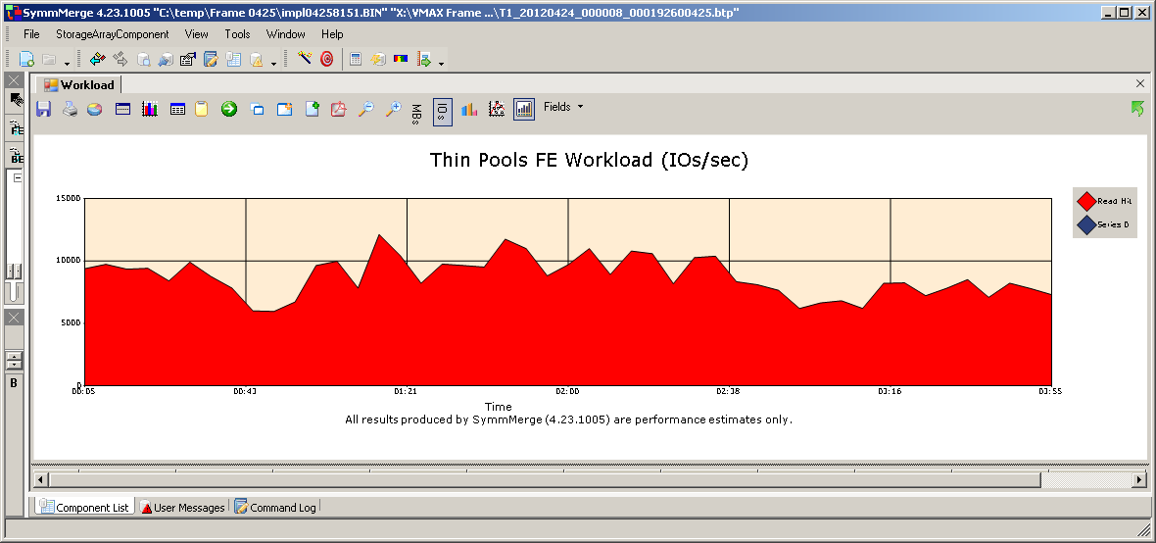
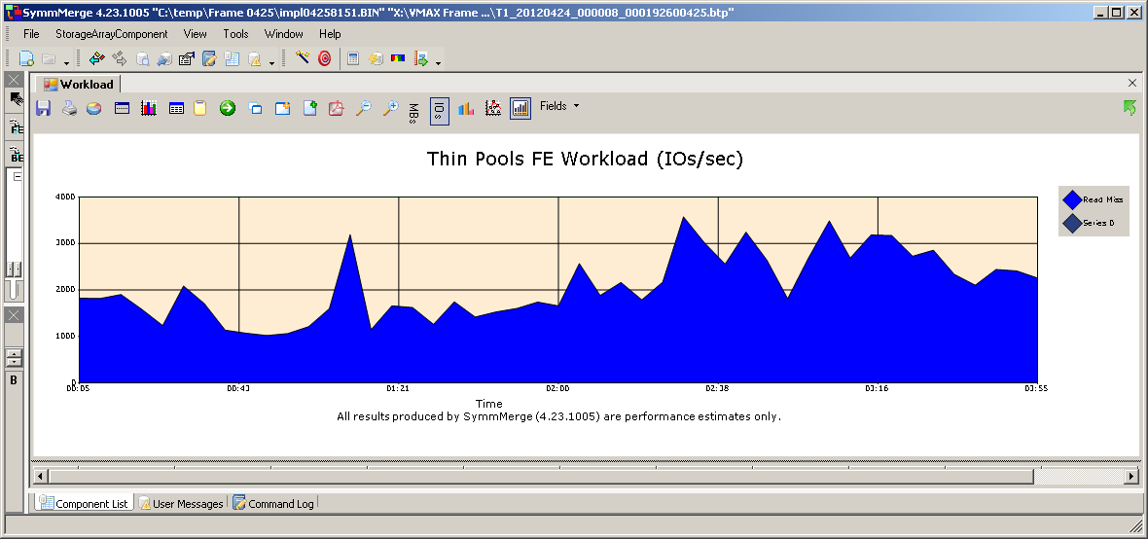
FE Read Hit & Miss

Slide 39
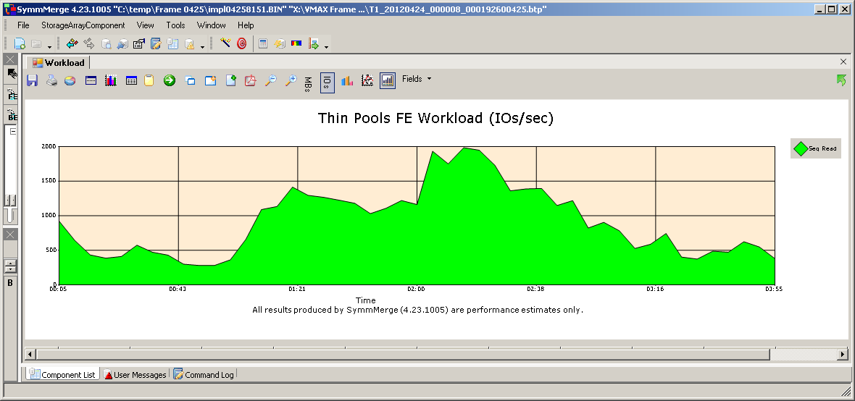
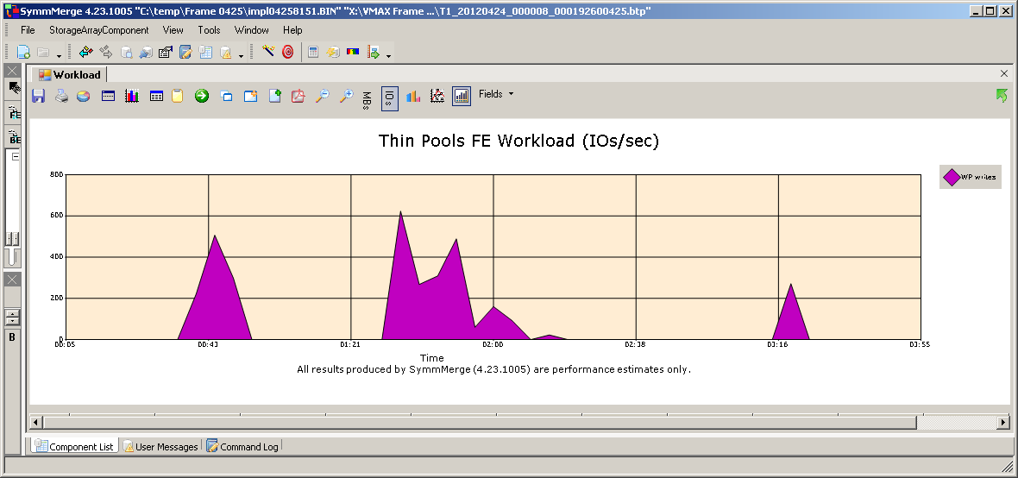
Con’t FE Seq. Read & WP Writes

Slide 40
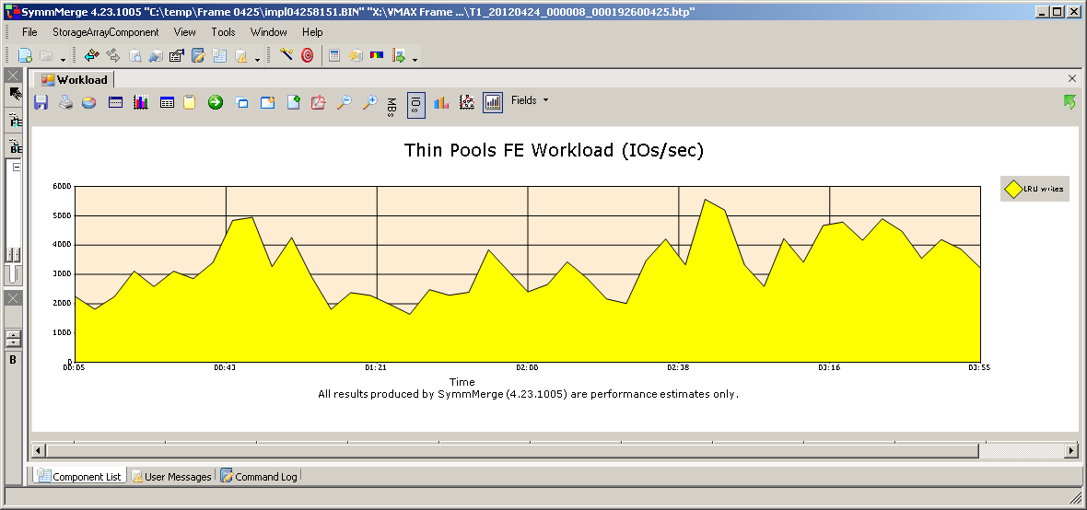
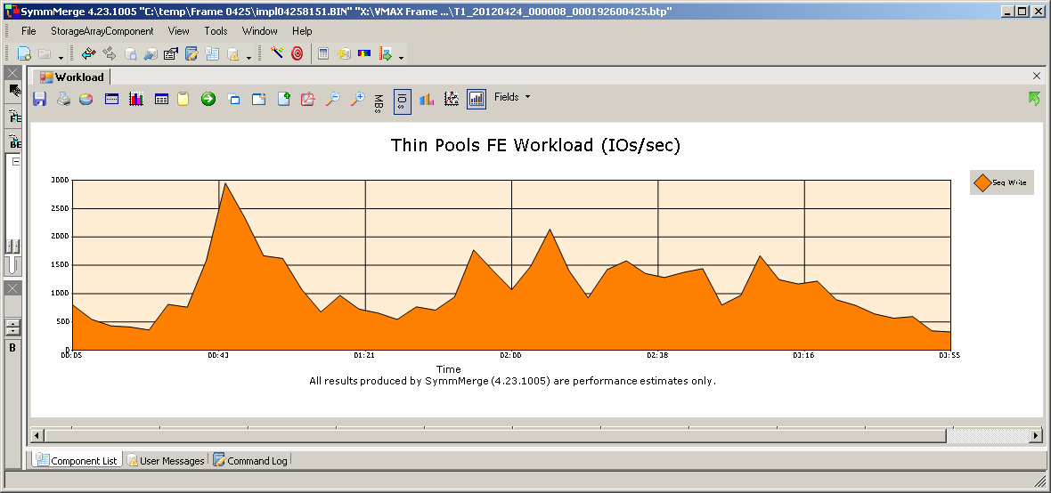
Con’t FE LRU &

Slide 41
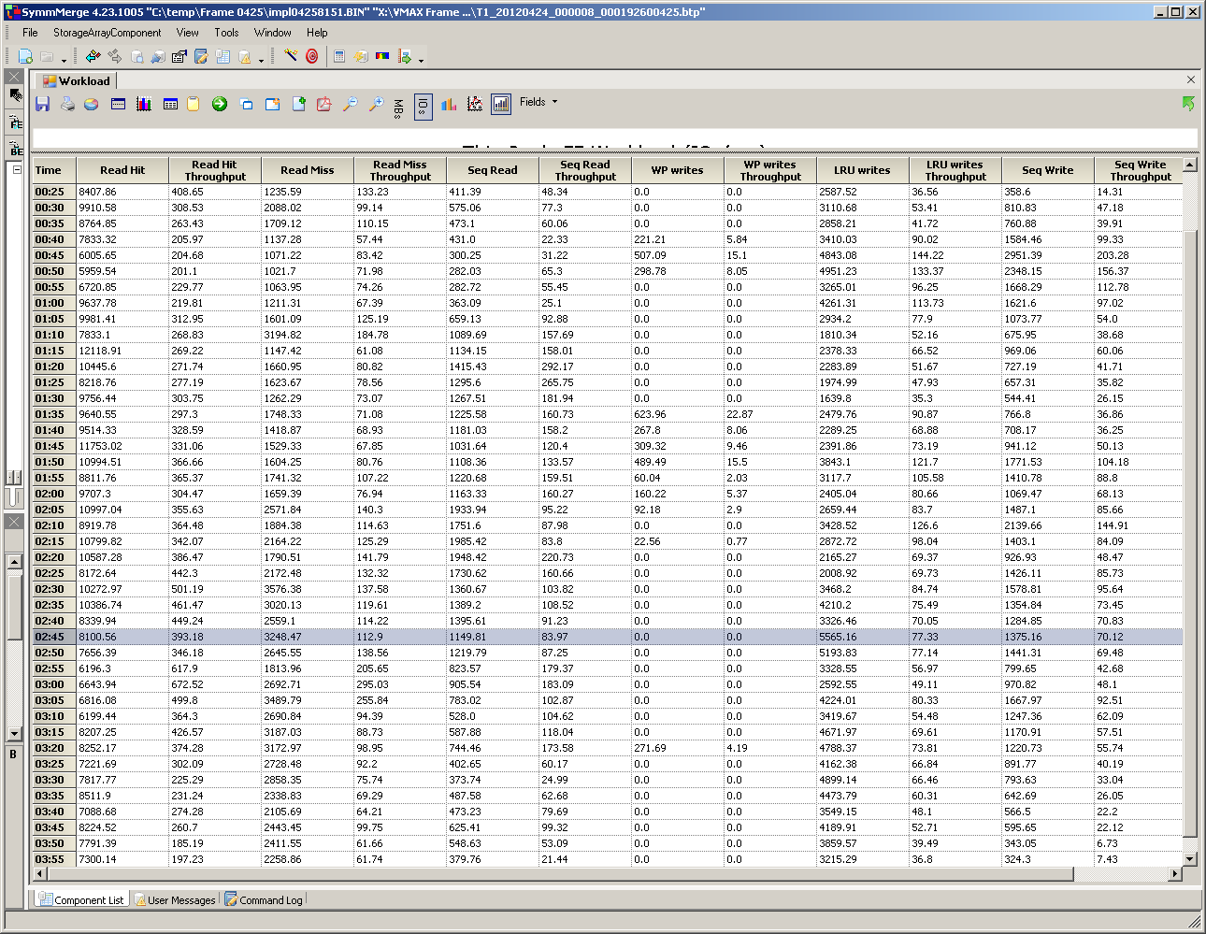
FE workload

Slide 42
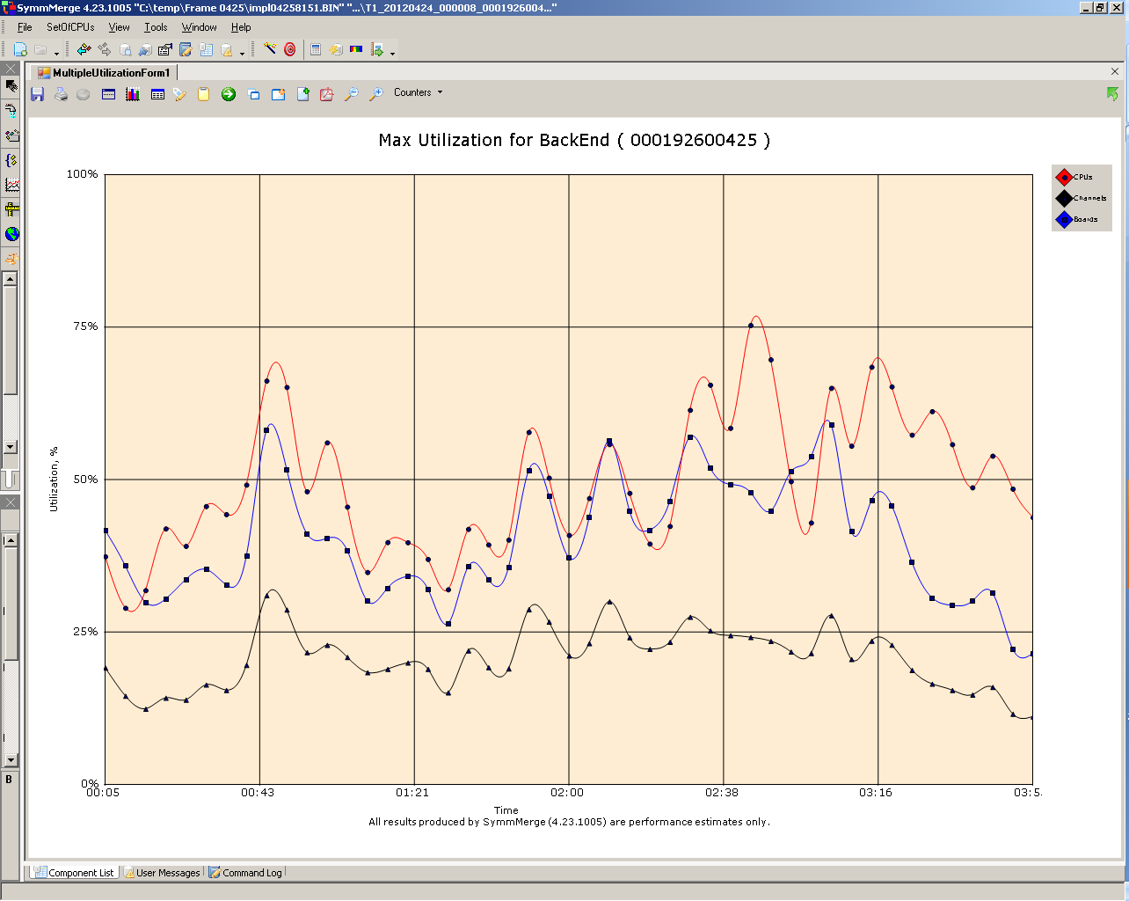
BE Graph

Slide 43
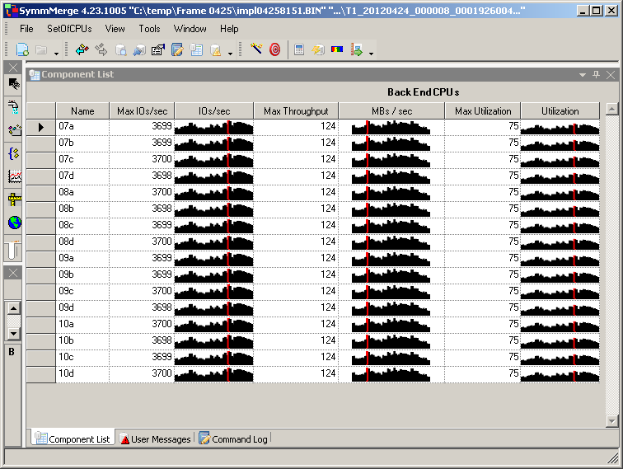
BE Loop Metrics

Slide 44
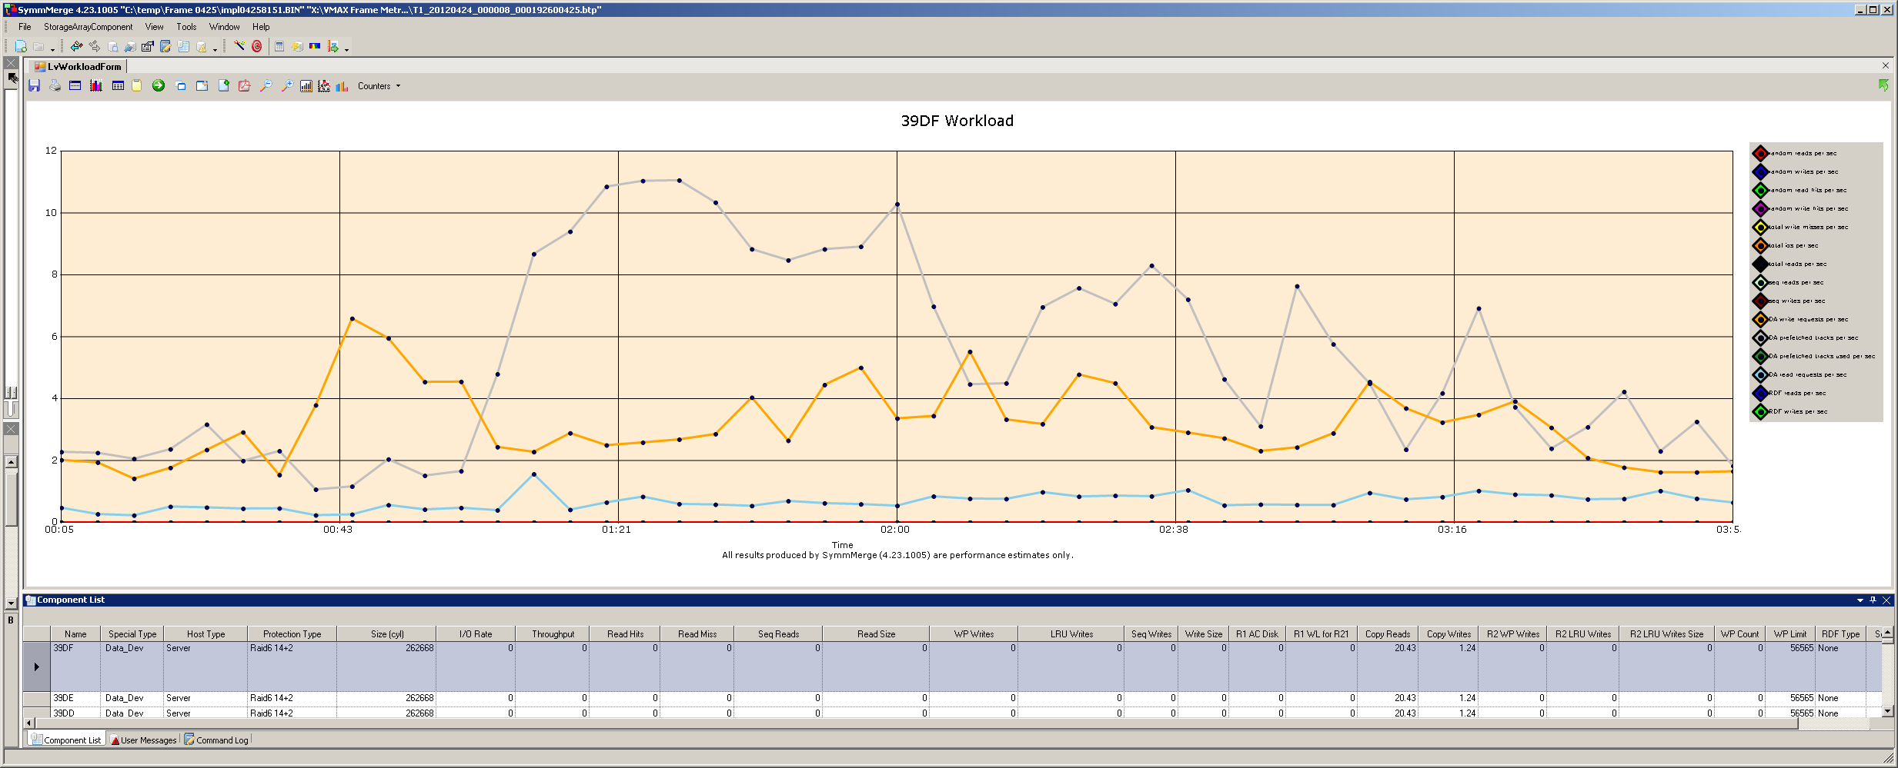
SATA Tier TDAT Example

Slide 45
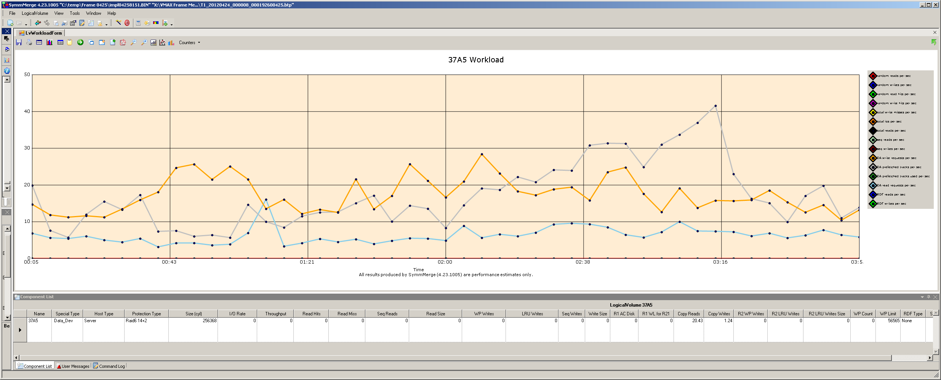
FC TDAT Example

Slide 46
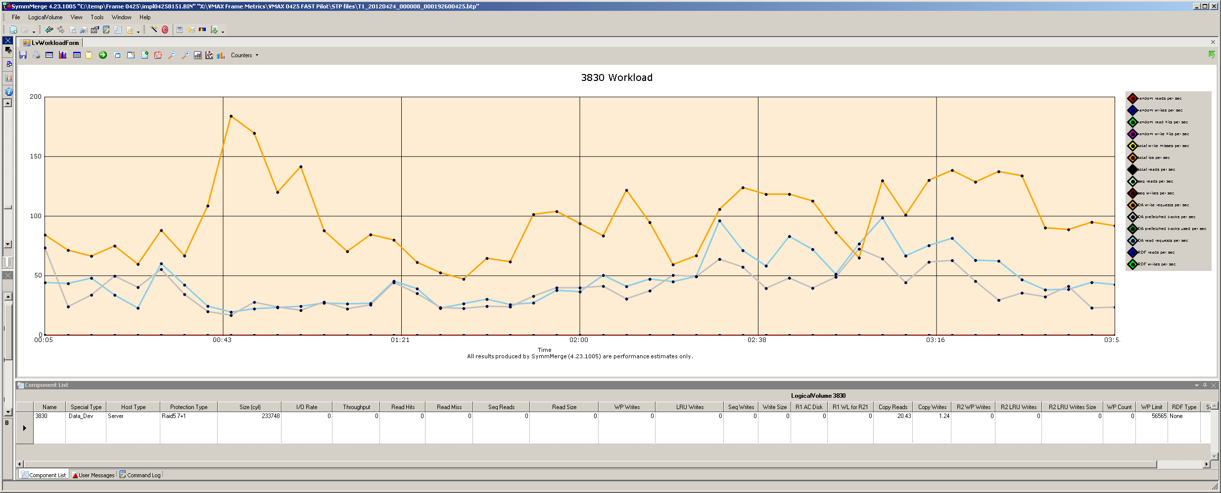
SSD TDAT Example

Slide 47
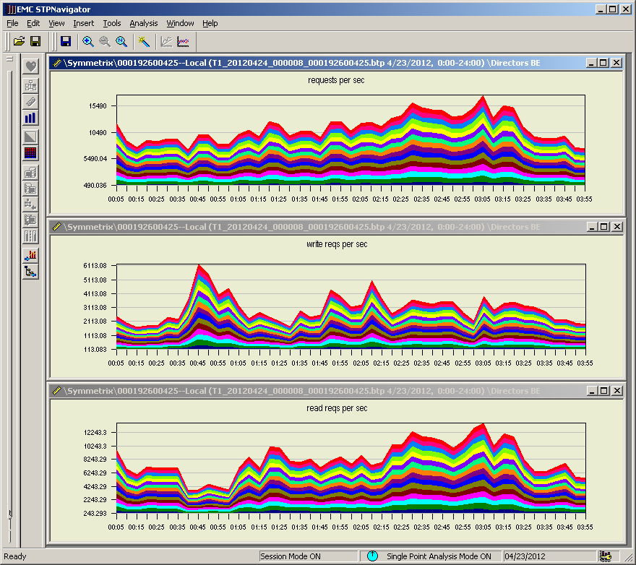
BE Total, Read & Write Request
Notes:
Wt @ 3300 + Rd @ 11,000 = 14,300 Graphs look correct

Slide 48
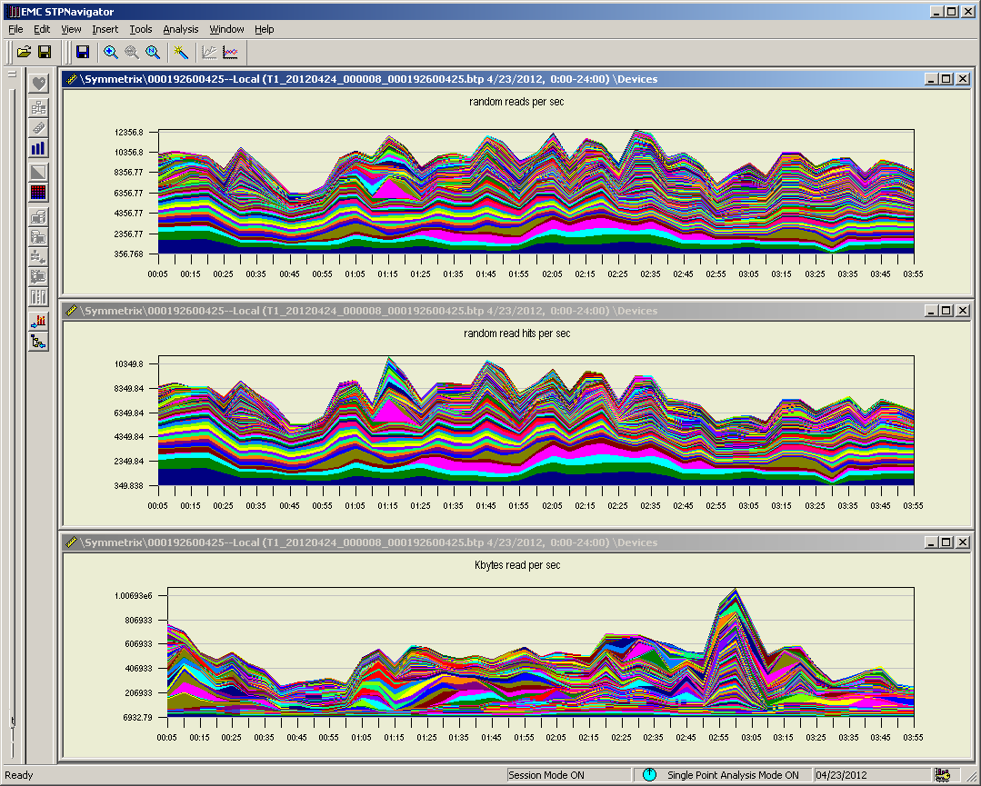
Device Random Read Metrics
Notes:
@2:45
Random Reads = 10356
Random Read Hits = 7300
Random Read Transaction rate = 530000KB/s
In total:
Write’s = 6250
Read’s = 11,356
Total = 17,606

Slide 49
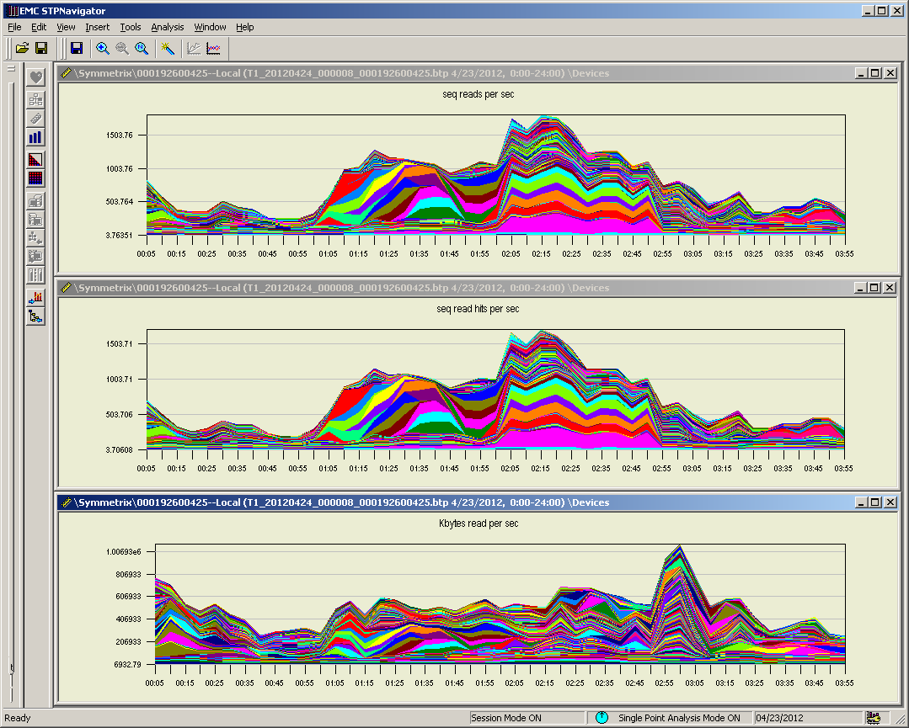
Device Sequential Read Metrics
Notes:
@2:45
Seq read = 1100
Seq read hits = 900
KB/s = 590,000

Slide 50
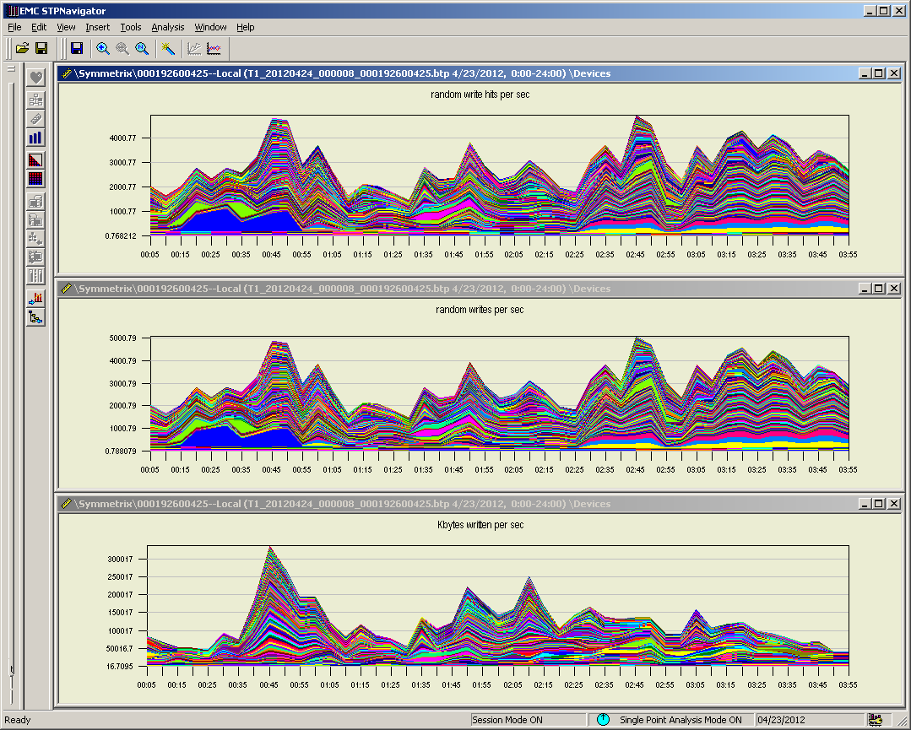
Device Random Write Metrics
Notes:
@ 2:45
Random writes and write hits are equal = 5000
Writes KB = 140,000

Slide 51

Device Sequential Read Metrics
Notes:
@ 2:45
Seq writes & seq write hits = 1250
KB/s = 140,000

Slide 52

FE All Port Metrics
Notes:
@ 2:45
IOPS = 16900
KB/s = 690000
Avg. transaction size ~100KB

Slide 53

Percent Busy Observation
FE % busy ranged from 60.81 – 8.51 across 12 slices.
BE % busy ranged from 52.66 – 38.65 across 16 loops.

Slide 54


% Busy Observation con’t
Notes:
FE slice 18.97% average busy with a standard deviation of 17.14.
BE loop 45.74% average busy with a standard deviation of 4.28.
Percent metrics obtained across a 4 hour sample period.
In a frame with no RDF, no manual internal migrations, host read I/O of 10668 reads with a 74.5% hit rate and host write I/O of 4067 with a 73.4% hit rate makes the ratio of FE to BE % busy perplexing. As determine by the simulator the BE to FE is 1.43, while the actual BE to FE ratio for frame 0425 is 2.9. This ratio places ~30,000 BE requests unaccounted for.

Slide 55

% Busy Observations - Algorithm Adjustments
Adjustments to the algorithms calculating load like “alg_dm_wr_factor” may make load metric correlations more accurate and balanced.

Slide 56
Actual Heat Map Apr. 24th
BE to FE ratio of 2.9:1

Slide 57

Actual Heat Map from Apr. 23rd
BE to FE ratio of 2.7:1
Notes:
Heat map drawn 20 hours apart still shows a high BE to FE ratio. This indicates that the BE to FE ratio is consistent right or wrong.

Slide 58
Summary Throughput
Metric sample at 2:45
  FE Port Total = 16,900 IOPS
  BE Loop Total = 23,260 IOPS
  Disk Total = 18,590 IOPS
  Device Total = 17,606IOPS
  VLUN Migration:
    Reads = 214 @ 16,250KB/s
    Writes = 197 @15,940KB/s
  Thin Pool Info: Ingress & Egress tracks/sec 240ea. Equal to 15,360KB/s
FE port 18.97% average busy with a standard deviation of 17.14 across four hour sample.
BE loop 45.74% average busy with a standard deviation of 4.28 across four hour sample.

Slide 59
Observations
VLUN migrations doesn’t support read optimization and write optimization is very limited. EMC has confirmed this finding, but is reluctant to provide an exact number to use for my calculation. My estimate indicates that an extent group may generate up to 700-840 BE requests to move 7.5MB.
The BE percent busy seems consistently high as compared to the amount of I/O on the FE port. BE loops and drives.
The number of thin pool FAST ingress and egress correlates to the VLUN migration read and write transaction rate.
In the sample selected, 480 requests was needed to migrate ~15MB (250 tracks) that equates to 240 read and write requests at 64KB each. This migration used 1680 BE requests, 240 X 6 = 1440 plus the 240 64KB reads (9.1KB per request).
Would like to see EMC migrate by stripes reducing the number of requests by a factor of 2.2.
Difficult to determine is BE request include the BE to BE migrations

