Slide 1
VSI Platform
Second Generation Architecture

Slide 2
NASSWD018VM Baseline
During 9-5 operation (de-dupe and backup not running)
  CPU – 60% busy, 7246 IOP/s
  Disk – 34% utilization, 86 disk op/s/spindle, 7290 disk op/s (81 data spindles)
  20.03TB Usable, 11.72TB Used (59% utilized)

Slide 3
“Average” VM Datastore
24 VM datastores (4 Swap, 28 total); for each datastore
  302 IOP/s
  304 disk op/s
  490 GB used storage
  Avg 12 VM/datastore

Slide 4
Scaling Factors
3270 is 1.2x 3170
Flashcache disk ops reduction 30% (per SPCS)
  Disk op/s/VM DS – 210 op/s
For this workload
  50% CPU 3270 – 7246 op/s
  75% CPU 3270 – 10,869 op/s
  50% Disk utilization – 125 disk op/s

Slide 5
Solutions:3270 w Flashcache
50% CPU, 50% Disk 3270 Utilization
  24 VM Datastores; 288 VMs
  40 Data disk spindles
  11.72TB Used storage
75% CPU 50% Disk 3270 Utilization
  36 VM Datastores; 432 VMs
  60 Data disk spindles
  17.6TB Used storage
Pick disk size to achieve efficiency objectives

Slide 6
Solutions:3270 w/o Flashcache
50% CPU, 50% Disk 3270 Utilization
  24 VM Datastores; 288 VMs
  58 Data disk spindles
  11.72TB Used storage
75% CPU 50% Disk 3270 Utilization
  36 VM Datastores; 432 VMs
  88 Data disk spindles
  17.6TB Used storage
Pick disk size to achieve efficiency objectives

Slide 7
Other Factors
Flashcache
10Gb networking
1 Large Aggregate
  Uneven utilization in 3 aggregate model

Slide 8
TO/GB Considerations
No issues with TO/GB success wrt load
  Load impacts latency of combined workloads
50% Load
  Minimal impact to latency
  For very critical biz apps (which may not even be in VM datastores)
75% Load
  2-3x impact on latency
  In general, where a lot of people operate, trading off efficiency and potential issues

Slide 9
Operational Discussion

Slide 10
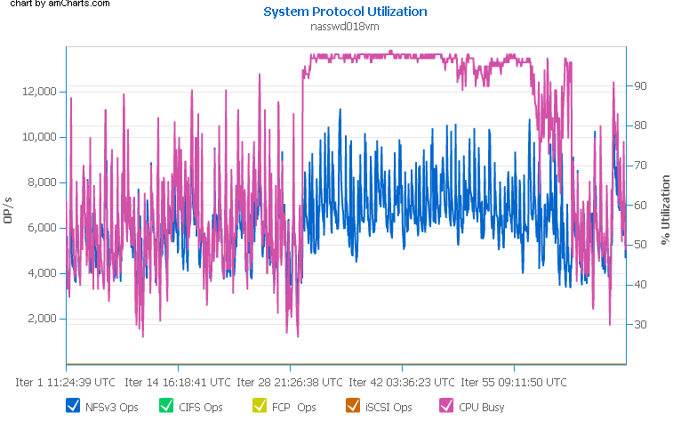
What to watch: CPU, op rate
Watch for CPU during “normal operation”
CPU avg 50-75%
Op Rate Upper bound ~14K for this workload

Slide 11
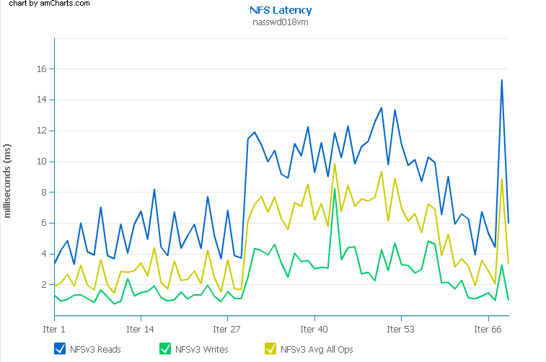
What to watch: Latency
Writes typically <2ms
Reads typically 7-10ms
Upper Bounds
  Writes <5ms
  Reads <20ms

Slide 12
What to watch: Disk Utilization
Need Graphs

Slide 13
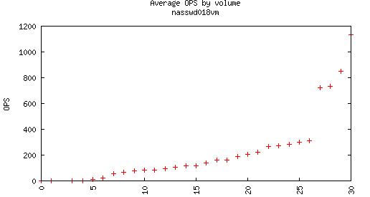
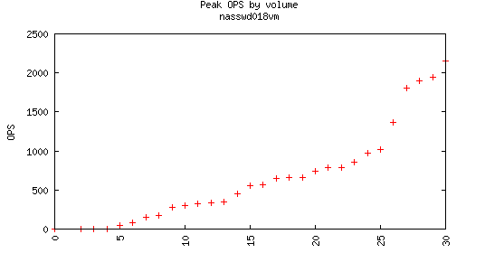
What to watch: “The Big-uns”

Slide 14
Backup

Slide 15
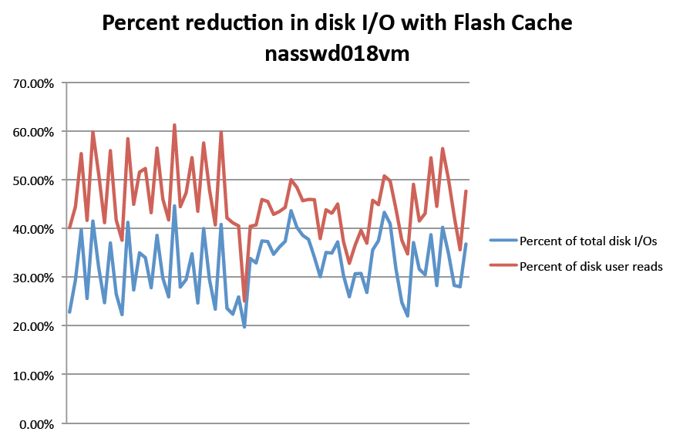
SPCS Results

Slide 16
3210 Configuration (w/o Flashcache)
Scaling 3210 is .5x 3270
50% CPU, 50% Disk 3210 Utilization
  12 VM Datastores; 144 VMs
  30 Data disk spindles
  5.9TB Used storage
75% CPU 50% Disk 3210 Utilization
  18 VM Datastores; 216 VMs
  44 Data disk spindles
  8.8TB Used storage

Slide 17
3240 Configuration (w/o Flashcache)
Scaling 3240 is .75x 3270
50% CPU, 50% Disk 3240 Utilization
  18 VM Datastores; 216 VMs
  44 Data disk spindles
  8.8TB Used storage
75% CPU 50% Disk 3240 Utilization
  27 VM Datastores; 324 VMs
  66 Data disk spindles
  13.2TB Used storage

Slide 18
6210 Configuration (Flashcache)
Scaling 6210 is 1.5x 3270
50% CPU, 50% Disk 6210 Utilization
  36 VM Datastores; 432 VMs
  61 Data disk spindles
  17.6TB Used storage
75% CPU 50% Disk 6210 Utilization
  54 VM Datastores; 648 VMs
  91 Data disk spindles
  26.5TB Used storage

Slide 19
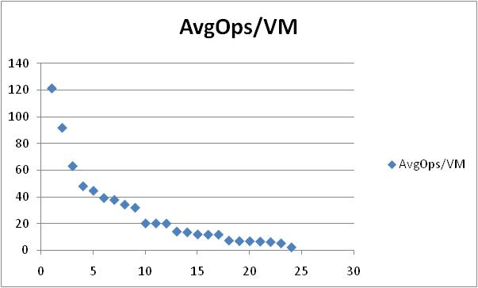
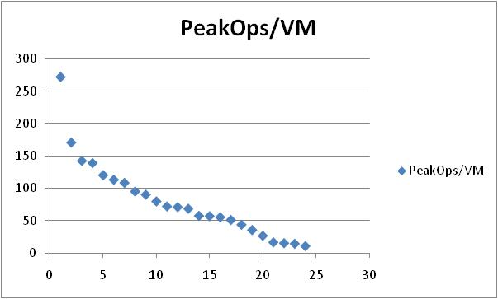
Ops/VM

Slide 20
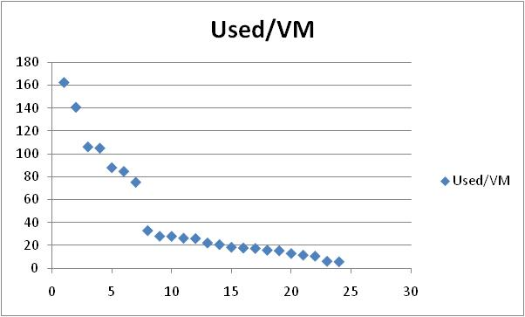
Used/VM

