Slide 1
OpenStack information for Citi

Slide 2
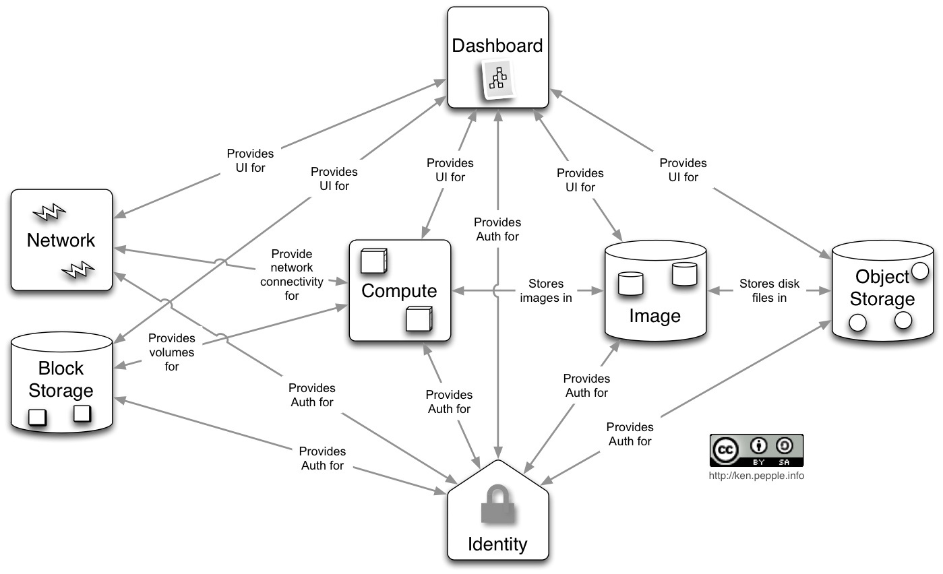
OpenStack Project Architecture

Slide 3
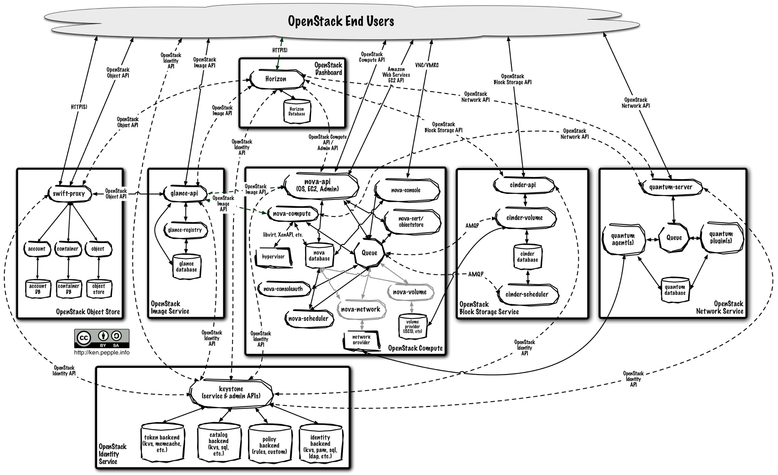
OpenStack Logical Architecture

Slide 4
Current Reality
OpenStack has become more credible with Grizzly release
Remain focused on Amazon-style use case only – openly negative to Enterprise workloads
OpenStack has achieved project “critical mass” and market mindshare
  OpenStack Summit still less than 10% customers, over 90% vendors

Slide 5
Point 1: One Trick (Workload) Pony
OpenStack vendors talk negatively about traditional Enterprise workloads because the product is not designed to embrace the workload
VMware integration is getting better with Grizzly but still “in flux”
VMware kept “the good stuff” for vCD only

Slide 6
Point 2: Scalability is Still Lacking
Focus today is around basic functionality and interoperability of projects
  Product not mature enough to perform scale testing
Nova does not scale beyond 500 hosts
  Clouds with 2000 hosts are actually 4+ Nova installs
Large number of management servers are required for the control plane
  As many as 150:1 compared to CloudPlatform
API polling and host update mechanism generate a lot of backend work
  Each server updates every 10 seconds

Slide 7
Point 3: Difficult to Run Successfully
Example clouds (Best Buy, Comcast) are still on Essex – 2 versions back
No Interoperability between distributions
Upgrades are difficult at best
No commitment to API backwards compatibility
  Your integration investment is not safe
Admins must be highly skilled, python knowledgeable ideally
12+ sub-projects provide flexibility, but do you have the dev and ops team to understand and manage the resulting complexity?
Billing support very weak

Slide 8
Point 4: No Commitment to EC2
AWS EC2 is the cloud API that matters
  $1B+ in revenue, who else is close?
CloudPlatform embraced it with compatibility layer
OpenStack community insists on defining their own API and shuns compatibility
Yes, a start-up has a compatibility layer but it will not get into the project

Slide 9
Point 5: POCs Are Hard
Typical OpenStack POC measured in weeks
  Complexity and Interoperability between projects often complex and time consuming
  Product functionality often does not meet sales and marketing promises
Typical CloudPlatform POC measured in days

Slide 10
OpenStack Summit Impressions
Good (for them): Red Hat & Rackspace received most press and favorable impressions
Bad: OpenStack Interoperability a huge issue, many vendors considered bad citizens (not donating code back, lock in to their distribution)
Ugly: Interoperability, Scalability & Upgrades, Operations were common topics – Focus still on getting the product to work and adding Minimum Viable Product (MVP) functionality

Slide 11
Conclusion
Two workload story is a weakness for OpenStack
Questions remain about OpenStack maturity
  Focus today is functionality, not scalability
  Enterprise level expectations are not met (API stability, upgrades, interoperability, etc.)
EC2 API may help in some Amazon-style situations where OpenStack is stronger
Project complexity & limitations show in PoCs
Production data points still old and weak, but improving
OpenStack gaining customers via Red Hat, CloudScaling, Mirantis and Canonical

Slide 12
Supporting Material

Slide 13
Key Feature and Capability Differences
Not designed for traditional workloads
  Direct integration to ESXi
    No vCenter, no HA, live migration, DRS
  No ability to use “big LUN” design from server virt
    Pushes admins and hardware into new territory
A dozen sub-projects make for loose coupling
  Complex debugging and deployment architecture
  Every module does error handling and logging differently
Admin features are lacking
  Most functions are CLI driven, not API driven
  Cell design only appearing now
  Admins must be expensive guys with python knowledge
Targets cloud workload but no EC2 API
  That’s the only API standard in the cloud today

Slide 14
Key Feature and Capability Differences
Lack of network services
  Quantum slow in developing and maturing
  Physical device support is weak
    No AutoScale, no dedicated/tenant
  Lacking full-fledged VPC model (no tiering)
  One firewall per zone and one LB per zone (max)
  No VPN services
Project belief of OpenStack
  “Do it yourself” vs CloudStack/CCP “out of box”
  Requires developers to succeed
No product equivalent to CPBM

Slide 15
Production Use Remains Difficult
Customers have been unable to go live or had severe quality issues
  AT&T, Deutsche Telekom, HP, Dell, Samsung SDS
  Rackspace’s own service is limited in features
  100+ engineers work to stand up cloud and fail
No support for upgrade in the open source software
  How can you run a cloud that you cannot upgrade?
  Major example customers (Best Buy, Comcast) are on Essex
Limited hypervisor choice with commercial support
  Only Canonical support VMware, only SUSE supports (open source) Xen
  No Hyper-V nor XenServer commercial support
Reference architectures immature
  Don’t cover HA for each component well

Slide 16
Scalability is Poor
Deployments with 2000 hosts are 4+ separate clouds
  Nova does not support more than 500 hosts in practice
API polling generates a lot of backend activity (RabbitMQ message, to the scheduler, to Nova, very expensive)
API calls require keystone look-up every time (no caching)
Large number of servers required for control plane when compared to CloudStack (maybe 150 : 1 at scale)
Some operations require hosts to acquire global lock, limiting throughput of operations

Slide 17
Scalability is Poor
Each compute node updates its status in DB every 10 seconds
  Creates scale issues for database tier
Quantum uses global locks in some cases, limiting ability for it to carry out operations in parallel
Quantum routes external network traffic through a single node

Slide 18
Ecosystem and Foundation Challenges
Competitors are seeking advantage over each other
  Limited changes are returned to the community
Ecosystem has to integrate to 4+ forks of the code
  Hurts ecosystem engagement (app management, PaaS, …)
Lack of API backwards compatibility
  Investments are not safe (impacts customer directly)
  Foundation to start policing “fake clouds” due to incompatibilities
  Ecosystem development is inhibited
“Pay to play” foundation limits participation of smaller companies
Notes:
Confidentially many of our ecosystem partners will tell us they “hate” OpenStack because of the variability of deployments

Slide 19
CloudPlatform (Byron: Nov 2012) | OpenStack (Folsom: Sept 2012)
Hypervisor Support
Manage ESX hosts through vCenter | Not supported
OVM | Not supported
Support for Live migration, DRS, multiple virtual driver options on ESX | Not supported
High Availability
Automatic restart of VMs on host failure | Not supported on KVM, ESX & OVM
Automatic restart of VMs on storage failure | Not supported on KVM, ESX & OVM
Work Load Management
Live migration on ESX, XenServer, KVM, OVM | Live Migration on KVM, XS with no Shared Storage

Slide 20
CloudPlatform (Byron: Nov 2012) | OpenStack (Folsom: Sept 2012)
Resource Allocators
User-concentrated & User-dispersed allocation | Not supported
Optimize Windows SPLA licensing | Not supported
Snapshots
Scheduled snapshots (hourly, daily, weekly, monthly) | Not supported
Full Snapshots on Local & Shared storage for ESX | Not supported
History of Snapshot / Volume | Not Supported
Usage Tracking
Usage records (hourly, daily, weekly, monthly) | Not supported on ESX, OVM
Aggregation of Usage data | Not supported
Integration with Netflow/sFlow | Not supported

Slide 21
CloudPlatform (Byron: Nov 2012) | OpenStack (Folsom: Sept 2012)
Virtual Router
Load Balancer services | Not supported
Firewall services (Static NAT, Source NAT, Interface NAT, Port Address Translation, Port Forwarding, Remote-access VPN) | Not supported
Redundant Virtual Router | Not supported
N-Tier Applications | Partial (minimal support)
Remote Gateway support (Site-Site VPN, Private Gateways) | Not supported
Networks
Physical separate guest, storage & public networks | Supported in Quantum but can’t combine Nova and Quantum Features
Notes:
CloudPlatform Load balancer

Slide 22
CloudPlatform (Byron: Nov 2012) | OpenStack (Folsom: Sept 2012)
Load Balancer
Integration with NetScaler MPX, VPX & SDX | Not supported
Integration with F5 BigIP | Not supported
CloudPlatform Load Balancer | Not supported
Elastic Load Balancer support (in Shared networks) | Not supported
Firewall
Source NAT, Remote-access VPN support on SRX | Not supported
Firewall services (Static NAT, Source NAT, Interface NAT, Port Address Translation, Port Forwarding, Remote-access VPN) | Not supported
Console View
Console view on ESX | Not supported
Managed SSL certificate | Not supported
Notes:
CloudPlatform Load balancer

Slide 23
CloudPlatform (Byron: Nov 2012) | OpenStack (Folsom: Sept 2012)
Service, Disk & Network Offering
Storage tiers in Disk offerings through host tags | Not supported (Partial support only for NetApp)
Allow users to set HA through Service offering | Not supported
Set network throughput via network offering | Not supported
Network as a Service (NaaS) Create multiple network offerings and allow users to upgrade/downgrade | Not supported
Storage
NFS based secondary storage | Not supported
Multiple secondary storages (NFS, Swift) | Not supported
Notes:
CloudPlatform Load balancer

Slide 24
CloudPlatform (Byron: Nov 2012) | OpenStack (Folsom: Sept 2012)
Cloud Operation / Maintenance
Unmanaged state for hosts, clusters, pods & Zones | Not supported
Disabled state for hosts, clusters, pods & Zones | Not supported
Non-disruptive upgrade process (User VMs, System VMs & MS) | Not supported
Alerts for: Host status, Resource status (CPU, RAM, Network, Storage) @ host, cluster, pod & zone levels | Not supported
Centralized logging; Audit logging | Not supported
Hypervisor upgrades w/o affecting VMs | Not supported

Slide 25
CloudPlatform (Byron: Nov 2012) | OpenStack (Folsom: Sept 2012)
Hybrid Clouds
Partners with RightScale, Enstratus to support: Federated cloud management including auto-scaling etc. Bursting into Amazon, Rackspace, 50+ CloudPlatform clouds Fully integrated solutions | Partial support on OpenStack (OpenSource) No distributions integrated with RightScale, enStatus
Cloud Business Solutions
Integrates with Citrix CloudPortal to provide a variety of business solutions Pricing & Billing CRM, Ticketing, Community Account, partner management | Not supported
API Compatibility
EC2 Compatible APIs | Supported in open-source but no vendor distribution support
Comprehensive, polished
Admin & End-user UI
Limited functionality,
Prototype UI

Slide 26
Apache CloudStack Community

Slide 27
Impartial Analysis of Open Source IaaS Community Growth
Source http://www.qyjohn.net/?p=3120

Slide 28
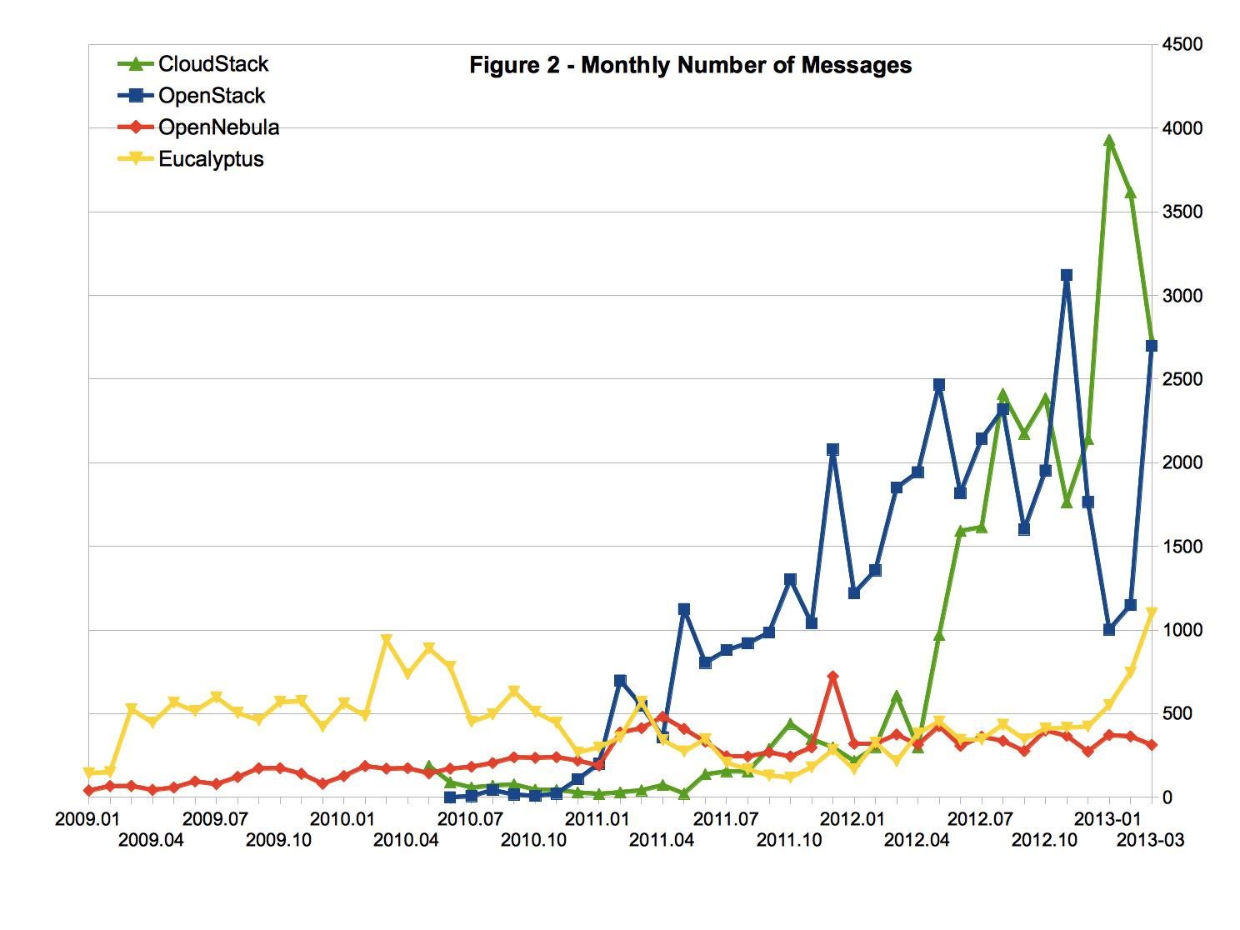
Messages = Posts
Source: http://www.qyjohn.net/?p=3120

Slide 29
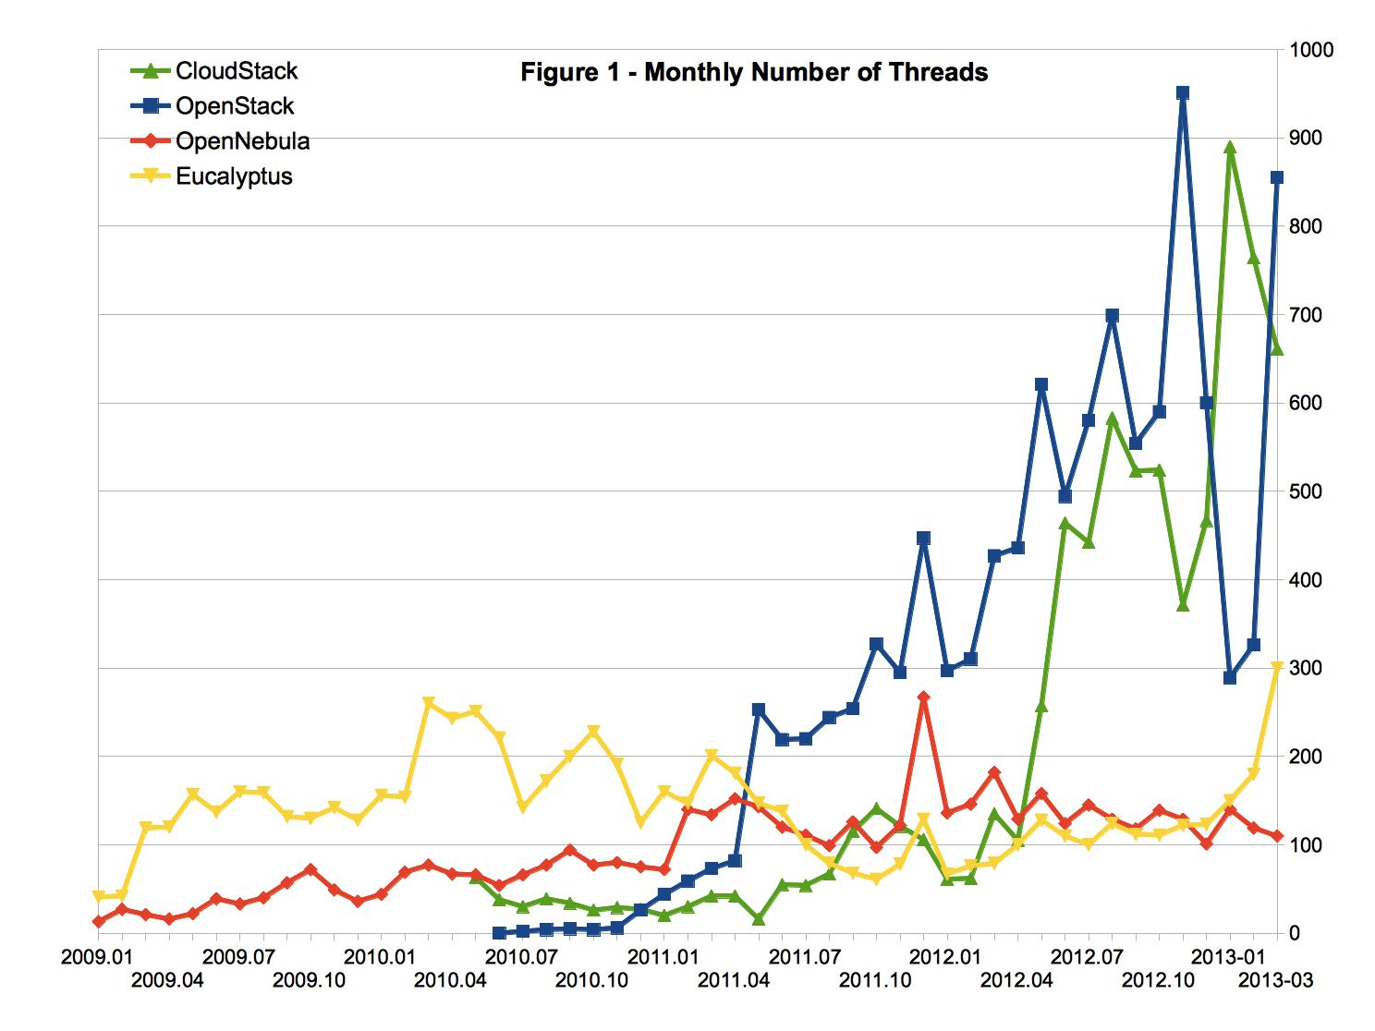
Threads = Topics
Source: http://www.qyjohn.net/?p=3120

Slide 30
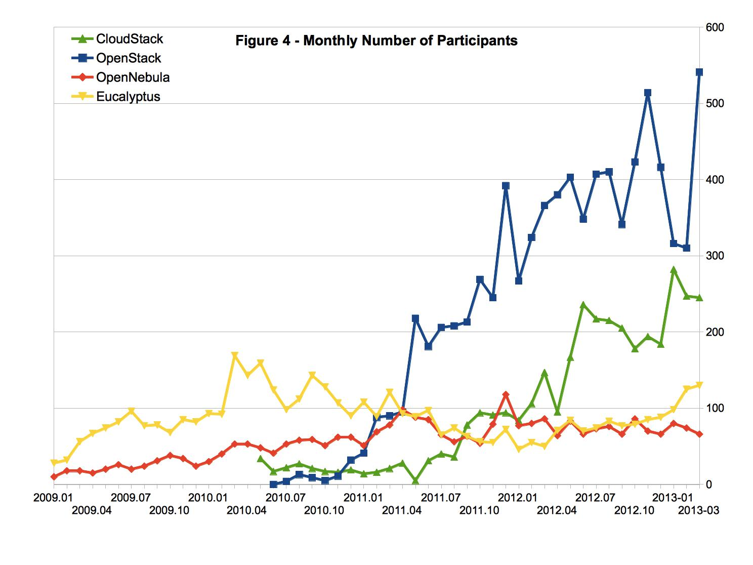
Source: http://www.qyjohn.net/?p=3120
Note: Although the number of active participants of CloudStack is less than OpenStack, the volume of discussion (in terms of monthly number of threads and messages) of the two projects are on the same level (Figure 3). This indicates that the active members in the CloudStack club are talking more than those in the OpenStack club on average.

Slide 31
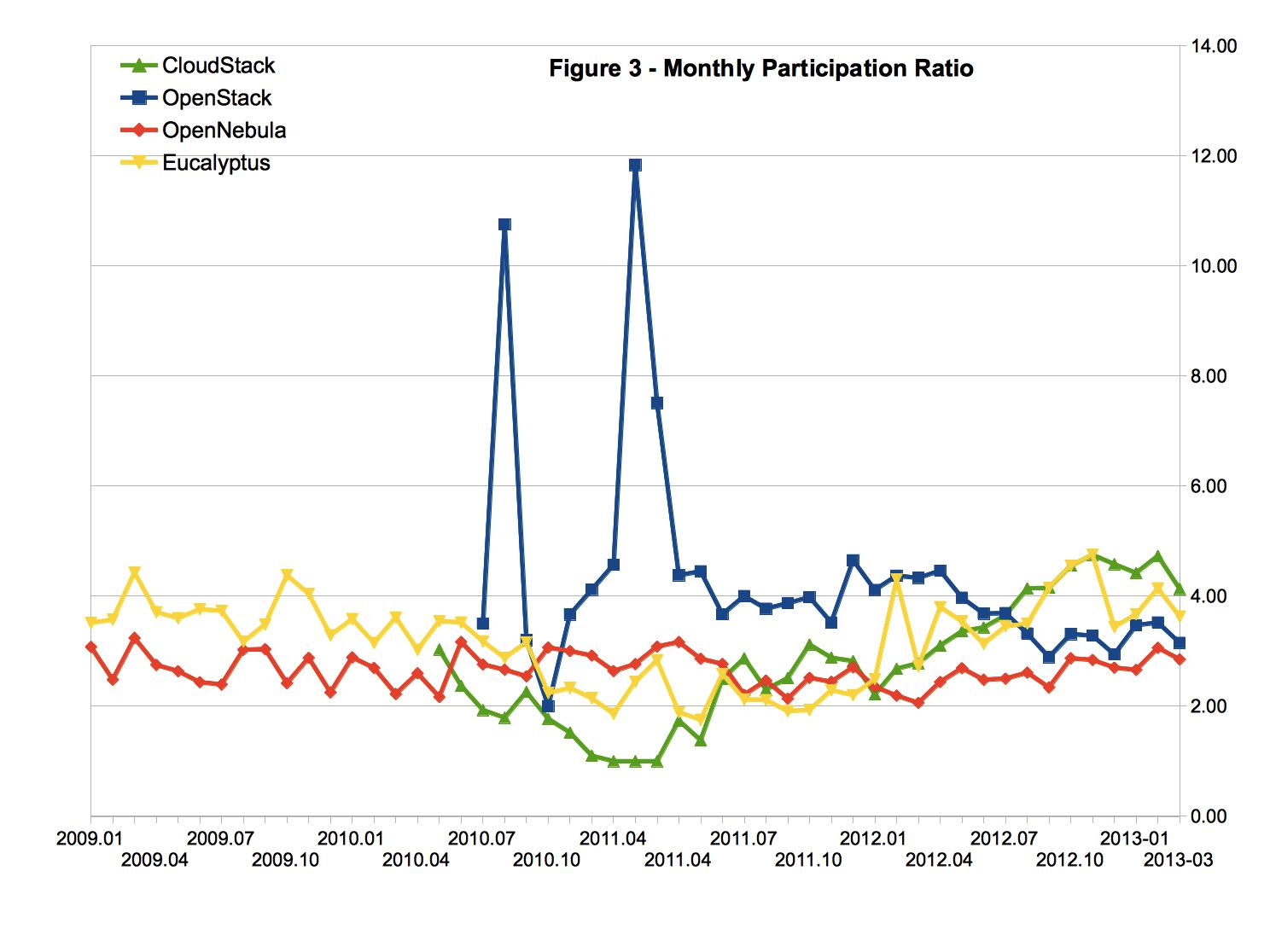
Participation Ratio = # of Posts / # of Topics
Source: http://www.qyjohn.net/?p=3120

Slide 32
Citrix Analysis of CloudStack Community Growth

Slide 33
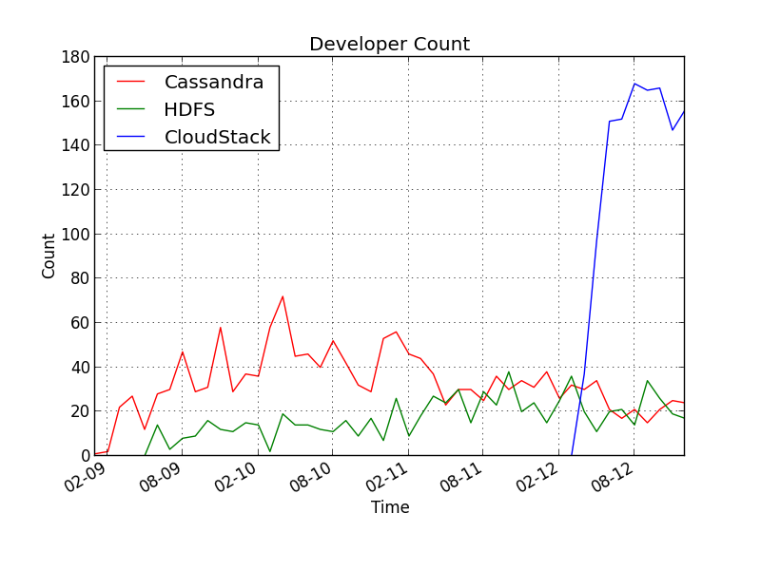
Apache Comparison (Individuals per Month)

Slide 34
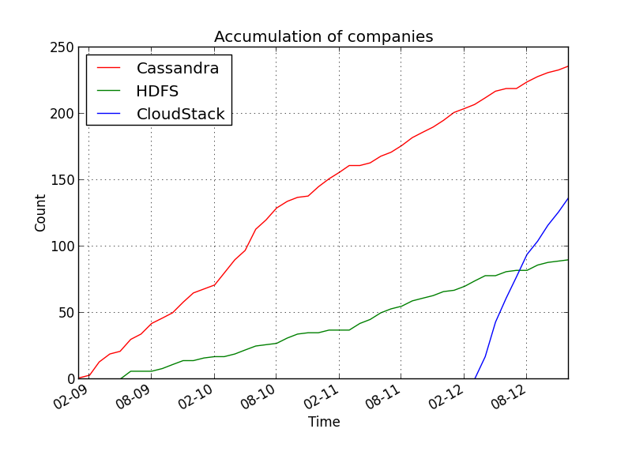
Apache Comparison (Total Companies)

Slide 35
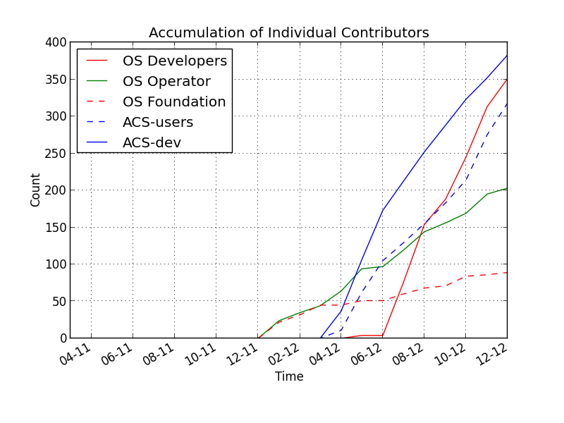
OpenStack Comparison (Total Individuals)

Slide 36
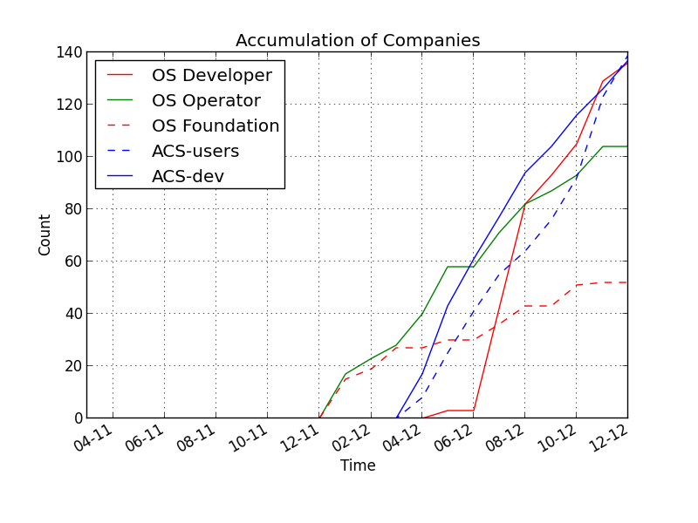
OpenStack Comparison (Total Companies)

Slide 37
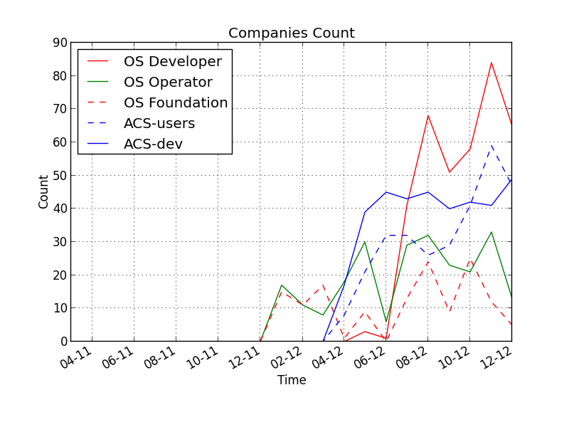
OpenStack Comparison (Companies per Month)

