Slide 1
What’s New in Hitachi Command Suite v8
HDS Account Team

Slide 2
Software Strategy

Slide 3
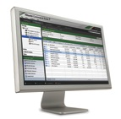
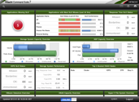
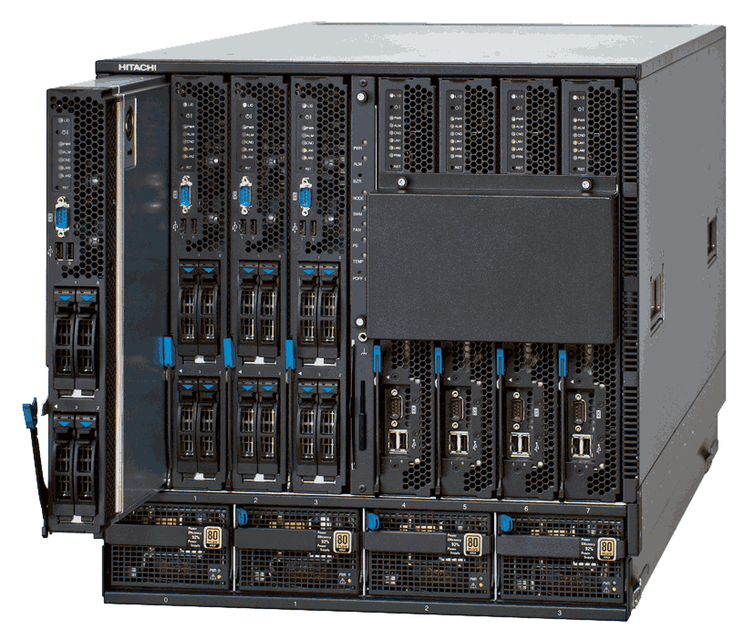







Unified Management
Across all storage and compute platforms
Across management functions
Across file, block and content
Business Intelligence
Configure
Analyze
Mobilize
Protect
Unified Management Framework
Compute
Block
File
Unified
Content
Appliance
Hitachi Blade Server
HNAS
HUS100 File
HCP
HDI
VSP, HUS VM, HUS100

Slide 4
Unified Management
Across all storage and compute platforms
Across management functions
Across file, block and content
HCmD
HDvM/HCSM
HTnM
HTSM/HDT
HRpM
Unified Management Framework
In the coming 12 to 24 months
3 Years Ago
Over The Last 2 years
Compute
Block
File
Unified
Content
Appliance
Hitachi Blade Server
HNAS
HUS100 File
HCP
HDI
VSP, HUS VM, HUS100

Slide 5
Single Pane of Glass

Slide 6
SN2/HCS Integration/Consolidation
VSP G1000 ONLY
Single Pane of Glass (SN/HCS GUI Integration)
  Login screen and certain functions will be consolidated/enhanced to HCS. Legacy SN2 will be in-context launch pop-out
Consolidated User Resource Management
  User Management and Resource Groups will be consolidated to HCS
Consolidated Task list under HCS
  Task executed on behalf of SN2 functions will be consolidated to the HCS tasks list (separate tabs in HCS)
Improved synchronization of HCS/SN2 configuration
  Refresh times of storage systems will be greatly reduced

Slide 7
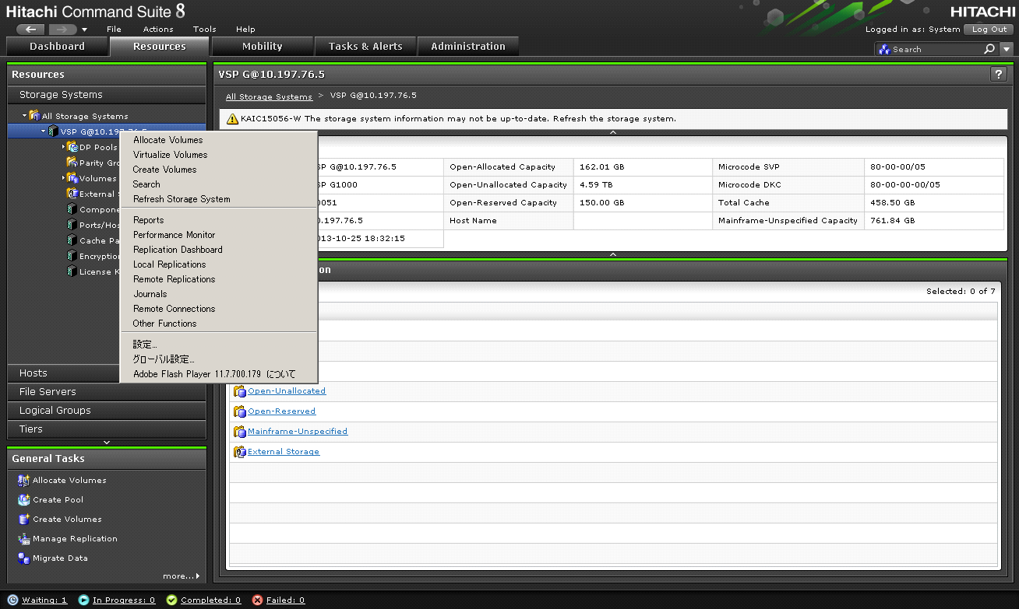
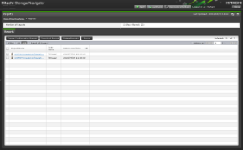
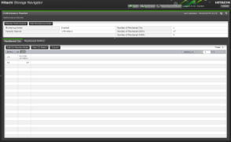
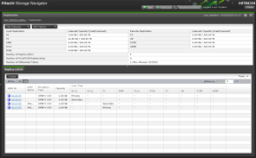
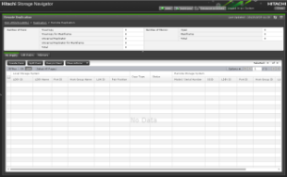
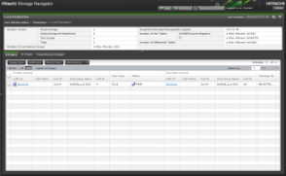
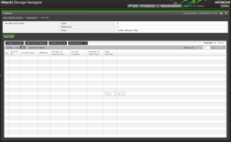
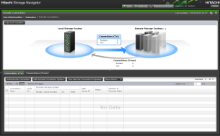
Single pane of glass
A list to show in a right clicked menu
Reports
Select VSP G1000 and right-click
Performance Monitor
Replication Dashboard
Remote Replication
Local Replication
Journals
Remote Connections
VSP G1000 context menu for launching System GUI
Other Functions
System GUI screen

Slide 8
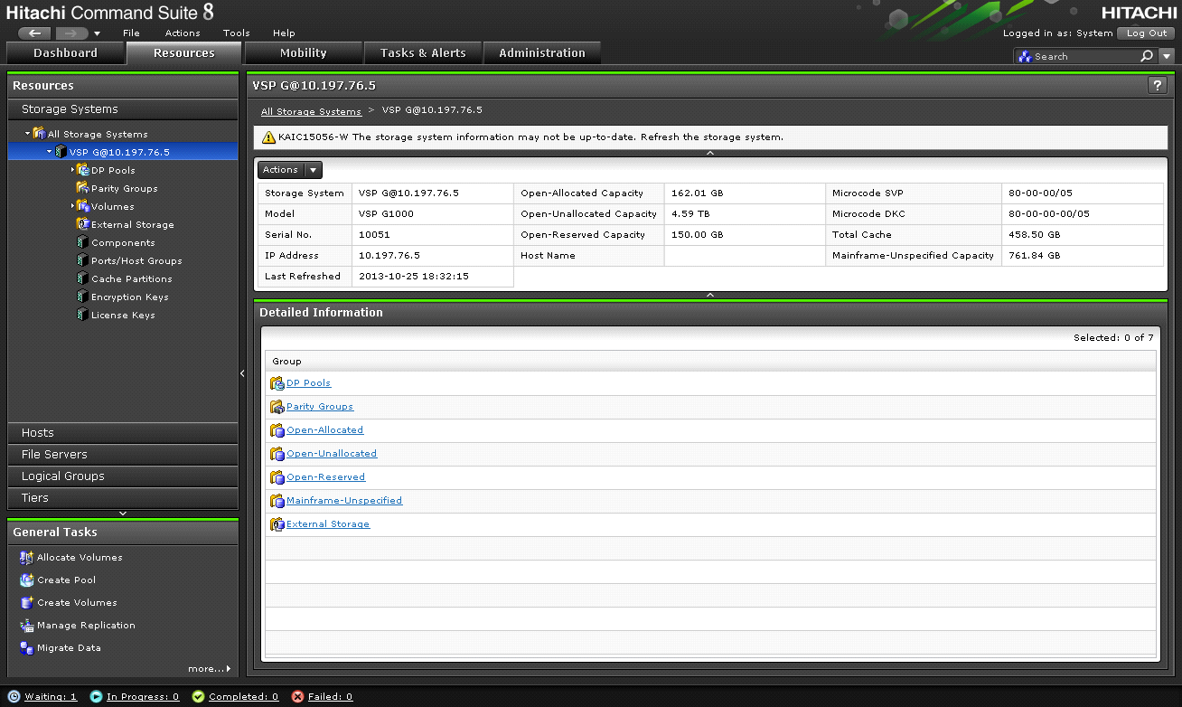
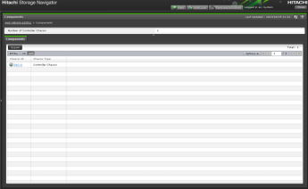
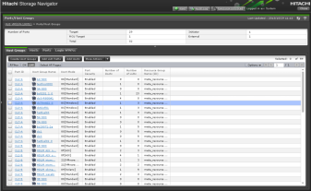
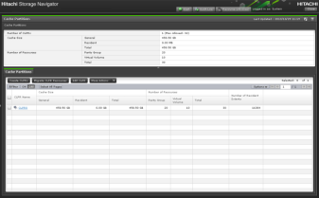
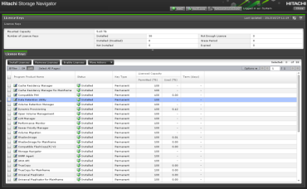
Single pane of glass
Add a tree node in HDvM for a launch point to launch System GUI
Components
Ports/Host Groups
Encryption Keys
Click each sub node in VSP G1000
Cache Partitions
License Keys
System GUI screen

Slide 9
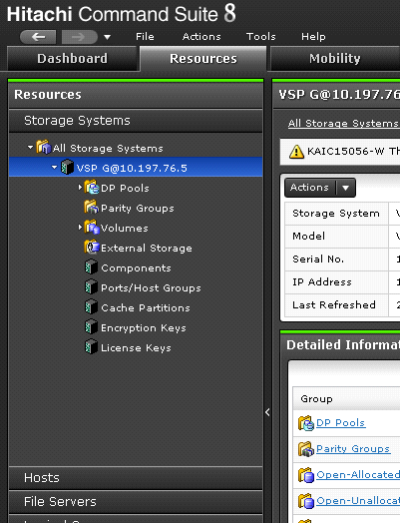
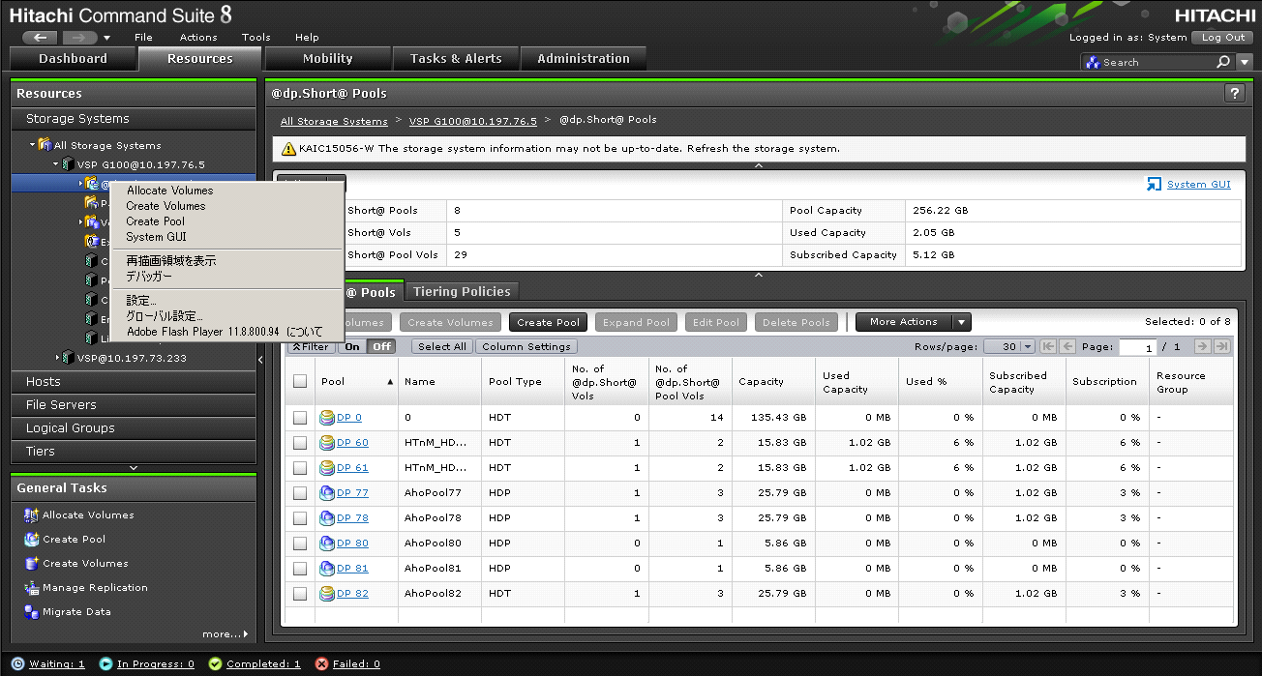
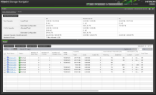
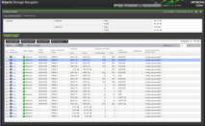
Single pane of glass
Add a link in HDvM view to launch System GUI
Click the link
Right-click and select System GUI
Select sub node in VSP G1000
DP Pools
Parity Groups
Volumes
You can execute advanced storage settings which were available in legacy SN function operation.
External Storage
System GUI Screen

Slide 10
Consolidated User & Resource Management
All Users/User Groups will be consolidated to a single database under HCS
Resource Group Management will be controlled from HCS. All HCS defined/managed Resource Groups will be propagated to SN2
There will be an emergency mode if HCS is not available – a default emergency mode user id with “whole system” authority will be available
Mainframe Only users will be allowed to access SN2 – business as usual

Slide 11



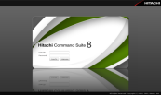
New HDvM v8 and Element Manager Integration Simplifies Management
Novice User
Expert User
Maintenance User
MF admin
HCS address
Legacy SN address
(R700 compatible address)
Physical View address
in emergency mode
For MF usage SN address
Warning
Storage Navigator
HCS Mgmt
Server
Function restricted mode
Emergency
mode
MF
mode
Maintenance mode
Service Processor

Slide 12
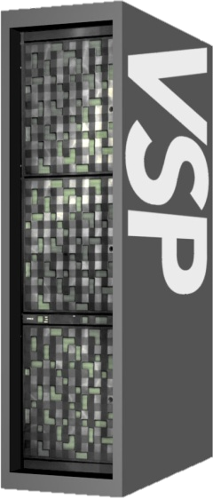

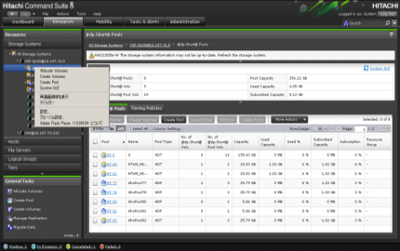
Synchronization improvement
After integration
User doesn’t have to care about “Refresh” operation any more. HCS automatically updates own DB based on the task execution result.
HCS v8
AUTO SYNC
HCS DB

Slide 13
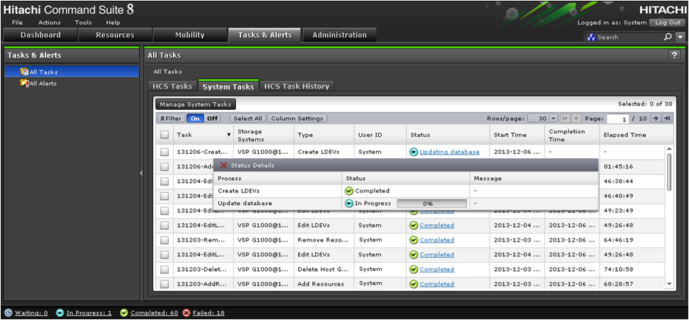
Improved synchronization of HCS/SN2
- Update Database Step
Each HCS/SN2 executed task will have a refresh step added before the task is returned as complete
Clicks

Slide 14
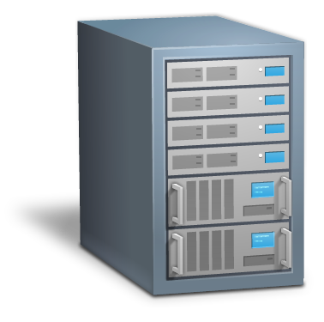





Native 64bit OS support
HCS has already supported 64bit OS, hasn’t it?
  Yes, HCS could run on 64bit OS, but it runs as a 32 bit mode application. It cannot fully utilize 64bit OS merit, like large memory beyond 4GB.
  HCS v8.X runs as a 64bit mode application. It removes 4GB memory limit in 32 bit mode and will enable higher scalability in HCS.
V7
V8
32bit
mode
64bit
mode
64bit
mode
32bit
mode
64bit OS
64bit OS
64bit platform
64bit platform

Slide 15
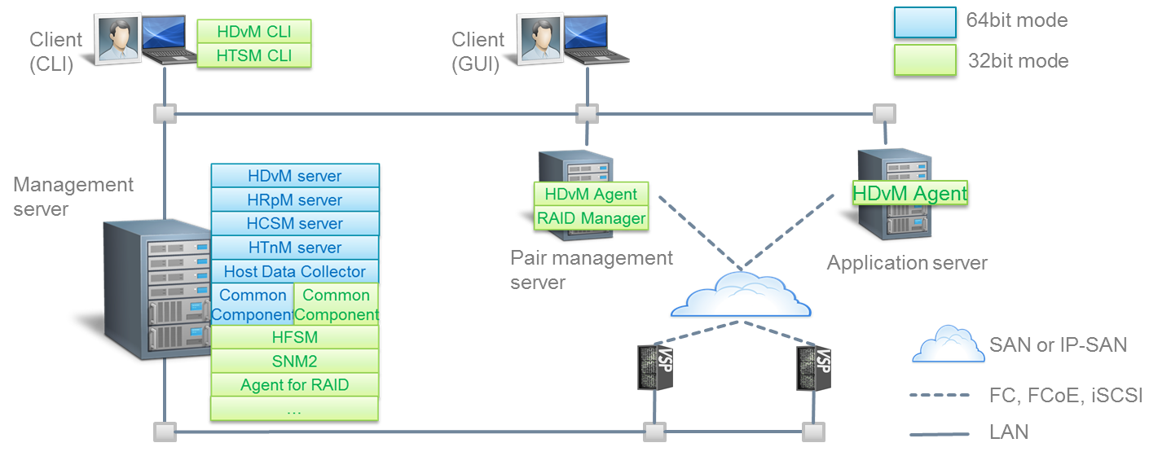
Native 64bit OS support
All HCS components work with 64bit mode?
  No, only the HCS management server and related components run as a 64bit mode application.
  Other components such as agents still run as a 32bit mode application.

Slide 16
Analytics - Agenda -
  VSP G1000 Support
  REST API
  New Metrics
  HNAS Monitoring
  Analytics Tab Enhancements
    Longer Minutely Data
    Problem Solving Guidance Message
  Supported Resources
    Platform / Switch / FOS
  Usability
    Dashboards
    Report Viewer
  Forecasting Capacity
  SLO
    Automated Recommendations
    Infrastructure granularity
  REST API
HCMD
HTnM

Slide 17
Thank You

