Slide 1
Texas Tornado ++
January 7, 2015

Slide 2
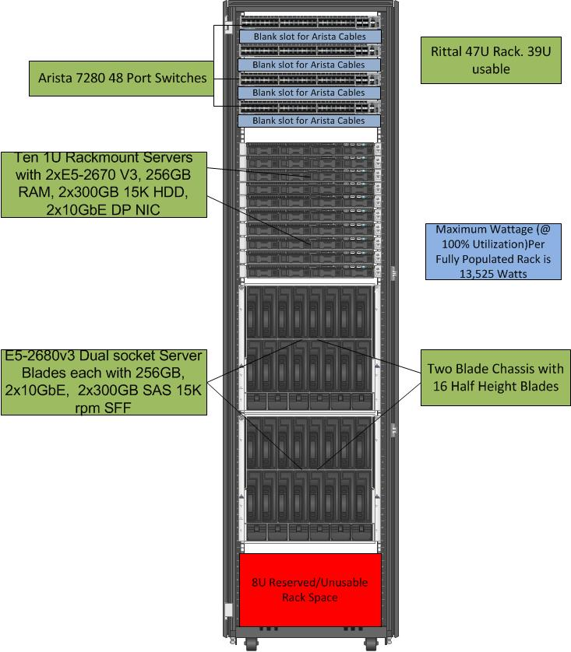
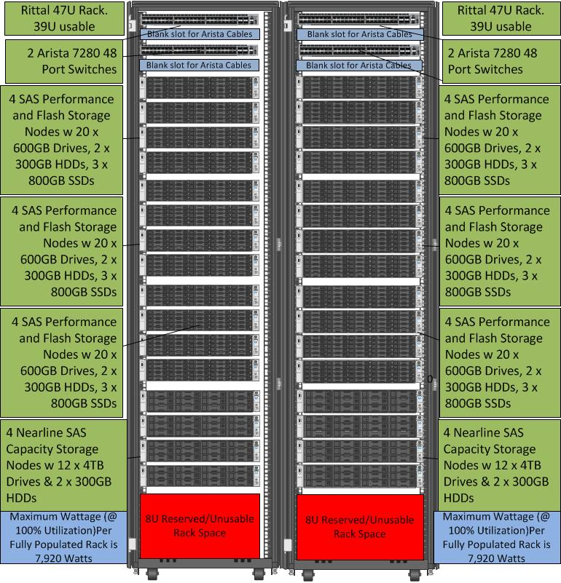
Citi POD Definition (Separate Compute and Storage)
A POD consists of multiple Compute and Storage Building Blocks (racks).
POD Design
3 Racks
8 Arista 7280 Switches
42 Compute Servers
  2 blade chassis/32 Blades (768 Cores)
  10 Rackmount Servers (240 Cores)
  1,008 Cores combined
32 Storage Nodes, Total Combined RAW Storage is 729.6 TB:
  57.6 TB of Flash SSD
  288 TB of SAS (600GB Drives)
  384 TB of SAS (4TB Drives)
Compute Node Building Block (1 rack)
Storage Node Building Block (2 racks)

