Slide 1
Third Quarter Wrapup
Problems and Solutions

Slide 2
Our Situation
Sales are down for Minnesota and North Dakota
Customer satisfaction is down
Two new competitors have started servicing our key areas

Slide 3

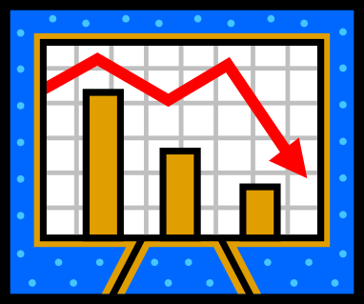
Loss of Customers – Key Factors
A large shipment was lost and customers had to find a replacement product
They are very satisfied with the new product and the service they are receiving

Slide 4
Third Quarter Sales
Region October November December
Northern $10,200 $13,400 $12,909
Southern $22,100 $14,050 $16,788
Eastern $13,270 $12,120 $14,323
Western $17,113 $14,209 $14,431

Slide 5
The Numbers
Region | October | November | December
Northern | $10,200 | $13,400 | $12,909
Southern | $22,100 | $14,050 | $16,788
Eastern | $13,270 | $12,120 | $14,323

Slide 6
Five Biggest Customers

Slide 7
Recommendations
Contact each customer
Offer a discount for one year
Meet with customers monthly to ensure satisfaction
Increase advertising in trade journals

Slide 8

Our Vision for the Future
Next year’s sales to exceed last year’s
Five new products to address customer needs
Increased customer satisfaction
First quarter to return to last year’s level

