Slide 1

EMC Storage Intelligence Portal Solutions
Automating Efficiency and Providing Transparency
November 10, 2008

Slide 2

Introductions
Bill Haralampoudis – Managing Client Solutions Director
Jeff Powers – Client Solutions Director
Pat DiSanto – Account Manager
Ray Leone – EMC Infrastructure Consulting Practice Manager
Dave Stephanik – EMC Application Consulting Solution Principal
Matt Roberts – EMC Application Consulting Practice Manager

Slide 3

Today’s Agenda
Introductions
Complexity Of Today’s Storage Management
EMC Storage Portal Solutions
  Storage Decision Solution
  Storage Request Automation Solution
  Storage Intelligence Solution
Solution Architecture & Technology Platform
Questions and Next Steps
Notes:
Title
Month Year
3

Slide 4

Complexity Of Today’s Storage Management
The Challenges
Unrelenting Growth Of Storage Capacity / Increasing Utilization
Escalating Costs – Acquiring, Deploying, Administering
  Buy vs. Re-Allocate Decisions are a manual exercise
Incompatible Tools And Data
  So many vendor tools, but no consistency
  Not all tools play well together
  Tools not extensible (“black-box syndrome”)
  Data is not centralized making identification of trends challenging
Minimal Automation
  Most processes are manual, automation is typically in place for “point solutions” only
  No “Self-Service” access to information
Limited Agility
  Difficult to make quick decisions due to the downstream effect those decisions have on software, systems, hardware
What Are The Impacts Of This?
Tendency for Reactive, Labor Intensive Operations
Inability to track storage utilization or reclamation
Complex, in-efficient decision-making
Lack of visibility into key metrics
Inaccurate Forecasting / Budgeting
Notes:
Title
Month Year
4

Slide 5


EMC Storage Portal Solutions
EMC Consulting has created three (3) distinct but integrated solutions that provide automation and intelligence to the management of storage environments.
EMC Storage Portal Solutions include:
Storage Decision Tool
Storage Request Automation Solution
Storage Intelligence Solution

Slide 6

Storage Decision Tool
The Storage Decision Tool allows engineers and business consumers to compare cost and performance profiles to ensure the right storage tier/solution is used .

Slide 7

Storage Decision Tool - Opportunity
Changing the mindset…
Today
All storage is tiered based on request and best current fit.
Tomorrow
Storage aligns to service levels based on application requirements
and business impact.

Slide 8

Storage Decision Tool
The Storage Decision Tool allows the Storage Admins, Application Development Managers/Directors, and Business Analysts to determine the cost of storage that is required for any application
The SDT also allows requestors to perform “What-If Analysis” to determine what the costs or savings would be by using different tiers for application storage.
The SDT can optionally pre-fill in Storage Requests that can be retrieved/referenced at any time.
Customized to your environment and definition of tiers, SLAs, and cost models
Notes:
Title
Month Year
8

Slide 9
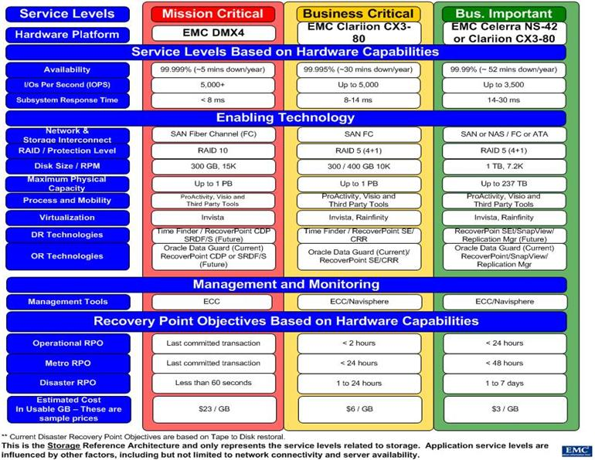
Storage Decision Tool – Sample SLA/Tiering
Notes:
Title
Month Year
9

Slide 10
Customization/Solution Architecture
The SDT Database stores both Storage Request data and Application Metadata.
The application metadata can be configured to:
  Add/remove Service Areas (eg. Primary Storage, Archiving, etc)
  Add/remove number of tiers per service area (independent of each other)
  Add/remove Storage Requirements Questions
  Add/remove Answer Options for Requirements Questions
  Answers can be Drop Down Lists, Checkboxes, or Free Text
  Answers can be added/removed from the Tier determination algorithm
  A Requirement Question can be set as Required or Not Required
The application requires minimal changes to the code base from customer to customer.

Slide 11
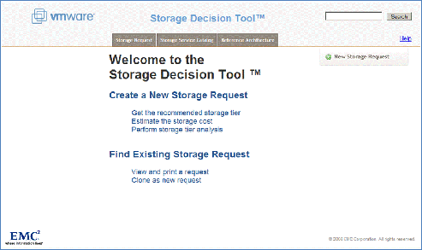
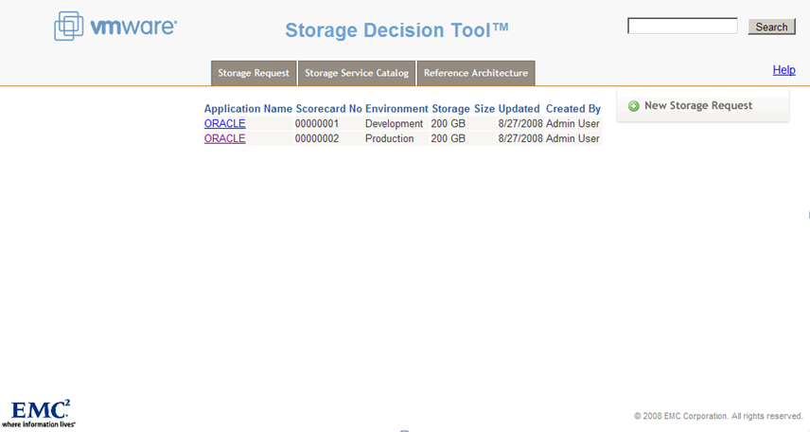
Storage Decision Tool
Create & Search for Requests

Slide 12
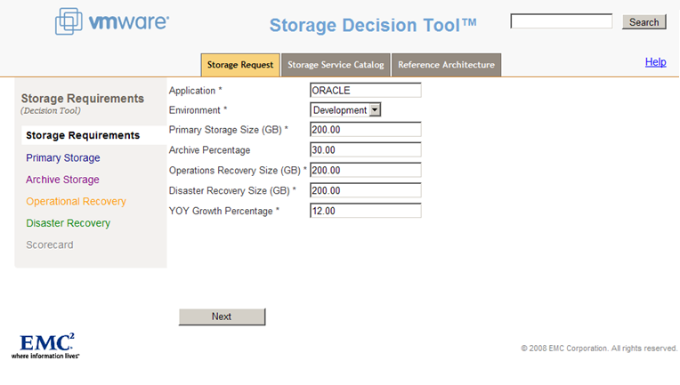
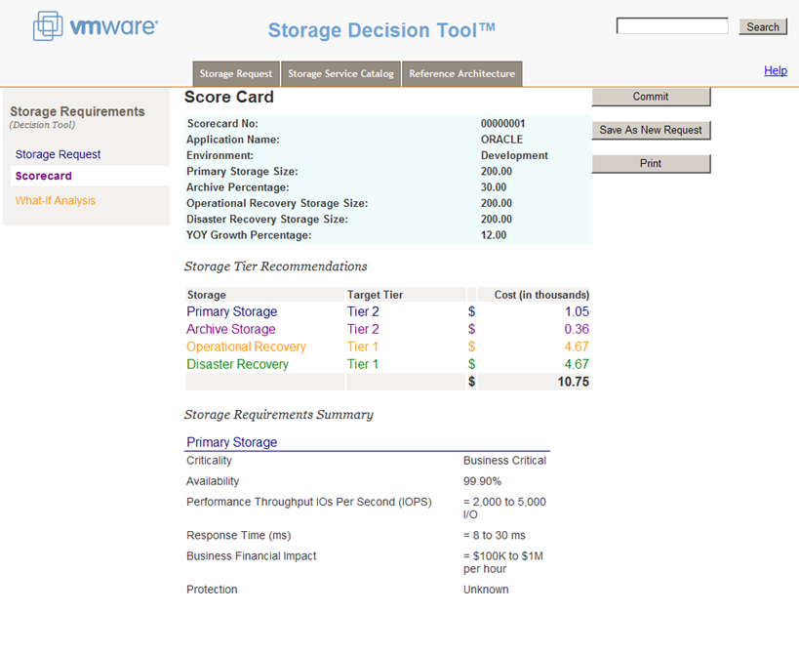
Storage Decision Tool
Storage Request Wizard

Slide 13
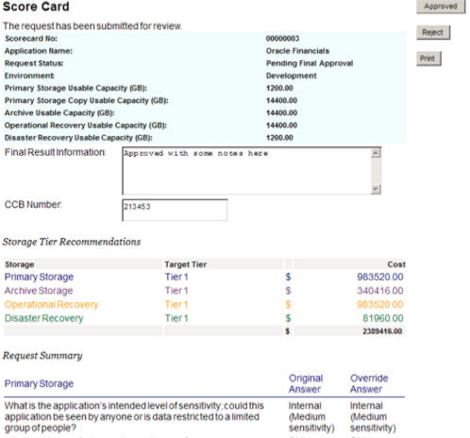
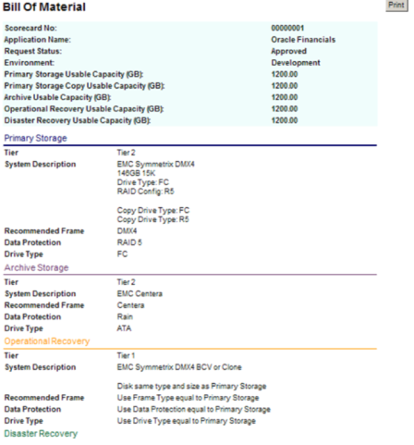
Solution Features
Approval Workflow and Bill of Materials

Slide 14
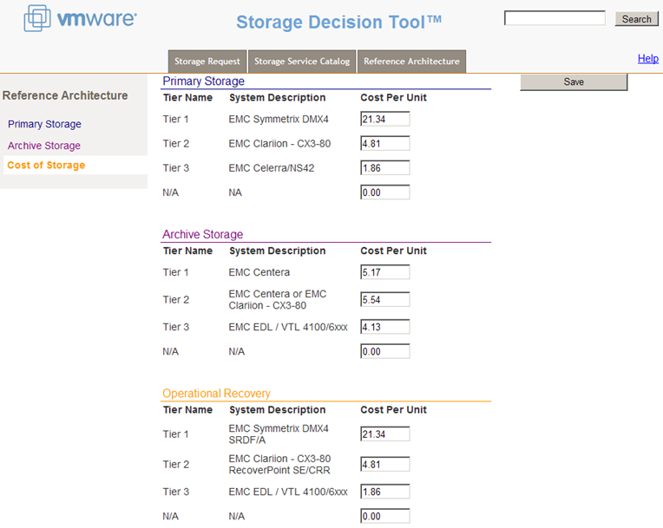
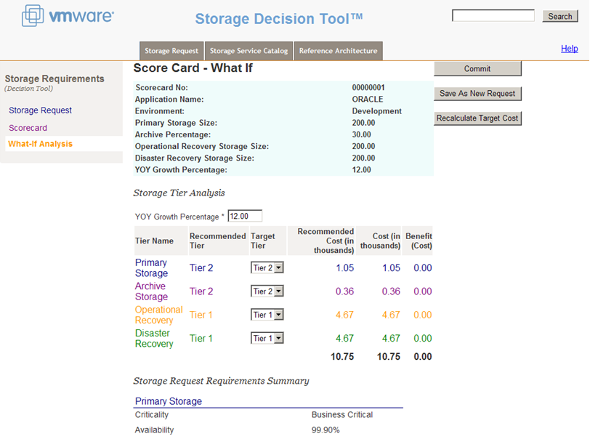
Storage Decision Tool
Perform What-If Cost Benefit Analysis

Slide 15
Solution Value Summary
Primary:
Cost Avoidance: Allows IT to utilize the most cost effective storage for an application.
Secondary:
Business Case Cost Accuracy: Provides a quick and accurate cost estimate of storage for the application business case.

Slide 16

Storage Request Automation Solution
EMC’s Storage Provisioning Portal helps automate the request/demand process and allows for formal workflow, approval cycles, and full transparency.

Slide 17

EMC Storage Provisioning Portal Solution
Benefits:
Provide a simple user friendly mechanism for a requestor to fill out a Storage Quotation Request Form
Allows for technical review/approval workflows
Provide a simple mechanism for an Approver to generate a Storage Price Quotation from a properly submitted Storage Quotation Request.
Provide process management tools and metrics data.
Generate informational and confirmation E-Mails in response to various workflow events
Personalized views, workflows, & task “queues”
Access all forms from a thin client (Web browser)
Minimize development costs
Minimize software upgrade costs
Notes:
Title
Month Year
17

Slide 18

EMC Storage Provisioning Portal Solution
Value:
Simplify the procedure that the requester follows to submit a storage quote request
Increase transparency in the storage request and provisioning process
Reduce the workflow execution time.
Standardize the Request and Pricing Documents
Improve communication between the requester and the approver
Provide workflow status reporting and management capabilities.
Integrate with Storage Decision Tools and Storage Intelligence Solution
Notes:
Title
Month Year
18

Slide 19
EMC Storage Provisioning Portal Solution
Notes:
Title
Month Year
19

Slide 20
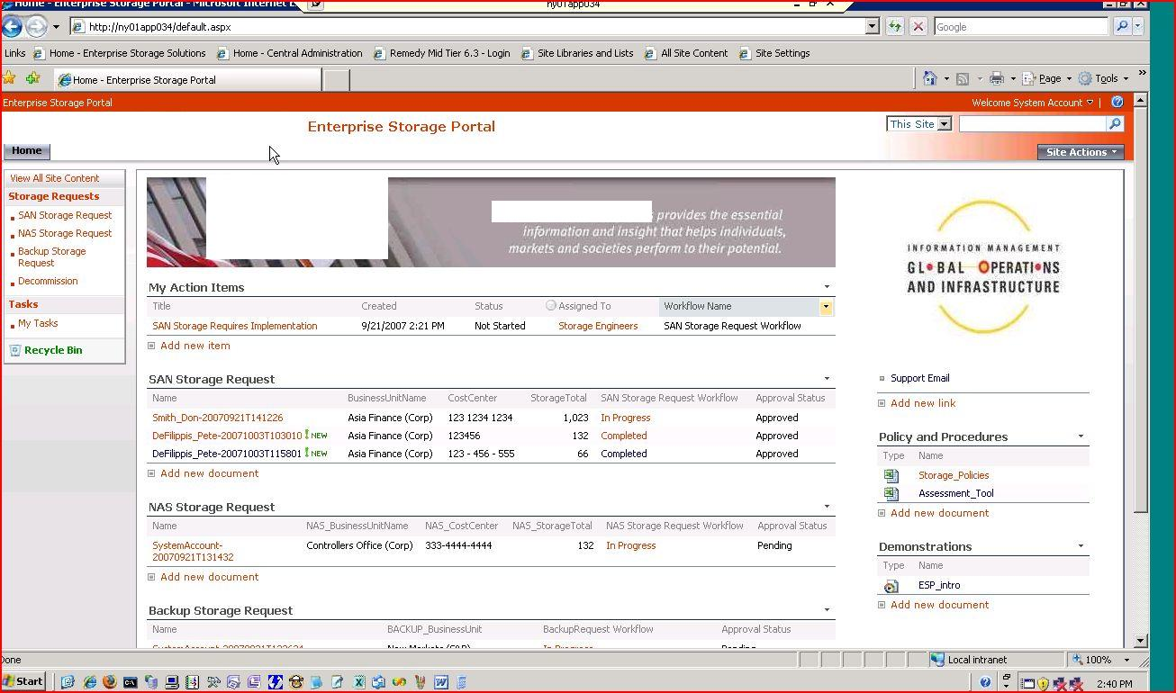
EMC Storage Provisioning Portal Solution
Notes:
Title
Month Year
20

Slide 21
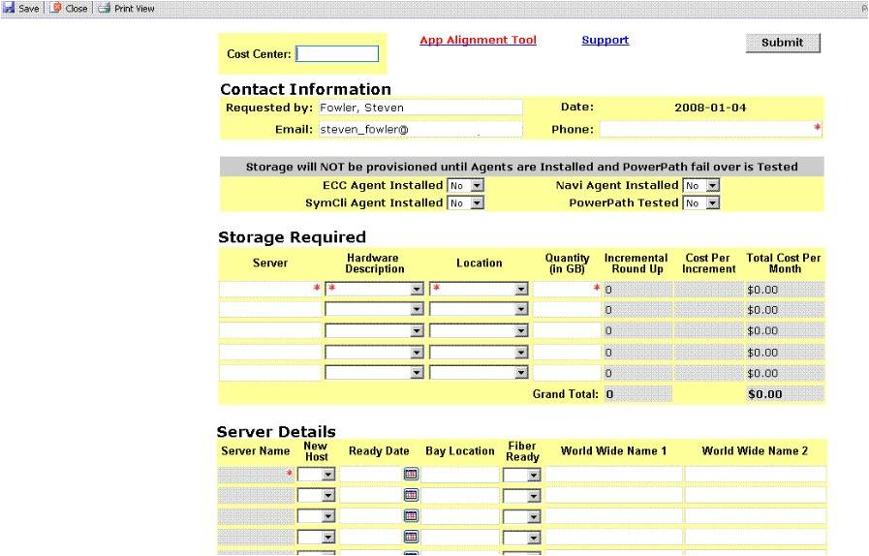
EMC Storage Provisioning Portal Solution
Notes:
Title
Month Year
21

Slide 22
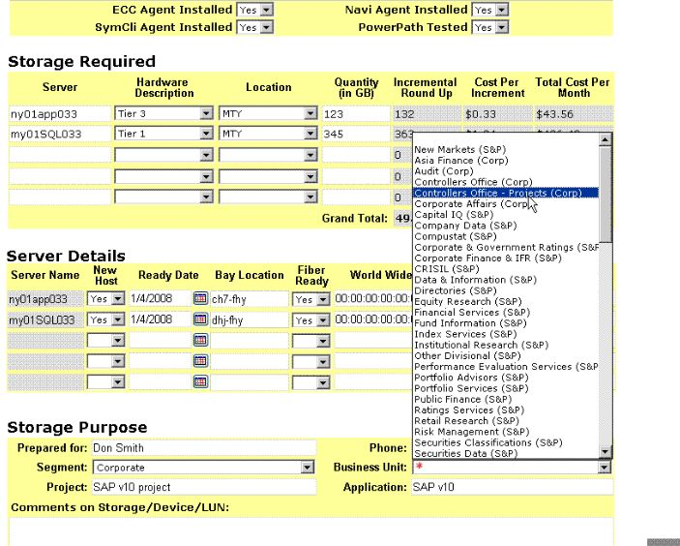
EMC Storage Provisioning Portal Solution
Notes:
Title
Month Year
22

Slide 23
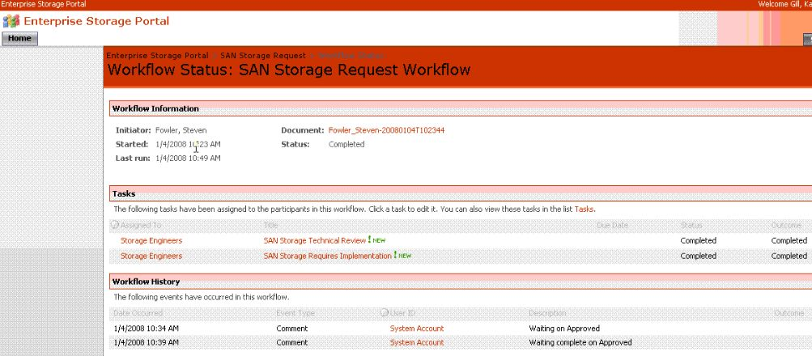
EMC Storage Provisioning Portal Solution
Notes:
Title
Month Year
23

Slide 24
Solution Value Summary
Primary:
Request Data Transparency: Allows remote access to Storage Request data and the ability to create reports/dashboards that show request history and trends over time.
Secondary:
Lead Time: Allows IT to insight into forecasted needs to enable procurement of storage well in advance. Allows better opportunity for ‘bulk’ pricing from storage supplier.

Slide 25

Storage Intelligence Solution
EMC’s Storage Intelligence Solution leverages the Portal and Business Intelligence concepts to provide unique forecasting, trending, analytics, and self-service insight into storage (and other IT infrastructure) operations

Slide 26









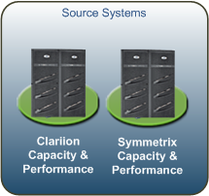

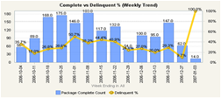
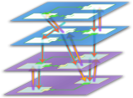

EMC Storage Intelligence Solution Offering
This offering puts in place an end-to-end Business Intelligence framework that extends current IT reporting and analysis by enabling key performance indicator-based Reporting, Analytics, and Alerting of critical Storage Capacity Planning and Performance metrics.
End-To-End Automation
What You Have Today
Automated Data Transformation!
Actionable IT Dashboards!
ECC 5x/6x Repository
Stage
Stage
Star Schema
Multi-Dimensional Cubes
Notes:
Monitoring and measurement underpins CSI and the 7-Step Improvement Process, and is an essential part of being able to manage services and processes, and report value to the business. Many organizations today measure at the component level, and although this is necessary and valuable, service measurement must go up a level to provide a view of the true customer experience of services being delivered.
There are three types of metrics that an organization needs to collect to support CSI activities as well as other process activities.
Technology metrics: often associated with component and application based metrics such as performance, availability.
Process metrics: captured in the form of Critical Success Factors (CSFs), Key Performance Indicators (KPIs) and activity metrics.
Service metrics: the results of the end-to-end service. Component/technology metrics are used to compute the service metrics.
An integrated Service Measurement Framework needs to be put in place that defines and collects the required metrics and raw data, and supports the reporting and interpretation of that data.
Service Reporting
A significant amount of data is collated and monitored by IT in the daily delivery of quality service to the business, but only a small subset is of real interest and importance to the business. The business likes to see a historical
representation of the past period’s performance that portrays their experience, but it is more concerned with those historical events that continue to be a threat going forward, and how IT intends to mitigate against such threats.
It is not enough to present reports depicting adherence or otherwise to SLAs. IT needs to build an actionable approach to reporting, i.e. what happened, what IT did, how IT will ensure it doesn’t impact again and how IT are working to
improve service delivery generally. A reporting ethos which focuses on the future as strongly as it focuses on the past also provides the means for IT to market its offerings directly aligned to the positive or negative experiences of the business.

Slide 27
EMC Consulting: Cost Benefit For BI
Value & Cost Benefit
This solution enables improved decision making by providing real-time visibility and context into the infrastructure that runs your business. It makes it possible to proactively identify issues and address them prior to escalation by users/customers. Productivity is increased as the system eliminates time wasted manually transforming, aggregating, and cleaning data that is incomplete, of poor quality, not timely, and/or inconsistently defined.
EMC BI Framework for IT
Identifying Cost & Revenue Improvements
Service Knowledge
Management System
Revenue Increase
Identification of new opportunities
More effective support / servicing
Faster opportunity recognition
Faster time to market on internal projects
Profit Increase
Ability to prioritize requests based on revenue generation vs cost to implement
Early warning of declining system health
Identification of under-performing
metrics directly impacting revenue
Identification of internal inefficiencies
More efficient infrastructure management
Service Strategy
Continual Service Improvement
Service Transition
Savings Increase
Reduction in under utilized hardware
Reduction in customized reporting requests
Service Operation
Customer Satisfaction
Improved understanding of customer wants
Improved customer-to-hardware matching
Improved offerings to internal customers
Increased agility to move with the business
Faster resolution of customer issues
Market Share Gain
Better appeal to customer wants & needs
Potential Increase to the number of customers gained from competition
Much higher customer retention rate
(year over year; versus competition)
Notes:
A data warehouse is not just a data store. It is a data store capable of providing decision support. This means it must be integrated with the environment around it. This means that the DW must be supplemented with a process and metadata architecture that the various data marts hold in common. It also means that this process and metadata architecture must be scalable to the enterprise level.

Slide 28


What is Business Intelligence (BI)? –
More Than Just Reports!
What is happening?
What happened?
Scorecards & Dashboards
Reporting
Why?
Analytics
Strategy
What will happen?
Forecasting
What do I want to happen?
Planning, Budgeting, Consolidation
Process requires past information, present conditions and future outcomes
Notes:
Title
Month Year
28

Slide 29
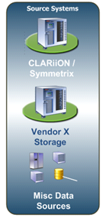
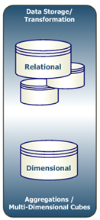
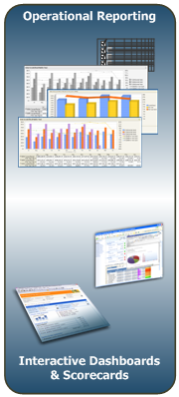

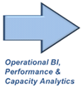
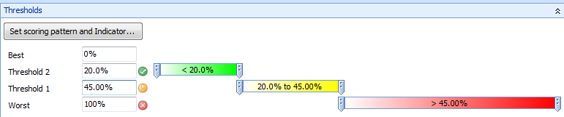
Storage Intelligence Solution Key Features
This solution brings Capacity Planning, Inventory Performance, and other operational/business data together into a single user interface.
Solution Key Features/Benefits:
Tailored for Each Client’s Environment
Provides Information for Multiple
Audiences
Enable Forecasting/Trending
Capacity Planning Analysis
Efficient Storage Reclamation
KPI-Based Analysis (Red/
Yellow/Green)
Enterprise ETL Framework
Inventory Performance Analysis
Early Detection to Potential Problems
Enforces Consistency by Centralizing Business Rules
Wizard-based Dashboard and UI Creation
Multi-Dimensional Data for Detailed Drilling
Eg. Utilization% KPI Setup
Notes:
Title
Month Year
29

Slide 30
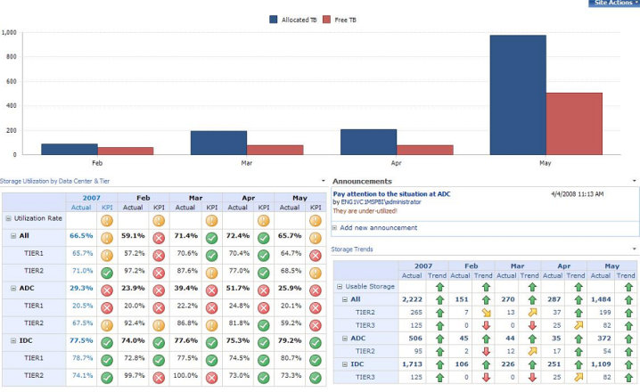
Advanced Features Offered With This Solution
Reports, KPIs, Metrics, Forecasts, & Analytics all Tailored to Specific Needs
Join Capacity Planning and Performance Management Data Together:
    Data Center, Array, Tier Level Performance Reports including Top Applications based on IOPs, Throughput, Reads/Writes, and Seeks combined with capacity by vendor, data center, array, etc.
    KPI based dashboards blending actual performance against baseline goals, trending, and forecasting
Storage Reclamation Availability: Gain insight into opportunities for reducing new expenditures.
Map Applications and Business Units to Servers and Underlying Storage: Track capacity and performance by consuming application
Track, Report, and Manage SLA’s: Load SLA’s and service levels/tiers, then manage compliance
What If Scenarios: Show potential affect of certain events on all aspects of the environment
Additional Functionality:
  Notifications can be sent to phones, email, pagers
  Reports can be scheduled for automated delivery
  Integrated Workflow, Tasks, & Collaborative features
  Data Mining identifies often missed trends in data
Notes:
Scheduled Reporting, Analytics & Alerting
Configurable alerts
Alerts are highly configurable, assigned against KPIs and to users themselves using email. Once a PPS KPI is created and it’s values assigned to a user/group it is then checked during the ETL process. If alerts are triggered, emails are sent automatically, message content is customizable and contingent on KPI state (i.e. is the KPI green, yellow or red).
Alerts are table driven, assigned to business users via email, and to KPIs. Once a PerformancePoint KPI is created, the values of that KPI is assigned to a business user or users, and then validated during the ETL process. When the data is being loaded during the ETL process, alerts are automatically generated via email. The text in the email changes based on the KPI being yellow or red and is also completely customizable.
Alerts can be sent to phones, email, pagers
Reports can be scheduled for automated delivery
Data Mining identifies often missed trends in data
Because this is a SQL Server 2005 system, Data Mining can be used to identify trends in the data that would be typically overlooked. Data Mining has algorithms built in that assist in the process of identifying these trends.

Slide 31
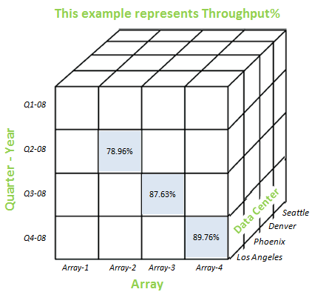
It’s All About The Data!
The data for this solution resides in a Data Cube, which is a data structure that allows fast analysis of data. It rearranges data so that all data in a database can be summarized, and then analyzed.
Stores all historical data loaded every 10 minutes
Data capture time is built to each client requirement
Pre-aggregates queries for instant response
Navigate data using pre-built “Groupings”
Data Center → Array → Hyper/Lun → Disk
Blends data sources into 1 analytic dataset
Can include financial data (chargeback pricing
models) and application/server/array mappings
Common Questions This Solution Answers:
  What are the top 3 Applications by Array for IOPs, Throughput, Reads/Writes, Seeks
  What’s the Utilization%, Raw TB, Configured TB, Allocated TB for each Data Center / Application / Tier
  What’s the variance by Department of Requested GB and actual Used GB
  How much of that storage can be reclaimed from each dept, by what date
This represents Throughput for Array-2 For Q2-08 in the Phoenix Data Center.
This represents Throughput for Array-3 For Q3-08 in the Denver Data Center.
Notes:
Title
Month Year
31

Slide 32
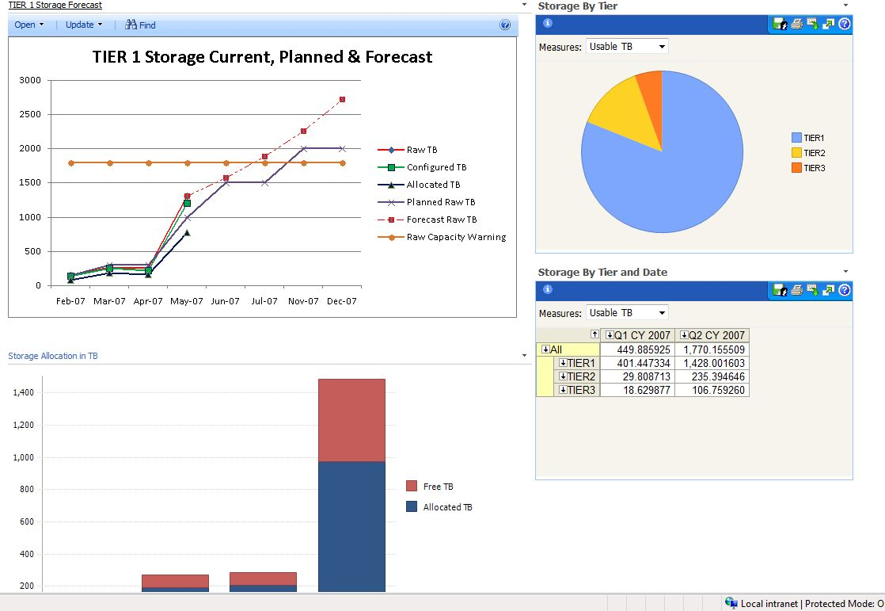
BI for Storage –
Sample Trending Dashboard
Notes:
This is a diagram of the entire solution. Data moving from the data sources moves into the staging system. Once the data is in the staging system, it is then moved to the relational database. From the relational database, the data is transformed into the dimensional data structure where it is prepared to be loaded into the Analysis Services cube. The data is then moved into the cube where it is processed as often as the data needs to be to stay as current as possible with the source systems.
Note that data can be queried from both the relational and dimensional data structures. Some clients prefer to have access to the relational structure (although not recommended), which is why the relational structure is tuned and optimized for query access. This ensures that if users are accessing the relational data, it does not negatively impact the performance of keeping the cube updated. All analytics come from the Dimensional data structure, the cube, to ensure fast access and drilling capabilities.

Slide 33
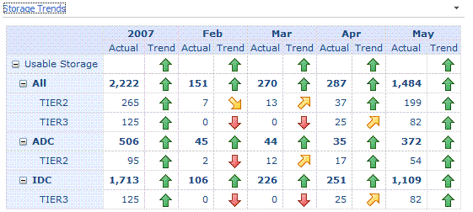
BI for Storage –
Usable Storage Trending Drilldown
Notes:
This is a diagram of the entire solution. Data moving from the data sources moves into the staging system. Once the data is in the staging system, it is then moved to the relational database. From the relational database, the data is transformed into the dimensional data structure where it is prepared to be loaded into the Analysis Services cube. The data is then moved into the cube where it is processed as often as the data needs to be to stay as current as possible with the source systems.
Note that data can be queried from both the relational and dimensional data structures. Some clients prefer to have access to the relational structure (although not recommended), which is why the relational structure is tuned and optimized for query access. This ensures that if users are accessing the relational data, it does not negatively impact the performance of keeping the cube updated. All analytics come from the Dimensional data structure, the cube, to ensure fast access and drilling capabilities.

Slide 34
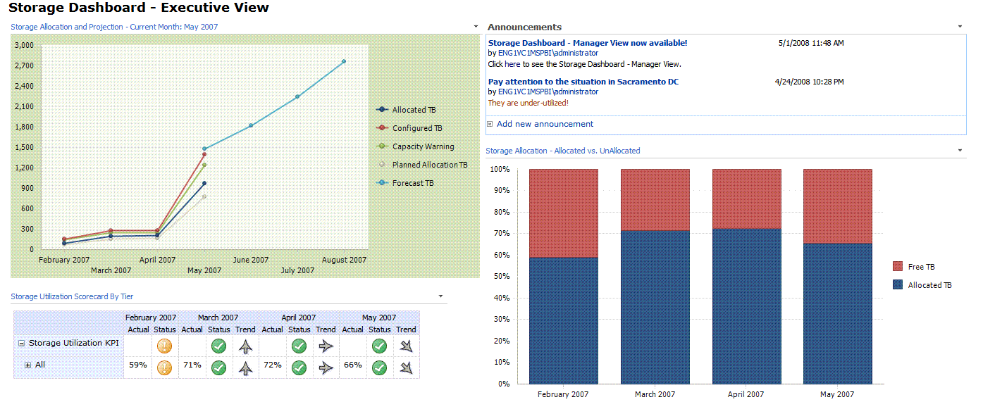
BI for Storage –
Sample Executive Dashboard
Notes:
This is a diagram of the entire solution. Data moving from the data sources moves into the staging system. Once the data is in the staging system, it is then moved to the relational database. From the relational database, the data is transformed into the dimensional data structure where it is prepared to be loaded into the Analysis Services cube. The data is then moved into the cube where it is processed as often as the data needs to be to stay as current as possible with the source systems.
Note that data can be queried from both the relational and dimensional data structures. Some clients prefer to have access to the relational structure (although not recommended), which is why the relational structure is tuned and optimized for query access. This ensures that if users are accessing the relational data, it does not negatively impact the performance of keeping the cube updated. All analytics come from the Dimensional data structure, the cube, to ensure fast access and drilling capabilities.

Slide 35
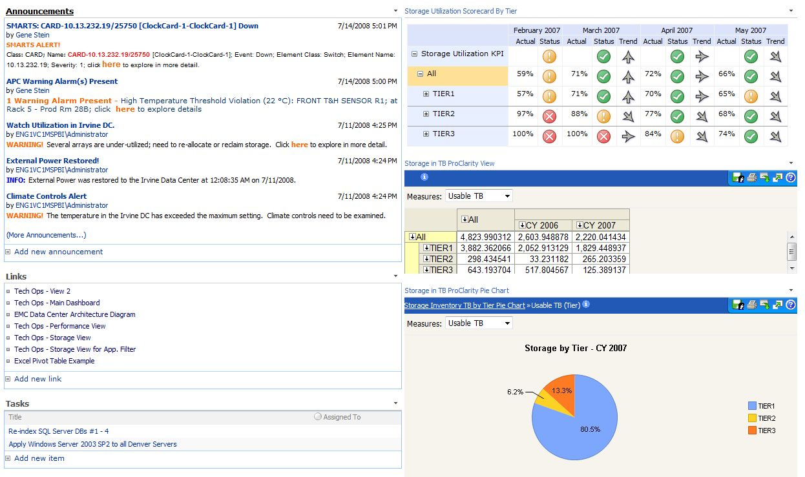
BI for Storage –
Sample Executive Dashboard #2
Notes:
This is a diagram of the entire solution. Data moving from the data sources moves into the staging system. Once the data is in the staging system, it is then moved to the relational database. From the relational database, the data is transformed into the dimensional data structure where it is prepared to be loaded into the Analysis Services cube. The data is then moved into the cube where it is processed as often as the data needs to be to stay as current as possible with the source systems.
Note that data can be queried from both the relational and dimensional data structures. Some clients prefer to have access to the relational structure (although not recommended), which is why the relational structure is tuned and optimized for query access. This ensures that if users are accessing the relational data, it does not negatively impact the performance of keeping the cube updated. All analytics come from the Dimensional data structure, the cube, to ensure fast access and drilling capabilities.

Slide 36
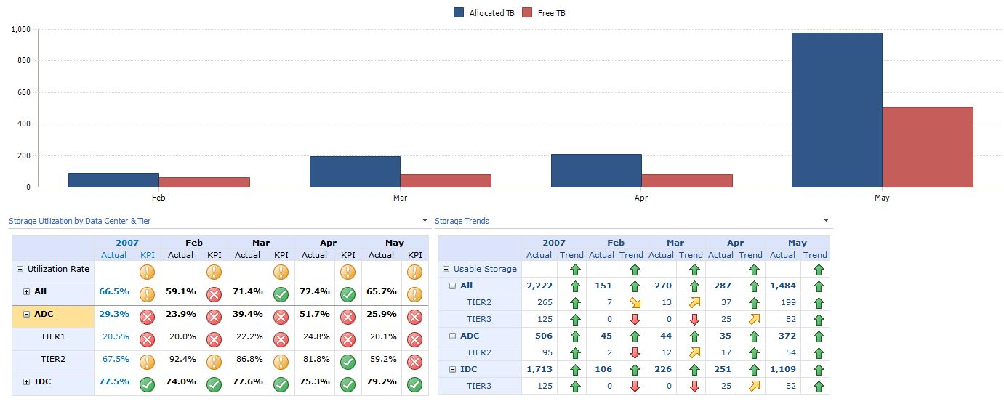
BI for Storage –
Sample Manager Dashboard
Notes:
This is a diagram of the entire solution. Data moving from the data sources moves into the staging system. Once the data is in the staging system, it is then moved to the relational database. From the relational database, the data is transformed into the dimensional data structure where it is prepared to be loaded into the Analysis Services cube. The data is then moved into the cube where it is processed as often as the data needs to be to stay as current as possible with the source systems.
Note that data can be queried from both the relational and dimensional data structures. Some clients prefer to have access to the relational structure (although not recommended), which is why the relational structure is tuned and optimized for query access. This ensures that if users are accessing the relational data, it does not negatively impact the performance of keeping the cube updated. All analytics come from the Dimensional data structure, the cube, to ensure fast access and drilling capabilities.

Slide 37
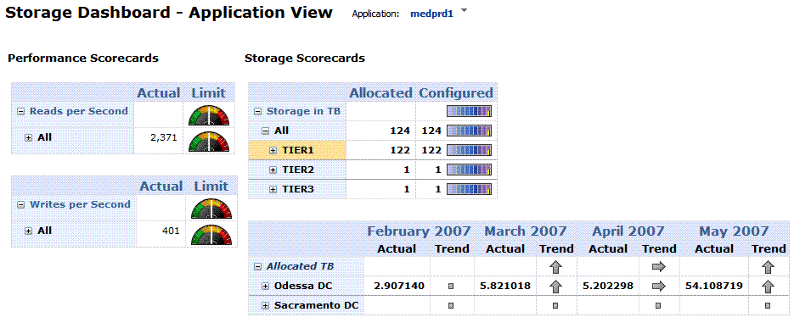
BI for Storage –
Sample Application Dashboard
Notes:
This is a diagram of the entire solution. Data moving from the data sources moves into the staging system. Once the data is in the staging system, it is then moved to the relational database. From the relational database, the data is transformed into the dimensional data structure where it is prepared to be loaded into the Analysis Services cube. The data is then moved into the cube where it is processed as often as the data needs to be to stay as current as possible with the source systems.
Note that data can be queried from both the relational and dimensional data structures. Some clients prefer to have access to the relational structure (although not recommended), which is why the relational structure is tuned and optimized for query access. This ensures that if users are accessing the relational data, it does not negatively impact the performance of keeping the cube updated. All analytics come from the Dimensional data structure, the cube, to ensure fast access and drilling capabilities.

Slide 38
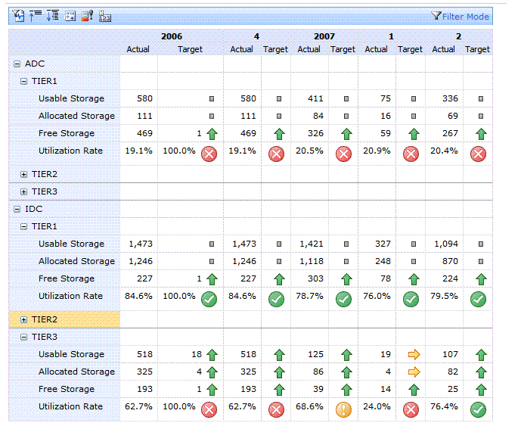
BI for Storage –
Storage Usage Trending Dashboard
Notes:
This is a diagram of the entire solution. Data moving from the data sources moves into the staging system. Once the data is in the staging system, it is then moved to the relational database. From the relational database, the data is transformed into the dimensional data structure where it is prepared to be loaded into the Analysis Services cube. The data is then moved into the cube where it is processed as often as the data needs to be to stay as current as possible with the source systems.
Note that data can be queried from both the relational and dimensional data structures. Some clients prefer to have access to the relational structure (although not recommended), which is why the relational structure is tuned and optimized for query access. This ensures that if users are accessing the relational data, it does not negatively impact the performance of keeping the cube updated. All analytics come from the Dimensional data structure, the cube, to ensure fast access and drilling capabilities.

Slide 39
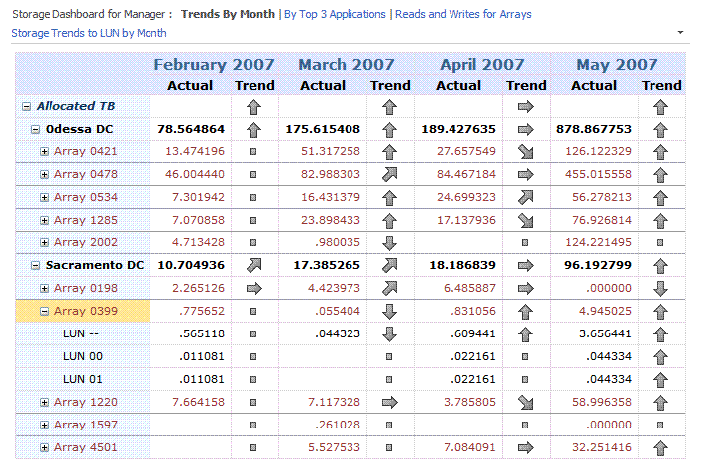
BI for Storage –
Storage Usage Trending Drilldown By Month
Notes:
This is a diagram of the entire solution. Data moving from the data sources moves into the staging system. Once the data is in the staging system, it is then moved to the relational database. From the relational database, the data is transformed into the dimensional data structure where it is prepared to be loaded into the Analysis Services cube. The data is then moved into the cube where it is processed as often as the data needs to be to stay as current as possible with the source systems.
Note that data can be queried from both the relational and dimensional data structures. Some clients prefer to have access to the relational structure (although not recommended), which is why the relational structure is tuned and optimized for query access. This ensures that if users are accessing the relational data, it does not negatively impact the performance of keeping the cube updated. All analytics come from the Dimensional data structure, the cube, to ensure fast access and drilling capabilities.

Slide 40
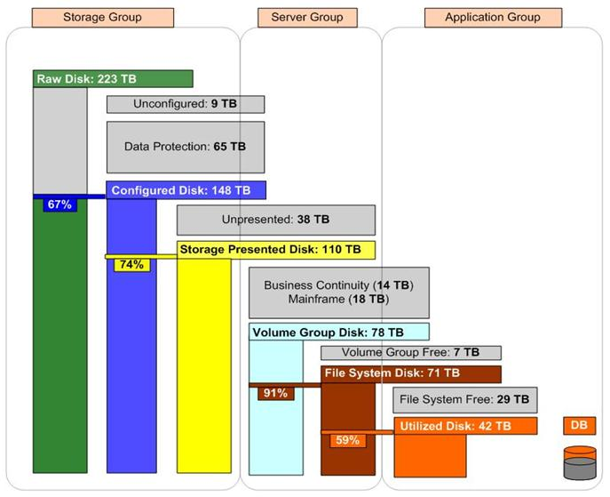
Storage Classifications Breakdown
Notes:
Title
Month Year
40

Slide 41
Solution Value Summary
Primary:
Automated Surfacing of Capacity and Performance Data: Reduce time wasted on manually aggregating data for weekly, monthly, quarterly, and annual reports.
Identify Opportunities for Storage Consolidation/Reclamation: Identify over-allocated systems and applications.
Automate Chargeback/Memoback Mechanisms: Integrate with accounting/ERP systems to automate chargebacks.
Accurately Forecast, Trend, and Plan for Budget Allocations: Leverage the wealth of data to accurately plan and forecast capacity growth and associated costs.
Secondary:
Identify Mis-Configured Agents or Management Software: The transparency and depth of data presented can un-earth problems in the underlying storage management software or data collection agents.

Slide 42
Solution Architecture & Technology Platform
Technology platform overview

Slide 43



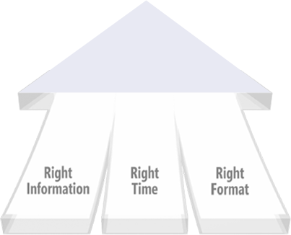
Microsoft BI – Ready for the Masses
Improving organizations
by providing insights to all personnel leading to better, faster, more relevant decisions
2008 Leader in Gartner BI Magic Quadrant
Complete and integrated BI offering
Widespread delivery of intelligence through Microsoft Office products such as Excel
Enterprise grade and affordable
SQL
MOSS
PPS
Notes:
Microsoft is a great platform company. They do a great job creating platforms that the partner ecosystem and developer community can expand.
Relative to BI, you are seeing a convergence of these platforms…
Underscore the following point: The convergence of these platforms is accelerating the opportunities to address business challenges that CIOs phase today!
Let’s talk about the technology

Slide 44






Microsoft’s Business Intelligence / Performance Management Offering
DELIVERY
SharePoint Server
Reports
Dashboards
Scorecards
Excel
Workbooks
Analytic
Views
Custom
Development
Plans
END USER TOOLS & PERFORMANCE MANAGEMENT APPS
Excel
PerformancePoint Server
BI PLATFORM
SQL Server
Reporting Services
SQL Server
Analysis Services
SQL Server DBMS
SQL Server Integration Services / Proactive Caching
Notes:
44

Slide 45
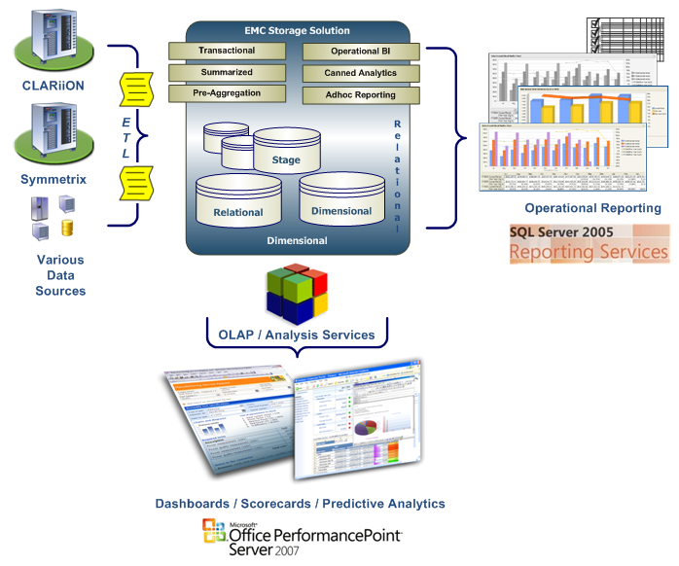
Solution Based on Microsoft Technologies
Solution Framework:
  SQL Server 2005/2008
  Integration Services 2005/2008
  Analysis Services 2005/2008
  Reporting Services 2005/2008
  PerformancePoint Server 2007
Notes:
This is a diagram of the entire solution. Data moving from the data sources moves into the staging system. Once the data is in the staging system, it is then moved to the relational database. From the relational database, the data is transformed into the dimensional data structure where it is prepared to be loaded into the Analysis Services cube. The data is then moved into the cube where it is processed as often as the data needs to be to stay as current as possible with the source systems.
Note that data can be queried from both the relational and dimensional data structures. Some clients prefer to have access to the relational structure (although not recommended), which is why the relational structure is tuned and optimized for query access. This ensures that if users are accessing the relational data, it does not negatively impact the performance of keeping the cube updated. All analytics come from the Dimensional data structure, the cube, to ensure fast access and drilling capabilities.

Slide 46
Part of an Overall IT Business Intelligence Framework
Customer Application
Synthetic Transactions
Consoles
Enterprise
Instrumentation Libraries
Instrumentation Infrastructure
Application
Application Server
Platform
Basic Instrumentation
App Server Agents
email
Database Server
Database Agents
Pager
ETL Tools
Warehouse
Reporting
Operating System
OS Agents
Dashboard
SLA
Server Platform
Hardware Agents
Analysis
Storage
Storage Agents
Trend
Forecast
Network
Network Agents
Plan
Change Management Database
Asset Management Database
Notes:
This is a diagram of the entire solution. Data moving from the data sources moves into the staging system. Once the data is in the staging system, it is then moved to the relational database. From the relational database, the data is transformed into the dimensional data structure where it is prepared to be loaded into the Analysis Services cube. The data is then moved into the cube where it is processed as often as the data needs to be to stay as current as possible with the source systems.
Note that data can be queried from both the relational and dimensional data structures. Some clients prefer to have access to the relational structure (although not recommended), which is why the relational structure is tuned and optimized for query access. This ensures that if users are accessing the relational data, it does not negatively impact the performance of keeping the cube updated. All analytics come from the Dimensional data structure, the cube, to ensure fast access and drilling capabilities.

Slide 47
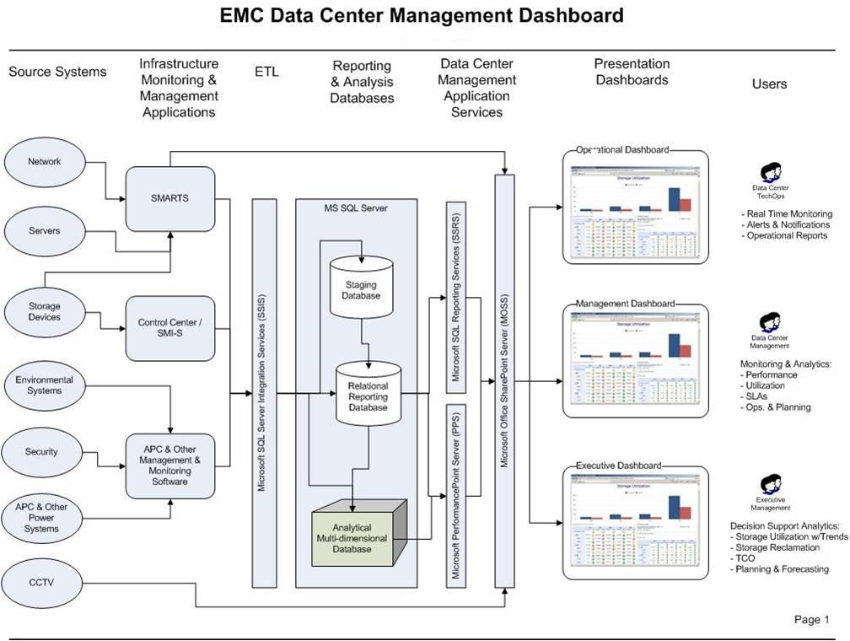
Part of an Overall IT Business Intelligence Framework
Notes:
This is a diagram of the entire solution. Data moving from the data sources moves into the staging system. Once the data is in the staging system, it is then moved to the relational database. From the relational database, the data is transformed into the dimensional data structure where it is prepared to be loaded into the Analysis Services cube. The data is then moved into the cube where it is processed as often as the data needs to be to stay as current as possible with the source systems.
Note that data can be queried from both the relational and dimensional data structures. Some clients prefer to have access to the relational structure (although not recommended), which is why the relational structure is tuned and optimized for query access. This ensures that if users are accessing the relational data, it does not negatively impact the performance of keeping the cube updated. All analytics come from the Dimensional data structure, the cube, to ensure fast access and drilling capabilities.

Slide 48

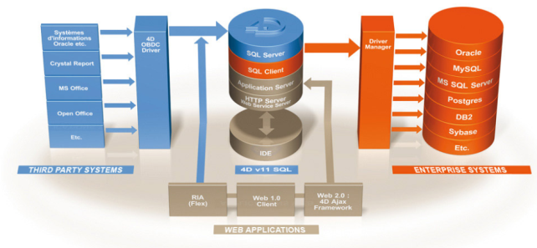
So Are These Products or Custom Applications?
Packaged
Product
You Are Here
Custom
Built
- Dashboards
- Scorecards
-Alerting
-Biz Rules
-Reporting
- Data Extraction
- Data Loading
- Data Sources
- Forecasting
- Performance Metrics
- Data Transformation
- Capacity/Plan Metrics
- Multi-Dimensional Cube
Fully Customizable
Notes:
Title
Month Year
48

Slide 49

Discussion / Q&A

Slide 50


