Slide 1
Hitachi Data Systems
HUS-VM Update
Tom Kirckof
Account Consultant
Hitachi Data Systems

Slide 2
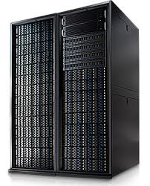
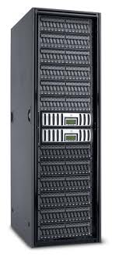
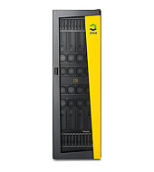
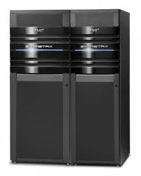

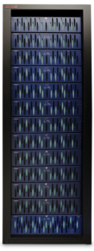
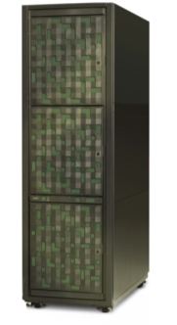
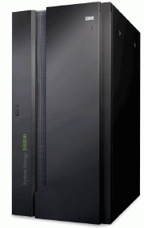
There is a Gap in the Storage Market
Forcing a choice between midrange and enterprise storage
?
Management complexity
Missed service levels
Disruptive data movement
Lower storage efficiency
Notes:
Storage platforms available today force buyers to choose between enterprise functionality and midrange cost.
These trade-offs force decisions to be made which can result in more complexity, missing service level objectives, disruptions in data mobility and less efficiency overall.
All contribute to a gap in between where more value is desired.
You should be able to achieve your goals without having to purchase multiple storage systems for different purposes:
Enterprise storage for consolidation, high performance and availability, mainframe support.
Midrange storage for specific applications, alternate sites, data growth.
Resulting in a sprawl of storage systems, differing management schemes and more complexity.

Slide 3
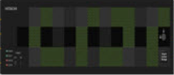
Hitachi HM700 “HUS-VM” Fills the gap
Enterprise class features and functions
at a mid-range price point.
HUS-VM
Same management tools as the VSP
Enterprise class redundancy and data protection
Online data mobility and migration
Greater storage efficiency
Notes:
Storage platforms available today force buyers to choose between enterprise functionality and midrange cost.
These trade-offs force decisions to be made which can result in more complexity, missing service level objectives, disruptions in data mobility and less efficiency overall.
All contribute to a gap in between where more value is desired.
You should be able to achieve your goals without having to purchase multiple storage systems for different purposes:
Enterprise storage for consolidation, high performance and availability, mainframe support.
Midrange storage for specific applications, alternate sites, data growth.
Resulting in a sprawl of storage systems, differing management schemes and more complexity.

Slide 4
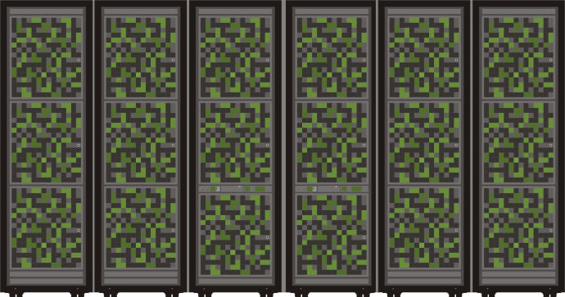
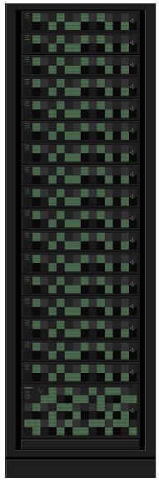
What is HUS-VM?
HUS-VM is a new storage system that combines
the best attributes of our existing VSP and HUS 100 products, into a new product designed for
the Tier 1.5 market.
  Design attributes from the VSP:
    Robust microcode base with its features for
    open systems
    Clustered controller architecture with global cache
  Design attributes from the HUS 150:
    Modularized form factor, installable in any standard 19” rack (using Hitachi supplied rails).
    Disks and Disk Trays are common at the
    hardware level (firmware installed on disk
    trays is unique to each platform)
    Improved hardware ergonomics and software usability
VSP
Tier 1 Enterprise
HUS-VM
Tier 1.5 Entry Level
Enterprise
HUS 100
Tier 2 Midrange

Slide 5

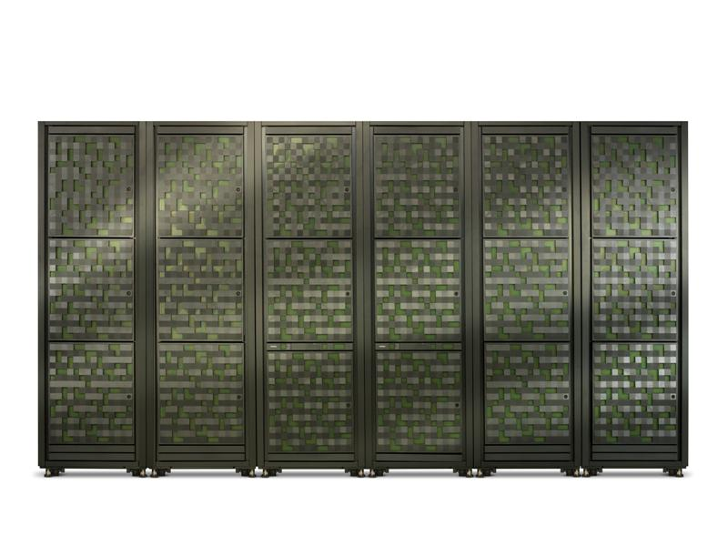
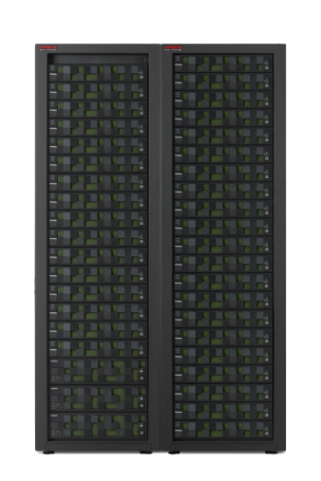
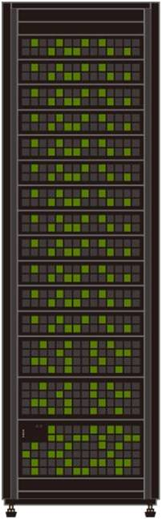
INTEGRATED SCALABLE PORTFOLIO
New Unified
Virtual Storage System
Entry Level Enterprise
Hitachi Unified
Storage 100
Midrange
Virtual Storage
Platform
Enterprise
Notes:
Within our integrated, scalable storage portfolio, this new platform fills the gap between enterprise and midrange
It will be positioned as a new, entry level enterprise storage platform
It is a unified extension to our new family of HUS products and bridges the gap to our VSP enterprise system
It is complemented by the rest of the portfolio of NAS, HCP, HDI
And unified management across the line creating a comprehensive architecture for all data

Slide 6
HUS-VM 5U Diskless ControllER
The HUS-VM controller is a 5U chassis that brings Enterprise functionality and performance (VSP)
into a modular form factor. HUS-VM is intended to provide Enterprise features and functionality at a
near mid-range price point.
HUS-VM
32 X 8 Gb FA Ports, 32 X 6Gb SAS
2 X 8 Core Sandybridge CPU, 256GB Cache
V03 +1 Microcode at GA ?
5U Block Module

Slide 7


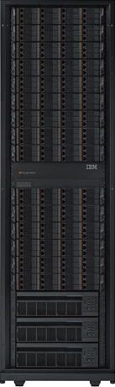
HUS-VM supports up to 64PB’s of virtualized capacity
HUS-VM supports being configured as a diskless virtualization
engine that supports up to 64PB of virtualized capacity.
This includes third party support of EMC, IBM, HP, and
other vendors. This configuration can be used for data migrations
or permanent virtualized configurations.
EMC
HUS-VM
HUS
IBM

Slide 8


HUS-VM supports up to 3.3PB of internal Storage
HUS-VM supports internal capacity of up to 1152 disks for a maximum internal raw
capacity of 3.3PB. This includes 2.5” SAS, 3.5” SAS, and 2.5” MLC SSD disks.
HUS-VM will also support HAFS (Tomahawk).
EMC
HUS-VM
HUS
24 Slot 2.5” (2U)
IBM
48 Slot 3.5” (4U)

Slide 9

Hitachi HNAS
HUS-VM is a Unified platform that has integration with Hitachi HNAS. HUS-VM will support up to 8PB of
NAS capacity at GA.
HNAS
EMC
HUS-VM
HUS
12 Slot 2.5” (2U)
IBM
48 Slot 3.5” (4U)

Slide 10
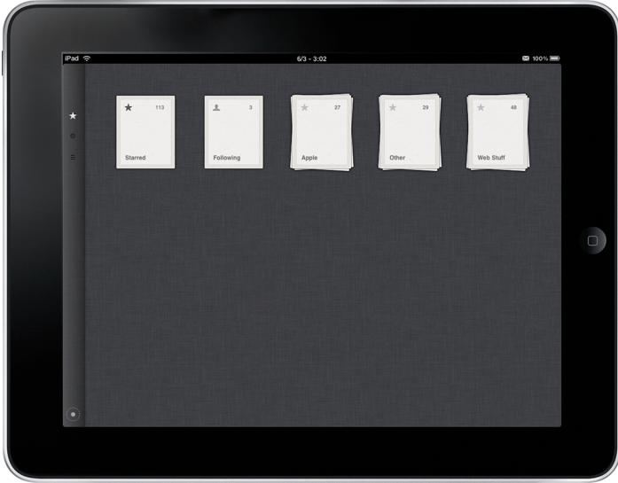
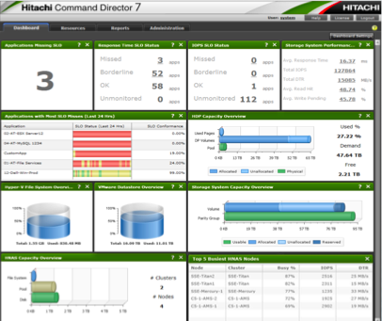
Hitachi Command Suite 7.4
Command Suite
HNAS
EMC
HCS provides a single management interface for both Block and File storage requirements.
HUS-VM
HUS
12 Slot 2.5” (2U)
IBM
48 Slot 3.5” (4U)

Slide 11
Improve quality of service
Designed for resilience and the highest availability
Hitachi HiTrack®
Monitor Service
100% Data Availability
Guarantee
Online service and
microcode updates
100% data availability
Ensure uninterrupted access to data
Automatic diagnostics with call home service
Update without service interruption
Mirrored
write cache
Active – active clustered file services
Shared resource
block controllers
Notes:
The100% data availability guarantee is available for Wister – no one else offers one
The 100% data availability guarantee is an optional contract exhibit, not everyone automatically receives it
The terms are the same as VSP: HiTrack is required and so is an active service agreement
Wister is an entry enterprise storage system based on VSP architecture, it is not midrange
Entry enterprise storage requires enterprise availability
The file module is available in a clustered configuration for higher availability
The block module features shared processor and cache resources
New design integrating VSP functions into smaller package utilizing the HiStar Network architecture
Not a scaled down VSP, an all new product specifically designed for this market segment
Cache backup protection is onboard via flash device which is battery powered
Hitachi HiTrack remote monitoring is available to oversee system functions
Updates of components and microcode can be accomplished under operation

Slide 12


Product Details
12

Slide 13
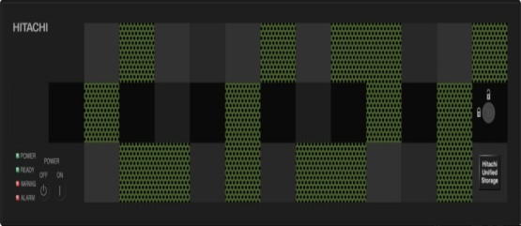
Product Component Overview
Modular components
Block module, 5U
  32 x 8Gb FC, 32(8x4WL) 6Gb SAS
  2 x 8 cores, 256GB* cache
File module, 3U
  6 x 1GE, 4 x 10GE, 4 x 4Gb FC
  NFS, CIFS, FC, iSCSI
Drive trays
  2U: 24 x 2.5” SAS 10K, 15K, SSD
  4U: 48 x 3.5” SAS 7.2K
Notes:
You will be able to choose a new storage virtualization controller with a selection of file option for a unified platform and the HDD and SSD storage options desired.
As I mentioned the block module is a new 5U design with up to 32 x 8Gb FC frontend host ports and 32 (8x4WL) 6Gb SAS backend ports. This new controller features 2 x 8 cores with up to 256GB cache at v02.
The file module is an existing 3U Hitachi NAS with up to 8 x 1GE ports or 4 x 10GE ports supporting NFS, CIFS, FC, iSCSI.
The drive trays offered are 2U 24 x 2.5” (SAS 10K, 15K, SSD) and 4U 48 x 3.5” (SAS 7.2K).

Slide 14
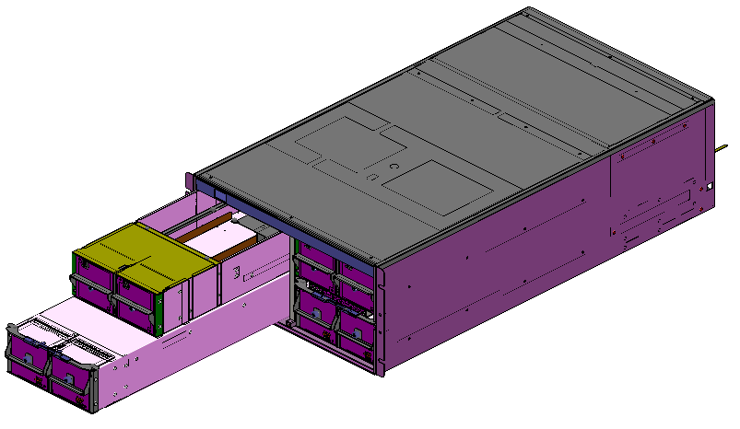
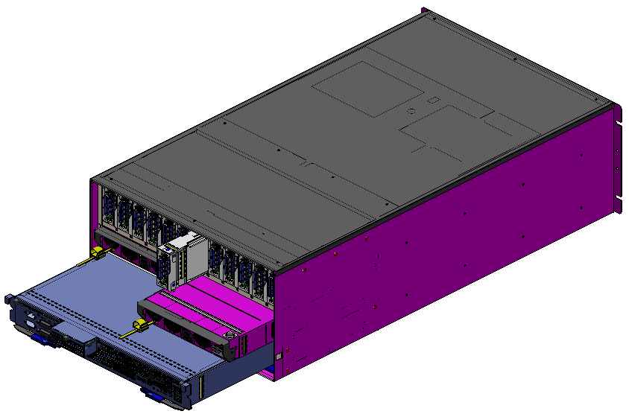
Hardware Components and Specifications
Controller Chassis (CBX) Components
Controller Module (CTL)
Power Supply (SWPS)
Main Module (Main)
Interface Modules
(CHB and DKB)
Microprocessor Module (MPB)
Service Processor (SVP)
CBX Front view
CBX Rear view
Item Description | Name | Qty per CBX | Contents
Controller Module | CTL | 2 | Main, MPB, Host/Backend Interfaces
Main Module | Main | 2 | ASICs, Cache DIMMs, Cache Flash Memory, Flash Battery
Microprocessor Module | MPB | 2 | CPU and CPU cache
Host I/O Interfaces Back end I/O Interfaces | CHB DKB | 2 – 12 0 - 4 | 8Gbps FC, 10Gbps (future) 6Gbps SAS
Switching Power Supply | SWPS | 2 | Redundant Power Supplies and Fans
Service Processor | SVP | 1 | Service CPU and Maintenance LAN interfaces
Notes:
The Controller Module (CTL) is a logical grouping of redundant processing components (modules) as follows:
There are two and only two CTL’s per subsystem (CTL0 and CTL1)
HUS-VM will not offer a single controller system
Each controller (CTL) contains:
One Main Module (1 x ASIC, up to 8 x Cache DIMMs, Flash memory module for Cache backup, Battery backup for Flash)
One Microprocessor Module (1 x 8 core CPU and CPU cache)
One Switch
Interface Modules:
Diskless Configuration: max 6 x Host I/O Interface Modules (for 8Gbps FC, up to 24 x FE ports per CTL)
Internal Disk Configuration: max 4 x Host I/O Interface Modules and max 2 x Backend I/O Interface Modules per CTL 8Gbs FC example: up to 16 x Host ports per CTL up to 4 x SAS 6Gbps Backend ports per CTL (up to 16 SAS WL per CTL)
One Switching Power Supply and Fan
Service Processor (SVP): Only single SVP is supported HUS-VM

Slide 15
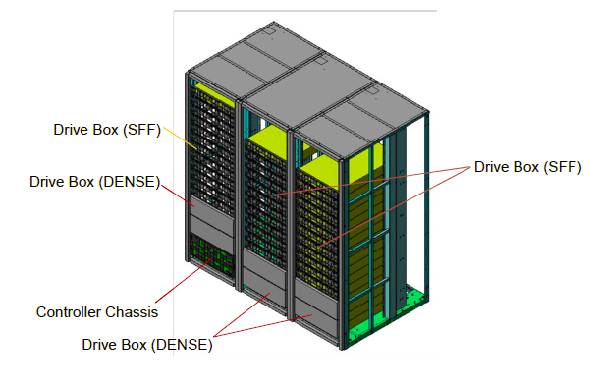
Hardware Components and Specifications
Major Components
The major components consist of:
  Controller Chassis Tray
  Drive Trays
  Rack
    HDS Rack or any standard
    19” rack using the HDS supplied rail kits
(DBL)
12 x 3.5” LFF (Future)
(DBS)
84 x 3.5” LFF
(Future)
24 x 2.5” SFF
(CBX)
48 x 3.5” LFF (DBX)
Item Description | Name | Height | Content and Specifications
Controller Chassis Box | CBX | 5U | Contains Controllers and the SVP
Drive Box | DBS | 2U | 24 drive tray (SFF 2.5” only)
Drive Box (Future) | DBL | 2U | 12 drive tray (LFF 3.5” only)
Drive Box | DBX | 4U | 48 drive tray (LFF 3.5” only)
Drive Box (Future) | [TBD] | 5U | 84 drive tray (LFF 3.5” only)

Slide 16
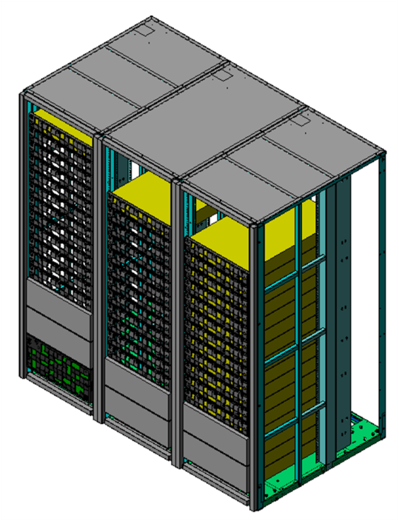
Physical overview
System |  |  | Specification
CPU | Type |  | Intel Xeon (Sandybridge)
 | Cores/Sys. |  | 16
Drives | 2.5" |  | 1,152
 | 3.5" |  | 1,152
Cache |  |  | 256GB*
FE Ports | FC 8G |  | 32
 | FCoE 10G |  | 16*
 | iSCSI 10G |  | 16*
BE Ports | Type |  | SAS-6G
 | Ports |  | 32 (4WLx8)
Enclosures and Trays | Controller |  | 5U
 | Drive Trays | 3.5” | 48HDD/4U
 |  | 2.5” | 24HDD/2U
Rack |  |  | 19”/42U or Customer
Performance Targets | Bandwidth from Disk |  | Seq: 11GB/s
 |  |  | SPC-1: 150K IOPS** Random: 240K IOPS**
5U Controller
2U SFF Drive Tray
4U LFF Drive Tray
* 6 months after launch
** estimated
Notes:
The core storage virtualization controller design is based on the Intel Xeon (Sandybridge) processor which is an 8 core design on dual blades in our 5U control chassis.
We will offer both 2.5” and 3.5” HDD and SSD drive options in either a 2U 24 SSF drive tray and 4U 48 LFF drive tray for up to 1,152 drives which may be mixed within the system.
Cache size will be 128GB at GA and increased to 256GB at the second update within 6 months.
The front end host I/O ports are up to 32 8Gb fibre channel ports. We plan to offer both 10Gb iSCSI and FCoE at our v02 release.
The back end storage I/O ports are up to 32 6Gb SAS, 8x4 wide lanes.
Initial shipments will be housed in HDS racks, but a universal rail kit will be made available for mounting in standard racks.
Our performance targets are 150,000 random mixed SPC-1 IOPS and 11GB/sec sequential transfer rate. Random reads target is 240,000 IOPS.

Slide 17
Hardware Components and Specifications
Controller Chassis (CBX) Specifications
 |  | VSP V03+1 | HUS-VM | HUS 150
Cache | Max Capacity | 1024GB | 128GB/256GB¹ | 32GB
 | Cache Flash Memory |  | 160GB
 | # Cache Flash Batteries |  | 2 | 2
Host Ports | FC-8G | 176 | 32 | 16
 | iSCSI | － | 16 *1 | 8
 | FCoE | 88 | 16 *1 | TBD
 | FICON (MF) | 176 | － | －
Back end path | SAS-6G | 2WL x 32 | 4WL x 8 | 4WL x 8
Chassis size | CTL | 14U (1module) | 5U | 3U
 | SVP | (in DKC 14U) | (in CBX 5U) | －
 | P/S | (in DKC 14U) | (in CBX 5U) | （in CBX 3U）
Power | AC Input | Single Phase 200-240 V | Single Phase 200-240 V | Single Phase 100-120 V 200-240V
SVP | # SVP Blades | 1-2 | 1 | －
 | LAN Ports | 1Gbps x 2 or 4 | 1Gbps x 2 | 1Gbps x 4 (in CTL)
¹ Future

Slide 18
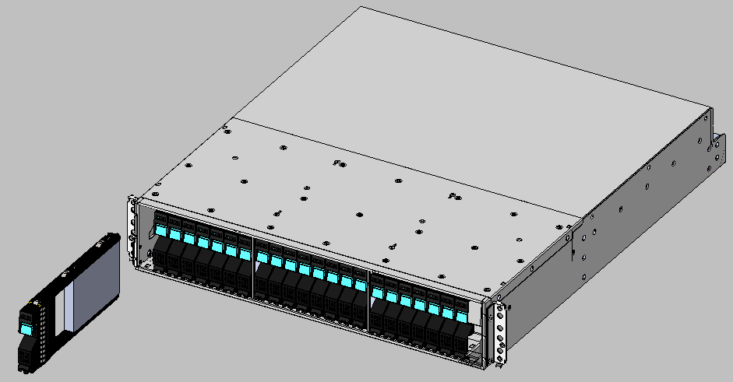
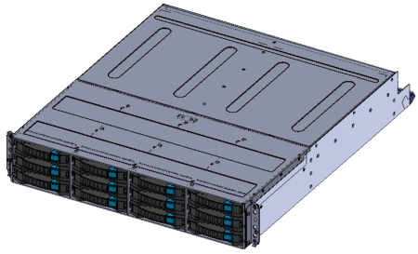
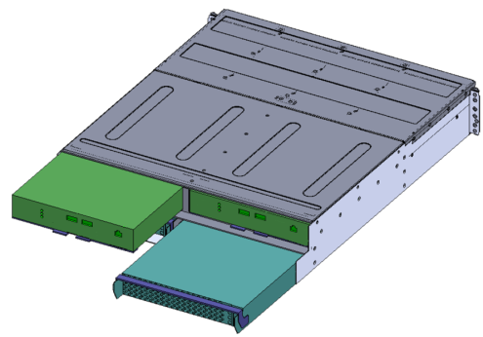
Hardware Components and Specifications
Drive Tray Specifications – 2.5” SFF DBS and 3.5” LFF DBL
2U
2U
DBS (2.5” SFF)
DBL (3.5” LFF)
(Future)
Rear
(same for DBS and DBL)
Standard Tray Specs (DBS / DBL) |  | Min/Max Per Tray | Max Per Subsystem
Number of HDD | 2.5” | 0¹ / 24 | 1152
 | 3.5” | 0¹ / 12 | 576
Number of SSD Flash | 2.5” | 0¹ / 24 | 128
 | 3.5” | － | －
Device Interface | DBS (2.5” SFF) DBL (3.5” LFF) | 6Gbps SAS / Dual Port 4WL x 2 | 6Gbps SAS / Dual Port 4WL x 8
Front
Size / Type | Transfer Rate (Gb/sec) | Speed/Flash Type | Capacity
2.5” SAS | 6 | 15,000 RPM | 300GB
2.5” SAS | 6 | 10,000 RPM | 600GB, 900GB
3.5” SAS | 6 | 7,200 RPM | 3TB
2.5” Flash | 6 | MLC | 200GB, 400GB
¹ Minimum 4 drives when the tray is the first tray in the subsystem. Empty tray is supported for additional trays.

Slide 19
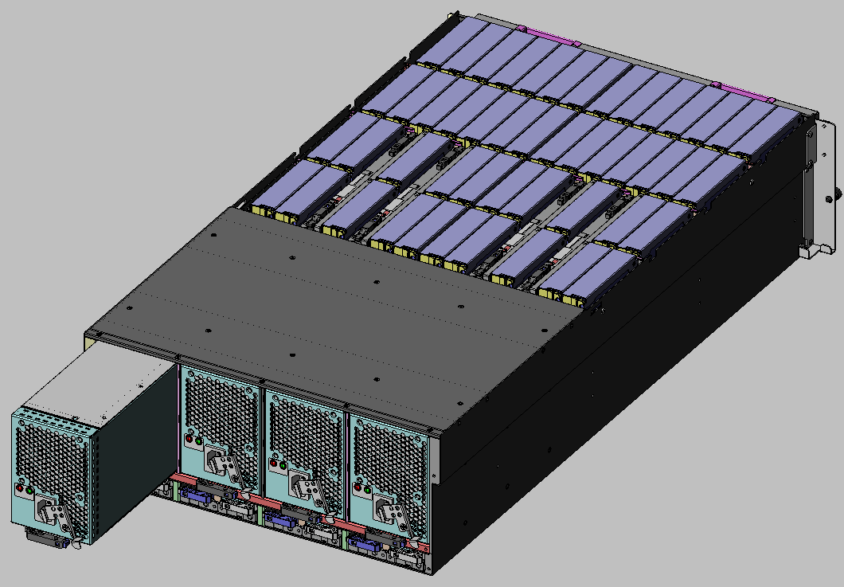
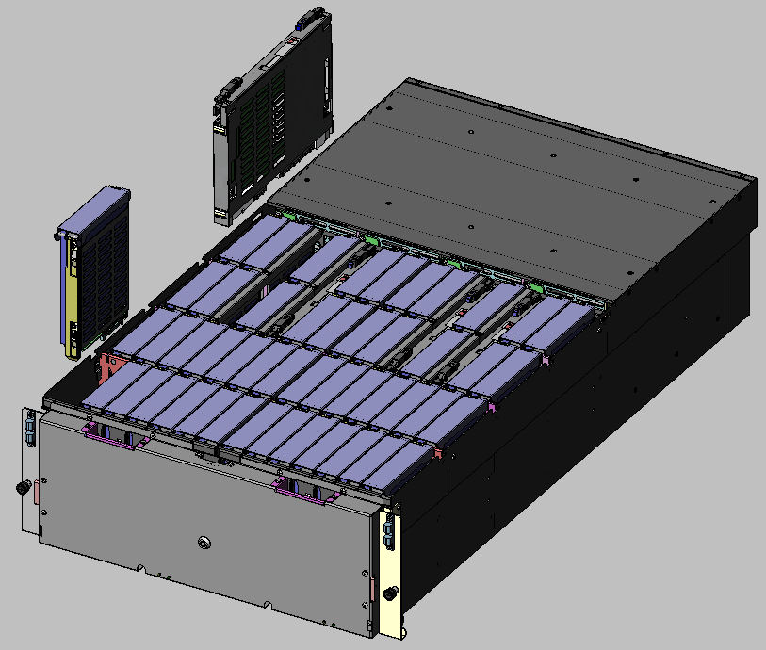
Hardware Components and Specifications
Drive Tray Specifications – 3.5” LFF DBX dense
ENC x 4
Power Supply x 4
(SWPS)
3.5” Canister
4U
Rear
Front
Dense Tray Specs (DBX) |  | Min / Max Per Tray | Max Per Subsystem
Number of HDD | 3.5” | 0^{*1} / 48 | 1152
Device Interface | DBX (3.5” LFF) | 6Gbps SAS / Dual Port 4WL x 4 | 6Gbps SAS / Dual Port 4WL x 8
Size / Type | Transfer Rate (Gb/sec) | Speed/Flash Type | Capacity
3.5” SAS | 6 | 7,200 RPM | 3TB
^{*1} Minimum 4 drives when the tray is the first tray in the subsystem. Empty tray is supported for additional trays.

Slide 20
Hardware Components and Specifications
Subsystem storage capacities and metrics
Number of Drives | Minimum | 4 or 0 (diskless config)
 | Maximum | 1152
 | SSD Flash Maximum | 128
Maximum Capacity | Internal (2.5”) | 2.2PB
 | Internal (3.5”) | 3.38PB
 | External Storage | 64PB (16K LDEV x 4TB)
Max Number of Volumes | Internal | 16,384
 | External | 16,384
Max Volume Size | Internal DP VOL | 60TB (4TB replication)
 | External | 60TB (4TB replication)
RAID Levels |  | RAID-1, RAID-5, RAID-6
RAID Group Configurations | RAID-1 | 2D + 2D, 4D +4D
 | RAID-5 | 3D +1P, 7D + 1P
 | RAID-6 | 6D + 2P, 14D + 2P
Maximum Number of Spare Drives |  | 64 (Global Spares)
Notes:
The minimum number of drives for a HUS-VM subsystem as follows:
Internal Drives Used: 4 minimum in the first drive tray
External Only (Diskless): 0 internal drives required
RAID Groups can be defined from drives located anywhere within the subsystem (internal drives).
This is also known as “HDD Roaming” or “Free Drive Location”.
Drive intermix between internal and external storage is not supported for RAID Group definitions.
Spare Drives can be located anywhere within the subsystem (internal drives). Larger capacity drives of the same type (SAS or MLC) can be used to spare small capacity drives of the same type.
For example, a 900GB SAS 10K can be used to spare both 900GB 10K and 600GB 10K.
While it is also possible to use a 900GB 10K to spare a 300GB 15K, it is not recommended for most cases due to possible performance imbalance in the 300GB 15K RAID Group.

Slide 21
Product Technical Info (Software)
Storage Virtualization | Universal Volume Manager | Number of supported LDEVs | 16k
 |  | Definable 1LU capacity | 47MB～60TB
 |  | Connection | Fibre Channel
 | Hitachi Dynamic Provisioning | Number of pools | 128
 |  | Number of virtual VOL | 16k
 | Hitachi Dynamic Tiering |  | 3 Tiers/pool, external tiers
 | Intelligent File Tiering |  | Tiered file system
Disaster Recovery | TrueCopy | Sync | 16k pair
 |  | VSP, USP V connection | Multi-generation
 | Universal Replicator | Number of pairs | 16k pair
 |  | Number of CTGs | 16/128
 |  | Number of pairs/CTG | 8192 pair/CTG
 |  | VSP, USP V connection | Multi-generation, multi-site
 | JetMirror | Object replication | Multi-target
Data migration | Block Data Migration |  | Virtualization
 | File Data Migration |  | Volume link migration
Backup Functions | ShadowImage | Number of pairs | 8k
 |  | Number of CTG | 128
 |  | Number of pair/CTG | 8192 pair/CTG
 | Copy On Write | Point-in-time virtual volumes | Supported
 | JetClone | Writeable file clones | 256TB file system
Security Functions | Partitions |  | Multiple tenants
Hitachi Command Suite |  |  | Storage management
Notes:
HUS-VM gains the enterprise software technology from the VSP.
Storage virtualization includes our Universal Volume Manager which will support 16,000 logical devices for a total of 64PB external fibre channel storage and allow for a single LUN capacity up to 60TB
Hitachi Dynamic Provisioning allows for creation of up to 128 pools with
Hitachi Dynamic Tiering for 3 tiers/pool including external tiered storage.
Disaster recovery includes TrueCopy for synchronous replication participating with multiple generations of Hitachi Storage and Universal Replicator for asynchronous multi-generation, multi-site replication.
Data migration is performed using our virtualization technology.
Virtual Partition Manager provides you with the ability to securely partition multiple tenants.
Backup functions include ShadowImage high-speed, non-disruptive, full volume RAID-protected local mirroring and point-in-time replication for nearly instant point-in-time recovery and Copy On Write point-in-time virtual volume snapshots to easily copy data to local or remote locations for test and development or other data repurposing needs.
Security functions are also inherited from VSP including external authentication, RADIUS integration, external key management, role-based access control, audit logging.
Encryption is planned for an onboard enhancement in a future release.

Slide 22

Hitachi Command Director
Provides business intelligence views across Hitachi storage environments to properly organize, optimize and plan storage assets
Enables centralized management for business-centric reporting, dashboards and policies
  Global dashboard tracks business applications and their use of shared storage resources
  Defines and monitors storage service-level objectives for business applications
  Provides capacity and performance visibility across Hitachi storage systems to enable common unified management for all data types
  Enables orchestration of storage to optimize CAPEX and OPEX by analyzing performance, capacity, configuration and business organization

Slide 23
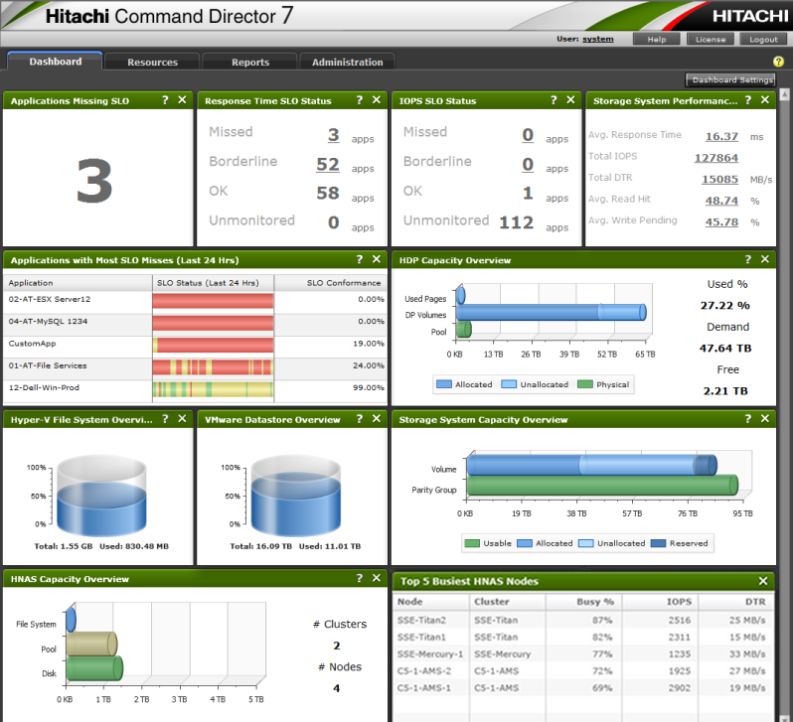
Hitachi Command Director:
Global Dashboard

Slide 24


