Slide 1
ICG Storage Service Review
January 7, 2015

Slide 2
ServiceNow

Slide 3
ServiceNow Update
  All dates are tentative at this juncture and dependent upon:-
    Access to ServiceNow Developer time
    Availability of SAN L3 Resource to continue with the project
    No Major Product Design rewrites or changes to the Product Release Dates
    Note: Carol Pinta will have overall sign off of any release dates
  There are 2 Weekly meetings ongoing that Storage are hosting / attending
    Monday – Developer / SAN L3
    Wednesday – ServiceNow Project Management meeting
  Progress to Date:
  Apr – Sept: SAN Installs Pilot designed and built in the Sandbox environment, limited testing performed due to unfinished Product. Access to Developer time limited. Several changes to the Project and Release Schedule mainly due to complexity and the inclusion to the overall ServiceNow Provisioning Project
  Sept – Dec: Project on Hold due to the lack of Developer Resources and rewrite of Core ServiceNow Provisioning flow. Preparation for NAS Template and improvements to the SAN templates continue.
  Current Status and Plan:
  Working with Phil Reader and Robbie Piggott to get to the improved Storage ServiceNow design into Excel, then added to the Sandbox environment for Testing by February.
  Working with Zara Drayton to include Storage Provisioning requirements to the overall ServiceNow Project Plan – Ongoing
  Improve Internal ServiceNow Provisioning (all Products) core workflow by end of January
  Storage Provisioning testing to be completed, with a Global Release by the end of March for SAN/NAS, all Regions, All Sectors, with no exceptions
  Automation improvement – ServiceNow will pull in WWN’s from Aperture, no longer the need to manually add these in the first phase – March
  Continuation of work to automate Provisioning using EMC’s ViPR - TBC

Slide 4
NAS

Slide 5
Current NAS Migrations
  Engagement has started with the SA Community to schedule time for migrations
  Important that agreed migrations slots are kept
  Biggest issue on previous migrations has been cancellations
  Appendix B shows what we are migrating
    Monthly Maintenance charge until we are complete
    Planned migration Dates and Impact to Citi
    Impact if we are still on Filers by End of the Year
    96 Filers need to be migrated – all are currently off warranty
    Total Cost to Citi in 2015 if we do not migrate will be an additional $4,778,937, on top of the approx. 4.6M we are paying to maintain them till the dates listed.

Slide 6
Request Management Metrics – NAS 2014
MTTR for new NAS allocation is 4 weeks . ***Provided the is required Storage is available ***
MTTR violation for NAS Incidents tickets queue are related to P4 Disaster Recovery Analytics tool, work is being performed to reduce the amount of false positives generated in this reporting tool.
The NAM NAS storage environment is composed of 340 TB of user PST data.
Clean up of PST data will dramatically reduce the amount of time it will take to complete the NAS Tech Refresh migrations
Summary of NAS storage Allocations for 2014 400 + NAS allocation completed this year.
NAS TCRS Allocation - NAM | 14-Jan | 14-Feb | 14-Mar | 14-Apr | 14-May | 14-Jun | 14-Jul | 14-Aug | 14-Sep | 14-Oct | 14-Nov | 14-Dec | Total For 2014
# of TCRS | 43 | 19 | 30 | 56 | 31 | 17 | 48 | 42 | 38 | 44 | 24 | 30 | 422
# of vFilers | 38 | 28 | 20 | 40 | 29 | 11 | 24 | 26 | 36 | 32 | 15 | 11 | 310
# of Volumes | 169 | 142 | 96 | 341 | 285 | 35 | 83 | 200 | 242 | 322 | 90 | 66 | 2071
Prod Storage (TB) | 126 | 166 | 40 | 114 | 91 | 44 | 52 | 60 | 299 | 96 | 40 | 39 | 1167
COB Storage (TB) | 26 | 20 | 14 | 56 | 63 | 8 | 10 | 32 | 28 | 60 | 15 | 27 | 359
Primary CAP Migration – Approach:
Prioritize based on current filers with high concentrations of CAP users.
28 Filers in NA hosting the majority of NA CAP User I Drives
All regions are being analyzed by NAS Ops for the same prioritization view
Prioritize destinations based on currently configured and available VNX
Need to quickly reconfigure the SWDC target to RAID 10 before we move more users there or we will not achieve the iOPS forecast
Reconfigure all remaining “CAP VNX” to RAID 10
Evaluate CATE performance analysis underway in EMEA. ETA End of December. This will help validate the ongoing plan
DC Ops is evaluating the gaps in current VNX for inventory availability – Confirming Disk BOM matches the Standard Config

Slide 7
SAN

Slide 8
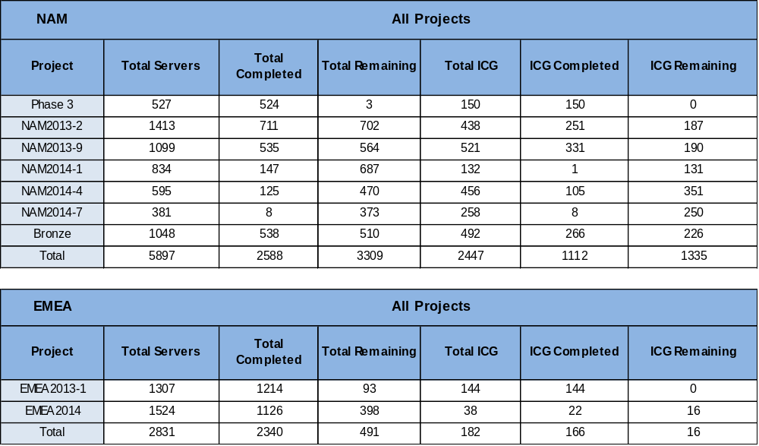
Current Scheduled SAN Migrations (ICG)
Notes:
Kylie Oglesby

Slide 9
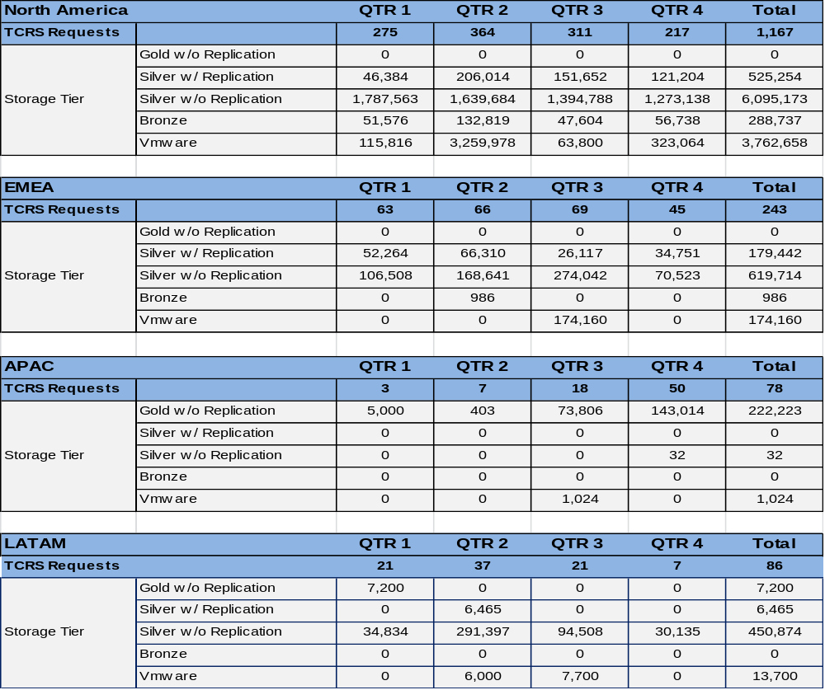
Request Management Metrics – SAN 2014
Notes:
Kylie Oglesby

Slide 10
Service - MIMs

Slide 11
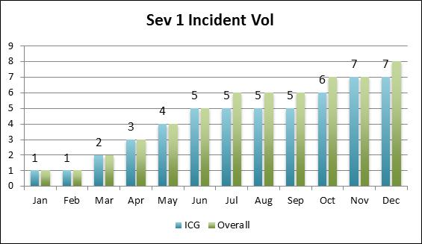
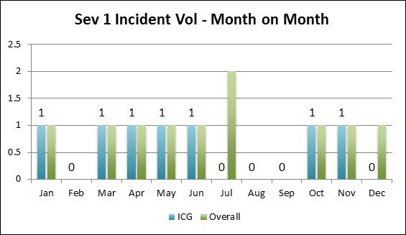
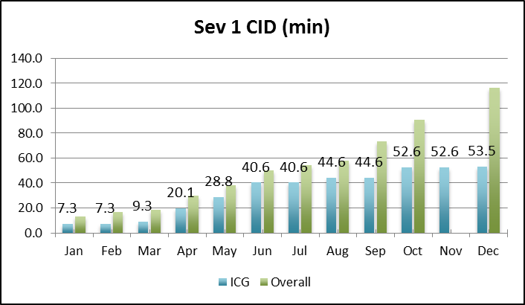
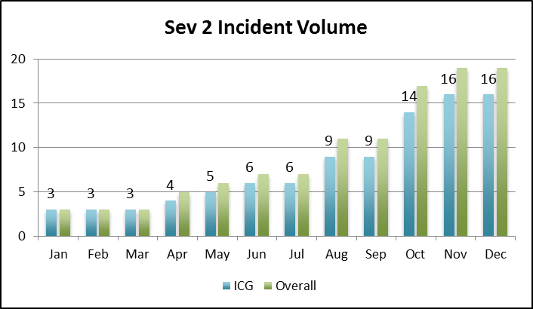
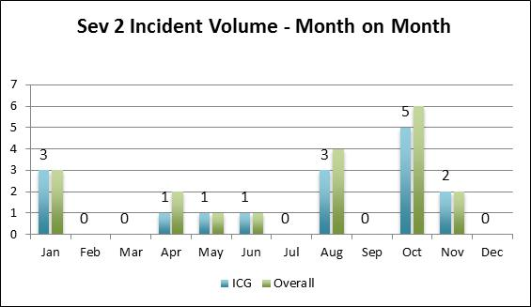
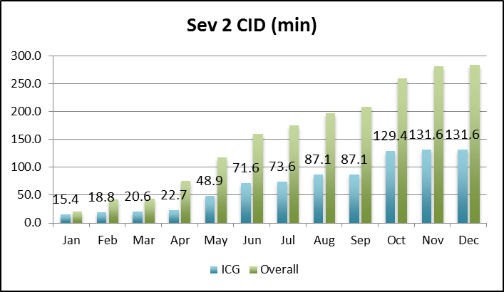
DCIS – Incident Volume and CID (YTD) All Storage vs ICG
5
Notes:
Nicole Smith
Graphs should update automatically
Need to determine Sev Targets for the new teams
Source – Common Metrics Dashboard

Slide 12
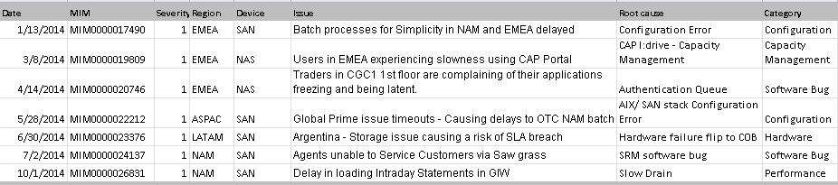
Storage Severity 1 MIM Incidents 2014

Slide 13
Storage Severity 2 MIM Incidents
Date | MIM | Severity | Region | Device | Issue | Root cause | Category
1/7/2014 | MIM0000017303 | 2 | EMEA | SAN | ICG - STARS application responding slow | Port flapping | Hardware
1/27/2014 | MIM0000017961 | 2 | NAM | NAS | ICG - Unable to open file on a shared folder in a shared drive - | CAP I:drive - Capacity Management | Capacity Management
1/28/2014 | MIM0000017986 | 2 | NAM | NAS | ICG - Unable to open file on a shared folder in a shared drive - | CAP I:drive - Capacity Management | Capacity Management
4/7/2014 | MIM0000020470 | 2 | ASPAC | NAS | ICG - Subset of TTS trade users located in TCS- India are unable to access CAP | Configuration Error | Configuration
5/15/2014 | MIM0000021738 | 2 | EMEA | SAN | FX MM PRODUCT PROCESSOR - UK Error | Software | Unknown
6/4/2014 | MIM0000022460 | 2 | EMEA | NetBackup | TTS - Intraday process failure updating the GIW | Capacity Management | Capacity Management
8/20/2014 | MIM0000025312 | 2 | LATAM | SAN | ICG - LATAM - Subset of Trades in the backlog due to SFE Data Base Server issue | Capacity Management | Unknown
8/21/2014 | MIM0000025332 | 2 | LATAM | SAN | ICG - LATAM - Subset of Trades in the backlog due to SFE Data Base Server issue | Capacity Management | Capacity Management
8/22/2014 | MIM0000025371 | 2 | LATAM | SAN | ICG - LATAM - Subset of Trades in the backlog due to SFE Data Base Server issue | Capacity Management | Capacity Management
10/6/2014 | MIM0000026969 | 2 | LATAM | NetBackup | ICG - Brazil - Sinacor is not avaliable for an issue on data base CGMBPRO | Unknown | Unknown
10/9/2014 | MIM0000027126 | 2 | NAM | NAS | Inode exhaust on file system | Capacity Management | Capacity Management
10/14/2014 | MIM0000027312 | 2 | NAM | NAS | ICG - CFX files and CitiDirect reports failing due to a NAS issue | Human Error | Human Error
10/14/2014 | MIM0000027322 | 2 | NAM | SAN | ICG, GCG - Multiple servers hosted in Midwest Data Center | Human Error | Human Error
10/31/2014 | MIM0000027987 | 2 | ASPAC | NAS | ICG, GCG - Citi users unable to access I and G drive - ASPAC | CAP I:drive - Capacity Management | Capacity Management
11/15/2014 | MIM0000028563 | 2 | EMEA | NAS | Subset of India TTS users in TCS Chennai & Kolkatta | Change | Change
11/16/2014 | MIM0000028591 | 2 | ASPAC | NAS | CC, GCG, ICG - Subset of PH users experienced slowness accessing intranet and outlook apps | Unknown | Unknown

Slide 14
Storage MIM Analysis 2014
  Since Jan 1, 2014 – Present Severity 1 or Severity 2 MIM Reports
    MIM Incidents – 7 x Sev1 and 16 x Sev2
  Severity 1 MIM Incident Breakdown
    1 Hardware Failure
    2 Software Bug - AIX stack error / Vipr SRM Software
    1 Capacity Management – CAP I:drive IOPs exhaust.
    2 Configuration Related – Host Configuration issues outside the control of the SAN Team
    1 Performance – Slow Drain
  Severity 2 Incident Breakdown
    1 Hardware Failure
    7 Capacity Management
    1 Configuration
    2 Human Error – Vendor Management and Process controls
    1 Change – COB testing let to production impact
    3 TBD – LATAM -SAN Support not Engaged / ASPAC Network Issues being Investigated

Slide 15
Storage – Lessons Learned
  NAS Trend Analysis – 2014 has seen a spike in performance related issues impacting the Citrix CAP desktop environment, 1 Sev1 and 3 x Sev2.
  NAS Capacity Management:
    Migrate CAP User I:drive to Dedicated NAS VNX Infrastructure. - To be completed by Q2 2015
    Improve Performance and Capacity Management with Global SRM deployment to be completed by Q1 2015.
    Increase monitoring capabilities to report to applications as well as SA team to capture i-node alerts & capacity threshold breaches - Completed 12/2014.
    Proactively work with the responsible Data Management SA teams to understand NAS IOPS - On Going
    OST Tool deployed across the Wintel Data SA’s community. On Going
  NAS Human Error
    Update policies, procedure, communicate on NAS change in huddle meetings - Completed 12/2014.
  SAN Trend Analysis – 2014 has seen a spike in performance and capacity related issues impacting critical applications 1 Sev1 and 4 x Sev2.
  SAN Capacity Management
  Monitoring and Alerting:
    Enabling Port Monitoring on both CORE and Edge Switches to identify port flapping, To be completed by Q2 2015
    Deploy Cisco DCNM 6.3 to help identify slow drain conditions on the fabric. To be completed Q2 2015
    Enhanced port monitoring on the Cisco MDS switches - Completed 12/2014.
  Human Error
    Revise SAN Run Book & validate step by steps with SA Team thus reducing mistakes and procedural gaps - On Going
    Reinforce the rules to vendors to ensure proper training and only qualified resources are allowed in CTI Data Centres.
    Configuration Assurance
    Implement HPNA tool to better monitor SAN environment for changes and slippage from CATE SBCC standards.

Slide 16
Global Storage Proactive Incident Avoidance
  NAS Trend Analysis – 2014 has seen a spike in performance related issues impacting the Citrix CAP desktop environment, 1 Sev1 and 3 x Sev2.
  Action items to address this trend :
  Separation of I drive data based on platform CAP I:drive performance concerns.
  Dedicated VNX NAS devices in EMEA and NAM are being reconfigured to RAID 10 to provide higher performance capabilities to address CAP workload. SA Teams will perform migrations to new NAS Infrastructure in Q1 2015.
  Sharing Capacity and Performance metrics with ICG CAP SAs using SRM.
  Proactively work with the responsible Data Management SA teams to understand NAS IOPS
  SAN Trend Analysis – 2014 has seen a spike in performance and capacity related issues impacting critical applications 1 Sev1 and 4 x Sev2.
  SAN - Enabling Port Monitoring on both CORE and Edge Switches to identify port flapping,
    Deploy Cisco DCNM 6.3 to help identify slow drain conditions on the fabric
    Enhanced port monitoring on the Cisco MDS switches

Slide 17
Global Storage MIM Incidents Avoidance
  50% reductions for all MIM Incidents with points of emphasis on Human Error, Change Management and Configuration
  Reduce MTTR on all MIM incidents by 25%
  Human Error
    Revise storage Run Book & validate step by steps with SA Team thus reducing mistakes and procedural gaps
    Reinforce the rules to vendors to ensure proper training and only qualified resources are allowed in CTI Data Centres.
    Change Management
      Storage Team publishing by Business per Data SA Group for EOL migrations.
        Setup weekly calls with SA team to manage and co-ordinate high risk changes
        Review changes to ensure all impacted assets and applications are listed as change approvers.

Slide 18
Appendix A Executive Dashboards

Slide 19
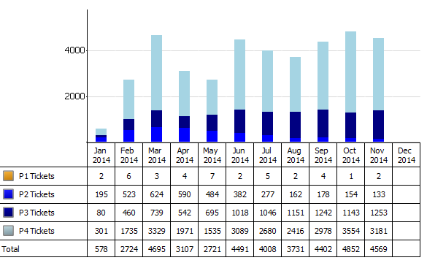
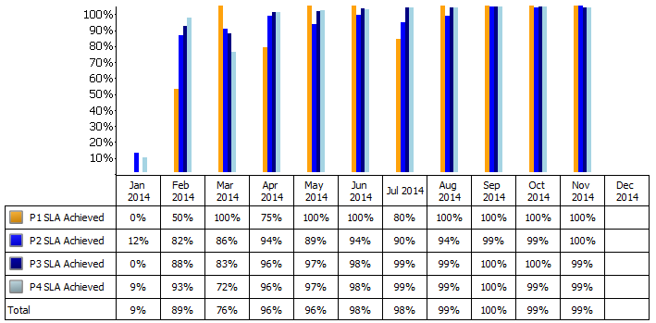
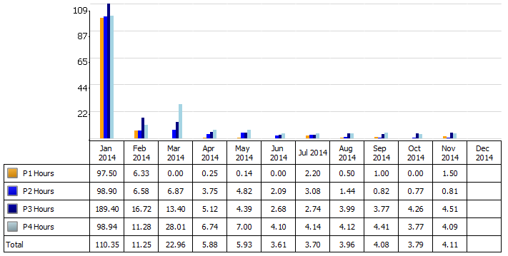
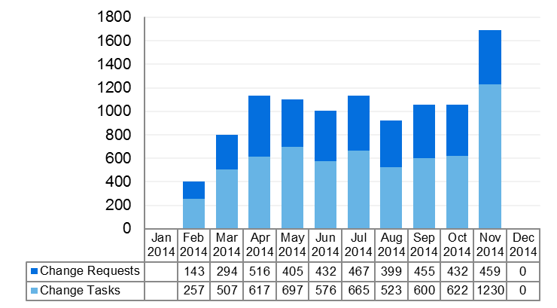
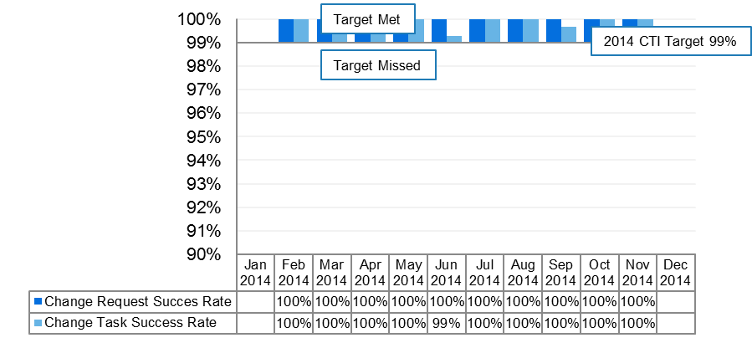
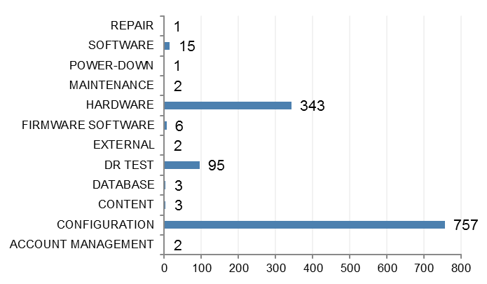
Executive Dashboard – L2 Storage Operations (EMEA & NAM)
Incidents
Incidents
Incident & Incident Tasks
Resolved Within SLA
Mean Time To Resolution (MTTR)
Change From Previous Month
-5.3%
-0.5%
8.4%
Incident Tickets
SLA Achieved
MTTR
Change Year to Date
690%
1009 %
-96.3%
Incident Tickets
SLA Achieved
MTTR
Change Requests
Change Requests
Change Requests & Change Tasks
Change Success Rate
Change Categories
Change From Previous Month
60 %
=%
Change Tickets
Success Rate
Change Year to Date
294%
=%
Change Tickets
Success Rate
Change Tickets
Success Rate
Accomplishments
Observations
Action Plan
Executed over 1600 changes and change tasks with a success rate of 100% for the month of November 2014. This is a 60% increase from the past month, which was attributed to Site COB test in EMEA as noted above
Another great month for achieving MTTR targets across all Incident priorities. MTTR being 4.11 for the month of November
Storage Ops performed the Frankfurt DC COB test in Nov, with shadowing from NAM. Modernized process was used for the first time to support both BCS and SA teams with all the requests and reporting moved from Marketplace to Service Now. Enhanced reporting allowed to monitor the progress online during the test. More than 200 changes and 500 change tasks was supported during the test.
The Increased amount of changes/change tasks is connected with Frankfurt DC COB Test.
Good progress in addressing the incidents which were coming into the top 10 offenders pool. The count of incidents went down significantly comparing to the last month. There was also low amount of repeated cases.
Continue working on Top offenders reductions.
Continue working with Asia Pac to standardize processes and identify opportunities for improvements
Continue to breakdown metrics to specific team and individual to identify opportunities for improvements
Please note: YTD measurements are from February 2014 due to unavailable data in ServiceNow

Slide 20
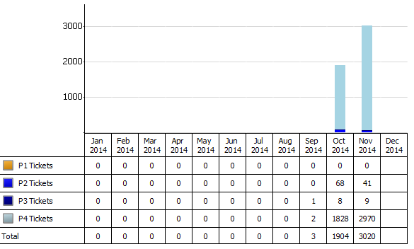
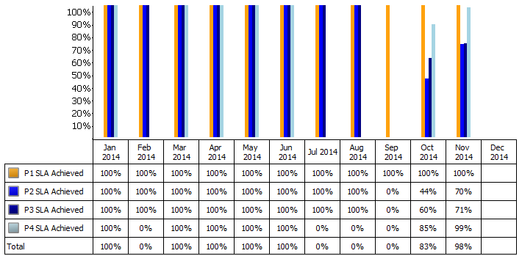
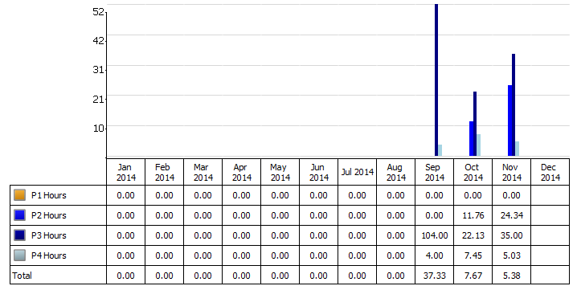
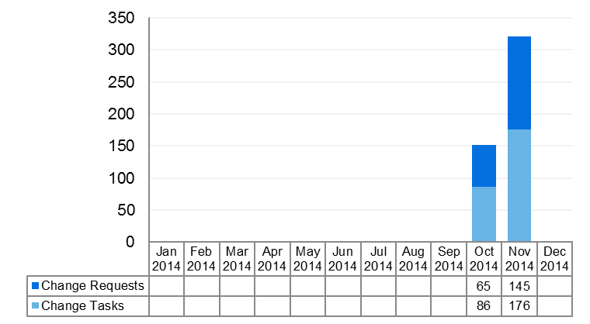
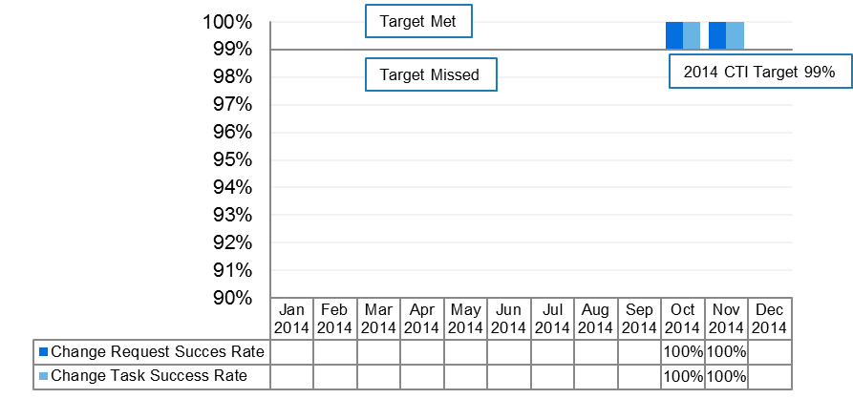
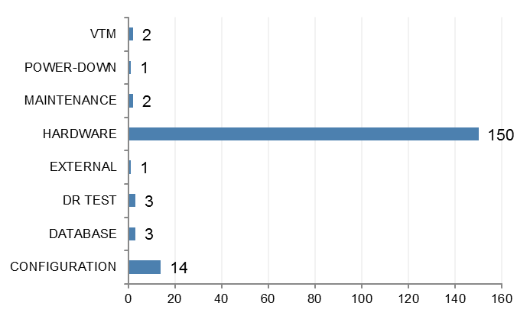
Executive Dashboard – L2 Storage Operations (APAC)
Incidents
Incidents
Incident & Incident Tasks
Resolved Within SLA
Mean Time To Resolution (MTTR)
Change From Previous Month
58.6%
18.3%
-29.8%
Incident Tickets
SLA Achieved
MTTR
Change Year to Date
%
98.2%
-85.6%
Incident Tickets
SLA Achieved
MTTR
Change Requests
Change Requests
Change Requests & Change Tasks
Change Success Rate
Change Categories
Change From Previous Month
112%
= %
Change Tickets
Success Rate
Change Year to Date
112%
= %
Change Tickets
Success Rate
Change Tickets
Success Rate
Accomplishments
Observations
Action Plan
Second full month of the LEAN model resulted in improvements for SLA targets for the month of November, while not all Incidents categories hit SLA targets, the overall SLA achievement rate was at 98% due to the high volume of P4 tickets. November demonstrated a marked improvement from the past month as LEAN processes continue to be enforced and stabilized.
Executed over 300 changes and change tasks with a 100% success rate for the month of November. This is a 112% increase in volume from the previous month
While SLA targets were not reached for all Incident categories, the overall MTTR was at 5.38 for the month of November
SLA Achievement has improved this second month after the LEAN model was implemented
P2 tickets for break/fix continue to impact SLA rate and continues to be a work in progress
Changes and change tasks are working smoothly as success rate remains at 100%
Incident ticket volume went up dramatically by over 1000 tickets (predominantly P4 tickets), while still being able to handle the influx of ticket volume with staffing levels
Continue to work on addressing and standardizing break/fix process related to P2 tickets
Review volume of Incident tickets to determine cause of increase
Continue working with other L2 teams to standardize processes
Please note: YTD measurements are from October 2014 due to unavailable data in ServiceNow

Slide 21
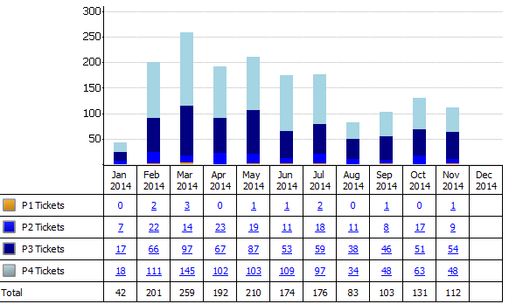
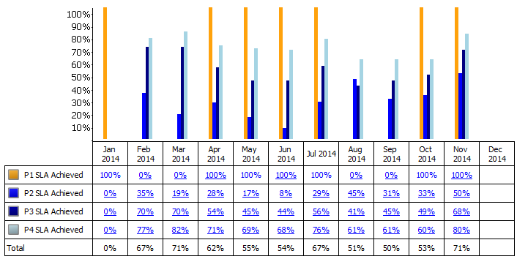
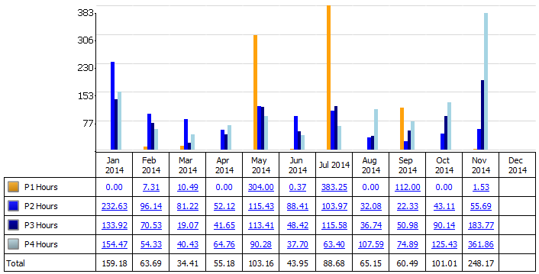
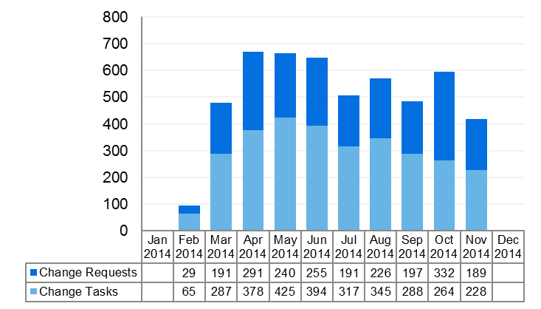
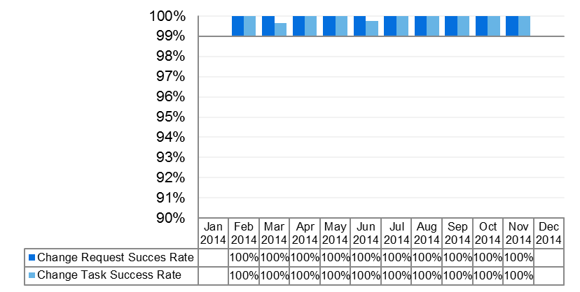
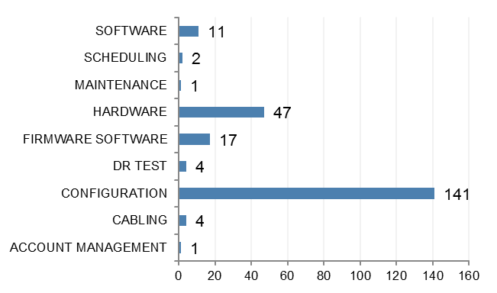
Executive Dashboard – L3 Storage Service Report
Incidents
Resolved Within SLA
Mean Time To Resolution (MTTR)
Incidents
Incident & Incident Tasks
Change From Previous Month
-14.5%
35.6%
145.7%
Incident Tickets
SLA Achieved
MTTR
Change Year to Date
166.7%
71.2%
-59.9%
Incident Tickets
SLA Achieved
MTTR
Change Requests
Change Requests & Change Tasks
Change Success Rate
Change Categories
Change Requests
Change From Previous Month
30.0%
0%
Change Tickets
Success Rate
Change Year to Date
343.6%
0%
Change Tickets
Success Rate
Accomplishments
Observations
Action Plan
Significant improvement in SLA this month over month due to daily huddle chat session to review the Incident queue and actions taken.
MTTR for P4 tickets increased due to DRA implementation.
Incidents down to 14.5% from October.
Change Requests down to 30.0% from October.
MTTR increased due to auto generated tickets from the Disaster Recovery (DRA) monitoring tool, continued work is being performed to reduce the alerting thresholds in this product,
Please note: YTD measurements are from February 2014 due to unavailable data in ServiceNow

Slide 22
SLA Breached INC Tickets L2 Storage Ops (EMEA & NAM)
SLA Breaches | Tickets
Anuraj Pahuja | 1
INC0013655183 | 1
4 - Low | 1
Resources not available | 1
OTHER - ADVISED/EDUCATED USER | 1
Deepak Shantilal Mistry | 1
INC0013968128 | 1
4 - Low | 1
3rd Party failure | 1
HARDWARE - COMPONENT RESTARTED/RELOADED/RESET | 1
Filip Sierzega | 1
INC0013439204 | 1
3 - Medium | 1
Change lead times | 1
HARDWARE - FIXED ISSUE WITH CONNECTION FAILURE | 1
Hector Palma Moreno | 1
INC0013770291 | 1
4 - Low | 1
Additional time required to determine re | 1
OTHER - NO FAULT FOUND/NO ACTION TAKEN | 1
Mushtaq Hussain | 6
INC0013771830 | 1
3 - Medium | 1
No SLA required | 1
SOFTWARE - LOG DISABLED/ENABLED | 1
INC0013773290 | 1
3 - Medium | 1
No SLA required | 1
SOFTWARE - LOG DISABLED/ENABLED | 1
INC0013773386 | 1
3 - Medium | 1
No SLA required | 1
SOFTWARE - LOG DISABLED/ENABLED | 1
INC0013774950 | 1
3 - Medium | 1
No SLA required | 1
SOFTWARE - LOG DISABLED/ENABLED | 1
INC0013776142 | 1
3 - Medium | 1
No SLA required | 1
SOFTWARE - LOG DISABLED/ENABLED | 1
INC0013788246 | 1
3 - Medium | 1
No SLA required | 1
SOFTWARE - LOG DISABLED/ENABLED | 1
Paul Oakley | 1
INC0013960204 | 1
4 - Low | 1
Resources not available | 1
OTHER - ADVISED/EDUCATED USER | 1
Praveen Mummaneni | 2
INC0013341932 | 1
4 - Low | 1
Incorrect incident assignment | 1
OTHER - WORKING AS DESIGNED. ENHANCEMENT REQUIRED | 1
INC0013915856 | 1
3 - Medium | 1
Additional time required to determine re | 1
OTHER - WORKING AS DESIGNED. ENHANCEMENT REQUIRED | 1
Ram Devineni | 1
INC0013972276 | 1
3 - Medium | 1
Incorrect incident assignment | 1
HARDWARE - RE-CONFIGURATION UNINSTALLED/RE-INSTALL | 1
Siva Prasad Malempati | 1
INC0013912829 | 1
4 - Low | 1
Resources not available | 1
SOFTWARE - BATCH JOB CORRECTED/RESTARTED | 1
Grand Total | 15

Slide 23
SLA Breached INC Tickets - L2 Storage Operations APAC
SLA Breaches | Tickets
Christopher Espiritu | 1
INC0013510968 | 1
4 - Low | 1
(blank) | 1
OTHER - NO FAULT FOUND/NO ACTION TAKEN | 1
Derrick Allan Lim | 21
INC0013480916 | 1
2 - High | 1
Change lead times | 1
HARDWARE - DISK REPLACED | 1
INC0013520073 | 1
4 - Low | 1
(blank) | 1
OTHER - NO FAULT FOUND/NO ACTION TAKEN | 1
INC0013525479 | 1
4 - Low | 1
(blank) | 1
OTHER - KNOWN ERROR OR LIMITATION | 1
INC0013557404 | 1
4 - Low | 1
(blank) | 1
OTHER - NO FAULT FOUND/NO ACTION TAKEN | 1
INC0013574717 | 1
2 - High | 1
3rd Party failure | 1
HARDWARE - DISK REPLACED | 1
INC0013635068 | 1
4 - Low | 1
(blank) | 1
OTHER - KNOWN ERROR OR LIMITATION | 1
INC0013702183 | 1
4 - Low | 1
(blank) | 1
OTHER - KNOWN ERROR OR LIMITATION | 1
INC0013708181 | 1
4 - Low | 1
(blank) | 1
OTHER - KNOWN ERROR OR LIMITATION | 1
INC0013711614 | 1
4 - Low | 1
(blank) | 1
OTHER - KNOWN ERROR OR LIMITATION | 1
INC0013711645 | 1
4 - Low | 1
(blank) | 1
OTHER - KNOWN ERROR OR LIMITATION | 1
INC0013711651 | 1
4 - Low | 1
(blank) | 1
OTHER - KNOWN ERROR OR LIMITATION | 1
INC0013833675 | 1
4 - Low | 1
(blank) | 1
OTHER - KNOWN ERROR OR LIMITATION | 1
INC0013892312 | 1
4 - Low | 1
Additional time required to determine re | 1
HARDWARE - CAPACITY ISSUE CORRECTED | 1
INC0013902785 | 1
4 - Low | 1
No SLA required | 1
NETWORK - OUTAGE | 1
INC0013930955 | 1
4 - Low | 1
Additional time required to determine re | 1
HARDWARE - CAPACITY ISSUE CORRECTED | 1
INC0013997820 | 1
3 - Medium | 1
No SLA required | 1
HARDWARE - FAILOVER ACTIVATED | 1
INC0014000513 | 1
3 - Medium | 1
Change lead times | 1
HARDWARE - DISK REPLACED | 1
INC0014129425 | 1
4 - Low | 1
(blank) | 1
SOFTWARE - BATCH JOB CORRECTED/RESTARTED | 1
INC0014146150 | 1
4 - Low | 1
Change lead times | 1
HARDWARE - CAPACITY ISSUE CORRECTED | 1
INC0014161500 | 1
4 - Low | 1
Change lead times | 1
HARDWARE - DISK REPLACED | 1
INC0014198635 | 1
4 - Low | 1
Resources not available | 1
SOFTWARE - BATCH JOB CORRECTED/RESTARTED | 1
Francisco Ordonio, Jr | 8
INC0013277653 | 1
4 - Low | 1
Change lead times | 1
OTHER - NO FAULT FOUND/NO ACTION TAKEN | 1
INC0013282282 | 1
4 - Low | 1
Change lead times | 1
OTHER - KNOWN ERROR OR LIMITATION | 1
INC0013389690 | 1
4 - Low | 1
Change lead times | 1
OTHER - NO FAULT FOUND/NO ACTION TAKEN | 1
INC0013498081 | 1
4 - Low | 1
Change lead times | 1
HARDWARE - CAPACITY ISSUE CORRECTED | 1
INC0013505118 | 1
4 - Low | 1
Change lead times | 1
OTHER - NO FAULT FOUND/NO ACTION TAKEN | 1
INC0013659384 | 1
4 - Low | 1
(blank) | 1
OTHER - NO FAULT FOUND/NO ACTION TAKEN | 1
INC0013789895 | 1
4 - Low | 1
Change lead times | 1
OTHER - KNOWN ERROR OR LIMITATION | 1
INC0014101054 | 1
4 - Low | 1
Change lead times | 1
HARDWARE - CAPACITY ISSUE CORRECTED | 1
Jerson Mata | 2
INC0013508501 | 1
4 - Low | 1
Resources not available | 1
OTHER - KNOWN ERROR OR LIMITATION | 1
INC0013508701 | 1
4 - Low | 1
Resources not available | 1
OTHER - NO FAULT FOUND/NO ACTION TAKEN | 1
Jimmy Fuentes | 4
INC0013418034 | 1
2 - High | 1
Change lead times | 1
HARDWARE - DISK REPLACED | 1
INC0013418125 | 1
2 - High | 1
Change lead times | 1
HARDWARE - DISK REPLACED | 1
INC0013623604 | 1
4 - Low | 1
(blank) | 1
OTHER - NO FAULT FOUND/NO ACTION TAKEN | 1

Slide 24
SLA Breached INC Tickets - L2 Storage Operations APAC
INC0013709675 | 1
4 - Low | 1
(blank) | 1
OTHER - NO FAULT FOUND/NO ACTION TAKEN | 1
Mark Pal | 4
INC0013442019 | 1
2 - High | 1
Change lead times | 1
HARDWARE - DISK REPLACED | 1
INC0013509442 | 1
4 - Low | 1
Change lead times | 1
OTHER - NO FAULT FOUND/NO ACTION TAKEN | 1
INC0013511057 | 1
4 - Low | 1
Change lead times | 1
OTHER - NO FAULT FOUND/NO ACTION TAKEN | 1
INC0014055132 | 1
4 - Low | 1
No SLA required | 1
OTHER - NO FAULT FOUND/NO ACTION TAKEN | 1
Marlon Tesorero | 8
INC0013453078 | 1
2 - High | 1
Change lead times | 1
HARDWARE - DISK REPLACED | 1
INC0013473230 | 1
2 - High | 1
Change lead times | 1
HARDWARE - DISK REPLACED | 1
INC0013785535 | 1
2 - High | 1
No SLA required | 1
HARDWARE - DISK REPLACED | 1
INC0013804242 | 1
2 - High | 1
Change lead times | 1
HARDWARE - DISK REPLACED | 1
INC0013807659 | 1
2 - High | 1
Change lead times | 1
HARDWARE - DISK REPLACED | 1
INC0013854511 | 1
2 - High | 1
Change lead times | 1
HARDWARE - DISK REPLACED | 1
INC0013890707 | 1
4 - Low | 1
No SLA required | 1
OTHER - WORK-AROUND IMPLEMENTED | 1
INC0013890735 | 1
2 - High | 1
Change lead times | 1
HARDWARE - DISK REPLACED | 1
Michael Acal | 18
INC0013261196 | 1
4 - Low | 1
(blank) | 1
OTHER - NO FAULT FOUND/NO ACTION TAKEN | 1
INC0013261236 | 1
4 - Low | 1
(blank) | 1
OTHER - NO FAULT FOUND/NO ACTION TAKEN | 1
INC0013261237 | 1
4 - Low | 1
(blank) | 1
OTHER - NO FAULT FOUND/NO ACTION TAKEN | 1
INC0013261251 | 1
4 - Low | 1
(blank) | 1
OTHER - NO FAULT FOUND/NO ACTION TAKEN | 1
INC0013261294 | 1
4 - Low | 1
(blank) | 1
OTHER - NO FAULT FOUND/NO ACTION TAKEN | 1
INC0013261300 | 1
4 - Low | 1
(blank) | 1
OTHER - NO FAULT FOUND/NO ACTION TAKEN | 1
INC0013261345 | 1
4 - Low | 1
(blank) | 1
OTHER - NO FAULT FOUND/NO ACTION TAKEN | 1
INC0013261403 | 1
4 - Low | 1
(blank) | 1
OTHER - NO FAULT FOUND/NO ACTION TAKEN | 1
INC0013261404 | 1
4 - Low | 1
(blank) | 1
OTHER - NO FAULT FOUND/NO ACTION TAKEN | 1
INC0013261405 | 1
4 - Low | 1
(blank) | 1
OTHER - NO FAULT FOUND/NO ACTION TAKEN | 1
INC0013261407 | 1
4 - Low | 1
(blank) | 1
OTHER - NO FAULT FOUND/NO ACTION TAKEN | 1
INC0013280273 | 1
4 - Low | 1
(blank) | 1
OTHER - NO FAULT FOUND/NO ACTION TAKEN | 1
INC0013393030 | 1
4 - Low | 1
(blank) | 1
OTHER - NO FAULT FOUND/NO ACTION TAKEN | 1
INC0013408585 | 1
4 - Low | 1
(blank) | 1
OTHER - NO FAULT FOUND/NO ACTION TAKEN | 1
INC0013494878 | 1
4 - Low | 1
(blank) | 1
OTHER - NO FAULT FOUND/NO ACTION TAKEN | 1
INC0013502106 | 1
4 - Low | 1
(blank) | 1
OTHER - NO FAULT FOUND/NO ACTION TAKEN | 1
INC0013502107 | 1
4 - Low | 1
(blank) | 1
OTHER - NO FAULT FOUND/NO ACTION TAKEN | 1
INC0013502108 | 1
4 - Low | 1
(blank) | 1
OTHER - NO FAULT FOUND/NO ACTION TAKEN | 1
Michelle Lu | 4
INC0013426541 | 1
4 - Low | 1
(blank) | 1
OTHER - NO FAULT FOUND/NO ACTION TAKEN | 1
INC0013426543 | 1
4 - Low | 1
(blank) | 1
OTHER - NO FAULT FOUND/NO ACTION TAKEN | 1
INC0013978771 | 1
2 - High | 1
No SLA required | 1
HARDWARE - DISK REPLACED | 1
INC0014358122 | 1
2 - High | 1
No SLA required | 1
HARDWARE - DISK REPLACED | 1
Paulo Cometa | 1
INC0013948706 | 1
4 - Low | 1
Change lead times | 1
HARDWARE - DISK REPLACED | 1

Slide 25
SLA Breached INC Tickets - L2 Storage Operations APAC
Sherryl Guevarra | 3
INC0013510907 | 1
4 - Low | 1
Change lead times | 1
HARDWARE - CAPACITY ISSUE CORRECTED | 1
INC0013520503 | 1
4 - Low | 1
Change lead times | 1
OTHER - NO FAULT FOUND/NO ACTION TAKEN | 1
INC0014199453 | 1
4 - Low | 1
(blank) | 1
OTHER - NO FAULT FOUND/NO ACTION TAKEN | 1
(blank) | 1
INC0013450189 | 1
3 - Medium | 1
(blank) | 1
HARDWARE - DISK REPLACED | 1
Grand Total | 75

Slide 26
SLA Breached INC Tickets – L3 Storage
SLA Breaches | Tickets
Abdul Hameed | 1
INC0013790037 | 1
2 - High | 1
Resources not available | 1
HARDWARE - CAPACITY ISSUE CORRECTED | 1
Clive Bates | 1
INC0013227721 | 1
3 - Medium | 1
Additional time required to determine re | 1
HARDWARE - FIXED ISSUE WITH CONNECTION FAILURE | 1
Godfrey Fernandes | 1
INC0014105469 | 1
2 - High | 1
No SLA required | 1
MONITORING DISABLED/ENABLED | 1
Krishnam Raju Vathsavai | 1
INC0013458927 | 1
2 - High | 1
Change lead times | 1
DATA - DATA CORRECTED | 1
Raja Balasubramanian | 1
INC0014157054 | 1
2 - High | 1
Incorrect incident assignment | 1
HARDWARE - FIXED ISSUE WITH CONNECTION FAILURE | 1
Scott Taylor | 3
INC0013805690 | 1
4 - Low | 1
Insufficient documentation | 1
OTHER - NO FAULT FOUND/NO ACTION TAKEN | 1
INC0013945704 | 1
3 - Medium | 1
No SLA required | 1
HARDWARE - FIXED HARDWARE FAILURE | 1
INC0014110513 | 1
3 - Medium | 1
No SLA required | 1
HARDWARE - CAPACITY ISSUE CORRECTED | 1
Sekhar Ati | 1
INC0013191426 | 1
4 - Low | 1
Additional time required to determine re | 1
OTHER - NO FAULT FOUND/NO ACTION TAKEN | 1
Simon Gibbs | 1
INC0013183665 | 1
4 - Low | 1
No SLA required | 1
HARDWARE - INSTALLED/REINSTALLED | 1
Susan Kaplow | 2
INC0013532942 | 1
4 - Low | 1
Additional time required to determine re | 1
OTHER - WORK-AROUND IMPLEMENTED | 1
INC0013536109 | 1
4 - Low | 1
Additional time required to determine re | 1
OTHER - WORK-AROUND IMPLEMENTED | 1
Utham Pulavarpu | 1
INC0013987998 | 1
3 - Medium | 1
3rd Party failure | 1
OTHER - WORK-AROUND IMPLEMENTED | 1
Witold Pietruk | 2
INC0013639179 | 1
3 - Medium | 1
Resources not available | 1
SOFTWARE - CONFIGURATION CHANGE MADE | 1
INC0014034118 | 1
3 - Medium | 1
Resources not available | 1
SOFTWARE - CONFIGURATION CHANGE MADE | 1
ZBIGNIEW KLOS | 2
INC0013598195 | 1
3 - Medium | 1
3rd Party failure | 1
HARDWARE - FIXED ISSUE WITH ELECTRICAL FAILURE | 1
INC0013651933 | 1
3 - Medium | 1
No SLA required | 1
SOFTWARE - CONFIGURATION CHANGE MADE | 1
Grand Total | 17

Slide 27
Appendix B NAS Migrations

Slide 28
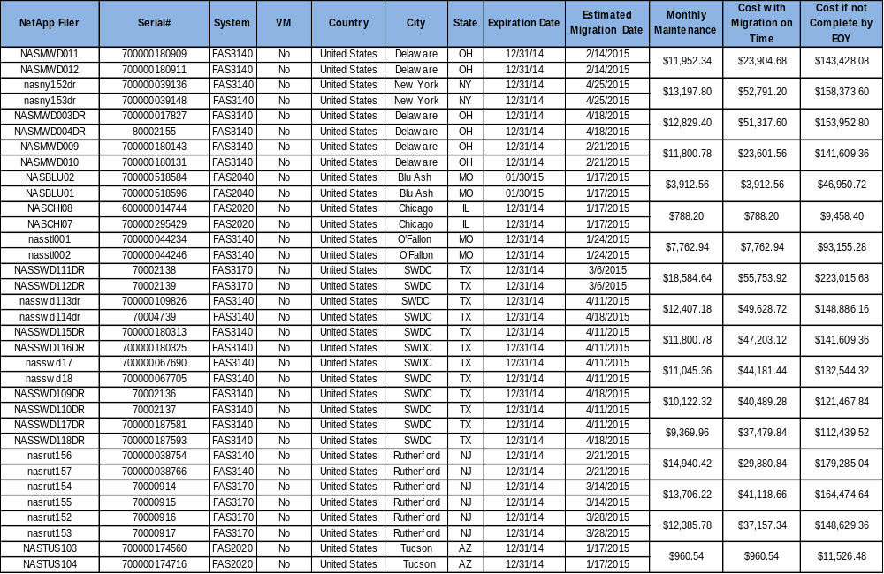
Current Scheduled NAS Migrations
Notes:
Kylie Oglesby

Slide 29
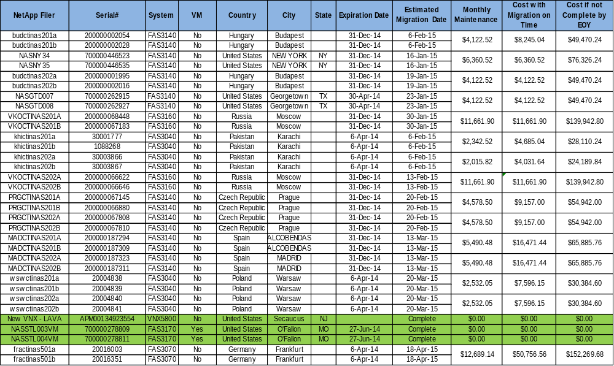
Current Scheduled NAS Migrations
Notes:
Kylie Oglesby

Slide 30
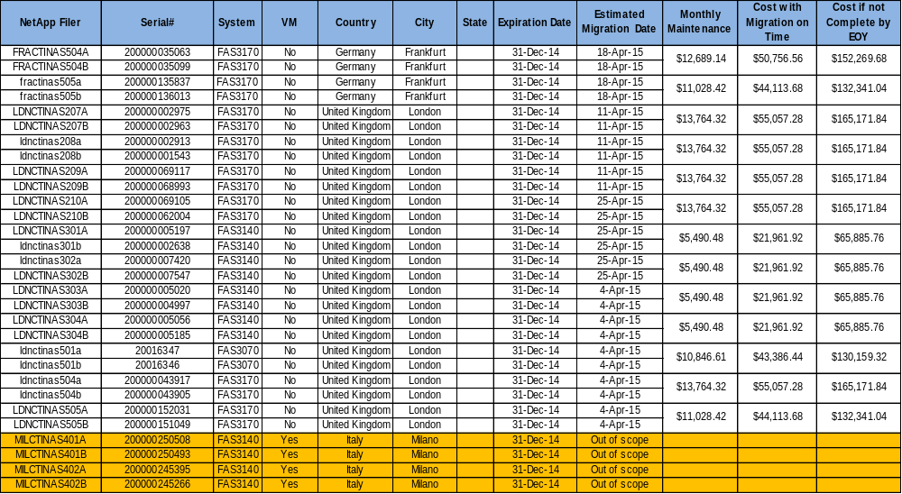
Current Scheduled NAS Migrations
Notes:
Kylie Oglesby

