Slide 1
Long-Term Storage Vision
Office of the CTO | Citi Architecture and Technology Engineering (CATE)
Our strategic (5-year) vision of storage is that 4 main types of storage will exist and be able to cater for the vast majority of use-cases:
Data “Temperature”
HOT (read/Write frequently with very low latency) - Platinum Tier
Most active workloads – e.g. low-latency or high-intensity use-cases
Dedicated all-flash storage solutions potentially with bespoke connectivity to minimize latency
Target technologies: All-flash EMC ScaleIO, EMC XtremIO appliance, eval of Pure Storage appliance
WARM (read/Write frequently) – SAN Replacement
Mainstream runtime environments and application data (e.g. Oracle/SQL Svr DBs) and analytics
Commodity server hardware and scale-out storage software delivering block over IP
Initially 10k SAS disk but increasingly will become all-flash with good data reduction capabilities
Target technologies: EMC ScaleIO (SDDC and physical x86) and Red Hat Ceph Block (Cloud.NEXT)
Other options like Nutanix, Soft-XIV, IBM GPFS and Red Hat Gluster examined but ruled-out
COOL (write once, read occasionally) – Data Lake and User File Data
User file data and data exported from primary application and may have future analytic value
Commodity server hardware and scale-out software with NL-SAS/SATA disk (no tape or optical)
Object storage solution, not suitable for compliance archival and requiring application to catalog
User file data use-case will require presentation layer to user – CIFS shim (Maginatics?) or Dropbox
Target technologies: Cleversafe via HP (general purpose) and Red Hat Ceph Object (Cloud.NEXT)
Other options reviewed and ruled-out at this stage – continue to watch EMC ViPR Object
COLD (write once, read almost never) – Archive
Coldest data kept long-term for regulatory or other archive reasons but with low analytic value
Tiered solution with disk for data ingestion and tape or optical for long-term persistence
Target technology: IBM GPFS + LTFS (Linear Tape File System) with NFS interface (object planned)

Slide 2
Storage Strategies In-Support of that Vision
Office of the CTO | Citi Architecture and Technology Engineering (CATE)
Faster
Storage
Extend Citi's existing use of Flash/SSD as a tier within hybrid arrays to add offerings which are 100% flash suitable for a small subset of apps. The resulting very significant increase in IOPS capacity and reduction in latency is expected to enable new capabilities for suitable applications (e.g. ability to run batch multiple times a day) and enable significant off-setting cost-savings on reductions in required compute capacity and software licenses.
All-flash variants of HDS and EMC conventional SAN arrays
EMC XtremIO scale-out all-flash array with in-line de-duplication
Scale-out commodity-hardware all-flash storage offerings
Scale-Out
Storage
Deliver scale-out storage solutions which deliver clustering and/or federation across many conventional arrays with a single namespace to enable greater utilization of available assets and significant operational simplification of day-to-day capacity management, expansion and tech-refresh operations.
Scale-out, commodity hardware based block, file and object storage platforms for full range of Citi workloads to progressively replace legacy array architectures
Software-
Defined Storage
Abstract storage into larger, more fungible pools and implement API-driven automation to enable straight-through provisioning of SAN and NAS storage and fully automated modification to existing allocations and movement within a storage pool or between tiers when required. Will include delivery of Object storage services suitable for large-scale image repositories and application data.
Leverage VMware capabilities for Storage DRS, vMotion, vCAC blueprints
Introduce EMC ViPR “storage hypervisor” for provisioning automation.
Leverage next-gen commodity-hardware based storage services.
Cheaper
Storage
Implement a range of further enhancements to storage services aimed at reducing cost and increasing efficiency including introduction of cheaper tiers of storage including a "bronze" SAN tier and true very low-cost tier, archival of suitable data to the cheapest tier, application of compression/de-dup where not already used and leveraging the cheapest appropriate storage access method and transport.
Cheap, deep and wide archival storage
Bronze tier of SAN for Dev/UAT
Wider adoption of NAS for app data
NetApp Compression and FlashPools,
True thin-provisioning on VNX
Netbackup Appliances for ROBO + DC
Storage
Service Quality
Deliver increased visibility and optimized proactive alerting for SAN and NAS issues and identification of capacity and utilization trends requiring action. Deliver scalable and sustainable storage operations dashboards and replace existing legacy chargeback and billing platform with fit-for-purpose alternative with improved scale, simplicity and customization.
Replace ECC with agentless SRM Suitefor chargeback/billing
Leverage SRM Suite to deliver storage dashboards and capacity management
Optimize Tivoli alerting to reduce noise and increase value of alerts
Storage
Solutions
Deliver optimized and fully-integrated storage solutions for key high-scale workloads as a layer within the fully integrated Engineered Systems approach including VDI, CAP, Cloud, Grid, Sharepoint, Exchange and Voice Recording.
Selection of most appropriate storage solution for given workload from DAS, NAS, SAN and other emerging options
Fully-integrated design sized and scaled for the workload and globally deployable

Slide 3
Focus Technologies and Future Challengers
Office of the CTO | Citi Architecture and Technology Engineering (CATE)
Object Storage (Write Once, Read Often)
      Target application data with analytic value and user data
      Leading candidate based on our assessment to-date is Cleversafe
      Data Lake will be comprised of an object store with analytics access via either S3 or direct HDFS (subject to requirements)
      Ceph Object being piloted in Cloud.NEXT as secondary storage
      Continue to monitor other developing object storage platforms (e.g. EMC ViPR Object)

Slide 4
Focus Technologies and Future Challengers
Office of the CTO | Citi Architecture and Technology Engineering (CATE)
Cheap and Deep Archival Storage (Write Once, Read Maybe/Never)
      Policy-driven tiered solution with extremely low-cost tier for long-term persistence
      Leading candidate is IBM GPFS + LTFS (Linear Tape File System)
      None of the candidate object storage solutions can tier-down to lowest cost media
Scale-out storage on COTS (R/W all the time)
      General-purpose replacement for vast majority of online application workloads
      Leading candidates are EMC Scale IO (proprietary) and Red Hat Ceph (Open Source)
      Focus on Ceph for Cloud.NEXT and ScaleIO for physical and SDDC/Cloud 1.5
      Continue to monitor other storage software (GPFS and Lustre) for longer-term potential

Slide 5
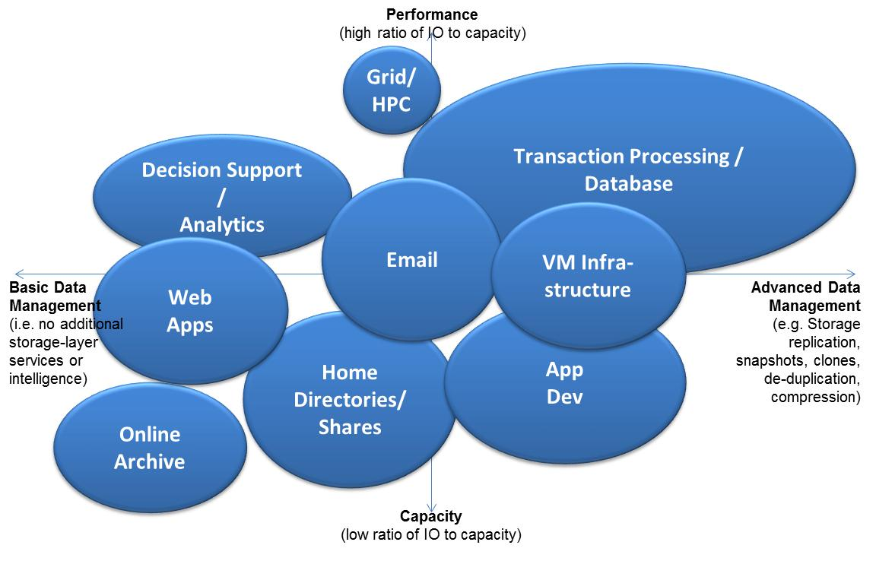
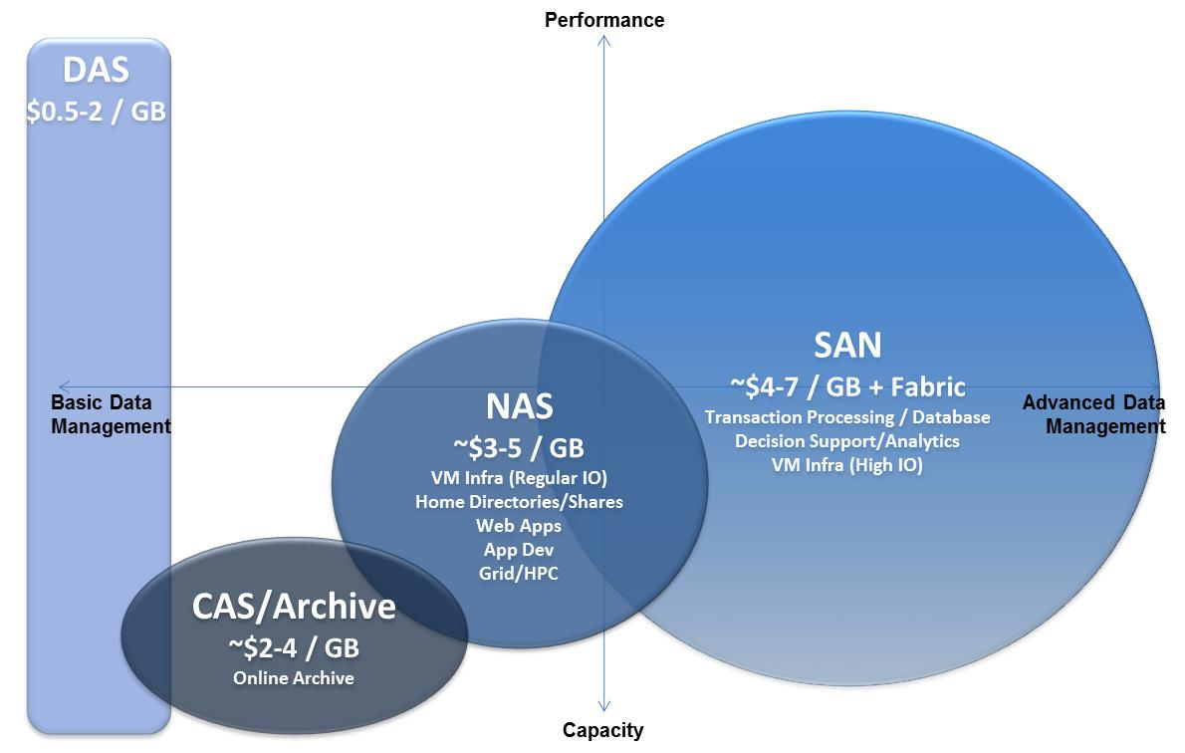
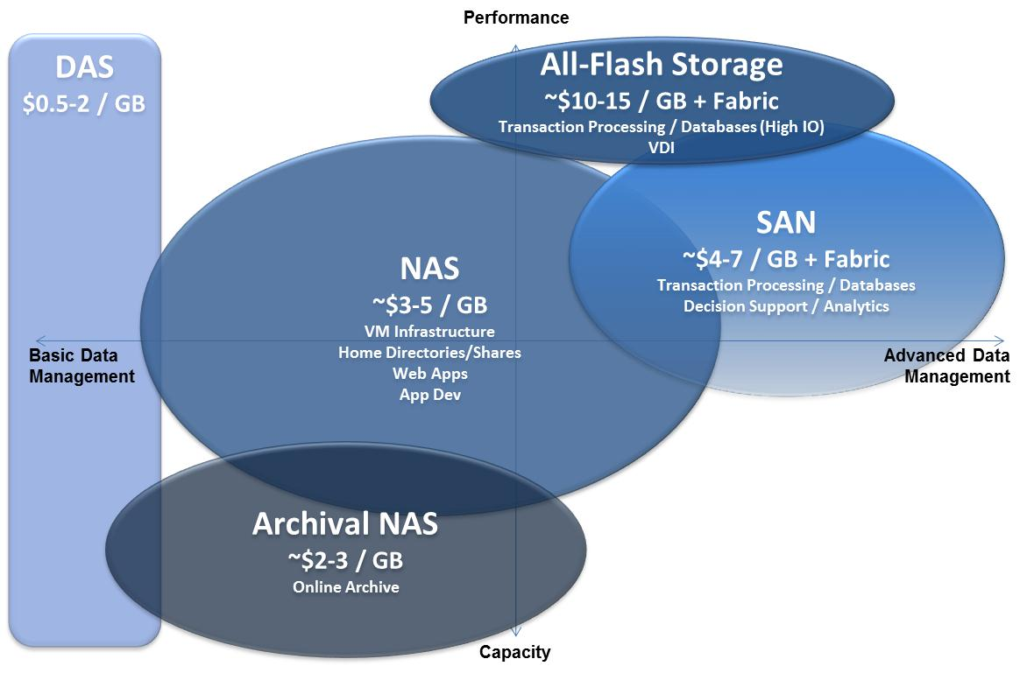
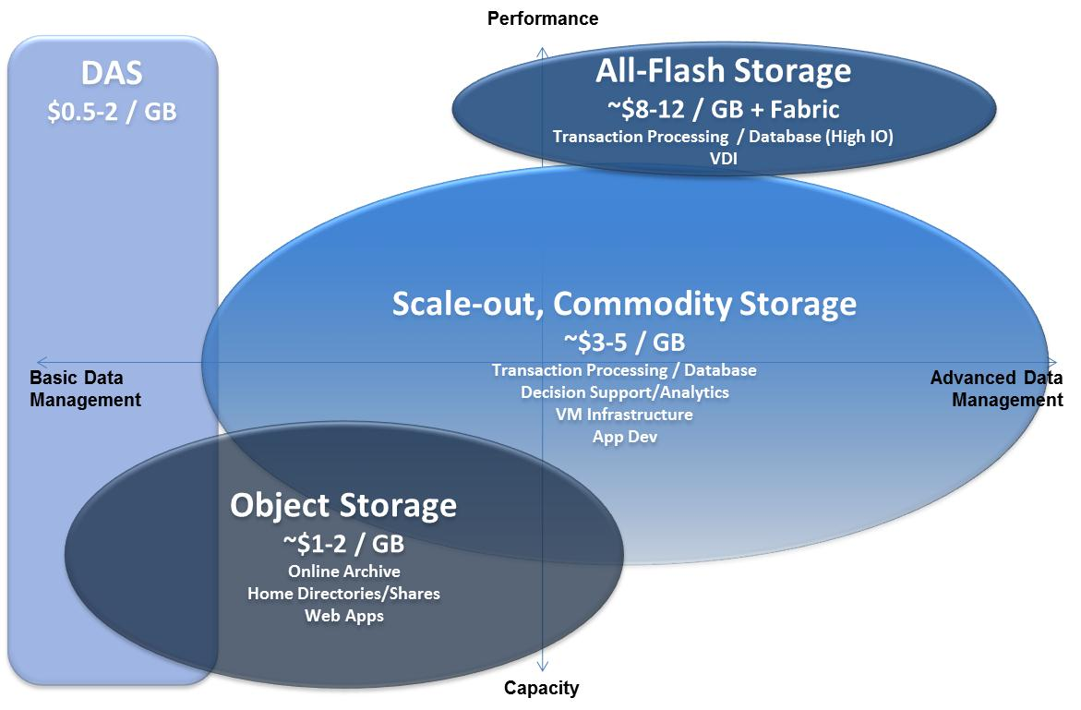
Vision of Storage Consumption in Citi
Office of the CTO | Citi Architecture and Technology Engineering (CATE)
Citi Storage Today
Storage Target: 2015
Storage Target: 2016 and Beyond

Slide 6
Storage Applicability to Key Use-Cases
Office of the CTO | Citi Architecture and Technology Engineering (CATE)
 |  | Use Case | Today | Target | Trend
Application Hosting | Legacy Physical | Legacy High Risk Applications | FC SAN | CSoIP ¹ | DECREASING
 |  | Oracle/RHEL and Windows/SQL | FC SAN | CSoIP
 | VSI / Cloud | VSI - General Purpose | NAS | CSoIP | INCREASING
 |  | VSI - high IO (LVM) | FC SAN | CSoIP
 | Other | Grid | NAS | GPFS / CSoIP | INCREASING
 |  | Hadoop (high analytic value) | DAS | HDFS / CSoIP
 |  | Data Lake (lower analytic value) |  | Object
 |  | NoSQL (e.g. MongoDB) | DAS / SAN | CSoIP
 |  | Low latency/deterministic performance | FC SAN | AFA / CSoIP
 |  | Application Data Archival (random I/O) | NAS | Object
 |  | Low Cost Archival (write once/read seldom) | TAPE/NAS | GPFS/LTFS
Citi User | Desktop Hosting | XenApp | NAS | CSoIP | FLAT
 |  | VDI | NAS | CSoIP / vSAN ²
 | User Data | I:/G: Drives | NAS | NAS / Object ³
 | Desktop Apps | Exchange / SharePoint | FC SAN | DAS / vSAN ⁴
CSoIP = Commodity Storage over IP
AFA = All Flash Array
Some legacy apps may stay on FC for an extended time
Interim VDI 2.0 architecture is based on AFA
Object storage targeted to replace user shares, whereas NAS use will continue for group/app shares
Microsoft stack will also be considered including Hyper-V

Slide 7
CitiNetwork and CitiStorage
Software Defined Data Center | Key Deliverable Challenges – 2015
  Georgetown Development Cloud Pilot will migrate into production rollout in Q1 2015.
Capability | Functionality | 2014 |  |  | 2015 |  |  |  | 2016
SDDC 1.0 | Network Virtualization/IP Mobility for Infrastructure optimization and elasticity
 | End-to-end Infrastructure Visibility for service improvement starting with NSX and vCentre
 | Network Segmentation for development/databases
 | Network Services Automation-Load Balancer
 | Multi-Tier Storage Automation
 | Backup and Restore Automation
SDDC 2.0 | EMC ViPR for storage provisioning automation in Virtualized environment
 | Network Virtualization integration with physical network/appliances
 | Scale IO for block Storage with Two Tiers (Capacity, Performance)
 | Migration of existing virtualized environment under SDDC orchestration
 | Portable Data Volumes for data mobility (Based on Use-Case from NFS, VMDK, or Object)
 | Usage Based Billing to provide cost optimized solution based on application capacity needs (ITBM)
 | End to End Topology, Monitoring and Alerting, Performance, Capacity Reporting and Trending( VCOPs, SRM)
 | Backup and Restore Automation (Additional capabilities)
Development
Pilot
Production Roll out

Slide 8
Cleversafe SWOT Analysis
Office of the CTO | Citi Architecture and Technology Engineering (CATE)
STRENGTHS
- Scale-out to multi-PB scale using commodity hardware
- Uses distributed erasure coding protection to improve storage efficiency
- Architected to withstand multiple node failures plus the total loss of a site.
- Supports standard object APIs such as S3 and Swift
- Robust management with REST API support, allows automation of storage provisioning
WEAKNESSES
- Minimum multi-site configuration requires 3 sites and minimum of 9 slicestor node, 3 per site.
- Single namespace across sites, hence single distributed copy of objects.
- No re-protection of data after node loss; reliant on overprotection of data and replacement of failed nodes.
- Allows full automation and self-service for provisioning and quotas
- New storage class to replace traditional bulk storage for archive type data
- Enabler for new application architectures as widely used for cloud applications
- With suitable client translation layer could replace NAS for suitable home and group areas
OPPORTUNITIES
- Risk as small company
- Major vendors all moving into this product space
THREATS

Slide 9
GPFS + LTFS SWOT Analysis
Office of the CTO | Citi Architecture and Technology Engineering (CATE)
STRENGTHS
- Lowest cost of storage using large capacity tape media.
- Capacity can scale massively into many PB’s
- Capacity and throughput can be scaled independently by adding tape media (capacity), disk cache and tape drives (throughput) or GPFS nodes (compute and network)
- Abstracts data images from physical tape media allowing for data mobility and media refresh
WEAKNESSES
- Access requires data movement to disk cache, restore storms or high read frequency impact performance/data access
- Data protection provided by creating duplicate datasets across two locations which requires replication.
- Replication not integrated into GPFS/LTFS, requires external scripts/products
- Reporting and management is immature
- LTFS leveraging GPFS as a disk cache provide
- Long term retention of backup images, with media refresh
- Low cost tier (via NAS access) as an overspill to current NAS (I: & G: drive) storage.
OPPORTUNTIES
- Only suitable in limited use cases where frequency of access is limited.
- Application interaction with GPFS/LTFS storage is not aware of the tape component so the tape access times my impact performance and application stability
- Access method for windows clients is dependent on a CIFS stack for Linux. Currently this is SAMBA
THREATS

Slide 10
ScaleIO SWOT Analysis
Office of the CTO | Citi Architecture and Technology Engineering (CATE)
STRENGTHS
- Robustness and Self-Healing: failed daemons restart, automated data re-protection on component failure
- Self-management: automated rebalancing of data where nodes/disks are added or removed.
- Supported by strategic vendor – EMC
- Effective Management Dashboard
- Highly Scalable and tested with hundreds of nodes
- QoS tools have the ability to throttle IO traffic
WEAKNESSES
- Weak security, internal local accounts. No integration with AD/kerberos/LDAPS
- Management tooling gaps. No SNMP trap support, limited monitoring and capacity planning tools
- Data integrity – no persistent CRC checks of the data
- No remote replication today (coming via RecoverPoint)
- Potential to use for VMware in SDDC due to inclusion of SDC in the Hypervisor
- Facilitates Separate Scaling of Compute and Storage
- Generic block storage solution for physical servers to replace SAN at a lower cost
OPPORTUNITIES
- Ability of EMC to fix gaps raised by Citi (18 High, 30 Med, 32 Low)
- Operational Support of ScaleIO. We need to automate and integrate with management/orchestration products
- Cost. EMC need to reduce costs as currently software cost > hardware. Dual vendor strategy important
THREATS

Slide 11
Ceph Block SWOT Analysis
Office of the CTO | Citi Architecture and Technology Engineering (CATE)
STRENGTHS
- Unified block/(file)/object with high-scalability
- Unique/strong features (e.g. CRUSH, persistent software-based CRC to combat silent data corruption)
- Purposely designed to run on unreliable hardware
- Continuous access to data when the cluster is being serviced (server taken down, tech refreshes, etc).
- Now supported by a Citi strategic vendor
WEAKNESSES
- Not Enterprise ready (e.g. security/controls; SNMP support, AD/LDAP int. etc)
- Some features are still experimental (e.g. Ceph file system)
- Some key functionality missing (e.g. block-storage remote replication, quotas, standardized monitoring, storage consumption reporting, etc)
- Not a simple product to support internally
- Weak support for multiple storage tiers
- Transparency of an open source product
- Good integration with other Open Source products
- Competitive pricing compared with similar proprietary offerings
OPPORTUNTIES
- Ability of open source community and RedHat to address Citi-identified gaps
- Poor integration with proprietary systems (e.g. VMware hypervisor)
- Less focused on performance than some other proprietary offerings (e.g. ScaleIO)
THREATS
Test

