Slide 1
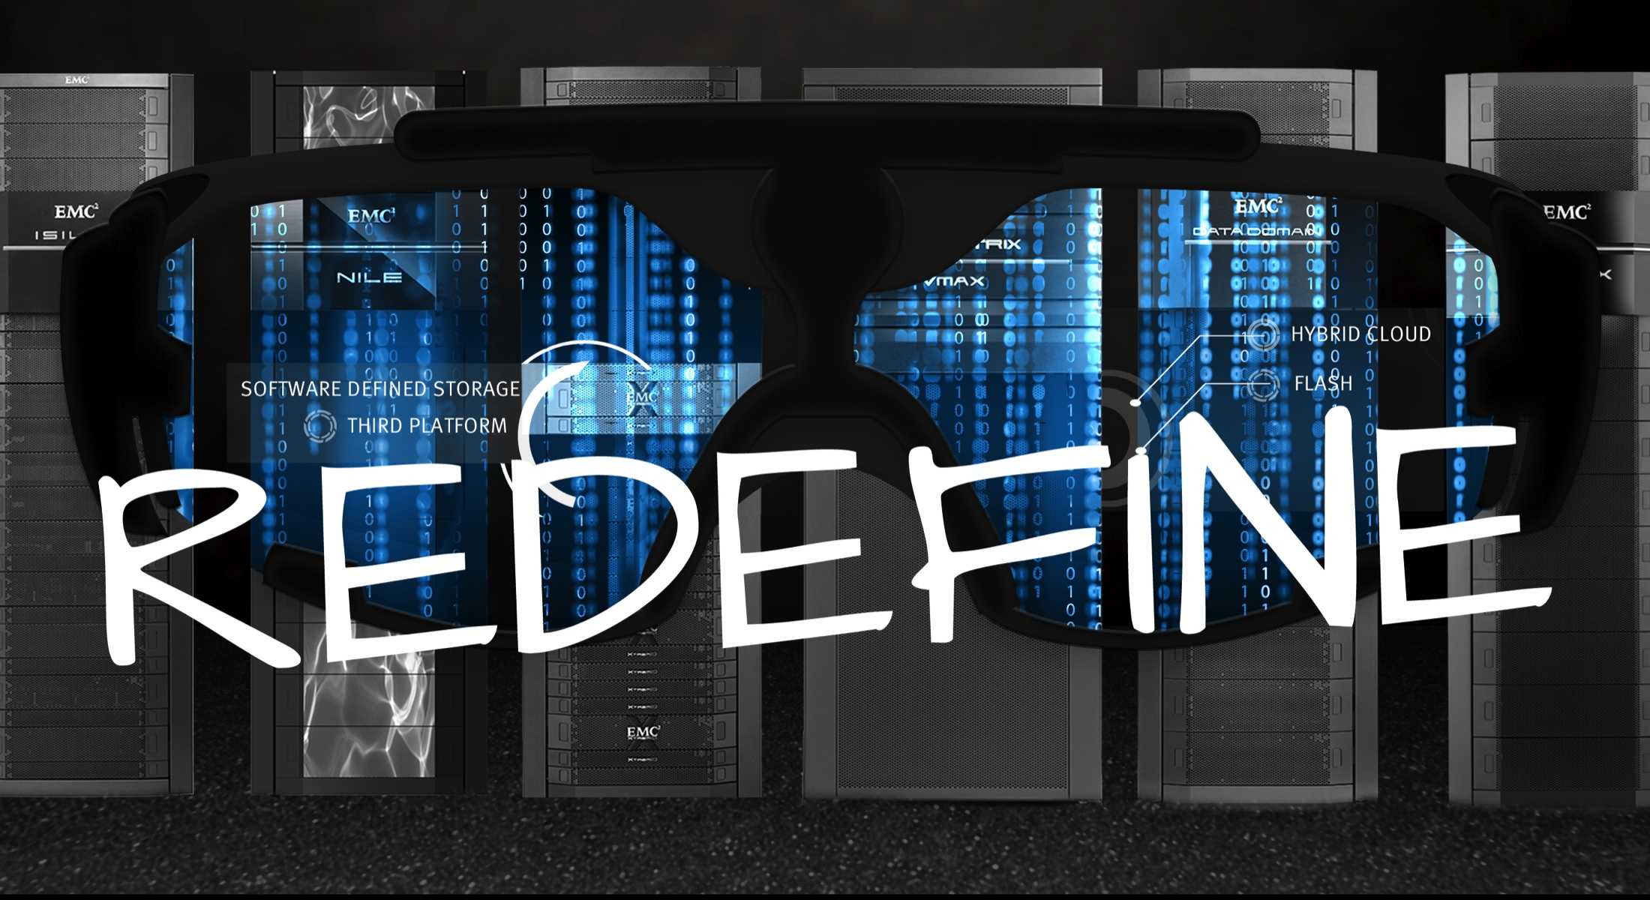
EMC ViPR Software-Defined Storage
Customer Presentation

Slide 2


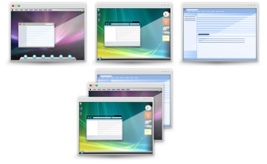
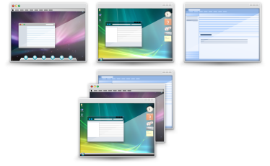




Today’s Storage Infrastructure
BLOCK
FILE
FILE
BLOCK
FILE
OBJECT
HDFS
Notes:
<<CLICK>>
If you were to walk into any data center in the world today you would most likely find a storage infrastructure that consists of multiple platforms from many different vendors resulting in individual storage silos based on application, workload and/or data type. These storage silos lead to inefficient resource utilization and escalating costs due to data growth.
<<CLICK>>

Slide 3
Today’s Storage Infrastructure
#create enhancedGlobalMirrorGroup userLabel="enhancedGlobalMirrorGroupName"
(remoteStoragesubsystemName="storagesubsystemName" | remoteStoragesubsystemWwn="wwID")
interfaceType=(FC | iSCSI)
[remotePassword="password"
syncInterval=integer (minutes | hours | days)
warningSyncThreshold=integer (minutes | hou)
# ./hadoop fs -mkdir /user/hadoop/dir1 /user/hadoop/dir2
# ./hadoop fs -mkdir hdfs://nn1.example.com/user/hadoop/dir hdfs://nn2.example.com/user/hadoop/dir
# ./hadoop fs -put localfile /user/hadoop/hadoopfile
# ./hadoop fs -put localfile1 localfile2 /user/hadoop/hadoopdir
# ./hadoop fs -get /user/hadoop/file localfile
# naviseccli –h 1.2.3.4 - user < > -password < > -scope 0 connection –addset -name mv_iscsi_connection_to_456
# naviseccli –h 1.2.3.4 - user < > -password < > -scope 0 connection –addpath –name mv_iscsi_connection_to_456 –target <MirrorView iSCSI port IP address on target SP-a> –sp a –portid < MV ISCSI port ID on 123 array’s SPA>
# objectcfg volume geo-replication datastore remote.emc.net:/object/geo-replication config remote-syncd /usr/lib/object/syncd
# objectcfg volume geo-replication datastore remote.emc.net:/object/geo-replication/ start
# objectcfg volume geo-replication datastore remote.emc.net:/object/geo-replication/ status
# fdisk /dev/sdc
# fdisk /dev/sdd
# mdadm --zero-superblock /dev/sdc /dev/sdd
# mdadm --create /dev/md0 --level=1 --raid-devices=2 /dev/sdc1 /dev/sdd1
# mkfs.ext3 /dev/md0
# mkdir /raid1
# mount /dev/md0 /raid1
# ./symdev -sid 78 list –noport
# ./symconfigure -sid 78 list -freespace -units CYLINDER
# ./symdisk -sid 78 list -by_diskgroup
#./symconfigure -sid 78 -cmd "create dev count=1,size=18414,emulation=FBA,config=RAID-5,data_member_count=7,disk_group=1;" prepare
# disk assign lun3 -p0
# disk assign lun3 -p1
# disk assign lun4 -p0
# disk assign lun4 –p1
# aggr create siteAaggr -m -d lun1 lun2
# aggr create sitebaggr -m -d lun3 lun4
BLOCK
FILE
FILE
BLOCK
FILE
OBJECT
HDFS
Notes:
In addition, many of these storage silos have their own proprietary storage management tools that requires a specialized storage administrator who must execute repetitive, serial, manual tasks every time an addition or change needs to be made to the storage.
<<CLICK>>
This results in static, slow-to-respond storage infrastructures and long provisioning times that drives end-users around IT to public cloud providers.

Slide 4



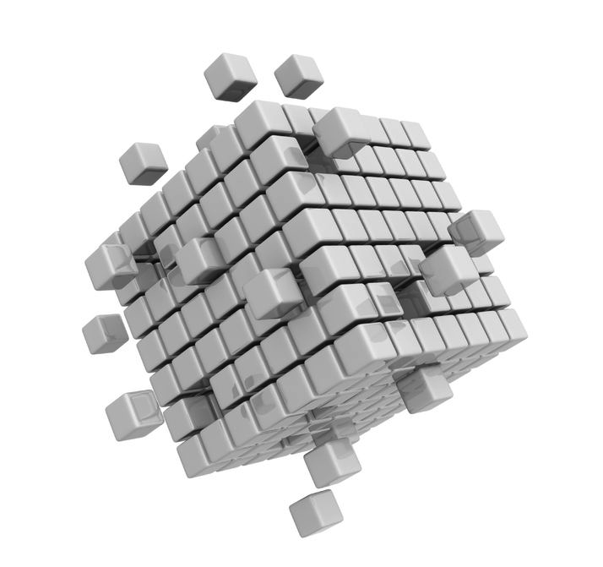
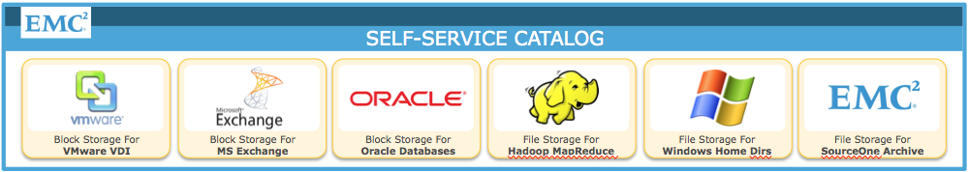
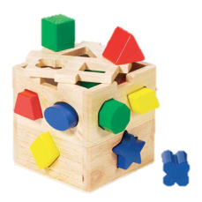

IT’S ONLY GOING TO GET
WORSE
NEW PLATFORMS & APPROACHES
END USER DEMAND FOR CLOUD
MASSIVE DATA GROWTH
Notes:
And It’s Only Going To Get Worse!
End users have more and more options for public cloud services. According to IDC, public IT cloud services will have a compound annual growth rate of 27.6%, four times that of the industry as a whole. In the last year alone, major public IT cloud service providers like Amazon have released over 200 new features.
And while traditional storage platforms are not going away anytime soon, massive data growth, especially in unstructured and semi-structured data, is driving the need for new hyper-scale storage platforms and converged infrastructures that can handle new application workloads cost-effectively and quickly respond to end-user needs.

Slide 5
Help Me
Reduce
Costs
Give Me Freedom of Choice
I Want a Path to the Cloud
Notes:
Our customers have told us, we need to address three main issues:
Help me reduce my costs – both in terms of operating costs but also CAPEX – help me be more efficient and avoid unnecessary purchases. Throwing more capacity is unsustainable, we need better utilization and simpler management.
Give me the freedom to choose the hardware, software (the storage and data services) and management independently. The era of data silos has to end.
Lastly, give me cloud-like capabilities. Multi-tenancy, elasticity, self-service access, metering, etc. And, most importantly the economics.

Slide 6
How Do We
Solve
for This?
Notes:
So How Do We Solve For This?

Slide 7

Notes:
EMC ViPR Software-Defined Storage. ViPR provides a single way to automate provisioning and deliver storage resources by policy across mixed storage array types and vendors improving OPEX, giving customers the flexibility and choice they need and providing cloud-like capabilities.

Slide 8
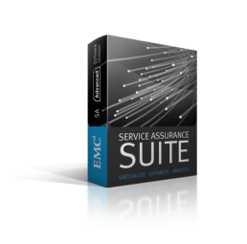
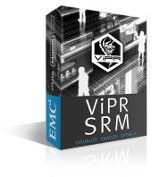











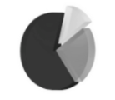
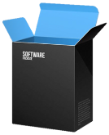










EMC ViPR: Software-Defined Storage
Optimize Current Infrastructure and Meet Demands of Cloud
Performance & Mission-Critical Workloads
New & Basic Workloads
ViPR
Controller
Provisioning
Self-Service
Automation
Reporting
OBJECT
HDFS
BLOCK
FILE
New
ViPR
Services
ScaleIO
EMC
Non-EMC
Array Support via OpenStack
Protect Current Investments
Commodity Hardware
ECS Appliances
Notes:
ViPR is an EMC-developed software solution that has two components:
(Click) The first component, the ViPR Controller, abstracts and pools multi-vendor storage arrays in to a single virtual storage pool that can then be managed by policy. ViPR Controller automates repetitive storage provisioning tasks and provides self-service access to storage. ViPR makes it as easy to consume enterprise storage as it is to consume a public cloud storage service. ViPR Controller also provides a simple way to manage storage resources, performance, and utilization. For deeper insight and visualization across multi-vendor, traditional and Software-Defined Storage environments including chargeback, (click) ViPR integrates with ViPR SRM and Storage Service Assurance Suite (SA).
(Click) The second component is ViPR Services. ViPR Services can be thought of as a storage engine – entirely in software - that support multiple access methods – Object, HDFS, Block, and in the future File. ViPR services run on both commodity hardware and on traditional arrays. This allows customers to reuse existing storage assets, and mix and match them with commodity hardware.
Customers have three ways to procure ViPR :
1) (Click) As a software product that can be installed and run on customer provided, traditional EMC or 3rd Party arrays, such as VMAX, VNX or Isilon
2) (Click) As a software product that can be installed on customer provided OS and commodity storage
Or, 3) (Click) As a complete storage appliance which includes ViPR Controller, ViPR Services and bundled commodity hardware, which is the ECS appliance

Slide 9
Do you want to eliminate storage silos? Or increase utilization of your storage?
ViPR can help!
Notes:
Do you want to eliminate storage silos? Or increase utilization of your storage?
ViPR can help!

Slide 10





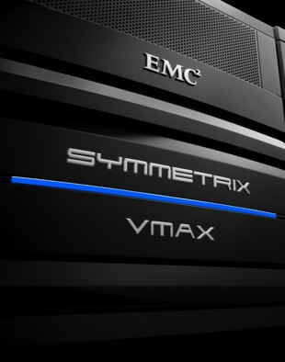
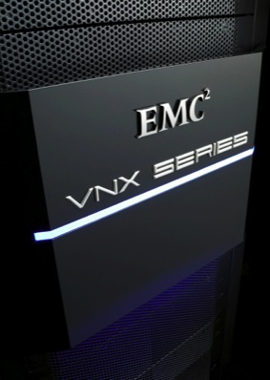
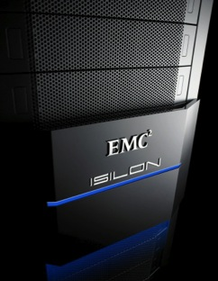
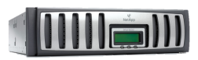
Eliminate Storage Silos
Abstracts storage into policy-based single pools of storage
VDI
EXCHANGE
DATABASE
HADOOP
HOME
DIRECTORY
ARCHIVE
VIRTUAL STORAGE POOLS
VIRTUAL STORAGE ARRAY
VIRTUAL STORAGE ARRAY
VMAX
40K
VMAX
40K
VMAX
40K
NetApp FAS
VNX
Isilon
Notes:
ViPR abstracts multi-vendor storage into policy-based single pools of storage. First the storage administrator creates virtual storage arrays that are managed at the virtual layer according to automated policies. Virtual storage arrays are a software representation of the physical storage infrastructure. Storage administrators create virtual storage arrays in ViPR that they can manage at the virtual layer according to automated policies. This approach is very similar to how server administrators create many virtual machines with unique characteristics from one or more physical servers. Remember these are abstract arrays where a virtual storage arrays can span multiple physical arrays.
Next the storage administrator configures virtual storage pools. Virtual storage pools are sets of storage capabilities required by unique application workloads. Rather than provisioning capacity on storage arrays, storage administrators give users the ability to subscribe to virtual storage pools that meet their unique requirements. These virtual storage pools created by ViPR eliminate storage silos and allow customers to maximize utilization of storage reducing costs.

Slide 11
Do you need to reduce repetitive, manual administrative tasks?
ViPR can help!
Notes:
Do you need to reduce repetitive, manual administrative tasks?
ViPR can help!

Slide 12


Reduce Provisioning Time to Minutes
Administrators can focus on value-driven activities
<60 seconds: Discover and ingestion new storage
5 Simple Steps: End-user self-service access to storage resources
63%: Average reduction in time to provision storage
“Reduces the risk of human error and the need for lengthy management reviews and can make your organization more nimble” – Principled Technologies
Realizing Software-Defined Storage with EMC ViPR, Principled Technologies, 2014
Notes:
One of the key benefits of ViPR is it’s ability to automate provisioning. By centrally automating storage, storage administrators are freed up from repetitive, manual administrative tasks so they can focus on strategic, value-driven activities.
Principled Technologies, which provides industry-leading technology assessments, was commissioned by EMC to complete independent lab testing on ViPR in April of 2014.
Principled Technologies reported the following results:
Ingestion of storage into ViPR took less than one minute which included ViPR automatically identifying the connected storage, discovery of storage capabilities and registering it for use.
Execution of provisioning from ViPR self-service catalog on all tested storage tool 5 or less clicks
Performing one-time SAN zoning requires no time or administrative efforts over the 24 step or more manual process that is required each time the network required changes.
Provisioning block and file storage compared to performing those same task manually, on average, reduced time for administrator to provision storage by 63%.
Overall, Principled Technologies found that ViPR reduces the risk of human error and the need for lengthy management reviews, and can make an organization more nimble.

Slide 13
Do you need to manage storage platforms from more than one vendor?
ViPR can help!
Notes:
Do you need to manage storage platforms from more than one vendor?
ViPR can help!

Slide 14
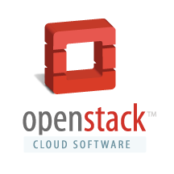



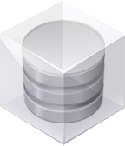
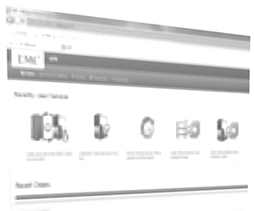

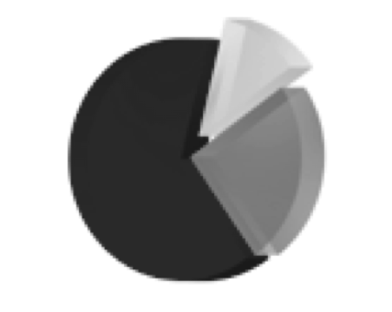
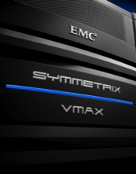

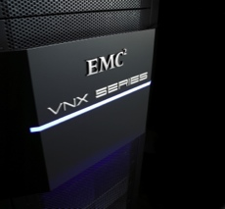
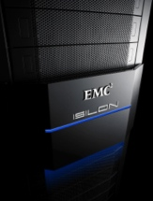
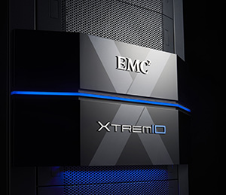
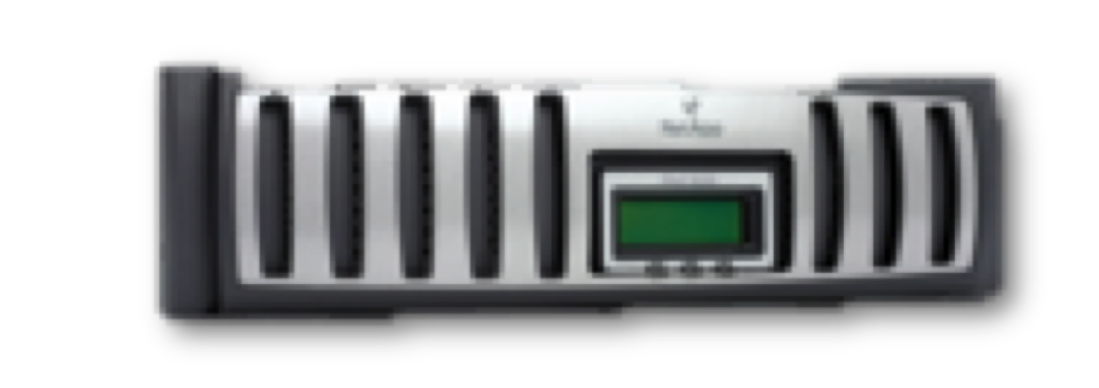
Manages All Storage with One Software Platform
100% Open & Extensible
Northbound & Southbound APIs
Works with EMC VMAX, VNX, Isilon, XtremIO, VPLEX, RecoverPoint, and ECS Appliance
ViPR
Controller
Provisioning
Self
Service
Automation
Reporting
Integrates with 3rd Party Storage Hitachi, IBM, HP, SolidFire, NetApp, & Oracle
Storage Arrays
3rd Party
VMAX
VNX
Isilon
Xtrem-
IO
Integrates with Cloud Stacks VMware, Microsoft and OpenStack
New feature
Notes:
ViPR give customers the freedom to make the choice that's right for their business by providing the ability to manage all storage with one software platform
EMC provides open access to ViPR southbound and northbound APIs so it can integrate with any storage platforms or applications – including commodity, cloud and data center operations stacks.
ViPR currently supports:
EMC Storage Platforms : EMC VMAX, VNX, VPLEX, Isilon, XtremIO, RecoverPoint and ECS Appliance
Third-party Storage Platforms: Hitachi, IBM, HP, SolidFire, NetApp and Oracle and
Cloud Stacks: OpenStack, VMware, and Microsoft

Slide 15
Do you need to integrate commodity platforms into your environment?
ViPR can help!
Notes:
Integrating commodity platforms into your environment? ViPR can help.

Slide 16








Adds the Intelligence of ViPR to Commodity
Simplifies management and enables ViPR Services
BLOCK
Brings commodity hardware under ViPR controller management (HP SL4530 )
Provides health monitoring, provisioning and upgrade & patch management
ViPR services enable intelligence of enterprise storage on low cost commodity hardware
Works with 3rd party commodity servers and storage (DAS)
Commodity hardware fully managed by ViPR as a clustered system
HDFS
…
ScaleIO
OBJECT
FILE
CONTROLLER
SL4540
SL4540
SL4540
SL4540
Certified Commodity Hardware
Notes:
ViPR now supports commodity hardware. Users can add the intelligence of ViPR to commodity drives. ViPR is currently on HP SL4540 but several other commodity certifications are on the roadmap.
EMC ViPR enables customers to bring their own commodity hardware and run ViPR Services such as ViPR Object, ViPR Block and ViPR HDFS. Customers benefit from both the low cost of commodity hardware while not compromising enterprise storage capabilities such as geo replication, data snapshots and more.
Customers can purchase their own hardware and switches, commodity servers and deploy their own OS images. ViPR adds value by simplifying management such as health monitoring, provisioning and upgrade and patch management.

Slide 17
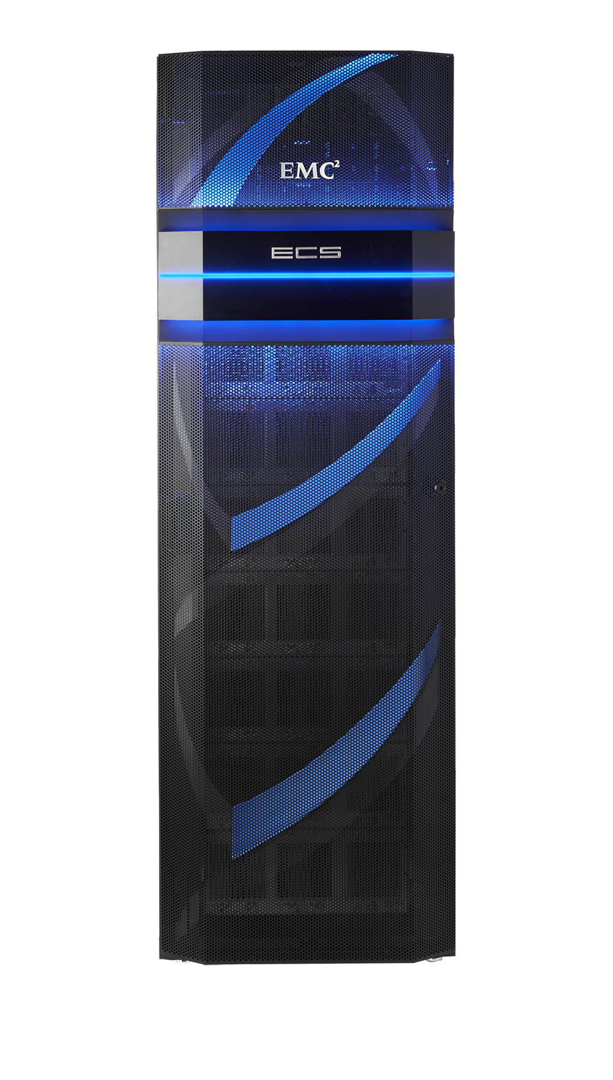
Brings Hyper-Scale to Commodity
Lower cost than public cloud
Unmatched combination of storage efficiency and data access
Anywhere read/write access with strong consistency simplifies application development
No single points of failure increases availability and performance
Universal accessibility eliminates storage silos and inefficient ETL processes
Comprehensive types satisfy the broadest range of application needs
Notes:
On June 26th, EMC began shipping the ECS Appliance. This makes ViPR available as an integrated appliance. The ECS Appliance is a commodity-based storage appliance differentiated by the ViPR software. For the first time, customers can purchase a complete cloud storage platform in a box with self-service access and universal protocol support. The ECS appliance’s support for Object, Block and HDFS eliminates storage silos and inefficient Extract/Transform and Load (ETL) processes.
The ECS Appliance also offers a lower cost than public cloud – EMC TCO models show that the ViPR Services and the ECS appliance are up to 28% cheaper than public cloud alternatives at scale. It’s built for hyper-scale – it leverages commodity components, architected in such a way that it features no single points of failure and delivers and enterprise-grade reliability.
The ECS appliance delivers a state-of-the-art unstructured storage engine that offers an unmatched combination of storage efficiency and data access. It also features anywhere read/write access to content with strong consistency to simplify data access and application development. It’s also a very cost-effective HDFS platform and extends Big Data analytics and applications to geo-distributed, unstructured content.

Slide 18
Do you want to deliver public cloud self-service storage with the benefits of on-premise storage?
ViPR can help!.
Notes:
Do you want to deliver public cloud self-service storage with the benefits of on-premise storage?
ViPR can help!.

Slide 19
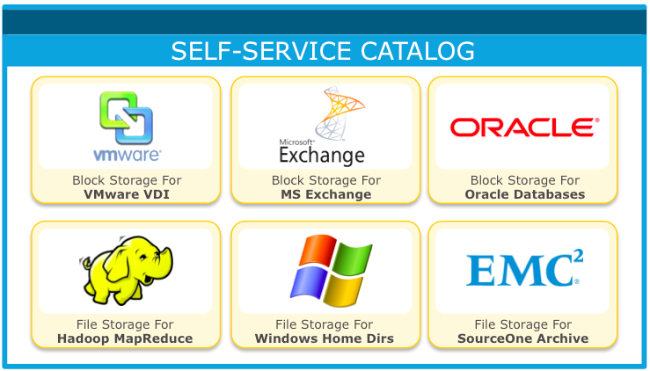
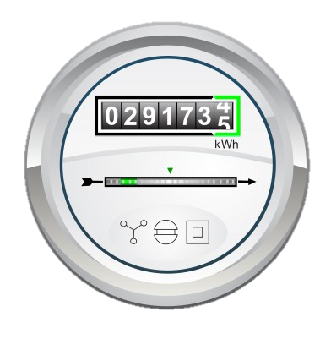



Delivers Self-Service Access to Storage
Empower your customers and reduce reliance on IT
Five or Less Simple Steps
Notes:
ViPR delivers storage to users and tenants via a policy-driven self-service catalog – on-demand. Users can easily subscribe – in 5 or less simple steps - to storage resources that meets their workload demands. The user does not need to know or care about the underlying hardware and software that is providing the storage to their application.
For example, a user with a transactional workload would subscribe to storage resources that feature the characteristics of a high-performance block store such as EMC VMAX. A user with an online file and content sharing application would subscribe to a storage resources that feature the characteristics of a distributed object or file-based storage cloud.
EMC ViPR automatically provisions the right hardware and software to meet the need. Storage is instantly available—on-demand.
This helps storage administrators:
Minimize user-IT interactions – empowering users and reducing their reliance on IT
Automate the process of identifying available storage capacity and
Better map application workload requirements to the right combination of software and hardware storage resources—instead of the repetitive, time consuming, labor intensive task of provisioning storage manually.
Enterprise IT can now provide access to storage in the same or less time than it takes to go to an external cloud vendor—all while utilizing their existing storage infrastructure.
ViPR also provides metering, billing and chargeback capabilities (in-conjunction with ViPR SRM) to ensure end-users can be held accountable for the they storage they use

Slide 20
Do you want to have better visibility into your entire storage infrastructure?
ViPR & ViPR SRM can help!
Notes:
Do you want to have better visibility into your entire storage infrastructure?
ViPR & ViPR SRM can help!.

Slide 21

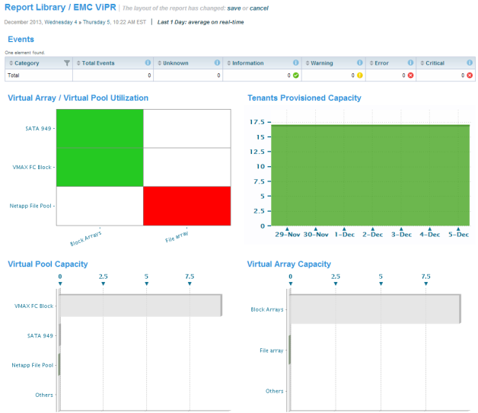
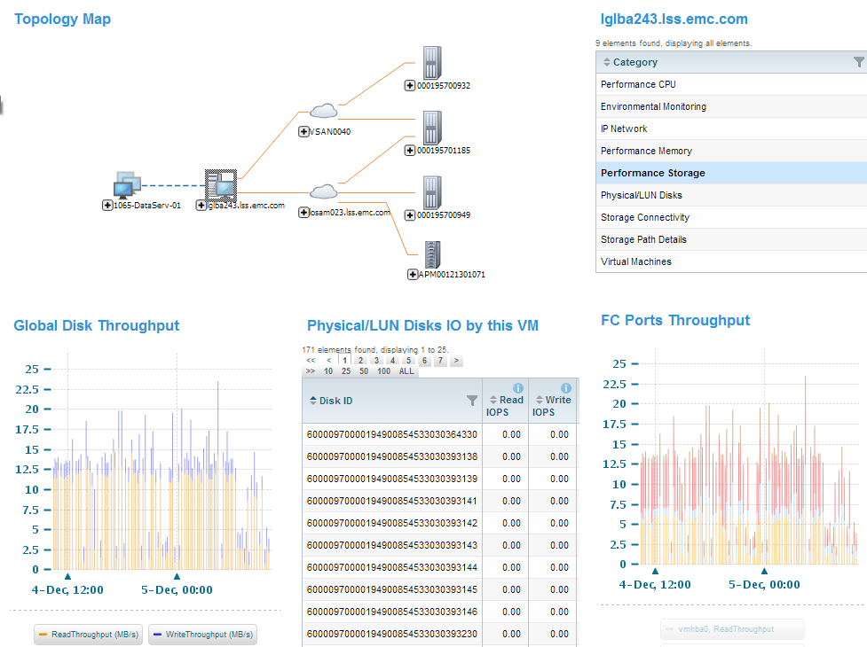
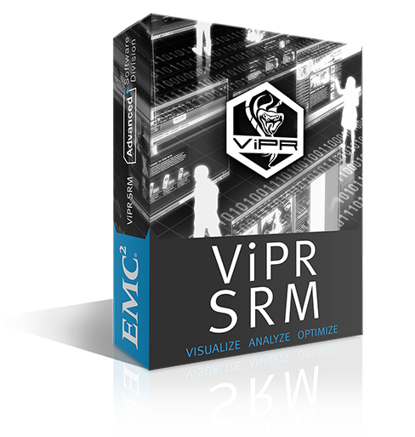
Provides Simple Way to Get Better Visibility
Traditional and Virtual Storage Resources
ViPR Monitoring and Reporting
  Capacity reporting for ViPR virtual resources
  Discovers capacity available to support provisioning to ViPR
ViPR SRM
  Enables management of physical infrastructure under ViPR control
  Associates relationships between physical and software-defined resources
  Tracks use of capacity on physical arrays to support purchasing processes
  Chargeback reporting
  Enables SLA management
Notes:
The ViPR Monitoring and Reporting SolutionPack which is included with the ViPR Controller provides a simple way to get better visibility into the ViPR virtual storage resources. The SolutionPack offers capacity reporting for ViPR virtual storage resources. And, it discovers capacity available from physical arrays to support the provisioning of storage to ViPR.
ViPR SRM extends customers’ investments in ViPR by reporting on the physical infrastructure managed by ViPR It helps storage teams ensure service levels in both traditional and software-defined storage environments. ViPR SRM provides the following key features:
Tracks capacity consumption across the storage environment including the arrays that present capacity to ViPR to improve capacity planning and purchasing processes.
Monitors and reports on performance trends in ViPR environments to identify when service levels are not being met and provides end-to-end views of the physical infrastructure to simplify troubleshooting processes.
Presents views of the physical resources associated with ViPR components, as well as the ability to map ViPR virtual pools to ViPR SRM service levels to streamline chargeback reporting;
Tracks changes and monitors compliance with design best practices and the EMC Support Matrix to ensure your environment is always configured right to meet service levels.
EMC ViPR and ViPR SRM share a common console to centralize management and provide end-to-end analysis across multi-vendor storage environments enabling customers to maximize their storage resources and assure service levels.

Slide 22
Do you need to provide cloud-scale storage services on your existing infrastructure?
ViPR can help!.
Notes:
Do you need to provide cloud-scale storage services on existing infrastructure?
ViPR can help!.

Slide 23




ViPR Services
Cloud-scale storage services on commodity and arrays
ViPR
Services
BLOCK
STORAGE
HDFS
STORAGE
OBJECT
STORAGE
Geo-Replicated Data Protection
Active-Active read/write support with strong consistency
No single point of failure
Performance and efficiency for small and large objects
SITE 1
SITE 2
SITE 3
Notes:
ViPR Services are built using cloud principles and are different from traditional storage systems in the following ways:
Software-Defined:
ViPR Service are Software-defined which separates the software layer from the hardware. This separation allows ViPR Services to be installed on a variety of commodity servers, running bare metal or virtualized.
Multi-Vendor support:
ViPR Services can store data on both commodity arrays and on traditional arrays. ViPR Services can write data to commodity disks using erasure coding for site level data protection, or on traditional “protected” arrays, in which case it makes only a single site level copy. This allows customers to reuse existing storage assets, and mix and match them with commodity servers, all while serving data through a single namespace and storage system spread across these different assets
Fully Geo-Capable.
ViPR Services replicates data both within and across multiple sites for resiliency against site failures. And it does so at a lower overhead at higher performance than any other cloud storage system. It provides a global namespace with true anywhere access – buckets span sites; any data can be written to or read from any site, with strong consistency.
Built from Ground Up
ViPR Services are built from the ground up to run on commodity infrastructure such as SATA JBOD drives that fail routinely. There is no single point of failure locally or geographically. Failing over to a second site is seamless and applications automatically read from any available sites. This leads to much lower TCO for the storage system. ViPR Services optimizes performance by eliminating WAN traffic for disk repairs or when reading from local site.
Low latency
ViPR can also execute a large # of user transactions concurrently with very little latency. ViPR Services support box-carting to handle workloads with high transaction rates. When an application is writing a lot of small files with high I/O, ViPR Services can take multiple requests together and write them as one. This improves performance by reducing the round trips to the underlying storage.
Multiple access methods.
ViPR Services include ViPR Object and ViPR HDFS. ViPR Block is also available via ScaleIO software. ViPR Services can support industry standard Object storage APIs and is compatible with any Hadoop 2.x distribution.

Slide 24
Do you want to try ViPR at a deeply discounted price?
Get the ViPR Controller Starter Pack!.
Notes:
Want to try ViPR at a deeply discounted price?
Get the ViPR Controller Starter Pack!.

Slide 25
VIPR Controller Starter Pack
50TB ViPR Controller
All For
$10,000*
3 Year Maintenance
75%
off list
40 Hour Professional Services
* Limited time offer! Please talk to your EMC Account Rep today for details!
Notes:
The ViPR Starter Pack is a simple, complete package that provides customers with a easy, cost-effective way to realize the benefits of ViPR Controller. For $10,000 – which is 75% off list – customer receive:
A 50TB ViPR Controller License
3 Years Pre-paid Maintenance
And 40 Hours remote professional services which is a highly focused, remotely delivered implementation that helps customers drive value and benefit from the ViPR Starter Pack.
This is a limited time offer. Please talk to your EMC Account Rep today for additional details.

Slide 26
Do you want to get more information on ViPR, try ViPR at no charge or get support from ViPR experts?
Join the ViPR Community
Notes:
Do you want to get more information on ViPR, try ViPR at no charge or get support from ViPR experts?
Join the ViPR Community!

Slide 27
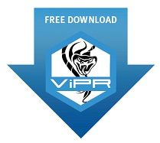
Join the ViPR Community…
www.emc.com/viprcommunity
Learn | Try | Develop | Collaborate
Explore how-to videos, helpful guides, and training
Download ViPR FREE with no time limit – for non-production use
Access SDKs, FAQs, forums, technical documentation, sample apps, and more
Ask the experts, talk to peers, share ideas and experiences
www.emc.com/getvipr
Notes:
The EMC ViPR Community provides a single place to learn more about ViPR Software-Defined Storage, ViPR SRM, and ECS Appliance.
Visit the ViPR Community at www.emc.com/viprcommunity and download a trial version of ViPR at no charge – for non-production use, find technical product documentation, access developer resources such as SDKs, and get support from EMC Experts, other community members, and more.

Slide 28
Re-Define and Transform Your Storage
Abstract, Pool, Automate for Storage Services On-Demand
Simplifies managing multi-vendor storage
Reduces provisioning time by 63% (on average)
Delivers self-service storage resources – on demand
Helps reclaim public cloud workloads
Notes:
To re-cap. With ViPR, organizations can re-define and transform their existing storage infrastructure into a software-defined platform to deliver that will:
Simplifies managing of multi-vendor storage
Reduces provisioning time by 63% (on average)
Delivers self-service storage resources – on demand
Helps re-claim public cloud workloads

