Slide 1

OpStor
- A multi vendor storage resource management and capacity forecasting software

Slide 2

AGENDA
Understanding the user i.e, Storage Administrator, his duties and the challenges he faces
Introduction about OpStor
Overview of OpStor
Advantages of using OpStor
Benefits of using OpStor

Slide 3
STORAGE ADMINISTRATORS - Duties
Create LUNs
Resolve storage shortages
Maintain a proper backup schedule and perform backups
System performance tuning
Forecast Storage growth
Monitor current storage environment
Make hardware / configuration changes when adding new servers

Slide 4
CHALLENGES FACED BY STORAGE ADMINISTRATORS
Prevent system panic
Isolating the problem
Responsiveness
Forecasting future storage demands
Operate with products from different OEM
Security of the data (availability and retention)

Slide 5
OPSTOR
OpStor from Manage Engine is a multi vendor SRM (Storage Resource Management) solution
It monitors Storage Area Network (SAN) and Network Attached Storage (NAS) devices such as storage arrays, fabric switches, tape libraries, host servers and host bus adapter cards
It performs auto-discovery to deliver asset, capacity, performance, and configuration information on storage devices and their components
It generates reports, forecasts storage demand and also performs escalations on alerts

Slide 6
5 EASY STEPS TO UNDERSTAND OPSTOR
Home - Autodiscovers devices and shows recent alarm logs
Alarms - Allows you to select device type and view their alarms
Maps - Gives a pictorial representaion of the storage network
Reports - Gives reports on performance, capacity, availability etc
Admin - Helps in scheduling the reports and for custom setting

Slide 7
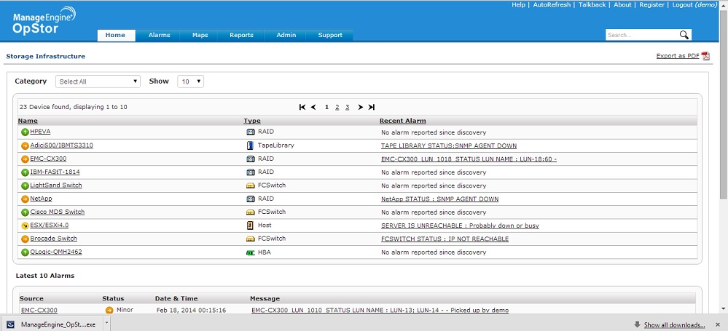
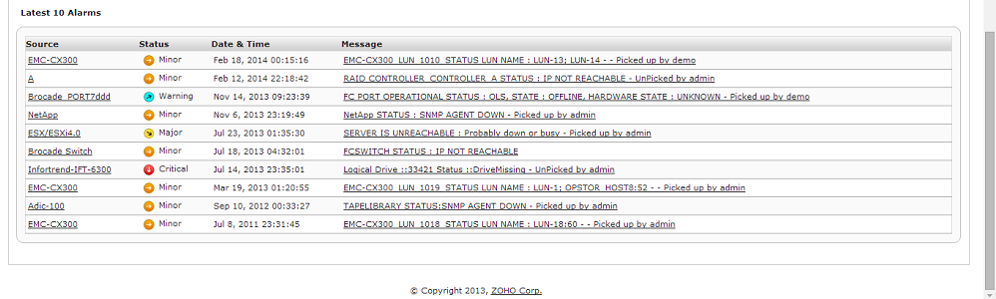
HOME - Autodiscovers devices and shows recent alarm logs

Slide 8
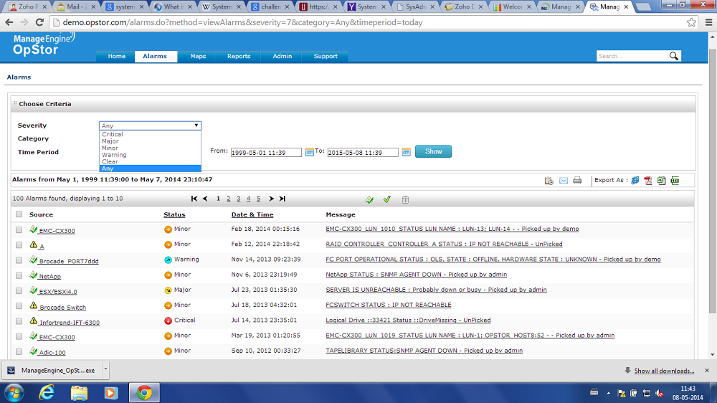
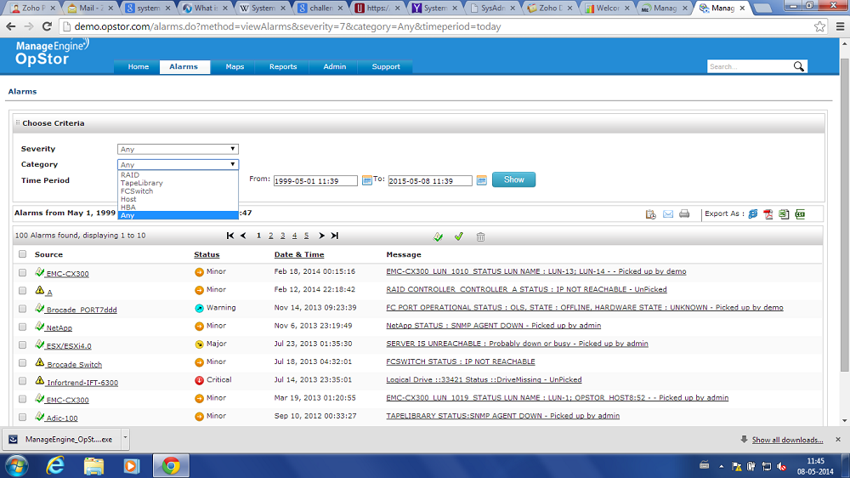
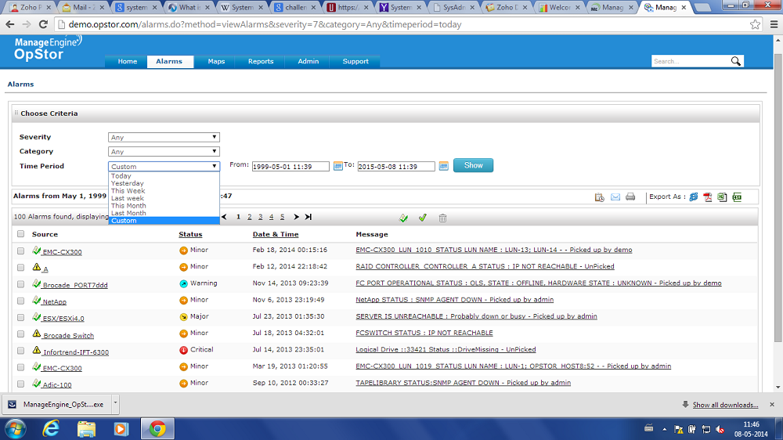
ALARMS - Allows you to select device type and view their alarms

Slide 9
ALARMS - Allows you to select device type and view their alarms

Slide 10
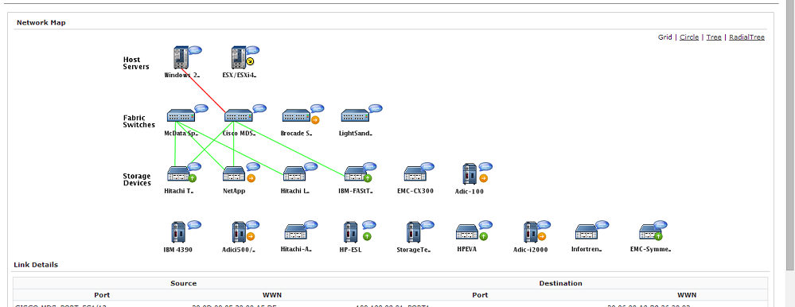
MAPS - Gives a pictorial representation of the storage network
Bad / disrupted Connection
Good / Operational Connection

Slide 11
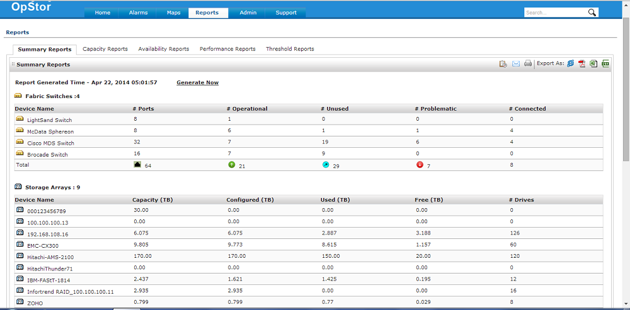
REPORTS - Gives reports on performance, capacity, availability etc
Summary Reports - gives the summary of activity for all the devices for the day

Slide 12
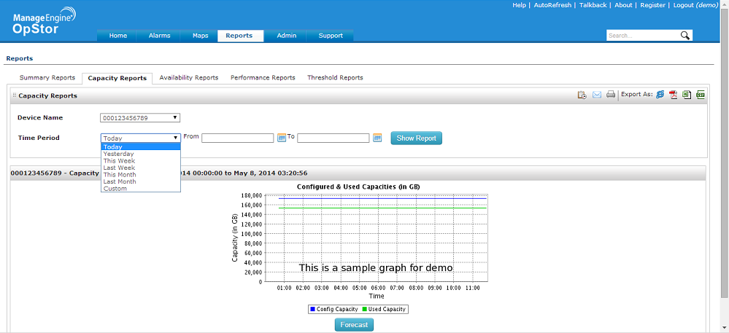
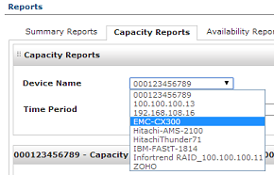
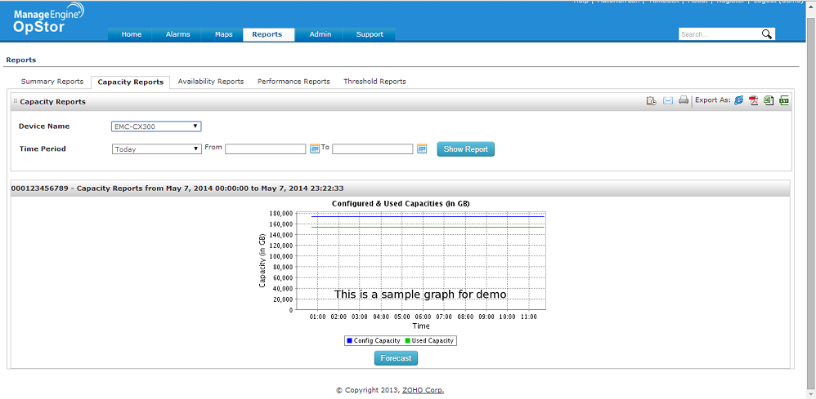
REPORTS
Capacity Reports - monitors the existing capacity and the used capacity for different storage device

Slide 13
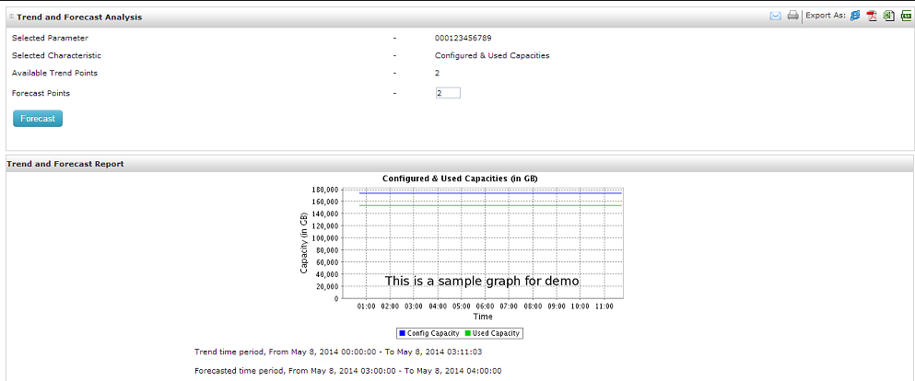
REPORTS
Forecasts - Helps you to understand the storage demand requirements for the future

Slide 14
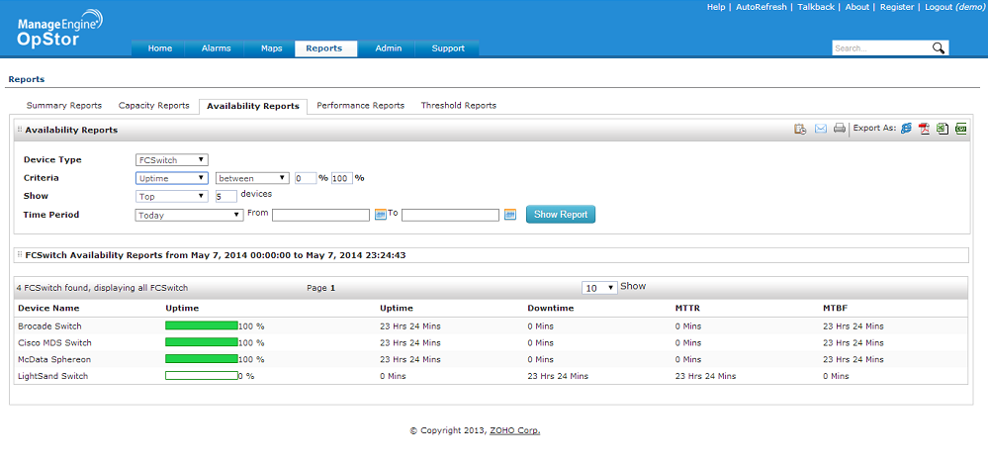
REPORTS
Availability - Show the Uptime, Downtime, MTTR and MTBF for different devices that are connected to the network

Slide 15
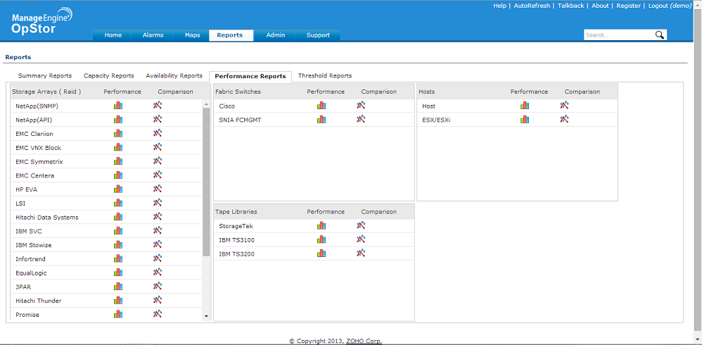
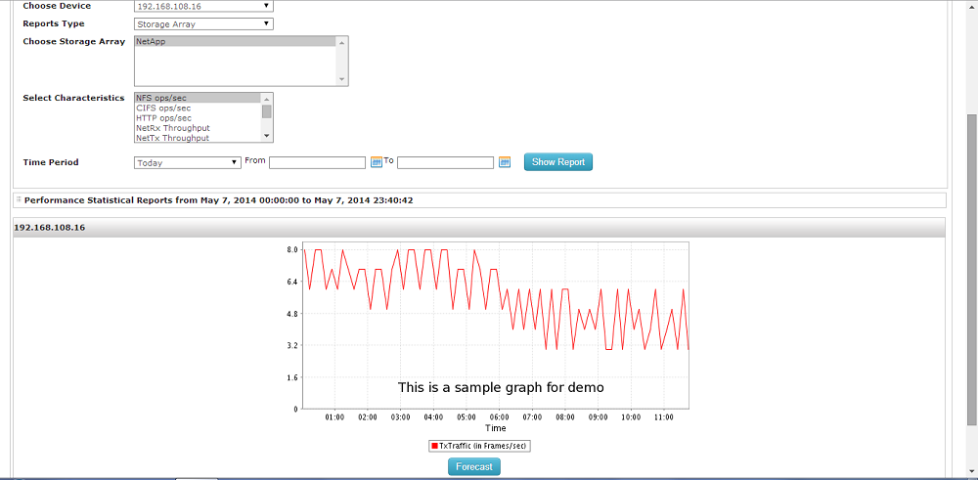
REPORTS
Performance - Provides performance reports for all devices

Slide 16
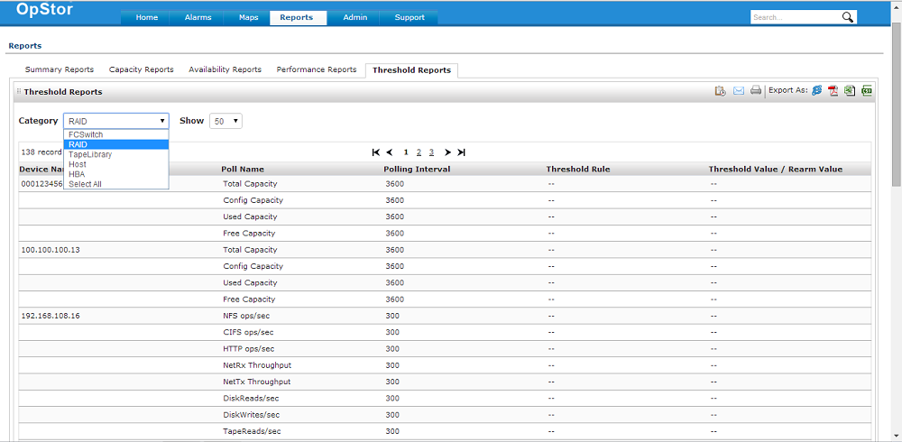
REPORTS
Threshold - Shows the limits for raising alarms on each device as well as the rate of data collection from each device (Polling Interval)

Slide 17
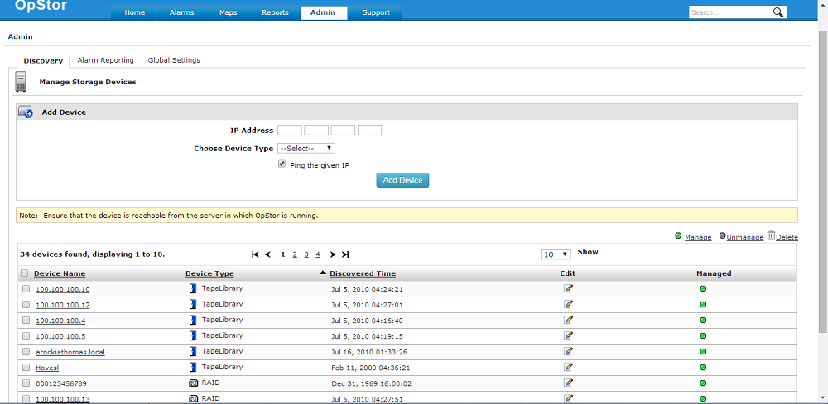
ADMIN
Discovery - Helps you to add devices manually using their IP addresses

Slide 18
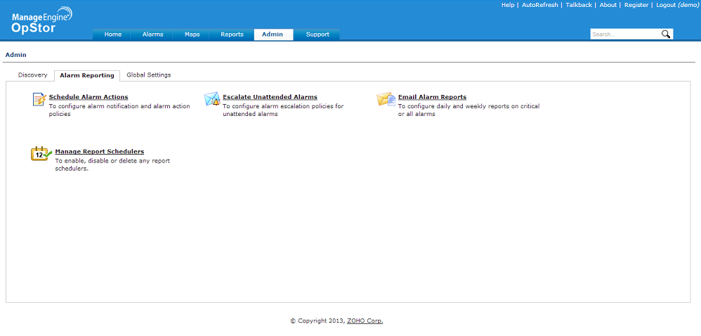
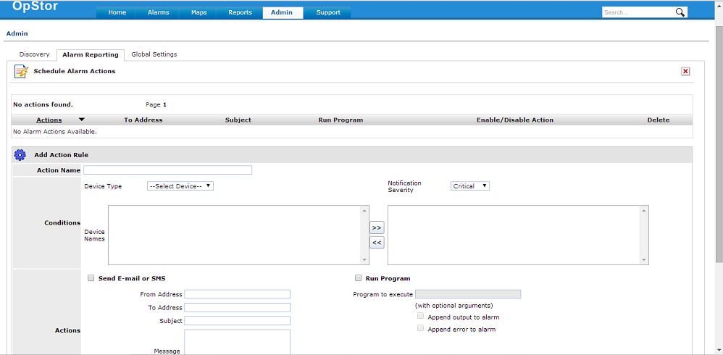
ADMIN - Helps in scheduling the reports and for custom settings
Schedule Alarm Actions - This helps in sending alert mails to the mentioned email ids

Slide 19
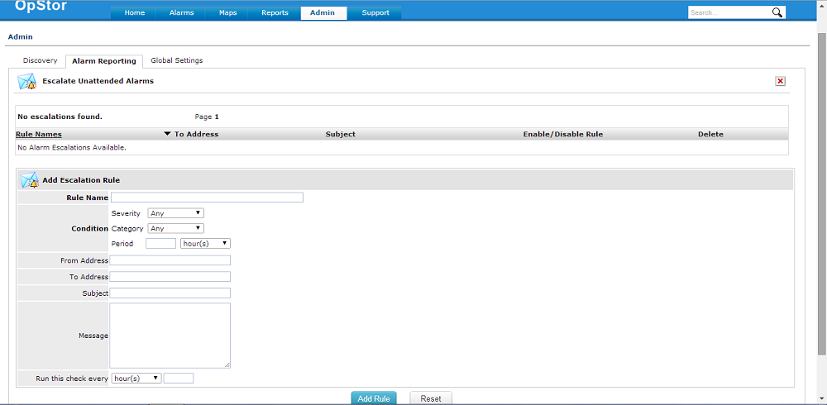
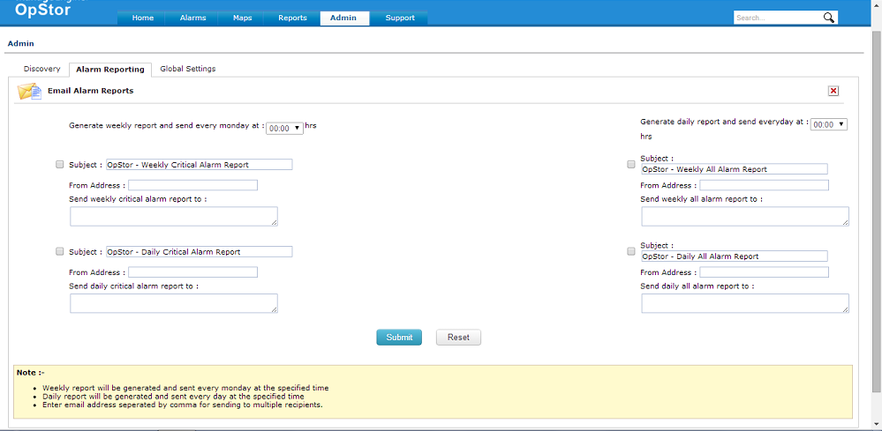
ADMIN
Escalates Alarms which are not attended to
Sends daily and weekly reports to prespecified email ids

Slide 20
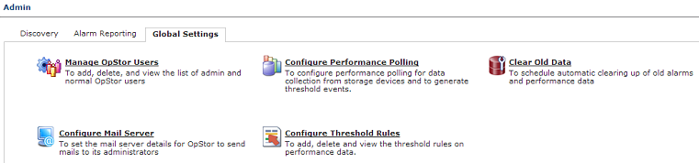
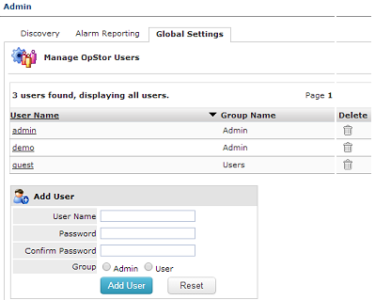
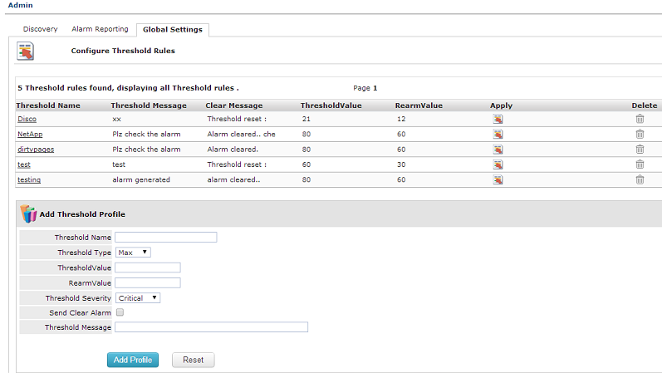
ADMIN
Global Settings - Helps you to manage accounts and mail servers, change polling, threshold rules etc

Slide 21
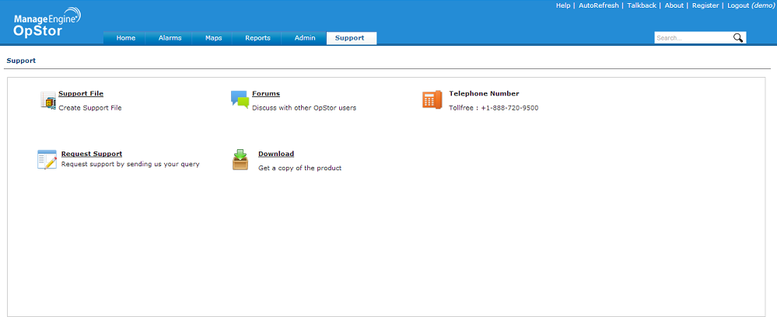
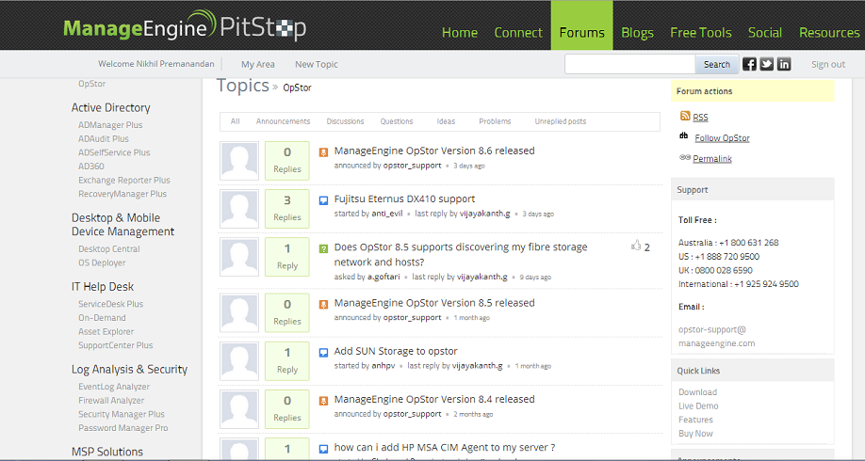
SUPPORT - for any queries or assistance
Forums - helps you to interact within the Opstor community about product upgrades and queries

Slide 22
ADVANTAGES OF USING OPSTOR
Supports devices from different vendors
Auto discovers all the devices that are connected in the storage network
Captures sensor faults such as power supply, temperature, fan and battery, as well as status change notifications
Has the map facility which provides the pictorial view of the storage network
Administrators receive alarms through email or SMS messages based on pre-set rules
Can be integrated with different ME products. Customers need not use different software for different applications

Slide 23
BENEFITS OF USING OPSTOR
Increased visibility with unified view of your storage environment
Reduced downtime with timely detection of problems
Saves administrative time with effective reporting and escalations
Lowers Total Cost of Ownership with NO extra software purchases
Simplified management at an affordable price

Slide 24

Download OpStor now
http://www.manageengine.com/products/opstor/download.html
For more inputs
http://www.manageengine.com/products/opstor/help.html
For personalized support
Write to us: opstor-support@manageengine.com Call Toll free : +1-888-720-9500

