Slide 1
EMEA SAN Capacity Team Review
August 2014

Slide 2
SAN Storage Growth – 5 Years
  Managed storage increased substantially
Comments:-
Trend report shows that EMEA SAN capacity increased from 3.5PB to 15.1PB

Slide 3
EMEA SAN CAPACITY SUMMARY
Comments:-
Total EMEA SAN Capacity – 18.6PB
Physical/RAW Capacity – 15.2PB
Usable Capacity – 10.4PB
Allocated Capacity – 8.5PB
Used Capacity – 6.2PB
Currently 112% of Over subscription Allocation rate in Final MOR Arrays
pool written size in Final MOR Arrays is 67%
Overall 82% is over subscription rate and 60% is pool written

Slide 4
SAN Install (Raw) Base by Vendor
location | Centera | Clariion | DMX | HDS | Vmax | VNX | XIV | Grand Total(TB)
CGC | 0 | 0 | 64 | 83 | 1,098 | 0 | 0 | 1,245
FDC | 261 | 18 | 491 | 775 | 3,867 | 713 | 450 | 6,575
Poland | 143 | 0 | 0 | 0 | 0 | 0 | 0 | 143
RDC | 260 | 36 | 419 | 880 | 3,752 | 1,504 | 450 | 7,300
Russia DC | 0 | 57 | 0 | 0 | 0 | 0 | 0 | 57
Swiss | 34 | 0 | 0 | 0 | 98 | 0 | 0 | 133
Turkey DC | 98 | 4 | 0 | 0 | 0 | 0 | 0 | 102
Grand Total | 797 | 114 | 973 | 1,738 | 8,816 | 2,216 | 900 | 15,554
Comments:-
Total SAN RAW Installed in EMEA – 15.2PB
Majority of storage are in VMAX environment ( 32 Arrays)
XIV is mainly using for VMWARE
Clarriion and VNX are using for Exchange environment
DMX & HDS USP/USPV will decommission soon

Slide 5
SAN Storage Inventory
  Aug. 2014 SAN Install TB (Usable)
location | Centera | Clariion | DMX | HDS | Vmax | VNX | XIV | Grand Total (TB)
CGC | 0 | 0 | 56 | 73 | 762 | 0 | 0 | 891
FDC | 229 | 9 | 430 | 672 | 2,508 | 422 | 219 | 4,488
Poland | 125 | 0 | 0 | 0 | 0 | 0 | 0 | 125
RDC | 227 | 19 | 366 | 740 | 2,531 | 819 | 219 | 4,923
Russia DC | 0 | 28 | 0 | 0 | 0 | 0 | 0 | 28
Swiss | 30 | 0 | 0 | 0 | 86 | 0 | 0 | 116
Turkey DC | 86 | 2 | 0 | 0 | 0 | 0 | 0 | 88
Grand Total | 698 | 58 | 852 | 1,485 | 5,888 | 1,241 | 438 | 10,660
Comments:-
Total SAN Usable Installed TB in EMEA – 10,660
VMAX Usable Installed TB – 5,888

Slide 6
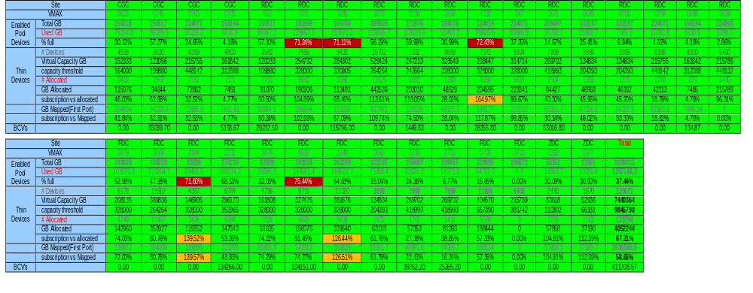
VMAX Pool (Virtual) Summary Report
Site | CGC Non-Rep | CGC-Rep | RDC Non-Rep | RDC-Rep | FDC Non-Rep | FDC-Rep | ZDC Non-Rep | Total Rep | Total Non-Rep | Total Rep+Non-Rep
Total GB | 474,090 | 306,711 | 1,243,712 | 1,348,439 | 1,413,104 | 1,155,016 | 88,242 | 2,810,165 | 3,219,148 | 6,029,313
Used GB | 113,050 | 94,341 | 408,400 | 521,812 | 536,972 | 501,835 | 29,394 | 1,117,989 | 1,087,817 | 2,205,806
% full | 23.85% | 30.76% | 32.84% | 38.70% | 38.00% | 43.45% | 33.31% | 39.78% | 33.79% | 36.58%
# Devices | 10,264 | 8,420 | 43,844 | 56,792 | 47,415 | 47,648 | 4,050 | 112,860 | 105,573 | 218,433
Virtual Capacity GB | 346,071 | 283,897 | 1,478,288 | 1,914,856 | 1,598,692 | 1,606,548 | 136,554 | 3,805,301 | 3,559,605 | 7,364,905
capacity threshold | 948,179 | 613,422 | 2,487,425 | 2,696,877 | 2,826,209 | 2,310,031 | 176,483 | 5,620,330 | 6,438,295 | 12,058,626
# Allocated | 5,612 | 3,036 | 32,020 | 25,099 | 30,082 | 22,864 | 3,085 | 50,999 | 70,799 | 121,798
GB Allocated | 189,220 | 102,365 | 1,079,618 | 846,263 | 1,014,275 | 770,905 | 104,017 | 1,719,533 | 2,387,130 | 4,106,663
subscription vs allocated | 39.91% | 33.38% | 86.81% | 62.76% | 71.78% | 66.74% | 117.88% | 61.19% | 74.15% | 68.11%
GB Mapped(First Port) | 178,917 | 101,963 | 865,379 | 676,941 | 1,010,742 | 585,361 | 104,017 | 1,364,265 | 2,159,054 | 3,523,319
subscription vs Mapped | 37.74% | 33.24% | 69.58% | 50.20% | 71.53% | 50.68% | 117.88% | 48.55% | 67.07% | 58.44%
Comments:-
Pool written is >70% on #678,#2804/#3286 & #4330/4652 arrays
In overall VMax environment, 68% is over subscription allocation rate and Pool written is 36%
Pool written & Over subscription rate is less due to many VMax arrays added as TECH-REFRESH target arrays in recently

Slide 7
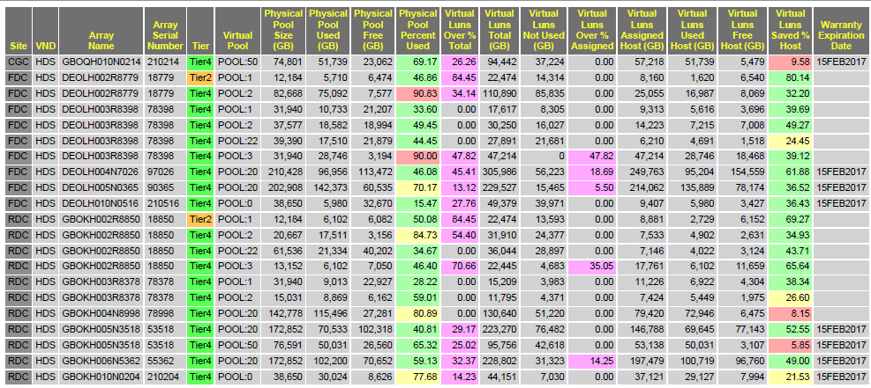
HDS Pool (Virtual) Summary Report
Comments:-
#18779/18850 & #78398/79378 & #78998 are part of TECH-REFRESH and will Decommission soon
Currently all VSP arrays mainly using for Non-Replicated requirements
HUS-VM arrays are #210214, #210516 & #210204 and mainly using for Bronze storage requirements
#210214 and #53518 (Pool 50) is mainly using for Archival Storage requirements

Slide 8
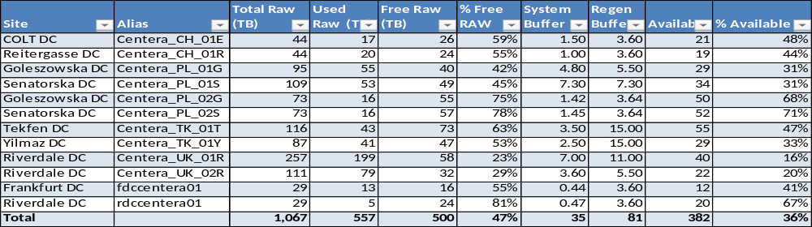
Centera and DMX Capacity Report
Centera Summary Report
DMX Summary Report
S.No | Loc | Column1 | Array | Allocated (GB) | Free Cap | Total
1 | FDC | Rep | 290103544 | 15,245 | 27,351 | 42,596
2 | FDC | Non-Rep | 290103564 | 14,878 | 87,315 | 102,193
3 | FDC | Rep | 290103810 | 475 | 53,479 | 53,954
4 | FDC | Non-Rep | 290103943 | 4,455 | 106,220 | 110,675
5 | FDC | Rep | 290105349 | 10,018 | 3,841 | 13,859
6 | RDC | Rep | 290103452 | 29,682 | 68,594 | 98,276
7 | RDC | Rep | 290103720 | 3,004 | 50,951 | 53,955
8 | RDC | Rep | 290105373 | 1,943 | 20,847 | 22,790
9 | CGC | Rep | 290102838 | 2,194 | 41,067 | 43,261
10 | RDC | Non-Rep | 290102819 | 13,689 | 91,719 | 105,408
11 | RDC | Rep | 290102839 | 1,081 | 41,880 | 42,961
 | Total |  |  | 96,664 | 593,264 | 689,930
Comments:-
Centera environment will move to Backup & Archiving team and currently Centera transition is going on
All DMX environment migrating to VMAX and all DMX arrays will decommission soon

Slide 9
CLARIION, VNX & XIV Summary Report
Loc | Type | Array | Market Standard | Formatted | format Lost | Physical total | Parity Lost | Pool Usable | Pool Used | Pool Free | Spare | %Used | Host Allocations | %Allocated
FDC | Clariion | fdc1a-ax4-0033 | 7,863 | 7,416 | 447 | 7,148 | 3,440 | 3,708 | 3,602 | 106 | 268 | 97% | 3,602 | 97%
FDC | Clariion | fdc1a-ax4-0039 | 7,863 | 7,416 | 447 | 7,148 | 3,440 | 3,708 | 3,602 | 106 | 268 | 97% | 3,602 | 97%
RDC | Clariion | rdc1-ax4-0082 | 4,079 | 3,976 | 103 | 3,708 | 1,720 | 1,988 | 1,720 | 268 | 268 | 87% | 1,720 | 87%
RDC | Clariion | rdc4-ac4-0576 | 20,877 | 18,979 | 1,898 | 18,979 | 8,964 | 10,015 | 10,015 | 0 | 1,051 | 100% | 10,015 | 100%
RDC | Clariion | rdc4-ax4-0006 | 7,863 | 7,416 | 447 | 7,148 | 3,440 | 3,708 | 3,440 | 268 | 268 | 93% | 3,440 | 93%
RDC | Clariion | rdc4-ax4-0007 | 7,646 | 7,219 | 427 | 6,951 | 3,243 | 3,708 | 3,708 | 0 | 268 | 100% | 3,708 | 100%
FDC | Clariion | fdc1a-ax4-0069 | 4,079 | 3,976 | 103 | 3,708 | 1,720 | 1,988 | 1,720 | 268 | 268 | 87% | 1,720 | 87%
Turkey DC | Clariion | Turkey_AX4_Mailbox | 3,962 | 3,602 | 360 | 3,602 | 1,801 | 1,801 | 1,801 | 0 | 0 | 100% | 1,801 | 100%
Russia DC | Clariion | pres-ax4-0062 | 23,003 | 20,911 | 2,091 | 20,911 | 10,456 | 10,456 | 10,456 | 0 | 0 | 100% | 10,456 | 100%
Russia DC | Clariion | prof-ax4-0054 | 23,003 | 20,911 | 2,091 | 20,911 | 10,456 | 10,456 | 10,456 | 0 | 0 | 100% | 10,456 | 100%
Russia DC | Clariion | prof-ax4-0127 | 8,847 | 8,043 | 804 | 8,043 | 4,021 | 4,021 | 4,021 | 0 | 0 | 100% | 4,021 | 100%
Russia DC | Clariion | prof-ax4-0103 | 8,847 | 8,043 | 804 | 8,043 | 4,021 | 4,021 | 4,021 | 0 | 0 | 100% | 4,021 | 100%
 | Total |  | 127,931 | 117,909 | 10,021 | 116,300 | 56,722 | 59,579 | 58,562 | 1,016 | 2,659 | 98% | 58,562 | 98%
Loc | Type | Array | Market Standard | Formatted | format Lost | Physical total | Parity Lost | Pool Usable | Pool Used | Pool Free | Spare | %Used | Host Allocations | %Allocated
RDC | VNX | GBOKC001N1737 | 922,300 | 838,455 | 83,845 | 769,906 | 350,387 | 419,519 | 419,519 | 0 | 0 | 100% | 419,519 | 100%
RDC | VNX | GBOKC002N0390 | 922,300 | 838,455 | 83,845 | 769,906 | 350,387 | 419,519 | 419,519 | 0 | 0 | 100% | 419,519 | 100%
FDC | VNX | DEOLC001N0374 | 583,722 | 530,657 | 53,066 | 436,644 | 183,005 | 253,639 | 253,639 | 0 | 0 | 100% | 253,639 | 100%
FDC | VNX | DEOLC002N0375 | 472,032 | 429,120 | 42,912 | 293,078 | 114,910 | 178,168 | 178,168 | 0 | 0 | 100% | 178,168 | 100%
 | Total |  | 2,900,354 | 2,636,686 | 263,668 | 2,269,534 | 998,689 | 1,270,845 | 1,270,845 | 0 | 0 | 100% | 1,270,845 | 100%
Loc | Type | Array | Market Standard | Formatted | format Lost | Physical total | Parity Lost | Pool Usable | Pool Used | Pool Free | Spare | %Used | Host Allocations | %Allocated
FDC | XIV | 61188 | 518,000 | 502,914 | 50,291 | 461,004 | 236,571 | 224,433 | 0 | 224,433 | 0 | 0% | 0 | 0%
RDC | XIV | 61239 | 518,000 | 502,914 | 50,291 | 461,004 | 236,571 | 224,433 | 0 | 224,433 | 0 | 0% | 0 | 0%
 | Total |  | 1,036,000 | 1,005,828 | 100,582 | 922,008 | 473,142 | 448,866 | 0 | 448,866 | 0 | 0% | 0 | 0%
Comments:-
Recently we had decommissioned 17 Old EOL clarrion arrays.
Clarrion and VNX arrays are mainly using for EXCHANGE server environment
XIV arrays are mainly using for VMWARE environment.

Slide 10
Tech-Refresh TB (Usable)
2013 Tech-Refresh TB
2014 Tech-Refresh TB
Loc | Type | Array | Pool Usable | Rep Status
RDC | DMX | 3452 | 99.47 | Rep
FDC | DMX | 3544 | 88.05 | Rep
FDC | DMX | 3564 | 103.14 | Rep
RDC | DMX | 3720 | 55.16 | Rep
FDC | DMX | 3810 | 110.19 | Rep
FDC | DMX | 3943 | 110.78 | non-rep
FDC | DMX | 5349 | 17.45 | Rep
RDC | DMX | 5373 | 51.45 | Rep
RDC | DMX | 2819 | 104.81 | non-rep
CGC | DMX | 2838 | 55.62 | Rep
RDC | DMX | 2839 | 55.38 | Rep
FDC | HDS | FDCHDS02 | 92.63 | Rep
RDC | HDS | RDCHDS02 | 105.02 | Rep
FDC | HDS | FDCHDS03 | 137.55 | Rep
RDC | HDS | RDCHDS03 | 45.87 | Rep
Senatorska DC | HP/HDS | XP24000 | 17.11 | non-rep
Goleszowska DC | HP/HDS | XP1024 | 18.84 | non-rep
 | Total |  | 1,268.52
Project | Source array | Capacity (TB) - 24Apr14 | Site | Rep status
TR2014 | 78998 | 91.88 | RDC | Non-Rep
TR2014 | 292600623 | 159.15 | CGC | Non-Rep
TR2014 | 292600745 | 88.12 | CGC | Rep
TR2014 | 292600552 | 61.06 | RDC | Rep
TR2014 | 292600678 | 236.07 | RDC | Non-Rep
TR2014 | 292600879 | 269.46 | FDC | Non-Rep
TR2014 | 292602230 | 166.51 | RDC | Rep
TR2014 | 292602231 | 174.23 | FDC | Rep
TR2014 | 292602262 | 55.84 | BLWG/ZURICH | Non-Rep
 | Total | 1302.32
comments:-
2013 Usable Tech-Refresh TB – 1,268
2014 Usable Tech-Refresh TB – 1,302

Slide 11
SAN Switch Inventory
  SAN Switch Hardware
    Cisco- 9513/9509/9506/9148
    McData - ED-140M/ED-64M
  SAN Switch Vendor Distribution
Region | Vendor | Port Capacity | Switch#
EMEA | Cisco | 18461 | 106
 | McData | 2730 | 22
 | Total | 21191 | 128
Comments:-
In EMEA, We manages Cisco and McData Switches. McData switches will be decommission soon
In EMEA, We Manages 128 Switches which is having 21,191 ports
SAN Team are taking care of Disk SAN and TAPE SAN Switches
Fabric Refresh project will implement in Ruby/Jade fabrics

Slide 12
SAN Switch Inventory – Cont’d
  Switch/Ports Site Distribution, Aug 2014
Citigroup Distributed Fibre Switch Capacity Report (EMEA) for Aug 2014
Site | San | Total Installed | Used Ports | Free Ports | % Free | Switch Count
Total All Sites |  | 21,191 | 12,575 | 8,616 | 40.7% | 128
Citigroup Centre DC, London | Core (Tape) Cisco | 96 | 32 | 64 | 66.7% | 2
Citigroup Centre DC, London | Core (Disk) Cisco | 408 | 182 | 226 | 55.4% | 2
Citigroup Centre DC, London | Edge (Disk) Cisco | 1,296 | 429 | 867 | 66.9% | 6
Citigroup Centre DC, London | Core SRDF Cisco | 144 | 20 | 124 | 86.1% | 2
Citigroup Centre DC, London | Core (Disk) McData | 235 | 72 | 163 | 69.4% | 2
Citigroup Centre DC, London | EDGE (Disk) McData | 279 | 52 | 227 | 81.4% | 2
Total Site |  | 2,458 | 787 | 1,671 | 68% | 16
Riverdale DC, London | Core (Tape) Cisco | 264 | 227 | 37 | 14.0% | 2
Riverdale DC, London | Core (Disk) Cisco | 1,511 | 844 | 667 | 44.1% | 6
Riverdale DC, London | Edge (Disk) Cisco | 5,824 | 3,861 | 1,963 | 33.7% | 34
Riverdale DC, London | Core SRDF Cisco | 599 | 371 | 228 | 38.1% | 4
Riverdale DC, London | Core (Disk) McData | 752 | 546 | 206 | 27.4% | 6
Riverdale DC, London | EDGE (Disk) McData | 1,464 | 370 | 1,094 | 74.7% | 12
Total Site |  | 10,414 | 6,219 | 4,195 | 40% | 64
Frankfurt DC, Germany | Core (Tape) Cisco | 240 | 205 | 35 | 14.6% | 2
Frankfurt DC, Germany | Core (Disk) Cisco | 1,831 | 1,290 | 541 | 29.5% | 10
Frankfurt DC, Germany | Edge (Disk) Cisco | 5,438 | 3,702 | 1,736 | 31.9% | 22
Frankfurt DC, Germany | Core SRDF Cisco | 360 | 121 | 239 | 66.4% | 2
Total Site |  | 7,869 | 5,318 | 2,551 | 32% | 36
Welle DC, Germany | Core (Tape) Cisco | 96 | 35 | 61 | 63.5% | 2
Welle DC, Germany | Core SRDF Cisco | 108 | 32 | 76 | 70.4% | 2
Total Site |  | 204 | 67 | 137 | 67% | 4
Swiss DC Blwg, Switzerland | Core (Tape) Cisco | 48 | 20 | 28 | 58.3% | 2
Swiss DC Blwg, Switzerland | Core (Disk) Cisco | 76 | 74 | 2 | 2.6% | 2
Total Site |  | 124 | 94 | 30 | 24% | 4
Swiss DC Colt, Switzerland | Core (Tape) Cisco | 48 | 20 | 28 | 58.3% | 2
Swiss DC Colt, Switzerland | Core (Disk) Cisco | 74 | 70 | 4 | 5.4% | 2
Total Site |  | 122 | 90 | 32 | 26% | 4
Total All CTI Sites |  | 21,191 | 12,575 | 8,616 | 40.7% | 128
Comments:-
In Swiss, currently we are having less available ports. So we are adding additional switches

Slide 13
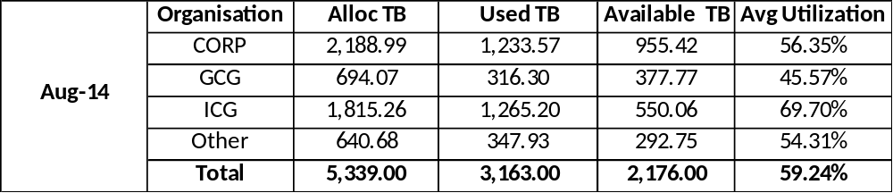
SAN Allocation by Business Sector

Slide 14
SAN Optimized & Virtualized (%)
Comments:-
Optimized: on Thin devices or on Thick (%util. >70%)
GCG business optimization is high ( 41%)
Corp Business Optimization is low ( 17%)
Virtualized: allocated on Thin devices
Virtualization is 98%
Currently DMX to VMAX migration is going on and soon virtualization will become 100%

Slide 15
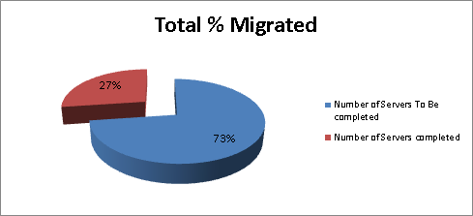
EMEA SAN Migrations Details
Summary of Migration Progress
Scope
Total Number of Servers | 1480
Number of Servers To Be completed | 1078
Number of Servers completed | 402

Slide 16
EMEA SAN Host Billing Report
    Generating and producing the Host Billing Report to charge back team on 1st day of the month.
    To process and generate the reports is taking 5 manual days
Host Billing scripts were written in 2011 according to the SAN configuration but now many changes in SAN environment. So every time we are struggling with many issues.
Reporting sources are ECC, SANScreen, CICSO Device Manager, Connectrix Manager, HDS Device Manager, SYMCLI, HDS CLI & Clariion Navsecicli
Executing the scripts and generating the text files on environment wise ( DMX, VMAX, HDS, Clariion ) are taking 2 working days
Covert text files to .xls is taking 2 working days as we are using MS access database and its taking huge time because of more than 100k records in each database
To prepare and generate the final files is taking 2 days & Validation is taking 1 day to review the final Report
In addition, it is a process that cannot be delivered in parallel and requires careful following of more than 60 page document to generate the files
Need to re-write new scripts or need to find out a good reporting tool . I hope EMC VIPR-SRM product will be for Chargeback reporting tool

Slide 17
EMEA SAN MOR Reports
    MOR Report need to generated on a monthly basis, and to be submitted by the 24th day of the month
    To process and generate the final reports is taking 5 manual days
The reporting process contains both a number of manual tasks, some of which require a number of different steps. The origins of the reporting data comprise several sources, which are generally databases from various business applications or command line output
This report is produced based on various data sources in Citigroup, mainly from the Host Billing report, CSI, SAN Screen, and some ECC data.
MOR reports need to start once we have completed the Host billing reports. In addition,
it is a process that cannot be delivered in parallel and requires careful following of more than 100 page document to complete the final report
The organization structure along with its application information is the key information for organization break-out on this report are getting from the CSI website. So we are not sure how it was generated. We are segregating the host names by organization wise ( Corp ,ICG, GCG & others ) using the CSI database

Slide 18
EMEA SAN Capacity Team Tasks
  Currently myself and James are part of EMEA SAN Capacity team.
Conducting and contributing the inputs to SAN capacity review meeting on weekly basis and minutes are storing in share point site
Keeping Storage and Switch inventory databases are up-to-date to generate the reports to Global Storage Management team
Regularly monitoring/reviewing the pool utilization and over subscription percentage and defining the guidelines for further allocations/restrictions
Regularly reviewing and updating the V-Max Capacity, V-Max pools capacity, HDS Capacity reports, Thin provisioning summary, Centera capacity reports, DMX Capacity Report and Switch Utilization Reports .
Regularly reviewing the SAN utilization reports in meetings and taking the actions accordingly
Earlier Capacity team is reviewing TCRS tickets on regular basis and providing the SAN Pre/Post design approvals without any delay as per SAN SLO and reserving the disks in SAN SCREEN is keep up-to-date to avoid provisioning delays.
Now above task is performing by Global Provisioning team but still we are monitoring and helping them for any TCRS/Provisioning related queries/issues
Requesting and chasing the PEPs , if the SAN requirement is >10TB

Slide 19
EMEA CAPACITY REPORT
  AOB

