Slide 1
EMEA SAN Capacity Team Review
September 2014

Slide 2
SAN Storage Growth – 5 Years
  Managed storage increased substantially
Comments:-
Trend report shows that EMEA SAN capacity increased from 3.5PB to 15.2PB

Slide 3
EMEA SAN CAPACITY SUMMARY
Comments:-
Total EMEA SAN Capacity – 18.6PB
Physical/RAW Capacity – 15.2PB
Usable Capacity – 10.4PB
Allocated Capacity – 8.5PB
Used Capacity – 6.1PB
Currently 104% of Over subscription Allocation rate in Final MOR Arrays
pool written size in Final MOR Arrays is 60%
Overall 82% is over subscription rate and 59% is pool written

Slide 4
SAN Installed (Raw) Base by Vendor
location | Centera | Clariion | DMX | HDS | Vmax | VNX | XIV | Grand Total(TB)
CGC | 0 | 0 | 64 | 83 | 1,098 | 0 | 0 | 1,245
FDC | 261 | 18 | 491 | 775 | 3,867 | 713 | 450 | 6,575
Poland | 143 | 0 | 0 | 0 | 0 | 0 | 0 | 143
RDC | 260 | 36 | 419 | 880 | 3,752 | 1,504 | 450 | 7,300
Russia DC | 0 | 57 | 0 | 0 | 0 | 0 | 0 | 57
Swiss | 34 | 0 | 0 | 0 | 98 | 0 | 0 | 133
Turkey DC | 98 | 4 | 0 | 0 | 0 | 0 | 0 | 102
Grand Total | 797 | 114 | 973 | 1,738 | 8,816 | 2,216 | 900 | 15,554
Comments:-
Total SAN RAW Installed in EMEA – 15.2PB
Majority of storage are in VMAX environment ( 32 Arrays)
XIV is mainly using for VMWARE
Clarriion and VNX are using for Exchange environment
DMX & HDS USP/USPV will decommission soon

Slide 5
SAN Storage Inventory
  Sept. 2014 SAN Install TB (Usable)
location | Centera | Clariion | DMX | HDS | Vmax | VNX | XIV | Grand Total (TB)
CGC | 0 | 0 | 56 | 73 | 762 | 0 | 0 | 891
FDC | 229 | 9 | 430 | 672 | 2,508 | 422 | 219 | 4,488
Poland | 125 | 0 | 0 | 0 | 0 | 0 | 0 | 125
RDC | 227 | 19 | 366 | 740 | 2,531 | 819 | 219 | 4,923
Russia DC | 0 | 28 | 0 | 0 | 0 | 0 | 0 | 28
Swiss | 30 | 0 | 0 | 0 | 86 | 0 | 0 | 116
Turkey DC | 86 | 2 | 0 | 0 | 0 | 0 | 0 | 88
Grand Total | 698 | 58 | 852 | 1,485 | 5,888 | 1,241 | 438 | 10,660
Comments:-
Total SAN Usable Installed TB in EMEA – 10,660
VMAX Usable Installed TB – 5,888

Slide 6
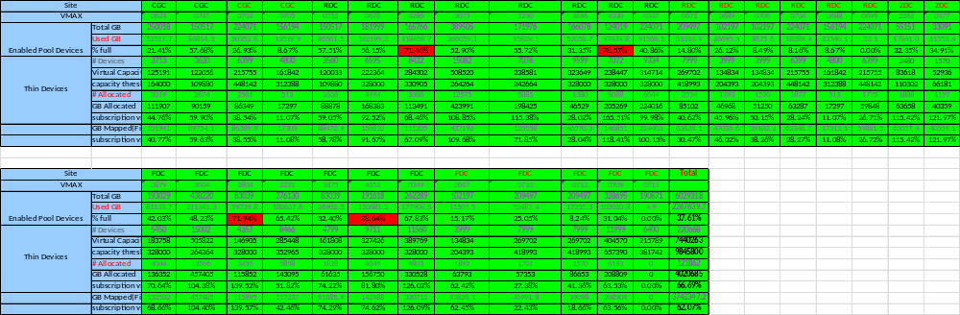
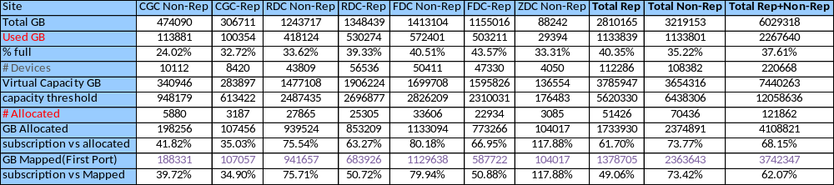
VMAX Pool (Virtual) Summary Report
Comments:-
Pool written is >70% on #2804/#3286 & #4330/4652 arrays
Pool written is <20% on #705, #671, #706, #704, #688, #699, #712 & #713 due to recently these installed for Tech-refresh Target arrays
In overall VMax environment, 62% is over subscription allocation rate and Pool written is 37%
Pool written & Over subscription rate is less due to many VMax arrays added as TECH-REFRESH target arrays in recently

Slide 7
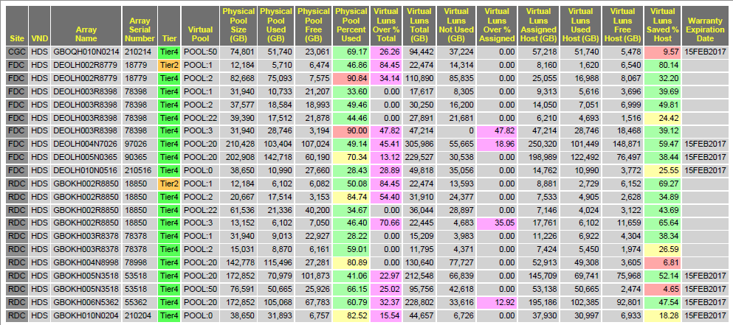
HDS Pool (Virtual) Summary Report
Comments:-
#18779/18850 & #78398/79378 & #78998 are part of TECH-REFRESH and will Decommission soon
Currently all VSP arrays mainly using for Non-Replicated requirements
HUS-VM arrays are #210214, #210516 & #210204 and mainly using for Bronze storage requirements
#210214 and #53518 (Pool 50) is mainly using for Archival Storage requirements

Slide 8
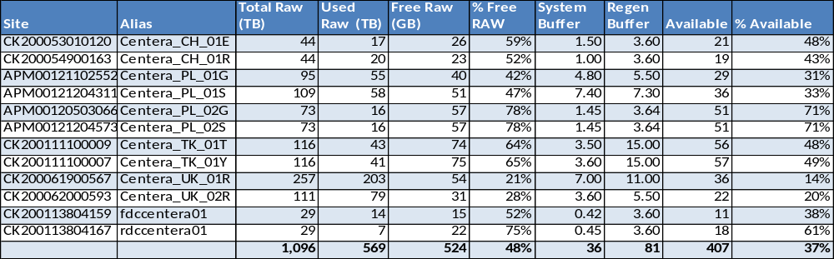
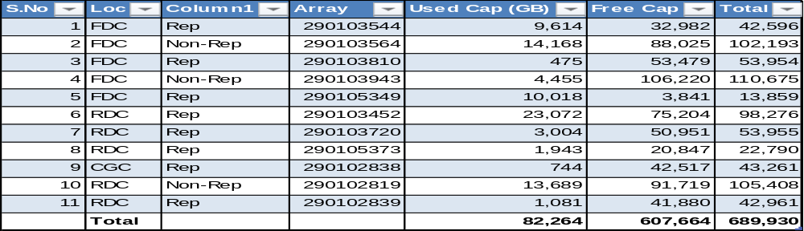
Centera and DMX Capacity Report
Centera Summary Report
DMX Summary Report
Comments:-
Centera environment will move to Backup & Archiving team and currently Centera transition is going on
All DMX environment migrating to VMAX and all DMX arrays will decommission soon

Slide 9
CLARIION, VNX & XIV Summary Report
Loc | Type | Array | Market Standard | Formatted | format Lost | Physical total | Parity Lost | Pool Usable | Pool Used | Pool Free | Spare | %Used | Host Allocations | %Allocated
FDC | Clariion | fdc1a-ax4-0033 | 7,863 | 7,416 | 447 | 7,148 | 3,440 | 3,708 | 3,602 | 106 | 268 | 97% | 3,602 | 97%
FDC | Clariion | fdc1a-ax4-0039 | 7,863 | 7,416 | 447 | 7,148 | 3,440 | 3,708 | 3,602 | 106 | 268 | 97% | 3,602 | 97%
RDC | Clariion | rdc1-ax4-0082 | 4,079 | 3,976 | 103 | 3,708 | 1,720 | 1,988 | 1,720 | 268 | 268 | 87% | 1,720 | 87%
RDC | Clariion | rdc4-ac4-0576 | 20,877 | 18,979 | 1,898 | 18,979 | 8,964 | 10,015 | 10,015 | 0 | 1,051 | 100% | 10,015 | 100%
RDC | Clariion | rdc4-ax4-0006 | 7,863 | 7,416 | 447 | 7,148 | 3,440 | 3,708 | 3,440 | 268 | 268 | 93% | 3,440 | 93%
RDC | Clariion | rdc4-ax4-0007 | 7,646 | 7,219 | 427 | 6,951 | 3,243 | 3,708 | 3,708 | 0 | 268 | 100% | 3,708 | 100%
FDC | Clariion | fdc1a-ax4-0069 | 4,079 | 3,976 | 103 | 3,708 | 1,720 | 1,988 | 1,720 | 268 | 268 | 87% | 1,720 | 87%
Turkey DC | Clariion | Turkey_AX4_Mailbox | 3,962 | 3,602 | 360 | 3,602 | 1,801 | 1,801 | 1,801 | 0 | 0 | 100% | 1,801 | 100%
Russia DC | Clariion | pres-ax4-0062 | 23,003 | 20,911 | 2,091 | 20,911 | 10,456 | 10,456 | 10,456 | 0 | 0 | 100% | 10,456 | 100%
Russia DC | Clariion | prof-ax4-0054 | 23,003 | 20,911 | 2,091 | 20,911 | 10,456 | 10,456 | 10,456 | 0 | 0 | 100% | 10,456 | 100%
Russia DC | Clariion | prof-ax4-0127 | 8,847 | 8,043 | 804 | 8,043 | 4,021 | 4,021 | 4,021 | 0 | 0 | 100% | 4,021 | 100%
Russia DC | Clariion | prof-ax4-0103 | 8,847 | 8,043 | 804 | 8,043 | 4,021 | 4,021 | 4,021 | 0 | 0 | 100% | 4,021 | 100%
 | Total |  | 127,931 | 117,909 | 10,021 | 116,300 | 56,722 | 59,579 | 58,562 | 1,016 | 2,659 | 98% | 58,562 | 98%
Loc | Type | Array | Market Standard | Formatted | format Lost | Physical total | Parity Lost | Pool Usable | Pool Used | Pool Free | Spare | %Used | Host Allocations | %Allocated
RDC | VNX | GBOKC001N1737 | 922,300 | 838,455 | 83,845 | 769,906 | 350,387 | 419,519 | 419,519 | 0 | 0 | 100% | 419,519 | 100%
RDC | VNX | GBOKC002N0390 | 922,300 | 838,455 | 83,845 | 769,906 | 350,387 | 419,519 | 419,519 | 0 | 0 | 100% | 419,519 | 100%
FDC | VNX | DEOLC001N0374 | 583,722 | 530,657 | 53,066 | 436,644 | 183,005 | 253,639 | 253,639 | 0 | 0 | 100% | 253,639 | 100%
FDC | VNX | DEOLC002N0375 | 472,032 | 429,120 | 42,912 | 293,078 | 114,910 | 178,168 | 178,168 | 0 | 0 | 100% | 178,168 | 100%
 | Total |  | 2,900,354 | 2,636,686 | 263,668 | 2,269,534 | 998,689 | 1,270,845 | 1,270,845 | 0 | 0 | 100% | 1,270,845 | 100%
Loc | Type | Array | Market Standard | Formatted | format Lost | Physical total | Parity Lost | Pool Usable | Pool Used | Pool Free | Spare | %Used | Host Allocations | %Allocated
FDC | XIV | 61188 | 518,000 | 502,914 | 50,291 | 461,004 | 236,571 | 224,433 | 0 | 224,433 | 0 | 0% | 0 | 0%
RDC | XIV | 61239 | 518,000 | 502,914 | 50,291 | 461,004 | 236,571 | 224,433 | 0 | 224,433 | 0 | 0% | 0 | 0%
 | Total |  | 1,036,000 | 1,005,828 | 100,582 | 922,008 | 473,142 | 448,866 | 0 | 448,866 | 0 | 0% | 0 | 0%
Comments:-
Clarrion and VNX arrays are mainly using for EXCHANGE server environment
XIV arrays are mainly using for VMWARE environment.

Slide 10
Tech-Refresh TB (Usable)
2013 Tech-Refresh TB
2014 Tech-Refresh TB
Loc | Type | Array | Pool Usable | Rep Status
RDC | DMX | 3452 | 99.47 | Rep
FDC | DMX | 3544 | 88.05 | Rep
FDC | DMX | 3564 | 103.14 | Rep
RDC | DMX | 3720 | 55.16 | Rep
FDC | DMX | 3810 | 110.19 | Rep
FDC | DMX | 3943 | 110.78 | non-rep
FDC | DMX | 5349 | 17.45 | Rep
RDC | DMX | 5373 | 51.45 | Rep
RDC | DMX | 2819 | 104.81 | non-rep
CGC | DMX | 2838 | 55.62 | Rep
RDC | DMX | 2839 | 55.38 | Rep
FDC | HDS | FDCHDS02 | 92.63 | Rep
RDC | HDS | RDCHDS02 | 105.02 | Rep
FDC | HDS | FDCHDS03 | 137.55 | Rep
RDC | HDS | RDCHDS03 | 45.87 | Rep
Senatorska DC | HP/HDS | XP24000 | 17.11 | non-rep
Goleszowska DC | HP/HDS | XP1024 | 18.84 | non-rep
 | Total |  | 1,268.52
Project | Source array | Capacity (TB) - 24Apr14 | Site | Rep status
TR2014 | 78998 | 91.88 | RDC | Non-Rep
TR2014 | 292600623 | 159.15 | CGC | Non-Rep
TR2014 | 292600745 | 88.12 | CGC | Rep
TR2014 | 292600552 | 61.06 | RDC | Rep
TR2014 | 292600678 | 236.07 | RDC | Non-Rep
TR2014 | 292600879 | 269.46 | FDC | Non-Rep
TR2014 | 292602230 | 166.51 | RDC | Rep
TR2014 | 292602231 | 174.23 | FDC | Rep
TR2014 | 292602262 | 55.84 | BLWG/ZURICH | Non-Rep
 | Total | 1302.32
comments:-
2013 Usable Tech-Refresh TB – 1,268
2014 Usable Tech-Refresh TB – 1,302

Slide 11
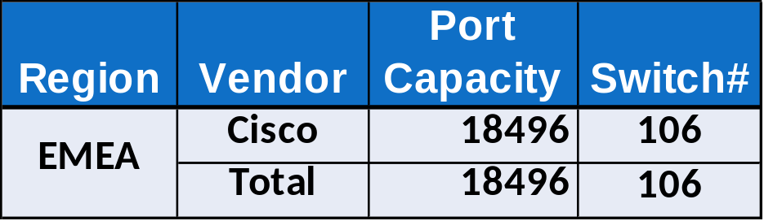
SAN Switch Inventory
  SAN Switch Hardware
    Cisco- 9513/9509/9506/9148
  SAN Switch Vendor Distribution
Comments:-
In EMEA, currently we manages only Cisco switches
Last week, we had decommissioned all the McData switchs in RDC & CGC
In EMEA, We Manages 106 Switches which is having 18,496 ports
SAN Team is taking care of Disk SAN and TAPE SAN Switches
Fabric Refresh project will implement in Ruby/Jade fabrics

Slide 12
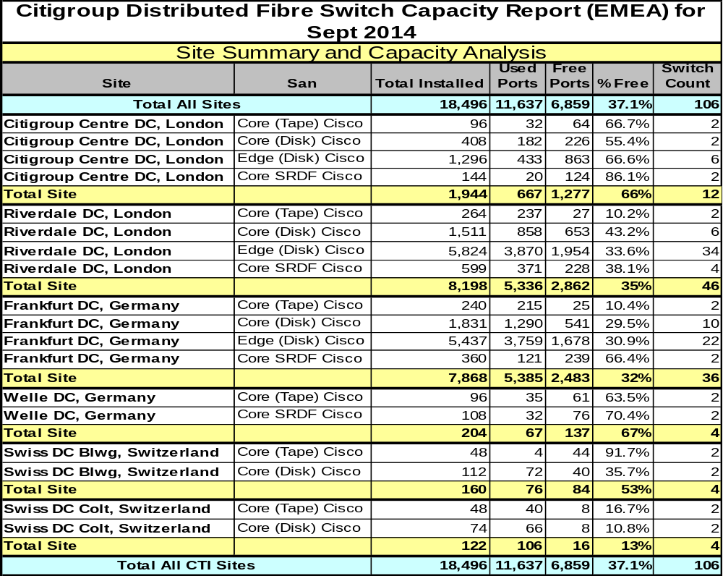
SAN Switch Inventory – Cont’d
  Switch/Ports Site Distribution, Sept 2014
Comments:-
In Swiss, currently we are having less available ports. So we are adding additional switches

Slide 13
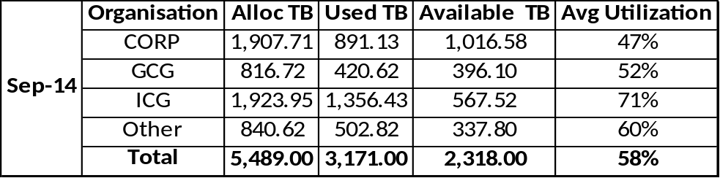
SAN Allocation by Business Sector

Slide 14
SAN Optimized & Virtualized (%)
Comments:-
Optimized: on Thin devices or on Thick (%util. >70%)
GCG business optimization is high ( 42%)
Corp Business Optimization is low ( 18%)
Virtualized: allocated on Thin devices
Virtualization is 98%
Currently DMX to VMAX migration is going on and soon virtualization will become 100%

Slide 15
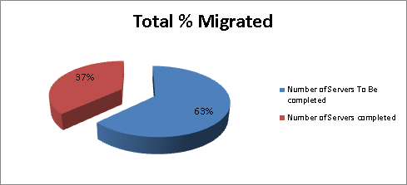
EMEA SAN Migrations Details
Summary of Migration Progress
Scope
Total Number of Servers | 1480
Number of Servers To Be completed | 933
Number of Servers completed | 547

Slide 16
EMEA CAPACITY REPORT
  AOB

