Slide 1
EMEA SAN team Review
October 2013

Slide 2
SAN Storage Growth – 3 Years
  Managed storage increased substantially
Source: MOR + SANScreen

Slide 3
SAN Install Base by Vendor
Source: MOR + SANScreen

Slide 4
SAN Storage Inventory
  OCT. 2013 SAN Install TB (after configuration)
Site | EMC | HDS | HP | Grand Total
London (RDC) | 1963 | 833 |  | 2796
Frankfurt | 2032 | 677 |  | 2709
London (CGC) | 459 | 73 |  | 532
Senatorska (Poland) | 123 | 0 | 15 | 138
Switzerland | 130 | 0 |  | 130
Turkey | 129 | 0 |  | 129
Goleszowska (Poland) | 110 | 0 | 11 | 121
Russia | 25 | 0 |  | 25
Welle | 4 | 0 |  | 4
Grand Total | 4976 | 1583 | 26 | 6585
Source: MOR + SANScreen

Slide 5
SAN Install Base by Site (N.A.)
EMEA SAN RAW Install
Total: 6585TB by Oct, 2013
Source: MOR + SANScreen

Slide 6
SAN Fabric Inventory
  SAN Switch Hardware
    Cisco 9513/9509
    McData
  SAN Switch Vendor Distribution (Oct, 2013)
Region | Vendor | Port Capacity | Switch#
EMEA RDC/FDC/CGC | Cisco | 21820 | 86
 | McData | 3129 | 26
Source: SANScreen

Slide 7
SAN Fabric Inventory – Cont’d
  Switch/Ports Site Distribution, Oct. 2013
Data Center | Ports Capacity | Ports Used | Ports Free | Switch#
London (RDC) | 9993 | 6159 | 3834 | 48
Frankfurt | 8563 | 6194 | 2369 | 40
CGC | 2661 | 1015 | 1646 | 16
Goleszowska | 136 | 69 | 67 | 6
Senatorska | 96 | 42 | 54 | 6
Switzerland | 96 | 40 | 56 | 4
Grand Total | 21545 | 13519 | 8026 | 120
Source: MOR

Slide 8
SAN Install by Bus. Sector
Bus. Sector Allocated (TB)
Oct, 2013 EMEA
Source: MOR

Slide 9
SAN Optimized & Virtualized (%)
Optimized: on Thin devices or on Thick (%util. >70%)
Virtualized: allocated on Thin devices
Source: MOR

Slide 10
Annual RDC COB Tests

Slide 11
Annual FDC and Rainbow COB Tests

Slide 12
EMEA SAN Provisioning Details
 | January | February | March | April | May | June | July | August | September | October | November | December
Number of tickets | 62 | 161 | 212 | 270 | 225 | 216 | 276 | 192 | 208 | 215 | 74 | 0

Slide 13
EMEA SAN Migrations Details
Migrations (Hitachi) 658 YTD + SMART421 270 Jan to May = Total 928 YTD (103 per month average). Currently 20 frames under tech refresh projects.
HDS details :-
March | 23
April | 45
May | 67
Jun | 93
Jul | 193
Aug | 104
Sep | 133

Slide 14
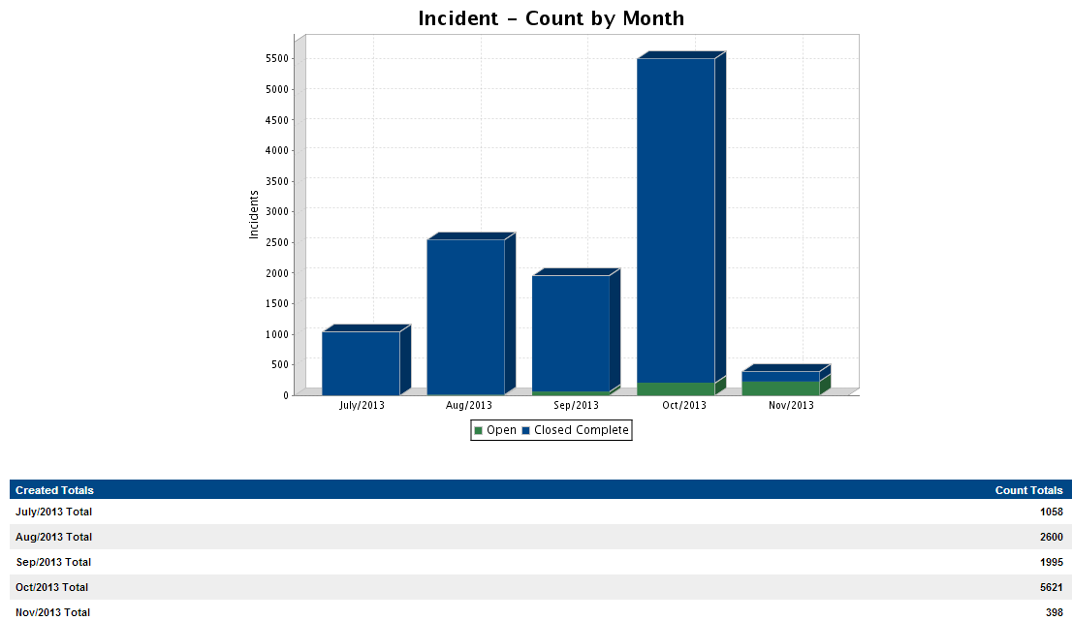
ServiceNow Incidents

Slide 15
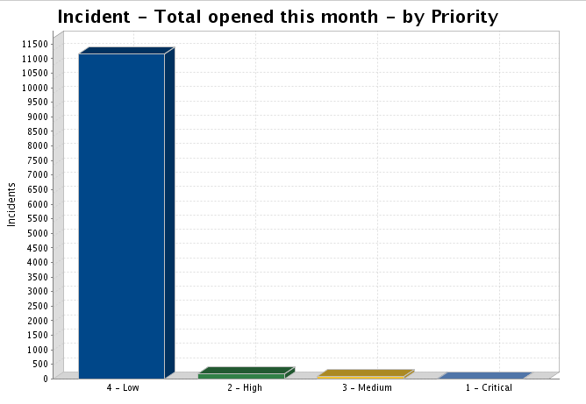
ServiceNow Incidents by priority
Created | Priority | Count | Percent
Jul-13 | 1 - Critical | 2 | 0.19%
 | 2 - High | 18 | 1.70%
 | 3 - Medium | 21 | 1.98%
 | 4 - Low | 1017 | 96.12%
Aug-13 | 1 - Critical | 3 | 0.12%
 | 2 - High | 36 | 1.38%
 | 3 - Medium | 18 | 0.69%
 | 4 - Low | 2543 | 97.81%
Sep-13 | 1 - Critical | 1 | 0.05%
 | 2 - High | 53 | 2.66%
 | 3 - Medium | 31 | 1.55%
 | 4 - Low | 1910 | 95.74%
Oct-13 | 2 - High | 61 | 1.09%
 | 3 - Medium | 11 | 0.20%
 | 4 - Low | 5549 | 98.72%
Nov-13 | 2 - High | 19 | 4.77%
 | 3 - Medium | 16 | 4.02%
 | 4 - Low | 363 | 91.21%
6 Critical, 187 High, 97 Medium, 11382 Low

Slide 16
Changes by priority

Slide 17
Team overview
BAU Team
 | UK | Poland | Singapore | Philippines | India
FTE | 2 | 3 | 2 | 2 | 0
Contractors | 2 | 0 | 0 | 0 | 2
Grads | 0 | 4 | 0 | 0 | 0
PIT Team
 | UK | Poland | Singapore
FTE | 2 | 1 | 1
Contractors | 1 | 0 | 0

Slide 18
EMEA SAN Support Overview
Break / Fix
SRDF Sessions
Problem / Incident
Alerting
Performance Analysis
COB Test Support
Major Incidents / EMS Support
    SAN Support team is engaged frequently for EMS support, investigation, and resolution as needed.
    Substantial amount of time is used for support and investigation even when there is no SAN issue
    Large amount of time for SAN issues related to resolution tasks, root cause analysis, and post-issue tasks (e.g. preventative improvements, problem review meetings, etc.)

