Slide 1
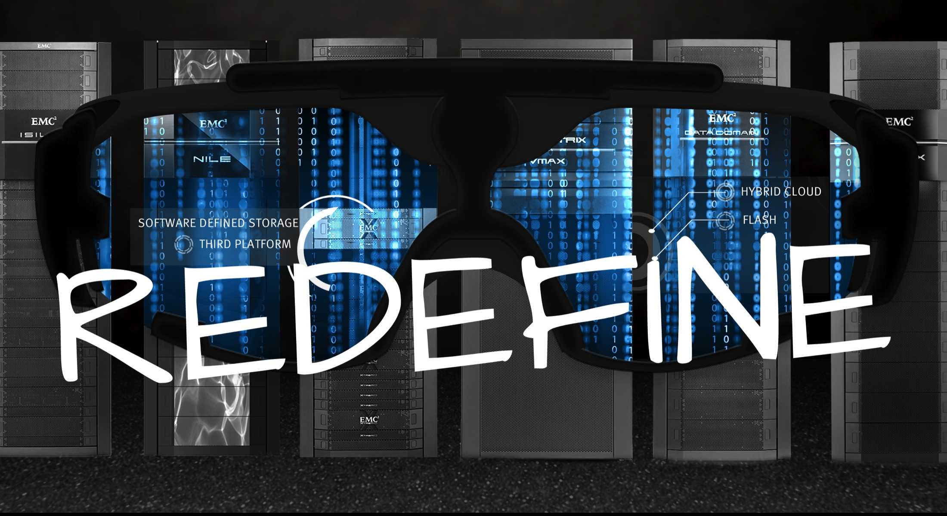

CITI Q3 EMEA Proposal
Rob Wilkie

Slide 2
Contents
This deck shows the
  Overview of elements included
  Breakdown of elements
  VPA Pricing

Slide 3
Overview
This document details the products being proposed to Citigroup within EMEA from EMC within the Q3 2014 proposal.
In summary, we have included product refreshes for existing EMC VMAXs in RDC and FDC and Clarions in Russia. We are proposing additional VNXs to refresh existing NetApp arrays deployed within RDC, CGC, FDC, Moscow, Budapest and Johannesburg.
In addition, we are proposing additional Bronze storage in the form of VNX arrays in RDC, CGC and FDC and additional XtremeIO devices for VDI.
The Data Domain backup appliances in RDC and FDC have high utilisation and capacity upgrades for both are proposed.
Finally there are VNXs being included for new VSI and Xenapp projects in RDC and FDC plus a VNX upgrade in plan for Moscow.

Slide 4
Proposal Overview
Title | Product | Description
FAST Refresh | VMAX | Refresh of 3073 and 3004 in RDC and FDC
Russia Clarion | VNX | Refresh of existing 4 x AX4 with 4 x VNX5200
NetApp Refresh | VNX | Refresh of remaining NetApp in RDC, CGC, FDC & JoBurg
VSI Refresh | VNX | Refresh of NetApp VSI in Moscow & Budapest
Moscow Upgrade | VNX | Capacity upgrade on existing VNX
Xenapp Capacity | VNX | Additional VNX in RDC & FDC (5 per site)
VSI Upgrades | VNX | Additional VNX in RDC & FDC (2 per site)
VDI Upgrades | XtremeIO | Additional XtremeIO in RDC & FDC
Backup Capacity | Data Domain | Additional 90TB for RDC & FDC
Bronze Storage | VNX | Bronze storage capacity for RDC, CGC & FDC

Slide 5
Detailed Breakdown

Slide 6
FAST VMAX refresh summary
This table shows the proposed VMAX refresh options.
Note that this is not a like for like replacement. To meet CATE standard configurations, two VMAX 40Ks are required to replace each existing VMAX. This will result in substantially more capacity being delivered and a corresponding significant increase in the IOPS capability when compared to the current storage.
VMAX S/N | Location | New VMAX array | Current Usable (TB) | New Usable (TB) | Comment
CK292603004 | FDC | VMAX40K-19g | 420 | 217 | Total usable=534 consist of 2 new silver Non-rep FAST-VP arrays 1 x small(19g) +1 x medium 11f - Note: approx. 114TB growth
 |  | VMAX40K-11f |  | 317
CK292603073 | RDC | VMAX40K-19g | 375 | 217 | Total usable=534 consist of 2 new silver Non-rep FAST-VP arrays 1 x small(19g) +1 x medium 11f - Note: approx. 159TB growth
 |  | VMAX40K-11f |  | 317

Slide 7
Moscow AX4 refresh summary
This table shows the proposed VNX refresh options
AX4 | Location | New VNX array | Current Usable (TB) | New Usable (TB) | Comment
SL7E9101300054 | Russia | VNX5200 | 7 | 8.9 | Using 74 x 300GB 15K SAS drives R1+0
SL7E9101300062 | Russia | VNX5200 | 7 | 8.9 | Using 74 x 300GB 15K SAS drives R1+0
FCNMM113000127 | Russia | VNX5200 | 4 | 5.2 | Using 46 x 300GB 15K SAS drives R1+0
FCNMM113000103 | Russia | VNX5200 | 4 | 5.2 | Using 46 x 300GB 15K SAS drives R1+0

Slide 8
NAS (NetApp) refresh summary-1
This table shows the proposed VNX refresh options
Data Centre | Prod / CoB | Usage | VNX Model | # DM | Actual EMC Usable (TB)
CGC - CIFS | Prod | CIFS | VNX5800 | 4 | 123.54
FDC - Apps Prod | CoB | NFS | VNX5400 | 2 | 30.76
FDC - Apps Prod | Prod | NFS | VNX5200 | 2 | 20.51
FDC - Apps UAT | CoB | NFS | VNX5200 | 2 | 20.51
FDC - Apps UAT | Prod | NFS | VNX5200 | 2 | 20.51
FDC - CIFS | Prod | CIFS | VNX5400 | 2 | 46.39
FDC - CIFS (RDC) | CoB | CIFS | VNX5400 | 2 | 41.02
FDC - FileNet | Prod | CIFS | VNX5400 | 2 | 51.27

Slide 9
NAS (NetApp) refresh summary-2
This table shows the proposed VNX refresh options
Data Centre | Prod / CoB | Usage | VNX Model | # DM | Actual EMC Usable (TB)
JNB - CIFS | CoB | CIFS | VNX5200 | 2 | 15.14
JNB - CIFS | Prod | CIFS | VNX5200 | 2 | 15.14
RDC - Apps Prod | Prod | NFS | VNX5400 | 2 | 30.76
RDC - Apps Prod (FDC) | CoB | NFS | VNX5200 | 2 | 20.51
RDC - Apps UAT | Prod | NFS | VNX5200 | 2 | 20.51
RDC - Apps UAT (FDC) | CoB | NFS | VNX5200 | 2 | 20.51
RDC - CIFS | Prod | CIFS | VNX5400 | 2 | 41.02
RDC - CIFS (CGC) | CoB | CIFS | VNX5800 | 4 | 123.54
RDC - CIFS (FDC) | CoB | CIFS | VNX5400 | 2 | 46.39
RDC - FileNet | CoB | CIFS | VNX5400 | 2 | 51.27

Slide 10
In Scope NAS refresh – 3
This table shows the proposed VNX refresh options
Data Centre | Prod / CoB | Usage | VNX Model | # DM | Actual EMC Usable (TB)
RDC - Grid (Dev/UAT) | CoB | CIFS | VNX5800 | 3 | 14
RDC - Grid (Dev/UAT) | Prod | CIFS | VNX5800 | 3 | 14
RDC - Grid (Prod) | CoB | CIFS | VNX5800 | 3 | 14
RDC - Grid (Prod) | Prod | CIFS | VNX5800 | 3 | 14
RDC - VDI 1 | Prod | VDI | XIO | 1 X-Brick | 36.86

Slide 11
VSI Refresh
This table shows the proposed VNX refresh options
Data Centre | Prod / CoB | Usage | VNX Model | # DM | Actual EMC Usable (TB)
BUD - VSI 1 | Prod | VSI | VNX5400 - VSI Smal NAS config #2 | 2 | 16
BUD - VSI 2 | Prod | VSI | VNX5400 - VSI Smal NAS config #2 | 2 | 16
VKO - VSI 1 | Prod | VSI | VNX5600-VSI Medium Nas Config #1 | 2 | 24
VKO - VSI 2 | Prod | VSI | VNX5600-VSI Medium Nas Config #1 | 2 | 24

Slide 12
Moscow VNX Upgrade
This table shows the proposed VNX upgrade
Data Centre | Prod / CoB | Usage | VNX Model | # Disks | Actual EMC Usable (TB)
VKO – SYS 1 | Prod | VSI | VNX5200 | 16 | 7
VKO – SYS 2 | Prod | VSI | VNX5200 | 16 | 7
VKO – SYS 3 | COB | VSI | VNX5200 | 16 | 7
VKO – SYS 4 | COB | VSI | VNX5200 | 16 | 7

Slide 13
Xenapp VNX Provision
This table shows the proposed VNX
Data Centre | Prod / CoB | Usage | VNX Model | # DM | Actual EMC Usable (TB)
RDC | Prod | Xenapp | VNX5200 x 5 | 2 | 67
FDC | Prod | Xenapp | VNX5200 x 5 | 2 | 67

Slide 14
VSI VNX Provision
This table shows the proposed VNX
Data Centre | Prod / CoB | Usage | VNX Model | # DM | Actual EMC Usable (TB)
RDC | Prod | VSI | VNX5600 x 2 | 2 | 68
FDC | Prod | VSI | VNX5600 x 2 | 2 | 68

Slide 15
VDI XtremeIO Provision
This table shows the proposed X-Bricks
Data Centre | Prod / CoB | Usage | XIO Model | Usable Capacity (TB)
RDC | Prod | VDI | D25 | 7.5
FDC | Prod | VDI | D25 | 7.5

Slide 16
Data Domain Upgrades
This table shows the proposed DD Upgrade
Data Centre | Prod / CoB | Usage | DD Model | Capacity (TB)
RDC | Prod | Backup | D990 Shelves | 90
FDC | Prod | Backup | D990 Shelves | 90

Slide 17
Net New Bronze
This table shows the initial suggested capacities for Bronze. Work is ongoing to refine the requirements for Bronze and it is expected that these initial configurations may alter.
New Bronze Proposed | Location | TB usable provided per VNX | Total Net New Capacity (assumed)
2 x VNX5800 | FDC | 321 | 643
1 x VNX5800 | CGC | 321 | 321
2 x VNX5800 | RDC | 321 | 643

Slide 18
Commercial

Slide 19
Commercial Offer
The prices shown in the following pages are standard Citi VPA prices as negotiated globally.
EMC recognise that certain assets proposed for refresh (VMAX, Clarion, NetApp) may have existing Net Book Values (NBV) and we have sought these from Citi to incorporate, where possible, a reduction in the VPA price corresponding to the NBV. Citi have only been able to provide these for a small subset of the equipment for which refreshes are proposed.
As a result of NBVs that have been provided, we have removed certain elements from our initial proposal (namely Rainbow VMAXs and Zurich NetApp refresh).
EMC also recognise that cheque backs based on a percentage of the Product values will be provided to Citi following the conclusion of this transaction. These are not detailed in this document and will be agreed with the EMC Global Account Manager.
Note that equipment supplied in Moscow, Budapest and Johannesburg is supplied via EMC Partners. Pricing shown for these locations is therefore indicative only and final pricing will be set by the partner.
All prices are exclusive of tax.

Slide 20
Prices
 | Data Centre | VPA Price | NBV | Price after NBV Reduction | NBV Notes
FAST VMAX Refresh
3073 refresh | RDC | $2,676,866 | $305,474 | $2,371,391
3004 refresh | FDC | $2,676,866 | $515,998 | $2,160,868
Russia AXR Clarion Refresh
4 x VNX 5200 | Moscow | $267,022 | $0 | $267,022
Russia VNX Upgrade
Upgrade 4 x VNX 5200 with 600 GB drives | Moscow | $71,253 |  | $71,253
VSI Refresh
2 x VNX5600 | Moscow | $335,123 | $89,065 | $246,058
2 x VNX5400 | Budapest | $179,289 |  | $179,289 | No NBV Available
XenAPP VNX
5 x VNX5200 for Xenapp | RDC | $266,976 |  | $266,976 | Not Applicable
5 x VNX5200 for Xenapp | FDC | $266,976 |  | $266,976 | Not Applicable
RDC / FDC VSI Projects
VSI Project 1 | RDC | $115,921 |  | $115,921 | Not Applicable
VSI Project 2 | RDC | $115,921 |  | $115,921 | Not Applicable
VSI Project 1 | FDC | $115,921 |  | $115,921 | Not Applicable
VSI Project 2 | FDC | $115,921 |  | $115,921 | Not Applicable

Slide 21
Prices Continued
 | Data Centre | VPA Price | NBV | Price after NBV Reduction | NBV Notes
XtremeIO
XtremeIO VDI | RDC | $208,496 |  | $ 208,496 | No NBV Available
XtremeIO VDI | FDC | $208,496 |  | $ 208,496 | No NBV Available
Bronze Storage
2 x VNX 5800 | RDC | $903,754 |  | $ 903,754 | Not Applicable
1 x VNX5800 | CGC | $451,877 |  | $ 451,877 | Not Applicable
2 x VNX 5800 | FDC | $903,754 |  | $ 903,754 | Not Applicable
NetApp Refresh
Netapp Refresh 2015-2017 | RDC | $1,115,548 | $ - | $ 1,115,548 | No NBV Available
Netapp Refresh 2015-2017 | CGC | $378,020 | $ - | $ 378,020 | No NBV Available
Netapp Refresh 2015-2017 GRID | RDC | $690,890 | $ - | $ 690,890 | No NBV Available
Netapp Refresh 2015-2017 | FDC | $737,528 | $ - | $ 737,528 | No NBV Available
Netapp Refresh | Johannesburg | $124,536 | $ - | $ 124,536 | No NBV Available
Data Domain
2 x 45TB shelves upgrade | RDC | $196,670 |  | $ 196,670 | Not Applicable
2 x 45TB shelves upgrade | FDC | $196,670 |  | $ 196,670 | Not Applicable
Totals |  | $ 13,320,293 | $ 910,537 | $ 12,409,756

